Slide 1
Who Owns a Boundary Tree?
Examples from American Case Law
James Komen
BCMA #WE-9909B, RCA #555
Notes:
Disclaimers:
My presentation and question/answer sessions do not create attorney-client relationship
This is not legal advice; it is merely a discussion of legal theories that HAVE BEEN employed in certain cases at certain points in time

Slide 2
Who Owns a Boundary Tree?
Property ownership fundamentals
Tree ownership
Joint ownership early theories
American theories

Slide 3
Property Ownership

Slide 4

Property Ownership
Possess

Slide 5
Property Ownership
Possess
Control

Slide 6
Property Ownership
Possess
Control
Exclude

Slide 7
Property Ownership
Possess
Control
Exclude
Enjoy

Slide 8
Property Ownership
Possess
Control
Exclude
Enjoy
Alienate

Slide 9
Property Ownership
Possess
Control
Exclude
Enjoy
Alienate
Destroy

Slide 10
Co-Ownership
Possess
Control
Exclude
Enjoy
Alienate
Destroy

Slide 11
Co-Ownership
Possess
Control
Exclude
Enjoy
Alienate
Destroy

Slide 12
Co-Ownership
Possess
Control
Exclude
Enjoy
Alienate
Destroy
(subject to co-owner)

Slide 13
Co-Ownership
Possess
Control
Exclude
Enjoy
Alienate
Destroy
(subject to co-owner)
(except co-owner)

Slide 14
Co-Ownership
Possess
Control
Exclude
Enjoy
Alienate
Destroy
(subject to co-owner)
(except co-owner)
(subject to co-owner)

Slide 15
Co-Ownership
Possess
Control
Exclude
Enjoy
Alienate
Destroy
(subject to co-owner)
(except co-owner)
(subject to co-owner)
(portion owned)

Slide 16

Co-Ownership
Possess
Control
Exclude
Enjoy
Alienate
Destroy
(subject to co-owner)
(except co-owner)
(subject to co-owner)
(portion owned)
(unless co-owner consents)

Slide 17
Co-Ownership
Tenancy In Common
Co-owner may “use [his] part as not unreasonably to injure or destroy the whole."
Robinson v. Clapp, 65 Conn. 365 (1985)

Slide 18
Tree Ownership Generally
“Ad coelum ad inferos”
Trees are fixtures on the land

Slide 19
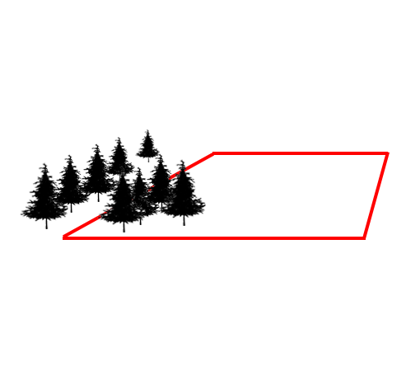
Tree Ownership Generally

Slide 20
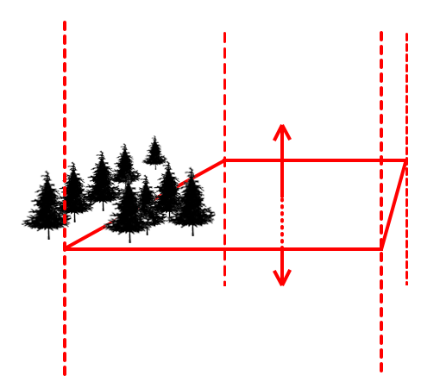
Tree Ownership Generally

Slide 21
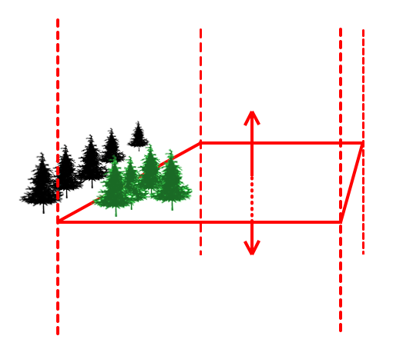
Tree Ownership Generally

Slide 22
Tree Ownership Generally
“Wholly the property of him on whose land the trunk stands”
Dubois v. Beaver, 25 N.Y. 123 (1862)

Slide 23
Boundary Trees

Slide 24

Boundary Trees
Near Line

Slide 25
Boundary Trees
Near Line
Partial

Slide 26
Boundary Trees
Near Line
Partial
Centered on Line

Slide 27
Boundary Trees
What is Covered by this Talk
Trees ON the line
Trees OFF the line, but still co-owned

Slide 28
Boundary Trees
What is Covered by this Talk
What is Not Covered
Trees ON the line
Trees OFF the line, but still co-owned
Trees NEAR the property line

Slide 29
Boundary Trees
What is Covered by this Talk
What is Not Covered
Trees ON the line
Trees OFF the line, but still co-owned
Examples and illustrations with case law
Trees NEAR the property line

Slide 30
Boundary Trees
What is Covered by this Talk
What is Not Covered
Trees ON the line
Trees OFF the line, but still co-owned
Examples and illustrations with case law
Trees NEAR the property line
Comprehensive theory
All states
Canada and other foreign jurisdictions
Whether cases are “good law”
Whether a tree is ON or NEAR the line
  Root flare vs. Trunk
  Measurement height

Slide 31
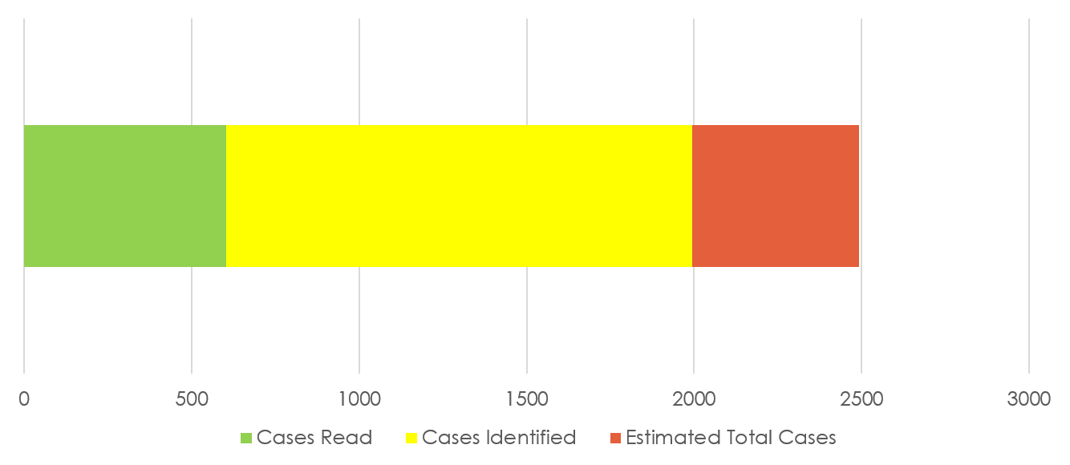
Case Law Research
Tree Law Research Progress
AL
OH
WY
AL
OH
WY

Slide 32
Early Theories of Joint Ownership of Trees

Slide 33
Early Theories of Joint Ownership of Trees
Masters v. Pollie (1620): Tree belongs to the owner of the land in which the tree was planted

Slide 34
Early Theories of Joint Ownership of Trees
Masters v. Pollie (1620): Tree belongs to the owner of the land in which the tree was planted
Waterman v. Soper (1697): Tree belongs to the owner of the land in which the roots grow.

Slide 35
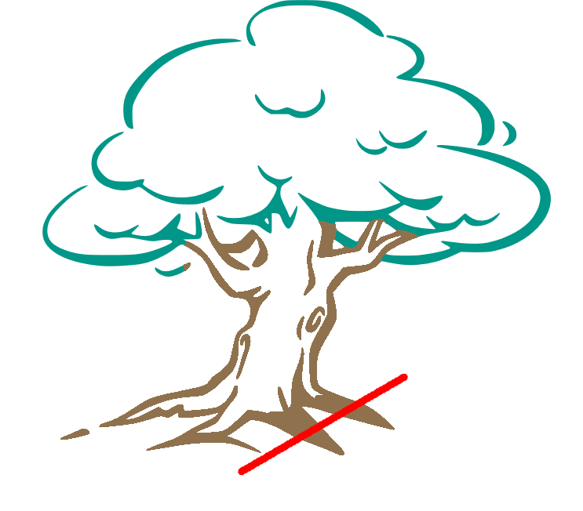
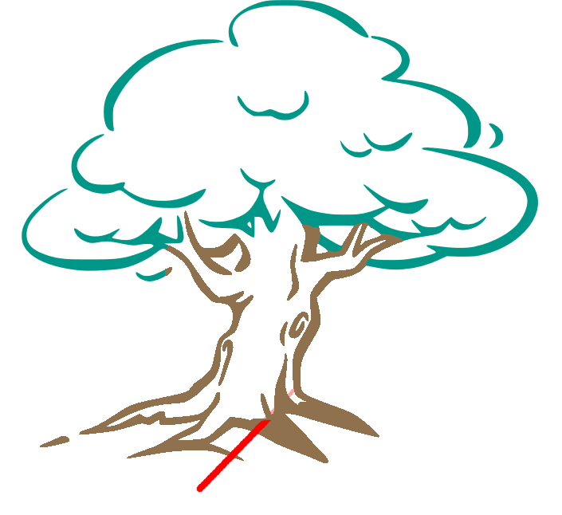
Early Theories of Joint Ownership of Trees

Slide 36
Early Theories of Joint Ownership of Trees
Masters:
Waterman:

Slide 37
Early Theories of Joint Ownership of Trees
Masters: No No
Waterman:

Slide 38
Early Theories of Joint Ownership of Trees
Masters: No No
Waterman: Yes Yes

Slide 39
American Theories of Joint Ownership of Trees
Absolute
Proportionate
Party Wall
Limited
Agreement
Statute
Presumption

Slide 40
Absolute

Slide 41
Absolute

Slide 42
Absolute
Yes

Slide 43
Absolute
Yes, any part
Yes

Slide 44
Absolute
Yes, if part of hedge
Yes, any part
Yes

Slide 45
Absolute
Yes, if part of hedge
Yes, any part
Yes

Slide 46
Absolute
Blalock v. Atwood (1913) KY: trunk ¼ over line is co-owned

Slide 47
Absolute
Blalock v. Atwood (1913) KY: trunk ¼ over line is co-owned
Yoakum v. Davis (1912) MO: ANY part of the trunk

Slide 48
Absolute
Blalock v. Atwood (1913) KY: trunk ¼ over line is co-owned
Yoakum v. Davis (1912) MO: ANY part of the trunk
Ridge v. Blaha (1988) IL: ANY part of the trunk

Slide 49
Absolute
Blalock v. Atwood (1913) KY: trunk ¼ over line is co-owned
Yoakum v. Davis (1912) MO: ANY part of the trunk
Ridge v. Blaha (1988) IL: ANY part of the trunk
Weisel v. Hobbs (1940) NE: ANY part of the trunk (“impinging tree”)

Slide 50
Absolute
Blalock v. Atwood (1913) KY: trunk ¼ over line is co-owned
Yoakum v. Davis (1912) MO: ANY part of the trunk
Ridge v. Blaha (1988) IL: ANY part of the trunk
Weisel v. Hobbs (1940) NE: ANY part of the trunk (“impinging tree”)
Harndon v. Stultz (1904) IA: co-owned if part of hedge on line, even if tree itself is not on line

Slide 51
Proportionate

Slide 52
Proportionate

Slide 53
Proportionate
Yes, 50%/50%

Slide 54
Proportionate
No
Yes, 50%/50%

Slide 55
Proportionate
No
Yes, ~90%/10%
Yes, 50%/50%

Slide 56
Proportionate
Doran v. Rugg (1960) CT: each landowner has interest “identical with the part which is upon his land”

Slide 57
Proportionate
Doran v. Rugg (1960) CT: each landowner has interest “identical with the part which is upon his land”
Luke v. Scott (1933) IN: “property interest of each owner is identical as to the extent the portion of the tree is upon his land”

Slide 58
Party Wall

Slide 59
Party Wall

Slide 60
Party Wall
No

Slide 61
Party Wall
No
Yes, 50%/50%

Slide 62
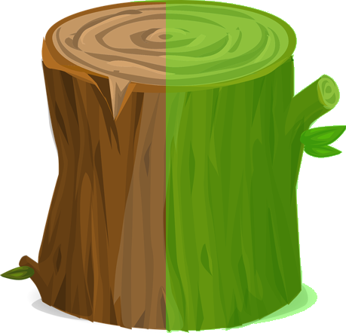
Party Wall
No
Yes, 50%/50%

Slide 63
Party Wall
No
Yes, 50%/50%
+ support easement

Slide 64

Party Wall
No
Yes, ~90%/10%
+ support easement
Yes, 50%/50%
+ support easement

Slide 65
Party Wall
Willis v. Maloof (1987) GA: “adjoining landowners…do not own the tree as tenants in common, but each owns in severalty the part…which rests upon his side of the line, with an easement of support from the other.”

Slide 66
Limited

Slide 67
Limited

Slide 68
Limited
No

Slide 69
Limited
No
No

Slide 70
Limited
No
No
Not necessarily

Slide 71
Limited
Love v. Klosky (2018) CO: if wholly on one side at planting, tree is not a “true boundary” tree

Slide 72
Limited
Love v. Klosky (2018) CO: if wholly on one side at planting, tree is not a “true boundary” tree
Holmberg v. Bergin (1969) MN: “something more than the mere presence of a portion of a tree trunk on a boundary line is necessary to make the tree itself a ‘boundary line tree’”

Slide 73
Limited
Love v. Klosky (2018) CO: if wholly on one side at planting, tree is not a “true boundary” tree
Holmberg v. Bergin (1969) MN: “something more than the mere presence of a portion of a tree trunk on a boundary line is necessary to make the tree itself a ‘boundary line tree’”
Loggia v. Grobe (1985) NY: tree located “predominantly” on one side belongs to that owner

Slide 74
Limited
Factors for determining boundary tree:
1) intent
2) acquiescence
3) agreement
4) joint planting

Slide 75
Agreement

Slide 76
Agreement

Slide 77
Agreement
Yes

Slide 78
Agreement
Yes
Yes

Slide 79
Agreement
Yes
Yes
Yes

Slide 80
Agreement
Yes
Yes
Yes
…IF AGREEMENT

Slide 81
Agreement
Wideman v. Faivre (1917) KS: co-owned if trees planted “on a line adopted or acquiesced in as the division line”

Slide 82
Agreement
Wideman v. Faivre (1917) KS: co-owned if trees planted “on a line adopted or acquiesced in as the division line”
Ridge v. Blaha (1988) IL: “agreement…can give one party a protectable interest, even if the subject tree is not actually on a boundary line” but agreement is not necessary

Slide 83
Agreement
Wideman v. Faivre (1917) KS: co-owned if trees planted “on a line adopted or acquiesced in as the division line”
Ridge v. Blaha (1988) IL: “agreement…can give one party a protectable interest, even if the subject tree is not actually on a boundary line” but agreement is not necessary
Love v. Klosky (2018) CO: sole property unless “jointly planted, jointly cared for, or treated as a partition between the two properties”

Slide 84
Agreement
Wideman v. Faivre (1917) KS: co-owned if trees planted “on a line adopted or acquiesced in as the division line”
Ridge v. Blaha (1988) IL: “agreement…can give one party a protectable interest, even if the subject tree is not actually on a boundary line” but agreement is not necessary
Love v. Klosky (2018) CO: sole property unless “jointly planted, jointly cared for, or treated as a partition between the two properties”
Holmberg v. Bergin (1969) MN: “the only way [this] tree…could become the common property…would be by actual agreement”

Slide 85
Statute

Slide 86
Statute
CA Civil Code § 834
ND Century Code § 47-01-17
MT Code § 70-16-204
“Trees whose trunks stand partly on the land of two or more coterminous owners belong to them in common.”

Slide 87
Presumption

Slide 88
Presumption
Dubois v. Beaver (1862) NY: presume co-owned

Slide 89
Presumption
Dubois v. Beaver (1862) NY: presume co-owned
Jack v. Successions of Albert (2018) LA: presume co-owned

Slide 90
Presumption
Dubois v. Beaver (1862) NY: presume co-owned
Jack v. Successions of Albert (2018) LA: presume co-owned
Vanderpool v. Hart (2022) MI: presume NOT co-owned until
property line is proven

Slide 91
Presumption

Slide 92
Presumption
Plaintiff’s burden to prove trunk is on property line

Slide 93
Presumption
Plaintiff’s burden to prove trunk is on property line
π Burden of Proof

Slide 94
Presumption
Plaintiff’s burden to prove trunk is on property line
Presume co-owned
π Burden of Proof

Slide 95
Presumption
Plaintiff’s burden to prove trunk is on property line
Presume co-owned
Co-ownership opponent’s burden to prove sole-ownership
π Burden of Proof

Slide 96
Presumption
Plaintiff’s burden to prove trunk is on property line
Presume co-owned
Co-ownership opponent’s burden to prove sole-ownership
Co-ownership opponent
Burden of Proof
π Burden of Proof

Slide 97
American Theories of Joint Ownership of Trees
Absolute
Proportionate
Party Wall
Limited
Agreement
Statute
Presumption

Slide 98
American Theories of Joint Ownership of Trees
Absolute
Proportionate
Party Wall
Limited
Agreement
Statute
Presumption
Yes, if planted
Yes, any part
Yes

Slide 99
American Theories of Joint Ownership of Trees
Absolute
Proportionate
Party Wall
Limited
Agreement
Statute
Presumption
No
Yes, ~90%/10%
Yes, 50%/50%

Slide 100
American Theories of Joint Ownership of Trees
Absolute
Proportionate
Party Wall
Limited
Agreement
Statute
Presumption
No
Yes, ~90%/10%
+ support easement
Yes, 50%/50%
+ support easement

Slide 101
American Theories of Joint Ownership of Trees
Absolute
Proportionate
Party Wall
Limited
Agreement
Statute
Presumption
No
No
Not necessarily

Slide 102
American Theories of Joint Ownership of Trees
Absolute
Proportionate
Party Wall
Limited
Agreement
Statute
Presumption
Yes
Yes
Yes
…IF AGREEMENT

Slide 103
American Theories of Joint Ownership of Trees
Absolute
Proportionate
Party Wall
Limited
Agreement
Statute
Presumption
Examples:
  CA Civ. Code §834
  ND Century Code § 47-01-17
  MT Code § 70-16-204

Slide 104
American Theories of Joint Ownership of Trees
Absolute
Proportionate
Party Wall
Limited
Agreement
Statute
Presumption
Example:
  LA Civ. Code §687
Plaintiff’s burden to prove property line
Co-ownership opponent’s burden to prove sole-ownership

Slide 105
Who Owns a Boundary Tree?
Examples from American Case Law
James Komen
BCMA #WE-9909B, RCA #555

