Slide 1
Valuing Tree Losses
Selections from Case Law
James Komen
BCMA #WE-9909B
RCA #555

Slide 2
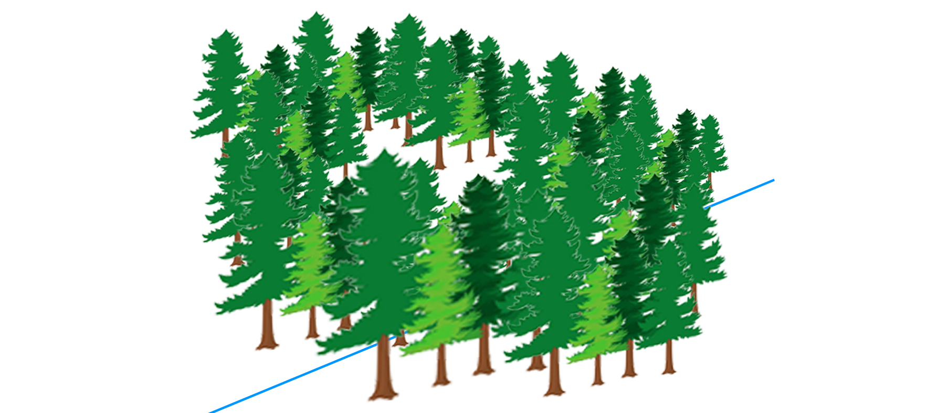
Mikol v. Vlahopoulos
86 Ariz. 93 (1959 AZ Sup. Ct.)
Notes:
Michael Mikol (developer) v. Xen Vlahopoulos (summer homesite owner)
Payson, AZ

Slide 3
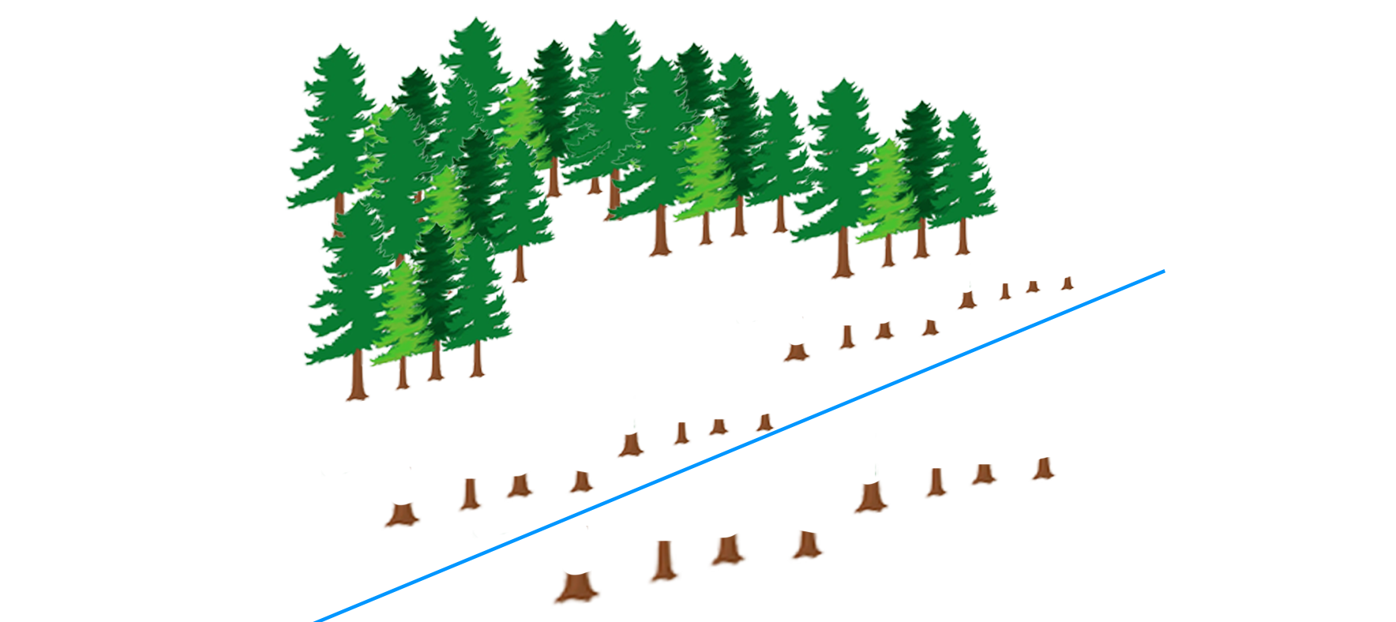
Mikol v. Vlahopoulos
86 Ariz. 93 (1959 AZ Sup. Ct.)
Notes:
Michael Mikol (developer) v. Xen Vlahopoulos (summer homesite owner)
Payson, AZ

Slide 4

Mikol v. Vlahopoulos
86 Ariz. 93 (1959 AZ Sup. Ct.)
π Evidence
Δ Evidence

Slide 5
Mikol v. Vlahopoulos
86 Ariz. 93 (1959 AZ Sup. Ct.)
π Evidence
Δ Evidence
Change in land value:
$$$

Slide 6
Mikol v. Vlahopoulos
86 Ariz. 93 (1959 AZ Sup. Ct.)
π Evidence
Δ Evidence
Change in land value:
Change in land value:
$$$
$

Slide 7
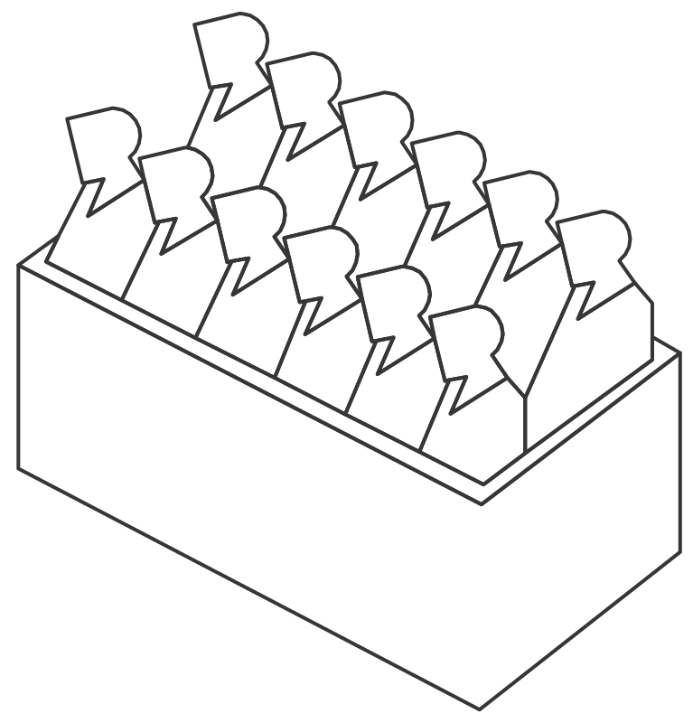
Mikol v. Vlahopoulos
86 Ariz. 93 (1959 AZ Sup. Ct.)

Slide 8
Mikol v. Vlahopoulos
86 Ariz. 93 (1959 AZ Sup. Ct.)
$$$

Slide 9

Mikol v. Vlahopoulos
86 Ariz. 93 (1959 AZ Sup. Ct.)
AZ Supreme Ct.
$$$

Slide 10
Mikol v. Vlahopoulos
86 Ariz. 93 (1959 AZ Sup. Ct.)
π Evidence
Δ Evidence
Change in Market Value of the Land:
Change in Market Value of the Land:
$$$
$

Slide 11

Mikol v. Vlahopoulos
86 Ariz. 93 (1959 AZ Sup. Ct.)
π Evidence
Δ Evidence
…
…

Slide 12
Mikol v. Vlahopoulos
86 Ariz. 93 (1959 AZ Sup. Ct.)
“If the land may be put back in its original condition, the cost of restoration may be used as the measure of damages

Slide 13
Mikol v. Vlahopoulos
86 Ariz. 93 (1959 AZ Sup. Ct.)
“If the land may be put back in its original condition, the cost of restoration may be used as the measure of damages…if it does not exceed the diminution in the market value of the land.”

Slide 14
Mikol v. Vlahopoulos
86 Ariz. 93 (1959 AZ Sup. Ct.)
“Where these two measures of damages are possible, and π gives evidence as to one of them, it is up to Δ …to show that the other measure would be less.”

Slide 15
Mikol v. Vlahopoulos
86 Ariz. 93 (1959 AZ Sup. Ct.)
AZ Supreme Ct.
$$$

Slide 16
Mikol v. Vlahopoulos
86 Ariz. 93 (1959 AZ Sup. Ct.)
AZ Supreme Ct.
✓
$$$

Slide 17

Heninger v. Dunn
(1980 CA Ct. App.)
Notes:
Henninger (landowner) v. Dunn (bulldozer)
Santa Clara County, CA

Slide 18
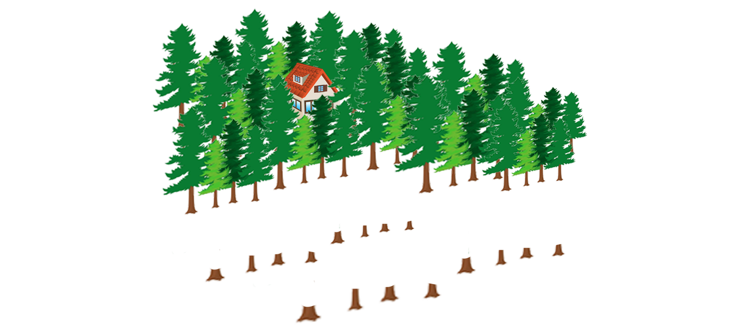
Heninger v. Dunn
(1980 CA Ct. App.)
Notes:
Henninger (landowner) v. Dunn (bulldozer)

Slide 19

Heninger v. Dunn
(1980 CA Ct. App.)
Notes:
Henninger (landowner) v. Dunn (bulldozer)

Slide 20
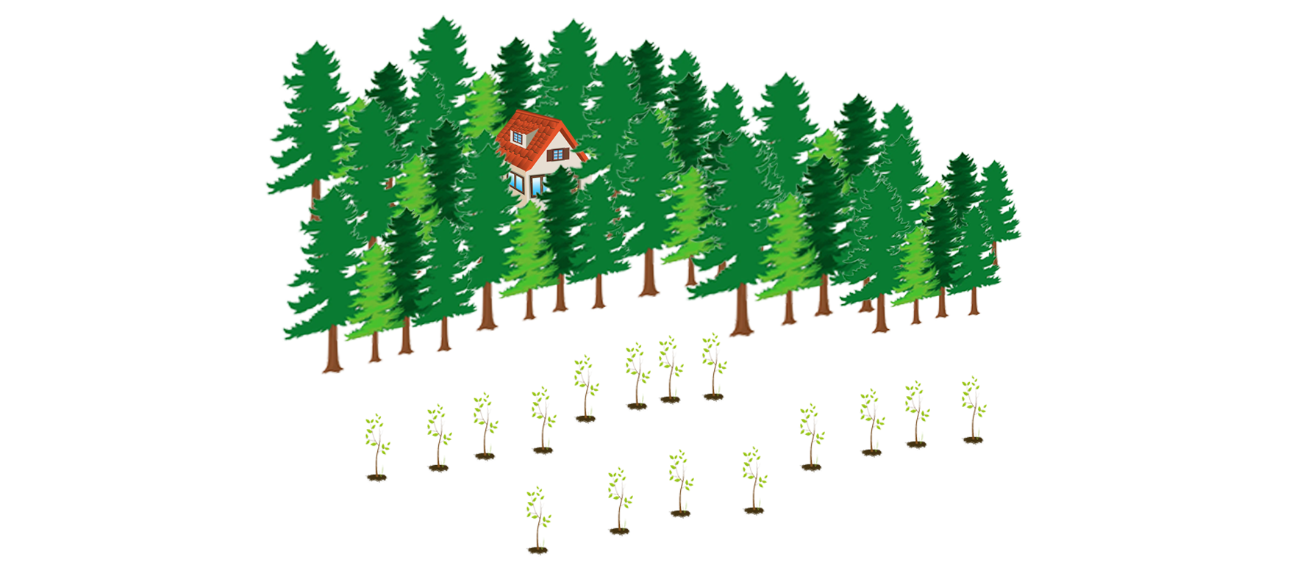
Heninger v. Dunn
(1980 CA Ct. App.)
Notes:
Henninger (landowner) v. Dunn (bulldozer)

Slide 21
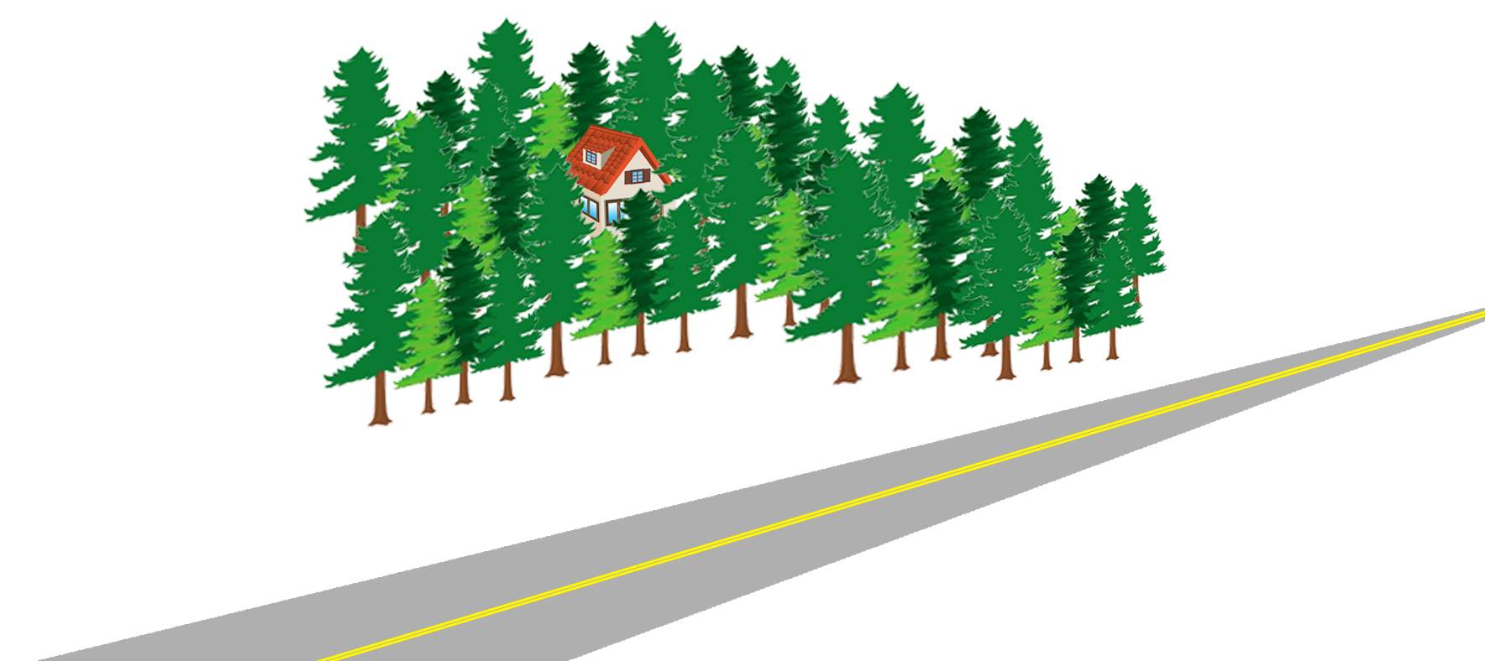
Heninger v. Dunn
(1980 CA Ct. App.)
Notes:
Henninger (landowner) v. Dunn (bulldozer)

Slide 22
Heninger v. Dunn
(1980 CA Ct. App.)
+$$$
Notes:
Henninger (landowner) v. Dunn (bulldozer)

Slide 23
Heninger v. Dunn
(1980 CA Ct. App.)
π Evidence
Δ Evidence

Slide 24
Heninger v. Dunn
(1980 CA Ct. App.)
π Evidence
Δ Evidence
Cost to replace trees:
$221,647

Slide 25
Heninger v. Dunn
(1980 CA Ct. App.)
π Evidence
Δ Evidence
Cost to replace trees:
$221,647
Cost to plant saplings:
$19,610

Slide 26
Heninger v. Dunn
(1980 CA Ct. App.)
π Evidence
Δ Evidence
Cost to replace trees:
$221,647
Cost to plant saplings:
$19,610
TOTAL land value:
$179,000

Slide 27
Heninger v. Dunn
(1980 CA Ct. App.)
π Evidence
Δ Evidence
Cost to replace trees:
$221,647
Cost to plant saplings:
$19,610
TOTAL land value:
$179,000
Change in land value:
INCREASED $5,000

Slide 28

Heninger v. Dunn
(1980 CA Ct. App.)

Slide 29
Heninger v. Dunn
(1980 CA Ct. App.)
Maximum Loss is Change in Land Value

Slide 30
Heninger v. Dunn
(1980 CA Ct. App.)
CA Ct. App.
Maximum Loss is Change in Land Value

Slide 31
Heninger v. Dunn
(1980 CA Ct. App.)
π Evidence
Δ Evidence
Cost to replace trees:
$221,647
Cost to plant saplings:
$19,610
TOTAL land value:
$179,000
Change in land value:
INCREASED $5,000

Slide 32
Heninger v. Dunn
(1980 CA Ct. App.)
“To hold that [Heninger] is without remedy merely because the value of the land has not been diminished would be to decide that by the wrongful act of another, an owner of land may be compelled to:
  - accept a change in his property, or
  - perform…restoration at his own expense”

Slide 33
Heninger v. Dunn
(1980 CA Ct. App.)
HOWEVER

Slide 34
Heninger v. Dunn
(1980 CA Ct. App.)
HOWEVER
“a reasonable approximation of the land’s former condition may involve something less than substantially identical restoration.”

Slide 35
Heninger v. Dunn
(1980 CA Ct. App.)
HOWEVER
“a reasonable approximation of the land’s former condition may involve something less than substantially identical restoration.”
“transplanting a large number of mature trees…is …a manifestly unreasonable expense in relation to the value of the land.”

Slide 36
Heninger v. Dunn
(1980 CA Ct. App.)
CA Ct. App.
Maximum Loss is Change in Land Value

Slide 37
Heninger v. Dunn
(1980 CA Ct. App.)
CA Ct. App.
X
Maximum Loss is Change in Land Value

Slide 38
Heninger v. Dunn
(1980 CA Ct. App.)
CA Ct. App.
X
Maximum Loss is Change in Land Value

Slide 39
Heninger v. Dunn
(1980 CA Ct. App.)
CA Ct. App.
X
Maximum Loss is Change in Land Value

Slide 40
Heninger v. Dunn
(1980 CA Ct. App.)
CA Ct. App.
X
Maximum Loss is Change in Land Value
Reasonable Restoration Costs

Slide 41
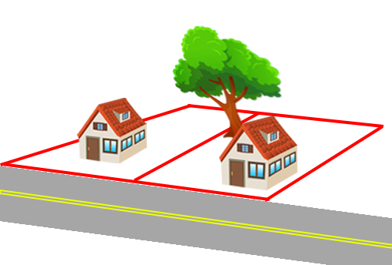
Rony v. Costa
(2012 CA Ct. App.)
Notes:
Ellen Rony v. Paolo Costa
Marin County, CA

Slide 42
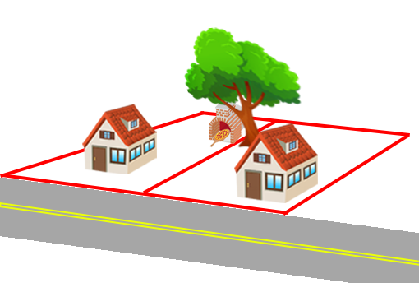
Rony v. Costa
(2012 CA Ct. App.)
Notes:
Ellen Rony v. Paolo Costa
Marin County, CA

Slide 43
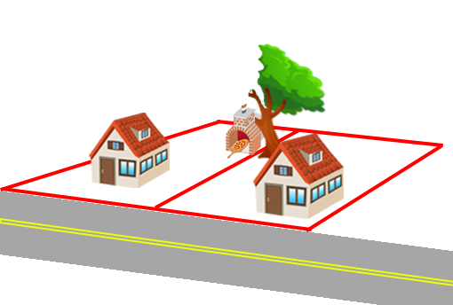
Rony v. Costa
(2012 CA Ct. App.)
Notes:
Ellen Rony v. Paolo Costa
Marin County, CA

Slide 44
Rony v. Costa
(2012 CA Ct. App.)
π expert:
  8th Edition Guide for Plant Appraisal
  “Cost of Cure” 108” box: $21,266
  Replacement and maintenance: $16,217
  Interest rate: 5%
  Appraised loss: $59,428

Slide 45
Rony v. Costa
(2012 CA Ct. App.)
Δ expert:
  9th Edition Guide for Plant Appraisal
  TFM Total Depreciated Cost: $20,000
  Amount of Canopy Loss: 30%
  Additional Costs: $1,530
  Appraised loss: $7,530

Slide 46
Rony v. Costa
(2012 CA Ct. App.)
π Evidence
Δ Evidence
Cost of Cure: $59,428
TFM: $7,530

Slide 47
Rony v. Costa
(2012 CA Ct. App.)

Slide 48
Rony v. Costa
(2012 CA Ct. App.)
TFM: $7,530

Slide 49
Rony v. Costa
(2012 CA Ct. App.)
TFM: $7,530
+
“Discomfort and Annoyance”: $15,000

Slide 50
Rony v. Costa
(2012 CA Ct. App.)
(
)
TFM: $7,530
+
“Discomfort and Annoyance”: $15,000
x2

Slide 51
Rony v. Costa
(2012 CA Ct. App.)
Court of Appeals
(
)
TFM: $7,530
+
“Discomfort and Annoyance”: $15,000
x2

Slide 52
Rony v. Costa
(2012 CA Ct. App.)
TFM “did not fully compensate π for all the detriment”
TFM “may account for a tree’s placement and condition in a utilitarian sense, but [not] the intangible, but very real loss in aesthetic pleasure.”

Slide 53
Rony v. Costa
(2012 CA Ct. App.)
Court of Appeals
(
)
TFM: $7,530
+
“Discomfort and Annoyance”: $15,000
x2

Slide 54
Rony v. Costa
(2012 CA Ct. App.)
Court of Appeals
✓
(
)
TFM: $7,530
+
“Discomfort and Annoyance”: $15,000
x2

Slide 55
Valuing Tree Losses
Selections from Case Law

Slide 56
Valuing Tree Losses
Selections from Case Law
Mikol v. Vlahopoulos
1959 AZ Sup. Ct.
Restoration costs OK
if less than change in land value,
but aren’t required
Δ burden to show smaller amount

Slide 57
Valuing Tree Losses
Selections from Case Law
Heninger v. Dunn
1980 CA Ct. App.
Mikol v. Vlahopoulos
1959 AZ Sup. Ct.
Restoration costs OK
if less than change in land value,
but aren’t required
Δ burden to show smaller amount
Reasonable restoration costs OK
EVEN IF more than change of market value
But must be reasonable

Slide 58
Valuing Tree Losses
Selections from Case Law
Heninger v. Dunn
1980 CA Ct. App.
Mikol v. Vlahopoulos
1959 AZ Sup. Ct.
Rony v. Costa
2012 CA Ct. App.
Restoration costs OK
if less than change in land value,
but aren’t required
Δ burden to show smaller amount
Reasonable restoration costs OK
EVEN IF more than change of market value
But must be reasonable
TFM did not fully compensate
“Discomfort and annoyance”

Slide 59
Valuing Tree Losses
Selections from Case Law
James Komen
BCMA #WE-9909B
RCA #555

