Slide 1
Tree Losses for Insurance Reporting
Digging Into
James Komen
BCMA #9909B, RCA #555
www.JamesKomen.com
jameskomen@gmail.com
May 10, 2023

Slide 2
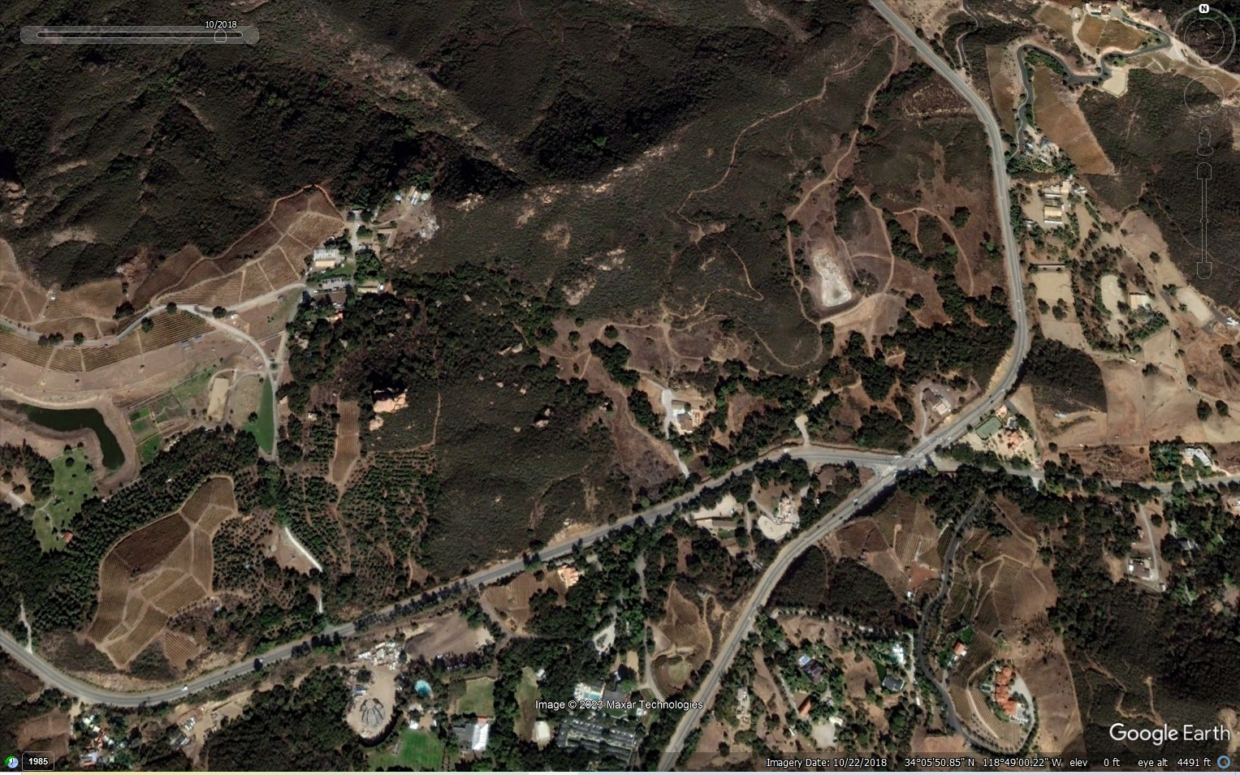

Slide 3
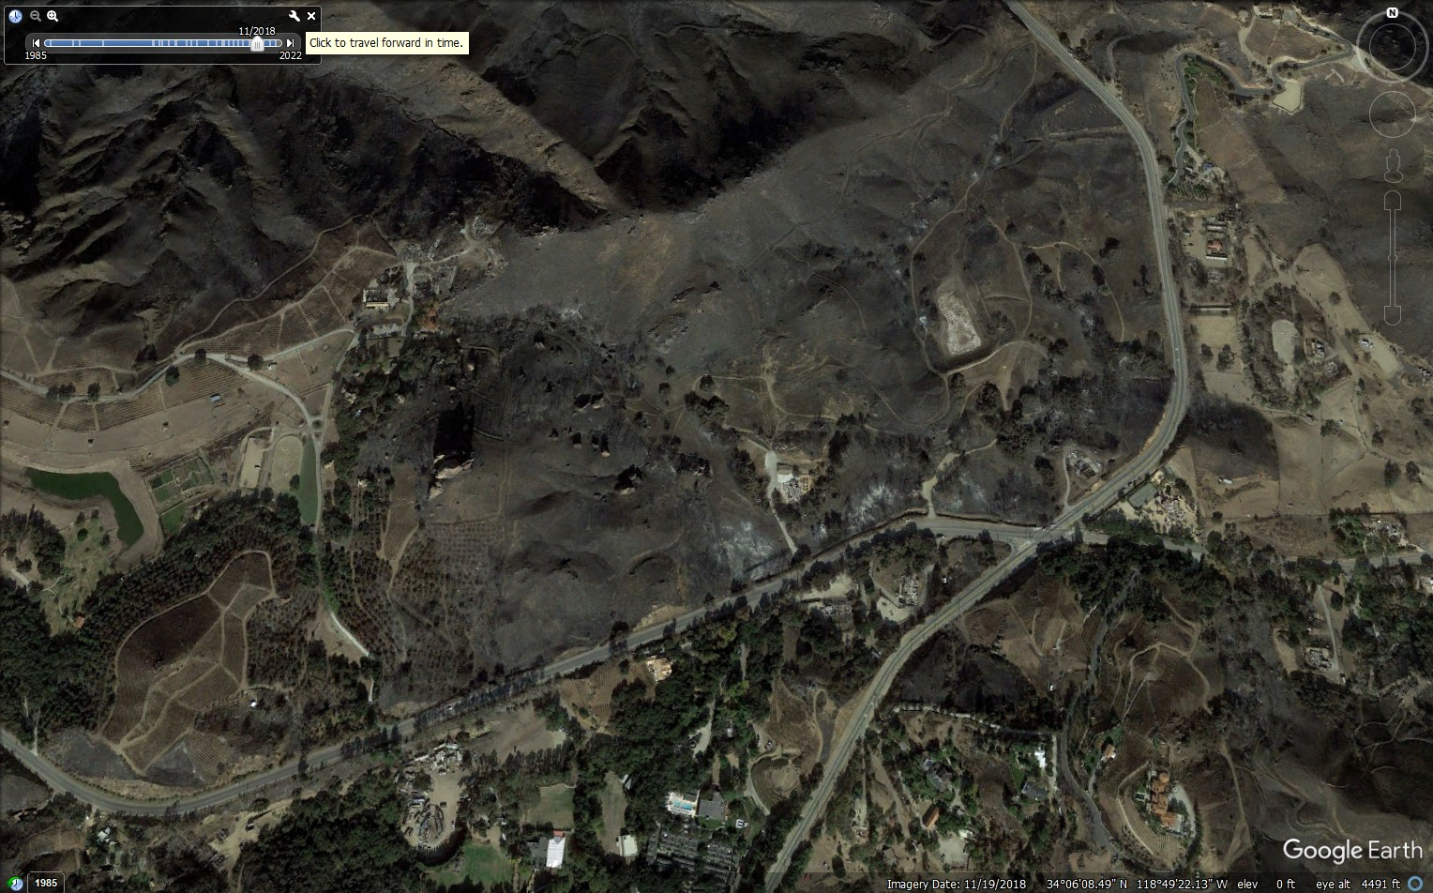

Slide 4
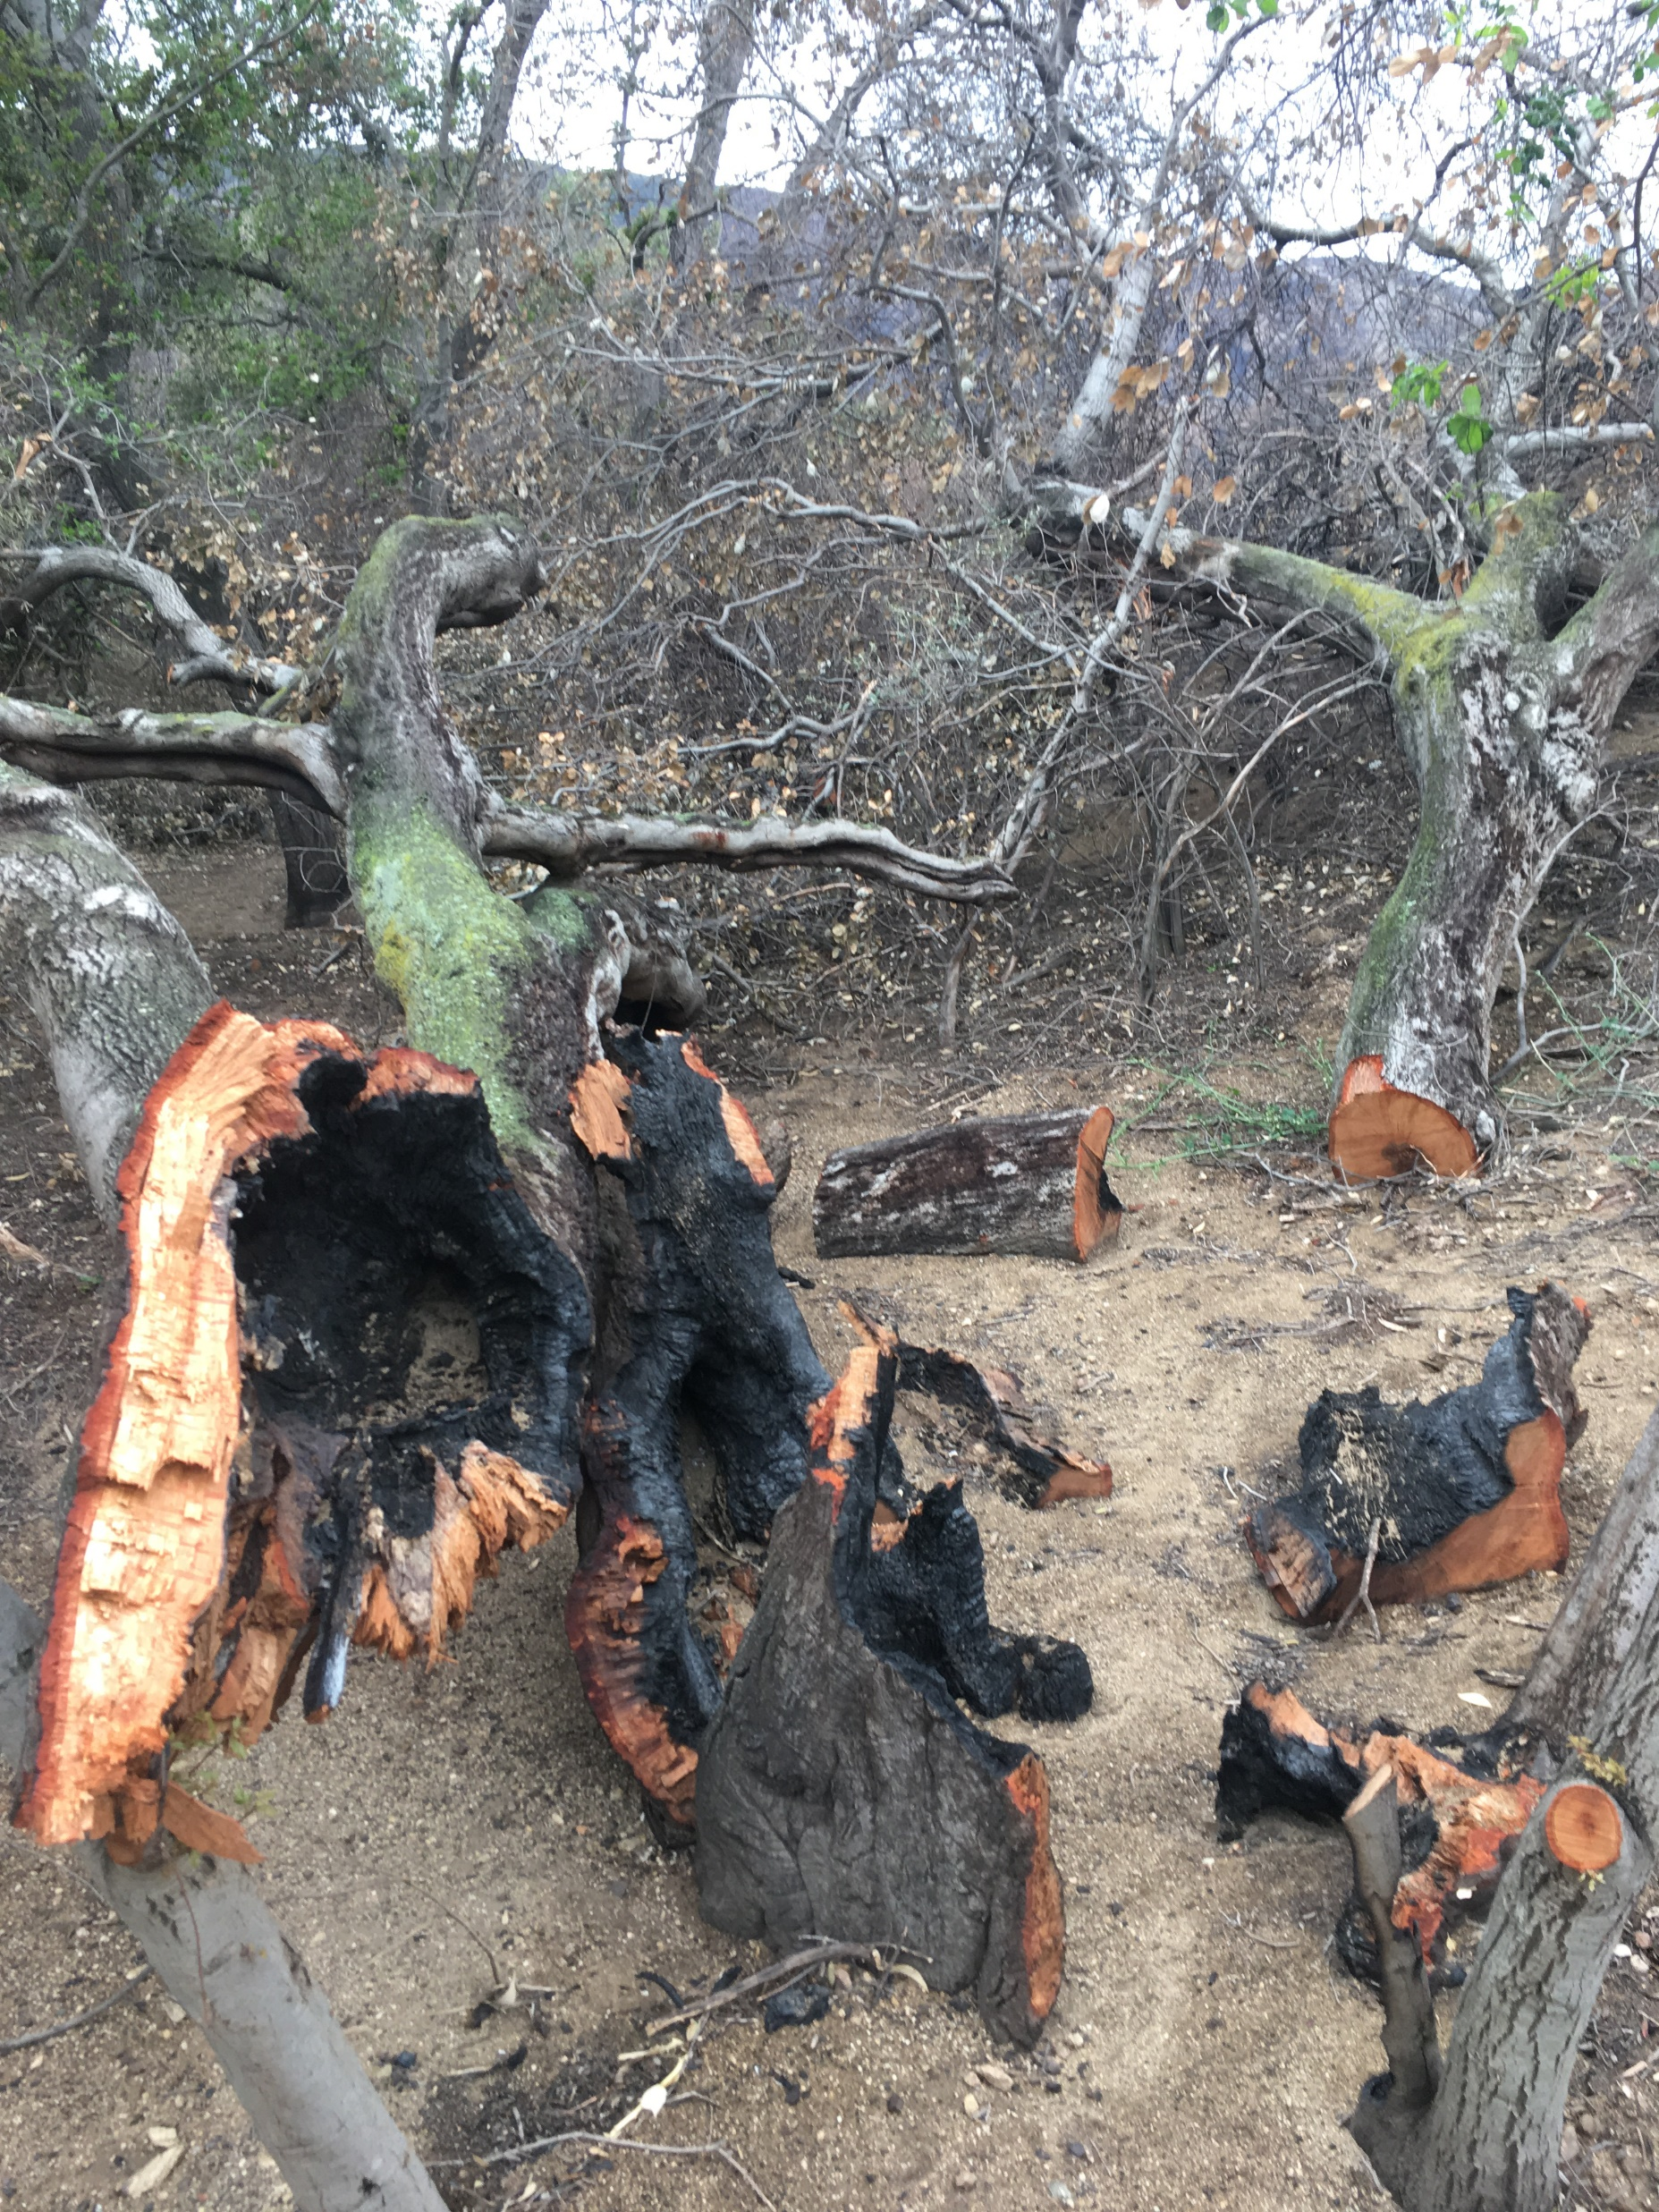
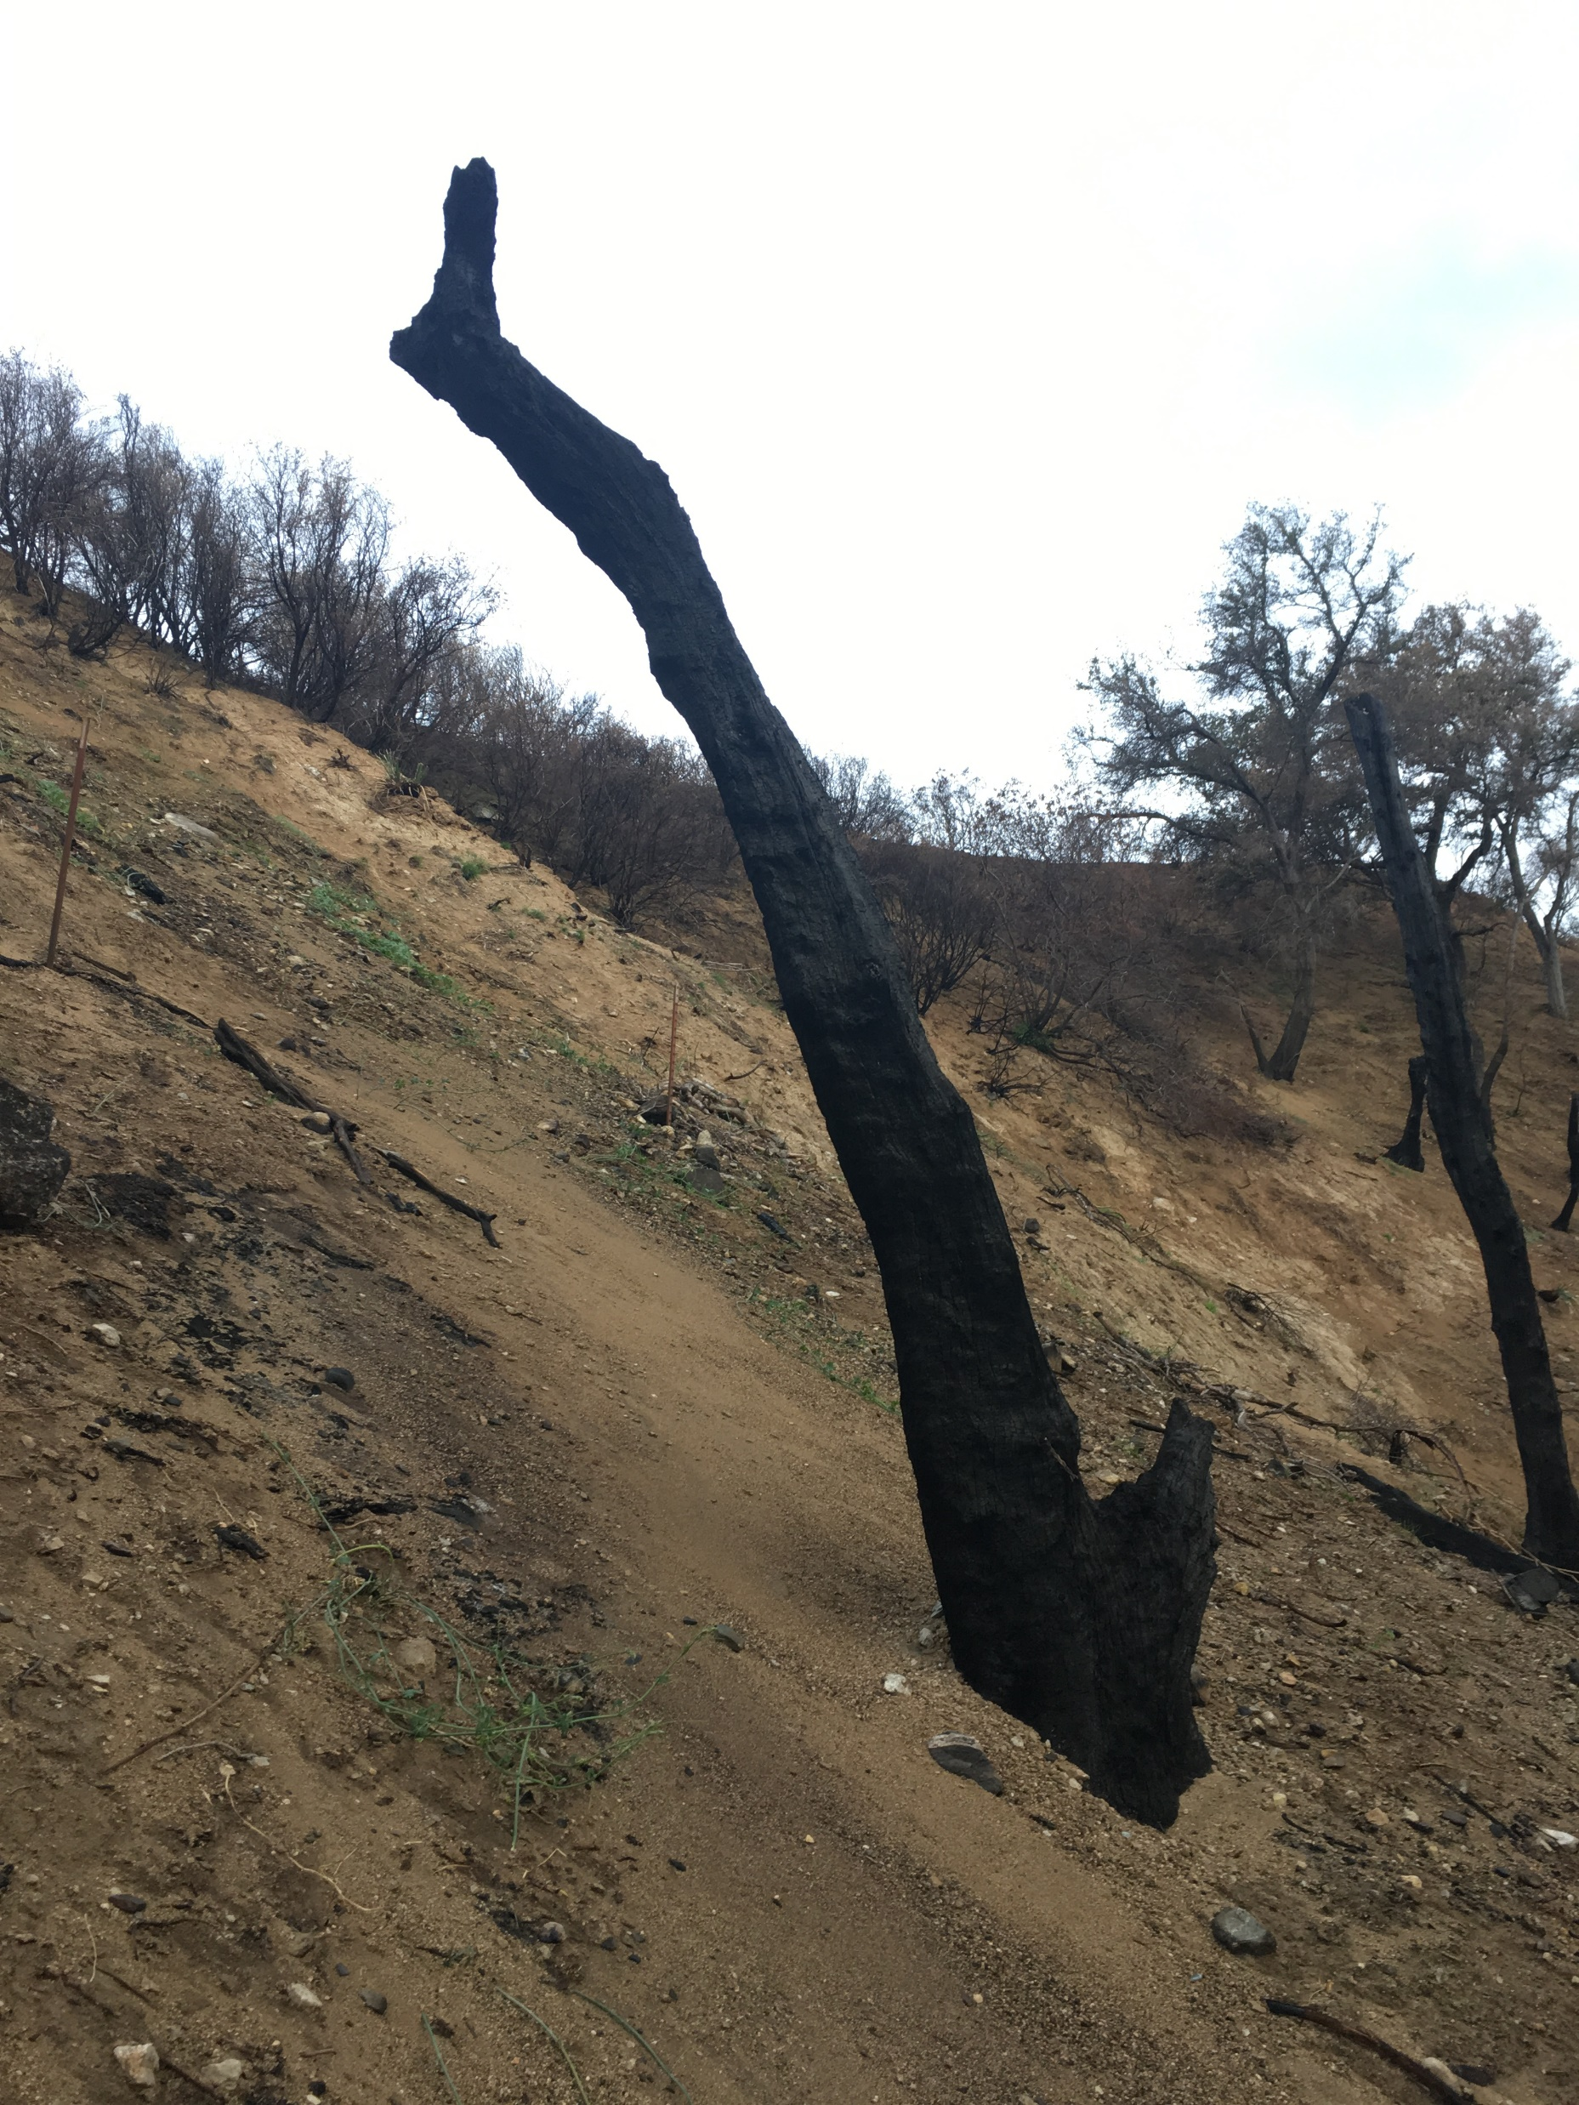
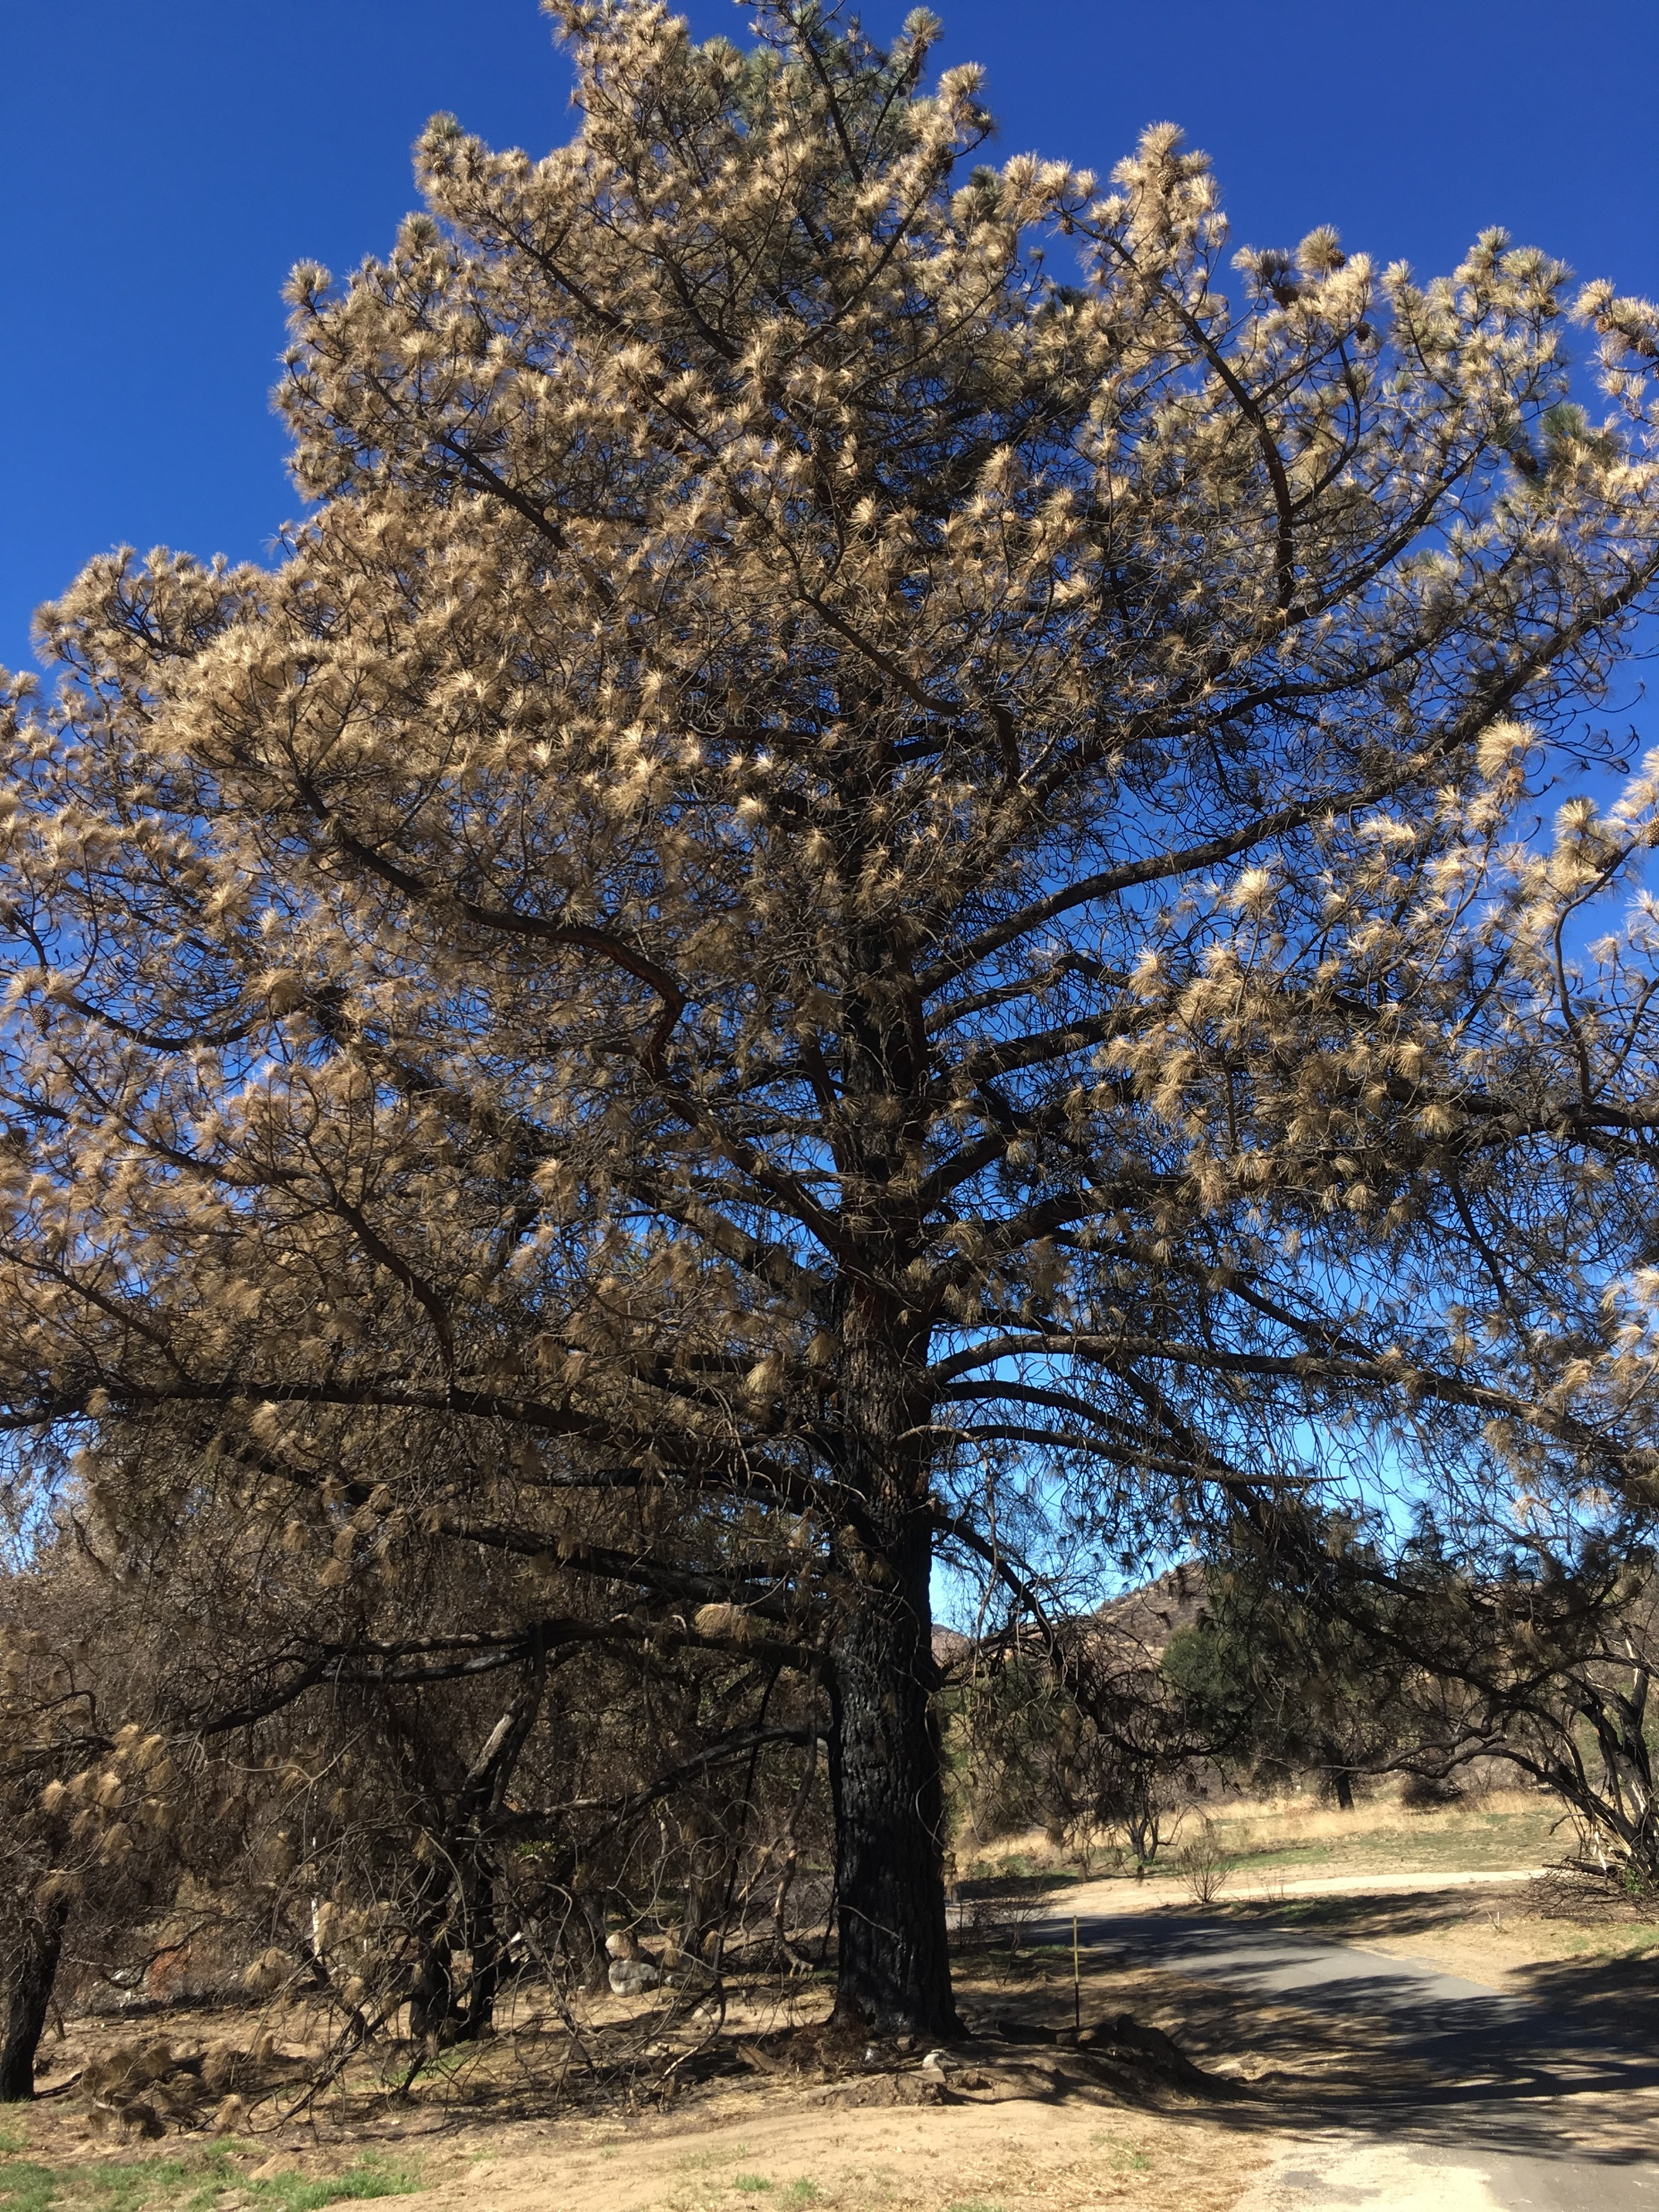
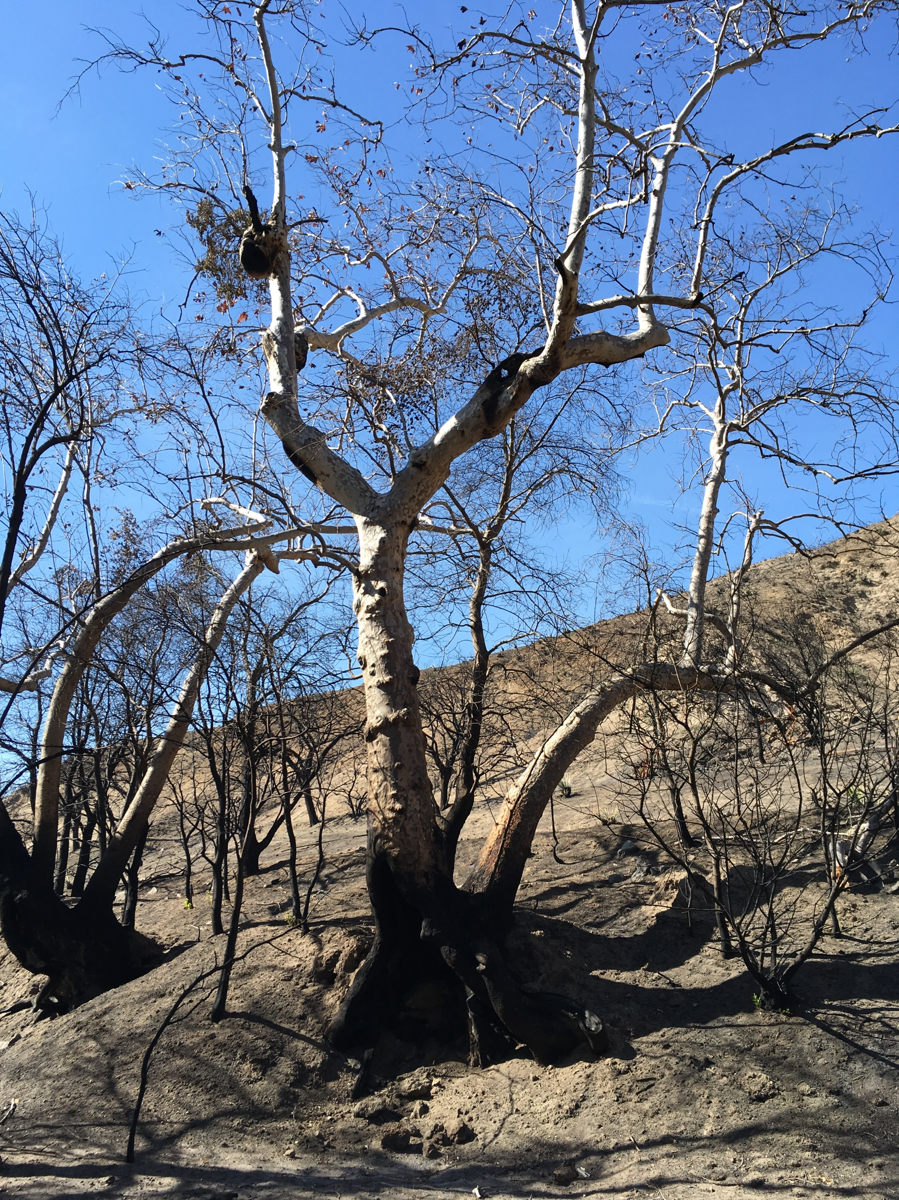

Slide 5
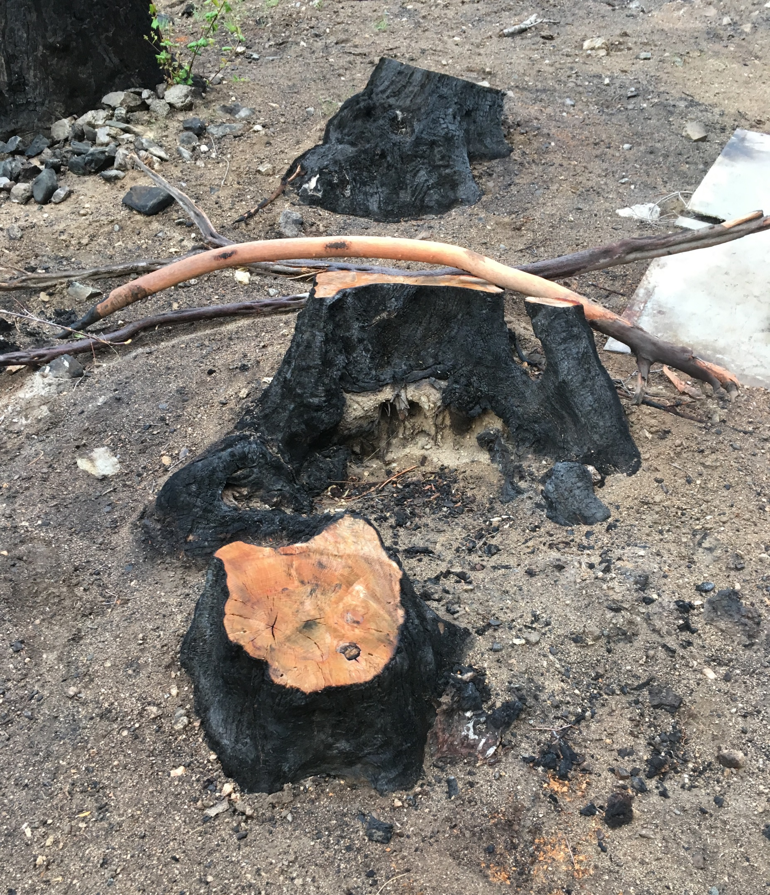
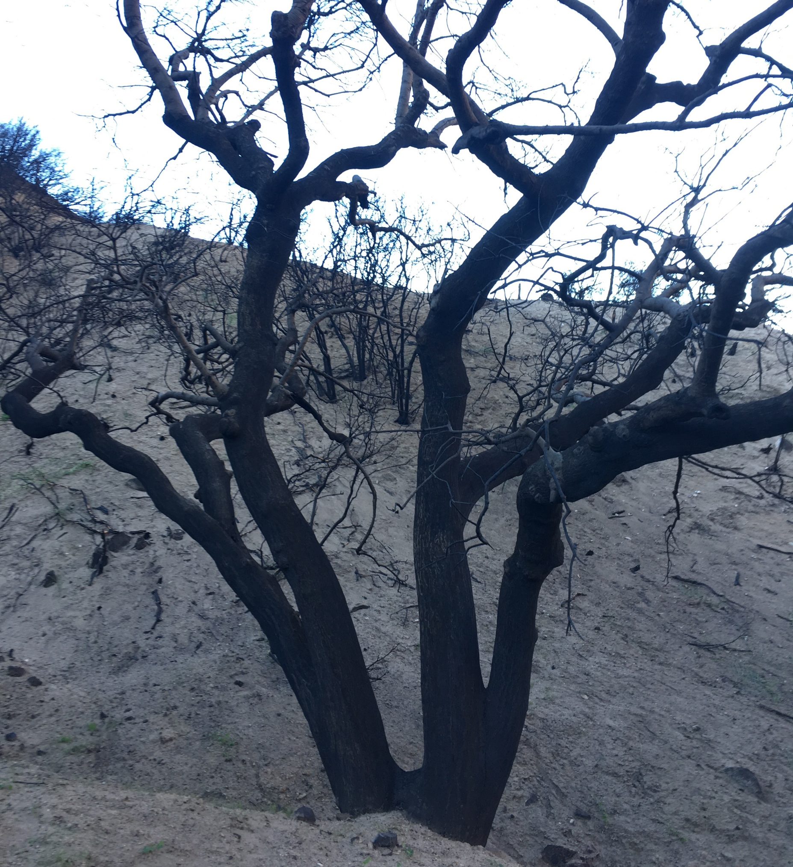

Slide 6
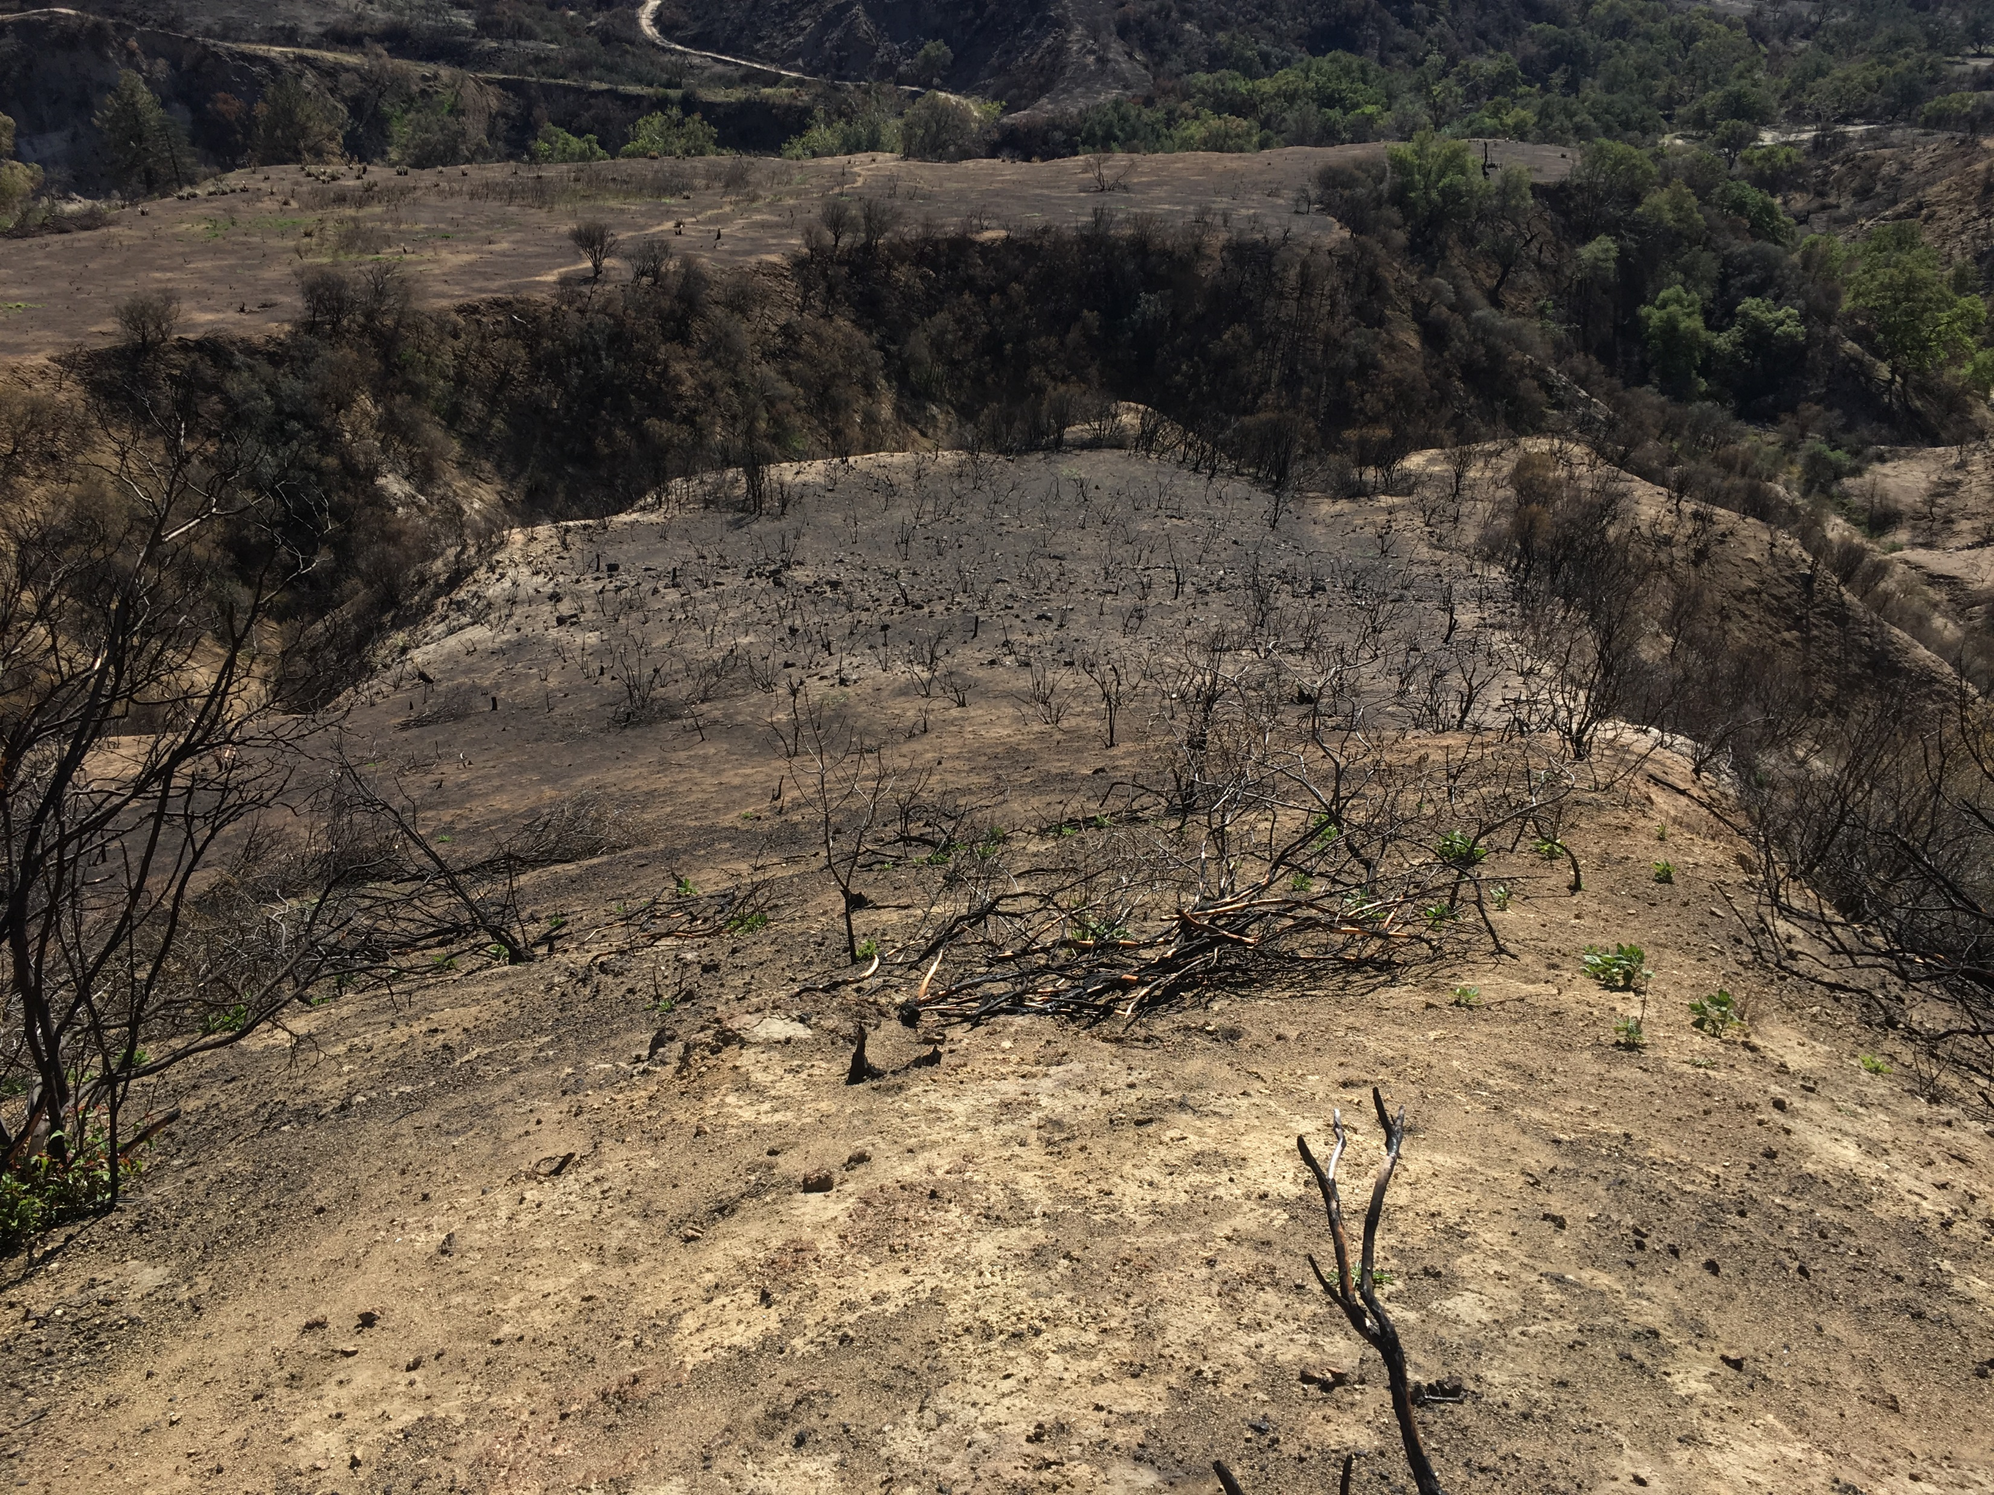
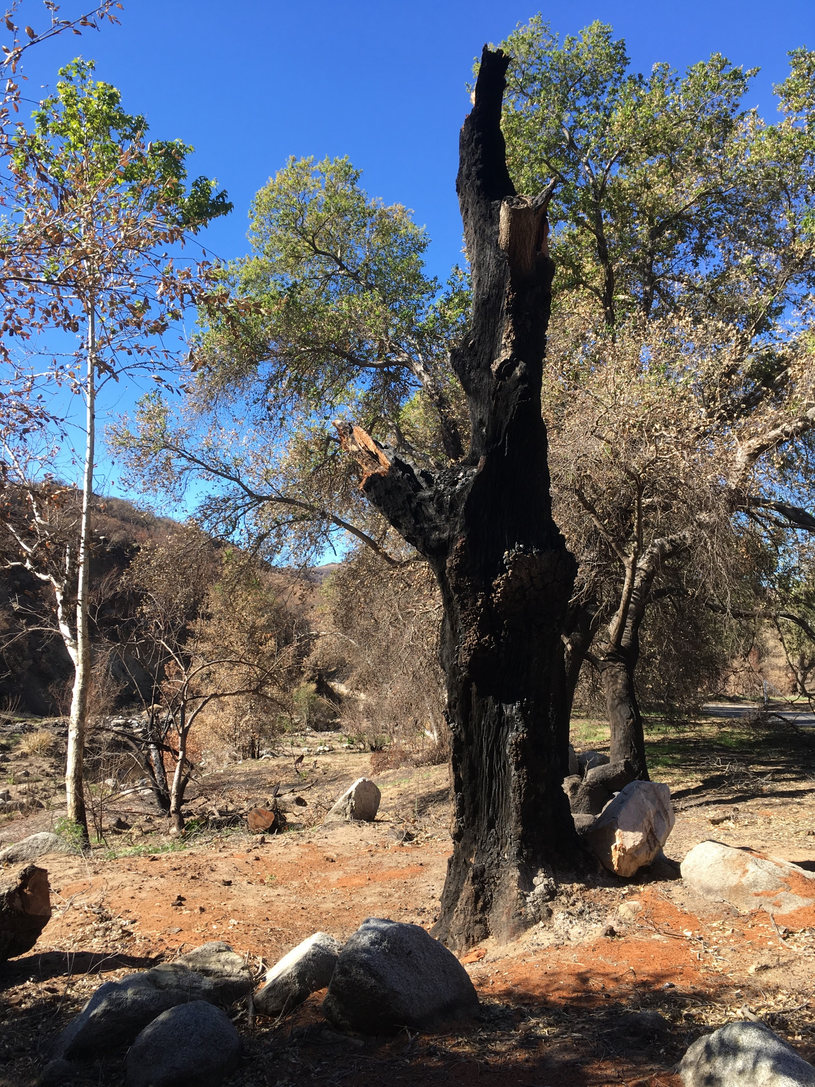
Notes:
“We’ve got 30 insureds in the area who have all suffered a loss, and we need you to investigate and appraise the damage to their landscapes.
When do you think you can get them all done?”
How do I answer that question? How do I budget my time so I can schedule these 30 cases efficiently, yet still give each property a thorough investigation?

Slide 7
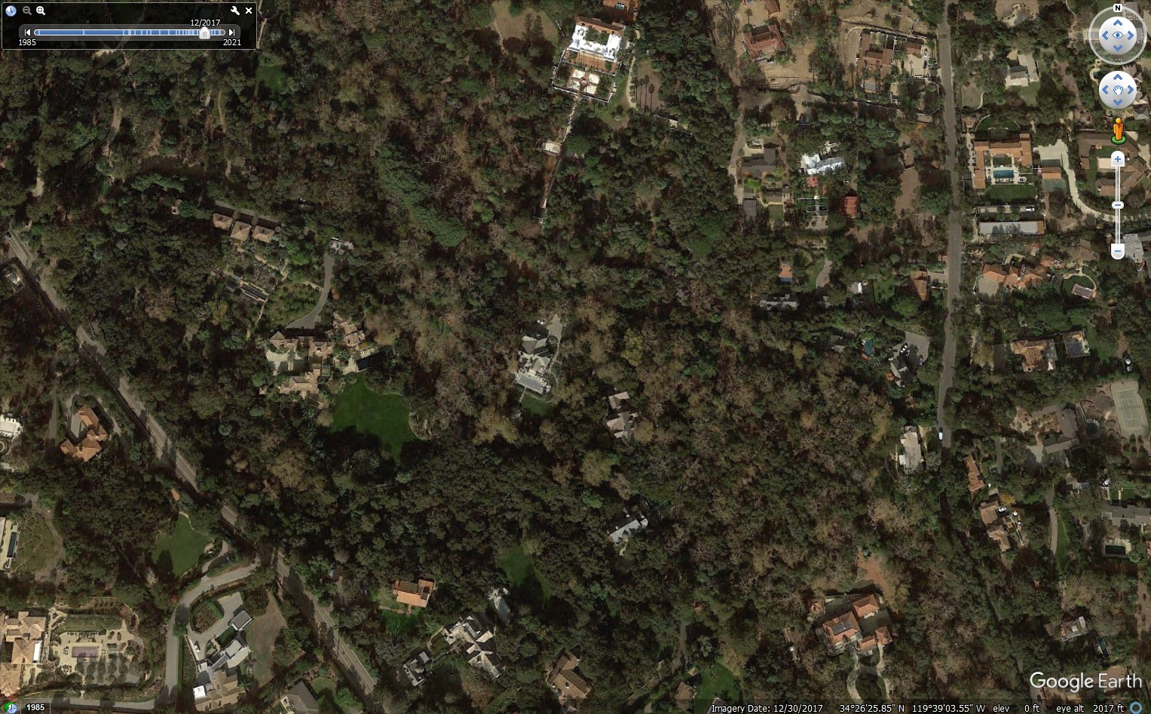

Slide 8
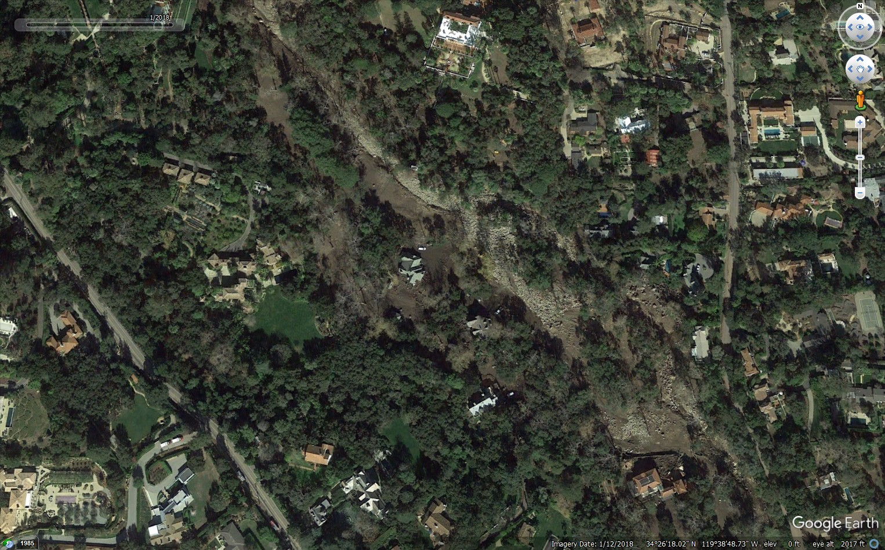

Slide 9
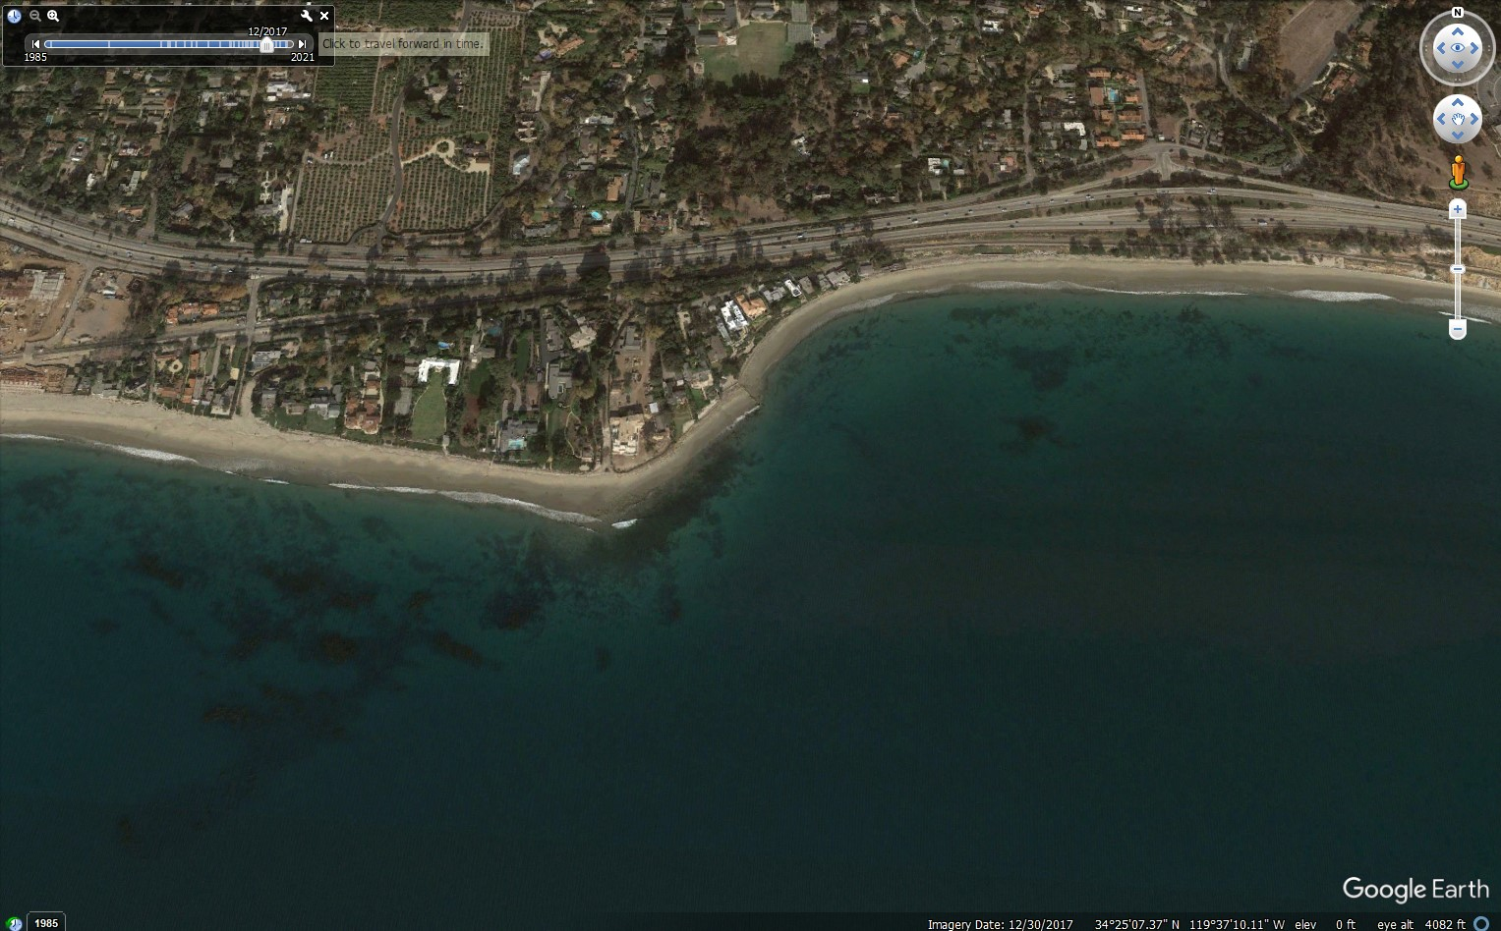

Slide 10
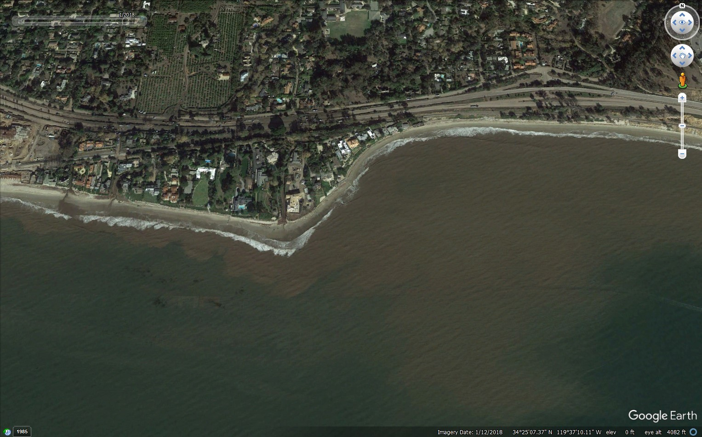

Slide 11
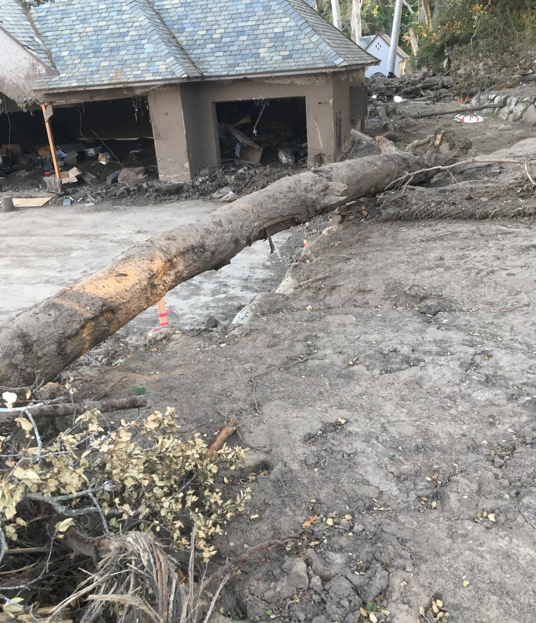
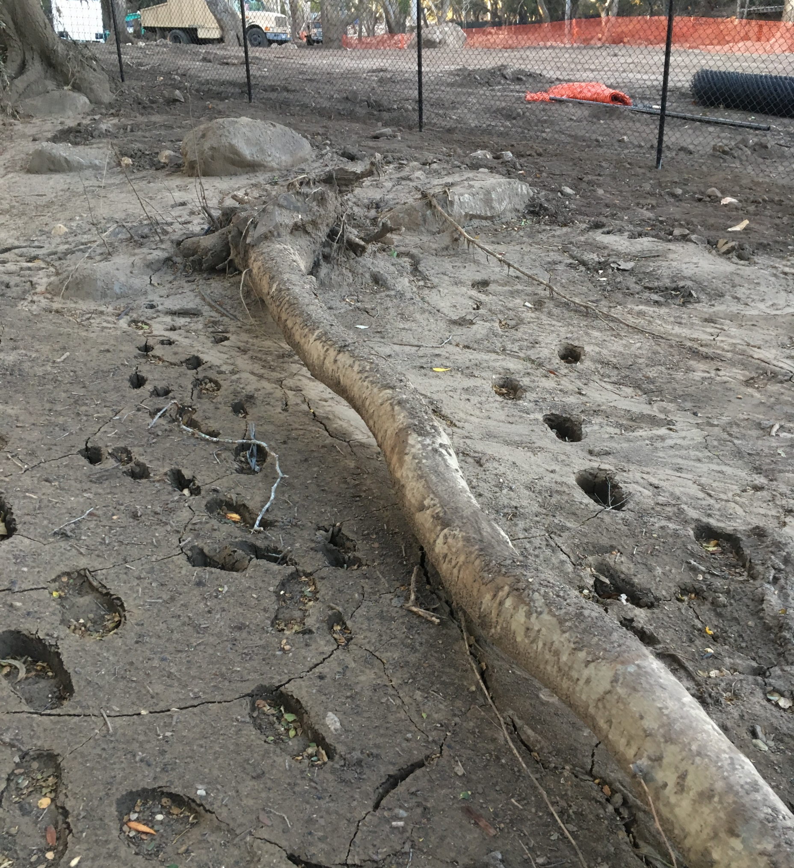
Notes:
Much of the evidence of prior landscapes was buried or completely washed away.
How should I go about collecting data to show what was damaged in the mudslide?

Slide 12
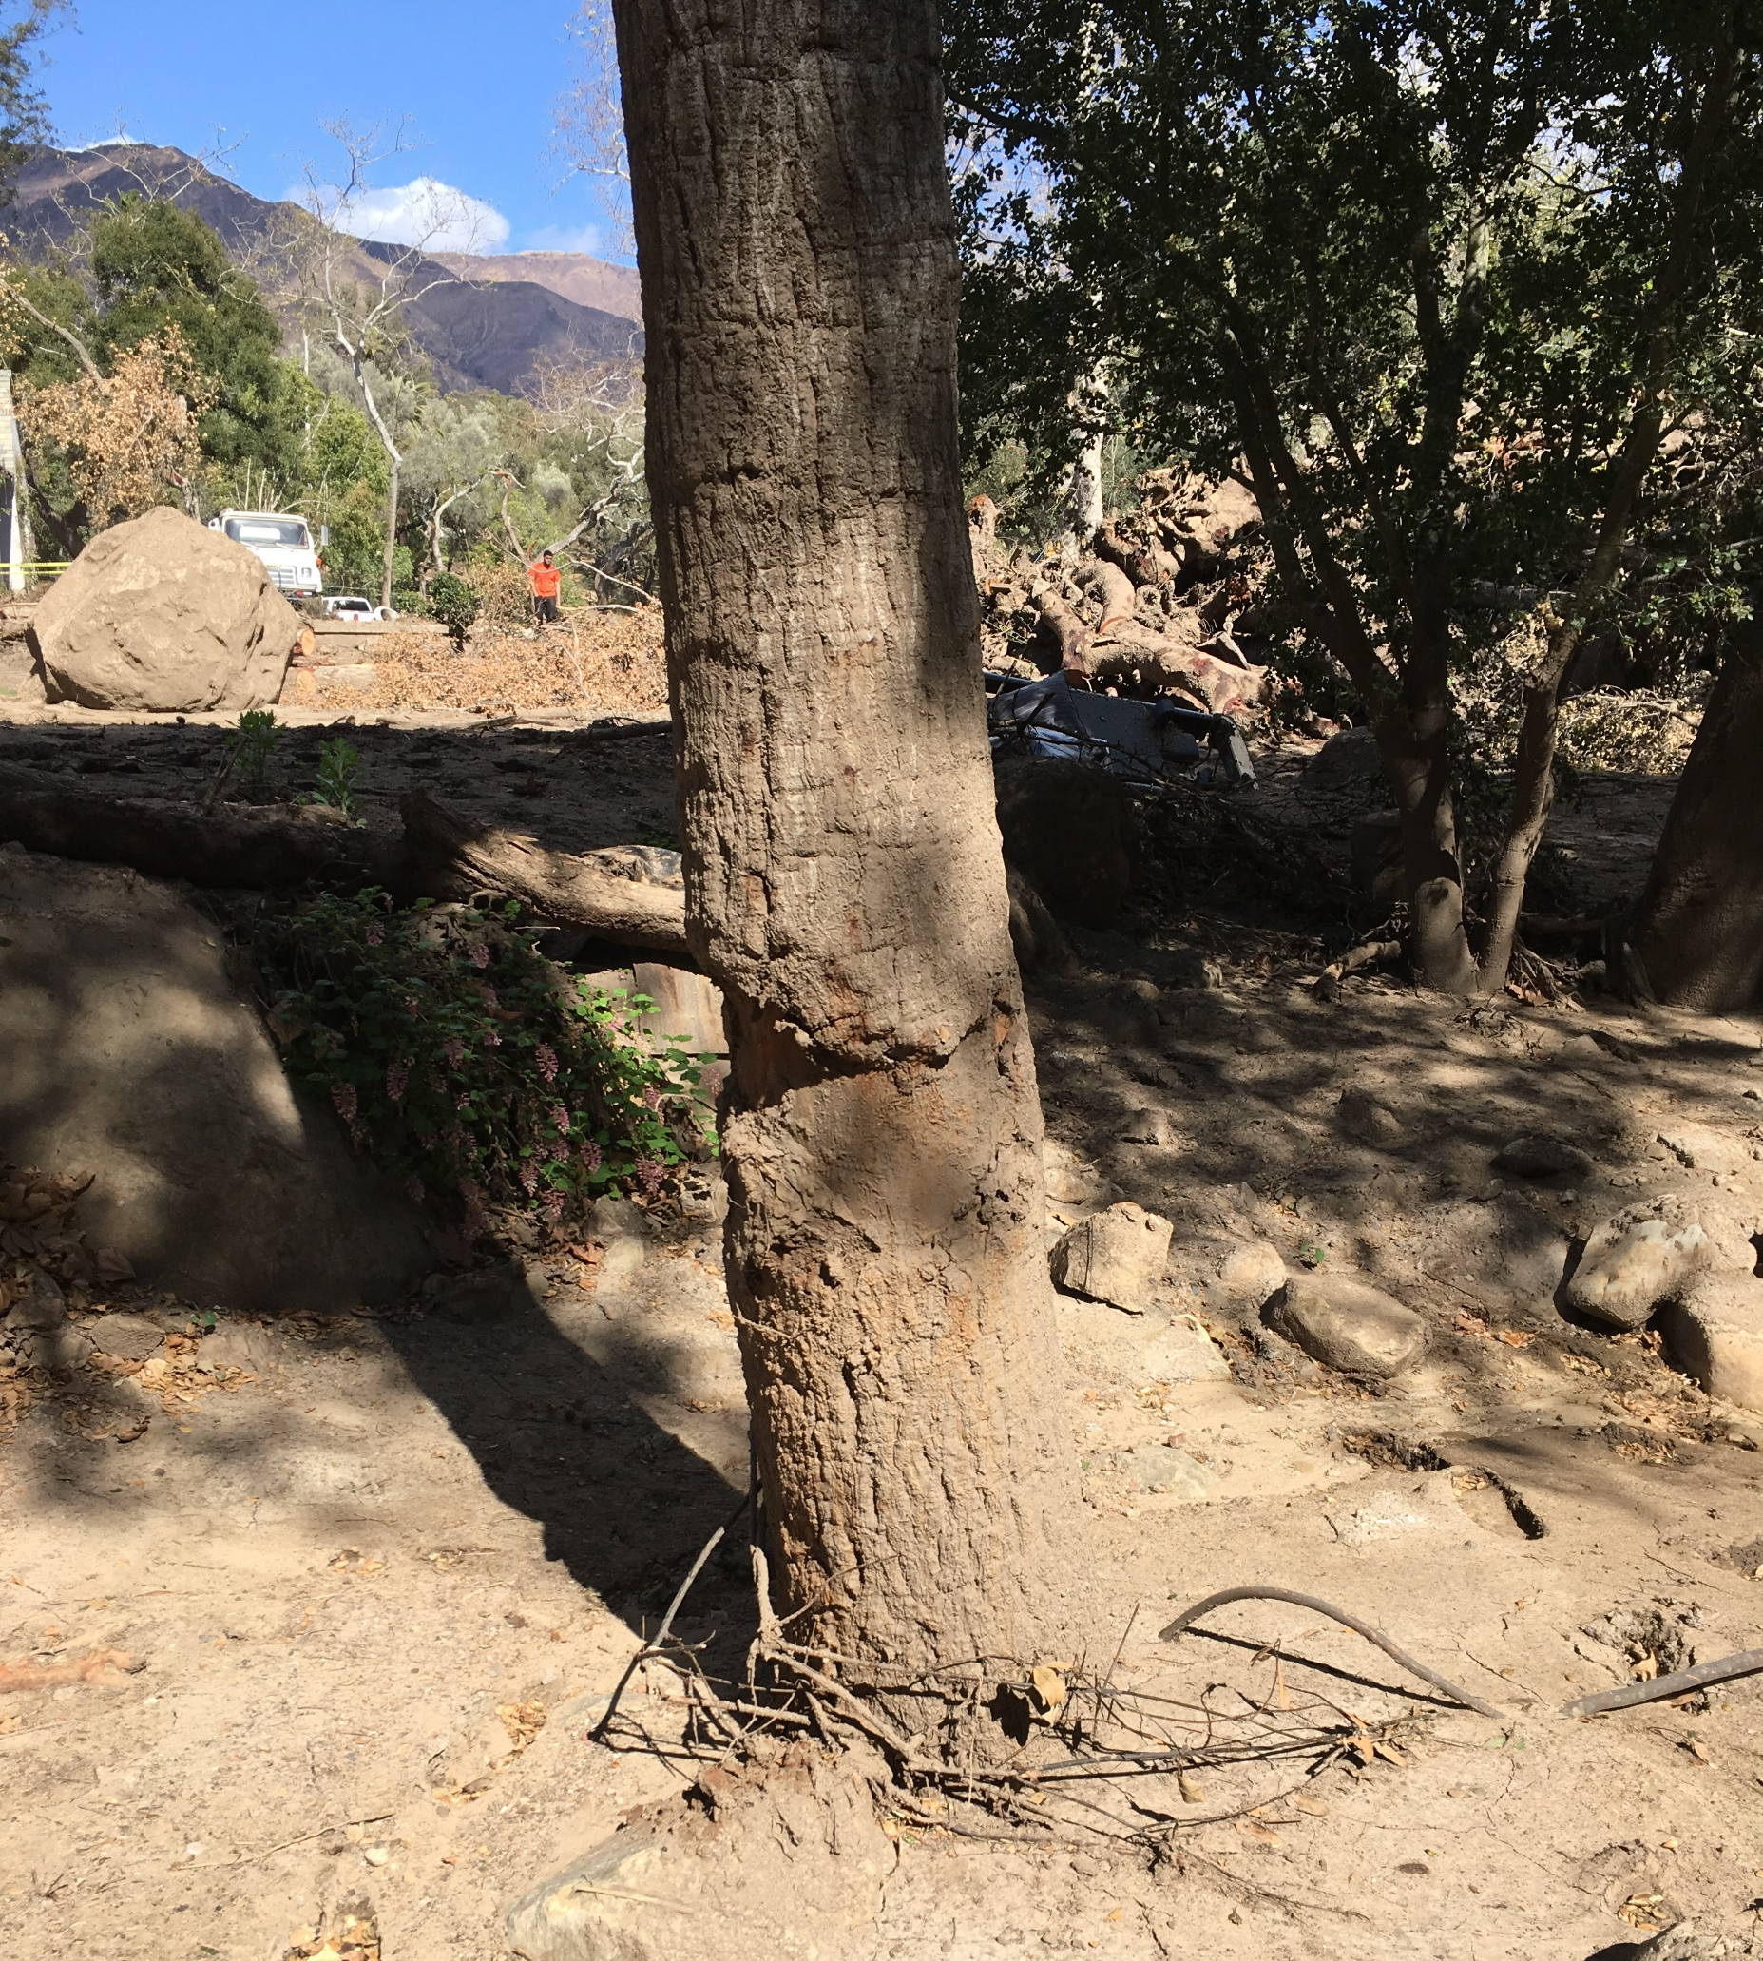
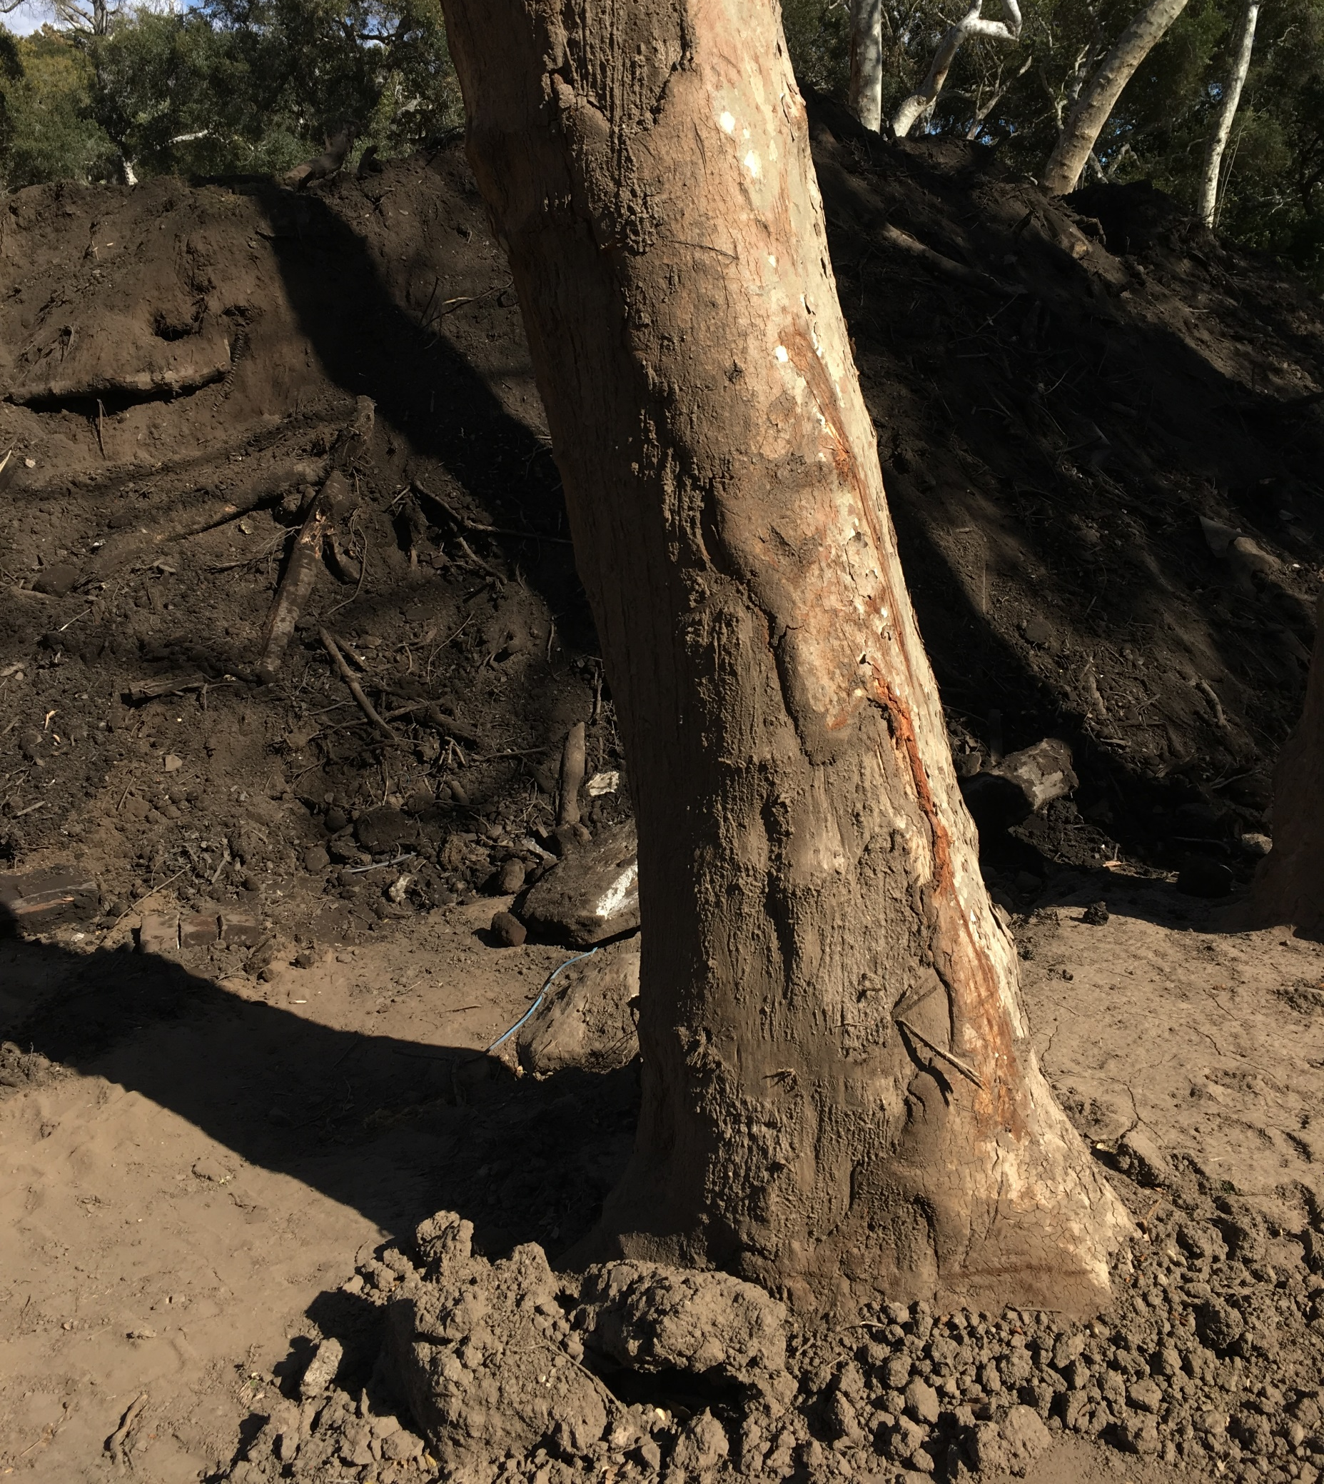
Field Data

Slide 13
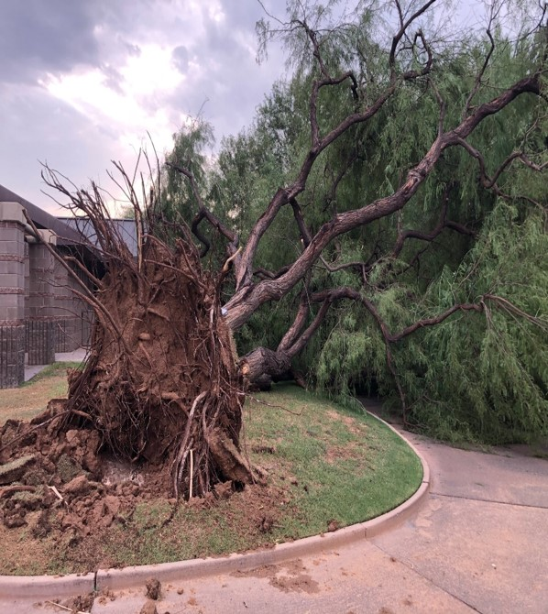
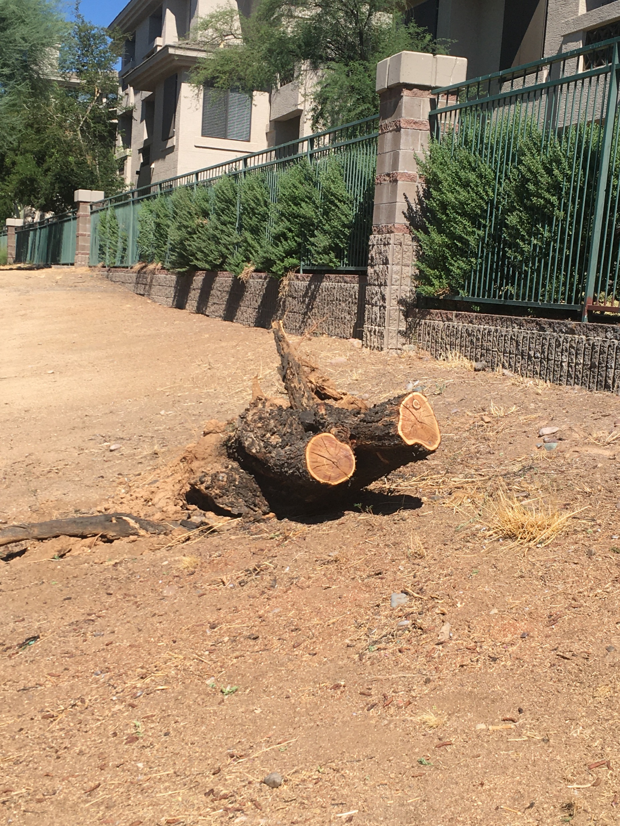

Slide 14
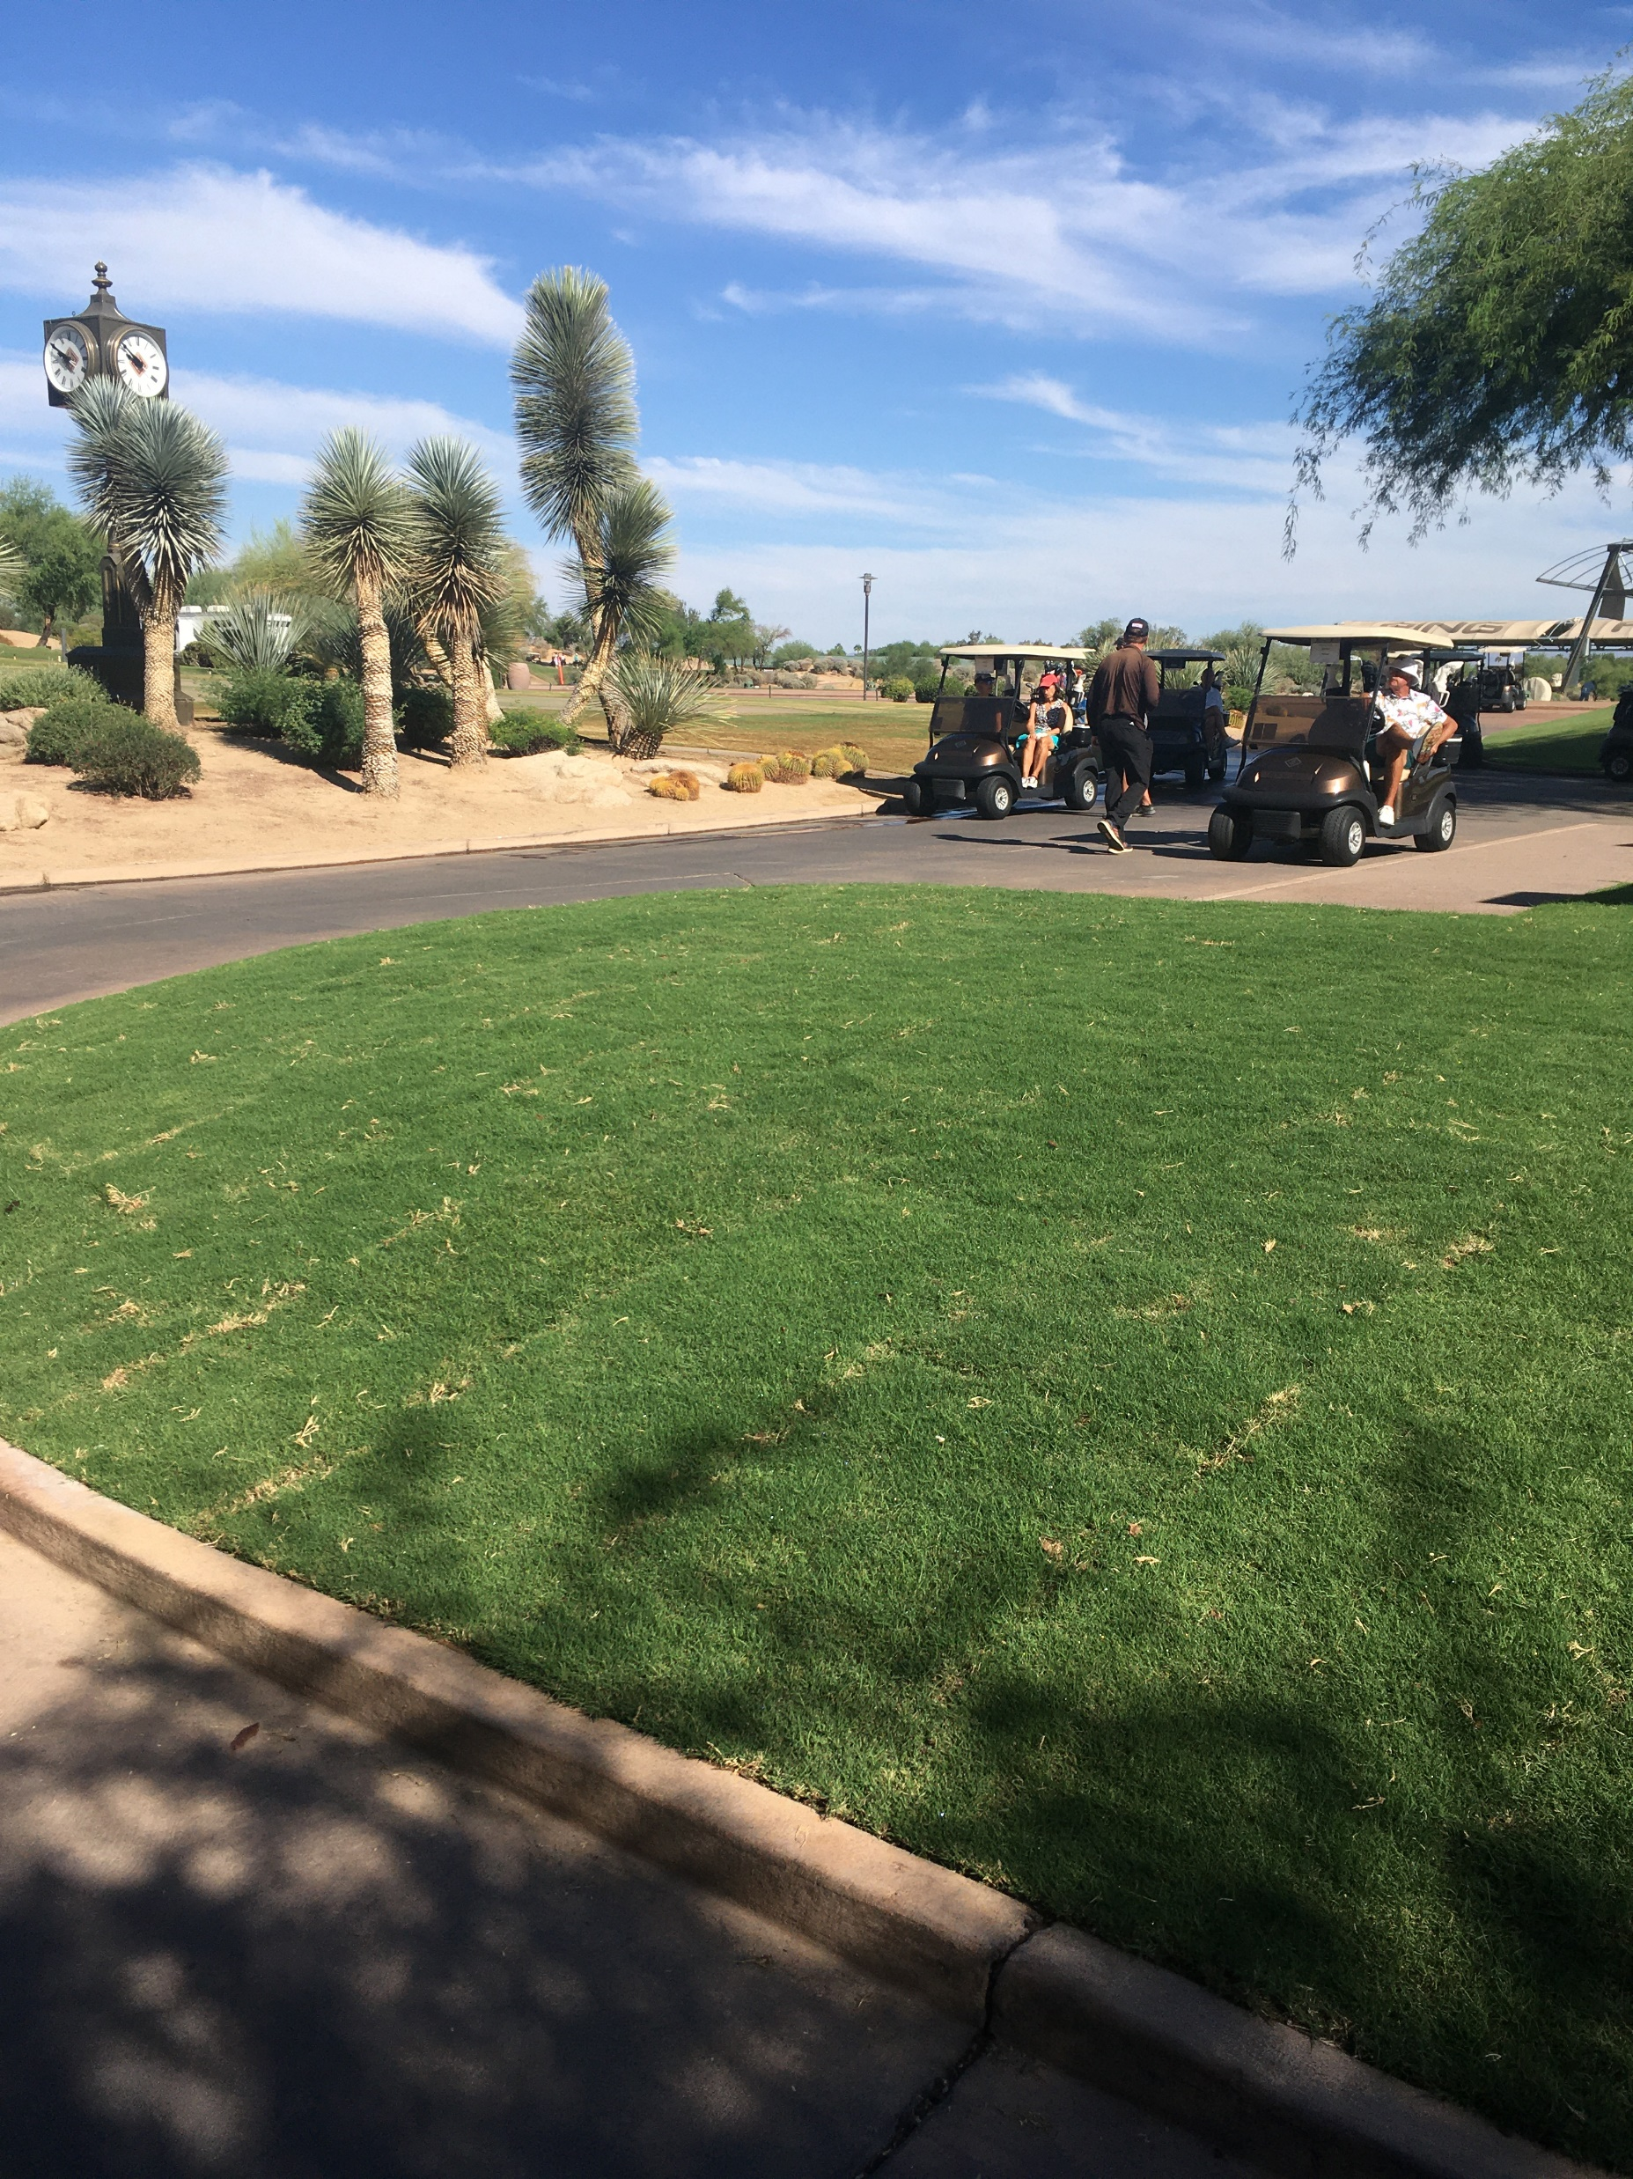
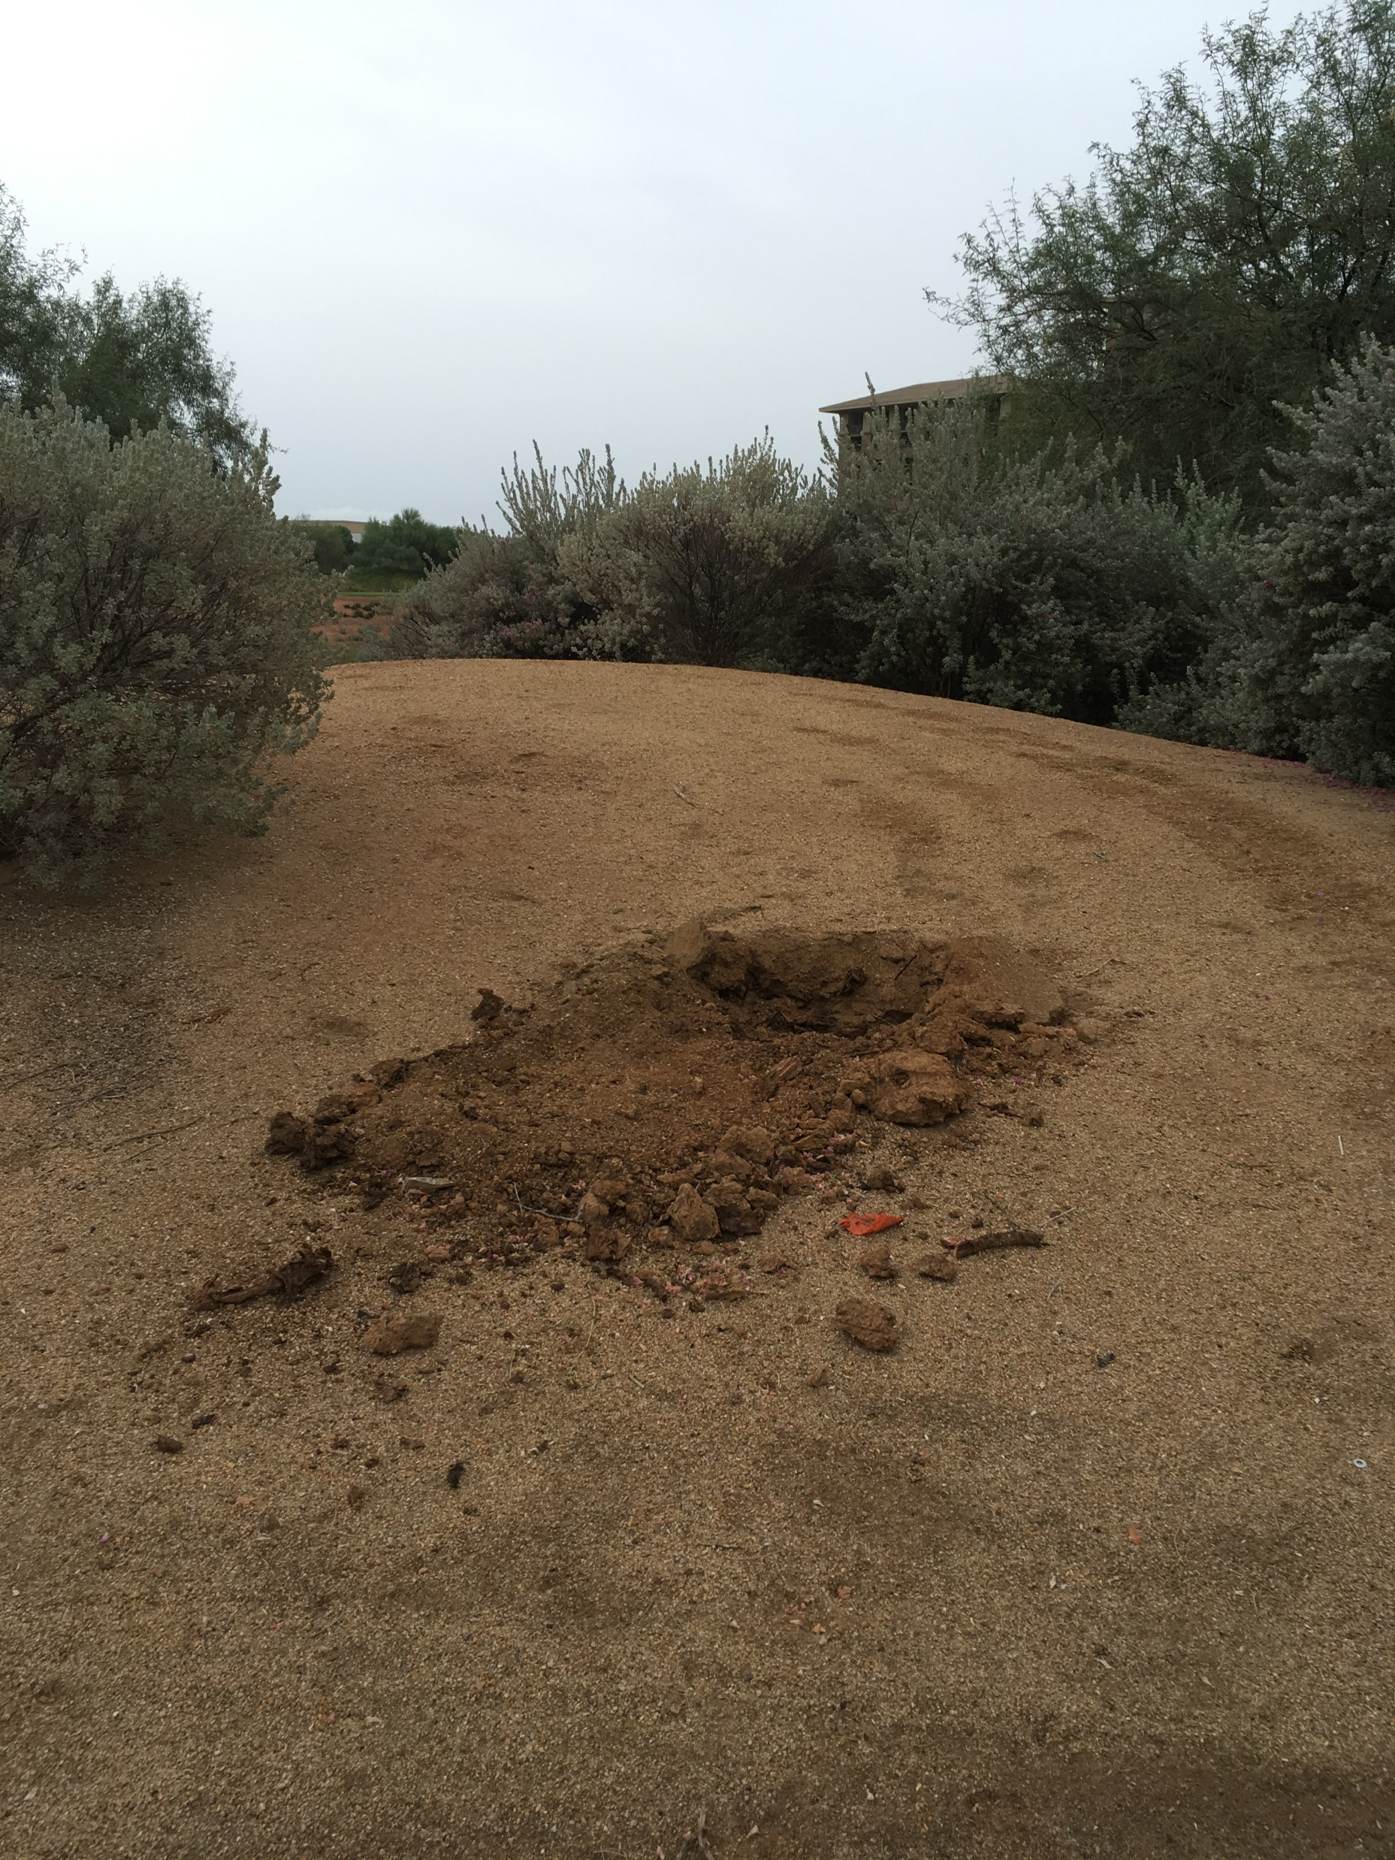
Notes:
Thankfully, the owners of these trees had insurance.
They have coverage that will pay for the losses caused by the storm.
A call comes in to me: “Can you be in Phoenix next week to investigate and appraise the trees that were lost?”
And my very next question is: “Who’s hiring me?”

Slide 15
Tree Losses for Insurance Reporting
Consultant’s Role
Estimating Scope of Assignment
Data Collection

Slide 16
Consultant’s Role

Slide 17
Consultant’s Role
Insured
Insurer
Adjuster
Consultant

Slide 18
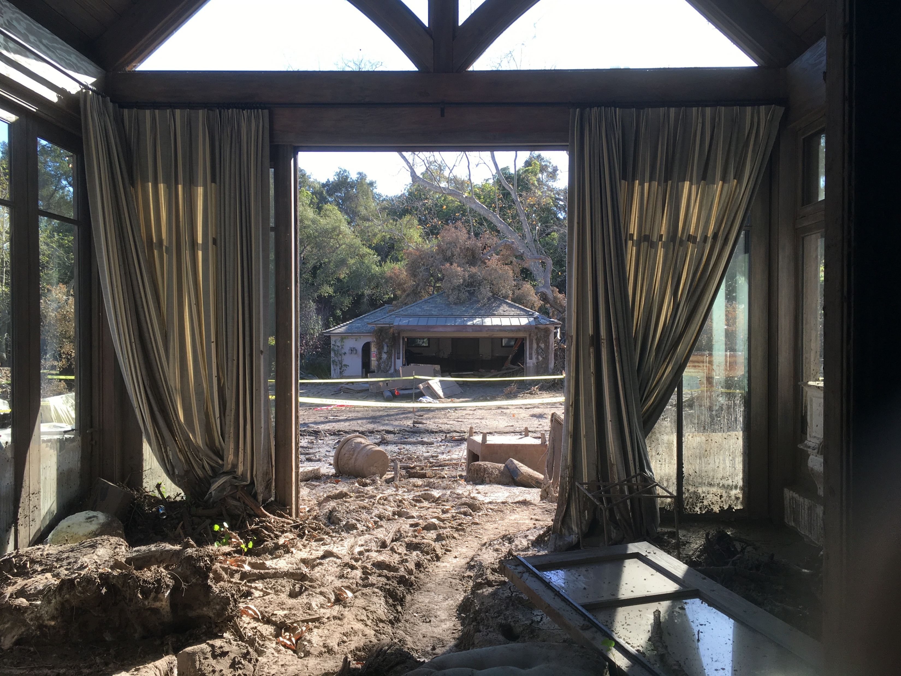
Consultant’s Role
Insured
Insurer
Adjuster
Consultant

Slide 19




Consultant’s Role
Insured
Insurer
Adjuster
Consultant

Slide 20
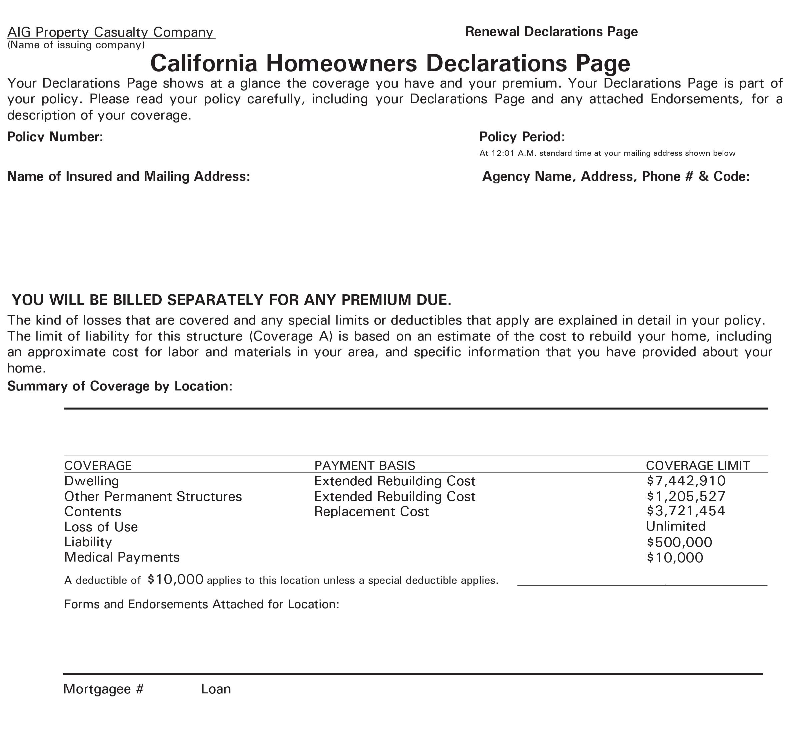
Consultant’s Role
Insured
Insurer
Adjuster
Consultant

Slide 21
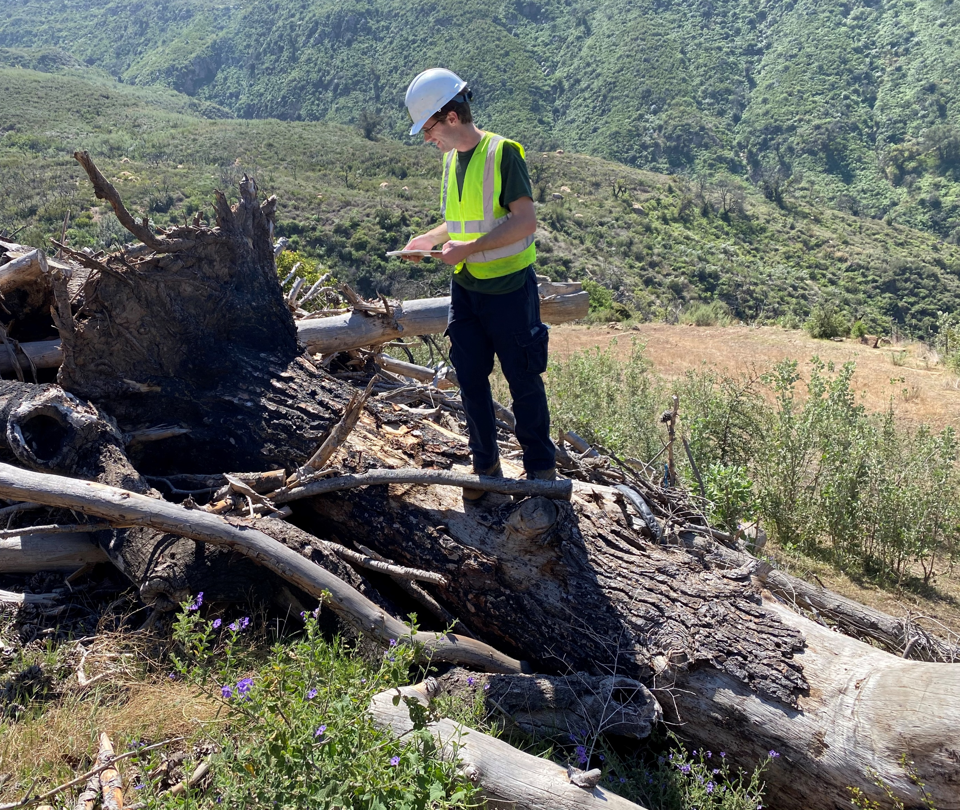
Consultant’s Role
Insured
Insurer
Adjuster
Consultant

Slide 22
Consultant’s Role
Insured

Slide 23
Consultant’s Role
Insurer
Insured

Slide 24
Consultant’s Role
Insurer
Independent Adjuster
Insured

Slide 25
Consultant’s Role
Insurer
Independent Adjuster
Arborist
Insured

Slide 26
Consultant’s Role
Insurer
Independent Adjuster
Consulting Firm
Arborist
Insured

Slide 27



Consultant’s Role
Mrs. Jones
Notes:
Mrs. Jones makes a claim with AIG
AIG hires Jim Buckley & Associates to investigate claim
JBA Hires HMI
HMI hires Class One (me)

Slide 28
Consultant’s Role
Insurer
Independent Adjuster
Consulting Firm
Arborist
Insured

Slide 29
Consultant’s Role
Insurer
Independent Adjuster
Public Adjuster
Consulting Firm
Arborist
Insured

Slide 30
Consultant’s Role
Insurer
Independent Adjuster
Public Adjuster
Consulting Firm
Arborist
Arborist
Insured

Slide 31
Consultant’s Role
Insurer
Independent Adjuster
Public Adjuster
Consulting Firm
Arborist
Arborist
Insured

Slide 32
Estimating the Scope of Assignment

Slide 33
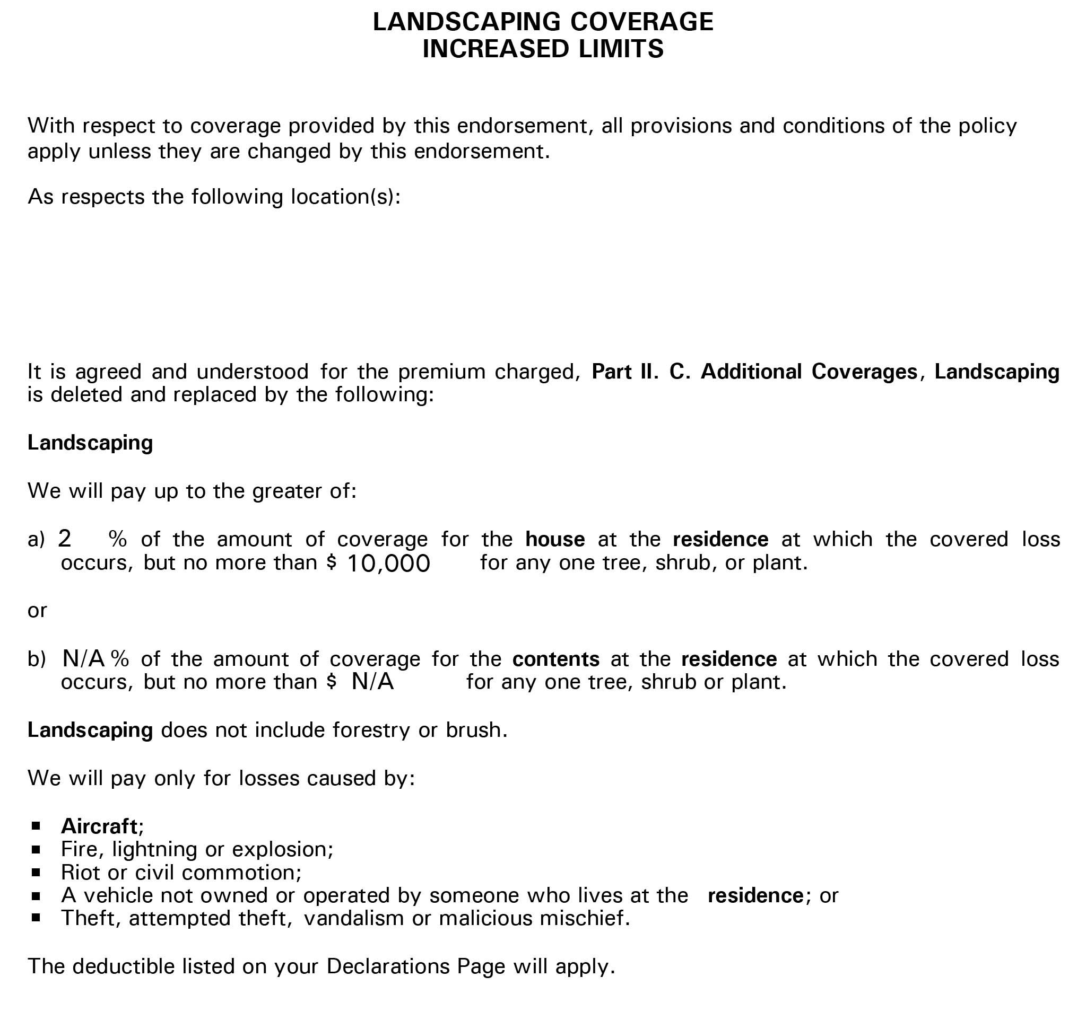
Estimating the Scope of Assignment

Slide 34
Estimating the Scope of Assignment
Overall landscape limit

Slide 35
Estimating the Scope of Assignment
Overall landscape limit
Per-tree sublimit

Slide 36
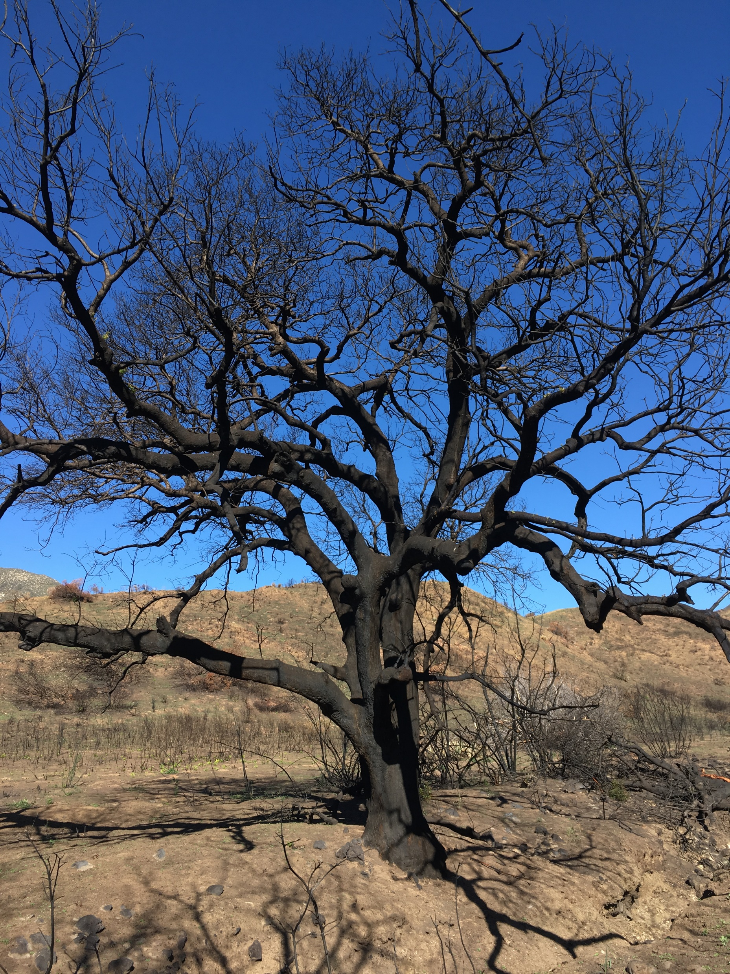
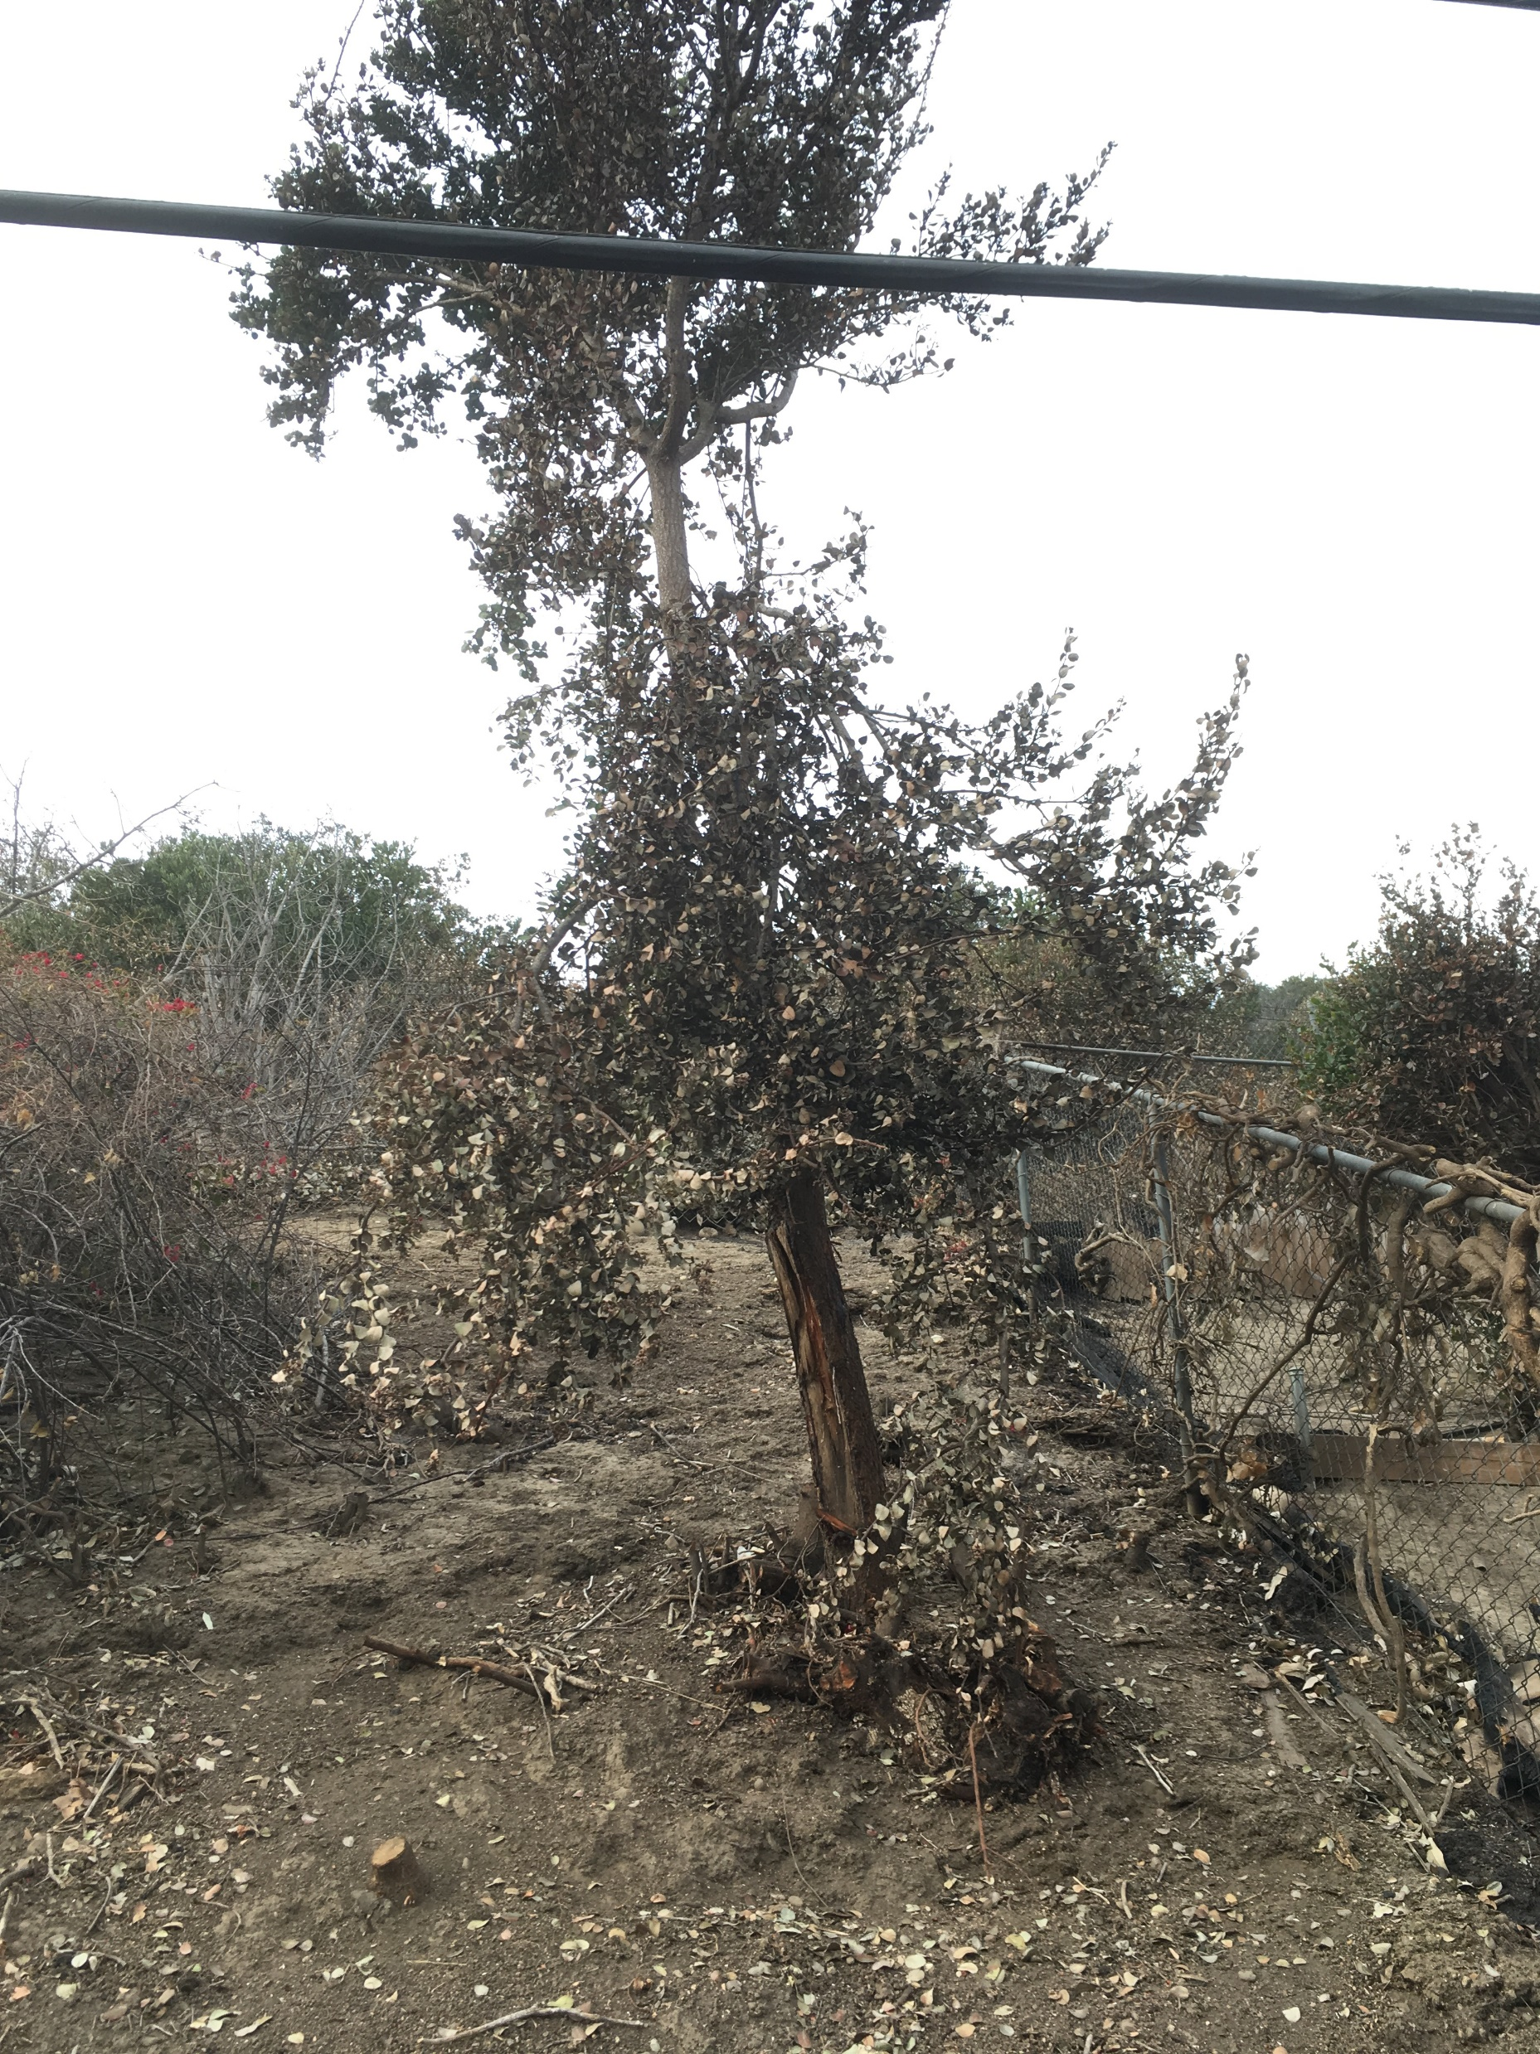
Estimating the Scope of Assignment

Slide 37
Estimating the Scope of Assignment
Per-Tree Sublimit
  Determine size threshold
  Reverse-TFT Calculation
  Sublimit determines speed

Slide 38
Estimating the Scope of Assignment
Per-Tree Sublimit
  Determine size threshold
  Reverse-TFT Calculation
  Sublimit determines speed
Per-Tree Sublimit | Tree Size (DBH)
$500.00 | 3.8 in
$1,000.00 | 5.3 in
$5,000.00 | 11.9 in
$10,000.00 | 16.8 in

Slide 39
Estimating the Scope of Assignment
Overall Landscaping Limits

Slide 40
Estimating the Scope of Assignment
Overall Landscaping Limits
  Easily Met: Choose large groups of medium-sized losses that are a little bit larger than de minimis size

Slide 41
Estimating the Scope of Assignment
Overall Landscaping Limits
  Easily Met: Choose large groups of medium-sized losses that are a little bit larger than de minimis size
  Close Call: Start with losses obviously larger than size threshold and then go back to collect close-call and smaller-value assets

Slide 42
Estimating the Scope of Assignment
Overall Landscaping Limits
  Easily Met: Choose large groups of medium-sized losses that are a little bit larger than de minimis size
  Close Call: Start with losses obviously larger than size threshold and then go back to collect close-call and smaller-value assets
  Not likely met: Collect data on every little twig – everything matters

Slide 43
Estimating the Scope of Assignment
Example:

Slide 44
Estimating the Scope of Assignment
Example:
  Overall Landscaping Limit: $50,000

Slide 45
Estimating the Scope of Assignment
Example:
  Overall Landscaping Limit: $50,000
  Per-Tree Sublimit: $5,000

Slide 46
Estimating the Scope of Assignment
Example:
  Overall Landscaping Limit: $50,000
  Per-Tree Sublimit: $5,000
  Size Threshold: 11.9 inches

Slide 47
Estimating the Scope of Assignment
Example:
  Overall Landscaping Limit: $50,000
  Per-Tree Sublimit: $5,000
  Size Threshold: 11.9 inches
  Number of Trees for Limits: 10 trees

Slide 48
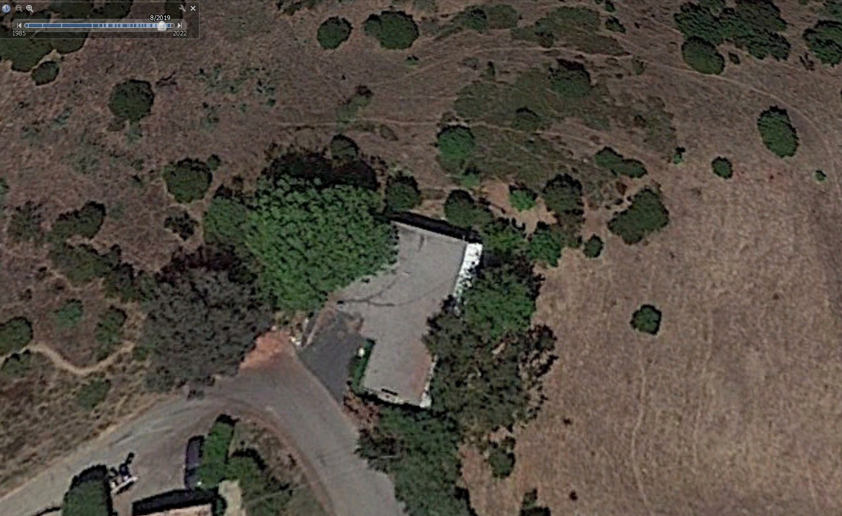
Estimating the Scope of Assignment

Slide 49
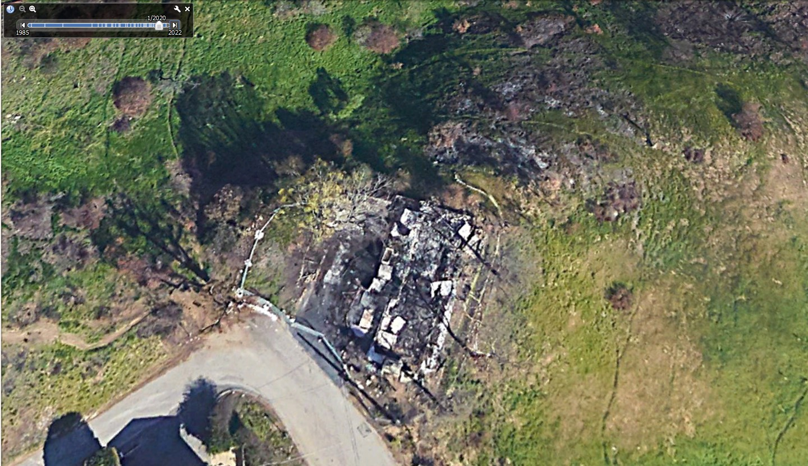
Estimating the Scope of Assignment

Slide 50
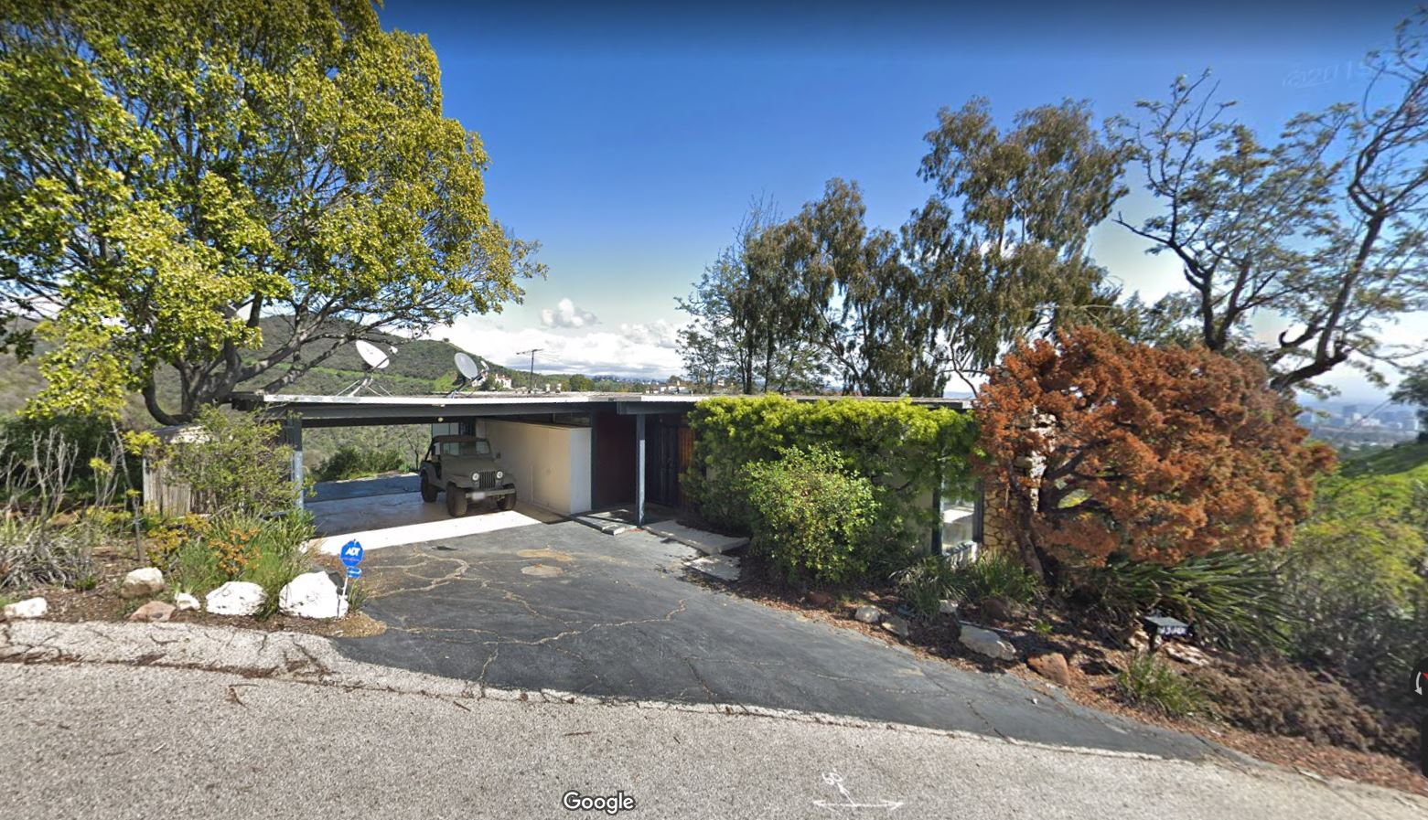
Estimating the Scope of Assignment

Slide 51
Estimating the Scope of Assignment
Example:

Slide 52
Estimating the Scope of Assignment
Example:
  Overall Landscaping Limit: $1,000,000

Slide 53
Estimating the Scope of Assignment
Example:
  Overall Landscaping Limit: $1,000,000
  Per-Tree Sublimit: $500

Slide 54
Estimating the Scope of Assignment
Example:
  Overall Landscaping Limit: $1,000,000
  Per-Tree Sublimit: $500
  Size Threshold: 3.8 inches

Slide 55
Estimating the Scope of Assignment
Example:
  Overall Landscaping Limit: $1,000,000
  Per-Tree Sublimit: $500
  Size Threshold: 3.8 inches
  Number of Trees for Limits: 2,000 trees

Slide 56
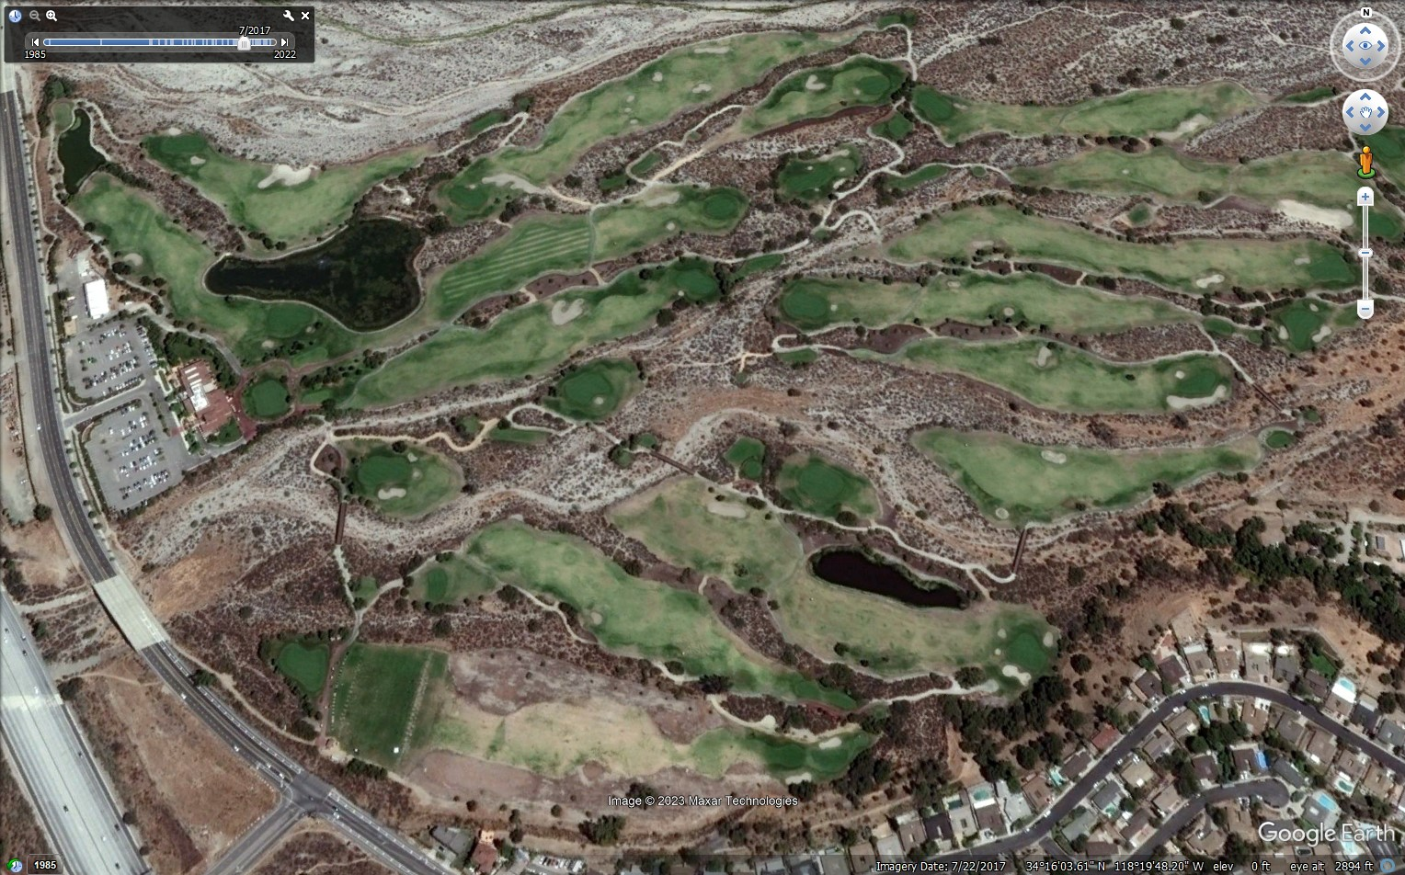
Estimating the Scope of Assignment

Slide 57
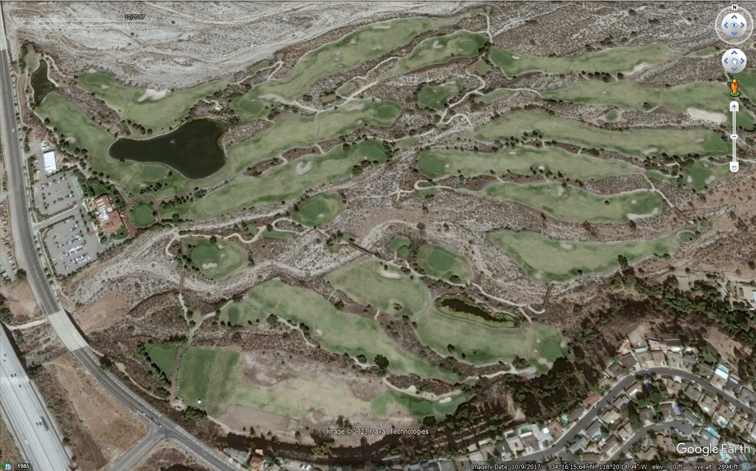
Estimating the Scope of Assignment

Slide 58
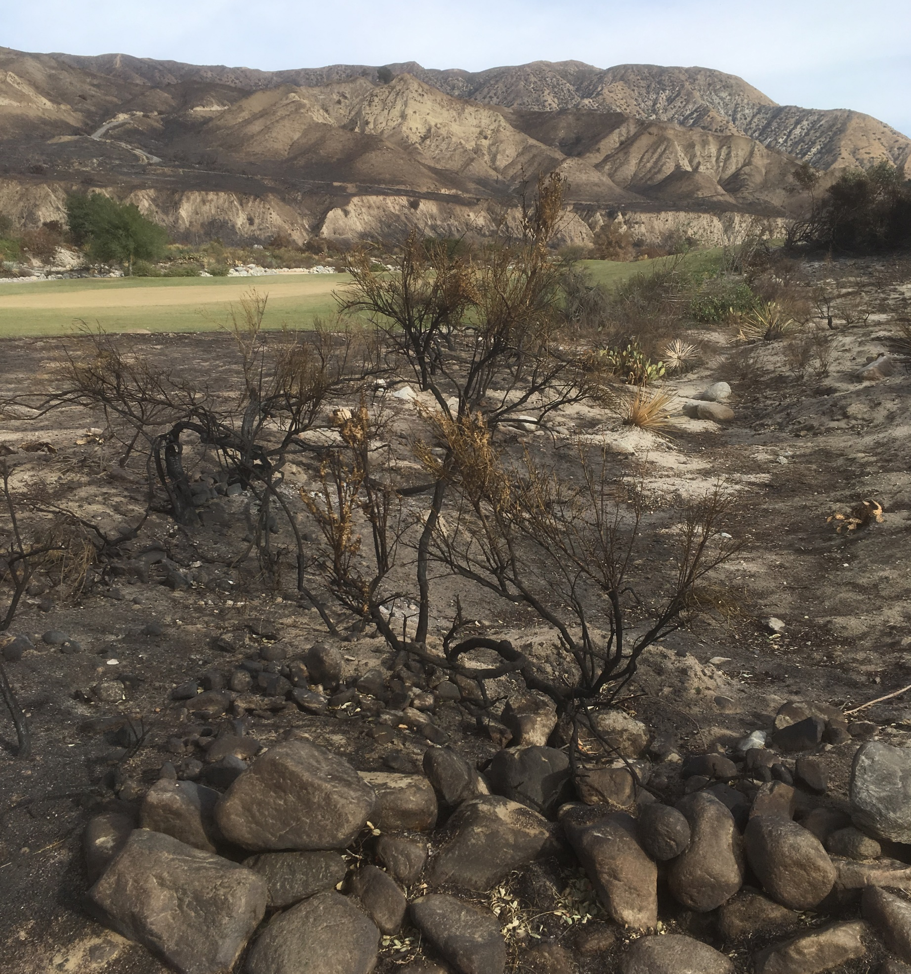
Estimating the Scope of Assignment
Notes:
Chamise, laurel sumac, toyon, spoon yucca, prickley pear cactus

Slide 59
Data Collection

Slide 60
Data Collection
Field Data
Mapping
Desk Review

Slide 61
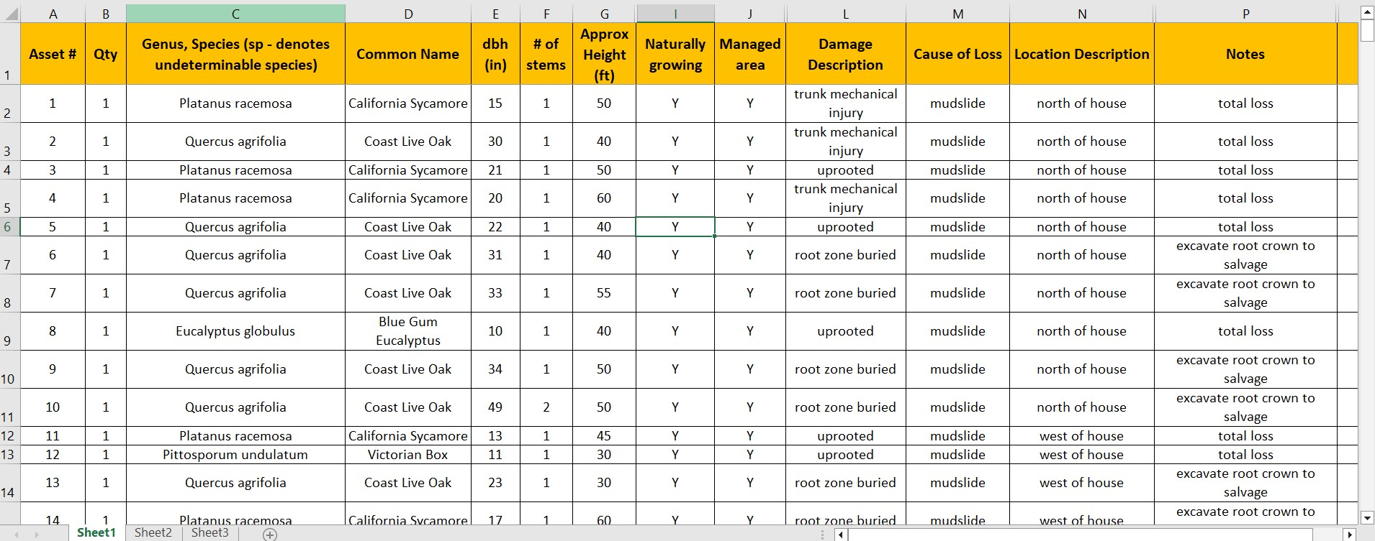
Field Data

Slide 62
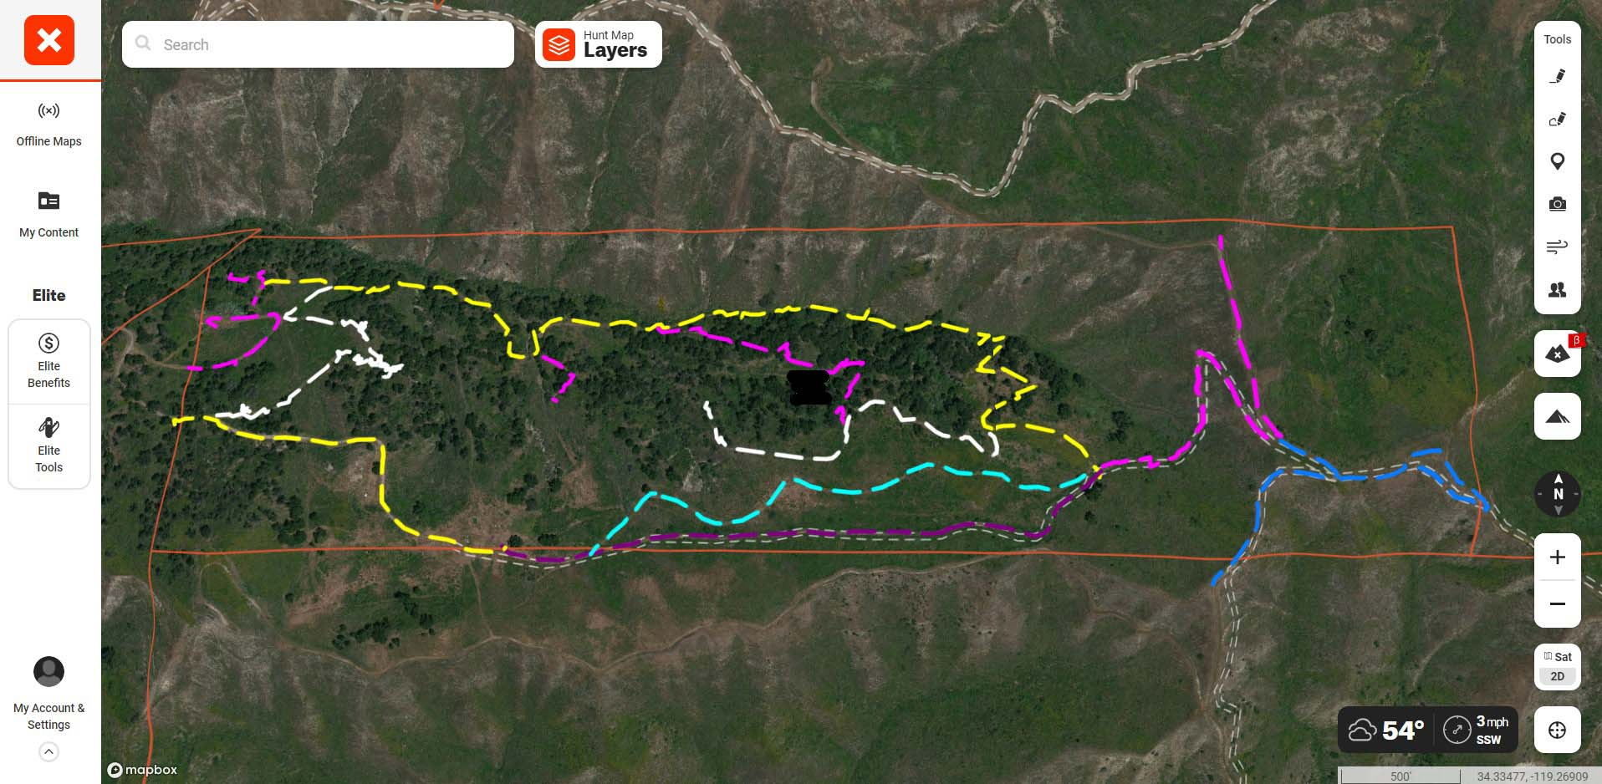
Field Data

Slide 63
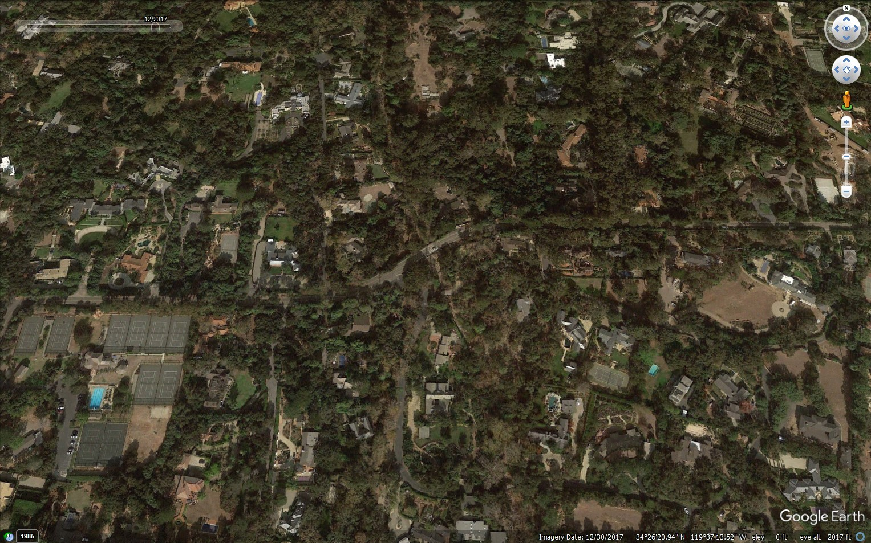
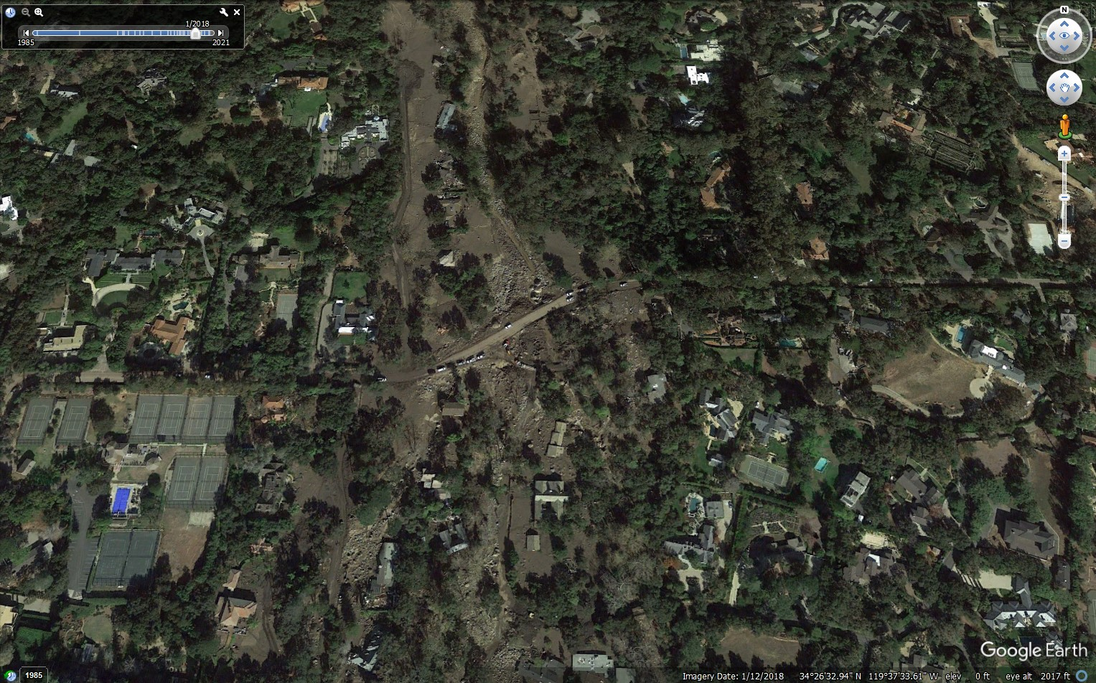
Desk Review

Slide 64

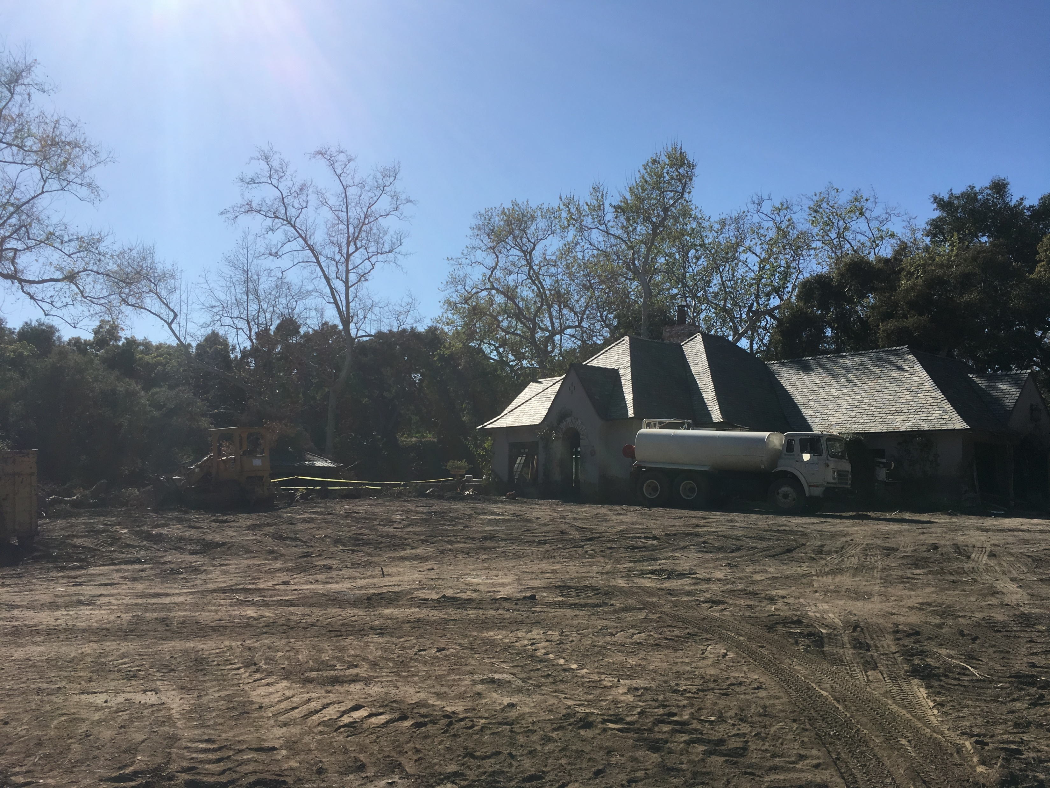
Desk Review

Slide 65

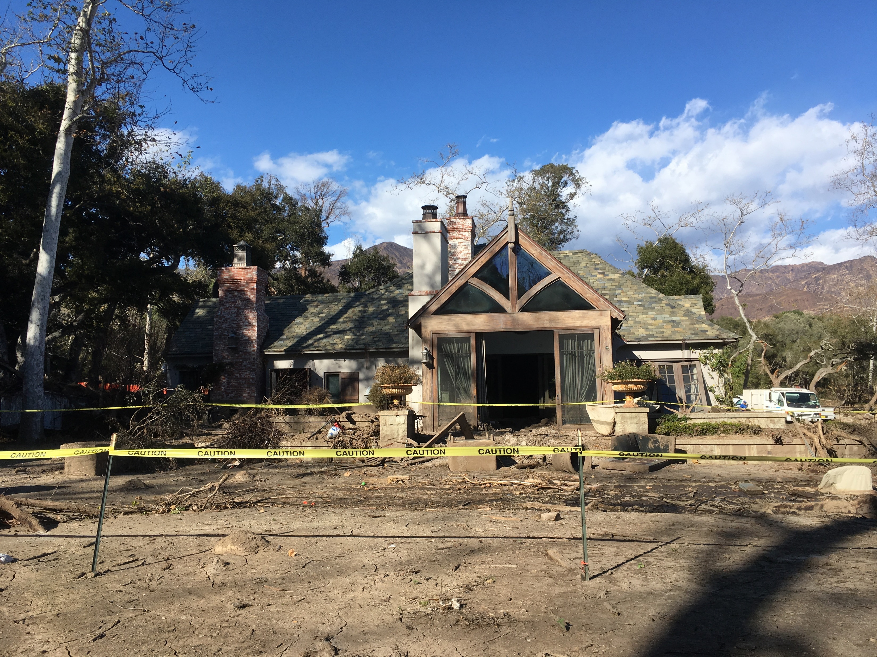
Desk Review

Slide 66
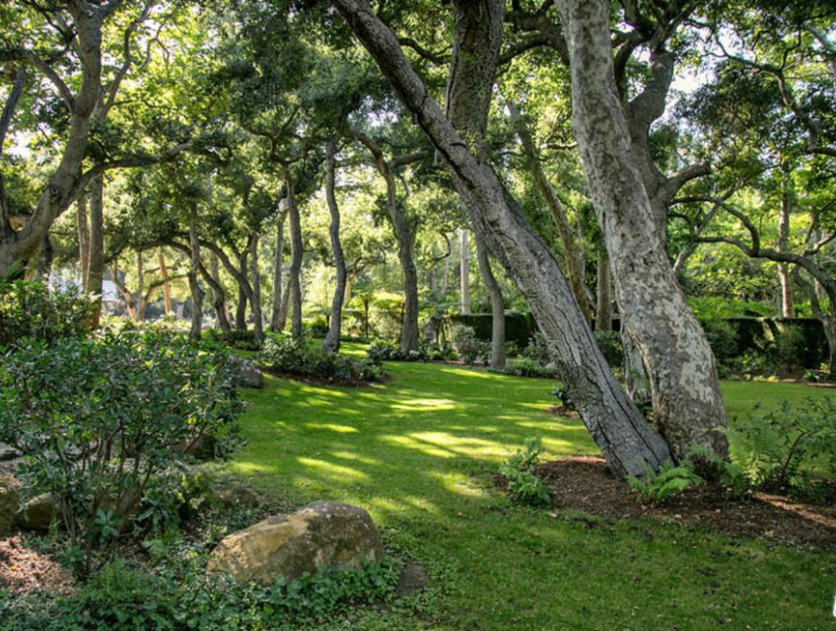
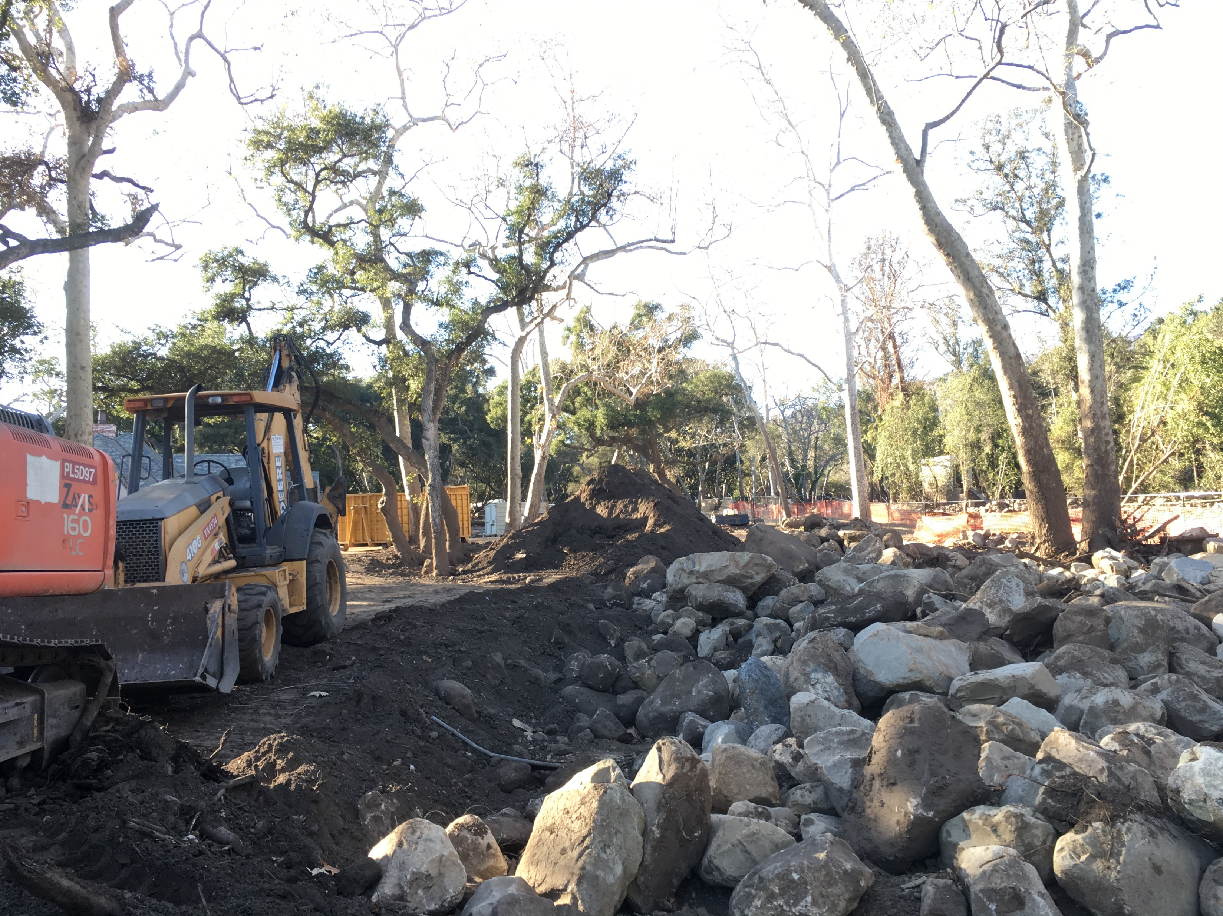
Desk Review

Slide 67
Tree Losses for Insurance Reporting
Consultant’s Role
Estimating Scope of Assignment
Data Collection

Slide 68
Tree Losses for Insurance Reporting
Digging Into
James Komen
BCMA #9909B, RCA #555
www.JamesKomen.com
jameskomen@gmail.com
May 10, 2023

