Slide 1
Tree Covenants as an Asset Class
James Komen
BCMA #9909B
ISA Conference 2017
Washington DC

Slide 2
“
What if there were a way to buy and sell trees
”
without moving them?
Notes:
New Idea: Open your imaginations
Illiquidity
Purchased as incidentals

Slide 3
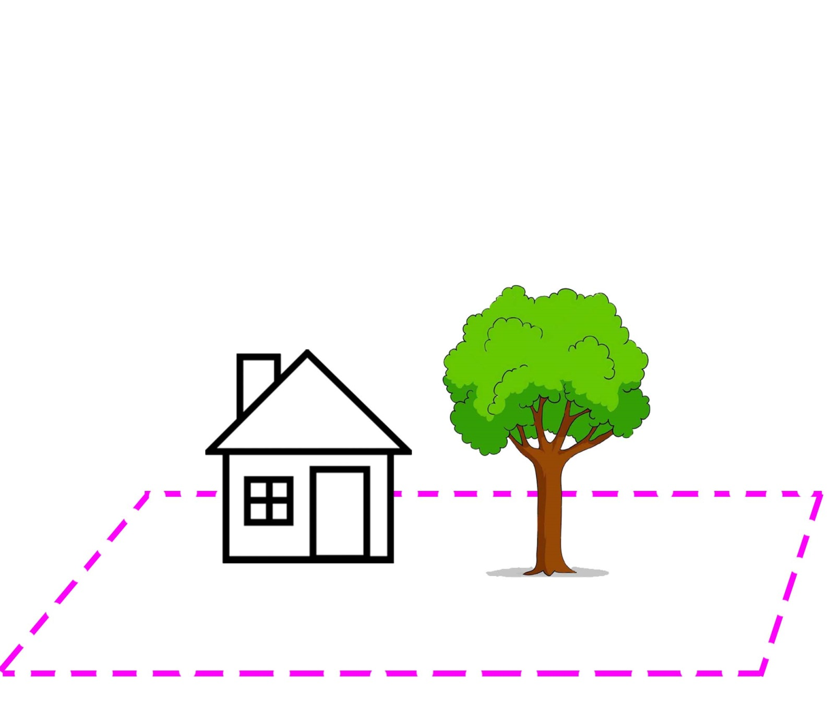
Tree Sellers
Trees are Liabilities
  Roots damage structures
  Obstructing views
  Obstructing signage
  Costly to maintain

Slide 4
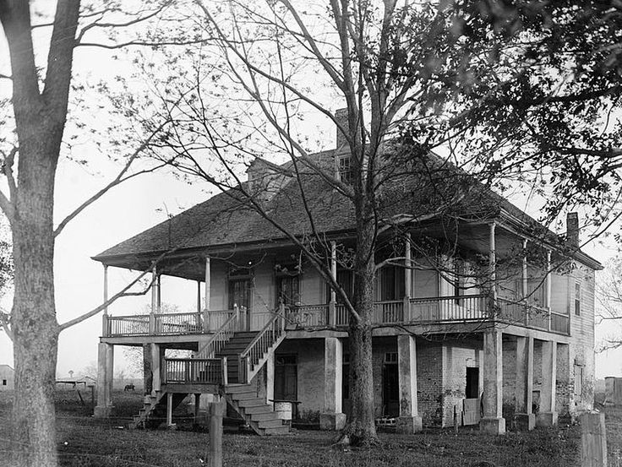
Tree Buyers
Trees are Assets
  Create value to parties other than the owner of the real property
Entities
  Neighboring Property Owners
  Historical societies
  Tree activists

Slide 5
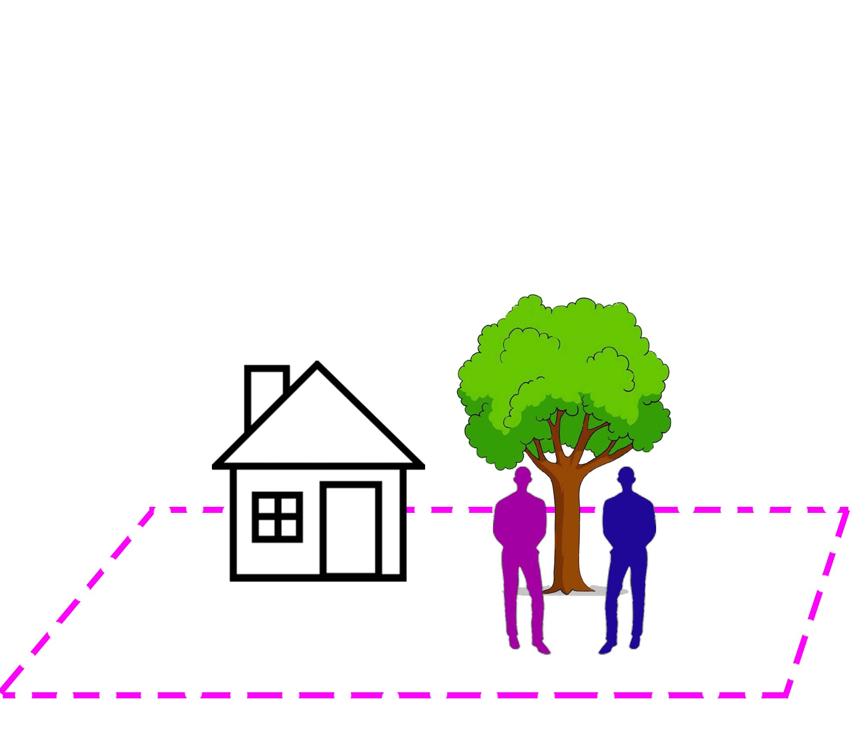
Pre-Existing Legal Tools
Private Party Contract

Slide 6
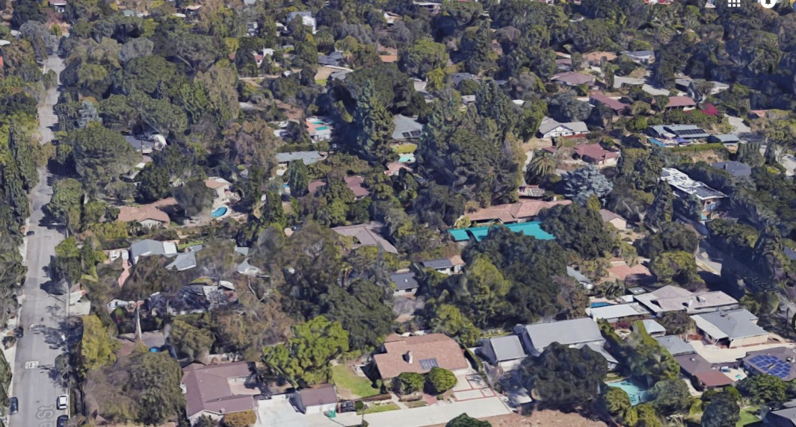
Pre-Existing Legal Tools
Private Party Contract
Municipal Ordinance

Slide 7
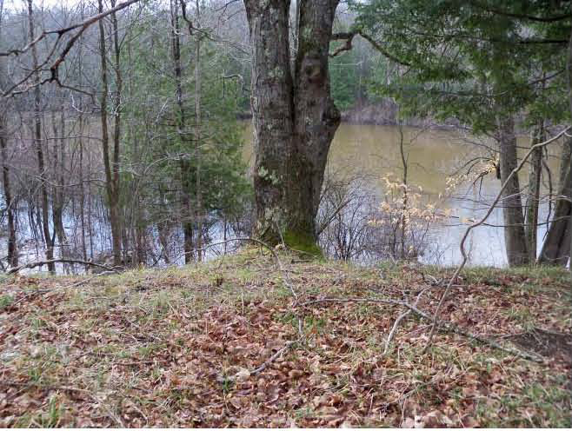
Pre-Existing Legal Tools
Private Party Contract
Municipal Ordinance
Preservation Easement

Slide 8
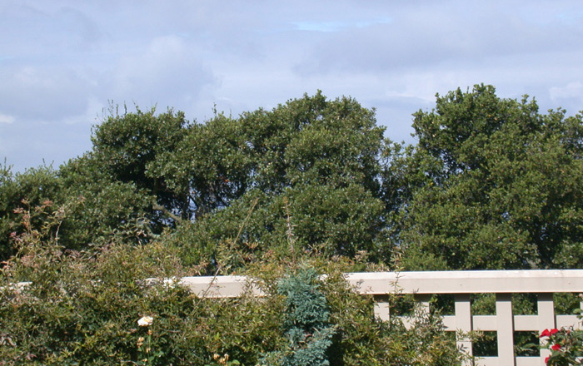
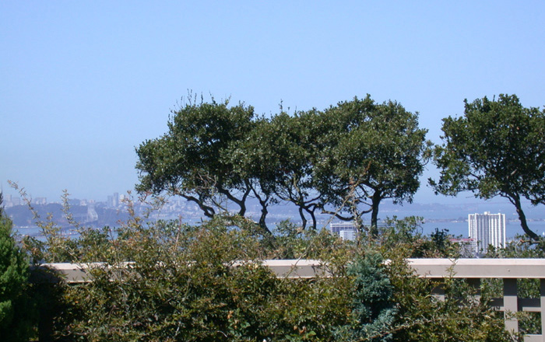
Pre-Existing Legal Tools
Private Party Contract
Municipal Ordinance
Preservation Easement
View Easement

Slide 9
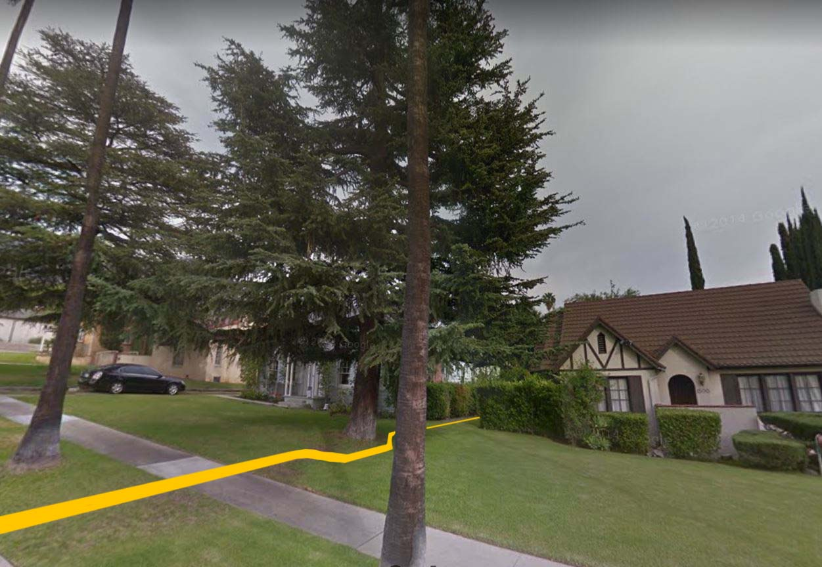
Pre-Existing Legal Tools
Private Party Contract
Municipal Ordinance
Preservation Easement
View Easement
Lot Line Adjustment

Slide 10
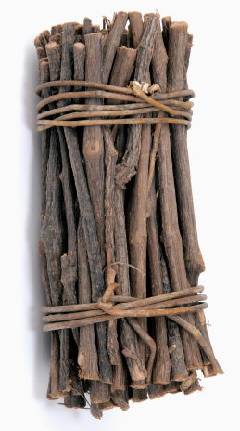
Real Property Ownership
Bundle of Rights
  Right to sell
  Right to modify
  Right to grant or restrict access

Slide 11
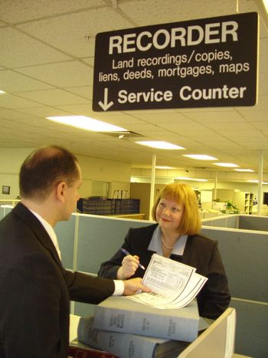
Real Property Ownership
Ownership Transfer
  Transfer document
  Recording office
  Does not require physical
  movement of property
Notes:
- Perform example with audience member of how houses are bought and sold

Slide 12
Contract vs. Covenant

Slide 13
Contract vs. Covenant
Contract created when two parties form agreement

Slide 14
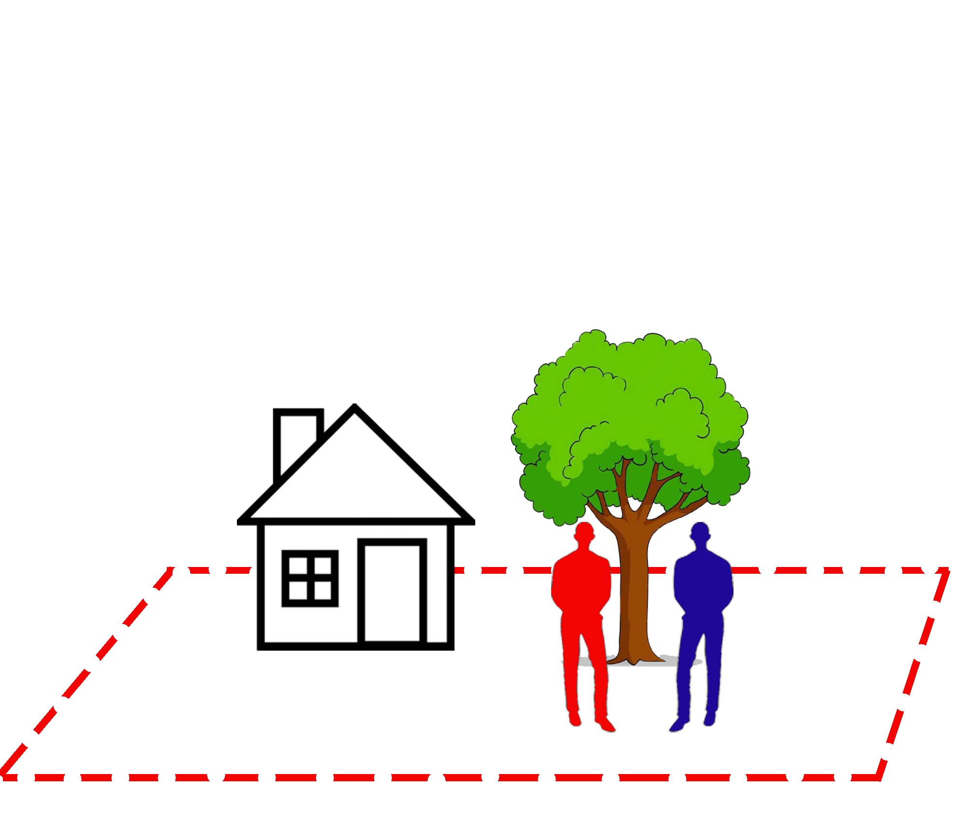
Contract vs. Covenant
Contract terminates when underlying property is sold

Slide 15

Contract vs. Covenant
Covenant “runs with the land”

Slide 16
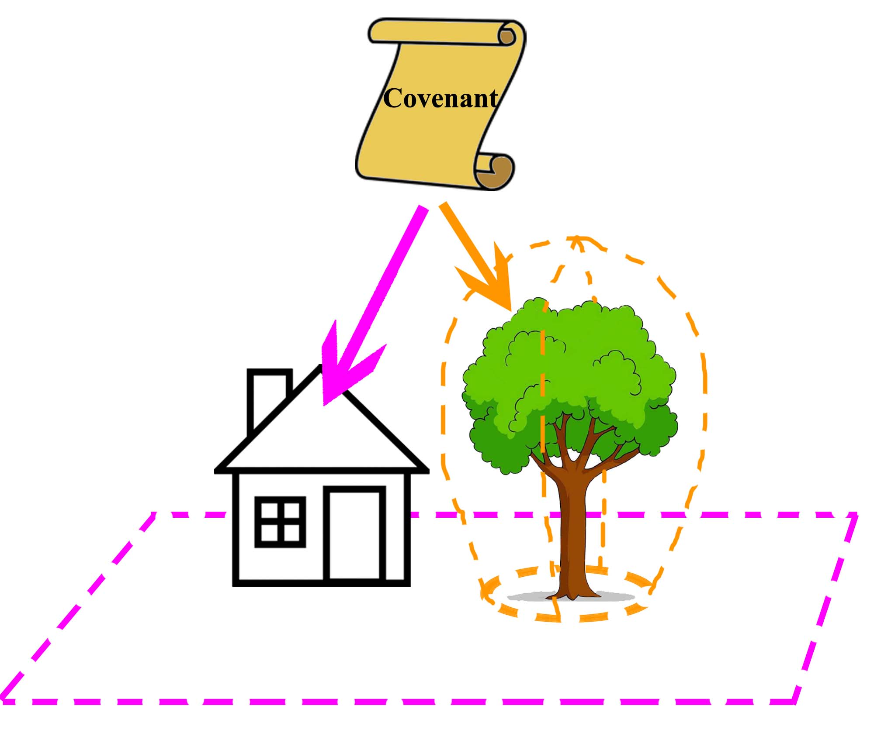

Slide 17
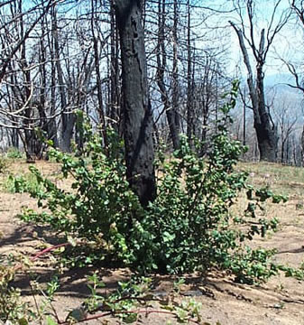
Specifics of the Agreement
Term
  Lifespan of tree: When is it dead?
  Buyback option
  Mutual agreement

Slide 18
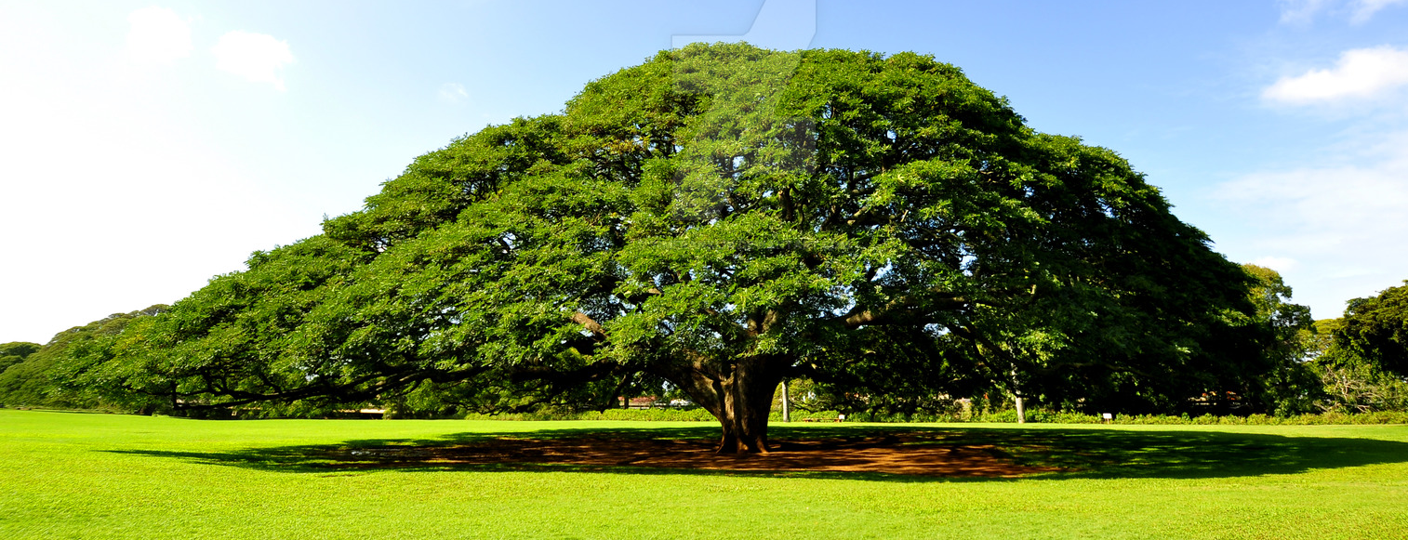
Specifics of the Agreement
Additional Rights
  Disturbance of adjacent land
  Access to tree
  Intellectual property of tree

Slide 19
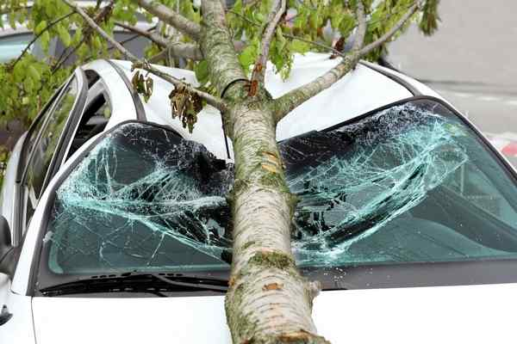
Specifics of the Agreement
Management of Liabilities
  Maintenance Cost
  Risk of Damage Caused by Tree
  Inspection
    Interval
    Responsible Party

Slide 20

Insurance
Comprehensive vs. Liability
Inputs
  Appraisal
  Actuarial data
Premiums

Slide 21
Implementation
Make the First Covenant Sale
Critical Mass of Tree Sales
Underwrite Insurance Policies

Slide 22
Conclusion
Trees owned by those who value them most
Economic incentives for planting and management for long term
Another tool for tree preservation and management

Slide 23


Slide 24
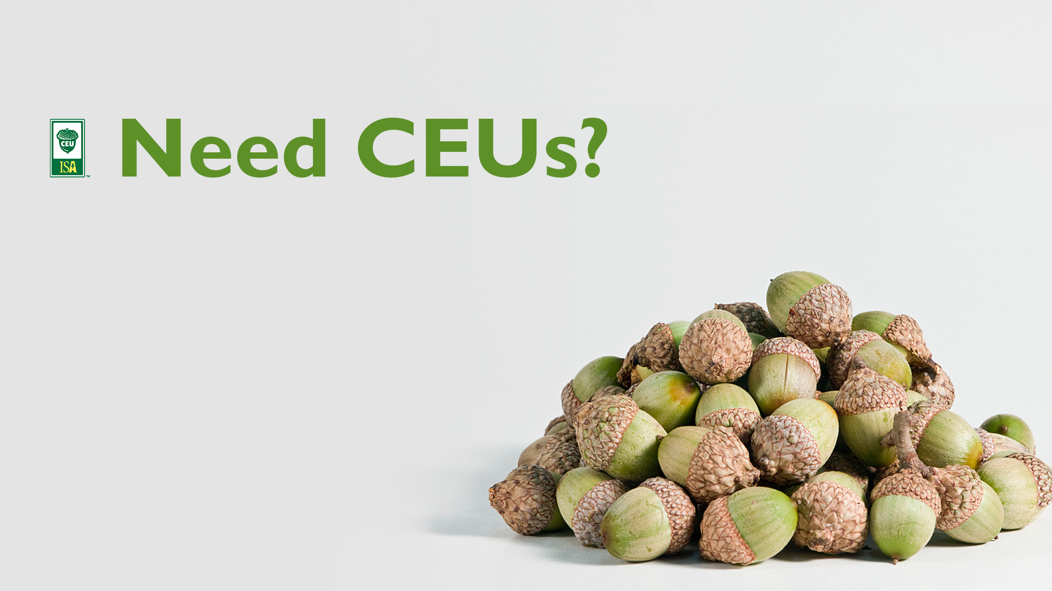
Tuesday, 01 August 2017
Educational Session
Tree Covenants as an Asset Class
James Komen
Code: CF-17-061
.75 AMBm

