Slide 1
Tree Appraisal and Washington Law
James Komen
BCMA #WE-9909B
RCA #555

Slide 2
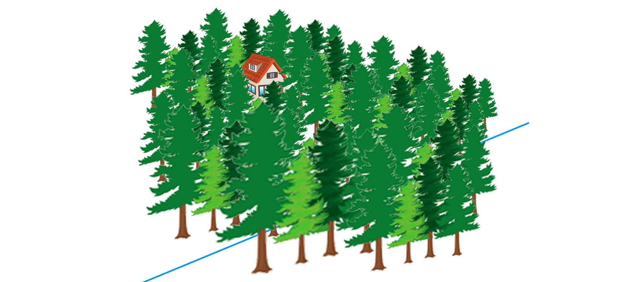
Sherrell v. Selfors
871 P.2d 168 (1994 Ct. App.)
Notes:
1982, Sherrells purchased lot in Pineloch Sun Development in Kittitas County and built a cabin

Slide 3
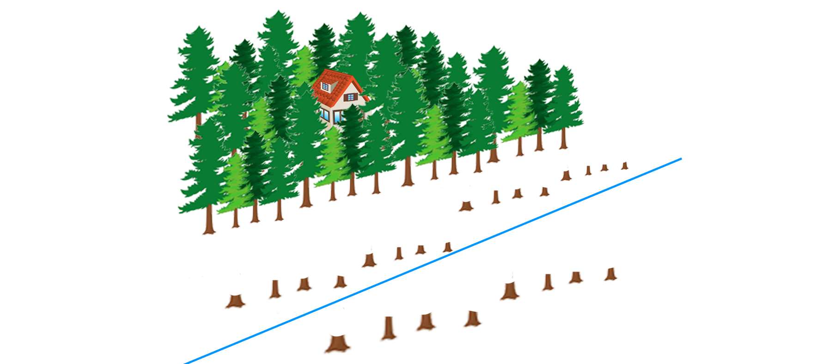
Sherrell v. Selfors
871 P.2d 168 (1994 Ct. App.)
Notes:
Selfors cleared his lot to build his own cabin, but crossed the property line
Sherrell argued for replacement cost, selfors argued for change in land value

Slide 4
Sherrell v. Selfors
871 P.2d 168 (1994 Ct. App.)
Trees “provided a noise and dust barrier as well as a visual screen.”
They were “ornamental and, practically speaking, functional.”
“The fact they were native or indigenous to the area is not, by itself, significant.”
“Whether deliberately planted or not, replacement was required to compensate Sherrells for their loss.”
Notes:
Upheld the jury verdict

Slide 5
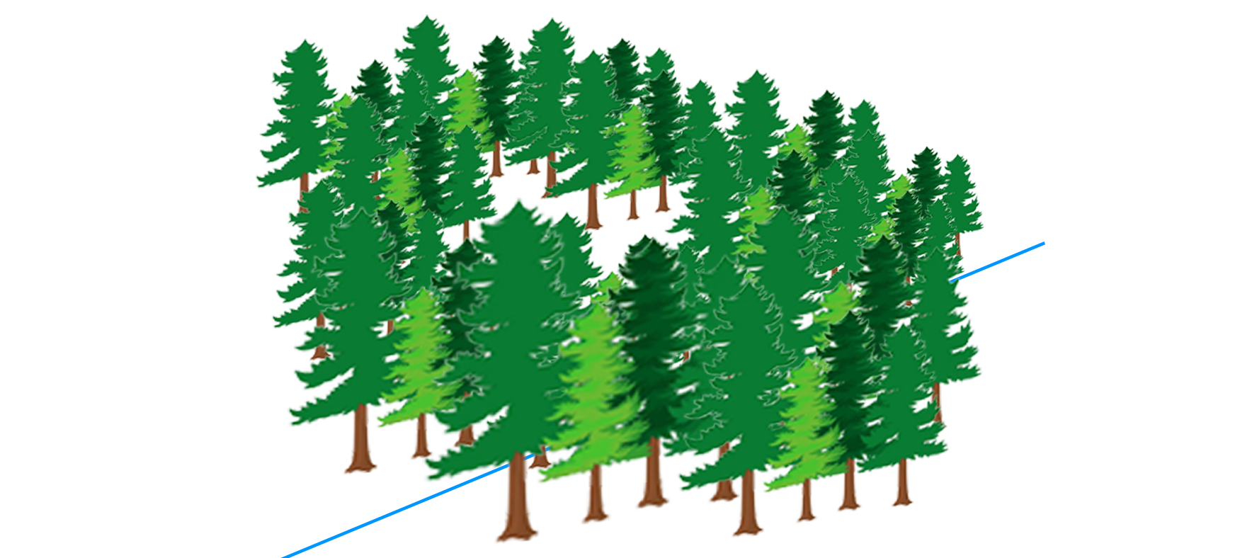
Scott v. McDonald
2000 Wash. App. LEXIS 402

Slide 6
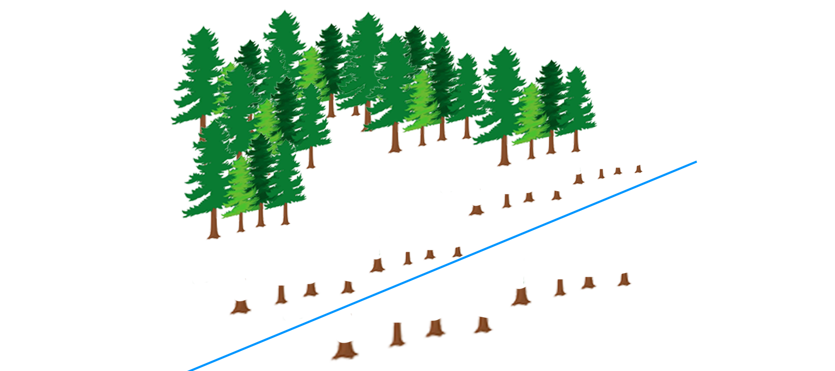
Scott v. McDonald
2000 Wash. App. LEXIS 402

Slide 7
Scott v. McDonald
2000 Wash. App. LEXIS 402
Restoration Cost: $70,000
Stumpage Value: $3,000
Jury Award: $18,452
Notes:
Upheld the jury verdict

Slide 8
Scott v. McDonald
2000 Wash. App. LEXIS 402
“Even though no one lived on the property, Scott
  Camped and hunted on it,
  Used its beach and trails,
  Harvested fruit on it
  Intended to develop it into a planned residential development
  Left trees as a buffer.”
Jury “could rationally have found that the use of the trees in issue was residential and ornamental, not merely commercial.”
Notes:
Upheld the jury verdict

Slide 9
Allyn v. Boe
943 P.2d 364 (1997 Ct. App.)
Notes:
1997 in Thurston County
Allyn family owned 10 acres of wooded undeveloped property for 85 years
During great depression, family lived on land and refused to cut trees for firewood
Allyn intended to retire on land, preserving the trees. No intend to commercially harvest them.

Slide 10
Allyn v. Boe
943 P.2d 364 (1997 Ct. App.)
Notes:
Boe knowingly trespassed and cut 2 acres (283 trees)

Slide 11
Allyn v. Boe
943 P.2d 364 (1997 Ct. App.)
Direct Cost Technique: ~$400,000
Trunk Formula Method: $84,597
Total Land Value: $27K-$35K
Stumpage Value: $16,355
Jury Award: $75,000 (+$25,000 emo distress)
NEW TRIAL ORDERED
Notes:
Allyn’s expert, Molly Beck, appraised using DCT, TFM, and Cost of Cure under 8th Ed. GPA
GPA8: “the appraised value of a tree should usually be reasonable in relation to the value of the property in which it is situated.” (usually 7-15% of total land value)
Judge found verdict an “injustice” and said he should have limited the amount to the total value of the property.

Slide 12
Allyn v. Boe
943 P.2d 364 (1997 Ct. App.)
Allyn “demonstrated personal reasons for restoring the land to its original condition.”
“The jury could award damages…in excess of the value of the underlying land.”
Notes:
Allyn’s expert, Molly Beck, appraised using DCT, TFM, and Cost of Cure under 8th Ed. GPA
GPA8: “the appraised value of a tree should usually be reasonable in relation to the value of the property in which it is situated.” (usually 7-15% of total land value)
Judge found verdict an “injustice” and said he should have limited the amount to the total value of the property.

Slide 13
Allyn v. Boe
943 P.2d 364 (1997 Ct. App.)
Allyn “demonstrated personal reasons for restoring the land to its original condition.”
“The jury could award damages…in excess of the value of the underlying land.”
HOWEVER
Notes:
Allyn’s expert, Molly Beck, appraised using DCT, TFM, and Cost of Cure under 8th Ed. GPA
GPA8: “the appraised value of a tree should usually be reasonable in relation to the value of the property in which it is situated.” (usually 7-15% of total land value)
Judge found verdict an “injustice” and said he should have limited the amount to the total value of the property.

Slide 14
Allyn v. Boe
943 P.2d 364 (1997 Ct. App.)
Allyn “demonstrated personal reasons for restoring the land to its original condition.”
“The jury could award damages…in excess of the value of the underlying land.”
HOWEVER
“Although timber trespass damages are not limited to the fair market value of the underlying property, such damages must still be reasonable in relation to the property value.”
Verdict was more than double the property value
Notes:
Allyn’s expert, Molly Beck, appraised using DCT, TFM, and Cost of Cure under 8th Ed. GPA
GPA8: “the appraised value of a tree should usually be reasonable in relation to the value of the property in which it is situated.” (usually 7-15% of total land value)
Judge found verdict an “injustice” and said he should have limited the amount to the total value of the property.

Slide 15
Allyn v. Boe
943 P.2d 364 (1997 Ct. App.)
DISSENT:
“The rule adopted here arbitrarily limits timber trespass damages by requiring that they be reasonably related to the fair market value of the land.”
Notes:
Allyn’s expert, Molly Beck, appraised using DCT, TFM, and Cost of Cure under 8th Ed. GPA
GPA8: “the appraised value of a tree should usually be reasonable in relation to the value of the property in which it is situated.” (usually 7-15% of total land value)
Judge found verdict an “injustice” and said he should have limited the amount to the total value of the property.

Slide 16
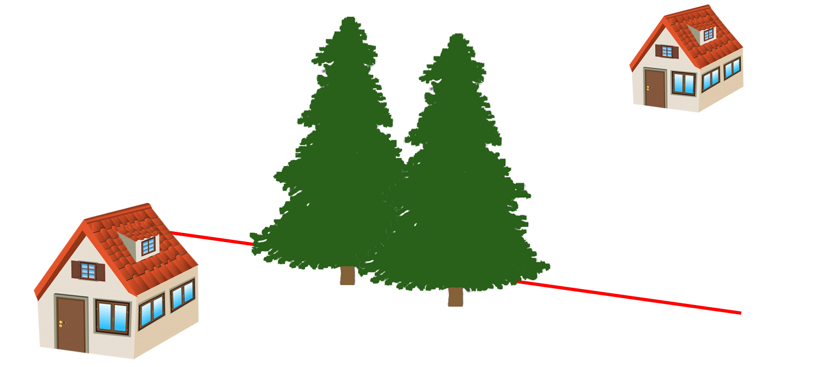
Wood v. Brummond
159 Wash.App. 1002 (2010 Ct. App.)
Notes:
Burien on a steep bluff above the Puget Sound
1982 Wood planted two Doug Firs and grew them for years

Slide 17
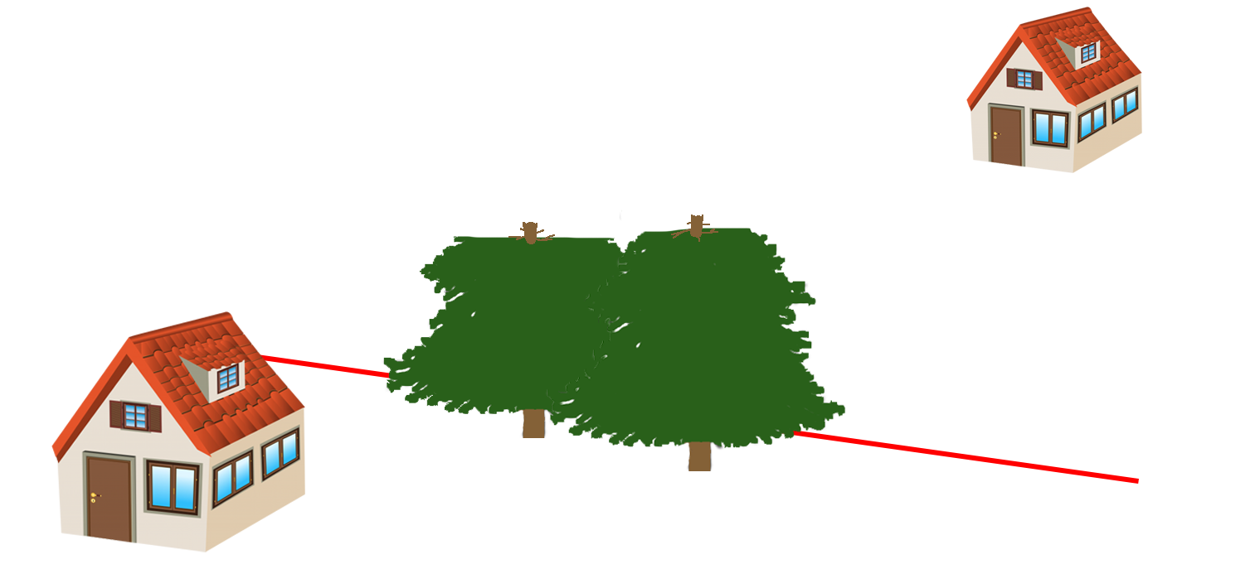
Wood v. Brummond
159 Wash.App. 1002 (2010 Ct. App.)
Notes:
Brummond topped the trees to improve the view
Brian Gilles appraised the trees for Wood, replacement and LCATT

Slide 18
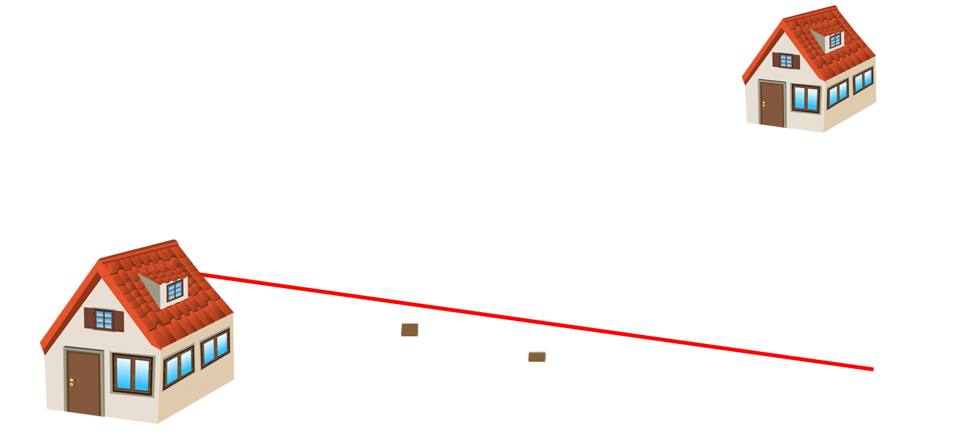
Wood v. Brummond
159 Wash.App. 1002 (2010 Ct. App.)

Slide 19
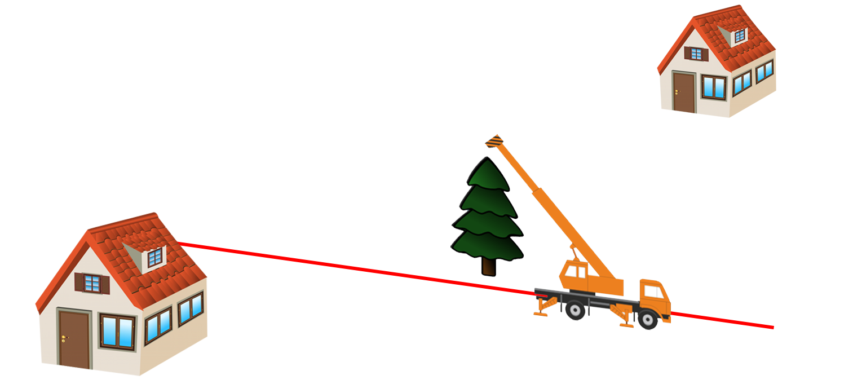
Wood v. Brummond
159 Wash.App. 1002 (2010 Ct. App.)
Notes:
Wood hired Scott Baker of Tree Solutions, Inc. to ACTUALLY REPLACE the trees
10” DBH
25ft Silver Fir
weighing 9,000 lbs

Slide 20
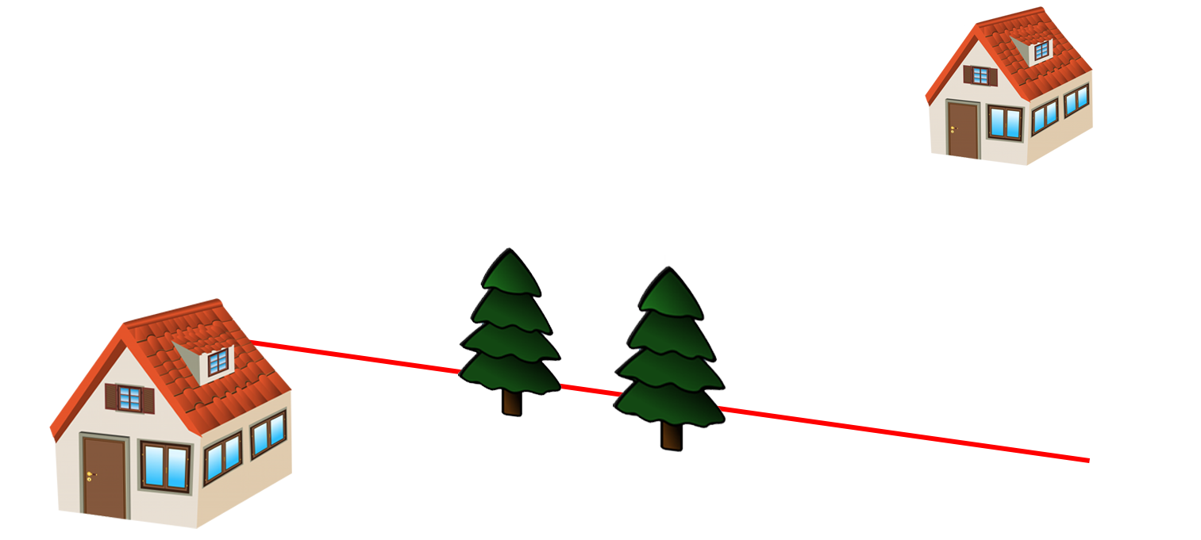
Wood v. Brummond
159 Wash.App. 1002 (2010 Ct. App.)
Notes:
Wood sued Brummond for replacement cost

Slide 21
Wood v. Brummond
159 Wash.App. 1002 (2010 Ct. App.)
Appraised Replacement Cost: $11,746
“Largest Commonly Available” replacement: $7,358
ACTUAL Replacement Cost: $96,171
Land Value: >$1M
Trunk Formula Method: $3,447
Jury Award: $6,854
Notes:
Wood argued that TFM should be excluded because it doesn’t actually return him to pre-loss condition
Trial Court overruled his objection, allowing testimony by Favero Greenforest
Trial court REFUSED to grant a new trial

Slide 22
Wood v. Brummond
159 Wash.App. 1002 (2010 Ct. App.)
TFM “does not put Wood in the exact same position”, but “it still relates to the question of reasonableness of restoration cost.”
“Wood’s own restoration project did not put him in the exact position before the trespass.”
Notes:
Upheld the jury verdict

Slide 23
Wood v. Brummond
159 Wash.App. 1002 (2010 Ct. App.)
“only reasonable costs of replacing destroyed trees…may be recovered.”
Replacement costs less than property value can still be unreasonable
Jury was “free to reject any damage evidence as unreasonable or unnecessary.”

Slide 24

Pearce v. G. R. Kirk Co.
92 Wash.2d 869 (1979 WA Supr. Ct.)
Notes:
1979, Mason County, WA
Sandra Pearce ran a Christmas Tree Farm
She grew the trees, harvested them, drove them into town, and sold them herself
GR Kirk company willfully trespassed and cut 426 of them
She sued for RETAIL value of the trees, WITHOUT DEDUCTING COSTS
Kirk Company claimed they only owed STUMPAGE

Slide 25
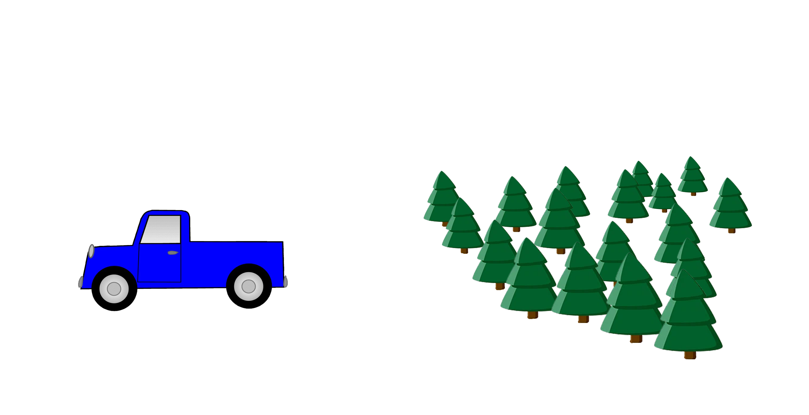
Pearce v. G. R. Kirk Co.
92 Wash.2d 869 (1979 WA Supr. Ct.)
Notes:
1979, Mason County, WA
Sandra Pearce ran a Christmas Tree Farm
She grew the trees, harvested them, drove them into town, and sold them herself
GR Kirk company willfully trespassed and cut 426 of them
She sued for RETAIL value of the trees, WITHOUT DEDUCTING COSTS
Kirk Company claimed they only owed STUMPAGE

Slide 26
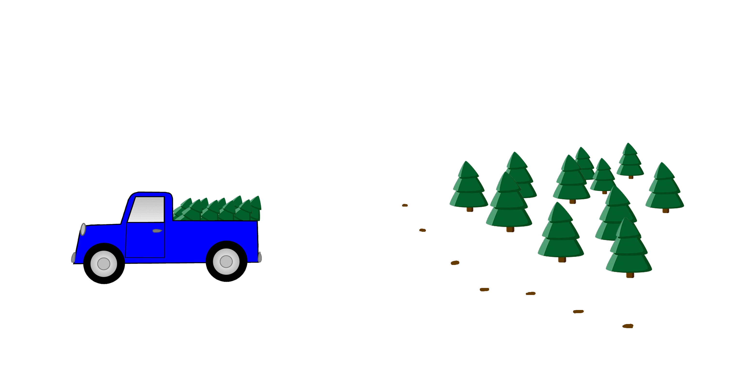
Pearce v. G. R. Kirk Co.
92 Wash.2d 869 (1979 WA Supr. Ct.)
Notes:
1979, Mason County, WA
Sandra Pearce ran a Christmas Tree Farm
She grew the trees, harvested them, drove them into town, and sold them herself
GR Kirk company willfully trespassed and cut 426 of them
She sued for RETAIL value of the trees, WITHOUT DEDUCTING COSTS
Kirk Company claimed they only owed STUMPAGE

Slide 27
Pearce v. G. R. Kirk Co.
92 Wash.2d 869 (1979 WA Supr. Ct.)
“[Pearce] planned, with the help of her father, to cut these Christmas trees and sell them at retail.”
Notes:
Upheld the jury verdict

Slide 28
Pearce v. G. R. Kirk Co.
92 Wash.2d 869 (1979 WA Supr. Ct.)
“[Pearce] planned, with the help of her father, to cut these Christmas trees and sell them at retail.”
“…to award her only the stumpage value would be to deny full compensation for her loss.”
Notes:
Upheld the jury verdict

Slide 29
Pearce v. G. R. Kirk Co.
92 Wash.2d 869 (1979 WA Supr. Ct.)
“[Pearce] planned, with the help of her father, to cut these Christmas trees and sell them at retail.”
“…to award her only the stumpage value would be to deny full compensation for her loss.”
NO DEDUCTION for labor of selling the trees because she would do it herself
Notes:
Upheld the jury verdict

Slide 30
Tree Appraisal and Washington Law
Native/Indigenous Trees
Trees on Developed/Undeveloped Land
“Reasonableness”

Slide 31
Tree Appraisal and Washington Law
James Komen
BCMA #WE-9909B
RCA #555

