Slide 1
Tree Risk Assessment
Report Writing and Law
James Komen
BCMA #WE-9909B
RCA #555
Dan Cathcart
BCMA #TX-1357BM
RCA #766

Slide 2
Carver v. Salt River Valley

Slide 3
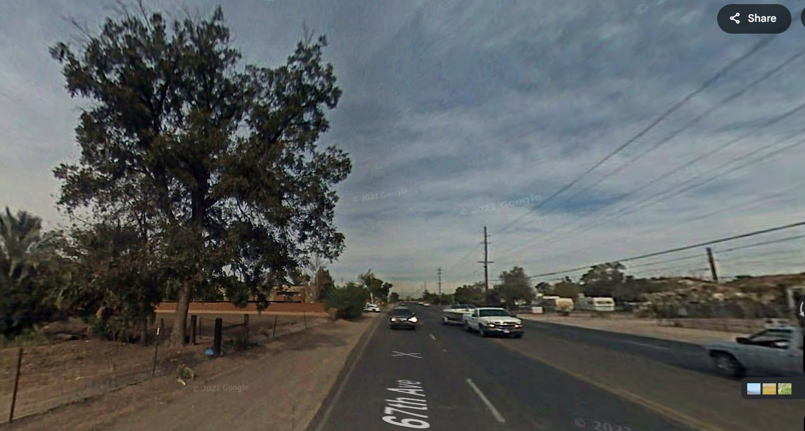
Carver v. Salt River Valley Water Users' Ass’n
104 Ariz. 513 (1969 AZ Supr. Ct.)
Notes:
1963, Maricopa County, AZ
Gail Carver was driving south on 67th Avenue in present-day Glendale, AZ
A large PLANTED cottonwood tree outside the ROW fell across the irrigation ditch onto her car
Plaintiff’s counsel hired Professor Decker, a tree physiologist, and located local witnesses to testify about condition of tree
They filed witness lists that neglected to include Decker. They repeatedly said “we’re ready for trial.”
6 days before trial, they realized the error. They found their one local witness was unavailable. With no witnesses, they attempted to do last-minute discovery.
ALL NEW WITNESSES EXCLUDED, Trial court held for defendants as matter of LAW.
Court of appeals reversed for Salt River: there was evidence of defective conditions
But NOT for county: trunk wasn’t OVER ROAD, so it wasn’t a public nuisance
Carver and Salt River both appeal to Supreme Court

Slide 4
Carver v. Salt River Valley Water Users' Ass’n
104 Ariz. 513 (1969 AZ Supr. Ct.)
Evidence:
  Char marks on the outside of the 3-ft stump
  Decay pocket inside the tree
  Undermining of root zone from water in irrigation ditch
  Photos of neighboring trees with many dead branches
Notes:
There may be char marks, but no evidence of place, nature, or extent of burns or affect on Likelihood of Failure
There may be decay, but there’s no evidence that it would have been EXTERNALLY VISIBLE
There may be undermining, but that’s not how the tree failed – no CAUSATION
Photos of neighboring trees irrelevant because no evidence that they were in the SAME CONDITION as the failed tree

Slide 5
Carver v. Salt River Valley Water Users' Ass’n
104 Ariz. 513 (1969 AZ Supr. Ct.)
Evidence:
  Char marks on the outside of the 3-ft stump
  Decay pocket inside the tree
  Undermining of root zone from water in irrigation ditch
  Photos of neighboring trees with many dead branches
Notes:
There may be char marks, but no evidence of place, nature, or extent of burns or affect on Likelihood of Failure
There may be decay, but there’s no evidence that it would have been EXTERNALLY VISIBLE
There may be undermining, but that’s not how the tree failed – no CAUSATION
Photos of neighboring trees irrelevant because no evidence that they were in the SAME CONDITION as the failed tree

Slide 6
Carver v. Salt River Valley Water Users' Ass’n
104 Ariz. 513 (1969 AZ Supr. Ct.)
Evidence:
  Char marks on the outside of the 3-ft stump
  Decay pocket inside the tree
  Undermining of root zone from water in irrigation ditch
  Photos of neighboring trees with many dead branches
Notes:
There may be char marks, but no evidence of place, nature, or extent of burns or affect on Likelihood of Failure
There may be decay, but there’s no evidence that it would have been EXTERNALLY VISIBLE
There may be undermining, but that’s not how the tree failed – no CAUSATION
Photos of neighboring trees irrelevant because no evidence that they were in the SAME CONDITION as the failed tree

Slide 7
Carver v. Salt River Valley Water Users' Ass’n
104 Ariz. 513 (1969 AZ Supr. Ct.)
Evidence:
  Char marks on the outside of the 3-ft stump
  Decay pocket inside the tree
  Undermining of root zone from water in irrigation ditch
  Photos of neighboring trees with many dead branches
Notes:
There may be char marks, but no evidence of place, nature, or extent of burns or affect on Likelihood of Failure
There may be decay, but there’s no evidence that it would have been EXTERNALLY VISIBLE
There may be undermining, but that’s not how the tree failed – no CAUSATION
Photos of neighboring trees irrelevant because no evidence that they were in the SAME CONDITION as the failed tree

Slide 8
Carver v. Salt River Valley Water Users' Ass’n
104 Ariz. 513 (1969 AZ Supr. Ct.)
Evidence:
  Char marks on the outside of the 3-ft stump
  Decay pocket inside the tree
  Undermining of root zone from water in irrigation ditch
  Photos of neighboring trees with many dead branches
Notes:
There may be char marks, but no evidence of place, nature, or extent of burns or affect on Likelihood of Failure
There may be decay, but there’s no evidence that it would have been EXTERNALLY VISIBLE
There may be undermining, but that’s not how the tree failed – no CAUSATION
Photos of neighboring trees irrelevant because no evidence that they were in the SAME CONDITION as the failed tree

Slide 9
Carver v. Salt River Valley Water Users' Ass’n
104 Ariz. 513 (1969 AZ Supr. Ct.)
Evidence:
  Char marks on the outside of the 3-ft stump
  Decay pocket inside the tree
  Undermining of root zone from water in irrigation ditch
  Photos of neighboring trees with many dead branches
No Evidence of Negligence
Notes:
There may be char marks, but no evidence of place, nature, or extent of burns or affect on Likelihood of Failure
There may be decay, but there’s no evidence that it would have been EXTERNALLY VISIBLE
There may be undermining, but that’s not how the tree failed – no CAUSATION
Photos of neighboring trees irrelevant because no evidence that they were in the SAME CONDITION as the failed tree

Slide 10
A300 Standards for
Risk Assessment Reports

Slide 11
A300 Standards – Risk Assessment
13.6.3: “[Risk Assessment] reports shall include:
  Objective
  Location
  Targets
  Date of Inspection
  Time Frame
  Risk Rating
  Risk Mitigation Options.”

Slide 12
A300 Standards – Risk Assessment
13.6.3: “[Risk Assessment] reports shall include:
  Objective
  Location
  Targets
  Date of Inspection
  Time Frame
  Risk Rating
  Risk Mitigation Options.”

Slide 13
A300 Standards – Risk Assessment
13.6.3: “[Risk Assessment] reports shall include:
13.3.4: “The tree risk assessor shall consider the likelihood of a tree failure impacting a target and the likely severity of the consequence.”
  Objective
  Location
  Targets
  Date of Inspection
  Time Frame
  Risk Rating
  Risk Mitigation Options.”

Slide 14
A300 Standards – Risk Assessment
13.6.3: “[Risk Assessment] reports shall include:
13.3.4: “The tree risk assessor shall consider the likelihood of a tree failure impacting a target and the likely severity of the consequence.”
  Objective
  Location
  Targets
  Date of Inspection
  Time Frame
  Risk Rating
  Risk Mitigation Options.”

Slide 15
A300 Standards – Risk Assessment
13.6.3: “[Risk Assessment] reports shall include:
13.3.4: “The tree risk assessor shall consider the likelihood of a tree failure impacting a target and the likely severity of the consequence.”
  Objective
  Location
  Targets
  Date of Inspection
  Time Frame
  Risk Rating
  Risk Mitigation Options.”

Slide 16
TRAQ Methodology

Slide 17
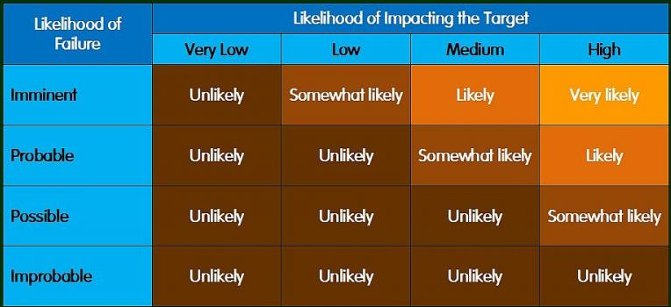
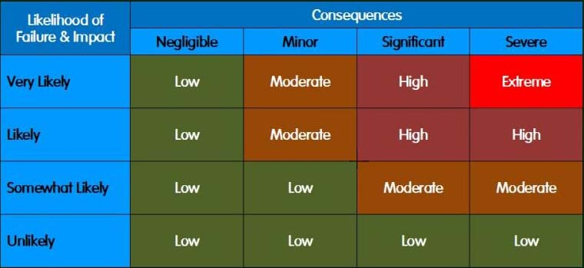
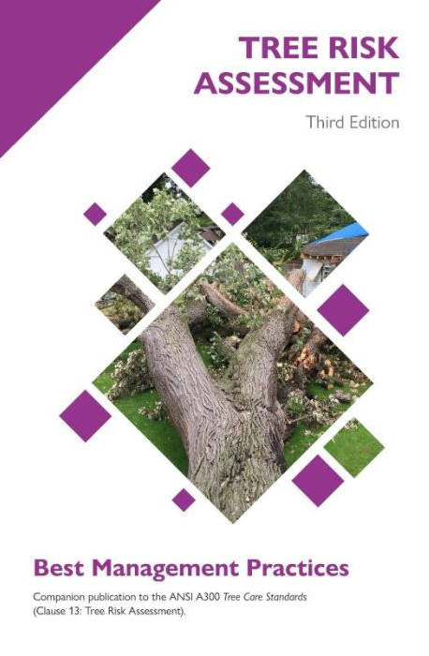


TRAQ Methodology
Components
  Likelihood of Failure
  Likelihood of Impact
  Consequences

Slide 18
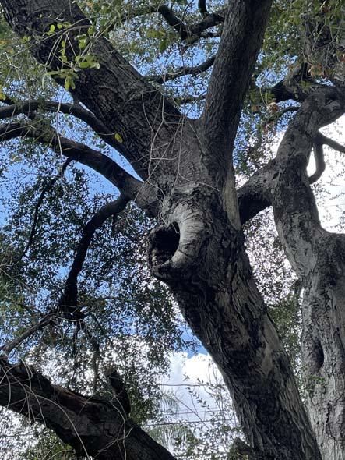
Likelihood of Failure
Chance that the tree or tree part will fail in a given time frame
  Imminent
  Probable
  Possible
  Improbable

Slide 19
Likelihood of Failure
Chance that the tree or tree part will fail in a given time frame
  Imminent
  Probable
  Possible
  Improbable
Has started to fail or will most likely fail in the near future under normal weather conditions.

Slide 20
Likelihood of Failure
Chance that the tree or tree part will fail in a given time frame
  Imminent
  Probable
  Possible
  Improbable
May occur in normal weather
Expected to occur in severe weather

Slide 21
Likelihood of Failure
Chance that the tree or tree part will fail in a given time frame
  Imminent
  Probable
  Possible
  Improbable
Not likely to fail in normal weather
May fail in severe weather

Slide 22
Likelihood of Failure
Chance that the tree or tree part will fail in a given time frame
  Imminent
  Probable
  Possible
  Improbable
Not likely to fail during normal or severe weather

Slide 23
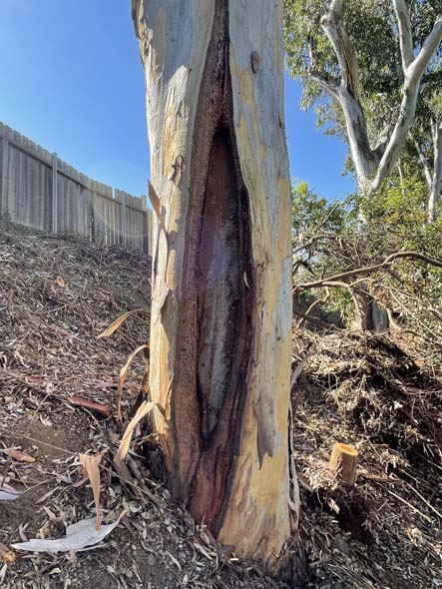
Likelihood of Failure
Factors
  Tree Species
  Tree Health
  Load
  Response Growth
  Defects and Conditions
  Site Factors

Slide 24
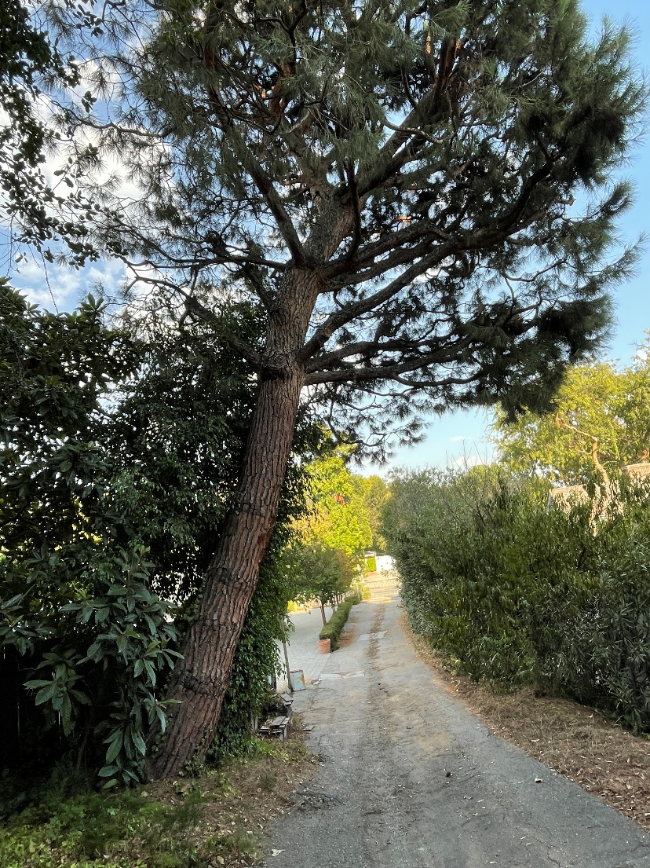
Likelihood of Impact
Chance that the tree or tree part will strike the target if it were to fail
  High
  Medium
  Low
  Very Low

Slide 25
Likelihood of Impact
Chance that the tree or tree part will strike the target if it were to fail
  High
  Medium
  Low
  Very Low
Likely to impact the target

Slide 26
Likelihood of Impact
Chance that the tree or tree part will strike the target if it were to fail
  High
  Medium
  Low
  Very Low
Could impact the target, but not expected to do so

Slide 27
Likelihood of Impact
Chance that the tree or tree part will strike the target if it were to fail
  High
  Medium
  Low
  Very Low
Slight chance of impacting the target

Slide 28
Likelihood of Impact
Chance that the tree or tree part will strike the target if it were to fail
  High
  Medium
  Low
  Very Low
Chance of impacting the target is remote

Slide 29
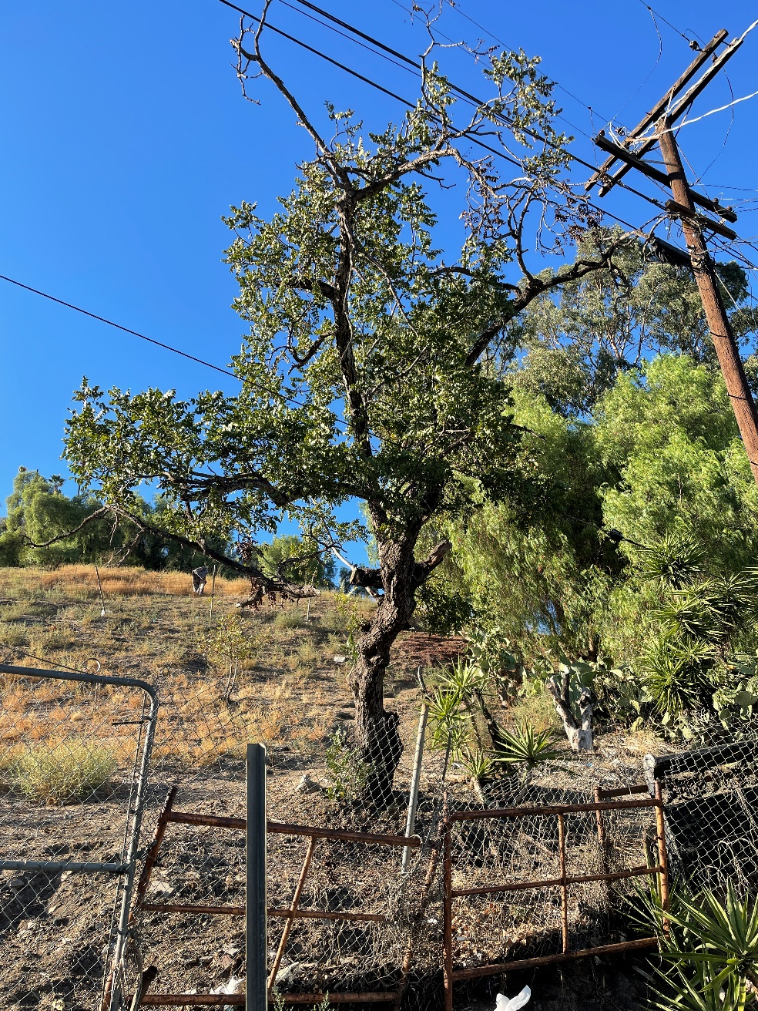
Likelihood of Impact
Factors
  Occupancy Rate
  Location of Target
  Direction of Fall
  Protection Factors

Slide 30
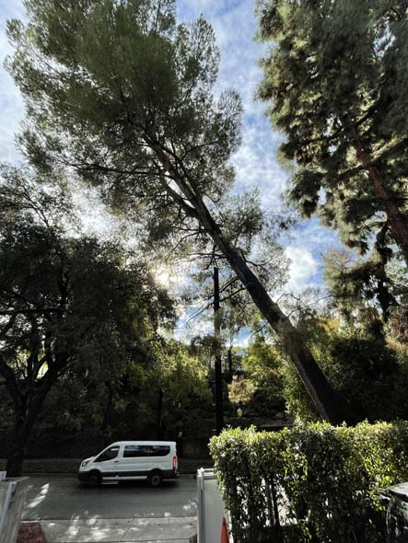
Consequences
The amount of damage or harm caused by impact
  Severe
  Significant
  Minor
  Negligible

Slide 31
Consequences
The amount of damage or harm caused by impact
  Severe
  Significant
  Minor
  Negligible
Death or serious injury, high-value property damage, or serious disruption

Slide 32
Consequences
The amount of damage or harm caused by impact
  Severe
  Significant
  Minor
  Negligible
Substantial personal injury, moderate- to high-value property damage, or considerable disruption

Slide 33
Consequences
The amount of damage or harm caused by impact
  Severe
  Significant
  Minor
  Negligible
Minor personal injury, low- to moderate-value property damage, small disruption of activities

Slide 34
Consequences
The amount of damage or harm caused by impact
  Severe
  Significant
  Minor
  Negligible
No personal injury, low-value property damage, disruptions that can be replaced or repaired

Slide 35
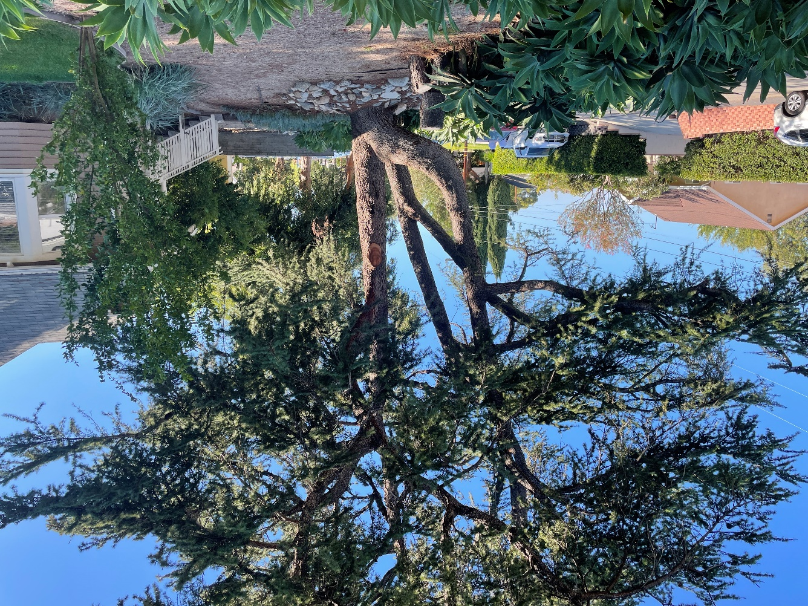
Consequences of Failure
Factors
  Value of Target
  Size of Part
  Distance of Fall
  Protection Factors

Slide 36
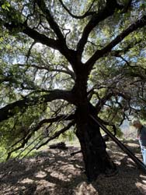
Time Frame
The period of time over which the likelihood of failure is assessed.
  Typically 1-3 years
  Rarely longer than 5 years

Slide 37
Risk Rating

Slide 38
Risk Rating
Likelihood Matrix

Slide 39
Risk Rating
Likelihood Matrix
Risk Matrix

Slide 40
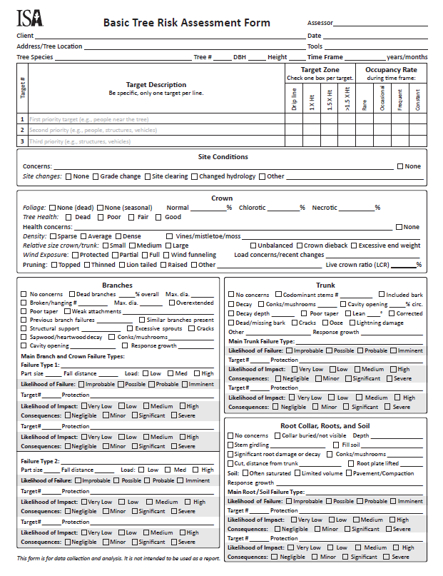
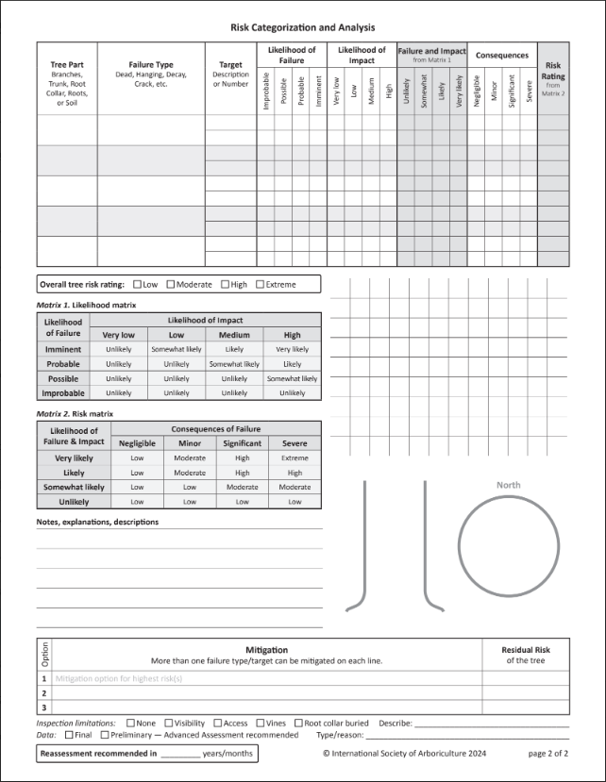
Risk Categorization

Slide 41
Risk Categorization

Slide 42
Risk Categorization

Slide 43
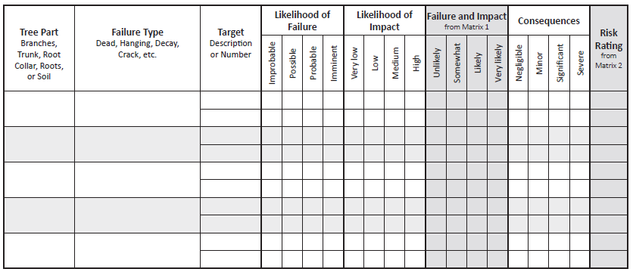
Risk Categorization
X
Scaffold
Branch
Parked cars
X
X
X
mod
Cracked Branch
X
X
low
Trunk
Trunk Cavity
Parked cars
X
X
Pedestrians
X
X
X
X
low

Slide 44
Risk Categorization
X
Scaffold
Branch
Parked cars
X
X
X
mod
Cracked Branch
X
X
low
Trunk
Trunk Cavity
Parked cars
X
X
Pedestrians
X
X
X
X
low

Slide 45
Risk Categorization
X
Scaffold
Branch
Parked cars
X
X
X
mod
Cracked Branch
X
X
low
Trunk
Trunk Cavity
Parked cars
X
X
Pedestrians
X
X
X
X
low

Slide 46
Overall Risk Rating
X
Scaffold
Branch
Parked cars
X
X
X
mod
Cracked Branch
X
X
low
Trunk
Trunk Cavity
Parked cars
X
X
Pedestrians
X
X
X
X
low

Slide 47
Overall Risk Rating
Highest Risk Rating combination
X
Scaffold
Branch
Parked cars
X
X
X
mod
Cracked Branch
X
X
low
Trunk
Trunk Cavity
Parked cars
X
X
Pedestrians
X
X
X
X
low

Slide 48
Overall Risk Rating
Highest Risk Rating combination
X
Scaffold
Branch
Parked cars
X
X
X
mod
Cracked Branch
X
X
low
Trunk
Trunk Cavity
Parked cars
X
X
Pedestrians
X
X
X
X
low

Slide 49
Overall Risk Rating
Highest Risk Rating combination
X

Slide 50
TRAQ Methodology
Components
  Likelihood of failure
  Likelihood of impact
  Consequences of failure
Terms
  Time Frame
  Risk Categorization
  Risk Rating
  Overall Risk Rating

Slide 51
Writing Effective Reports

Slide 52
Writing Effective Reports
Importance

Slide 53
Writing Effective Reports
Importance
Essential Components

Slide 54
Writing Effective Reports
Importance
Essential Components
Flow

Slide 55
Writing Effective Reports
Importance
Essential Components
Flow
Structure

Slide 56
Importance
Reports Convey Information

Slide 57
Importance
Reports Convey Information
Expertise

Slide 58
Importance
Reports Convey Information
Expertise
Opinion

Slide 59
Importance
Reports Convey Information
Expertise
Opinion
Informed Decision

Slide 60
Essential Components
Assignment

Slide 61
Essential Components
Assignment
Who are you working for?

Slide 62
Essential Components
Assignment
Who are you working for?
What is the scope of your work?

Slide 63
Essential Components
Assignment
Who are you working for?
What is the scope of your work?
What are the deliverables?

Slide 64
Essential Components
Observations/Data

Slide 65
Essential Components
Observations/Data
Field Work

Slide 66
Essential Components
Observations/Data
Field Work
Studying Aerial Imagery

Slide 67
Essential Components
Observations/Data
Field Work
Studying Aerial Imagery
Researching Applicable Ordinances

Slide 68
Essential Components
Testing/Analysis/Discussion

Slide 69
Essential Components
Testing/Analysis/Discussion
Bring It All Together

Slide 70
Essential Components
Testing/Analysis/Discussion
Bring It All Together
Explain Key Concepts

Slide 71
Essential Components
Testing/Analysis/Discussion
Bring It All Together
Explain Key Concepts
Reconcile Your Data

Slide 72
Essential Components
Testing/Analysis/Discussion
Bring It All Together
Explain Key Concepts
Reconcile Your Data
Form Your Opinions

Slide 73
Essential Components
Conclusion/Recommendations

Slide 74
Essential Components
Conclusion/Recommendations
Wrap It Up

Slide 75
Essential Components
Conclusion/Recommendations
Wrap It Up
State Your Opinions and Why

Slide 76
Essential Components
Conclusion/Recommendations
Wrap It Up
State Your Opinions and Why
Call to Action

Slide 77
Essential Components
Conclusion/Recommendations
Did I Fulfill
My Assignment?
Wrap It Up
State Your Opinions and Why
Call to Action
Specific Recommendations

Slide 78
Essential Components
Flow

Slide 79
Essential Components
Flow
Who is Your Audience?

Slide 80
Essential Components
Flow
Who is Your Audience?
What Story Are You Telling?

Slide 81
Essential Components
Flow
Who is Your Audience?
What Story Are You Telling?
Writing Style, Language & Tips

Slide 82
Essential Components
Structure

Slide 83
Essential Components
Structure
Plugging in the Pieces

Slide 84
Essential Components
Structure
Plugging in the Pieces
Does it Fulfill the Assignment?

Slide 85
Essential Components
Structure
Plugging in the Pieces
Does it Fulfill the Assignment?
Does it Make Sense

Slide 86
Essential Components
Structure
Plugging in the Pieces
Does it Fulfill the Assignment?
Does it Make Sense
Reread and Edit

Slide 87
Essential Components
Structure
Plugging in the Pieces
Does it Fulfill the Assignment?
Does it Make Sense
Reread and Edit
Reread and Edit, AGAIN

Slide 88
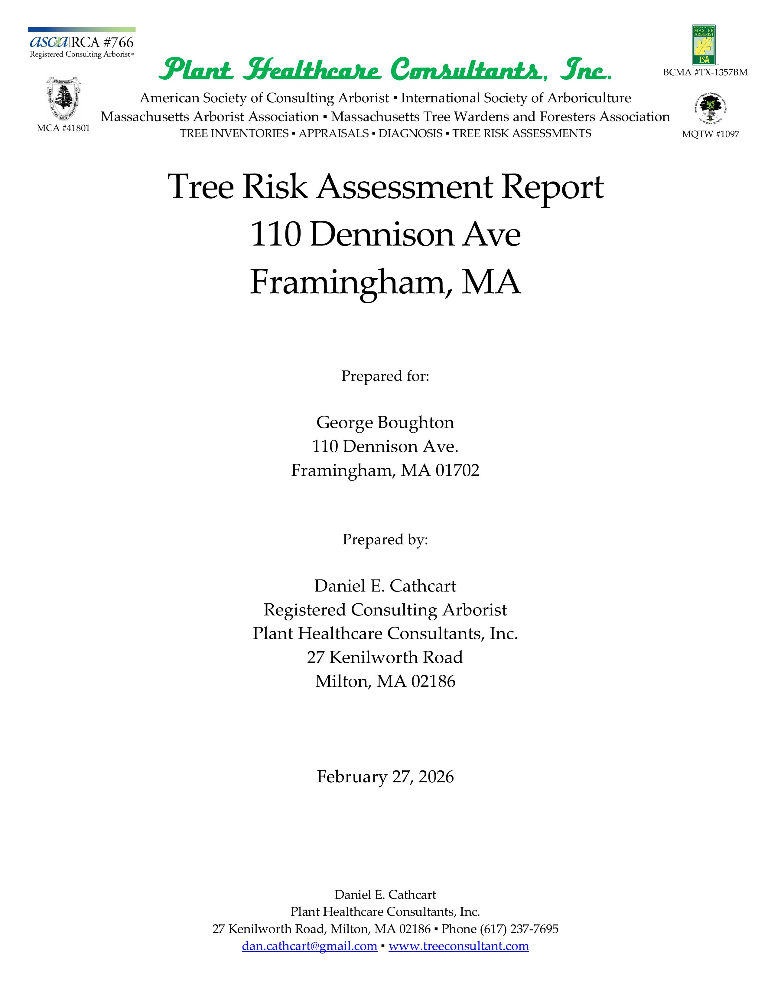
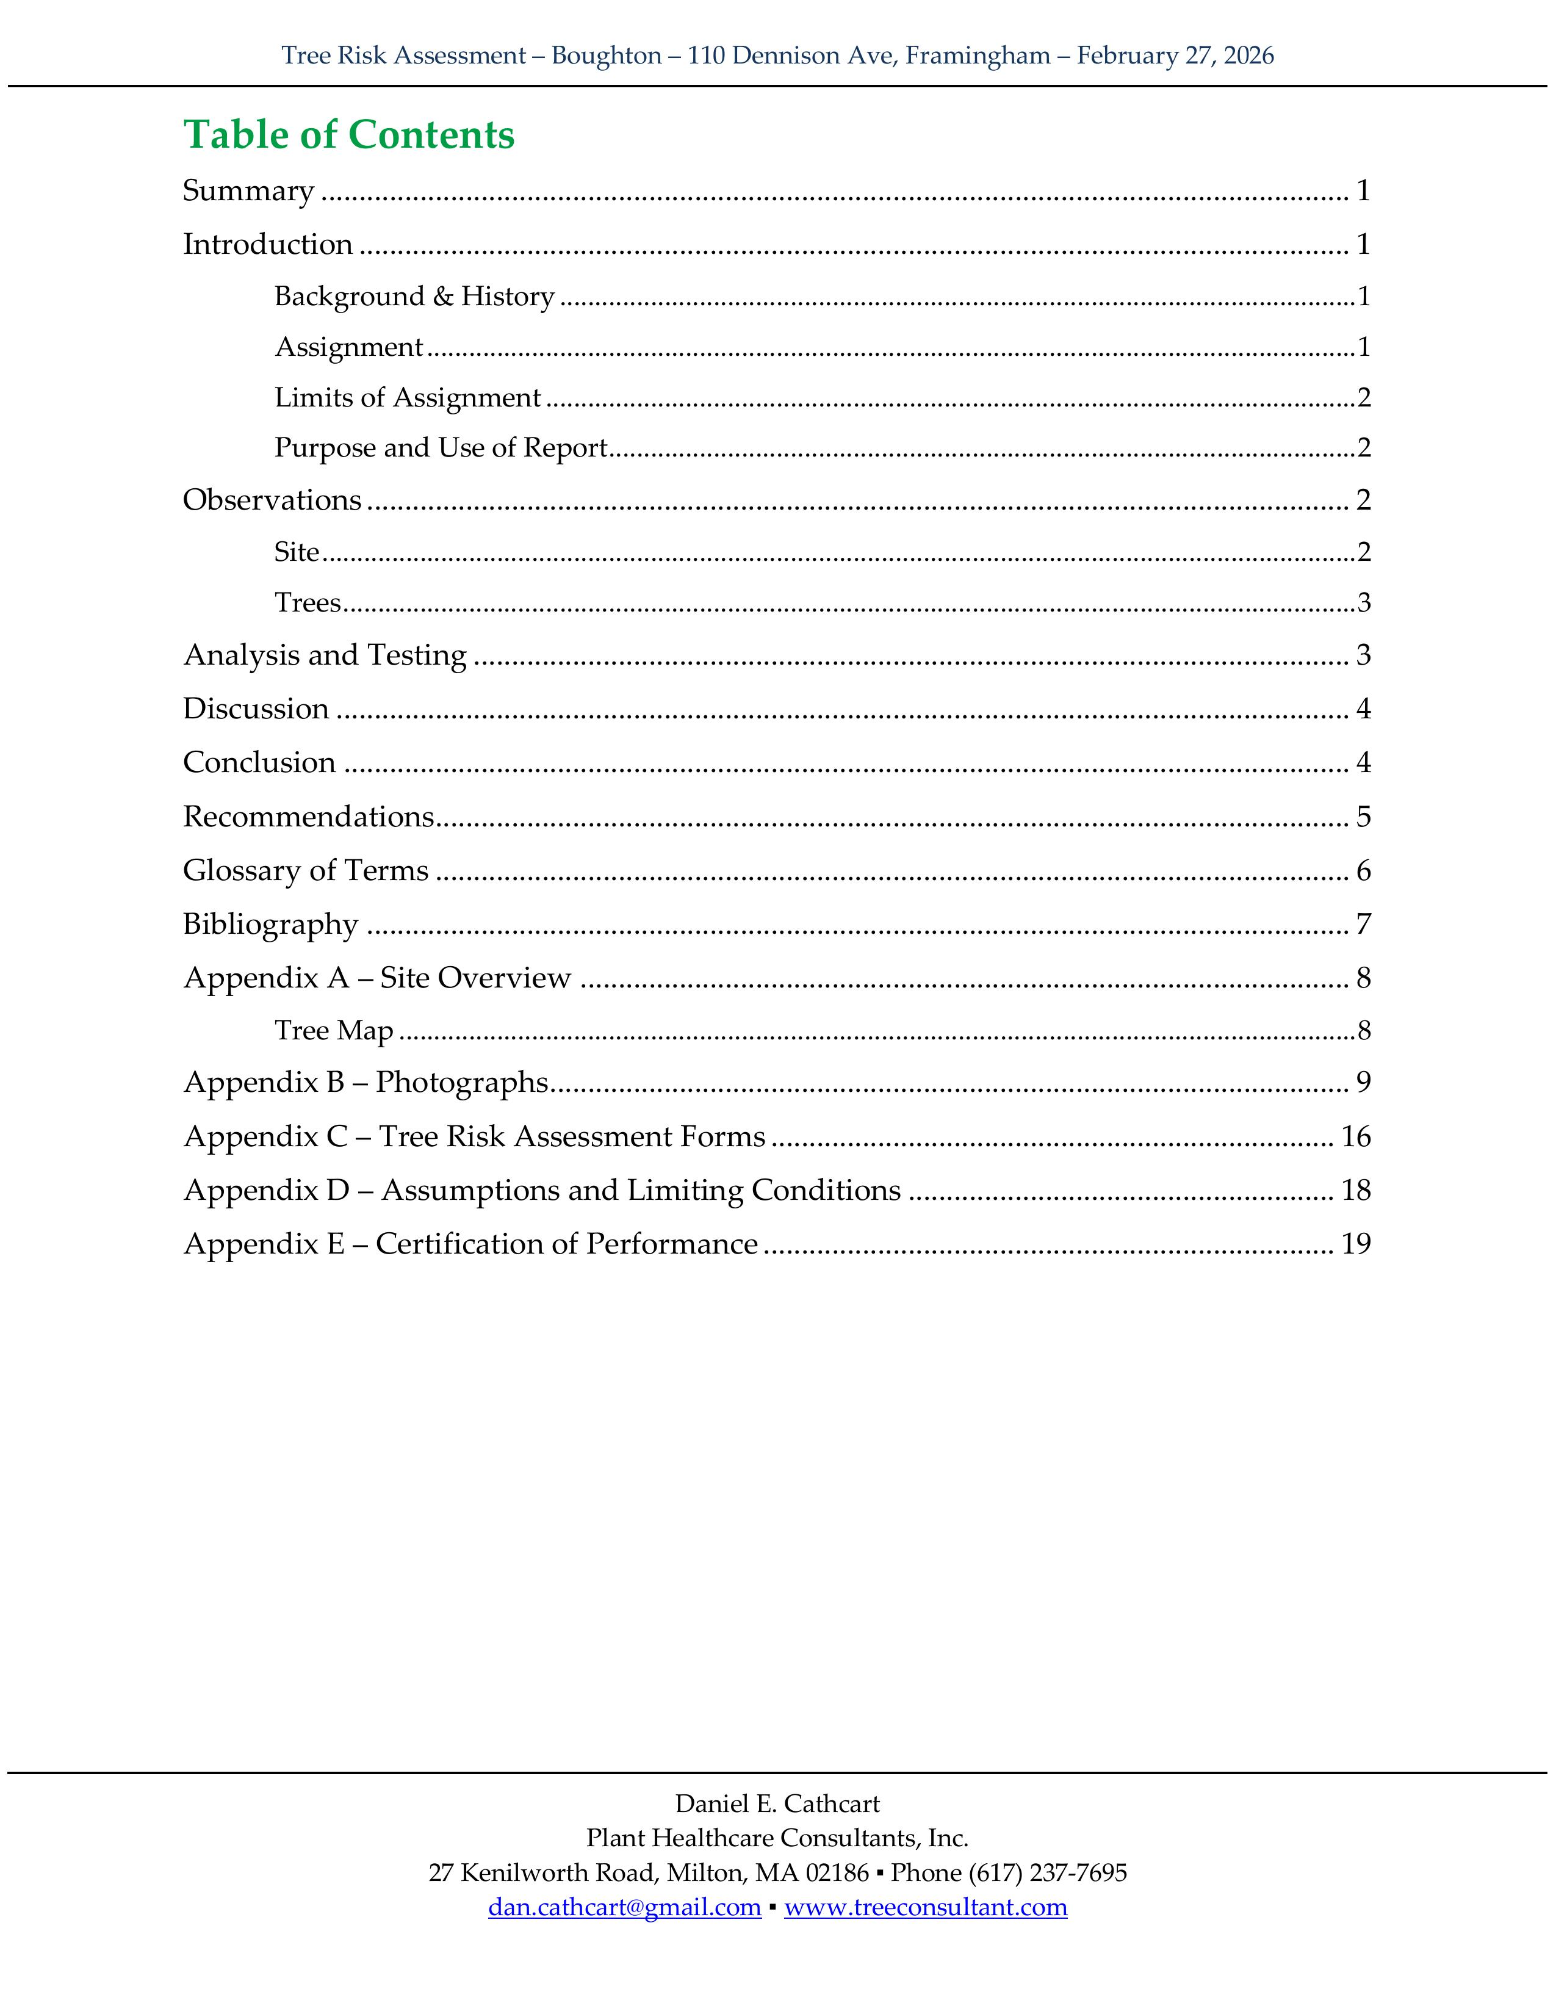

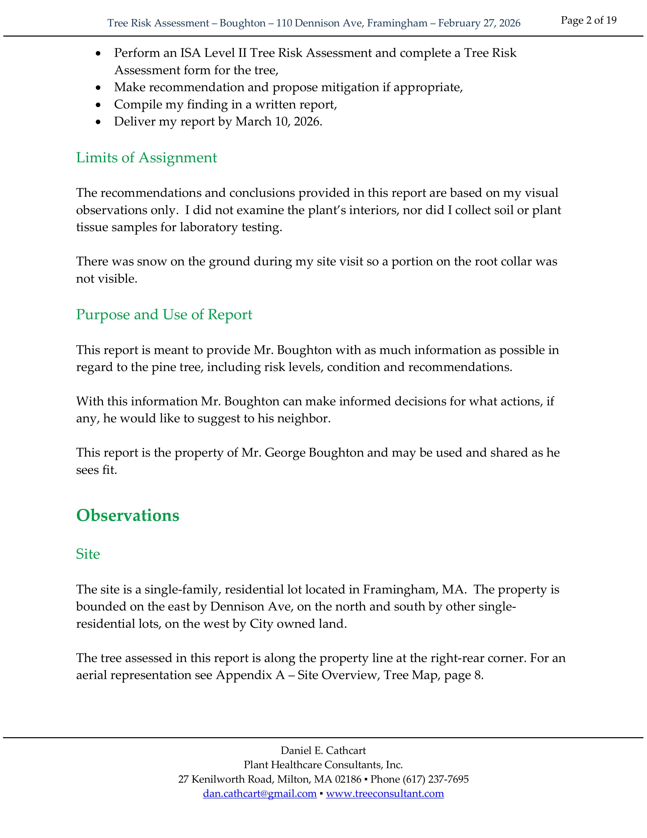
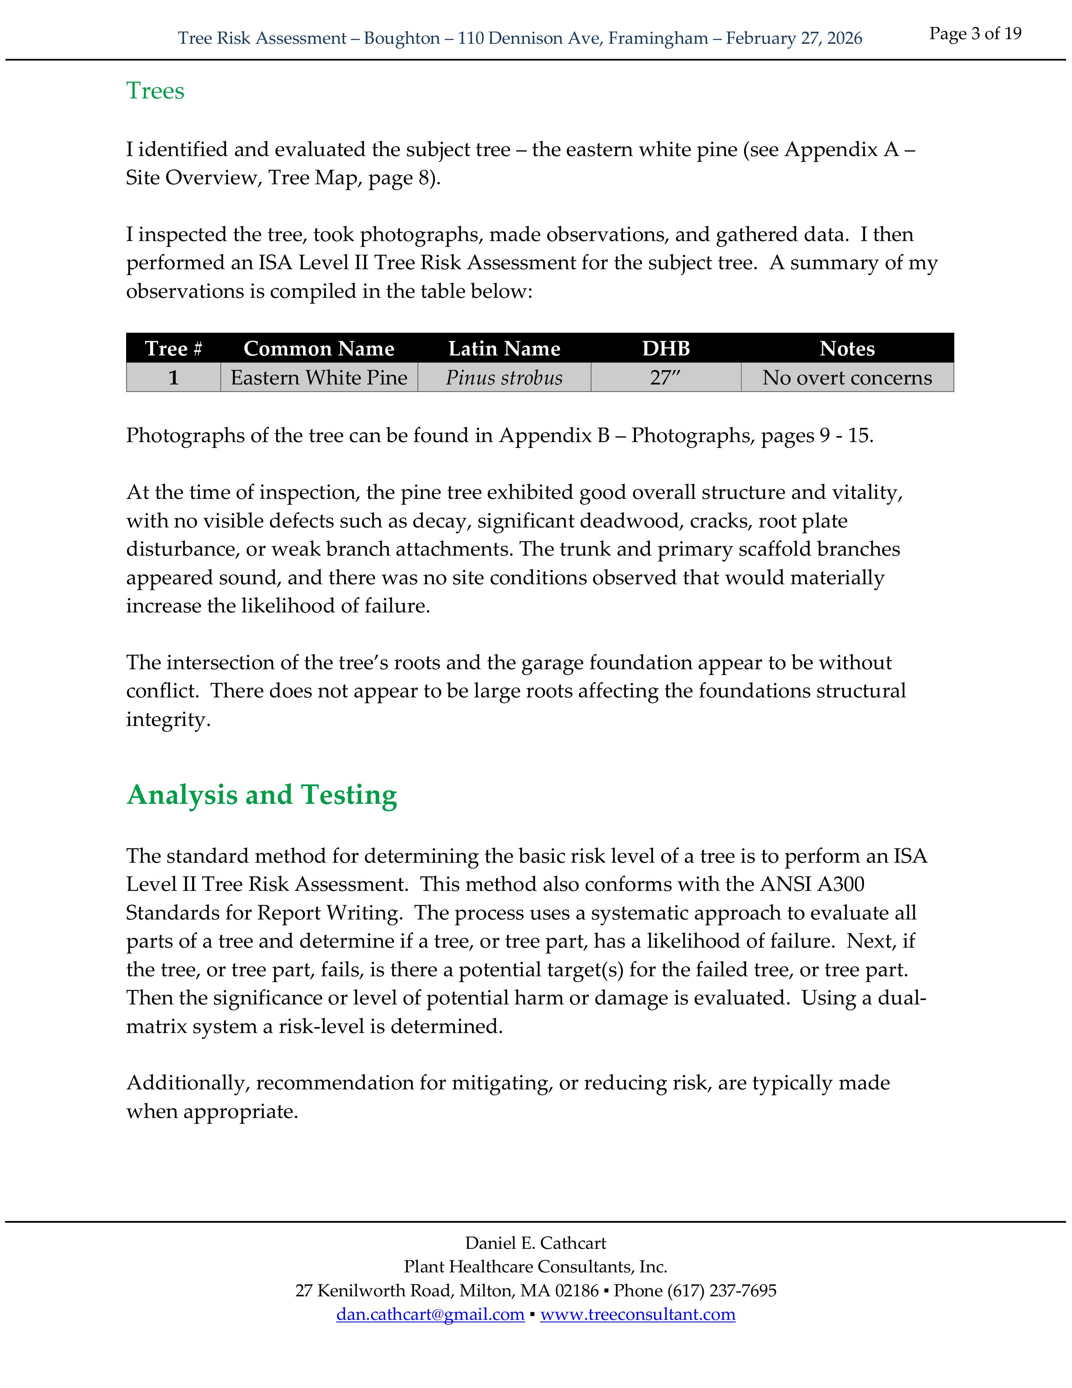
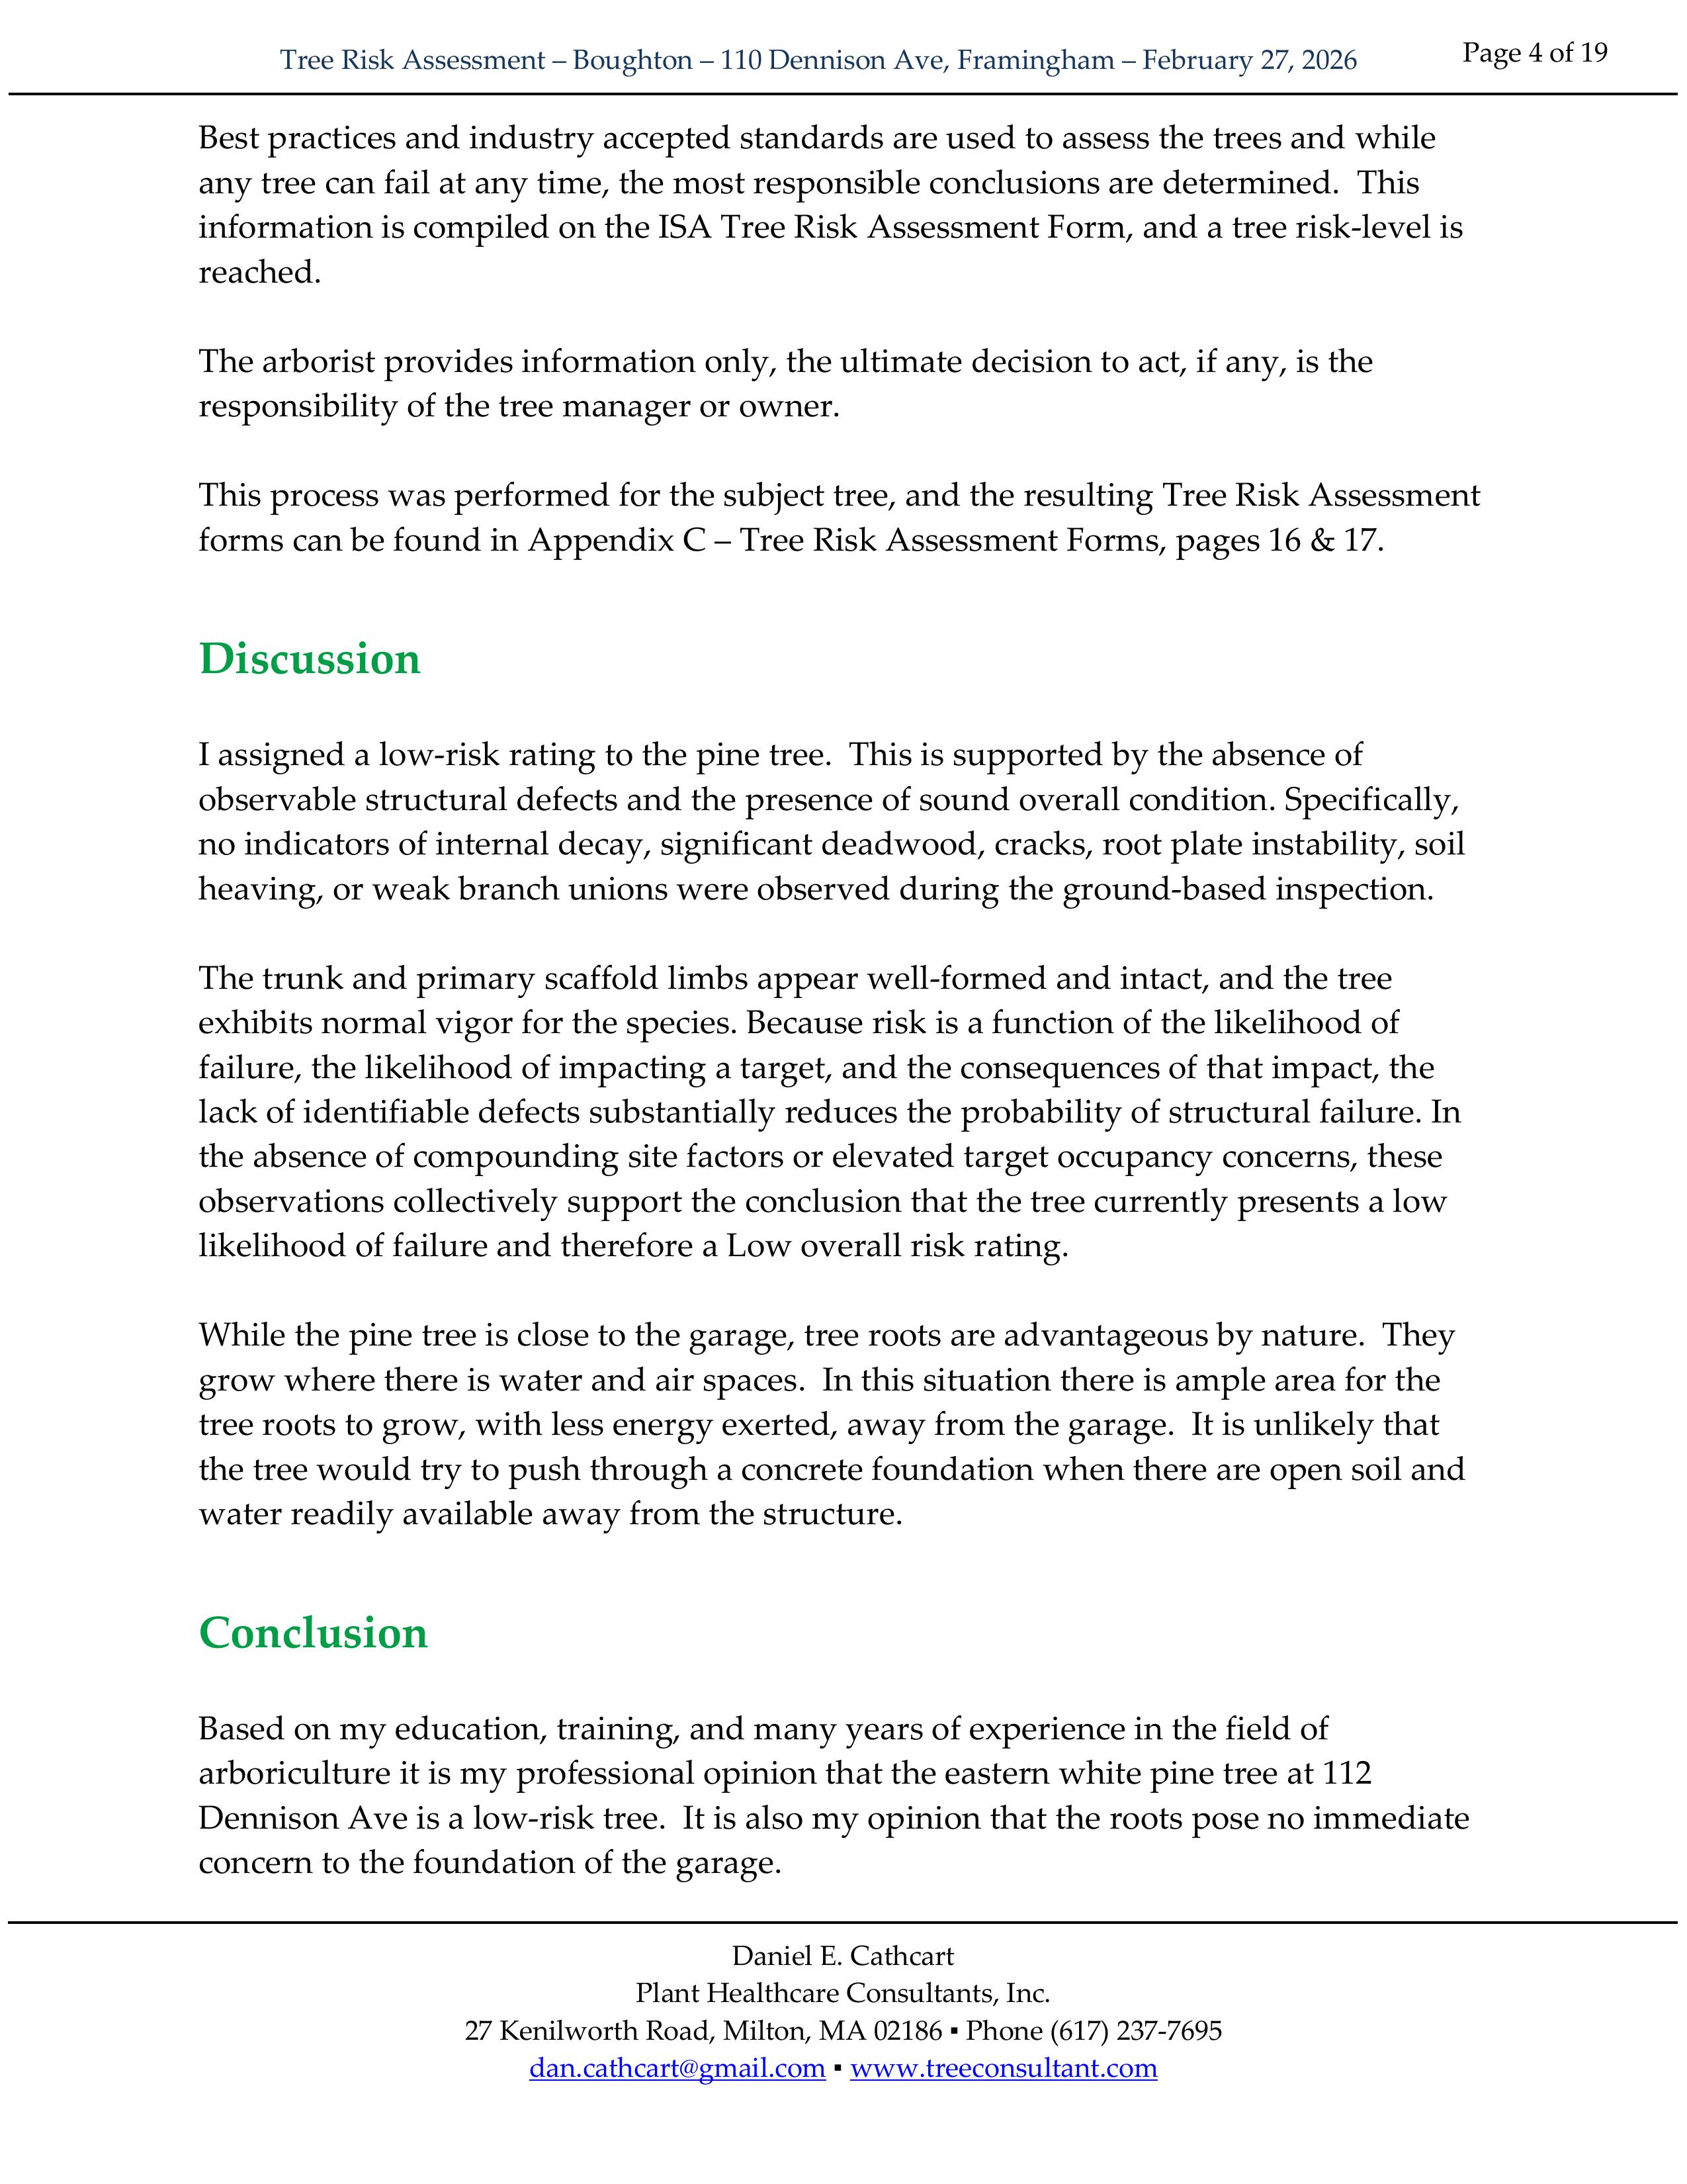

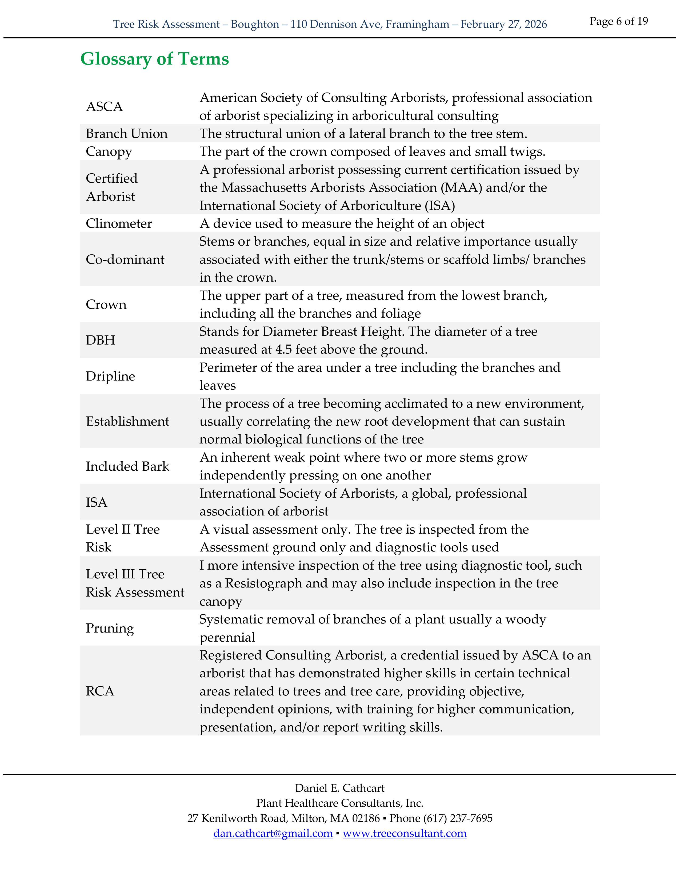
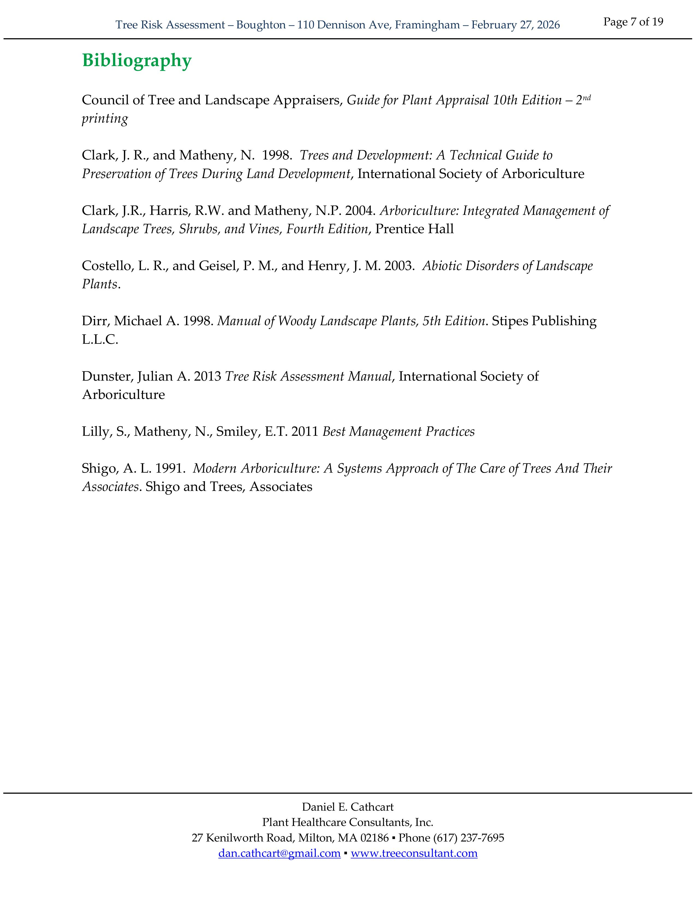
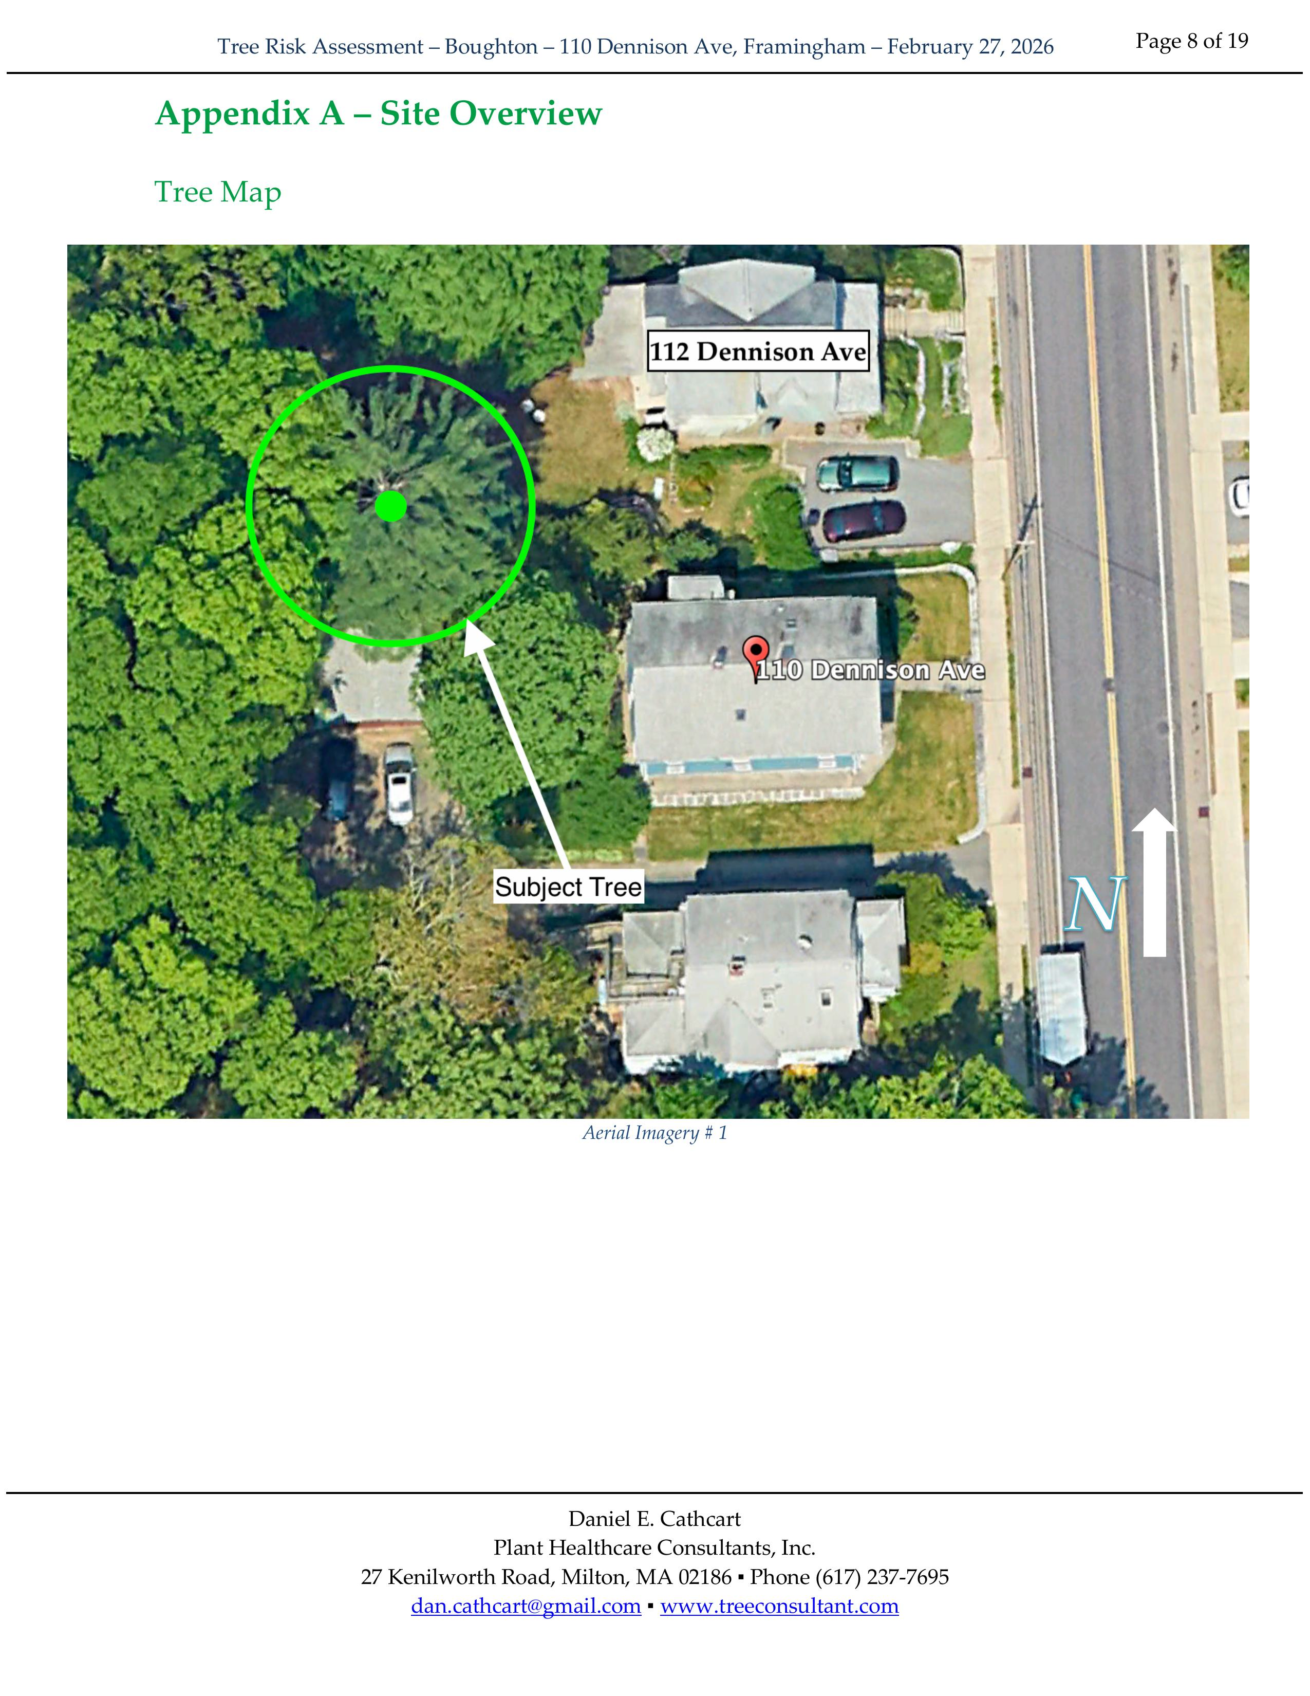
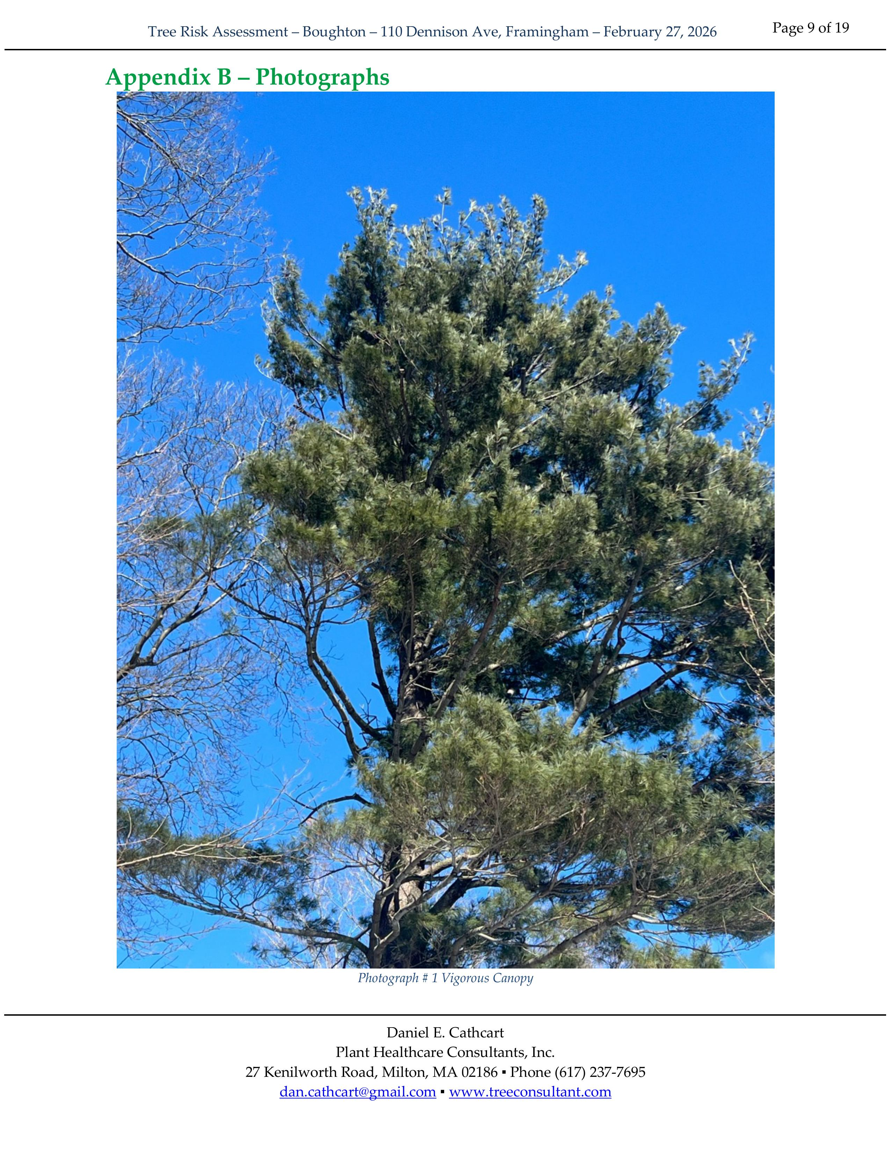
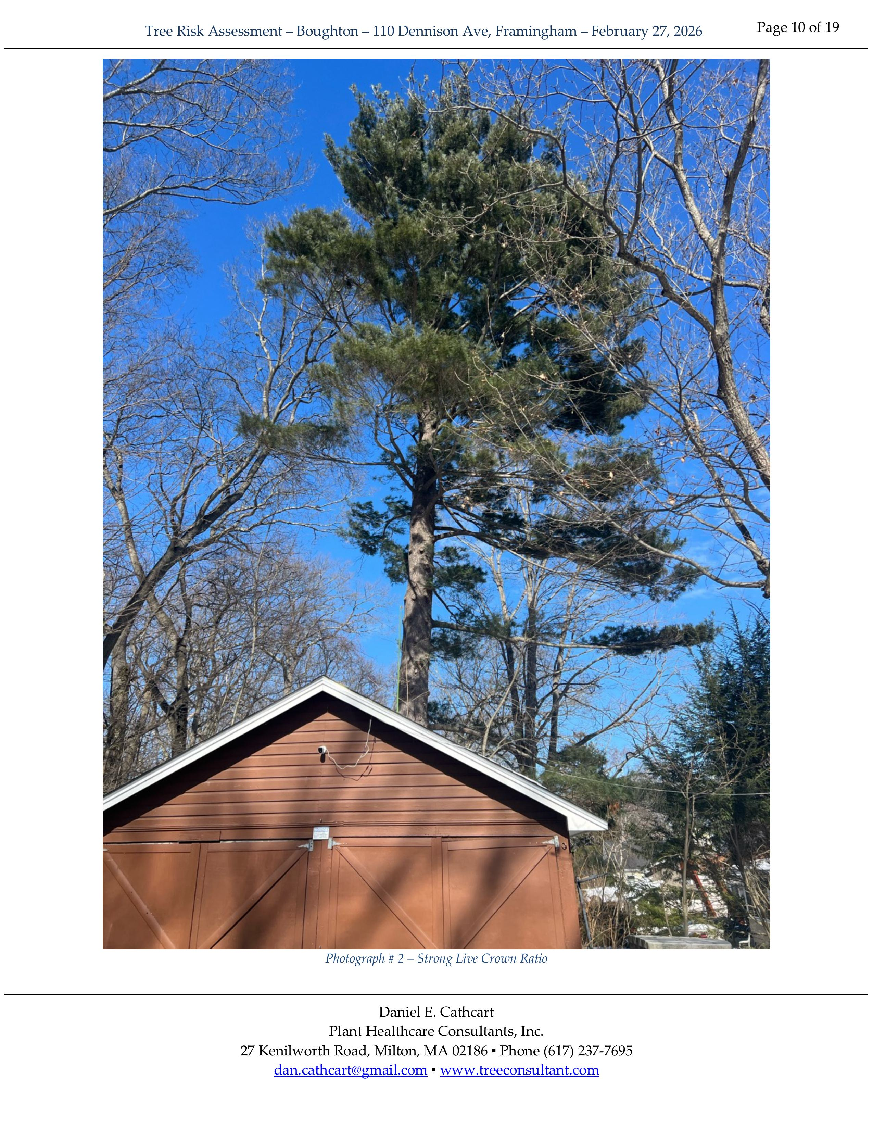
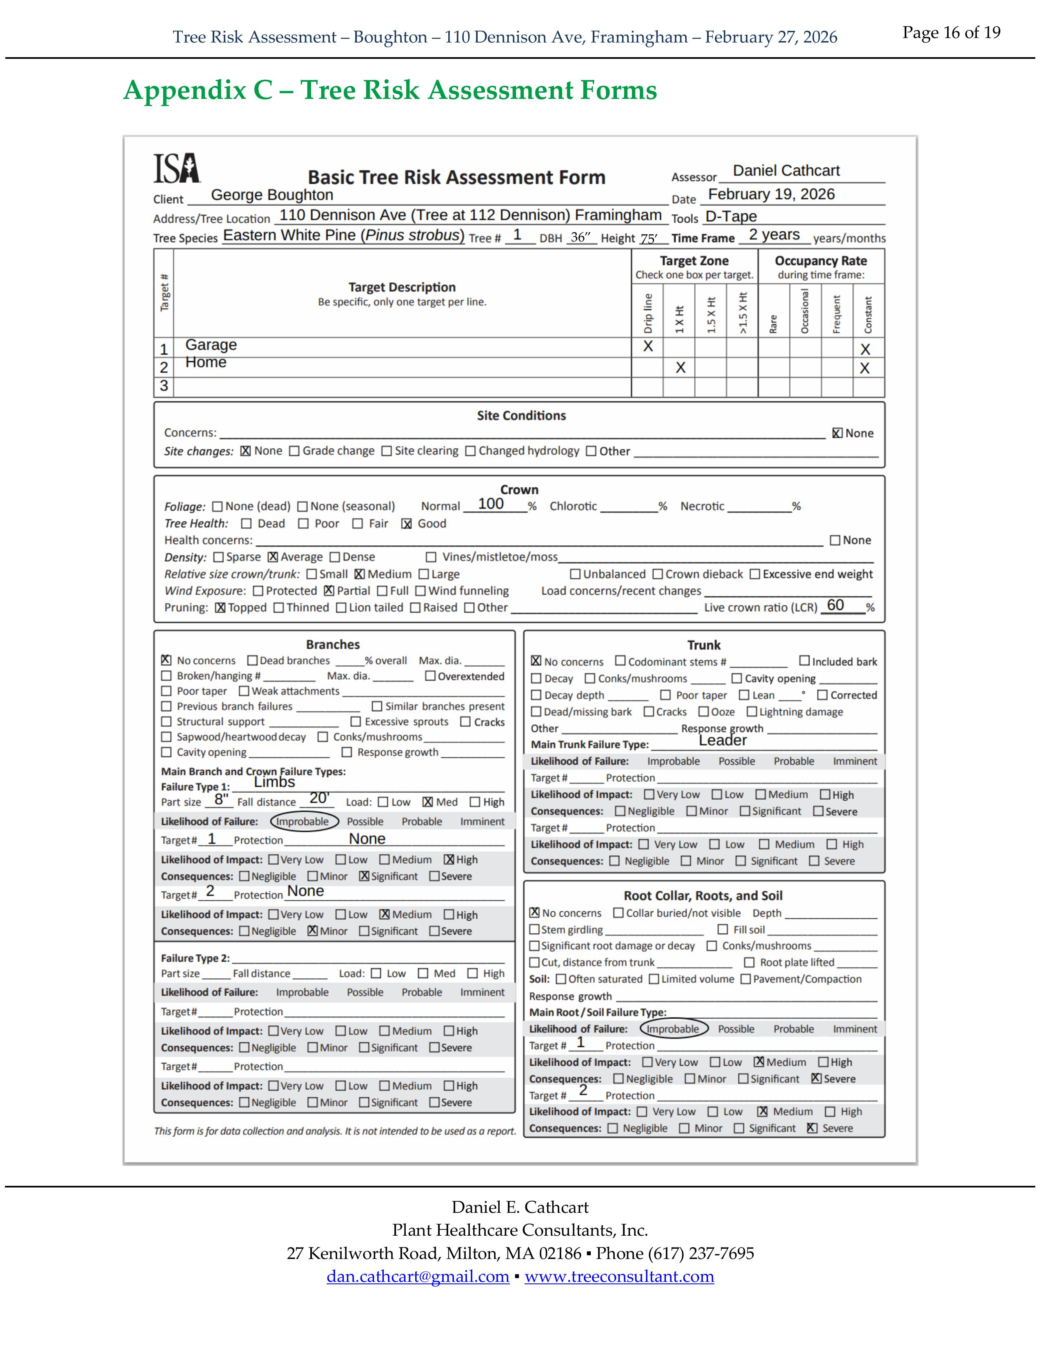
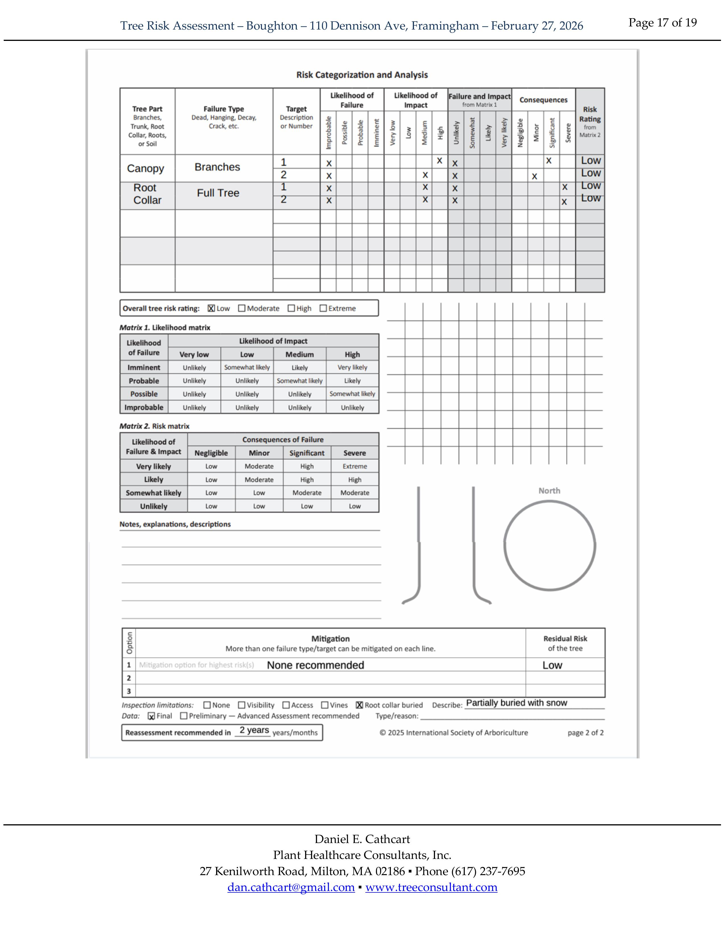
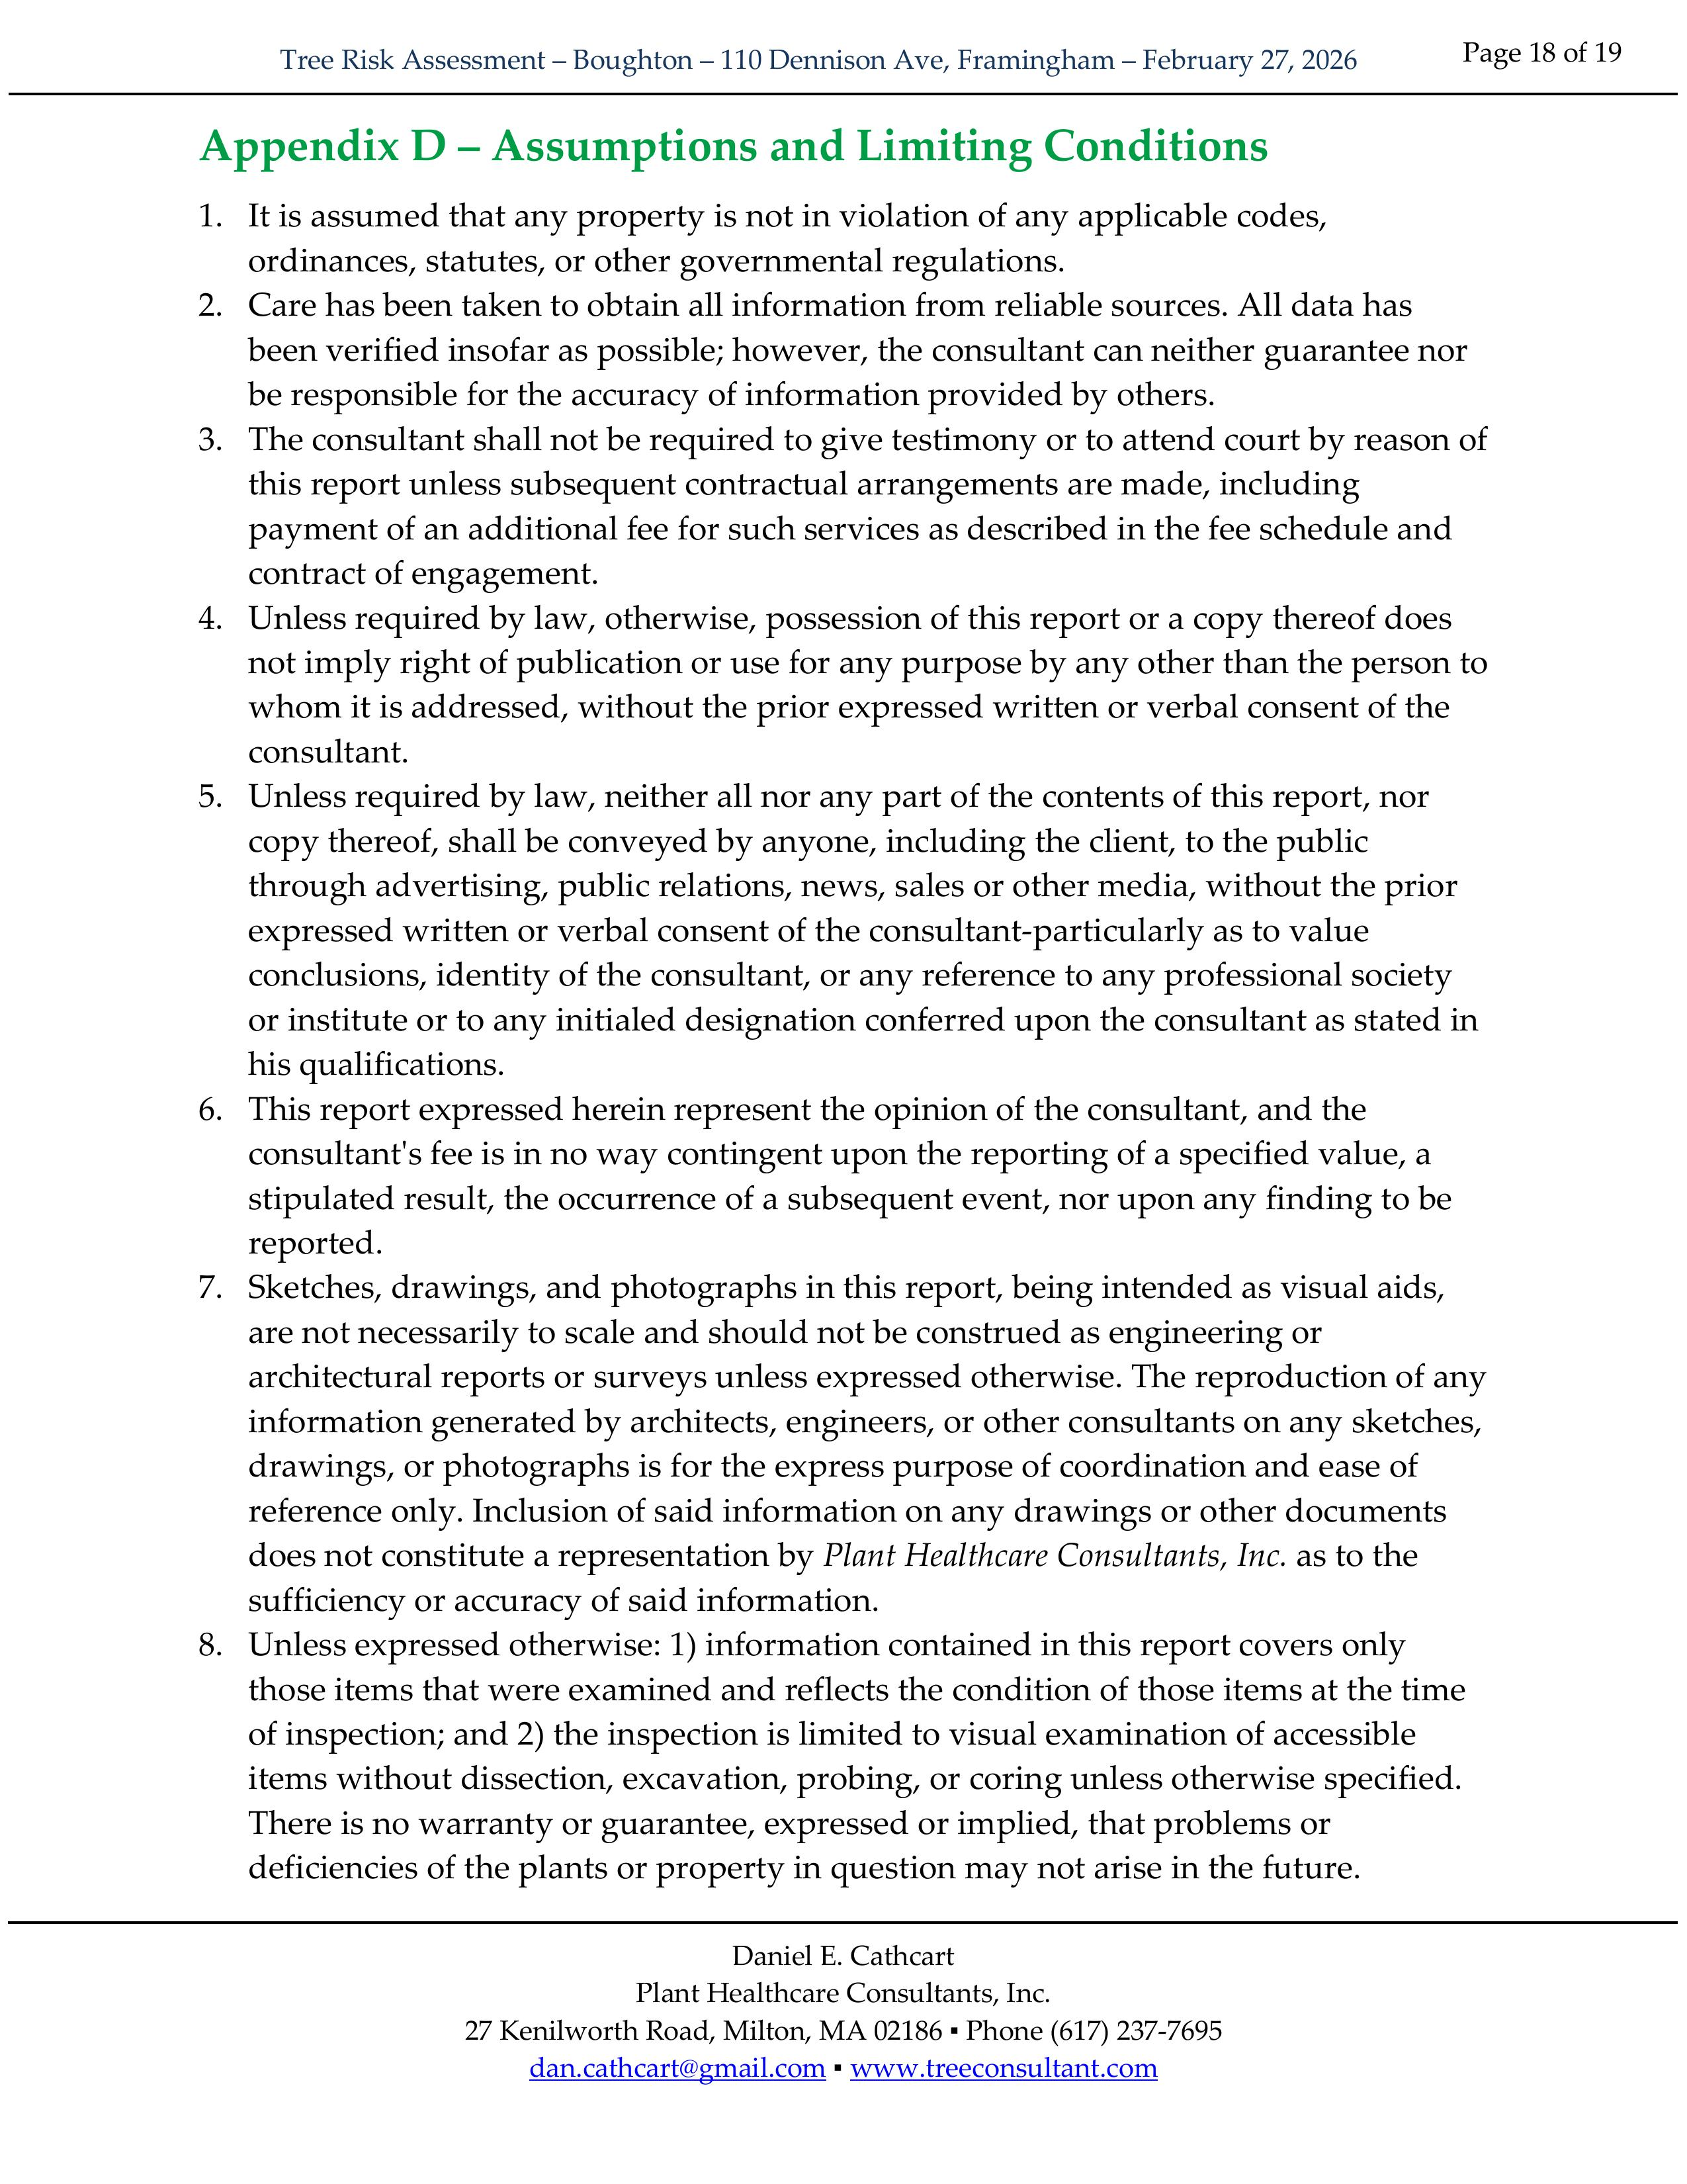
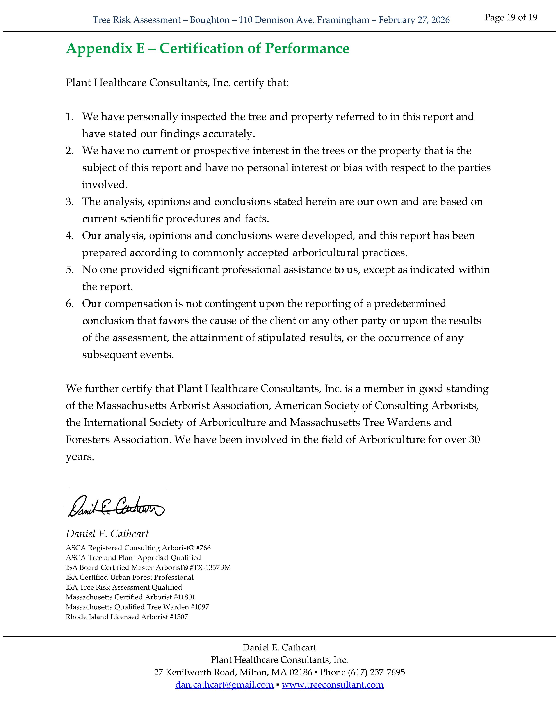

Slide 89
McGinn v. Omaha

Slide 90
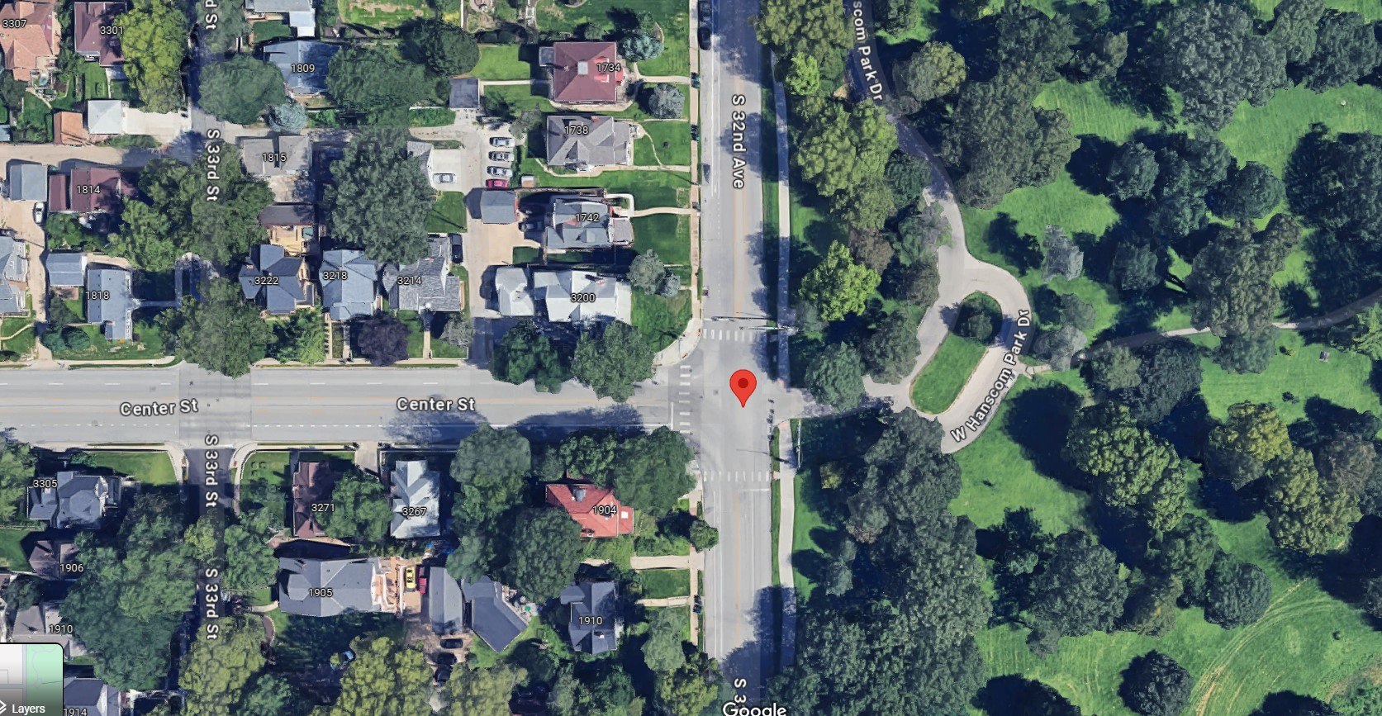
McGinn v. Omaha
352 N.W.2d 545 (NE Sup. Ct. 1984)
Notes:
June 1980 failure
Peter McGinn
32nd and Center Streets, near Hanscom Park in Omaha
Driver pulled over in a violent storm, parking beneath silver maple street tree
Quadriplegia

Slide 91
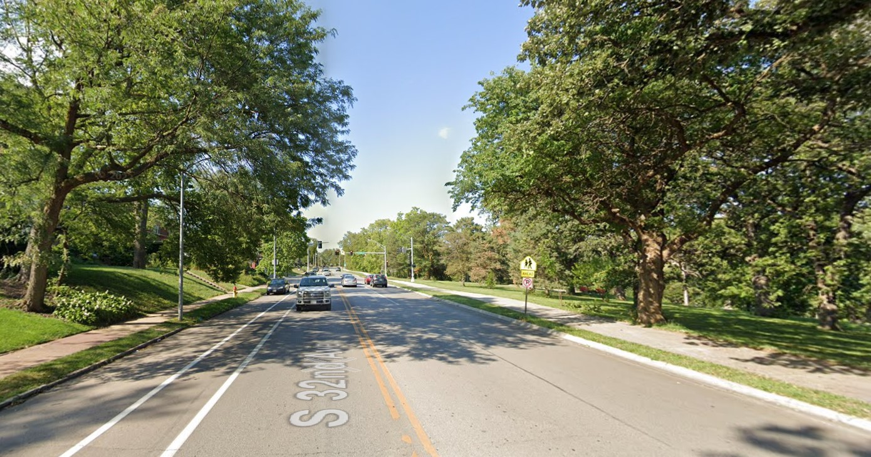
McGinn v. Omaha
352 N.W.2d 545 (NE Sup. Ct. 1984)
Notes:
June 1980 failure
Peter McGinn
32nd and Center Streets, near Hanscom Park in Omaha
Driver pulled over in a violent storm, parking beneath silver maple street tree
Quadriplegia

Slide 92

McGinn v. Omaha
352 N.W.2d 545 (NE Sup. Ct. 1984)
π Evidence
Δ Evidence
Silver maple
35-100 years old
Extensive decay
Prior branch failures
“Swollen knots”/ woundwood
“V-crotch”
59,600 street trees & 153,000 park trees
Managed by city forester + 26 field staff
Annual windshield inspections
No open wounds
No conks, cracks, breaks, holes
Notes:
Fact Witness Evidence

Slide 93
McGinn v. Omaha
352 N.W.2d 545 (NE Sup. Ct. 1984)
π Expert Witness
Δ Expert Witness
Removal ALL 50+ year old silver maples
ALL trees get 15-30 min Level 2 Basic Inspection
Half the city’s trees would be removed
12 min/tree inspection would take 6 inspectors a full year
“One of the best” urban tree inspection programs
Notes:
Expert Witness Evidence

Slide 94

McGinn v. Omaha
352 N.W.2d 545 (NE Sup. Ct. 1984)
Notes:
Case went to the jury

Slide 95
McGinn v. Omaha
352 N.W.2d 545 (NE Sup. Ct. 1984)
“π Wins”
Notes:
Jury found for McGinn

Slide 96

McGinn v. Omaha
352 N.W.2d 545 (NE Sup. Ct. 1984)
“π Wins”
NE Supreme Ct.
Notes:
City of Omaha appealed

Slide 97
McGinn v. Omaha
352 N.W.2d 545 (NE Sup. Ct. 1984)

Slide 98
McGinn v. Omaha
352 N.W.2d 545 (NE Sup. Ct. 1984)
π Evidence
Δ Evidence
Silver maple
35-100 years old
Extensive decay
Prior branch failures
“Swollen knots”/ woundwood
“V-crotch”
59,600 street trees & 153,000 park trees
Managed by city forester + 26 field staff
Annual windshield inspections
No open wounds
No conks, cracks, breaks, holes

Slide 99
McGinn v. Omaha
352 N.W.2d 545 (NE Sup. Ct. 1984)
π Evidence
Δ Evidence
Silver maple
35-100 years old
Extensive decay
Prior branch failures
“Swollen knots”/ woundwood
“V-crotch”
59,600 street trees & 153,000 park trees
Managed by city forester + 26 field staff
Annual windshield inspections
No open wounds
No conks, cracks, breaks, holes

Slide 100
McGinn v. Omaha
352 N.W.2d 545 (NE Sup. Ct. 1984)
π Evidence
Δ Evidence
Silver maple
35-100 years old
Extensive decay
Prior branch failures
“Swollen knots”/ woundwood
“V-crotch”
59,600 street trees & 153,000 park trees
Managed by city forester + 26 field staff
Annual windshield inspections
No open wounds
No conks, cracks, breaks, holes

Slide 101
McGinn v. Omaha
352 N.W.2d 545 (NE Sup. Ct. 1984)
π Evidence
Δ Evidence
Silver maple
35-100 years old
Extensive decay
Prior branch failures
“Swollen knots”/ woundwood
“V-crotch”
59,600 street trees & 153,000 park trees
Managed by city forester + 26 field staff
Annual windshield inspections
No open wounds
No conks, cracks, breaks, holes

Slide 102
McGinn v. Omaha
352 N.W.2d 545 (NE Sup. Ct. 1984)
π Evidence
Δ Evidence
Silver maple
35-100 years old
Extensive decay
Prior branch failures
“Swollen knots”/ woundwood
“V-crotch”
59,600 street trees & 153,000 park trees
Managed by city forester + 26 field staff
Annual windshield inspections
No open wounds
No conks, cracks, breaks, holes

Slide 103
McGinn v. Omaha
352 N.W.2d 545 (NE Sup. Ct. 1984)
π Evidence
Δ Evidence
Silver maple
35-100 years old
Extensive decay
Prior branch failures
“Swollen knots”/ woundwood
“V-crotch”
59,600 street trees & 153,000 park trees
Managed by city forester + 26 field staff
Annual windshield inspections
No open wounds
No conks, cracks, breaks, holes

Slide 104
McGinn v. Omaha
352 N.W.2d 545 (NE Sup. Ct. 1984)
π Evidence
Δ Evidence
Silver maple
35-100 years old
Extensive decay
Prior branch failures
“Swollen knots”/ woundwood
“V-crotch”
59,600 street trees & 153,000 park trees
Managed by city forester + 26 field staff
Annual windshield inspections
No open wounds
No conks, cracks, breaks, holes

Slide 105
McGinn v. Omaha
352 N.W.2d 545 (NE Sup. Ct. 1984)
“…no testimony…that a reasonable investigation would have revealed the extent of the decay”
“[no evidence that] indicators of decay…were readily visible from an onstreet inspection.”
“…external symptoms did not reveal the extent of decay”
“…a careful examination would not indicate the extent of the decay”

Slide 106

McGinn v. Omaha
352 N.W.2d 545 (NE Sup. Ct. 1984)
Notes:
Court decides the case AS A MATTER OF LAW, not FACT

Slide 107

McGinn v. Omaha
352 N.W.2d 545 (NE Sup. Ct. 1984)
Notes:
Court decides the case AS A MATTER OF LAW, not FACT

Slide 108
McGinn v. Omaha
352 N.W.2d 545 (NE Sup. Ct. 1984)
Level 1 Inspection
Notes:
Framework for Level 1 and Level 2 assessments

Slide 109
McGinn v. Omaha
352 N.W.2d 545 (NE Sup. Ct. 1984)
Level 1 Inspection
  IF EXTERNAL INDICATOR:
  Level 2 Inspection
Notes:
Framework for Level 1 and Level 2 assessments

Slide 110
McGinn v. Omaha
352 N.W.2d 545 (NE Sup. Ct. 1984)
Level 1 Inspection
  IF EXTERNAL INDICATOR:
  Level 2 Inspection
    IF INDICATOR OF EXTENSIVE DECAY:
    Mitigation Action
Notes:
Framework for Level 1 and Level 2 assessments

Slide 111
McGinn v. Omaha
352 N.W.2d 545 (NE Sup. Ct. 1984)
Level 1 Inspection
  IF EXTERNAL INDICATOR:
  Level 2 Inspection
    IF INDICATOR OF EXTENSIVE DECAY:
    Mitigation Action
Notes:
Framework for Level 1 and Level 2 assessments

Slide 112
McGinn v. Omaha
352 N.W.2d 545 (NE Sup. Ct. 1984)
Level 1 Inspection
  IF EXTERNAL INDICATOR:
  Level 2 Inspection
    IF INDICATOR OF EXTENSIVE DECAY:
    Mitigation Action
Notes:
Framework for Level 1 and Level 2 assessments

Slide 113
McGinn v. Omaha
352 N.W.2d 545 (NE Sup. Ct. 1984)
Dissent:
“…the crux of this case is not inspection of 10,000 silver maples, but the city’s inspection of just one tree.”
Notes:
Dissent

Slide 114
McGinn v. Omaha
352 N.W.2d 545 (NE Sup. Ct. 1984)
Dissent:
Silver maple
35-100 years old
Extensive decay
Prior branch failures
“Swollen knots”/ woundwood
“V-crotch”
59,600 street trees & 153,000 park trees
Managed by city forester + 26 field staff
Annual windshield inspections
No open wounds
No conks, cracks, breaks, holes
Notes:
Dissent believed that there was SOME evidence that the jury could have relied upon

Slide 115
McGinn v. Omaha
352 N.W.2d 545 (NE Sup. Ct. 1984)
Dissent:
Silver maple
35-100 years old
Extensive decay
Prior branch failures
“Swollen knots”/ woundwood
“V-crotch”
59,600 street trees & 153,000 park trees
Managed by city forester + 26 field staff
Annual windshield inspections
No open wounds
No conks, cracks, breaks, holes
Notes:
Dissent believed that there was SOME evidence that the jury could have relied upon

Slide 116


McGinn v. Omaha
352 N.W.2d 545 (NE Sup. Ct. 1984)
Dissent:
Notes:
The dissent would have allowed the jury’s verdict to stand.

Slide 117
Levels of Assessment
Level 1 Limited Visual
Level 2 Basic Assessment
Level 3 Advanced

Slide 118
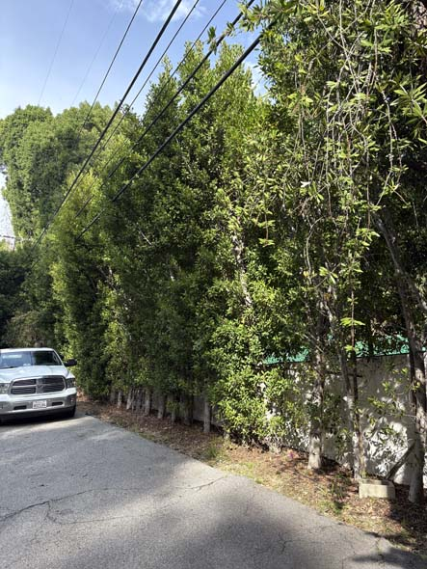
Levels of Assessment
Level 1 Limited Visual

Slide 119
Levels of Assessment
Level 1 Limited Visual
  Large population of trees
  Short period of time
  Fixed perspective

Slide 120
Levels of Assessment
Level 1 Limited Visual
13.5.1.1: “The tree(s), targets, and conditions of concern (if any) to be considered, and the perspective of the assessment, … shall be specified.”

Slide 121
Levels of Assessment
Level 1 Limited Visual
13.5.1.1: “The tree(s), targets, and conditions of concern (if any) to be considered, and the perspective of the assessment, … shall be specified.”

Slide 122
Levels of Assessment
Level 1 Limited Visual
13.5.1.1: “The tree(s), targets, and conditions of concern (if any) to be considered, and the perspective of the assessment, … shall be specified.”

Slide 123
Levels of Assessment
Level 1 Limited Visual
13.5.1.1: “The tree(s), targets, and conditions of concern (if any) to be considered, and the perspective of the assessment, … shall be specified.”
13.2.2.1: “Trees to be assessed at Level 1 may be viewed remotely or in person.”

Slide 124
Levels of Assessment
Level 1 Limited Visual
13.5.1.1: “The tree(s), targets, and conditions of concern (if any) to be considered, and the perspective of the assessment, … shall be specified.”
13.2.2.1: “Trees to be assessed at Level 1 may be viewed remotely or in person.”

Slide 125
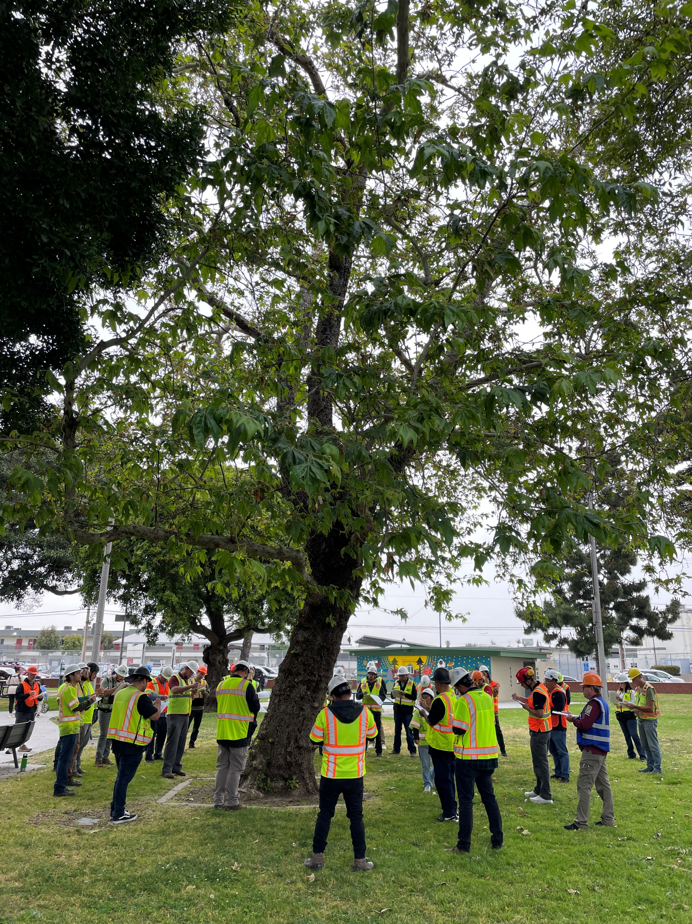
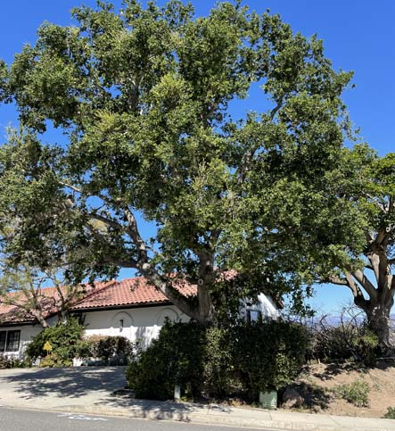
Levels of Assessment
Level 2 Basic Assessment

Slide 126
Levels of Assessment
Level 2 Basic Assessment
13.5.2.1: “Basic tree risk assessments shall include a 360 degree ground based inspection around the tree.”

Slide 127
Levels of Assessment
Level 2 Basic Assessment
13.5.2.1: “Basic tree risk assessments shall include a 360 degree ground based inspection around the tree.”

Slide 128
Levels of Assessment
Level 2 Basic Assessment
13.5.2.1: “Basic tree risk assessments shall include a 360 degree ground based inspection around the tree.”
13.2.2.2: “Trees to be assessed at Level 2 shall be visually inspected in person.”

Slide 129
Levels of Assessment
Level 2 Basic Assessment
13.5.2.1: “Basic tree risk assessments shall include a 360 degree ground based inspection around the tree.”
13.2.2.2: “Trees to be assessed at Level 2 shall be visually inspected in person.”

Slide 130
Levels of Assessment
Level 2 Basic Assessment
13.5.2.1: “Basic tree risk assessments shall include a 360 degree ground based inspection around the tree.”
13.2.2.2: “Trees to be assessed at Level 2 shall be visually inspected in person.”
13.5.2.3: “Simple tools may be used at the discretion of the risk assessor or shall be used as specified.”

Slide 131
Levels of Assessment
Level 2 Basic Assessment
13.5.2.1: “Basic tree risk assessments shall include a 360 degree ground based inspection around the tree.”
13.2.2.2: “Trees to be assessed at Level 2 shall be visually inspected in person.”
13.5.2.3: “Simple tools may be used at the discretion of the risk assessor or shall be used as specified.”

Slide 132
Levels of Assessment
Level 2 Basic Assessment
13.5.2.1: “Basic tree risk assessments shall include a 360 degree ground based inspection around the tree.”
13.2.2.2: “Trees to be assessed at Level 2 shall be visually inspected in person.”
13.5.2.3: “Simple tools may be used at the discretion of the risk assessor or shall be used as specified.”
13.5.2.3.1: “Simple tools may include:

Slide 133
Levels of Assessment
Level 2 Basic Assessment
13.5.2.1: “Basic tree risk assessments shall include a 360 degree ground based inspection around the tree.”
13.2.2.2: “Trees to be assessed at Level 2 shall be visually inspected in person.”
13.5.2.3: “Simple tools may be used at the discretion of the risk assessor or shall be used as specified.”
13.5.2.3.1: “Simple tools may include:
  Mallet;
  Probe
  Binoculars
  Trowel or shovel
  Diameter tape
  Clinometer/
  hypsometer

Slide 134
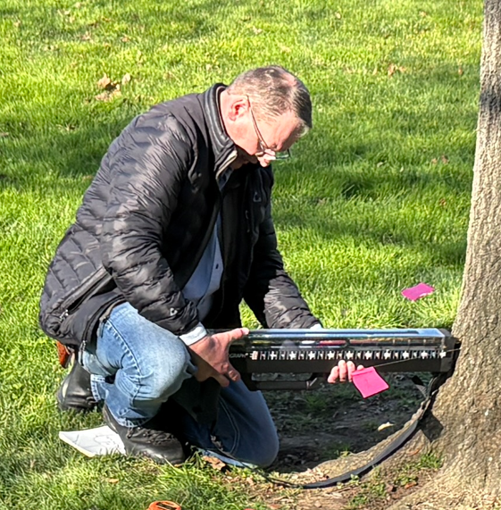
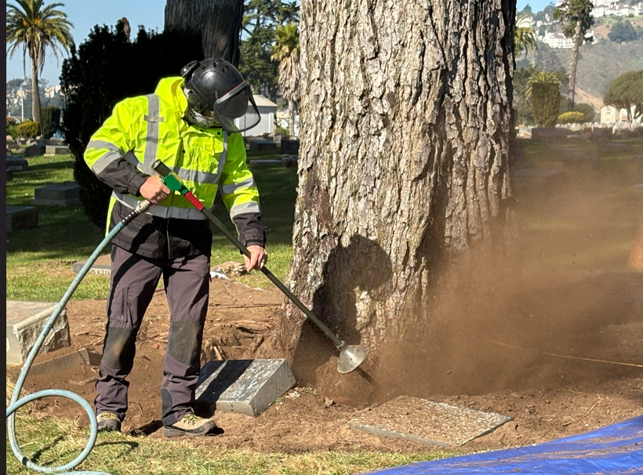
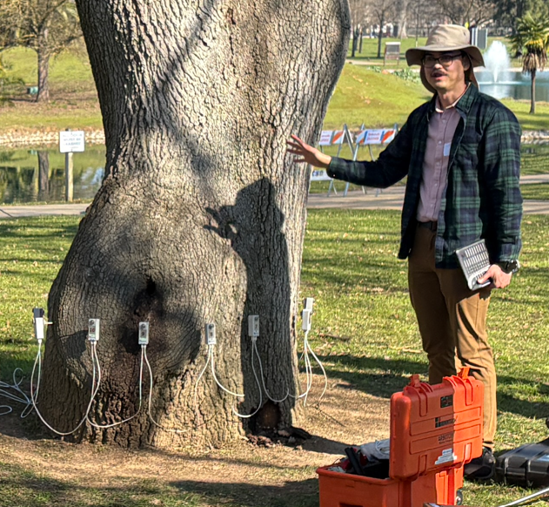
Levels of Assessment
Level 3 Advanced

Slide 135
Levels of Assessment
13.4.3: “Tree risk assessors shall not be required to assess trees other than those specified in the scope of work.”

Slide 136
Levels of Assessment
13.4.3: “Tree risk assessors shall not be required to assess trees other than those specified in the scope of work.”
13.4.4: “Tree risk assessors shall not be required to perform a higher level of assessment than specified in the scope of work.”

Slide 137
Levels of Assessment
13.4.3: “Tree risk assessors shall not be required to assess trees other than those specified in the scope of work.”
13.4.4: “Tree risk assessors shall not be required to perform a higher level of assessment than specified in the scope of work.”

Slide 138
Level I Tree Risk Assessment Report
Arboricultural Reports
Meets ASNI A300 Standard
Fulfills the Assignment
Clear
Concise
Professional
Actionable

Slide 139
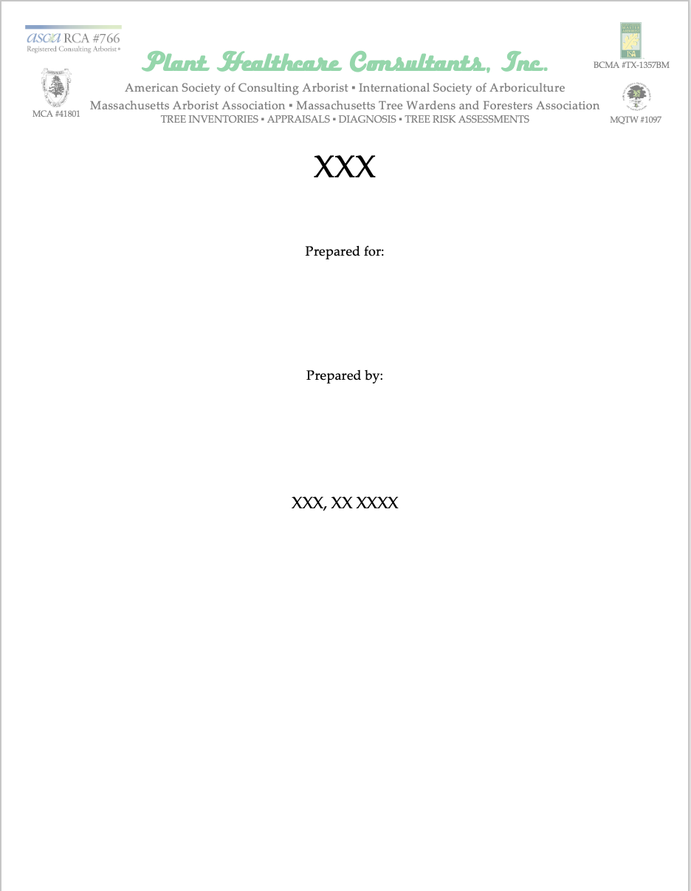
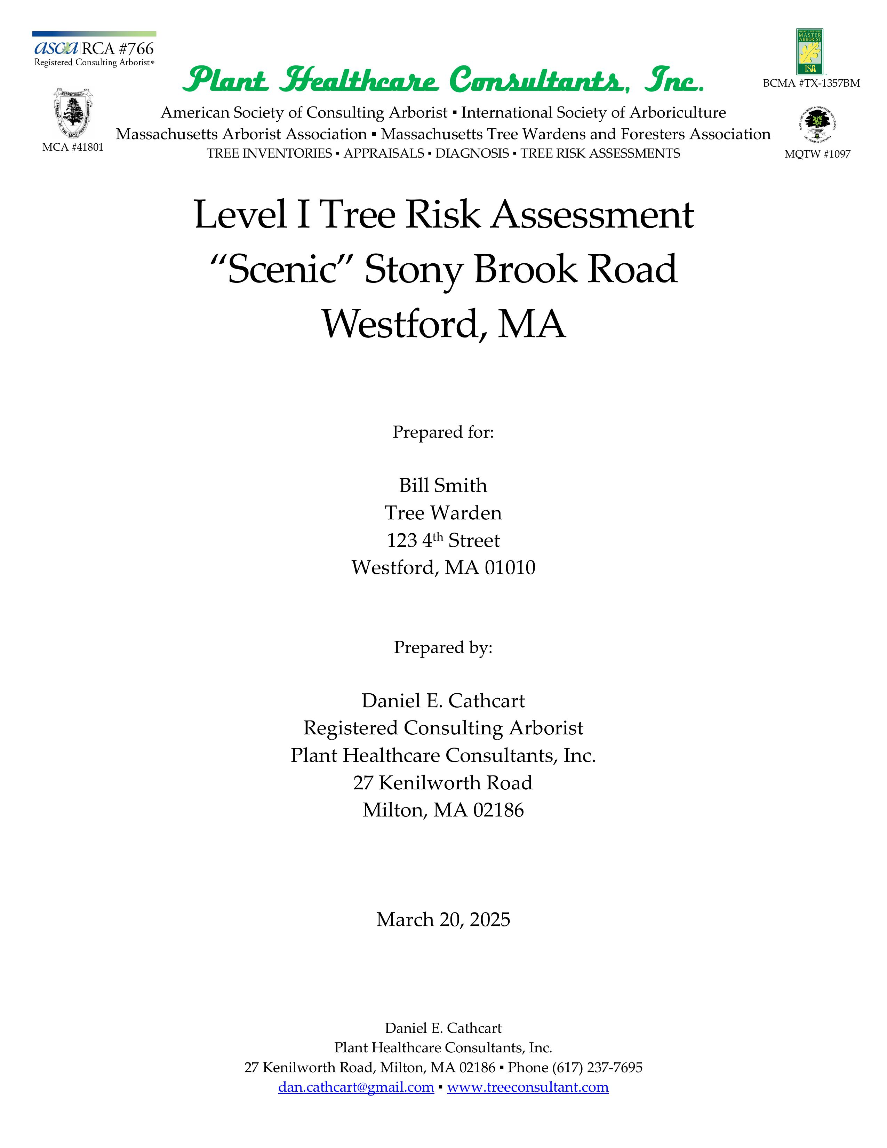

Slide 140
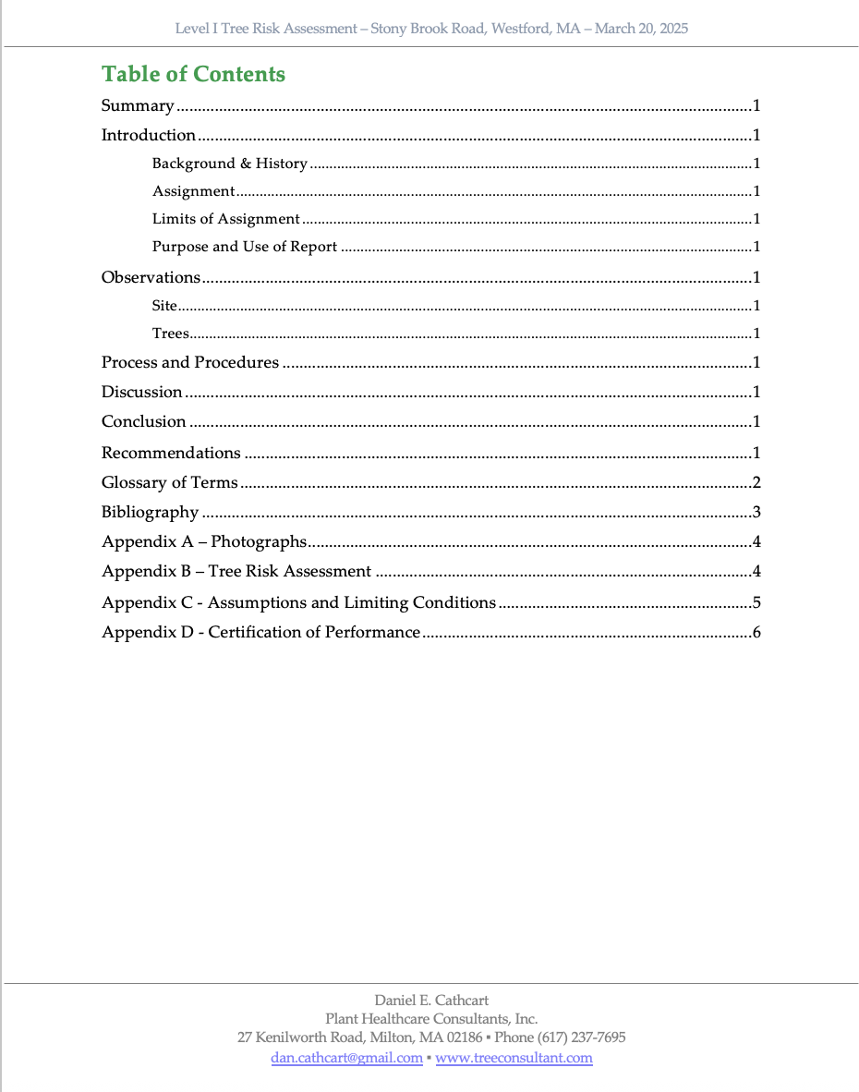

Slide 141
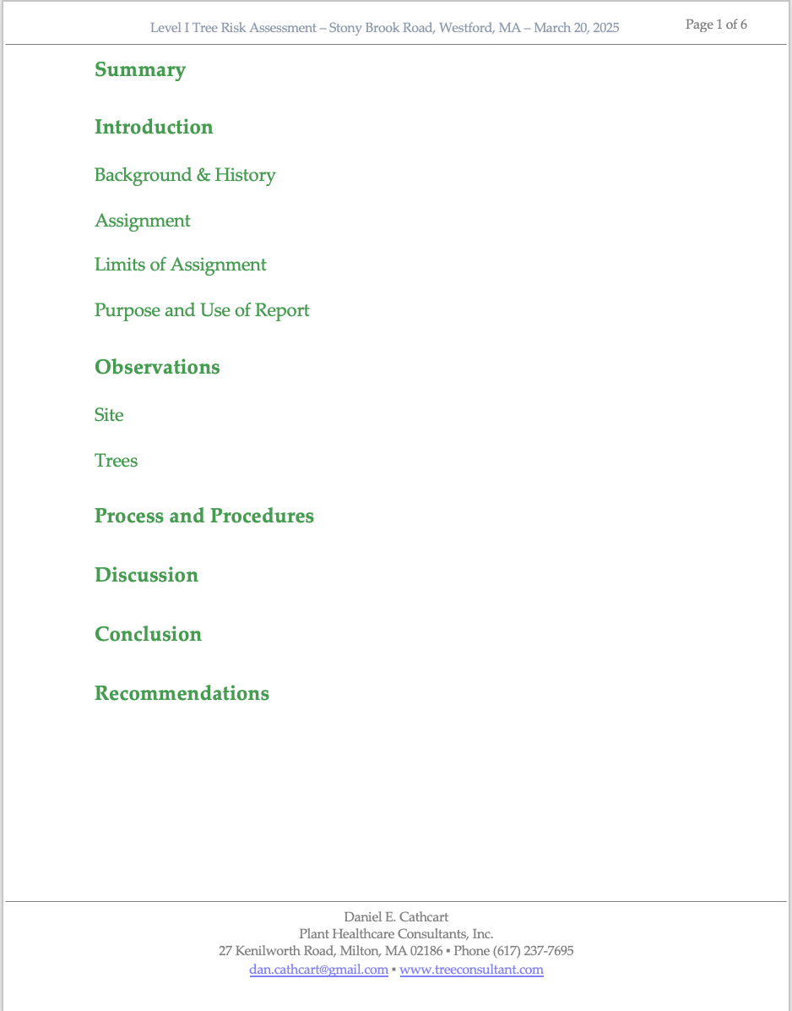
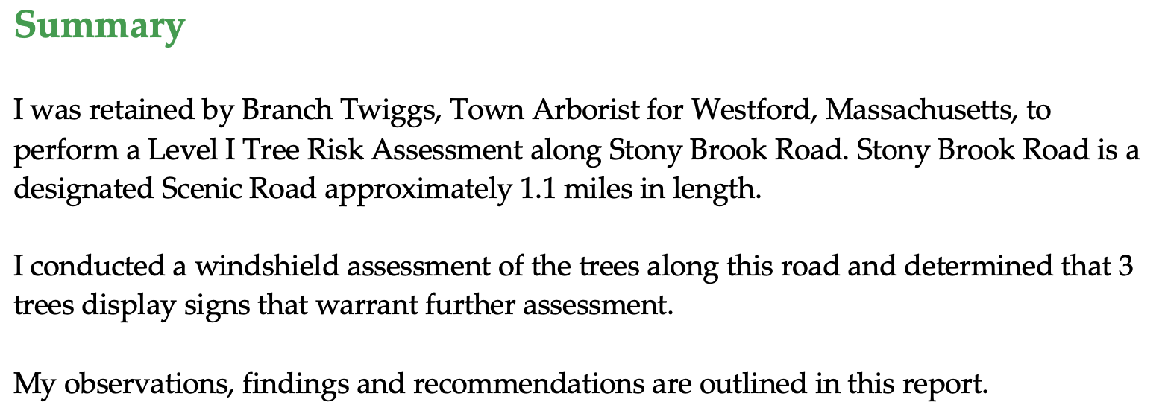

Slide 142
A300 Standards – Risk Assessment
13.6.3: “[Risk Assessment] reports shall include:
13.3.4: “The tree risk assessor shall consider the likelihood of a tree failure impacting a target and the likely severity of the consequence.”
  Objective
  Location
  Targets
  Date of Inspection
  Time Frame
  Risk Rating
  Risk Mitigation Options.”
✔️
✔️

Slide 143
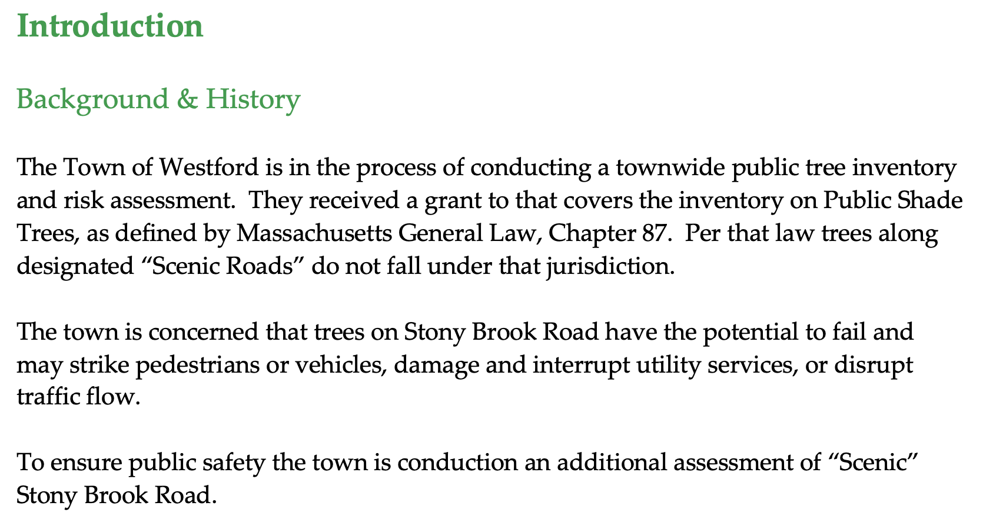

Slide 144
A300 Standards – Risk Assessment
13.6.3: “[Risk Assessment] reports shall include:
13.3.4: “The tree risk assessor shall consider the likelihood of a tree failure impacting a target and the likely severity of the consequence.”
  Objective
  Location
  Targets
  Date of Inspection
  Time Frame
  Risk Rating
  Risk Mitigation Options.”
✔️
✔️
✔️
✔️

Slide 145
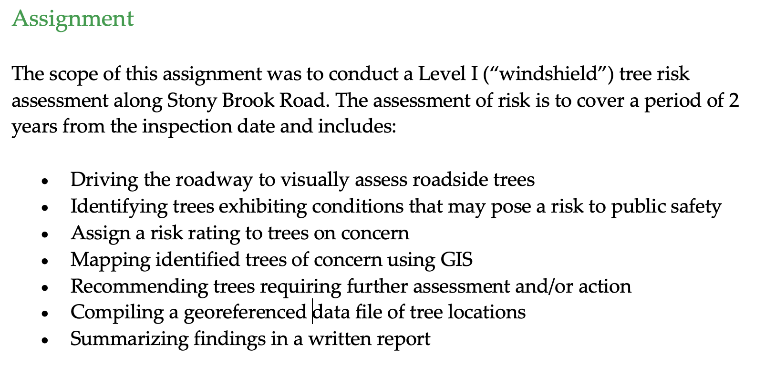

Slide 146
A300 Standards – Risk Assessment
13.6.3: “[Risk Assessment] reports shall include:
13.3.4: “The tree risk assessor shall consider the likelihood of a tree failure impacting a target and the likely severity of the consequence.”
  Objective
  Location
  Targets
  Date of Inspection
  Time Frame
  Risk Rating
  Risk Mitigation Options.”
✔️
✔️
✔️
✔️
✔️

Slide 147
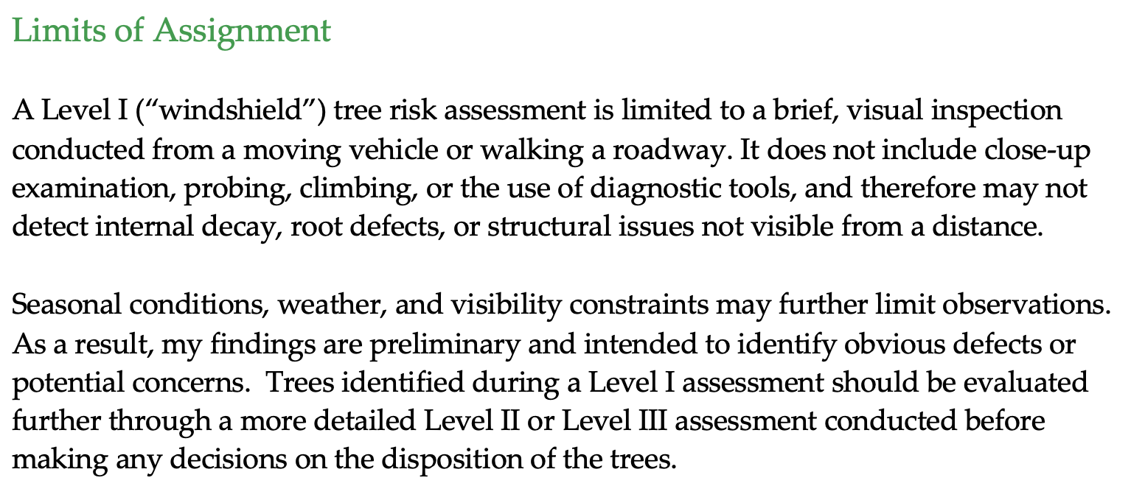

Slide 148
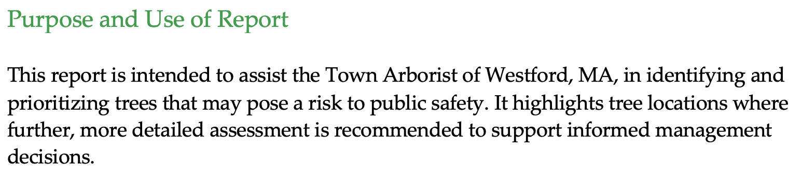

Slide 149
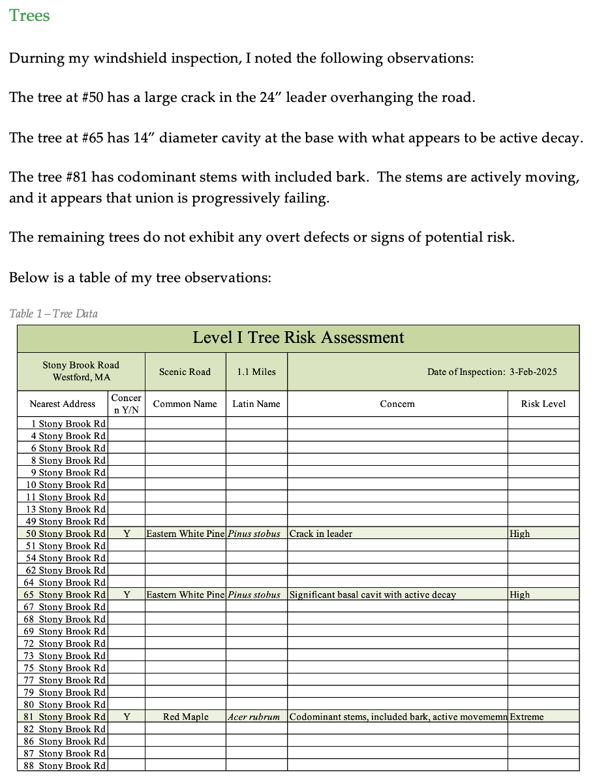
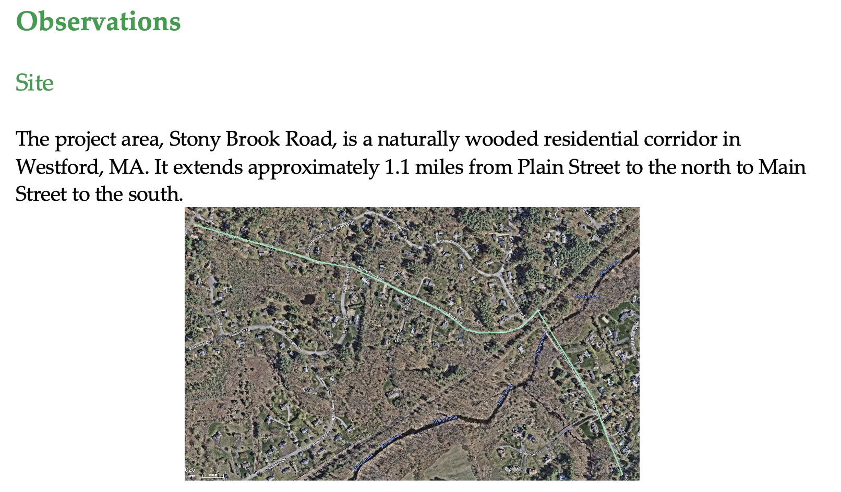

Slide 150
A300 Standards – Risk Assessment
13.6.3: “[Risk Assessment] reports shall include:
13.3.4: “The tree risk assessor shall consider the likelihood of a tree failure impacting a target and the likely severity of the consequence.”
  Objective
  Location
  Targets
  Date of Inspection
  Time Frame
  Risk Rating
  Risk Mitigation Options.”
✔️
✔️
✔️
✔️
✔️
✔️
✔️

Slide 151
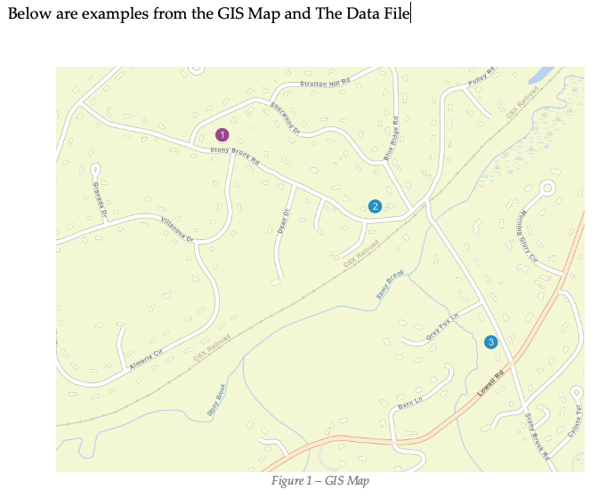
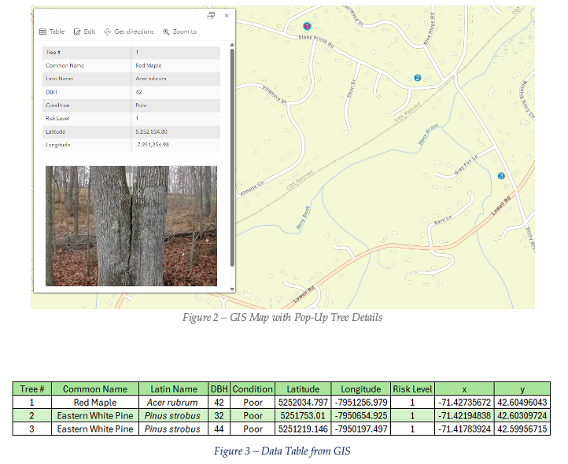
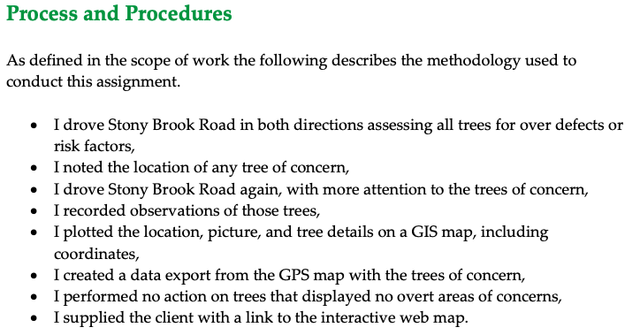

Slide 152


Slide 153
A300 Standards – Risk Assessment
13.6.3: “[Risk Assessment] reports shall include:
13.3.4: “The tree risk assessor shall consider the likelihood of a tree failure impacting a target and the likely severity of the consequence.”
  Objective
  Location
  Targets
  Date of Inspection
  Time Frame
  Risk Rating
  Risk Mitigation Options.”
✔️
✔️
✔️
✔️
✔️
✔️
✔️
✔️

Slide 154


Slide 155
A300 Standards – Risk Assessment
13.6.3: “[Risk Assessment] reports shall include:
13.3.4: “The tree risk assessor shall consider the likelihood of a tree failure impacting a target and the likely severity of the consequence.”
  Objective
  Location
  Targets
  Date of Inspection
  Time Frame
  Risk Rating
  Risk Mitigation Options.”
✔️
✔️
✔️
✔️
✔️
✔️
✔️
✔️
✔️

Slide 156


Slide 157














Slide 158
Case Illustrations in
Utility Vegetation Management Law

Slide 159

Alabama Power v. Ragland
406 So.2d 263 (AL Supr. Ct. 1981)
Notes:
1975 Bessemer, AL
Utility sent letter to Mr. Ragland of intent to cut trees. Mr. Ragland threatened to shoot anyone who came.
Despite attorney demand letters, utility came with sheriff anyway and cut 15 trees on Ragland’s property
Mr. Ragland’s forester determined trees “did not pose a concrete threat of injury” to the transmission lines (low risk).
Trees would withstand 80-mph winds, but not tornado winds of up to 300 mph.
Trees could be affected by pine beetles in the future.

Slide 160
Alabama Power v. Ragland
406 So.2d 263 (AL Supr. Ct. 1981)
“Danger Tree” = “any tree that would fall within five feet of the nearest conductor”
Likelihood of failure doesn’t matter

Slide 161
Alabama Power v. Ragland
406 So.2d 263 (AL Supr. Ct. 1981)
“the probability of a particular tree falling in a particular direction is not scientifically ascertainable”
“if AL Power has to make a tree-by-tree determination…based on the health of the tree and other arguable factors, the efficiency of tree-clearing operations will be substantially reduced and outages will probably increase”

Slide 162

Richardson v. PG&E
Case 24-09-006 (CA Pub. Util. Comm. 2026)
Notes:
CA Public Utilities Commission
2024 Sonoma County, CA
Charles Richardson lived on land that had been in his family for many years off PCH in NorCal.
Since 1953, land was burdened by utility easement for local drop. For decades, PG&E pruned trees to 15 radial feet of clearance.
February 7, 2024 after a major storm, PG&E cut down 308 trees along the lines that were tall enough to reach the lines.
Mr. Richardson sued for trespass. His arborist determined the cut trees were “low risk.” PG&E didn’t contradict this evidence.

Slide 163
Richardson v. PG&E
Case 24-09-006 (CA Pub. Util. Comm. 2026)
Local drop – only affects service to one property
Wet weather – no immediate fire risk
Historically pruned to 15’ radial clearance

Slide 164
Richardson v. PG&E
Case 24-09-006 (CA Pub. Util. Comm. 2026)
“Nothing in…the record supports as reasonable and necessary a standard that authorizes removal of any tree tall enough to fall upon the powerline. To find otherwise would grant utilities cart blanche to clearcut swaths of healthy trees in California’s forest lands based solely upon their height.”

Slide 165
Richardson v. PG&E
Case 24-09-006 (CA Pub. Util. Comm. 2026)
“PG&E argues that if a tree is tall enough that, were it to fall in the direction of a power line, it could strike or damage the line, the height alone is sufficient to justify the tree’s removal. That is not an ecologically, economically, or legally sound argument.”

Slide 166
Utility Vegetation Management Risk Assessment Report

Slide 167




Slide 168
A300 Standards – Risk Assessment
13.6.3: “[Risk Assessment] reports shall include:
13.3.4: “The tree risk assessor shall consider the likelihood of a tree failure impacting a target and the likely severity of the consequence.”
  Objective
  Location
  Targets
  Date of Inspection
  Time Frame
  Risk Rating
  Risk Mitigation Options.”
✔️
✔️
✔️
✔️

Slide 169





Slide 170
A300 Standards – Risk Assessment
13.6.3: “[Risk Assessment] reports shall include:
13.3.4: “The tree risk assessor shall consider the likelihood of a tree failure impacting a target and the likely severity of the consequence.”
  Objective
  Location
  Targets
  Date of Inspection
  Time Frame
  Risk Rating
  Risk Mitigation Options.”
✔️
✔️
✔️
✔️
✔️
✔️
✔️
✔️
✔️

Slide 171







Slide 172
Case Illustrations in Washington Tree Law

Slide 173

Lewis v. Krussel
101 Wn. App. 178 (2000 Ct. App.)
Notes:
1995 in Grey’s Harbor County
Dawn Lewis and Darold Teitzel expressed concern about safety of Krussel’s trees.
Gary Nancy Krussel said they would do something. They didn’t.
December 3, 1995 – windstorm

Slide 174

Lewis v. Krussel
101 Wn. App. 178 (2000 Ct. App.)
Notes:
2 large healthy hemlock trees fell on the home of Dawn Lewis and Darold Teitzel

Slide 175

Lewis v. Krussel
101 Wn. App. 178 (2000 Ct. App.)
Notes:
Then a THIRD tree fell on Krussel’s house
Krussels admit:
(1) other trees had fallen on his property
(2) He would have his mother stay elsewhere during windstorms

Slide 176
Lewis v. Krussel
101 Wn. App. 178 (2000 Ct. App.)
π Evidence
Hemlock trees are inherently prone to toppling over
π complained to Δ about tree risk

Slide 177
Lewis v. Krussel
101 Wn. App. 178 (2000 Ct. App.)
π Evidence
Δ Evidence
Hemlock trees are inherently prone to toppling over
π complained to Δ about tree risk
No evidence of rot or disease in the stump
Trees that fell appeared no more dangerous than any other standing tree

Slide 178
Lewis v. Krussel
101 Wn. App. 178 (2000 Ct. App.)
“the landowner is under no duty to consistently and constantly check for defects.”
“The alleged defect must be readily observable…”

Slide 179
Lewis v. Krussel
101 Wn. App. 178 (2000 Ct. App.)
“the landowner is under no duty to consistently and constantly check for defects.”
“The alleged defect must be readily observable…”
NO DUTY to remove healthy trees “merely because the wind might knock them down.”

Slide 180
Lewis v. Krussel
101 Wn. App. 178 (2000 Ct. App.)
“the landowner is under no duty to consistently and constantly check for defects.”
“The alleged defect must be readily observable…”
NO DUTY to remove healthy trees “merely because the wind might knock them down.”
“cannot rely on…bare allegations as to the alleged vulnerability of hemlock trees”

Slide 181

Thompson v. Dale
92 Wash.App. 1022 (1998 Ct. App.)
Notes:
Snohomish County Vacation Home in the forest
1992: upper half of trunk of NATURALLY-OCCURRING tree fell onto DALE’S house
THOMPSON asked for dale to remove the tree

Slide 182

Thompson v. Dale
92 Wash.App. 1022 (1998 Ct. App.)
Notes:
1992: upper half of trunk fell onto DALE’S house
THOMPSON asked for dale to remove the tree
1994: Thompson’s logger recommended removal of Dale’s tree

Slide 183

Thompson v. Dale
92 Wash.App. 1022 (1998 Ct. App.)
Notes:
Late 1994: tree fell on Thompson’s house

Slide 184
Thompson v. Dale
92 Wash.App. 1022 (1998 Ct. App.)
“Where the landowner has notice that a tree is dangerous and fails to take steps to make it safe, liability in negligence will lie.”

Slide 185
Thompson v. Dale
92 Wash.App. 1022 (1998 Ct. App.)
“Where the landowner has notice that a tree is dangerous and fails to take steps to make it safe, liability in negligence will lie.”
EVEN IF the tree is naturally occurring

Slide 186
Thompson v. Dale
92 Wash.App. 1022 (1998 Ct. App.)
“Where the landowner has notice that a tree is dangerous and fails to take steps to make it safe, liability in negligence will lie.”
EVEN IF the tree is naturally occurring
  WA does NOT follow out-of-state authority for “natural condition immunity”
Notes:
Refuses to follow Restatement 2nd Torts Section 363

Slide 187

Evans v. Spokane County
15 Wash.App.2d 1011 (2020 Ct. App.)
Notes:
July 23, 2014 – Severe windstorm
Carlton Evans was driving towards Chattaroy on E. Big Meadows Road

Slide 188

Evans v. Spokane County
15 Wash.App.2d 1011 (2020 Ct. App.)
Notes:
July 23, 2014 – Severe windstorm
Carlton Evans was driving towards Chattaroy on E. Big Meadows Road
80-90 foot Ponderosa pine fell on his car, impaling him and severing his left hand.
He survived.
Jury instructions that “no liab. if no reason to know THIS tree would fail” and “act of god”

Slide 189
Evans v. Spokane County
15 Wash.App.2d 1011 (2020 Ct. App.)
“Act of God”: “natural phenomenon…so far outside the range of human experience that ordinary care did not require that it should be anticipated”
“…it is not sufficient that such phenomena are unusual or of rare occurrence.”

Slide 190
Evans v. Spokane County
15 Wash.App.2d 1011 (2020 Ct. App.)
“…the fact that harm is brought about through the intervention of another force does not relieve the actor of liability.”
“…the risk that a diseased tree would snap in strong winds was within the ambit of the hazards covered by the County’s duty.”

Slide 191
Evans v. Spokane County
15 Wash.App.2d 1011 (2020 Ct. App.)
“there is no duty to consistently and constantly check…for non-visible rot.”
“…decay must be visible, apparent, and patent…”

Slide 192
Evans v. Spokane County
15 Wash.App.2d 1011 (2020 Ct. App.)
“there is no duty to consistently and constantly check…for non-visible rot.”
“…decay must be visible, apparent, and patent…”
FOR A LAYPERSON

Slide 193
Evans v. Spokane County
15 Wash.App.2d 1011 (2020 Ct. App.)
“there is no duty to consistently and constantly check…for non-visible rot.”
“…decay must be visible, apparent, and patent…”
FOR A LAYPERSON
But “…for those who have acquired knowledge beyond that of an ordinary person in the course of their work, the law will demand conduct consistent with that acquired knowledge.“

Slide 194
Polish & Shine

Slide 195
Polish & Shine
  Clear, Unambiguous, and Usable

Slide 196
Polish & Shine
  Clear, Unambiguous, and Usable
  Have clarity

Slide 197
Polish & Shine
  Clear, Unambiguous, and Usable
  Have clarity
  Be accurate

Slide 198
Polish & Shine
  Clear, Unambiguous, and Usable
  Have clarity
  Be accurate
  Be readable

Slide 199
Polish & Shine
  Clear, Unambiguous, and Usable
  Have clarity
  Be accurate
  Be readable
  Be simple to understand

Slide 200
    CONCLUSION

