Slide 1
Battle of the Branches:
Key Rulings Illustrating Louisiana Tree Law
James Komen
BCMA #WE-9909B
RCA #555
Notes:
Total Cases: 19 (+4)
Risk Assessments: 6 (+1)
Self-Help: 5
Valuation: 5 (+2)
Urban Forestry: 3 (+1)

Slide 2
Risk Assessments and Acts of God
Gibbs v. Tourres 50 So. 2d 652 (La. Ct. App. 1951)
Greene v. Fox Crossing Inc. 754 So. 2d 339 (La. Ct. App. 2000)
Rector v. Hartford Acci. & Indem. Co. 120 So. 2d 511 (La. Ct. App. 1960)
Kirsch v. Kappa Alpha Order 373 So. 2d 775 (La. Ct. App. 1979)
Walker v. Dept. of Transp. & Dev. 460 So. 2d 1132 (La. Ct. App. 1984)
Brown v. Williams 850 So. 2d 1116 (La. Ct. App. 2003)
Lewis v. State ex rel. Department of Transp. & Dev.
654 So. 2d 311 (La. 1995)
Notes:
6 cases
+1 supplemental

Slide 3
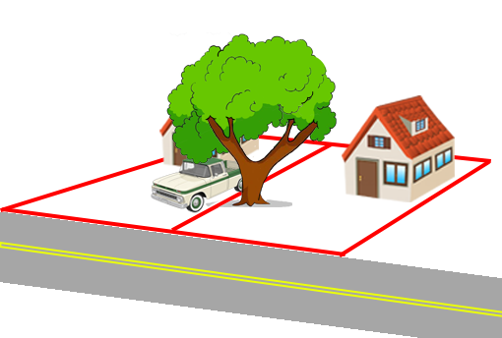
Gibbs v. Tourres
50 So. 2d 652 (La. Ct. App. 1951)
Notes:
THIS SIMPLE CASE INTRODUCES THE TOPIC
LA Ct. App. 1951
John Gibbs and Marguerite Tourres owned neighboring homes in Natchitoches. Gibbs owned a 1947 model panel-body Ford truck that he parked in his driveway along the property line.
On the Tourres side was a large tree. A large limb extended over Gibbs’ driveway where he parked his truck. Gibbs complained to Tourres about the overhanging limb and even got a bid to remove it.
Turns out the arborist had approached Marguerite on another occasion and offered to remove the tree for a nominal cost so he could use the wood. She had declined then.
Upon second inspection, the arborist observed a large concealed cavity. He increased his bid because the large decay meant the tree was not useful as wood. Again, Tourres refused to remove the tree.
June 9, 1948: a large storm caused the tree’s limb to fall and crush Gibbs’ truck.

Slide 4
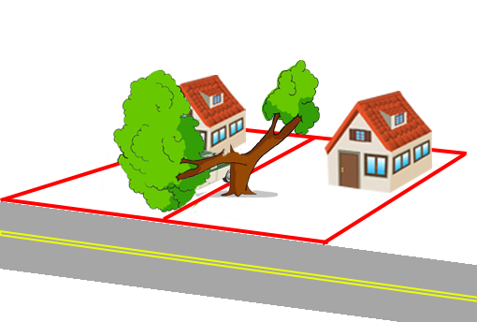
Gibbs v. Tourres
50 So. 2d 652 (La. Ct. App. 1951)
Notes:
LA Ct. App. 1951
John Gibbs and Marguerite Tourres owned neighboring homes in Natchitoches. Gibbs owned a 1947 model panel-body Ford truck that he parked in his driveway along the property line.
On the Tourres side was a large tree. A large limb extended over Gibbs’ driveway where he parked his truck. Gibbs complained to Tourres about the overhanging limb and even got a bid to remove it.
Turns out the arborist had approached Marguerite on another occasion and offered to remove the tree for a nominal cost so he could use the wood. She had declined then.
Upon second inspection, the arborist observed a large concealed cavity. He increased his bid because the large decay meant the tree was not useful as wood. Again, Tourres refused to remove the tree.
June 9, 1948: a large storm caused the tree’s limb to fall and crush Gibbs’ truck.
Trial court found Tourres was negligent. Tourres appealed. Affirmed.

Slide 5
Gibbs v. Tourres
50 So. 2d 652 (La. Ct. App. 1951)
“one is not responsible for unforeseen and improbable results”

Slide 6
Gibbs v. Tourres
50 So. 2d 652 (La. Ct. App. 1951)
“one is not responsible for unforeseen and improbable results”
HOWEVER
“there was some element of danger involved which was brought to the attention of [Tourres]”

Slide 7
Gibbs v. Tourres
50 So. 2d 652 (La. Ct. App. 1951)
“one is not responsible for unforeseen and improbable results”
HOWEVER
“there was some element of danger involved which was brought to the attention of [Tourres]”
“even though it was not apparent nor obvious, certainly [Tourres was] guilty of negligence”

Slide 8
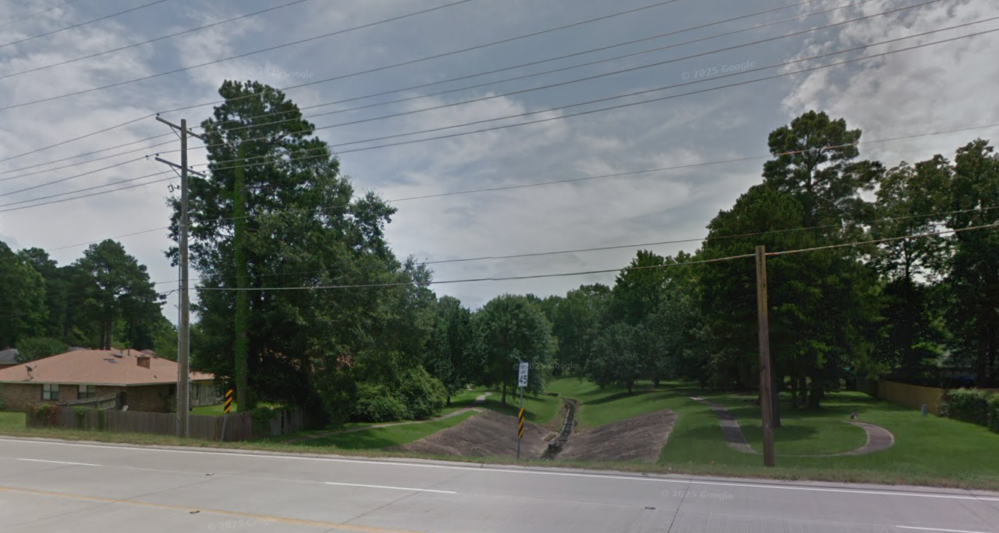
Greene v. Fox Crossing Inc.
754 So. 2d 339 (La. Ct. App. 2000)
Notes:
THIS CASE INTRODUCES CIV CODE 2317 AND ACTS OF GOD
LA Ct. App. 2000
Charles Green lived in Fox Crossing HOA, southwest of Shreveport
August 23, 1993, Green took a late-night walk in an HOA common area. He sat down on a swing. A dead branch fell from an oak tree and injured him.
Trial court found for Green. Fox Crossing appealed.
Was Fox Crossing Negligent?
Was this an Act of God?

Slide 9

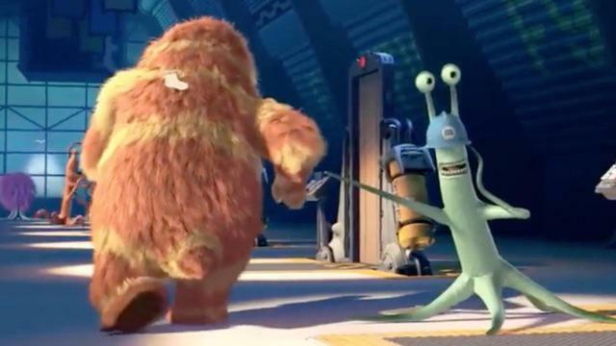
Greene v. Fox Crossing Inc.
754 So. 2d 339 (La. Ct. App. 2000)
LA C.C. Art 2317: “We are responsible…for that which is caused by the things which we have in our custody.”
  Vice or Defect
  Unreasonable Risk of Harm
  Custody
  Causation
LA Civ. Code
2317
Notes:
LA CIV CODE 2317 is VERY IMPORTANT.
It will come up multiple times in this lecture.

Slide 10
Greene v. Fox Crossing Inc.
754 So. 2d 339 (La. Ct. App. 2000)
“Unreasonable Risk of Harm” Factors
  Probability
  Consequences
  Burden of Precautions
  Social Priorities
  Degree of Culpability
  Economic Abilities
  Relationship to Instrumentality
  Foreseeability
  Location of Incident
  Victim’s Assumption of Risk

Slide 11
Greene v. Fox Crossing Inc.
754 So. 2d 339 (La. Ct. App. 2000)
“Unreasonable Risk of Harm” Factors
  Probability
  Consequences
  Burden of Precautions
  Social Priorities
  Degree of Culpability
  Economic Abilities
  Relationship to Instrumentality
  Foreseeability
  Location of Incident
  Victim’s Assumption of Risk

Slide 12
Greene v. Fox Crossing Inc.
754 So. 2d 339 (La. Ct. App. 2000)
“…everything in life comes with some degree of risk…”

Slide 13
Greene v. Fox Crossing Inc.
754 So. 2d 339 (La. Ct. App. 2000)
“…everything in life comes with some degree of risk…”
HOWEVER

Slide 14
Greene v. Fox Crossing Inc.
754 So. 2d 339 (La. Ct. App. 2000)
“…everything in life comes with some degree of risk…”
HOWEVER
“the limb had been dead for at least one year.”

Slide 15
Greene v. Fox Crossing Inc.
754 So. 2d 339 (La. Ct. App. 2000)
“…everything in life comes with some degree of risk…”
HOWEVER
“the limb had been dead for at least one year.”
“even a cursory, periodic inspection by grounds keepers would have identified the dead limb, which could have been removed at negligible cost.”

Slide 16
Greene v. Fox Crossing Inc.
754 So. 2d 339 (La. Ct. App. 2000)
“Act of God”

Slide 17
Greene v. Fox Crossing Inc.
754 So. 2d 339 (La. Ct. App. 2000)
“Act of God”
  “irresistible force…sufficient to excuse a defendant’s neglect of a duty and relieve him of liability”

Slide 18
Greene v. Fox Crossing Inc.
754 So. 2d 339 (La. Ct. App. 2000)
“Act of God”
  “irresistible force…sufficient to excuse a defendant’s neglect of a duty and relieve him of liability”
  “injury due directly and exclusively to natural causes which could not have been prevented by the exercise of reasonable care and foresight”

Slide 19
Greene v. Fox Crossing Inc.
754 So. 2d 339 (La. Ct. App. 2000)
“Act of God”
  “irresistible force…sufficient to excuse a defendant’s neglect of a duty and relieve him of liability”
  “injury due directly and exclusively to natural causes which could not have been prevented by the exercise of reasonable care and foresight”

Slide 20
Greene v. Fox Crossing Inc.
754 So. 2d 339 (La. Ct. App. 2000)
“Act of God”
  “irresistible force…sufficient to excuse a defendant’s neglect of a duty and relieve him of liability”
  “injury due directly and exclusively to natural causes which could not have been prevented by the exercise of reasonable care and foresight”

Slide 21
Greene v. Fox Crossing Inc.
754 So. 2d 339 (La. Ct. App. 2000)
“Act of God”
  “irresistible force…sufficient to excuse a defendant’s neglect of a duty and relieve him of liability”
  “injury due directly and exclusively to natural causes which could not have been prevented by the exercise of reasonable care and foresight”
“the dead limb’s falling could have been foreseen and…the damaging effects of the fall could have been avoided by the exercise of reasonable care and foresight”

Slide 22
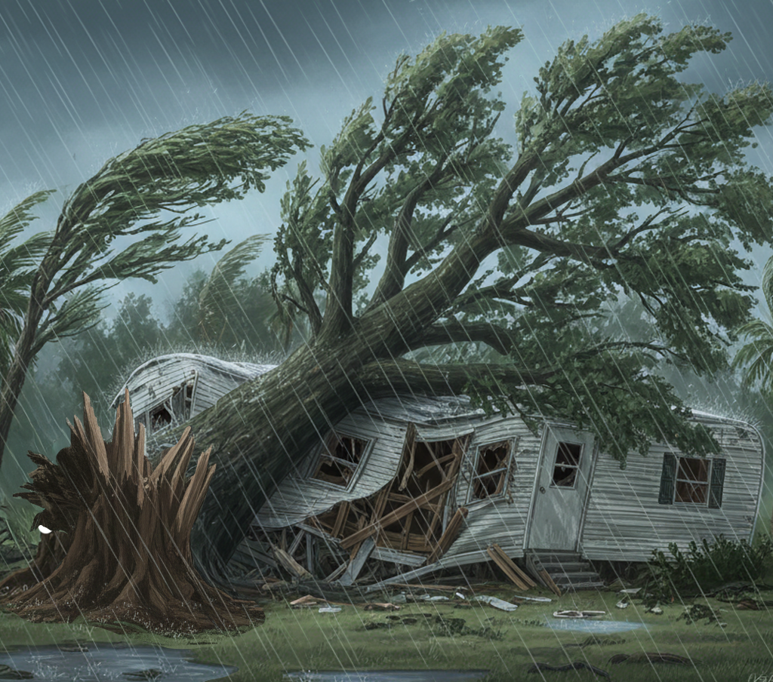
Rector v. Hartford Acci. & Indem. Co.
120 So. 2d 511 (La. Ct. App. 1960)
Notes:
LA Ct. App. 1960
Kenneth Rector lived at the Twin Cedar Trailer Park
November 18, 1957 at 11:30am, 2-3 ft elm tree fell over and crushed his trailer – while he was inside.

Slide 23
Rector v. Hartford Acci. & Indem. Co.
120 So. 2d 511 (La. Ct. App. 1960)
Tree was outwardly healthy
Broke at base by splintering
Large internal cavity not outwardly visible
Drilling would have been necessary to determine extent of decay
Both arborists would have recommended removal if they had inspected tree before failure
Other nearby trees had defects
Notes:
Jury Verdict for Rector, Hartford appealed.
WAS THIS AN ACT OF GOD?

Slide 24
Rector v. Hartford Acci. & Indem. Co.
120 So. 2d 511 (La. Ct. App. 1960)
“Act of God” = “unusual, extraordinary, sudden and unexpected manifestation of the forces of nature which cannot be prevented by human care, skill or foresight”

Slide 25
Rector v. Hartford Acci. & Indem. Co.
120 So. 2d 511 (La. Ct. App. 1960)
“Act of God” = “unusual, extraordinary, sudden and unexpected manifestation of the forces of nature which cannot be prevented by human care, skill or foresight”
BUT
“when an Act of God combines or concurs with the negligence of the defendant to produce an injury, the defendant is liable”

Slide 26
Rector v. Hartford Acci. & Indem. Co.
120 So. 2d 511 (La. Ct. App. 1960)
“had the tree been blown down because of its defective condition it would not have been twisted in splinters”
“the wind which blew this tree down…was of sufficient velocity and violence so that when it struck a tree, whether sound or defective,…it twisted it off”

Slide 27
Rector v. Hartford Acci. & Indem. Co.
120 So. 2d 511 (La. Ct. App. 1960)
“There was no reason…to believe different from every other resident of the trailer park who had observed this tree and thought that it was sound and healthy”

Slide 28
Rector v. Hartford Acci. & Indem. Co.
120 So. 2d 511 (La. Ct. App. 1960)
“There was no reason…to believe different from every other resident of the trailer park who had observed this tree and thought that it was sound and healthy”
“damage…was caused herein by an Act of God in the legal sense”

Slide 29
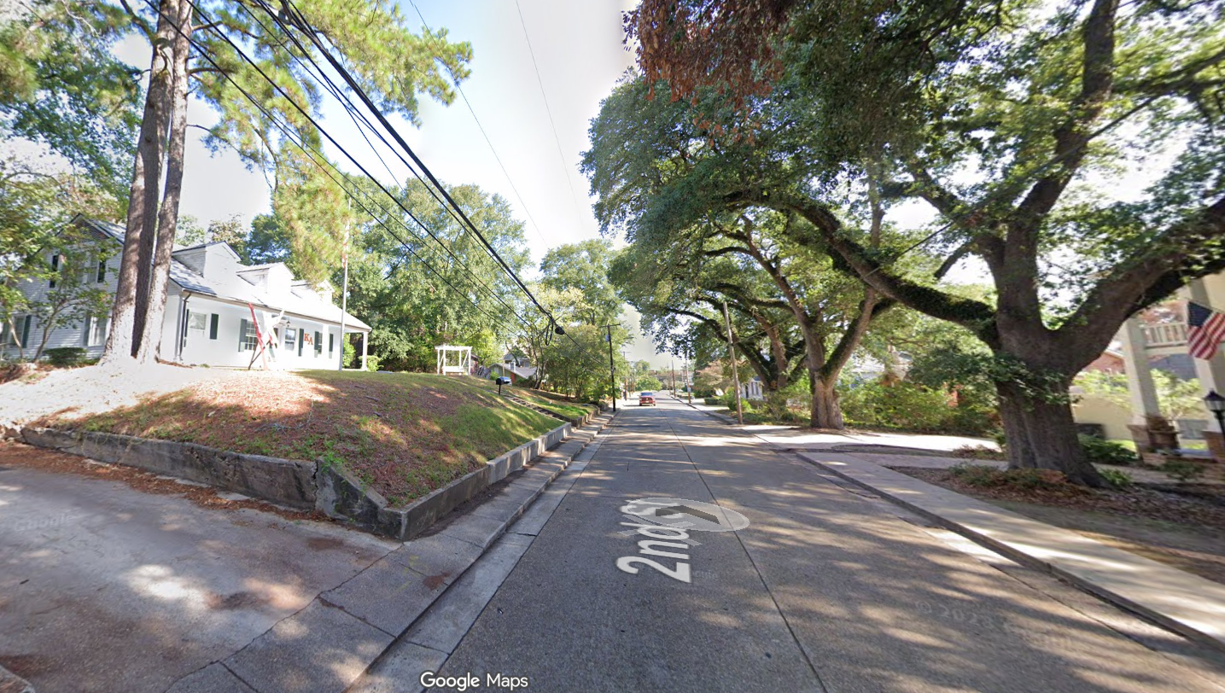
Kirsch v. Kappa Alpha Order
373 So. 2d 775 (La. Ct. App. 1979)
Notes:
LA Ct. App. 1979
Charles Kirsch owned property with two live oak trees across the street from the Kappa Alpha Order on 2nd St. in Natchitoches.
March 27, 1977, in a violent storm, a large tree on Kappa Alpha’s property fell and crushed Kirsch’s trees.
Tree was not dead or diseased. No complaints had ever been made by anybody that the tree was dangerous.
Trial court dismissed case as Act of God. Kirsch appealed. Affirmed.

Slide 30
Kirsch v. Kappa Alpha Order
373 So. 2d 775 (La. Ct. App. 1979)
LA C.C. Art 2317: “We are responsible…for that which is caused by the things which we have in our custody.”
  Vice or Defect
  Unreasonable Risk of Harm
  Custody
  Causation

Slide 31
Kirsch v. Kappa Alpha Order
373 So. 2d 775 (La. Ct. App. 1979)
LA C.C. Art 2317 is NOT APPLICABLE

Slide 32
Kirsch v. Kappa Alpha Order
373 So. 2d 775 (La. Ct. App. 1979)
LA C.C. Art 2317 is NOT APPLICABLE
  No “vice or defect”

Slide 33
Kirsch v. Kappa Alpha Order
373 So. 2d 775 (La. Ct. App. 1979)
LA C.C. Art 2317 is NOT APPLICABLE
  No “vice or defect”
  AND “tree fell as the result of a reasonably unforeseeable violent manifestation of nature, which…caused the damage independent of any defect in the tree” (Act of God)
Notes:
CONTRAST WITH PENNSYLVANIA CASE – tree on steep slope CAN BE a condition

Slide 34
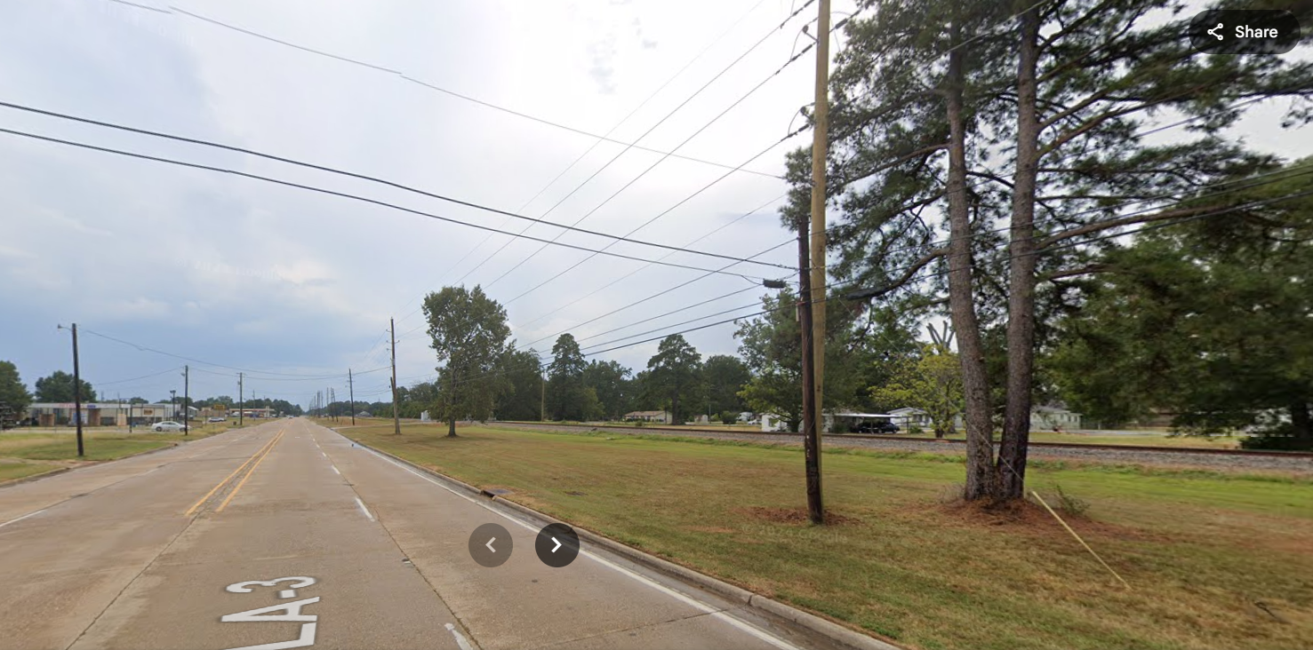
Walker v. Dept. of Transp. & Dev.
460 So. 2d 1132 (La. Ct. App. 1984)
Notes:
LA Ct. App. 1984
January 1, 1979 at 5:30am, Shelly Walker and her brother James Carr were traveling south on Hwy 3 (Benton Rd) in Bossier Parish. Carr was taking Walker to work.
Severe ice storm.
Old cottonwood tree on RR ROW fell across Hwy. 30 min later, car crashed into it, killing Walker.
Walker’s expert Henry Bango, consulting forester, inspected stump 18 months after accident.
Tree had heart rot. Upon careful examination, there was evidence of fire damage on the stump, which may have contributed to root rot and uprooting.
Trial court dismissed case against DOTD, Walker’s estate appealed.

Slide 35
Walker v. Dept. of Transp. & Dev.
460 So. 2d 1132 (La. Ct. App. 1984)
LA C.C. Art 2317: “We are responsible…for that which is caused by the things which we have in our custody.”
  Vice or Defect
  Unreasonable Risk of Harm
  Custody
  Causation

Slide 36
Walker v. Dept. of Transp. & Dev.
460 So. 2d 1132 (La. Ct. App. 1984)
“[The tree] did not become part of the highway. It was not a defect IN the highway which was under control of the DOTD.”

Slide 37
Walker v. Dept. of Transp. & Dev.
460 So. 2d 1132 (La. Ct. App. 1984)
“[The tree] did not become part of the highway. It was not a defect IN the highway which was under control of the DOTD.”

Slide 38
Walker v. Dept. of Transp. & Dev.
460 So. 2d 1132 (La. Ct. App. 1984)
“[The tree] did not become part of the highway. It was not a defect IN the highway which was under control of the DOTD.”
LA C.C. 2317 is NOT APPLICABLE

Slide 39
Walker v. Dept. of Transp. & Dev.
460 So. 2d 1132 (La. Ct. App. 1984)
“DOTD is not required to make a minute examination of the base of every tree along its right-of-way.”

Slide 40
Walker v. Dept. of Transp. & Dev.
460 So. 2d 1132 (La. Ct. App. 1984)
“DOTD is not required to make a minute examination of the base of every tree along its right-of-way.”
“The duty of DOTD is to observe and remove trees that are dead or leaning or otherwise appear defective by general observation.”

Slide 41
Walker v. Dept. of Transp. & Dev.
460 So. 2d 1132 (La. Ct. App. 1984)
“DOTD is not required to make a minute examination of the base of every tree along its right-of-way.”
“The duty of DOTD is to observe and remove trees that are dead or leaning or otherwise appear defective by general observation.”

Slide 42
Walker v. Dept. of Transp. & Dev.
460 So. 2d 1132 (La. Ct. App. 1984)
“DOTD is not required to make a minute examination of the base of every tree along its right-of-way.”
“The duty of DOTD is to observe and remove trees that are dead or leaning or otherwise appear defective by general observation.”
“It would be an impossible task to carefully inspect every tree on property adjacent to the highway right-of-way”

Slide 43
Brown v. Williams
850 So. 2d 1116 (La. Ct. App. 2003)

Slide 44
Brown v. Williams
850 So. 2d 1116 (La. Ct. App. 2003)
LA C.C. Art 2317: “We are responsible…for that which is caused by the things which we have in our custody.”
  Vice or Defect
  Unreasonable Risk of Harm
  Custody
  Causation

Slide 45
Brown v. Williams
850 So. 2d 1116 (La. Ct. App. 2003)
LA C.C. Art 2317.1
Effective April 16, 1996

Slide 46
Brown v. Williams
850 So. 2d 1116 (La. Ct. App. 2003)
LA C.C. Art 2317.1: “The…custodian…of a thing is answerable for damage…only upon a showing:
Effective April 16, 1996

Slide 47
Brown v. Williams
850 So. 2d 1116 (La. Ct. App. 2003)
LA C.C. Art 2317.1: “The…custodian…of a thing is answerable for damage…only upon a showing:
  that he knew or…should have known of the… defect which caused the damage,
Effective April 16, 1996

Slide 48
Brown v. Williams
850 So. 2d 1116 (La. Ct. App. 2003)
LA C.C. Art 2317.1: “The…custodian…of a thing is answerable for damage…only upon a showing:
  that he knew or…should have known of the… defect which caused the damage,
  that the damage could have been prevented by the exercise of reasonable care, and
Effective April 16, 1996

Slide 49
Brown v. Williams
850 So. 2d 1116 (La. Ct. App. 2003)
LA C.C. Art 2317.1: “The…custodian…of a thing is answerable for damage…only upon a showing:
  that he knew or…should have known of the… defect which caused the damage,
  that the damage could have been prevented by the exercise of reasonable care, and
  that he failed to exercise such reasonable care.”
Effective April 16, 1996

Slide 50
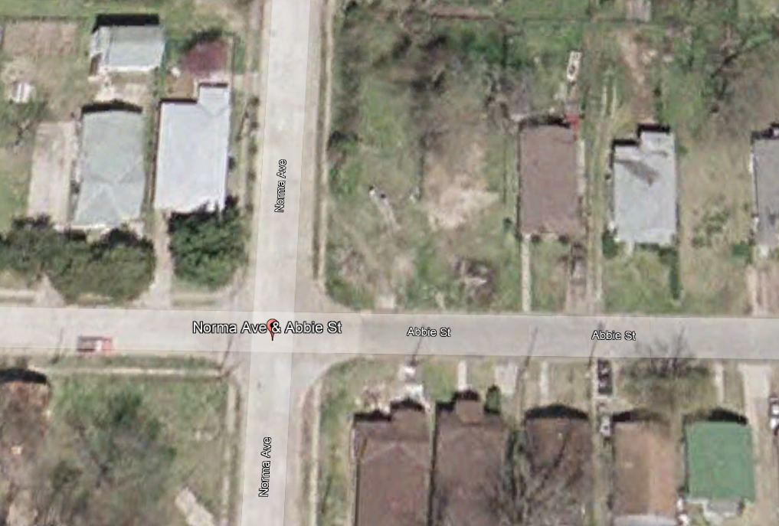
Brown v. Williams
850 So. 2d 1116 (La. Ct. App. 2003)
Notes:
LA Ct. App. 2003
Theresa Brown and Barbara Williams owned neighboring homes in Shreveport at the corner of Norma and Abbie Streets
Easter Sunday, April 23, 2000: an F-1 TORNADO passed through Shreveport.
The Williams oak tree snapped 4ft above grade, demolishing Brown’s home
Plaintiff’s arborist Rick Kilpatrick testified tree had “heart rot” that cause failure
Defense arborist Curtis Lambert testified high winds caused failure
Trial court held tree would have survived storm but-for the heart rot.
Trial court found Willaims negligent. Williams appealed.

Slide 51
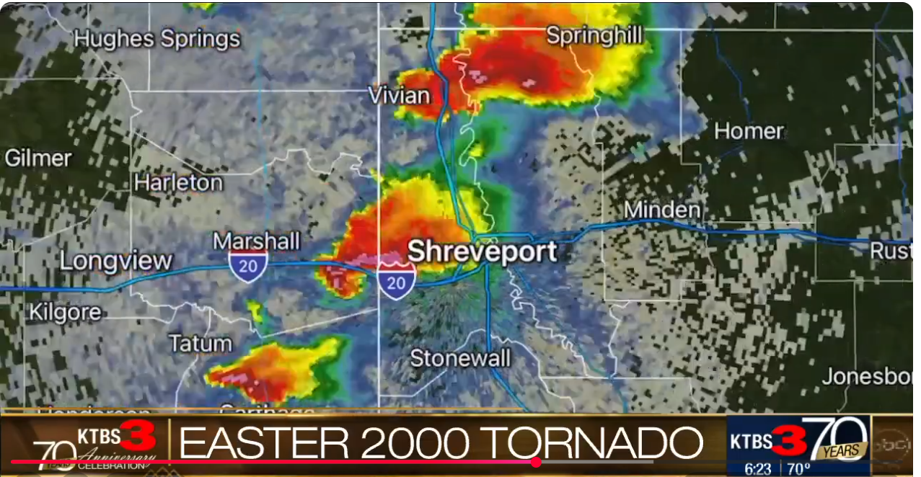
Brown v. Williams
850 So. 2d 1116 (La. Ct. App. 2003)
Notes:
LA Ct. App. 2003
Theresa Brown and Barbara Williams owned neighboring homes in Shreveport at the corner of Norma and Abbie Streets
Easter Sunday, April 23, 2000: an F-1 TORNADO passed through Shreveport.
The Williams oak tree snapped 4ft above grade, demolishing Brown’s home
Plaintiff’s arborist Rick Kilpatrick testified tree had “heart rot” that cause failure
Defense arborist Curtis Lambert testified high winds caused failure
Trial court held tree would have survived storm but-for the heart rot.
Trial court found Willaims negligent. Williams appealed.

Slide 52

Brown v. Williams
850 So. 2d 1116 (La. Ct. App. 2003)
Brown’s Evidence
Williams’ Evidence
Tree had “heart rot”
Tree broke above grade
Williams had NEVER hired a tree service to perform work on the tree
A large branch broke 10 years ago
Didn’t know of any defect or problem
Only 19% of cross-sectional area decayed
Meteorologist: tree would have failed regardless of decay
Notes:
LA Ct. App. 2003
Theresa Brown and Barbara Williams owned neighboring homes in Shreveport
Easter Sunday, April 23, 2000: an F-1 TORNADO passed through Shreveport.
The Williams oak tree snapped 4ft above grade, demolishing Brown’s home
Plaintiff’s arborist Rick Kilpatrick testified tree had “heart rot” that cause failure
Defense arborist Curtis Lambert testified high winds caused failure
Trial court held tree would have survived storm but-for the heart rot.
Trial court found Willaims negligent. Williams appealed. AFFIRMED

Slide 53
Brown v. Williams
850 So. 2d 1116 (La. Ct. App. 2003)
“Given the size of the tree, its proximity to [Brown’s] home, the gravity of the potential injury and the likelihood of serious harm to persons or property if the tree fell in this residential neighborhood, the trial court could reasonably find…an unreasonable risk”

Slide 54
Brown v. Williams
850 So. 2d 1116 (La. Ct. App. 2003)
“Given the size of the tree, its proximity to [Brown’s] home, the gravity of the potential injury and the likelihood of serious harm to persons or property IF the tree fell in this residential neighborhood, the trial court could reasonably find…an unreasonable risk”

Slide 55
Brown v. Williams
850 So. 2d 1116 (La. Ct. App. 2003)
“[Williams] accepted the benefits of the tree, but refused to act to provide minimal care for the tree or to assess the health of the tree, despite the risk of significant harm”

Slide 56
Brown v. Williams
850 So. 2d 1116 (La. Ct. App. 2003)
“[Williams] accepted the benefits of the tree, but refused to act to provide minimal care for the tree or to assess the health of the tree, despite the risk of significant harm”
NOT Act of God
  Broke mid-stem; did not uproot
  Tree was weakened by disease

Slide 57
Brown v. Williams
850 So. 2d 1116 (La. Ct. App. 2003)
CONCUR

Slide 58
Brown v. Williams
850 So. 2d 1116 (La. Ct. App. 2003)
CONCUR
“Once the tree’s branches encroached upon a neighboring tract, [Williams was] charged with the knowledge that the tree’s debris might cause damage”

Slide 59
Brown v. Williams
850 So. 2d 1116 (La. Ct. App. 2003)
CONCUR
“Once the tree’s branches encroached upon a neighboring tract, [Williams was] charged with the knowledge that the tree’s debris might cause damage”
“At what velocity such winds become an act of God is a question which I will humbly avoid in this case.”

Slide 60
Brown v. Williams
850 So. 2d 1116 (La. Ct. App. 2003)
DISSENT

Slide 61
Brown v. Williams
850 So. 2d 1116 (La. Ct. App. 2003)
DISSENT
“Fault should not be proven by hindsight.”

Slide 62
Brown v. Williams
850 So. 2d 1116 (La. Ct. App. 2003)
DISSENT
“Fault should not be proven by hindsight.”
“There is no duty on a homeowner to become a professional arborist in order to diagnose his apparently healthy but ailing water oak of non-apparent conditions.”

Slide 63
Brown v. Williams
850 So. 2d 1116 (La. Ct. App. 2003)
DISSENT
“Fault should not be proven by hindsight.”
“There is no duty on a homeowner to become a professional arborist in order to diagnose his apparently healthy but ailing water oak of non-apparent conditions.”
“This is an unwarranted return to strict liability.”

Slide 64
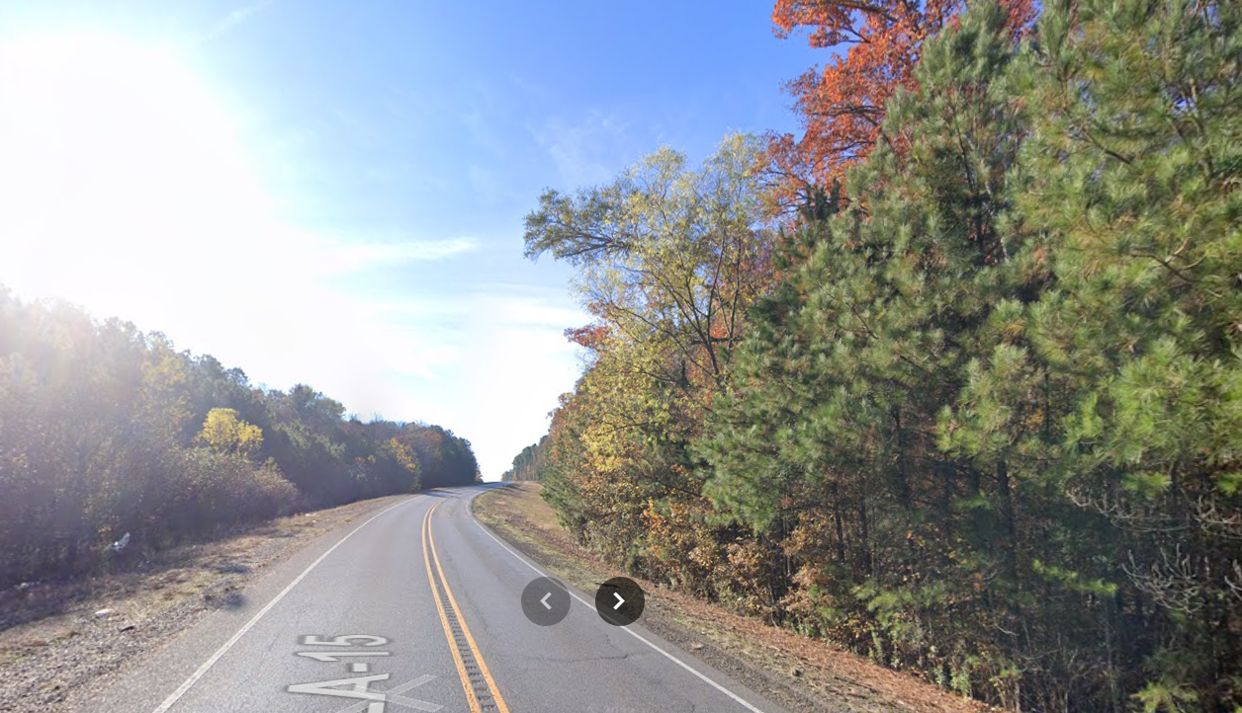
Lewis v. State ex rel. Department of Transp. & Dev.
654 So. 2d 311 (La. 1995)
Notes:
LA Sup. Ct. 1995
January 13, 1992: Candice Lewis, Richard Lewis, and their 3 minor children were returning from a trip to Arkansas along Hwy 15 in Union Parish.
A sweet gum tree fell across the road in front of them, and they crashed into it.
Tree was 44.6 feet from the center of the Hwy, 14.6 feet from edge of ROW, on property owned by Boy Scouts of America.
Lewis experts, Barry Preaus and Dr. F.F. Jewel, Professor of Forestry at LA Tech U: tree had been dead at least 2 years.
State’s inspector never had formal training on tree assessment.
Tree was partially obscured from view from the road by two smaller trees in front of it.
Trial judge dismissed action. Lewis appealed.
Ct. App. reversed, calling the trial court findings of obscurement “troublesome” and “clearly erroneous”
Supreme Court reversed again, affirming trial court.

Slide 65
Lewis v. State ex rel. Department of Transp. & Dev.
654 So. 2d 311 (La. 1995)
“DOTD is not the guarantor of the safety of travelers, but owes a duty to keep highways and shoulders reasonably safe”

Slide 66
Lewis v. State ex rel. Department of Transp. & Dev.
654 So. 2d 311 (La. 1995)
“DOTD is not the guarantor of the safety of travelers, but owes a duty to keep highways and shoulders reasonably safe”
Lewis must show:
  hazardous condition,
  DOTD knowledge of condition, and
  Failure to take corrective action within a reasonable time

Slide 67
Lewis v. State ex rel. Department of Transp. & Dev.
654 So. 2d 311 (La. 1995)
“DOTD is not the guarantor of the safety of travelers, but owes a duty to keep highways and shoulders reasonably safe”
Lewis must show:
  hazardous condition,
  DOTD knowledge of condition, and
  Failure to take corrective action within a reasonable time

Slide 68
Lewis v. State ex rel. Department of Transp. & Dev.
654 So. 2d 311 (La. 1995)
“…the canopy of the smaller trees would have expanded and could have obscured the top of the sweet gum”

Slide 69
Lewis v. State ex rel. Department of Transp. & Dev.
654 So. 2d 311 (La. 1995)
“…the canopy of the smaller trees would have expanded and could have obscured the top of the sweet gum”
“…the reason this dead tree was not noticed is not attributable to negligent conduct on the part of the state.”

Slide 70
Lewis v. State ex rel. Department of Transp. & Dev.
654 So. 2d 311 (La. 1995)
“…the canopy of the smaller trees would have expanded and could have obscured the top of the sweet gum”
“…the reason this dead tree was not noticed is not attributable to negligent conduct on the part of the state.”
Windshield inspection is fine. Level 2 not needed.

Slide 71
Risk Assessments and Acts of God - Summary
LA C.C. Art 2317:
  Vice or Defect
  Unreasonable Risk of Harm
  Custody
  Causation
LA C.C. Art 2317.1
Acts of God
Knowledge/Notice
Levels of Assessment

Slide 72
Self-Help
Wilson v. State 364 So. 2d 1313 (La. Ct. App. 1978)
Tissot v. Great Southern. Tel. & Tel. Co. 3 So. 261 (La. 1887)
Givens v. Town of Ruston 55 So. 2d 289 (La. Ct. App. 1951)
Fontenot v. Central LA Elec. Co. 147 So. 2d 773 (La. Ct. App. 1962)
Jack v. Successions of Albert 286 So. 3d 432 (La. Ct. App. 2019)
Notes:
5 cases

Slide 73

Wilson v. State
364 So. 2d 1313 (La. Ct. App. 1978)
Notes:
LA Ct. App. 1978
Debra Wilson was driving on Hwy 28 near Hicks at 3:15am. A tree had fallen across the road. They came upon it in the fog and crashed.
The tree fell from adjacent private property.
2 days prior to the accident, road crews noticed the tree was leaning and discussed removing it.
State did NOT contact private property owner.
Trial court held for Wilson. State appealed. Affirmed.

Slide 74
Wilson v. State
364 So. 2d 1313 (La. Ct. App. 1978)
“A public body may not destroy private property overhanging a public right of way without observing legal process

Slide 75
Wilson v. State
364 So. 2d 1313 (La. Ct. App. 1978)
“A public body may not destroy private property overhanging a public right of way without observing legal process UNLESS the property constitutes a public nuisance or poses imminent danger”

Slide 76
Wilson v. State
364 So. 2d 1313 (La. Ct. App. 1978)
“A public body may not destroy private property overhanging a public right of way without observing legal process UNLESS the property constitutes a public nuisance or poses imminent danger”
“the tree did pose an imminent danger…as evidenced by the fact that it fell within days of being inspected”

Slide 77
Wilson v. State
364 So. 2d 1313 (La. Ct. App. 1978)
“It is obvious that a highway with a large pine tree completely across it is not ‘reasonably safe’”
“[the State] cannot avoid liability…by showing that [the tree] stood on private property”

Slide 78
Wilson v. State
364 So. 2d 1313 (La. Ct. App. 1978)
“the [State] cannot sit back and ignore the dangers posed because the danger-causing object is situated on private property.”
“At worst,…had the State cut the tree down without the landowner’s permission, it could have subjected itself to a matter of a few hundred dollars in damages”

Slide 79

Tissot v. Great Southern. Tel. & Tel. Co.
3 So. 261 (La. 1887)
Notes:
LA Sup. Ct. 1887
J. L. Tissot owned a home in New Orleans with two mature magnolia trees.
Great Southern had contract with City to erect telegraph lines along the public street.
City passed ordinance declaring all trees interfering with the proposed lines were a nuisance.
Great Southern Tel. & Tel. Co. approached Tissot’s gardener and asked if they could top the trees to make way for utility lines.
Dispute over whether gardener said “yes.” Great Southern topped the trees.
Tissot sued for damages. Trial court held for Tissot. Great Southern appealed.
Affirmed, but award reduced.
Did they have consent?
Were they protected by the contract?
Were the trees a nuisance?
Did they have the right of self-help?

Slide 80
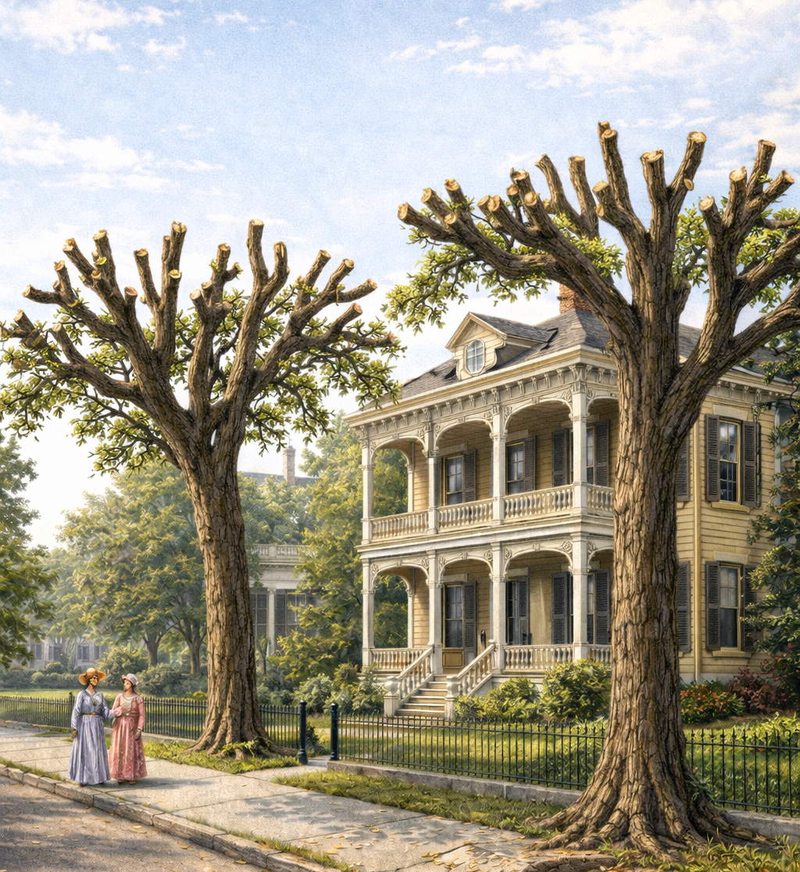
Tissot v. Great Southern. Tel. & Tel. Co.
3 So. 261 (La. 1887)
Notes:
LA Sup. Ct. 1887
J. L. Tissot owned a home in New Orleans with two mature magnolia trees.
Great Southern had contract with City to erect telegraph lines along the public street.
City passed ordinance declaring all trees interfering with the proposed lines were a nuisance.
Great Southern Tel. & Tel. Co. approached Tissot’s gardener and asked if they could top the trees to make way for utility lines.
Dispute over whether gardener said “yes.” Great Southern topped the trees.
Tissot sued for damages. Trial court held for Tissot. Great Southern appealed.
Affirmed, but award reduced.
Did they have consent?
Were they protected by the contract?
Were the trees a nuisance?
Did they have the right of self-help?

Slide 81
Tissot v. Great Southern. Tel. & Tel. Co.
3 So. 261 (La. 1887)
Consent:
  “keepers of the property had been placed upon it for its protection and not for its destruction”
  “any permission from them to the contrary was…of no value and protection”

Slide 82
Tissot v. Great Southern. Tel. & Tel. Co.
3 So. 261 (La. 1887)
Contract:
  “[the City] can do all acts appropriate or incidental to a beneficial use by the public, only where it acts in a proper and careful manner”
  “the city could not enter the premises of the abutting proprietors [or] cut down their trees”
  Should have re-routed the lines

Slide 83
Tissot v. Great Southern. Tel. & Tel. Co.
3 So. 261 (La. 1887)
Nuisance:
  “[the City has] the power to remove nuisances…provided the thing be a nuisance”
  “they are subject to the same perils and liabilities as an individual, if the nuisance is not in fact a nuisance”
  “The fact that a particular use of property is declared a nuisance…does not make that use a [legal] nuisance”
  “it is the better course to secure an adjudication from the courts before proceeding to abate it”

Slide 84
Tissot v. Great Southern. Tel. & Tel. Co.
3 So. 261 (La. 1887)
Self-Help:
  “the security of lives and property may sometimes require so speedy a remedy as not to allow time to call on the person on whose property has arisen to remedy it”
  HOWEVER
  “persons should not take the law into their own hands, but [should] appeal to a court of justice”

Slide 85
Tissot v. Great Southern. Tel. & Tel. Co.
3 So. 261 (La. 1887)
Damages:
  “under the circumstances, the damage done is daily being repaired and that, in the due course of time, it will hardly be perceptible”
  Award too high because trees will grow back

Slide 86
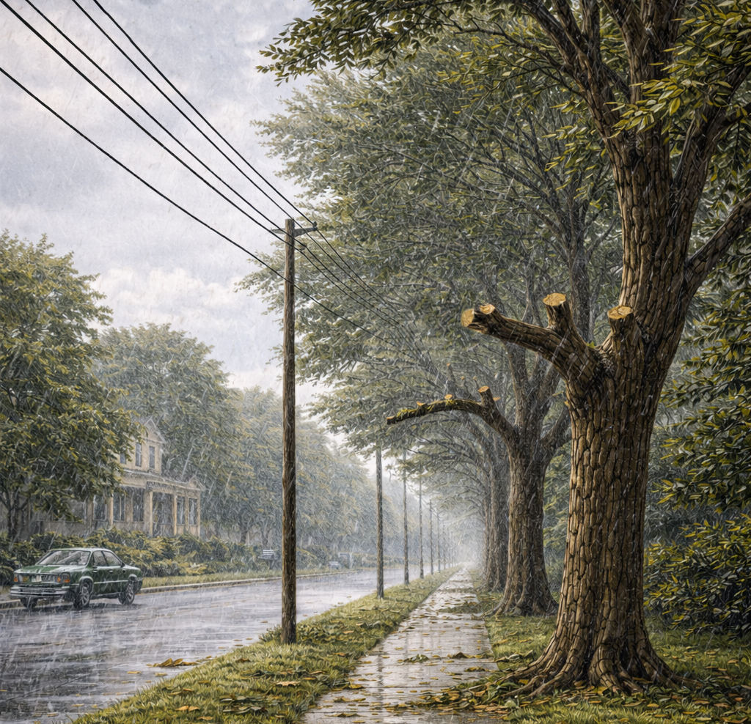
Givens v. Town of Ruston
55 So. 2d 289 (La. Ct. App. 1951)
Notes:
LA Ct. App. 1951
Ms. Sallie Givens own residential lots in Ruston, LA.
September 20, 1947 windstorm hit the town.
Next morning, Town employees pruned off all broken and hanging branches, and all branches “threatening” the lines
No limbs were removed on the side of the trees closest to the residence.
Givens sued for property damage and emotional distress.
Trial court dismissed the action. Givens appealed. AFFIRMED.

Slide 87
Givens v. Town of Ruston
55 So. 2d 289 (La. Ct. App. 1951)
“These limbs, as time passes, grow larger and longer, with increasing possibility to do damage to the wires by friction.”
“[The Town has the right], in instances of emergency, without resort to court, to take all reasonable means to quickly relieve the emergency.”
“the Town acted within its rights in cutting and removing the limbs”

Slide 88
Givens v. Town of Ruston
55 So. 2d 289 (La. Ct. App. 1951)
“Pictures taken after new foliage had grown, show healthy, symmetrical trees that produce about as much shade as formerly…The process of healing appears to be satisfactory. None will die.”

Slide 89
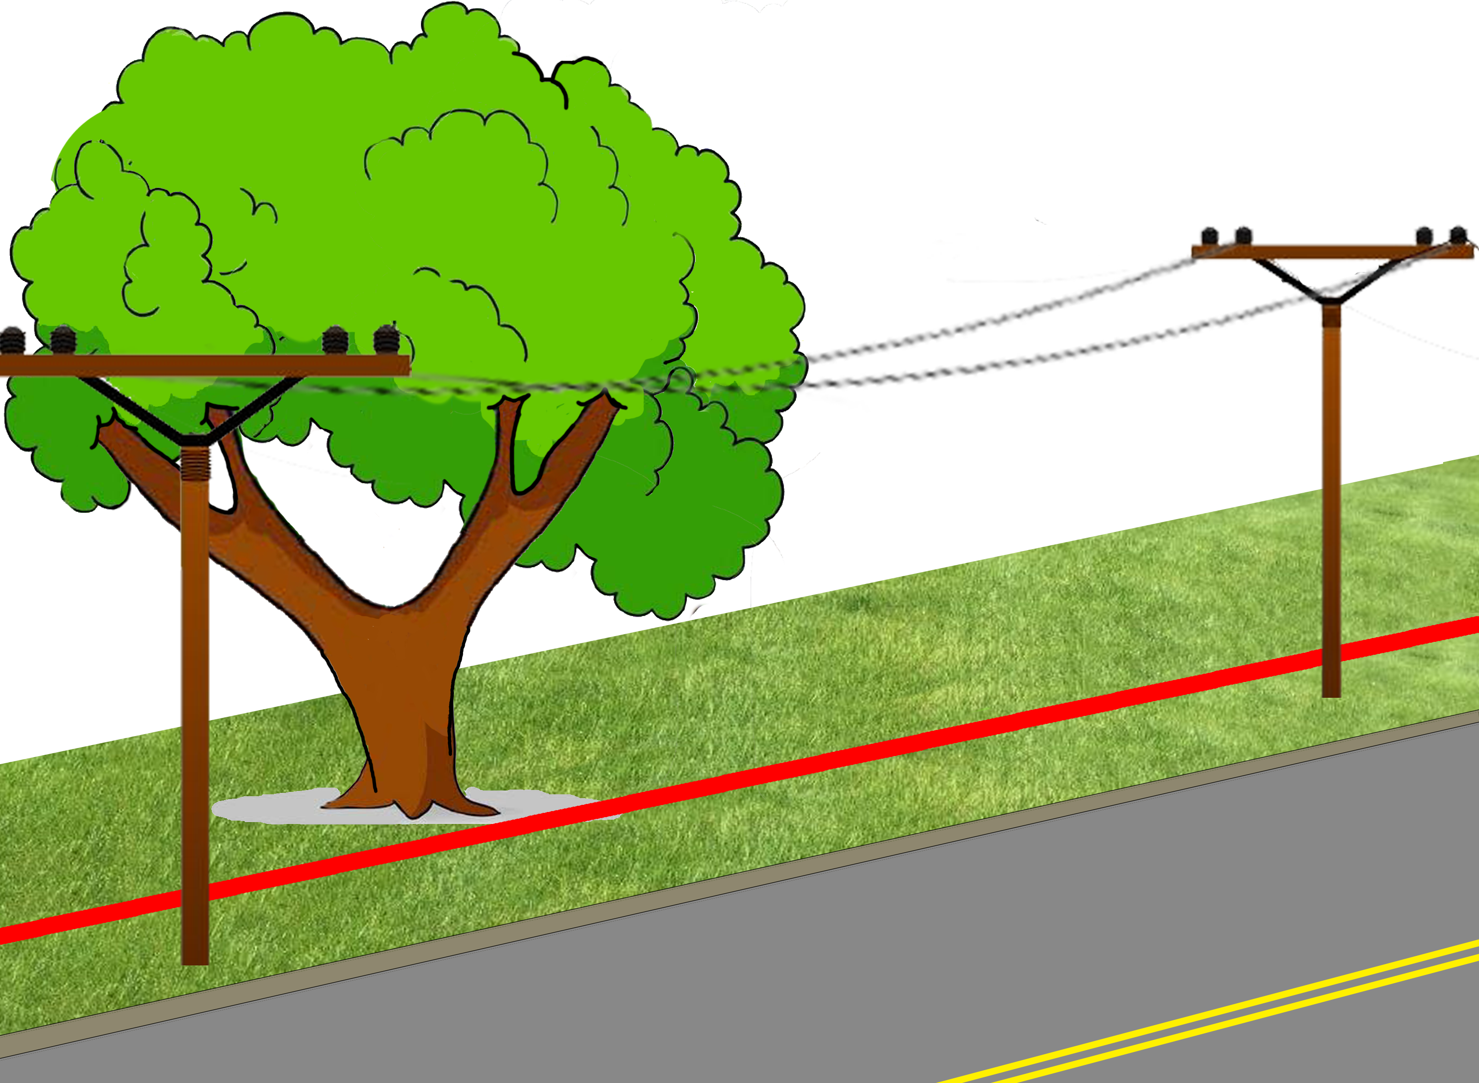
Fontenot v. Central Louisiana Electric Co.
147 So. 2d 773 (La. Ct. App. 1962)
Notes:
LA Ct. App. 3rd Cir.
1962 Ville Platte, LA
Central Louisiana Electric Co contracted Asplundh Tree Expert Company to clear lines
Asplundh asked for and received permission from Mrs. Fontenot to cut branches of her oak tree
Mr. Fontenot discovered the pruning, claiming she had no authority to dispose of marital property without his written consent

Slide 90
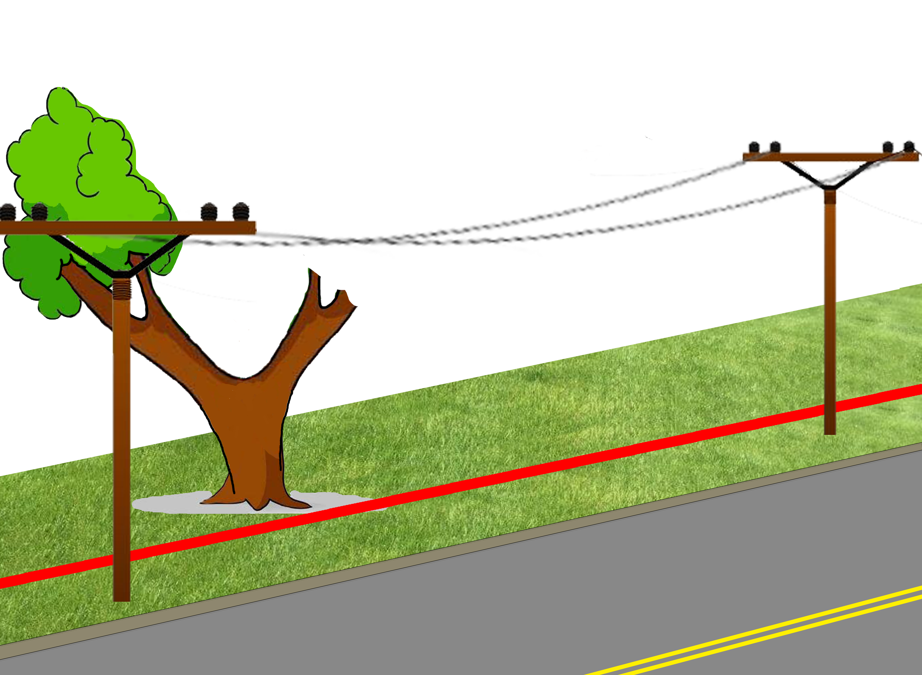
Fontenot v. Central Louisiana Electric Co.
147 So. 2d 773 (La. Ct. App. 1962)
Notes:
LA Ct. App. 3rd Cir.
1962 Ville Platte, LA
Central Louisiana Electric Co contracted Asplundh Tree Expert Company to clear lines
Asplundh asked for and received permission from Mrs. Fontenot to cut branches of her oak tree
Mr. Fontenot discovered the pruning, claiming she had no authority to dispose of marital property without his written consent

Slide 91
Fontenot v. Central Louisiana Electric Co.
147 So. 2d 773 (La. Ct. App. 1962)
“…where overhanging branches cause damage to an adjoining landowner, he can require the landowner to have the overhanging branches cut back to the boundary.”

Slide 92
Fontenot v. Central Louisiana Electric Co.
147 So. 2d 773 (La. Ct. App. 1962)
“…where overhanging branches cause damage to an adjoining landowner, he can require the landowner to have the overhanging branches cut back to the boundary.”
HOWEVER
“…while [the power company] could require [Fontenot] to trim the branches…; it could not avail itself of self-help.”

Slide 93
Fontenot v. Central Louisiana Electric Co.
147 So. 2d 773 (La. Ct. App. 1962)
Harvesting or selling timber from community property requires permission from both spouses.

Slide 94
Fontenot v. Central Louisiana Electric Co.
147 So. 2d 773 (La. Ct. App. 1962)
Harvesting or selling timber from community property requires permission from both spouses.
HOWEVER
Pruning branches is not disposal of community property
Wife’s permission was sufficient.

Slide 95
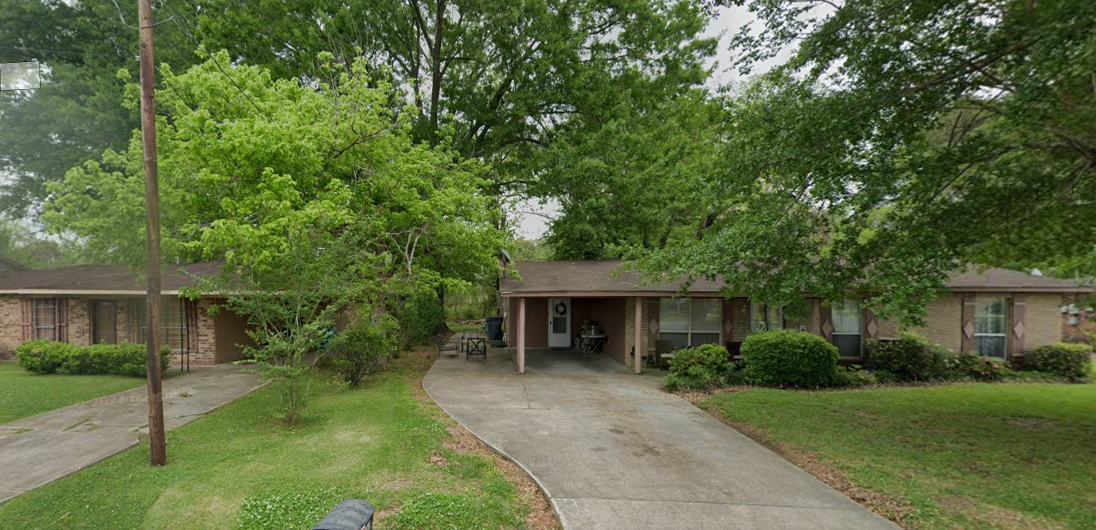
Jack v. Successions of Albert
286 So.3d 432 (La. Ct. App. 2019)
Notes:
LA Ct. App. 1st Cir.
2019 New Roads, LA
Large 48-inch oak tree on boundary line between Jacks (right) and Alberts (left)
Jacks sued to compel Alberts to remove tree and pay for driveway repairs

Slide 96
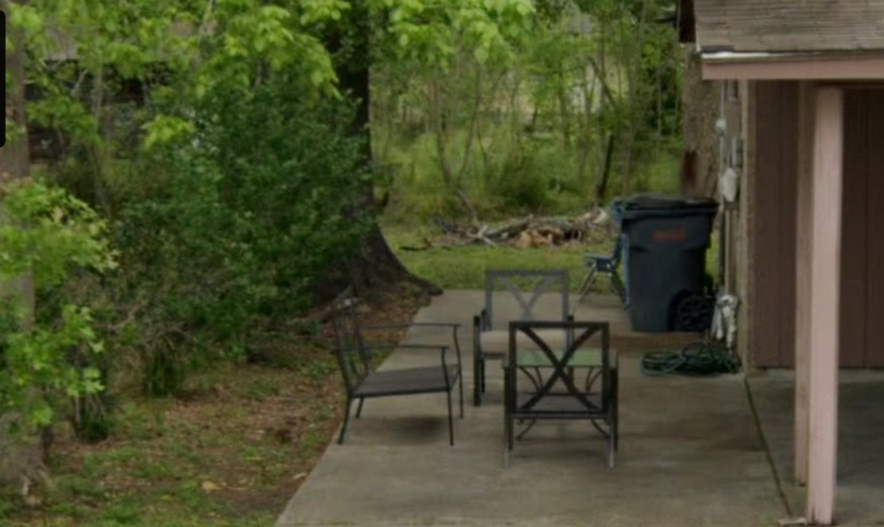
Jack v. Successions of Albert
286 So.3d 432 (La. Ct. App. 2019)
Notes:
Land surveyor said line passed through portion of trunk, but tree’s center was on Alberts’ side
NO ARBORIST TESTIMONY of (1) origin of tree, or (2) growth over the years

Slide 97
Jack v. Successions of Albert
286 So.3d 432 (La. Ct. App. 2019)
LA Civ. Code §688: landowner may demand neighbor trim encroaching branches and roots at neighbor’s expense
LA Civ. Code §687:
  trees on boundary are common unless proof to the contrary
  Landowner may remove tree at his own expense
  IF it interferes with enjoyment of his estate

Slide 98
Jack v. Successions of Albert
286 So.3d 432 (La. Ct. App. 2019)
“the Jacks…failed to…overcome the presumption of commonness”
Should have presented (arborist) evidence of:
  Origin of the tree
  Growth over the years

Slide 99
Jack v. Successions of Albert
286 So.3d 432 (La. Ct. App. 2019)
CONCUR
It’s absurd to require expert opinion of tree origin for every boundary tree case!
DISSENT
The center of the tree is on Albert’s side, so it’s Albert’s.

Slide 100

Jack v. Successions of Albert
286 So.3d 432 (La. Ct. App. 2019)

Slide 101
Jack v. Successions of Albert
286 So.3d 432 (La. Ct. App. 2019)
Plaintiff’s burden to prove trunk is on property line
π Burden of Proof

Slide 102
Jack v. Successions of Albert
286 So.3d 432 (La. Ct. App. 2019)
Plaintiff’s burden to prove trunk is on property line
Presume co-owned
π Burden of Proof

Slide 103
Jack v. Successions of Albert
286 So.3d 432 (La. Ct. App. 2019)
Plaintiff’s burden to prove trunk is on property line
Presume co-owned
Co-ownership opponent’s burden to prove sole-ownership
Co-ownership opponent
Burden of Proof
π Burden of Proof

Slide 104
Self-Help - Summary
Encroaching Branches
Nuisance
“Imminent Danger”
Private Property
Consent
Boundary Tree Presumption

Slide 105
Valuation
Cusachs v. Salmen Brick & Lumber Co. 2 Pelt. 433 (La. Ct. App. 1919)
Daray v. St. Tammany Parish 2009 WL 3255174 (La. Ct. App. 2009)
Sicily Island Holdings, LLC v. United States Aviation Underwriters Inc
297 So. 3d 935 (La. Ct. App. 2020)
Hornsby v. Bayou Jack Logging 902 So. 2d 361 (La. 2005)
Sagnibene v. Roy O. Martin Lumber Co., LLC 68 So. 3d 32 (La. 2011)
Curole v. Acosta 303 So. 2d 530 (La. Ct. App. 1974)
State, Dep't of Transp. & Dev. v. Knoll & Dufour Lands, LLC
158 So.3d 1 (La. Ct. App. 2013)
Notes:
5 cases
+2 supplemental

Slide 106

Cusachs v. Salmen Brick & Lumber Co.
2 Pelt. 433 (La. Ct. App. 1919)
Notes:
LA Ct. App. 1919
Gaspard Cusachs owned land in Orleans Parish.
The property was vacant and swampy. There were no fences or improvements.
Cusachs said “I always refused to get money from them. I have always refused to cut any timber on that land.”
The trees had sentimental value to him.
Employees of Salmen Brick & Lumber accidentally trespassed and cut many of Cusach’s trees.
Cuasch sued. Trial court awarded $2 for value of logs ONLY.

Slide 107
Cusachs v. Salmen Brick & Lumber Co.
2 Pelt. 433 (La. Ct. App. 1919)
“When the trespass is not willful, but the result of mere inadvertence, the value of the timber when first cut is the measure of damages.”
“there could not have been, under any circumstances, any character of value, no matter how deeply [Cuaschs] may have felt the loss of the trees in question.”

Slide 108
Cusachs v. Salmen Brick & Lumber Co.
2 Pelt. 433 (La. Ct. App. 1919)
“[Cuasch’s]…valuation of the property…is absolutely beyond even what the most reasonable of men have a right to judge or estimate values of the kind in question.”
HOWEVER
“these trees were cut and the property entered without permission…, whether malice was intended or not, the law holds [Salmen] liable for some damages for the unlawful entry”
+$50

Slide 109
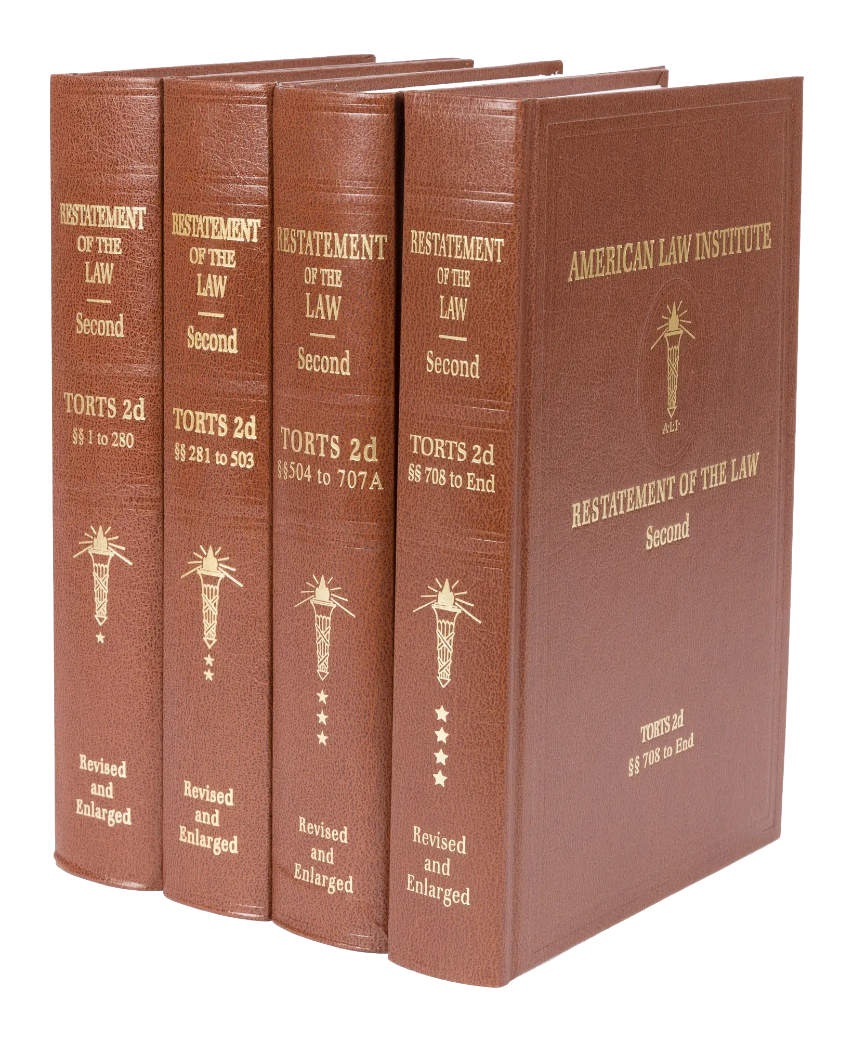
Restatement of the Law of Torts, 2d.

Slide 110
R2D Torts §929(1)
If one is entitled to a judgment for harm to land resulting from a past invasion and not amounting to a total destruction of value, the damages include compensation for:
  the difference between the value of the land before the harm and the value after the harm, or at his election in an appropriate case, the cost of restoration that has been or may be reasonably incurred,
  the loss of use of the land, and
  discomfort and annoyance to him as an occupant.

Slide 111
R2D Torts §929(1)
If one is entitled to a judgment for harm to land resulting from a past invasion and not amounting to a total destruction of value, the damages include compensation for:
  the difference between the value of the land before the harm and the value after the harm, or at his election in an appropriate case, the cost of restoration that has been or may be reasonably incurred,
  the loss of use of the land, and
  discomfort and annoyance to him as an occupant.

Slide 112
R2D Torts §929 cmt. b
“If…the cost of replacing the land in its original condition is disproportionate to the diminution in the value of the land...,
unless there is a reason personal to the owner for restoring the original condition,
damages are measured only by the [diminution in the value of the land].”

Slide 113
R2D Torts §929 cmt. b
“If…the cost of replacing the land in its original condition is disproportionate to the diminution in the value of the land...,
unless there is a reason personal to the owner for restoring the original condition,
damages are measured only by the [diminution in the value of the land].”

Slide 114
R2D Torts §929 Analysis
Restoration Cost vs. Diminution in Value
“Reason Personal”
“Reasonably Incurred” vs. “Disproportionate”

Slide 115
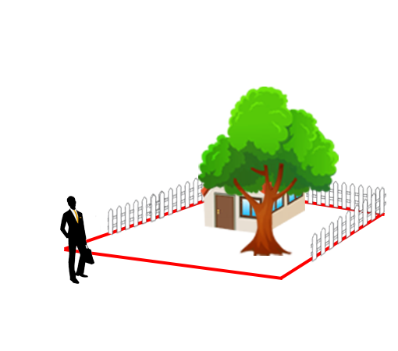
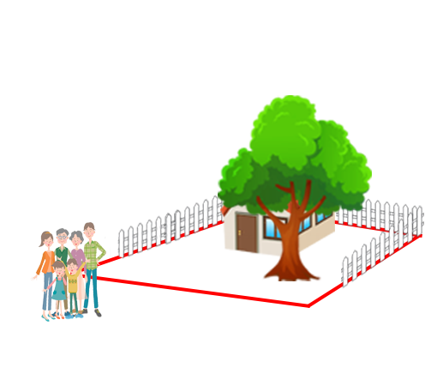
“Reason Personal”

Slide 116
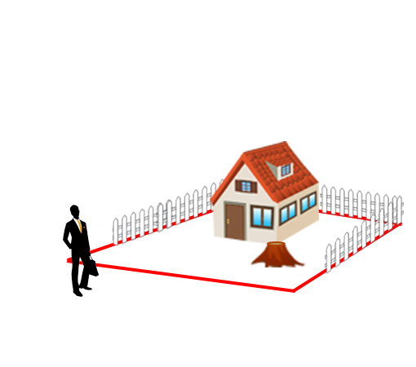
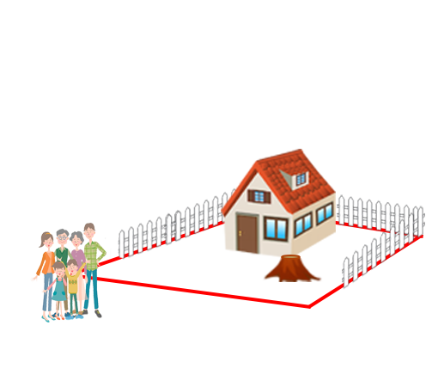
“Reason Personal”

Slide 117
“Reason Personal”
No “Reason Personal”

Slide 118
“Reason Personal”
No “Reason Personal”
“Reason Personal”

Slide 119
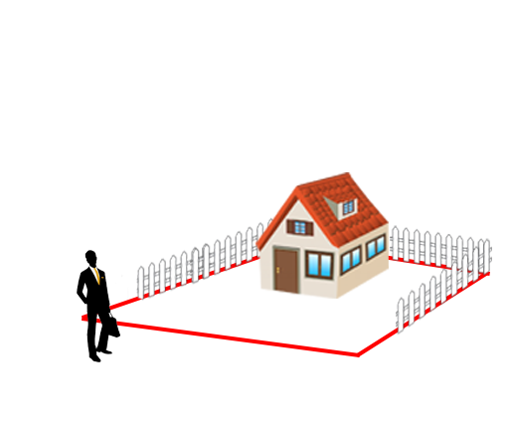
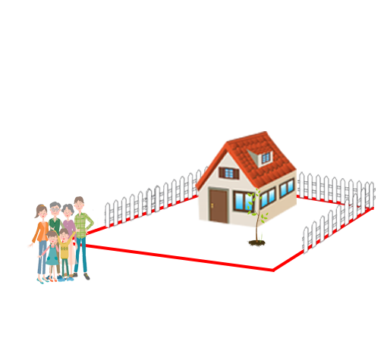
“Reason Personal”
No “Reason Personal”
“Reason Personal”

Slide 120
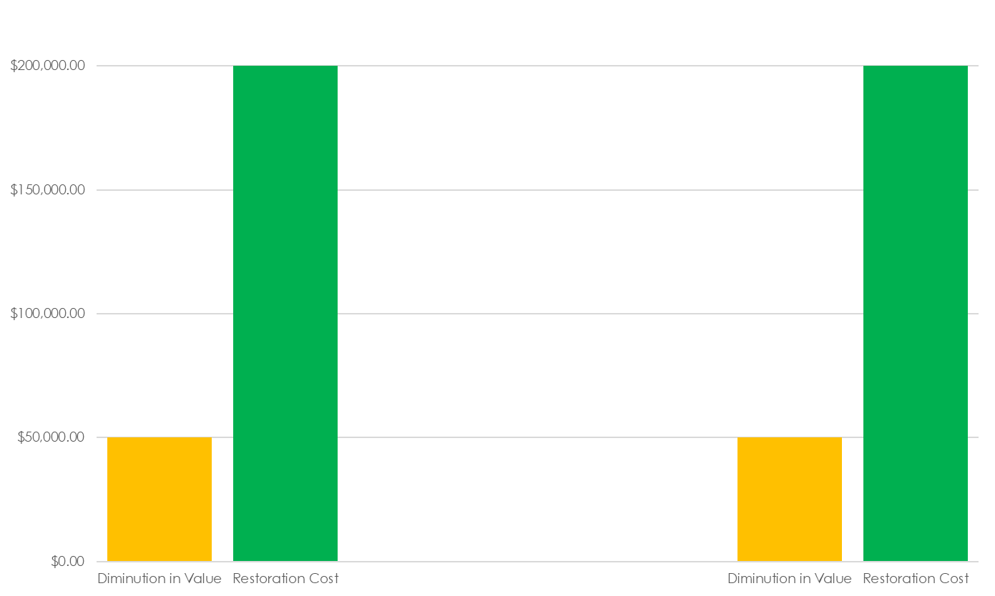
“Reason Personal”
No “Reason Personal”
“Reason Personal”

Slide 121
“Reason Personal”
No “Reason Personal”
“Reason Personal”
Max Award

Slide 122
“Reason Personal”
No “Reason Personal”
“Reason Personal”
Possible
Award
Max Award

Slide 123
R2D Torts §929 Analysis
Restoration Cost vs. Diminution in Value
“Reason Personal”
“Reasonably Incurred” vs. “Disproportionate”

Slide 124
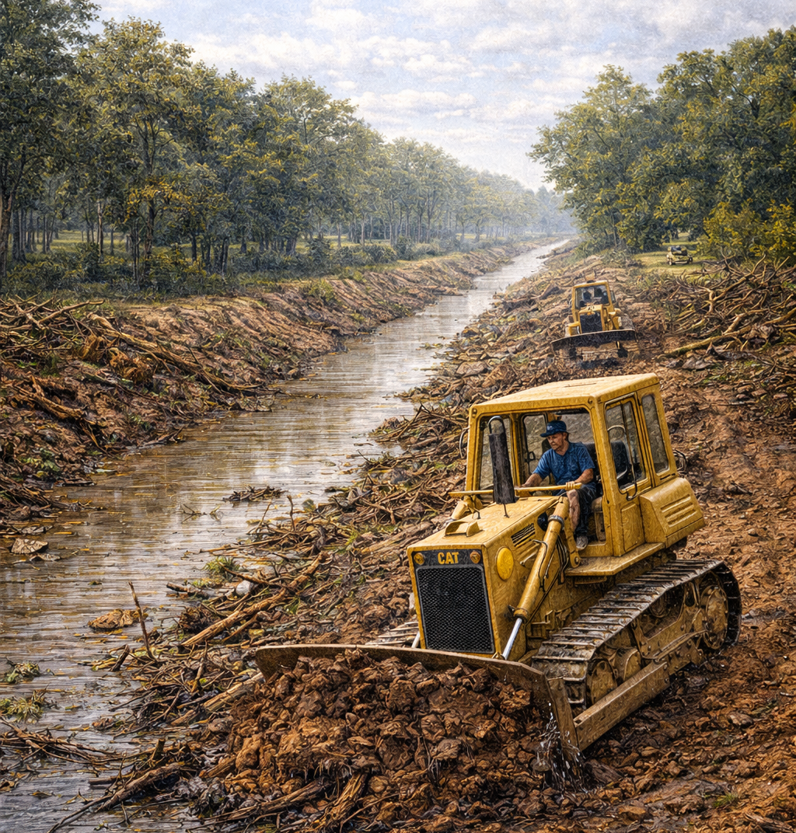
Daray v. St. Tammany Parish
2009 WL 3255174 (La. Ct. App. 2009)
Notes:
LA Ct. App. 2009
Andrew and Judith Daray owned forested land in St. Tammany Parish, just south of the Heritage Heights subdivision.
The parish owned a drainage easement, across one end of the property, far from the Daray residence.
The Darays had maintained the property in its natural state since they purchased it in 1976.
Around December of 1999, Parish employees widened the drainage easement 10 ft beyond its boundaries, destroying trees and leaving spoils on Daray land.
Darays presented evidence of replacement cost.
Malcolm Guidry testified for Parish
Trial court held for Darays and awarded replacement costs of trees PLUS general damages of $25K. Parish appealed.

Slide 125
Daray v. St. Tammany Parish
2009 WL 3255174 (La. Ct. App. 2009)
“A damage award…that exceeds the value of the property is not impermissibly excessive where the owner is able to articulate “personal reasons” which justify the higher award.”

Slide 126
Daray v. St. Tammany Parish
2009 WL 3255174 (La. Ct. App. 2009)
“there is evidence supporting the court’s conclusion that they had personal reasons to restore it:
  “[the Darays] had no intentions of developing it.”
  “[Daray] stated, ‘We want to keep our property just the way it is. We think its beautiful in its natural state.”

Slide 127
Daray v. St. Tammany Parish
2009 WL 3255174 (La. Ct. App. 2009)
HOWEVER
General damages award TOO HIGH:
  “Daray residence is not located anywhere near the damaged portion of their property”
  “physical privacy was not invaded”
  “[the Darays] have not had to view the unsightly mess on a daily basis”
Notes:
Reduced to $8K

Slide 128
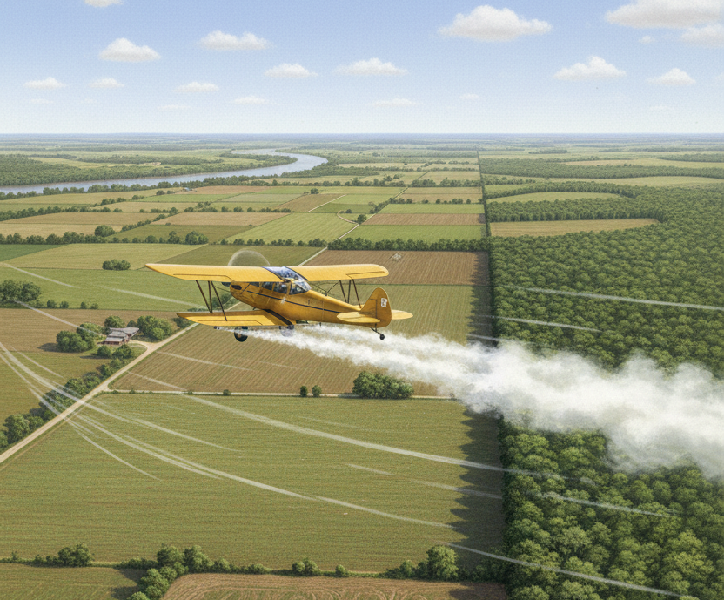
Sicily Island Holdings, LLC v. U.S. Aviation Underwriters Inc.
297 So. 3d 935 (La. Ct. App. 2020)
Notes:
LA Ct. App. 2020
Sicily Island Holdings and Andrew Harrison maintained a carbon-credit forest in Catahoula Parish. Carbon Credit forest subject to strict replacement requirements to maintain status. Harrison recreated and hunted on the property.
Drift from negligent aerial herbicide application damaged the trees.
Harrison and Sicily Island Holdings sued, demanding restoration costs.
Trial court held “no reason personal” and dismissed the case. Harrison appealed. REVERSED.

Slide 129
Sicily Island Holdings, LLC v. U.S. Aviation Underwriters Inc.
297 So. 3d 935 (La. Ct. App. 2020)
“The issue of whether damages are exorbitant or economically wasteful is a question of fact. Therefore, it is for the jury to determine.”

Slide 130
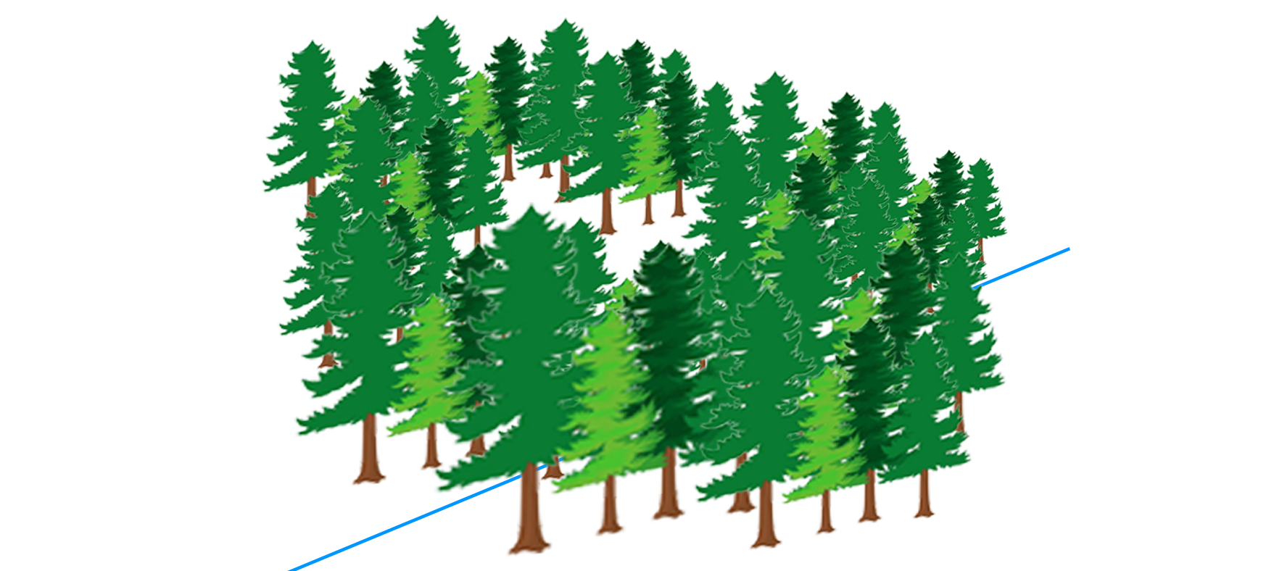
Hornsby v. Bayou Jack Logging
902 So. 2d 361 (La. 2005)
Notes:
LA Sup. Ct. 2005
Larry Hornsby owned land in Acadia Parish.
Kenneth Guillot, D/B/A Bayou Jack Logging believed he was harvesting trees from an adjacent property but crossed into the Hornsby property.
Hornsby sued for replacement cost of the trees.
Trial court found Hornsby had “reason personal” for restoring the land and awarded the restoration costs. Bayou Jack Logging appealed. Reversed.

Slide 131
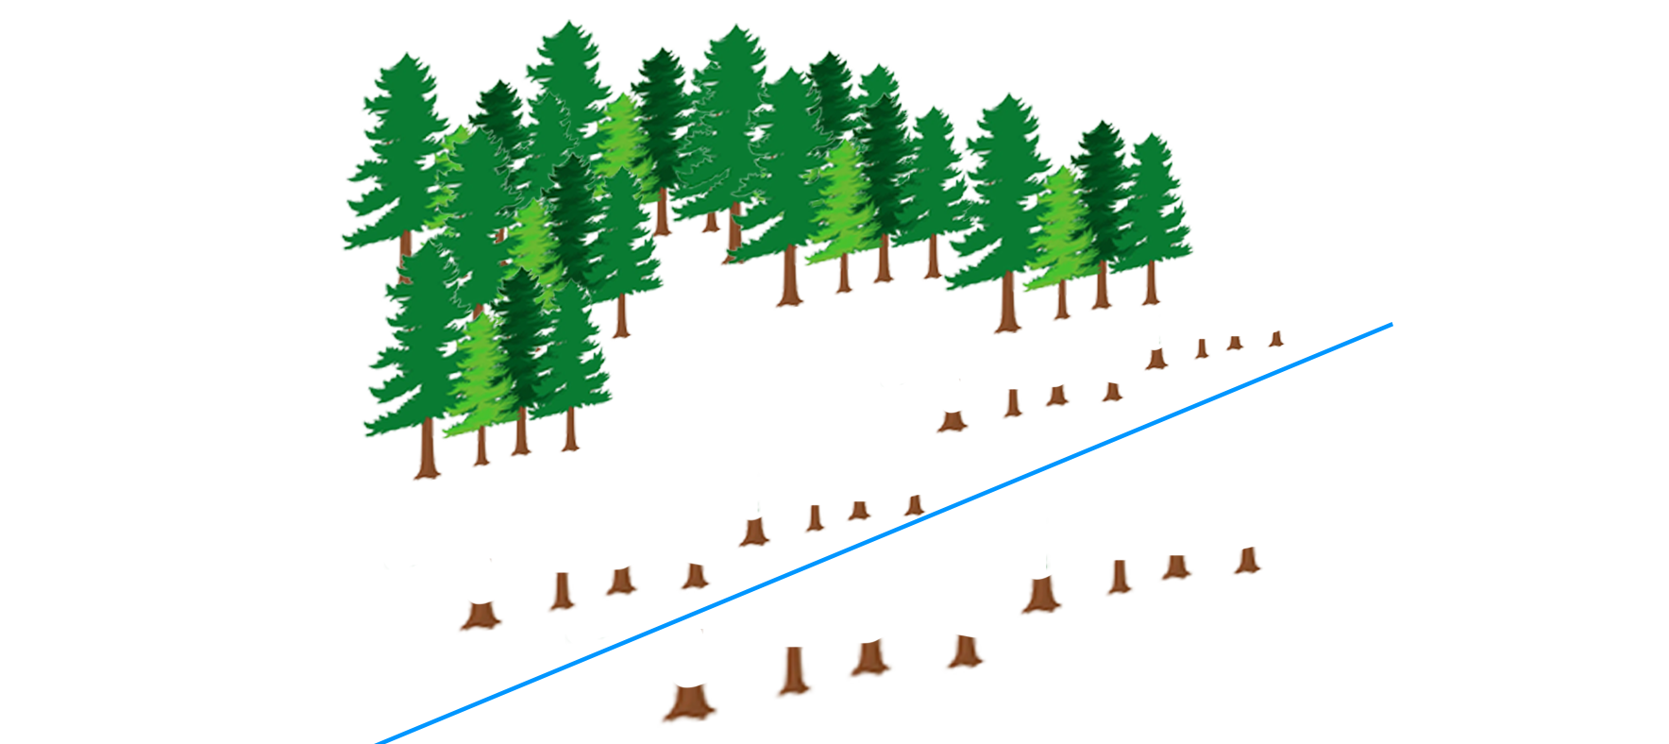
Hornsby v. Bayou Jack Logging
902 So. 2d 361 (La. 2005)
Notes:
LA Sup. Ct. 2005
Larry Hornsby owned land in Acadia Parish.
Kenneth Guillot, D/B/A Bayou Jack Logging believed he was harvesting trees from an adjacent property but crossed into the Hornsby property.
Hornsby sued for replacement cost of the trees.
Trial court found Hornsby had “reason personal” for restoring the land and awarded the restoration costs. Bayou Jack Logging appealed. Reversed.

Slide 132
Hornsby v. Bayou Jack Logging
902 So. 2d 361 (La. 2005)
“when π was a child, he and his cousins would play on the property every Sunday”
“the land has primarily been used for cattle grazing”
“there are no utility lines, water lines, or structures on the land”
“intent to build, at a future date, but failed to produce any tangible proof or documentation to support their intent”

Slide 133
Hornsby v. Bayou Jack Logging
902 So. 2d 361 (La. 2005)
“We do not find that plaintiffs' self-serving testimony of their inchoate intent to develop the land at some undetermined future point is sufficient to justify recovery of restoration costs in excess of the actual market value of the land and the trees cut. “

Slide 134
Hornsby v. Bayou Jack Logging
902 So. 2d 361 (La. 2005)
“We do not find that plaintiffs' self-serving testimony of their inchoate intent to develop the land at some undetermined future point is sufficient to justify recovery of restoration costs in excess of the actual market value of the land and the trees cut. “

Slide 135
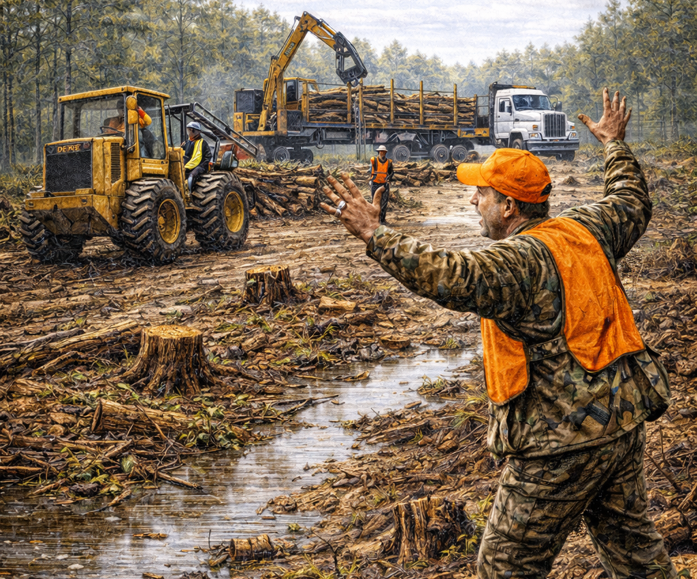
Sagnibene v. Roy O. Martin Lumber Co., LLC 68 So. 3d 32 (La. Ct. App. 2011)
Notes:
LA Ct. App. 2011
Angelo Sagnibene owned 4 acres of forested hunting land in St. Landry Parish
Over Sagnibene’s objections, Roy O Martin Lumber trespassed and cut trees.
Trial court awarded 3x damages AND restoration costs
Roy O Martin appealed. Reversed – just 3x timber.

Slide 136
Sagnibene v. Roy O. Martin Lumber Co., LLC 68 So. 3d 32 (La. Ct. App. 2011)
Property Value: $9,433
Timber Value: $13,459
Restoration Cost: $288,998
  Removing stumps
  Returning property to natural grade

Slide 137
Sagnibene v. Roy O. Martin Lumber Co., LLC 68 So. 3d 32 (La. Ct. App. 2011)
“if the land was left alone, without restoration work, merchantable trees would once again grow within fifteen years”
“testimony did not indicate that [the property] could no longer be used for [hunting]”
“the cost of restoring the property…is undoubtedly disproportionate to the value of the property”

Slide 138
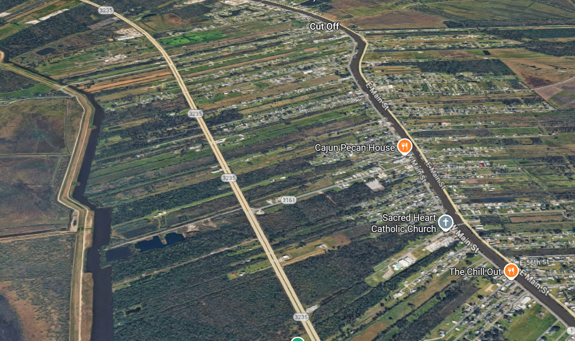
Curole v. Acosta
303 So. 2d 530 (La. Ct. App. 1974)
Notes:
LA Ct. App. 1974
Freddie Acosta and Johnny Curole owned adjacent property in Cut Off, near Bayou Lafourche
Curole was not living on the property, and there were no improvements.
Acosta’s contractor trespassed and cut trees on the Curole property. Curole sued.

Slide 139
Curole v. Acosta
303 So. 2d 530 (La. Ct. App. 1974)
Timber Value: $1,296.56
Land Value: $2,550.00
Trunk Formula: $22,548.00
Actual Award: $750.00
Notes:
Curole’s expert Cyril Banting applied “the National Shade Tree Conference” method of evaluation from the 2nd or 3rd Edition Guide for Plant Appraisal
Acosta appraised timber value and land value.
Trial Court disregarded ALL the appraisals and awarded $750.

Slide 140
Curole v. Acosta
303 So. 2d 530 (La. Ct. App. 1974)
“Replacement value is not the criterion for damages where trees and shrubs are concerned.”
HOWEVER
“the principal value of the destroyed trees was their aesthetic value rather than their value as commercial timber.”
Defers to trial judge to do “substantial justice”

Slide 141
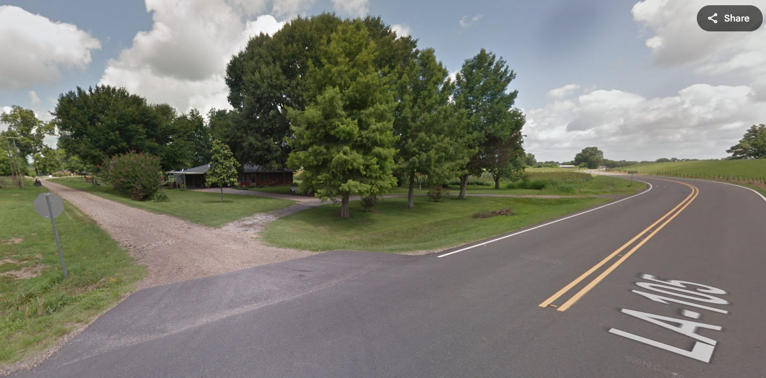
State, Dep't of Transp. & Dev. v. Knoll & Dufour Lands, LLC
158 So.3d 1 (La. Ct. App. 2013)
Notes:
LA Ct. App. 2013
Glenn and Barbara Dauzart owned, through Knoll & Dufour Lands, about 1.5 acres in Simmesport, LA
State Dept filed expropriation action to take strip of land to re-route a highway, requiring destruction of trees
Knoll’s appraiser contacted a local nursery for “tree values”
He then added the “tree values” to the land value.
Trial court awarded a large amount of money. State appealed.

Slide 142
State, Dep't of Transp. & Dev. v. Knoll & Dufour Lands, LLC
158 So.3d 1 (La. Ct. App. 2013)
“a property owner is not allowed compensation for the value of the land plus the individual value of the trees, but only for the value that the trees contribute to the value of the land.”

Slide 143
State, Dep't of Transp. & Dev. v. Knoll & Dufour Lands, LLC
158 So.3d 1 (La. Ct. App. 2013)
“a property owner is not allowed compensation for the value of the land PLUS the individual value of the trees, but only for the value that the trees contribute to the value of the land.”

Slide 144
State, Dep't of Transp. & Dev. v. Knoll & Dufour Lands, LLC
158 So.3d 1 (La. Ct. App. 2013)
“a property owner is not allowed compensation for the value of the land PLUS the individual value of the trees, but only for the value that the trees contribute to the value of the land.”
“There was no evidence that the loss of the trees decreased the value of the [land].”

Slide 145
Valuation - Summary
R2D §929
  Change in Value vs. Restoration Cost
  Reason Personal
  Reasonableness
  Loss of Use
Expropriation

Slide 146
Urban Forestry
Pepitone v. State Farm Mut. Auto. Ins. Co. 369 So. 2d 267 (La. Ct. App. 1979)
Brown v. Merz 429 So. 2d 463 (La. Ct. App. 1983)
Alexander v. Lafayette 584 So. 2d 327 (La. Ct. App. 1991)
White v. Louviere 664 So. 2d 603 (La. Ct. App. 1995)
Notes:
3 main cases
+1 supplemental

Slide 147
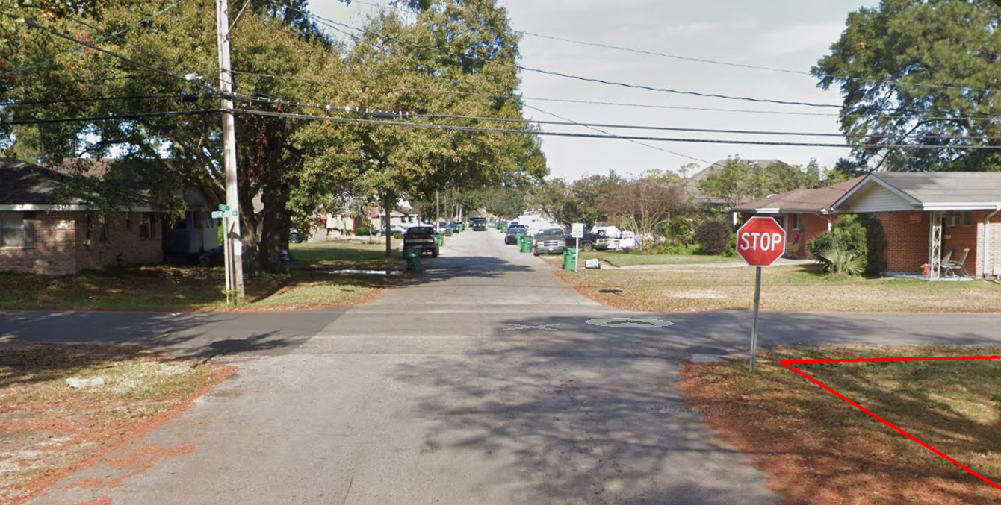
Pepitone v. State Farm Mut. Auto. Ins. Co.
369 So. 2d 267 (La. Ct. App. 1979)
Notes:
LA Ct. App. 1979
Pepitone was driving north on Kent Ave in Metairie.
The intersection of Kent Ave and Camphor Street was controlled by a stop sign.
But the stop sign was obscured by trees and shrubs growing IN the ROW.
Pepitone entered the intersection without stopping, crashed, and was fatally injured.
Pepitone’s estate sued Jefferson Parish and the adjacent landowner.
Trial court dismissed both actions, and the estate appealed. AFFIRMED.

Slide 148
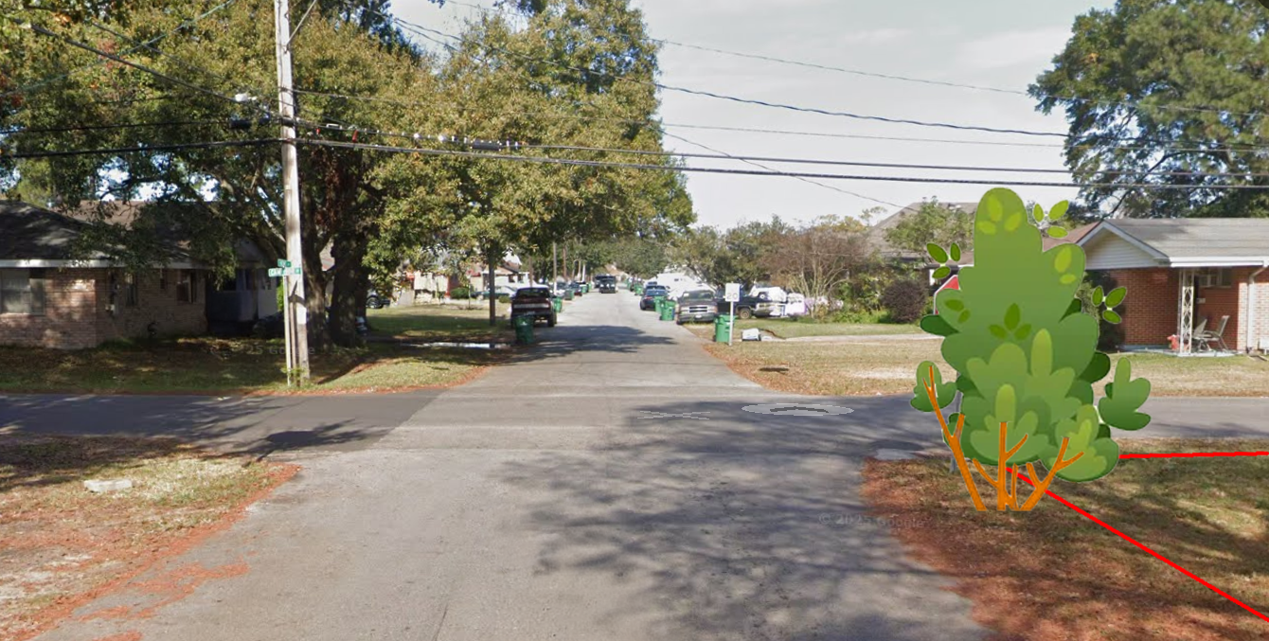
Pepitone v. State Farm Mut. Auto. Ins. Co.
369 So. 2d 267 (La. Ct. App. 1979)
Notes:
LA Ct. App. 1979
Pepitone was driving north on Kent Ave in Metairie.
The intersection of Kent Ave and Camphor Street was controlled by a stop sign.
But the stop sign was obscured by trees and shrubs growing IN the ROW.
Pepitone entered the intersection without stopping, crashed, and was fatally injured.
Pepitone’s estate sued Jefferson Parish and the adjacent landowner.
Trial court dismissed both actions, and the estate appealed. AFFIRMED.

Slide 149
Pepitone v. State Farm Mut. Auto. Ins. Co.
369 So. 2d 267 (La. Ct. App. 1979)
“The owner of property abutting the right of way…has no duty to motorists using the street to trim or remove trees…growing on the right of way which may obstruct traffic signs and controls.”
“‘damage occasioned by…things which we have in our custody’ does not extend to…things located on adjoining property”

Slide 150
Pepitone v. State Farm Mut. Auto. Ins. Co.
369 So. 2d 267 (La. Ct. App. 1979)
“a motorist approaching an uncontrolled intersection must proceed as if there were yield signs controlling traffic in all directions”
“an obstructed stop sign at an intersection of local neighborhood streets of equal dignity does not, as a matter of law, constitute a trap to motorists”
Trees obstructing the sign did not cause the crash

Slide 151
Pepitone v. State Farm Mut. Auto. Ins. Co.
369 So. 2d 267 (La. Ct. App. 1979)
Notes:
LA Ct. App. 1979
Pepitone was driving north on Kent Ave in Metairie.
The intersection of Kent Ave and Camphor Street was controlled by a stop sign.
But the stop sign was obscured by trees and shrubs growing IN the ROW.
Pepitone entered the intersection without stopping, crashed, and was fatally injured.
Pepitone’s estate sued Jefferson Parish and the adjacent landowner.
Trial court dismissed both actions, and the estate appealed. AFFIRMED.

Slide 152
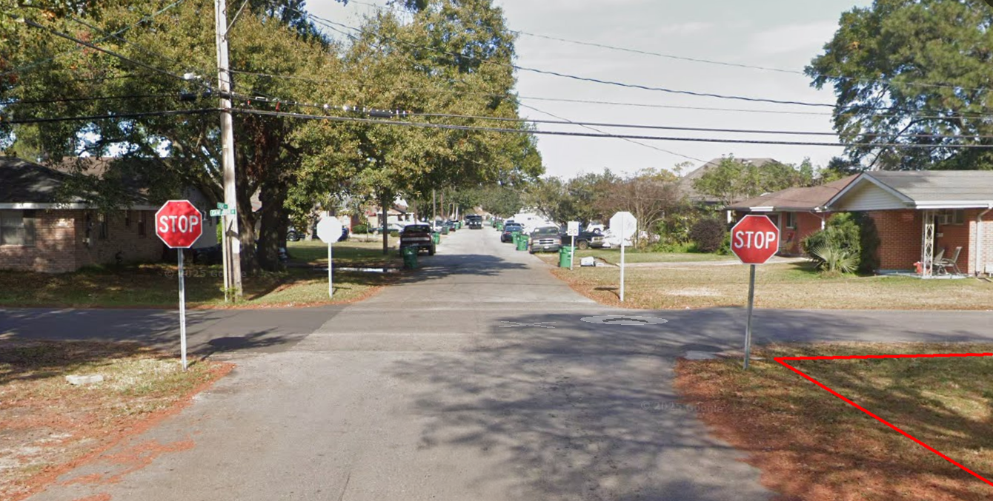
Pepitone v. State Farm Mut. Auto. Ins. Co.
369 So. 2d 267 (La. Ct. App. 1979)
Notes:
Now, there are stop signs at all four corners of the intersection.

Slide 153
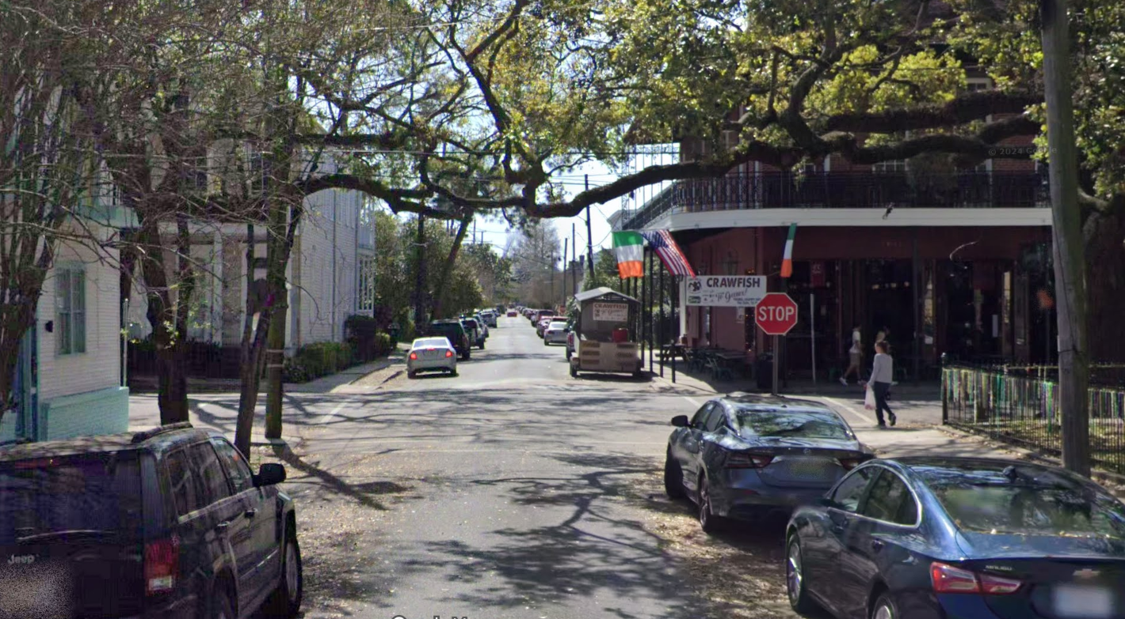
Brown v. Merz
429 So. 2d 463 (La. Ct. App. 1983)
Notes:
LA Ct. App. 1983
July 23, 1981, just after midnight. Beth Merz and Debbie McCloskey were coming home from a party, driving south on 3rd St.
The stop sign at Magazine St was obscured by a crape myrtle tree. They ran the stop sign and were broadsided by a car driven by Tom Brown. All were injured.
Trial judge held in favor of the injured parties against the City of New Orleans. City appealed. REVERSED.

Slide 154
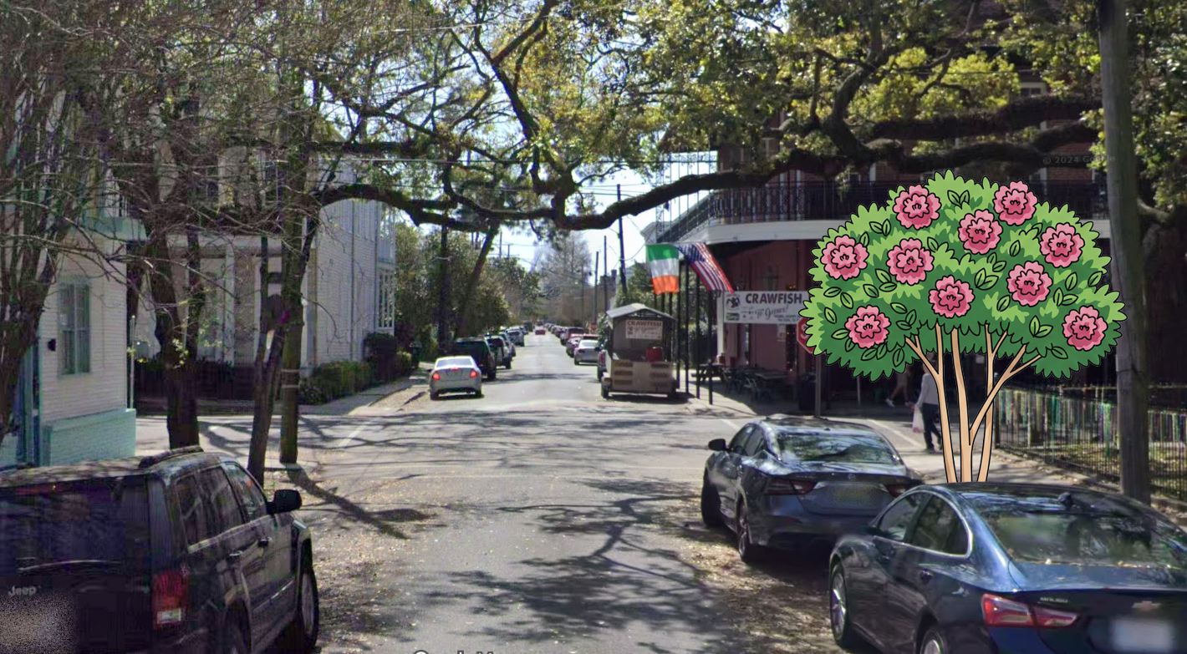
Brown v. Merz
429 So. 2d 463 (La. Ct. App. 1983)

Slide 155
Brown v. Merz
429 So. 2d 463 (La. Ct. App. 1983)
“a motorist who approaches an uncontrolled intersection with a street of equal dignity…must regard such an intersection as having an imaginary yield sign facing him”
“if there can be no trap created where the intersection streets appear to be of equal dignity, there certainly can be no trap…on an inferior street”
“Merz’ negligence [was] the sole legal cause of the accident”

Slide 156
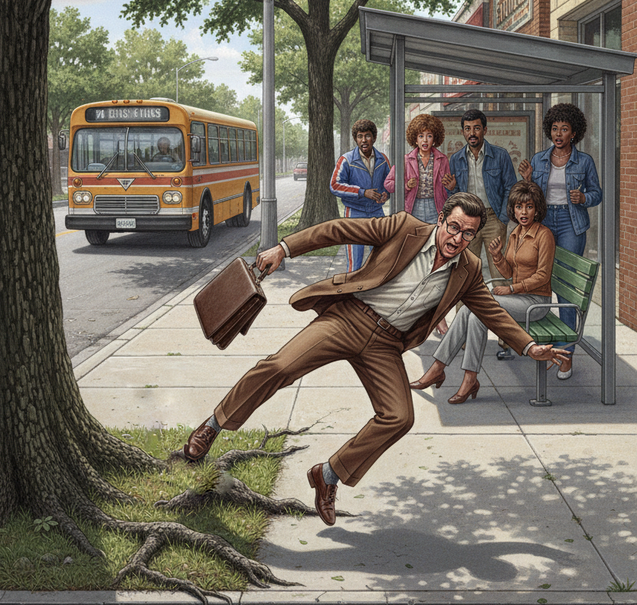
Alexander v. Lafayette
584 So. 2d 327 (La. Ct. App. 1991)
Notes:
LA Cit. App. 1991
December 15, 1983: Ravis Alexander was walking on the sidewalk past a bus stop in Lafayette, LA
He stepped briefly off the sidewalk, and took a few steps on the city-owned grassy area.
Alexander tripped on an exposed tree root and was injured. Alexander sued the City.
Trial court dismissed the action. Alexander appealed. AFFIRMED.

Slide 157
Alexander v. Lafayette
584 So. 2d 327 (La. Ct. App. 1991)
“An exposed tree root alone does not present an unreasonable risk of harm any more than irregularities and depressions such as ruts in a driveway…; or a cup-shaped hole on a vacant lot…; or a stump hole”
“The yard of a residence is not intended or expected to have a completely ‘tabletop’ smooth surface.”

Slide 158
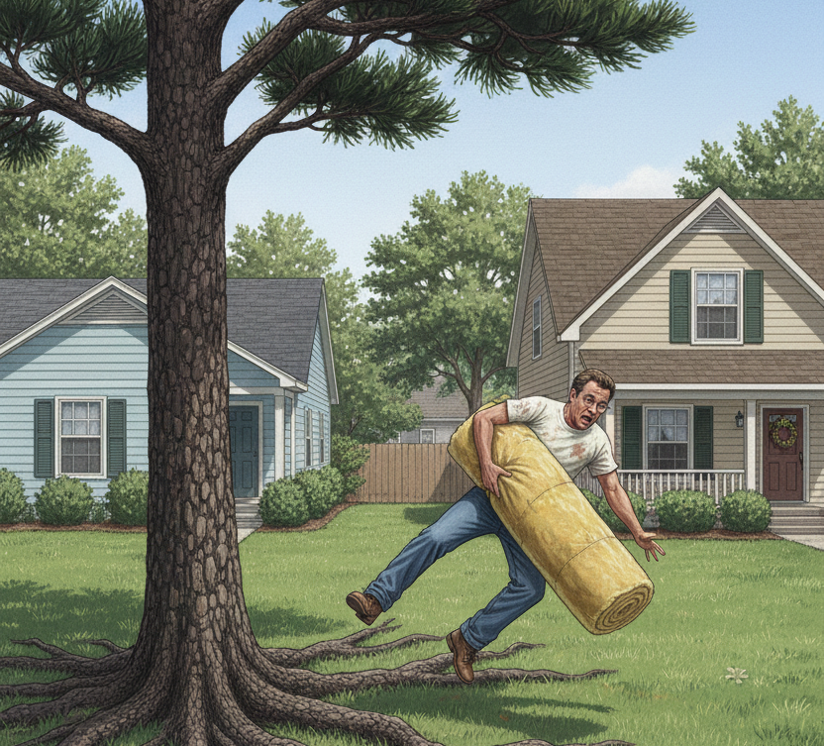
White v. Louviere
664 So. 2d 603 (La. Ct. App. 1995)
Notes:
LA Ct. App. 1995
Joseph White and Henry Louviere were neighbors in St. Martin Parish.
Roots from Louviere’s tree grew across the property line and were 4-8 inches above the surface of the soil.
White complained, and Louviere gave White permission to cut the roots, but White never did.
While carrying a roll of insulation, White tripped over one of the roots and was injured.
White sued. The trial court dismissed the case. White appealed. REVERSED.

Slide 159
White v. Louviere
664 So. 2d 603 (La. Ct. App. 1995)
By giving White permission to cut the roots, “Louviere exercised supervision and control over the roots”
Louviere planted the trees
“Ownership allows presumption of custody”
BUT
Not “unreasonable risk”

Slide 160
White v. Louviere
664 So. 2d 603 (La. Ct. App. 1995)
HOWEVER
LA Civ. Code §667: “Although a proprietor may do with his estate whatever he pleases, still he can not make any work on it, which may deprive his neighbor of the liberty of enjoying his own, or which may be the cause of any damage to him.”

Slide 161
White v. Louviere
664 So. 2d 603 (La. Ct. App. 1995)
“The basis for liability under LA Civ. Code §667 is that an owner is abusing his right of ownership to the point where it interferes with his neighbor’s right to enjoy the ownership of his property.”
“[White] has satisfied his burden of proof by showing that he has suffered damages to his knee and that his injuries were caused by the tree roots growing on his property from defendant’s tree.”

Slide 162
Urban Forestry - Summary
Stop Signs
Trip and Fall
  Unreasonable Risk of Harm
  Nuisance

Slide 163
Summary
Risk Assessments and Acts of God
Right of Self-Help
Tree Valuation
Urban Forestry
Notes:
Total Cases: 19 (+4)
Risk Assessments: 6 (+1)
Self-Help: 5
Valuation: 5 (+2)
Urban Forestry: 3 (+1)

Slide 164
Battle of the Branches:
Key Rulings Illustrating Louisiana Tree Law
James Komen
BCMA #WE-9909B
RCA #555
Notes:
Total Cases: 19 (+4)
Risk Assessments: 6 (+1)
Self-Help: 5
Valuation: 5 (+2)
Urban Forestry: 3 (+1)

Slide 165
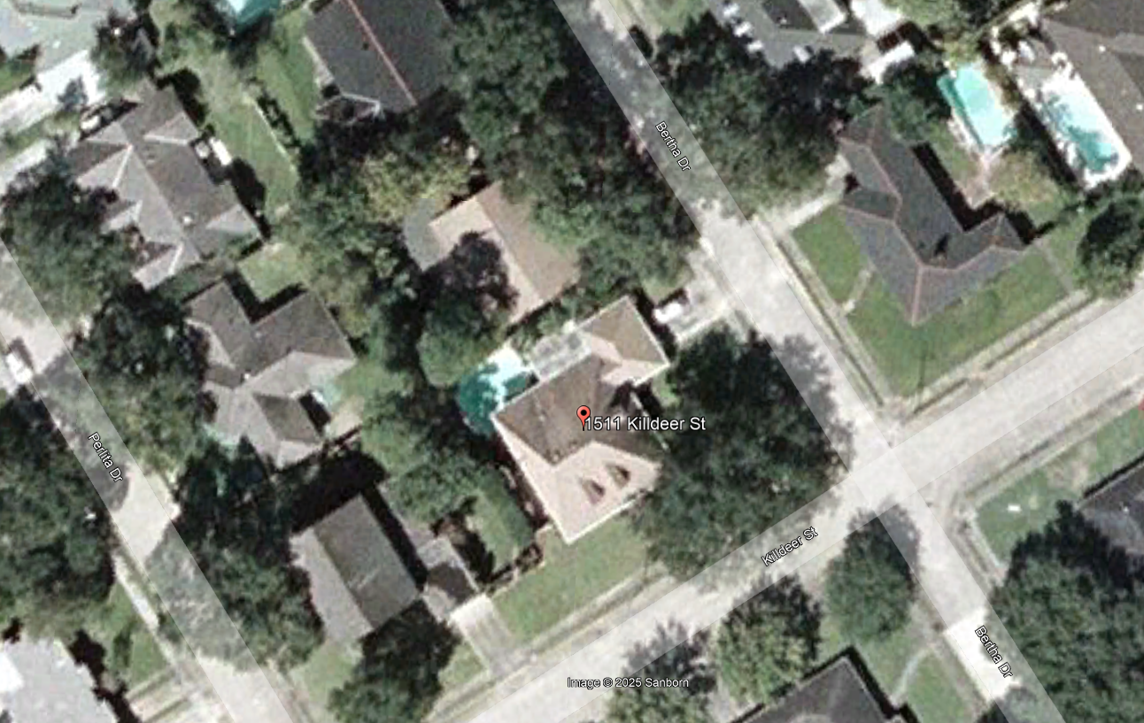
Hoerner v. Title
968 So. 2d 217 (La. Ct. App. 2007)
Notes:
LA Ct. App. 2007
In 2005, Linda and Harry Hoerner had lived at 1511 Killdeer St in New Orleans for the past 25 years.
Their neighbor Beulah Title had large trees that overhung the property line.
Many times, the Hoerners complained, and the Hoerners pruned them back, with Title’s permission.
In Hurricane Katrina, Title’s trees fell onto the Hoerner property, causing damage. Hoerners sued.
Trial court held Title NOT LIABLE for “failure to maintain.” Hoerners appealed. Affirmed.

Slide 166
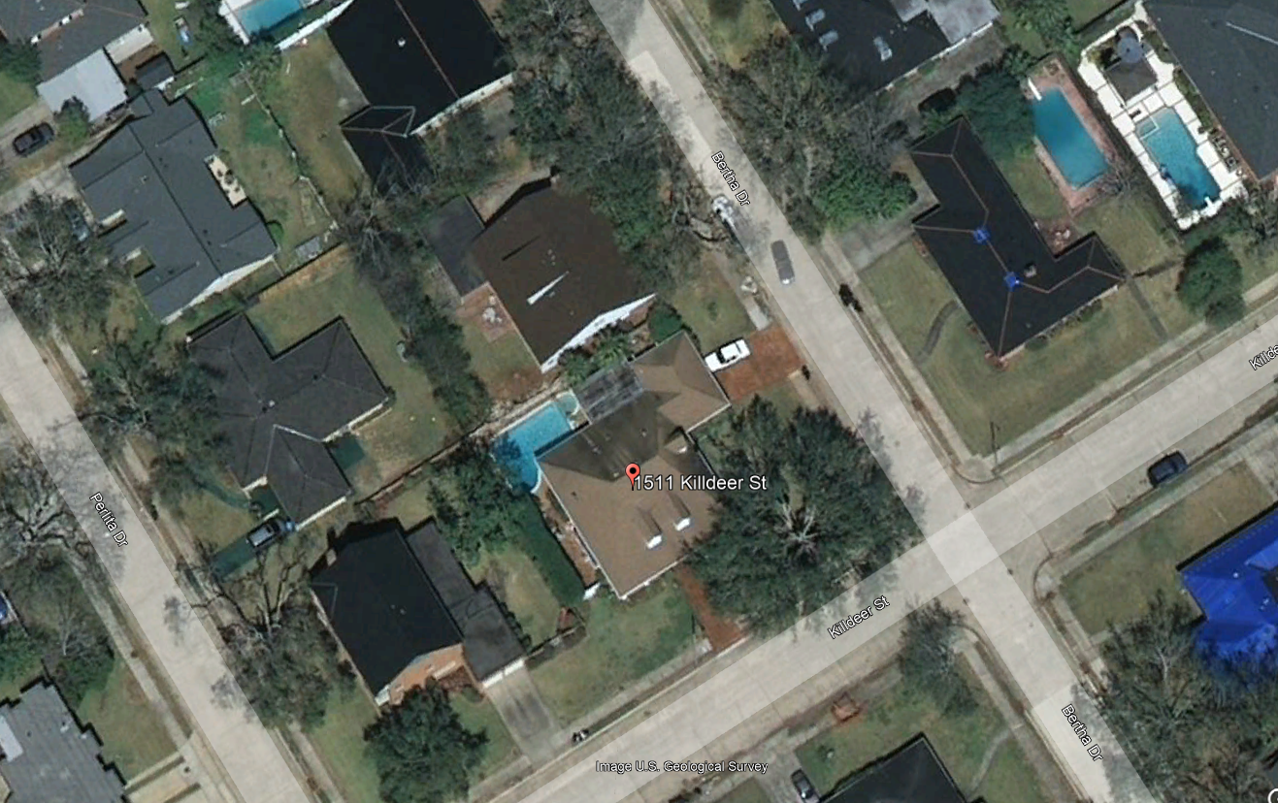
Hoerner v. Title
968 So. 2d 217 (La. Ct. App. 2007)
Notes:
LA Ct. App. 2007
In 2005, Linda and Harry Hoerner had lived at 1511 Killdeer St in New Orleans for the past 25 years.
Their neighbor Beulah Title had large trees that overhung the property line.
Many times, the Hoerners complained, and the Hoerners pruned them back, with Title’s permission.
In Hurricane Katrina, Title’s trees fell onto the Hoerner property, causing damage. Hoerners sued.
Trial court held Title NOT LIABLE for “failure to maintain.” Hoerners appealed. Affirmed.

Slide 167
Hoerner v. Title
968 So. 2d 217 (La. Ct. App. 2007)
“…the trees were blown over by the hurricane; the damage was not caused by branches hanging over the wall”
“Hurricane Katrina caused trees to fall and damage property regardless of maintenance and/or location”

