Slide 1
Tree Risk Assessment and Legal Liability in Nebraska
James Komen
BCMA #WE-9909B
RCA #555

Slide 2
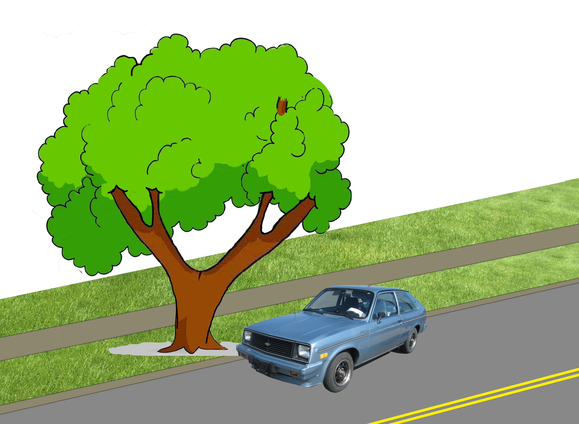
Negligence
Duty
Breach
Causation
Damages

Slide 3
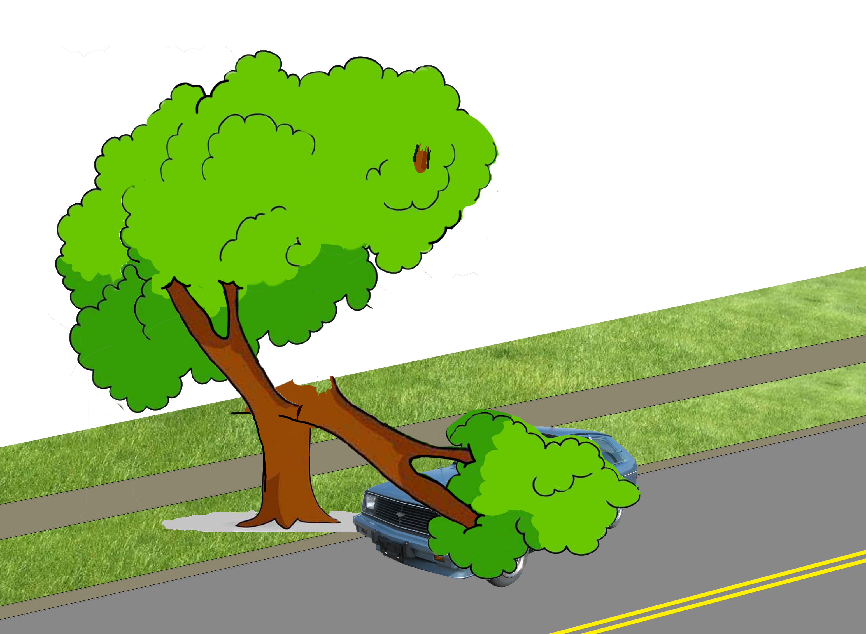
Negligence
Duty
Breach
Causation
Damages

Slide 4
Duty
Duty to Inspect
Duty to Mitigate Known Hazards

Slide 5
Breach
“Knowledge” of a defect
That would alert a reasonable person to act
With sufficient time to act
“The fact that the tree fell does not, by itself, prove negligence.”
McGinn v. Omaha 217 Neb. 579 (Sup. Ct. 1984)

Slide 6
Causation
“Knowledge” of defect would lead to further inspection
Further inspection would lead to mitigation action
Before harm would occur

Slide 7
Levels of Assessment
Level 1 Limited Visual
Level 2 Basic
Level 3 Advanced

Slide 8
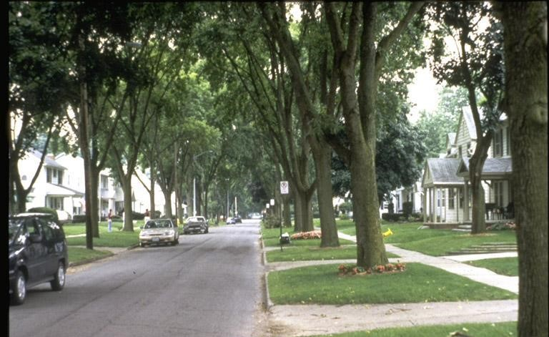
Levels of Assessment
Level 1 Limited Visual
Level 2 Basic
Level 3 Advanced

Slide 9
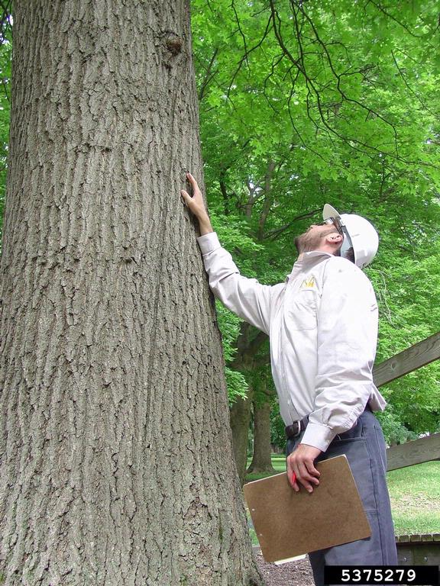
Levels of Assessment
Level 1 Limited Visual
Level 2 Basic
Level 3 Advanced

Slide 10
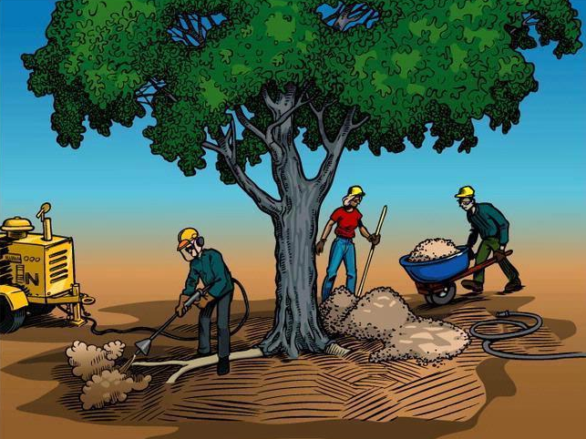
Levels of Assessment
Level 1 Limited Visual
Level 2 Basic
Level 3 Advanced

Slide 11
Indicators of Decay

Slide 12
Indicators of Decay
Definite Indicators
Fungal fruiting bodies
Cavity openings
Carpenter ants nesting in tree

Slide 13
Indicators of Decay
Definite Indicators
Potential Indicators
Fungal fruiting bodies
Cavity openings
Carpenter ants nesting in tree
Response growth
Dead or missing bark
Old wounds
Sap ooze
Declining health

Slide 14
Who Decides a Case

Slide 15


Who Decides a Case
Findings of Fact
Conclusions of Law

Slide 16
Who Decides a Case
Findings of Fact
Conclusions of Law
OR
Jury Trial
Bench Trial
Judge Only

Slide 17

Standard of Review
Appellate Court

Slide 18
Standard of Review
Appellate Court
Findings of Fact
Conclusions of Law

Slide 19

Standard of Review
Appellate Court
Findings of Fact
Conclusions of Law

Slide 20

Standard of Review

Slide 21

Standard of Review

Slide 22

Standard of Review

Slide 23

Standard of Review

Slide 24
Tree Risk and Nebraska Case Law
McGinn v. Omaha
217 Neb. 579 (Sup. Ct. 1984)
Mott v. City of Omaha
1993 Neb. App. LEXIS 358 (Ct. App. 1993) Unpublished
Holts v. City of Omaha
2002 WL 31002306 (Ct. App. 2002) Unpublished

Slide 25
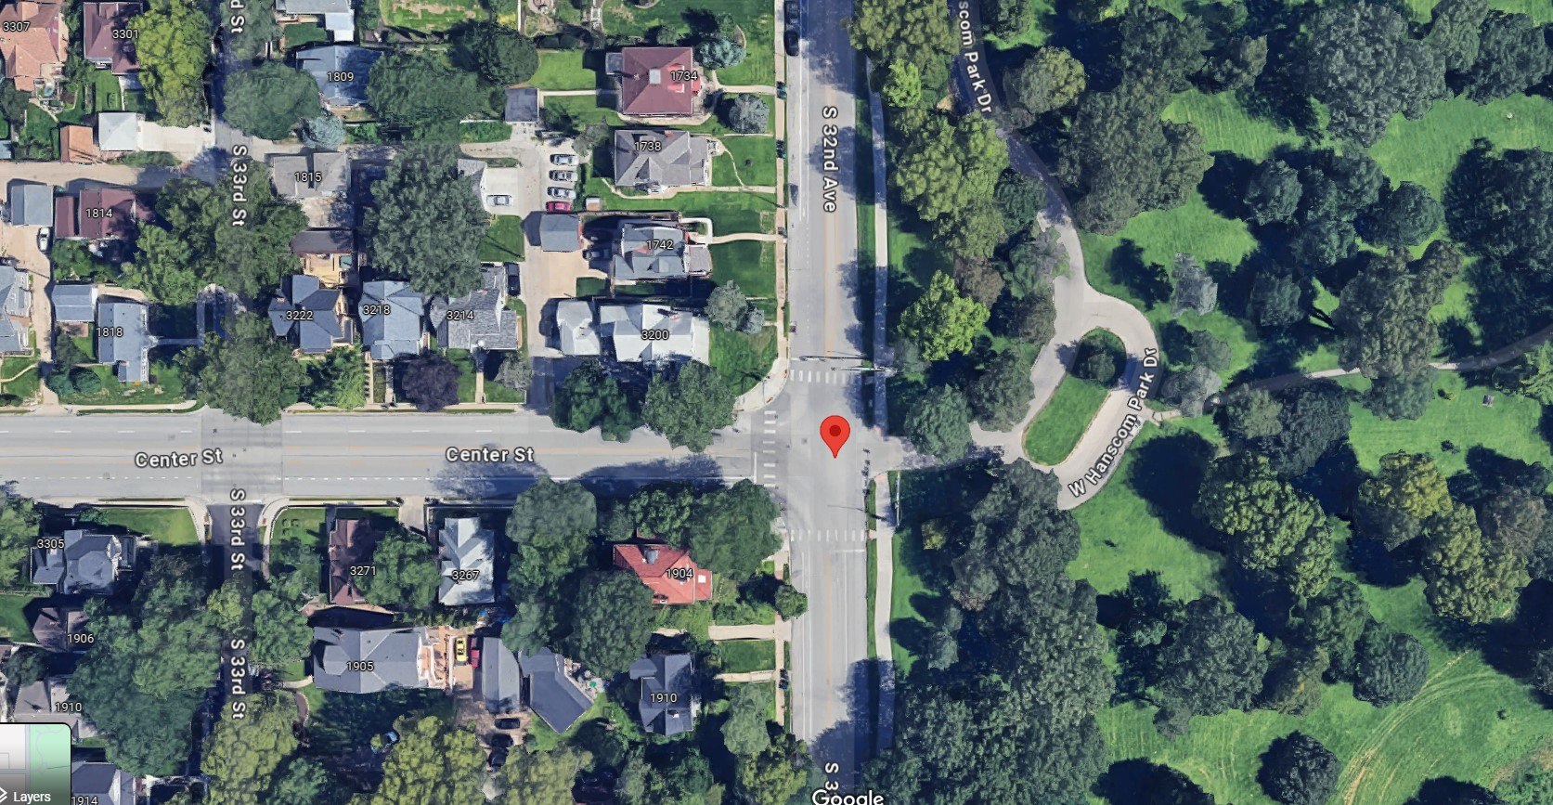
McGinn v. Omaha
217 Neb. 579 (Sup. Ct. 1984)
Notes:
June 1980 failure
Peter McGinn
32nd and Center Streets, near Hanscom Park in Omaha
Driver pulled over in a violent storm, parking beneath silver maple street tree
Quadriplegia

Slide 26
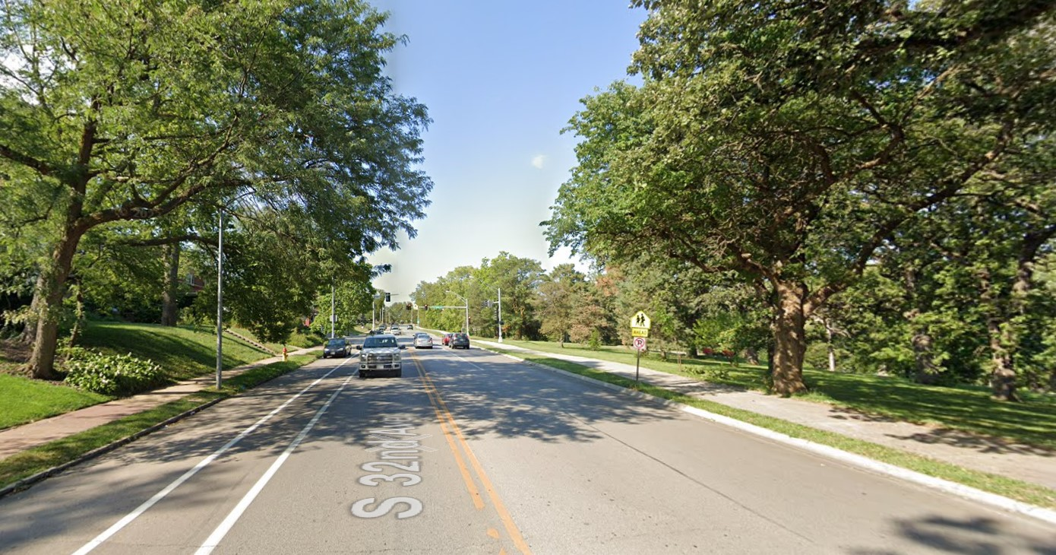
McGinn v. Omaha
217 Neb. 579 (Sup. Ct. 1984)
Notes:
June 1980 failure
Peter McGinn
32nd and Center Streets, near Hanscom Park in Omaha
Driver pulled over in a violent storm, parking beneath silver maple street tree
Quadriplegia

Slide 27
McGinn v. Omaha
217 Neb. 579 (Sup. Ct. 1984)
π Evidence
Δ Evidence
Silver maple
35-100 years old
Extensive decay
Prior branch failures
“Swollen knots”/ woundwood
“V-crotch”
59,600 street trees & 153,000 park trees
Managed by city forester + 26 field staff
Annual windshield inspections
No open wounds
No conks, cracks, breaks, holes
Notes:
June 1980 failure
Driver pulled over in a violent storm, parking beneath silver maple street tree
Quadriplegia

Slide 28
McGinn v. Omaha
217 Neb. 579 (Sup. Ct. 1984)
π Expert Witness
Δ Expert Witness
Removal ALL 50+ year old silver maples
ALL trees get 15-30 min Level 2 Basic Inspection
Half the city’s trees would be removed
12 min/tree inspection would take 6 inspectors a full year
“One of the best” urban tree inspection programs
Notes:
June 1980 failure
Driver pulled over in a violent storm, parking beneath silver maple street tree
Quadriplegia

Slide 29
McGinn v. Omaha
217 Neb. 579 (Sup. Ct. 1984)
Notes:
June 1980 failure
Driver pulled over in a violent storm, parking beneath silver maple street tree
Quadriplegia

Slide 30
McGinn v. Omaha
217 Neb. 579 (Sup. Ct. 1984)
“π Wins”
Notes:
June 1980 failure
Driver pulled over in a violent storm, parking beneath silver maple street tree
Quadriplegia

Slide 31
McGinn v. Omaha
217 Neb. 579 (Sup. Ct. 1984)
“π Wins”
NE Supreme Ct.
Notes:
June 1980 failure
Driver pulled over in a violent storm, parking beneath silver maple street tree
Quadriplegia

Slide 32
McGinn v. Omaha
217 Neb. 579 (Sup. Ct. 1984)
Notes:
June 1980 failure
Driver pulled over in a violent storm, parking beneath silver maple street tree
Quadriplegia

Slide 33
McGinn v. Omaha
217 Neb. 579 (Sup. Ct. 1984)
π Evidence
Δ Evidence
Silver maple
35-100 years old
Extensive decay
Prior branch failures
“Swollen knots”/ woundwood
“V-crotch”
59,600 street trees & 153,000 park trees
Managed by city forester + 26 field staff
Annual windshield inspections
No open wounds
No conks, cracks, breaks, holes
Notes:
June 1980 failure
Driver pulled over in a violent storm, parking beneath silver maple street tree
Quadriplegia

Slide 34
McGinn v. Omaha
217 Neb. 579 (Sup. Ct. 1984)
π Evidence
Δ Evidence
Silver maple
35-100 years old
Extensive decay
Prior branch failures
“Swollen knots”/ woundwood
“V-crotch”
59,600 street trees & 153,000 park trees
Managed by city forester + 26 field staff
Annual windshield inspections
No open wounds
No conks, cracks, breaks, holes
Notes:
June 1980 failure
Driver pulled over in a violent storm, parking beneath silver maple street tree
Quadriplegia

Slide 35
McGinn v. Omaha
217 Neb. 579 (Sup. Ct. 1984)
π Evidence
Δ Evidence
Silver maple
35-100 years old
Extensive decay
Prior branch failures
“Swollen knots”/ woundwood
“V-crotch”
59,600 street trees & 153,000 park trees
Managed by city forester + 26 field staff
Annual windshield inspections
No open wounds
No conks, cracks, breaks, holes
Notes:
June 1980 failure
Driver pulled over in a violent storm, parking beneath silver maple street tree
Quadriplegia

Slide 36
McGinn v. Omaha
217 Neb. 579 (Sup. Ct. 1984)
π Evidence
Δ Evidence
Silver maple
35-100 years old
Extensive decay
Prior branch failures
“Swollen knots”/ woundwood
“V-crotch”
59,600 street trees & 153,000 park trees
Managed by city forester + 26 field staff
Annual windshield inspections
No open wounds
No conks, cracks, breaks, holes
Notes:
June 1980 failure
Driver pulled over in a violent storm, parking beneath silver maple street tree
Quadriplegia

Slide 37
McGinn v. Omaha
217 Neb. 579 (Sup. Ct. 1984)
π Evidence
Δ Evidence
Silver maple
35-100 years old
Extensive decay
Prior branch failures
“Swollen knots”/ woundwood
“V-crotch”
59,600 street trees & 153,000 park trees
Managed by city forester + 26 field staff
Annual windshield inspections
No open wounds
No conks, cracks, breaks, holes
Notes:
June 1980 failure
Driver pulled over in a violent storm, parking beneath silver maple street tree
Quadriplegia

Slide 38
McGinn v. Omaha
217 Neb. 579 (Sup. Ct. 1984)
π Evidence
Δ Evidence
Silver maple
35-100 years old
Extensive decay
Prior branch failures
“Swollen knots”/ woundwood
“V-crotch”
59,600 street trees & 153,000 park trees
Managed by city forester + 26 field staff
Annual windshield inspections
No open wounds
No conks, cracks, breaks, holes
Notes:
June 1980 failure
Driver pulled over in a violent storm, parking beneath silver maple street tree
Quadriplegia

Slide 39
McGinn v. Omaha
217 Neb. 579 (Sup. Ct. 1984)
π Evidence
Δ Evidence
Silver maple
35-100 years old
Extensive decay
Prior branch failures
“Swollen knots”/ woundwood
“V-crotch”
59,600 street trees & 153,000 park trees
Managed by city forester + 26 field staff
Annual windshield inspections
No open wounds
No conks, cracks, breaks, holes
Notes:
June 1980 failure
Driver pulled over in a violent storm, parking beneath silver maple street tree
Quadriplegia

Slide 40
McGinn v. Omaha
217 Neb. 579 (Sup. Ct. 1984)
“…no testimony…that a reasonable investigation would have revealed the extent of the decay”
“[no evidence that] indicators of decay…were readily visible from an onstreet inspection.”
“…external symptoms did not reveal the extent of decay”
“…a careful examination would not indicate the extent of the decay”

Slide 41
McGinn v. Omaha
217 Neb. 579 (Sup. Ct. 1984)
Notes:
Court decides the case AS A MATTER OF LAW, not FACT

Slide 42
McGinn v. Omaha
217 Neb. 579 (Sup. Ct. 1984)
Notes:
Court decides the case AS A MATTER OF LAW, not FACT

Slide 43
McGinn v. Omaha
217 Neb. 579 (Sup. Ct. 1984)
Level 1 Inspection

Slide 44
McGinn v. Omaha
217 Neb. 579 (Sup. Ct. 1984)
Level 1 Inspection
  IF EXTERNAL INDICATOR:
  Level 2 Inspection

Slide 45
McGinn v. Omaha
217 Neb. 579 (Sup. Ct. 1984)
Level 1 Inspection
  IF EXTERNAL INDICATOR:
  Level 2 Inspection
    IF INDICATOR OF EXTENSIVE DECAY:
    Mitigation Action

Slide 46
McGinn v. Omaha
217 Neb. 579 (Sup. Ct. 1984)
Level 1 Inspection
  IF EXTERNAL INDICATOR:
  Level 2 Inspection
    IF INDICATOR OF EXTENSIVE DECAY:
    Mitigation Action

Slide 47
McGinn v. Omaha
217 Neb. 579 (Sup. Ct. 1984)
Level 1 Inspection
  IF EXTERNAL INDICATOR:
  Level 2 Inspection
    IF INDICATOR OF EXTENSIVE DECAY:
    Mitigation Action

Slide 48
McGinn v. Omaha
217 Neb. 579 (Sup. Ct. 1984)
Dissent:
“…the crux of this case is not inspection of 10,000 silver maples, but the city’s inspection of just one tree.”

Slide 49
McGinn v. Omaha
217 Neb. 579 (Sup. Ct. 1984)
Dissent:
Silver maple
35-100 years old
Extensive decay
Prior branch failures
“Swollen knots”/ woundwood
“V-crotch”
59,600 street trees & 153,000 park trees
Managed by city forester + 26 field staff
Annual windshield inspections
No open wounds
No conks, cracks, breaks, holes

Slide 50
McGinn v. Omaha
217 Neb. 579 (Sup. Ct. 1984)
Dissent:
Silver maple
35-100 years old
Extensive decay
Prior branch failures
“Swollen knots”/ woundwood
“V-crotch”
59,600 street trees & 153,000 park trees
Managed by city forester + 26 field staff
Annual windshield inspections
No open wounds
No conks, cracks, breaks, holes

Slide 51
McGinn v. Omaha
217 Neb. 579 (Sup. Ct. 1984)
Dissent:
Notes:
June 1980 failure
Driver pulled over in a violent storm, parking beneath silver maple street tree
Quadriplegia

Slide 52
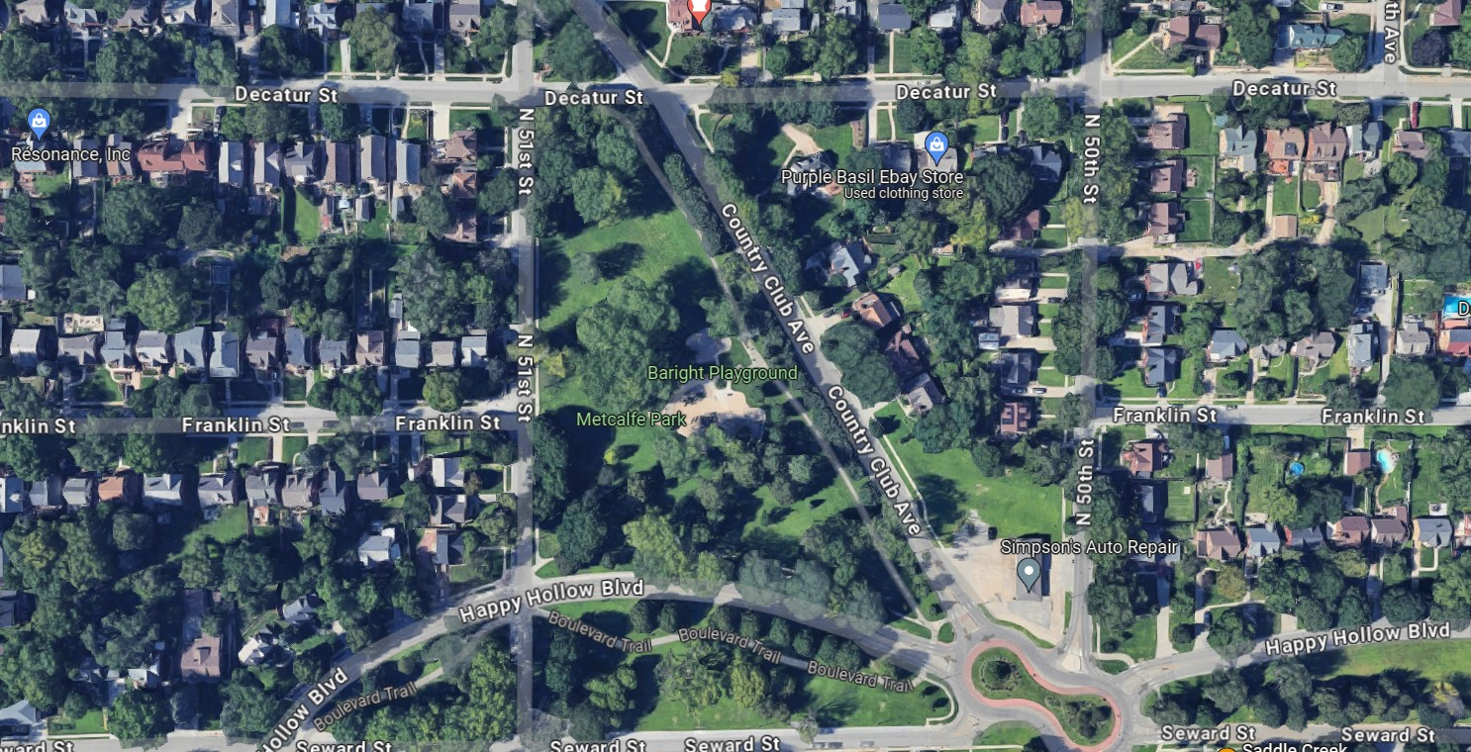
Mott v. City of Omaha
1993 Neb. App. LEXIS 358 (Ct. App. 1993)
Unpublished
Notes:
June 1988 failure
Clayton Mott driving by Metcalfe Park
Large branch from silver maple park tree fell on passing driver in severe thunderstorm, quadriplegic

Slide 53
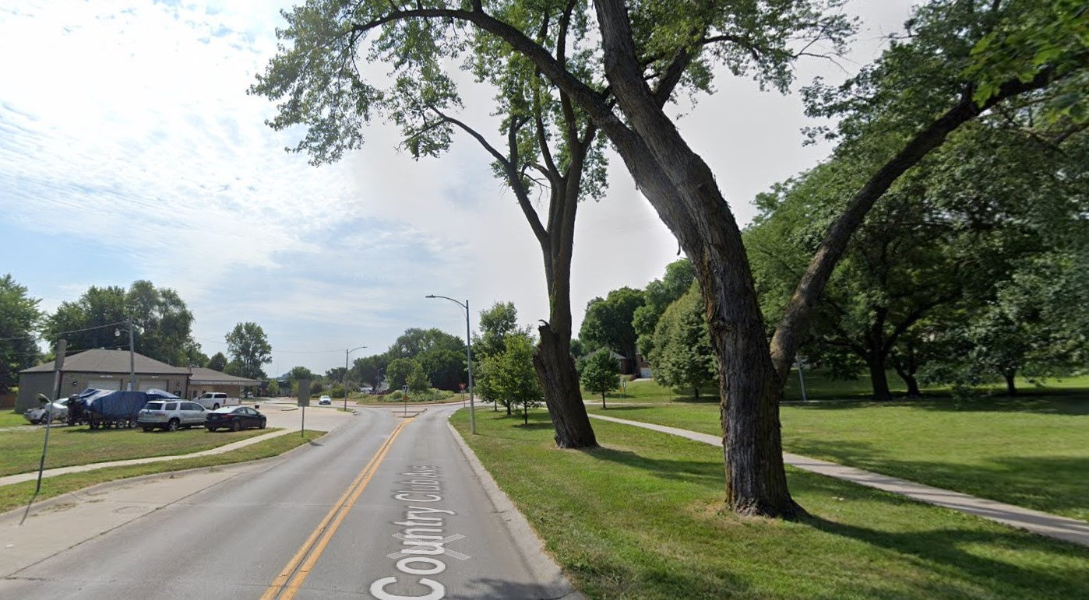
Mott v. City of Omaha
1993 Neb. App. LEXIS 358 (Ct. App. 1993)
Unpublished
Notes:
June 1988 failure
Clayton Mott driving by Metcalfe Park
Large branch from silver maple park tree fell on passing driver in severe thunderstorm, quadriplegic

Slide 54
Mott v. City of Omaha
1993 Neb. App. LEXIS 358 (Ct. App. 1993)
Unpublished
π Evidence
Δ Evidence
Epicormic branching
Old pruning wound
Open cavity at base
Mower-damaged roots
Bark loss on buttress roots
Chlorotic leaves
“Frass”
City removed tree after failure
Callous formation
Cavity only 5 inches deep
Splintered break at point of failure
>50% holding wood
Included bark at union visible from aerial lift, but not the ground
Drive-by inspection observed chlorosis and mower damage but did not probe cavity

Slide 55
Mott v. City of Omaha
1993 Neb. App. LEXIS 358 (Ct. App. 1993)
Unpublished
π Expert Witness
Δ Expert Witness
Epicormic branching indicates tree was stressed
“Frass” indicates wood-boring insects
Chlorosis indicates stress
Callous wood indicates the tree has successfully responded to decay
“Frass” was only soil or sawdust, but not insect detritus
Splintered wood indicates little decay
Mower damage not significant for branch failure

Slide 56
Mott v. City of Omaha
1993 Neb. App. LEXIS 358 (Ct. App. 1993)
Unpublished
Other Notable Points:
  Changed testimony
  Spoliation
  Subsequent remedial measures
Notes:
- City forester changed testimony at deposition. First, he was presented a photo of the tree, and he said he would take it out. Then he was told it was THE tree, and he said he would keep it.
Just because testimony is different doesn’t mean it should be excluded. He got new information (ID of the tree), so maybe he incorporated info he knew about his in-person inspection of the tree.
- Just because branch destroyed doesn’t mean adverse inference. Branch cleanup is normal, court didn’t impose a duty to preserve the branch here
- “Hindsight” is not measured by the same standard as “foresight”

Slide 57
Mott v. City of Omaha
1993 Neb. App. LEXIS 358 (Ct. App. 1993)
Unpublished
Notes:
June 1980 failure
Driver pulled over in a violent storm, parking beneath silver maple street tree
Quadriplegia

Slide 58
Mott v. City of Omaha
1993 Neb. App. LEXIS 358 (Ct. App. 1993)
Unpublished
Bench Trial
Notes:
June 1980 failure
Driver pulled over in a violent storm, parking beneath silver maple street tree
Quadriplegia

Slide 59
Mott v. City of Omaha
1993 Neb. App. LEXIS 358 (Ct. App. 1993)
Unpublished
Bench Trial
“equipoise”
Notes:
June 1980 failure
Driver pulled over in a violent storm, parking beneath silver maple street tree
Quadriplegia

Slide 60
Mott v. City of Omaha
1993 Neb. App. LEXIS 358 (Ct. App. 1993)
Unpublished
Bench Trial
NE Ct. App.
“equipoise”
Notes:
June 1980 failure
Driver pulled over in a violent storm, parking beneath silver maple street tree
Quadriplegia

Slide 61
Mott v. City of Omaha
1993 Neb. App. LEXIS 358 (Ct. App. 1993)
Unpublished
Changed testimony: new information OK
Spoliation: no bad faith
Subsequent remediation: “hindsight” is not “foresight”
Notes:
- City forester changed testimony at deposition. First, he was presented a photo of the tree, and he said he would take it out. Then he was told it was THE tree, and he said he would keep it.
Just because testimony is different doesn’t mean it should be excluded. He got new information (ID of the tree), so maybe he incorporated info he knew about his in-person inspection of the tree.
- Just because branch destroyed doesn’t mean adverse inference. Branch cleanup is normal, court didn’t impose a duty to preserve the branch here
- “Hindsight” is not measured by the same standard as “foresight”

Slide 62
Mott v. City of Omaha
1993 Neb. App. LEXIS 358 (Ct. App. 1993)
Unpublished

Slide 63
Mott v. City of Omaha
1993 Neb. App. LEXIS 358 (Ct. App. 1993)
Unpublished

Slide 64
Mott v. City of Omaha
1993 Neb. App. LEXIS 358 (Ct. App. 1993)
Unpublished
Level 1 Inspection
  IF EXTERNAL INDICATOR:
  Level 2 Inspection
    IF INDICATOR OF EXTENSIVE DECAY:
    Mitigation Action

Slide 65
Mott v. City of Omaha
1993 Neb. App. LEXIS 358 (Ct. App. 1993)
Unpublished
Level 1 Inspection
  IF EXTERNAL INDICATOR:
  Level 2 Inspection
    IF INDICATOR OF EXTENSIVE DECAY:
    Mitigation Action

Slide 66
Mott v. City of Omaha
1993 Neb. App. LEXIS 358 (Ct. App. 1993)
Unpublished
Level 1 Inspection
  IF EXTERNAL INDICATOR:
  Level 2 Inspection
    IF INDICATOR OF EXTENSIVE DECAY:
    Mitigation Action

Slide 67
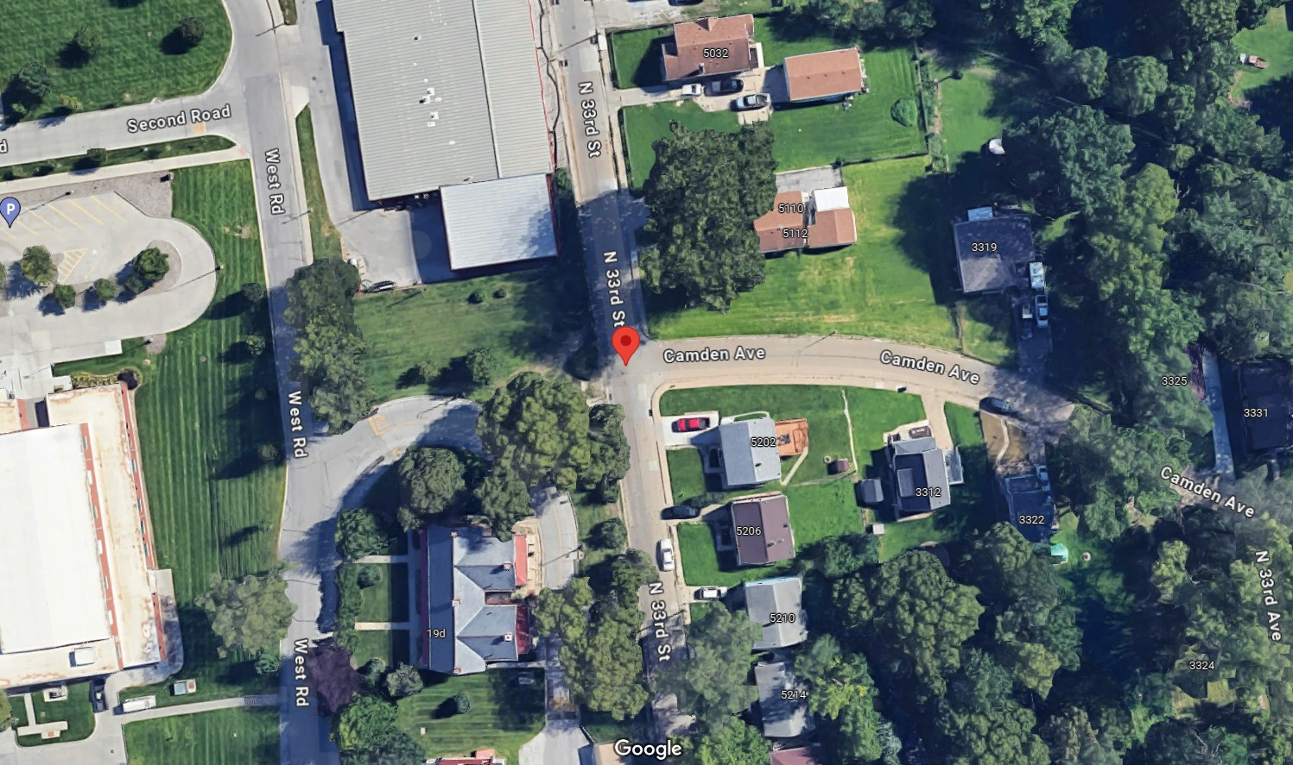
Holts v. City of Omaha
2002 WL 31002306 (Ct. App. 2002)
Unpublished
Notes:
April 1996 failure
Alois Holts, 13 y/o riding a go-cart on his sidewalk was killed, mother brought wrongful death action
Street Tree Green Ash failed in a 50-mph wind

Slide 68
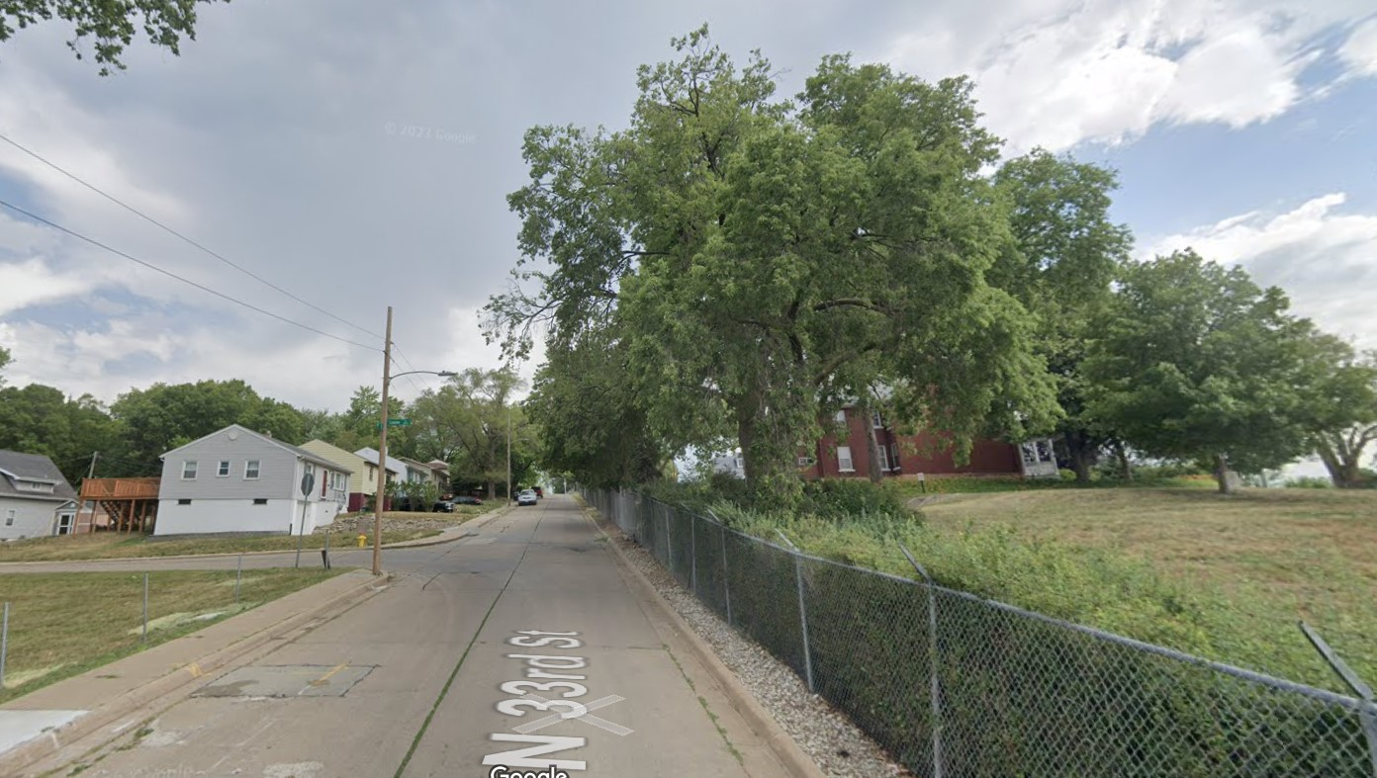
Holts v. City of Omaha
2002 WL 31002306 (Ct. App. 2002)
Unpublished
Notes:
April 1996 failure
Alois Holts, 13 y/o riding a go-cart on his sidewalk was killed, mother brought wrongful death action
Street Tree Green Ash failed in a 50-mph wind

Slide 69
Holts v. City of Omaha
2002 WL 31002306 (Ct. App. 2002)
Unpublished
Inspection
π Evidence
Δ Evidence
Tree was marked with a yellow “X” for more than 1 year
Prior branch failures over past 10 years
City inspected tree after failures and didn’t remove it
Neighbor requested removal 3 or 4 more times, City refused
Same windshield inspection protocol from McGinn
No city records of marking that tree

Slide 70
Holts v. City of Omaha
2002 WL 31002306 (Ct. App. 2002)
Unpublished
Tree Failure
π Evidence
Δ Evidence
Epicormic shoots
Bulge around branch tearout
Extensive decay
Cavity at base of tree
Roots overlapping curb
Prior branch failures
Failed in 50 mph wind
Cavity at branch union was concealed

Slide 71
Holts v. City of Omaha
2002 WL 31002306 (Ct. App. 2002)
Unpublished
π Expert Witness
Δ Expert Witness
Epicormics indicate stress
Bulge indicated unsuccessful compartmentalization
Windshield inspection is NOT reasonable
Drilling tests would have revealed the cavity
Epicormics stimulated by light, not rot
Bulge was response growth that strengthened union
Windshield inspection is reasonable and common
Trunk sounding is imprecise
Drilling tests are invasive

Slide 72
Holts v. City of Omaha
2002 WL 31002306 (Ct. App. 2002)
Unpublished
Trial Court:
  “the manner in which the City inspects for hazardous trees is problematic”
  “the [green ash] had been designated by an X for removal years prior to the time it fell”
  “even if the green ash had not been marked with an X, … it still should have been removed”
Notes:
Trial court rested findings on TWO ALTERNATIVE THEORIES:
- problematic inspection
-

Slide 73
Holts v. City of Omaha
2002 WL 31002306 (Ct. App. 2002)
Unpublished
Notes:
June 1980 failure
Driver pulled over in a violent storm, parking beneath silver maple street tree
Quadriplegia

Slide 74
Holts v. City of Omaha
2002 WL 31002306 (Ct. App. 2002)
Unpublished
Bench Trial
Notes:
June 1980 failure
Driver pulled over in a violent storm, parking beneath silver maple street tree
Quadriplegia

Slide 75
Holts v. City of Omaha
2002 WL 31002306 (Ct. App. 2002)
Unpublished
Bench Trial
“π Wins”
Notes:
June 1980 failure
Driver pulled over in a violent storm, parking beneath silver maple street tree
Quadriplegia

Slide 76
Holts v. City of Omaha
2002 WL 31002306 (Ct. App. 2002)
Unpublished
Bench Trial
NE Ct. App.
“π Wins”
Notes:
June 1980 failure
Driver pulled over in a violent storm, parking beneath silver maple street tree
Quadriplegia

Slide 77
Holts v. City of Omaha
2002 WL 31002306 (Ct. App. 2002)
Unpublished
Windshield inspections OK generally
  BUT must inspect L2 if defect
Does not opine on whether City’s methods of inspection are OK
π wins IF EITHER:
  Tree marked for removal (city knew) OR
  External indicators would have led to inspection/removal

Slide 78
Holts v. City of Omaha
2002 WL 31002306 (Ct. App. 2002)
Unpublished

Slide 79
Holts v. City of Omaha
2002 WL 31002306 (Ct. App. 2002)
Unpublished

Slide 80
Holts v. City of Omaha
2002 WL 31002306 (Ct. App. 2002)
Unpublished
Level 1 Inspection
  IF EXTERNAL INDICATOR:
  Level 2 Inspection
    IF INDICATOR OF EXTENSIVE DECAY:
    Mitigation Action

Slide 81
Holts v. City of Omaha
2002 WL 31002306 (Ct. App. 2002)
Unpublished
Level 1 Inspection
  IF EXTERNAL INDICATOR:
  Level 2 Inspection
    IF INDICATOR OF EXTENSIVE DECAY:
    Mitigation Action

Slide 82
Tree Risk and Nebraska Case Law

Slide 83
Tree Risk and Nebraska Case Law
McGinn
Mott
Holts
NE Supreme Court
(1984)
NE Court of Appeals
(1993)
NE Court of Appeals
(2002)

Slide 84

Tree Risk and Nebraska Case Law
McGinn
Mott
Holts

Slide 85
Tree Risk and Nebraska Case Law
McGinn
Mott
Holts
Burden of higher level inspections or mass removals exceeds the benefit of risk reduction
“Hindsight” is not “foresight”
Windshield inspection OK generally, but must L2 if defect

Slide 86
Tree Risk Assessment and Legal Liability in Nebraska
James Komen
BCMA #WE-9909B
RCA #555

