Slide 1
Wielding the A300 Standards: The Shield and the Sword
James Komen
BCMA #WE-9909B
RCA #555
www.jameskomen.com
jameskomen@gmail.com

Slide 2
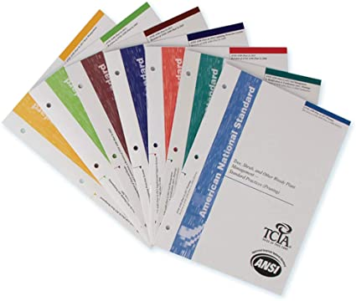
ANSI A300 Standards
American National Standards Institute
Consensus Document
Notes:
“Substantial Agreement” by “directly and materially affected interests”
More than SIMPLE MAJORITY, but not necessarily UNANIMITY
Examples of interests: ISA, TCIA, ASCA, USDA Forest Service, Utility Arborist Association, Large Private Companies: Davey and Bartlett

Slide 3
Language of the Standards

Slide 4
Language of the Standards
SHALL
SHOULD
ONLY
NOT
OR
AND
ALL
ANY

Slide 5
Language of the Standards
SHALL
SHOULD
ONLY
NOT
OR
AND
ALL
ANY

Slide 6
Language of the Standards
SHALL
SHOULD

Slide 7
Language of the Standards
10.45 “As used in this standard, denotes a mandatory requirement”
Annex C-2: “A mandatory requirement is not optional and must be followed for ANSI A300 compliance”
SHALL

Slide 8
Language of the Standards
10.45 “As used in this standard, denotes a mandatory requirement”
Annex C-2: “A mandatory requirement is not optional and must be followed for ANSI A300 compliance”
SHALL

Slide 9
Language of the Standards
10.48 “As used in this standard, denotes an advisory recommendation”
Annex C-1: “Advisory recommendations may not be followed when defensible reasons for non-compliance exist.”
SHOULD

Slide 10
Language of the Standards
10.48 “As used in this standard, denotes an advisory recommendation”
Annex C-1: “Advisory recommendations may not be followed when defensible reasons for non-compliance exist.”
SHOULD

Slide 11
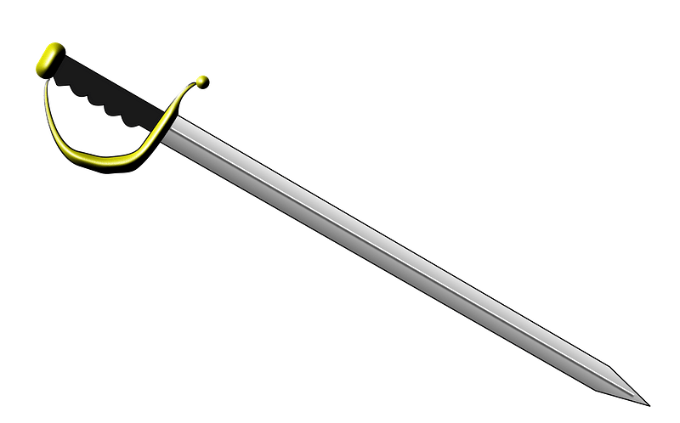

Slide 12
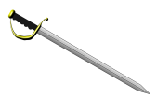
Applicability to Individuals

Slide 13
Applicability to Individuals
1.3: “ANSI A300 standards shall apply to any person or entity engaged in the management of trees, shrubs, palms, or other woody plants, including federal, state, or local agencies, utilities, arborists, consultants, arboricultural or landscape firms, and managers or owners of property.”

Slide 14
Applicability to Individuals
1.3: “ANSI A300 standards shall apply to any person or entity engaged in the management of trees, shrubs, palms, or other woody plants, including federal, state, or local agencies, utilities, arborists, consultants, arboricultural or landscape firms, and managers or owners of property.”

Slide 15
Applicability to Individuals
1.3: “ANSI A300 standards shall apply to any person or entity engaged in the management of trees, shrubs, palms, or other woody plants, including federal, state, or local agencies, utilities, arborists, consultants, arboricultural or landscape firms, and managers or owners of property.”

Slide 16
Applicability to Individuals
1.3: “ANSI A300 standards shall apply to any person … … engaged in the management of trees, … … , … … , … … … … … … … , including … … …, … … , … … … … … , … … , arborists, … … … …, … … … … … … … … … …, and managers or owners of property.”

Slide 17
Normative References

Slide 18
Normative References
3: “The following standards contain provisions, which, through reference in the text, constitute provisions of this American National Standard. … ANSI A300 for Tree Care Operations … all Parts ANSI Z60 Nursery stock ANSI Z133 … Safety Requirements …”

Slide 19
Normative References
3: “The following standards contain provisions, which, through reference in the text, constitute provisions of this American National Standard. … ANSI A300 for Tree Care Operations … all Parts ANSI Z60 Nursery stock ANSI Z133 … Safety Requirements …”

Slide 20
Who Can Prune Trees?

Slide 21
Who Can Prune Trees?
2.3.3: “Pruning shall be performed only by arborists or other qualified professionals who, through related training and on-the-job experience, are familiar with the standards, practices, and hazards of arboriculture related to pruning and the equipment used in such operations.”

Slide 22
Who Can Prune Trees?
2.3.3: “Pruning shall be performed only by arborists or other qualified professionals who, through related training and on-the-job experience, are familiar with the standards, practices, and hazards of arboriculture related to pruning and the equipment used in such operations.”

Slide 23
Who Can Prune Trees?
2.3.3: “Pruning shall be performed only by arborists or other qualified professionals who, through related training and on-the-job experience, are familiar with the standards, practices, and hazards of arboriculture related to pruning and the equipment used in such operations.”

Slide 24
Who Can Prune Trees?
2.3.3: “Pruning shall be performed only by arborists or other qualified professionals who, through related training and on-the-job experience, are familiar with the standards, practices, and hazards of arboriculture related to pruning and the equipment used in such operations.”

Slide 25
Who Can Prune Trees?
2.3.3: “Pruning shall be performed only by arborists … … … … … … … … ... ... who … … … …. … … … … … … … … … … … ... are familiar with the standards … … … … … … ... of arboriculture … … … … … … … …. … … … … … … … … … … … … ….”

Slide 26
Who Can Prune Trees?
2.3.3: “Pruning shall be performed only by arborists … … … … … … … ... ... who … … … …. … … … … … … … … … … … ... are familiar with the standards, practices, and hazards of arboriculture … … … … … … … …. … … … … … … … … … … … … ….”

Slide 27
Who Can Prune Trees?

Slide 28
Who Can Prune Trees?

Slide 29
Who Can Prune Trees?
2.3.3: “Pruning shall be performed only by arborists or other qualified professionals who, through related training and on-the-job experience … … … … … … … … … … … … … … … … … … … … … … … … … … … … …. … … … … … … … … … … … … ….”

Slide 30
Who Can Prune Trees?
2.3.3: “Pruning shall be performed only by arborists or other qualified professionals who, through related training and on-the-job experience … … … … … … … … … … … … … … … … … … … … … … … … … … … … …. … … … … … … … … … … … … ….”

Slide 31
Who Can Prune Trees?

Slide 32
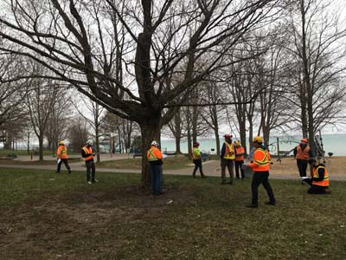
Who Can Prune Trees?

Slide 33
Who Can Implement IPM?

Slide 34
Who Can Implement IPM?
10.4.2: “IPM shall be implemented by a qualified arborist or IPM manager and specialists who, through related training or on-the-job experience, or both, are familiar with the standards, practices, and risks of pest management and the equipment used in such operations.”

Slide 35
Who Can Implement IPM?
10.4.2: “IPM shall be implemented by a qualified arborist or IPM manager and specialists who, through related training or on-the-job experience, or both, are familiar with the standards, practices, and risks of pest management and the equipment used in such operations.”

Slide 36
Who Can Implement IPM?
10.4.2: “IPM shall be implemented by a qualified arborist or IPM manager and specialists who, through related training or on-the-job experience, or both, are familiar with the standards, practices, and risks of pest management and the equipment used in such operations.”

Slide 37
Who Can Implement IPM?
10.4.2: “IPM shall be implemented by a qualified arborist or IPM manager and specialists who, through related training or on-the-job experience, or both, … … … … … … … … … … … … … … … … … … … … … … … … … … … … … … … … … … … … … … …”

Slide 38
Who Can Implement IPM?
10.4.2: “IPM shall be implemented by a qualified arborist or IPM manager and specialists who, through related training or on-the-job experience, or both, … … … … … … … … … … … … … … … … … … … … … … … … … … … … … … … … … … … … … … …”

Slide 39
Who Can Implement IPM?
10.4.2: “IPM shall be implemented by a qualified arborist or IPM manager and specialists who, through related training or on-the-job experience, or both, … … … … … … … … … … … … … … … … … … … … … … … … … … … … … … … … … … … … … … …”

Slide 40
Who Can Implement IPM?
10.4.2: “IPM shall be implemented by a qualified arborist or IPM manager and specialists who, through related training or on-the-job experience, or both, … … … … … … … … … … … … … … … … … … … … … … … … … … … … … … … … … … … … … … …”
2.3.3: “Pruning shall be performed only by arborists or other qualified professionals who, through related training and on-the-job experience … … … … … … … … … … … … … … … … … … … … … … … … … … … … …. … … … … … … … … … … … … ….”

Slide 41
Pruning Specifications

Slide 42
Pruning Specifications
6.3: “Species, size, age, condition, and site shall be considered when specifying the location and amount of live branches to be removed.”

Slide 43
Pruning Specifications
6.3: “Species, size, age, condition, and site shall be considered when specifying the location and amount of live branches to be removed.”

Slide 44
Pruning Specifications
6.3: “Species, size, age, condition, and site shall be considered when specifying the location and amount of live branches to be removed.”

Slide 45
Pruning Specifications
“Trees along 3rd Street: 25% thinning”
Notes:
Doesn’t consider the species of the tree
Don’t forget 1.3: it also applies to the tree managers, not just the pruning crew

Slide 46
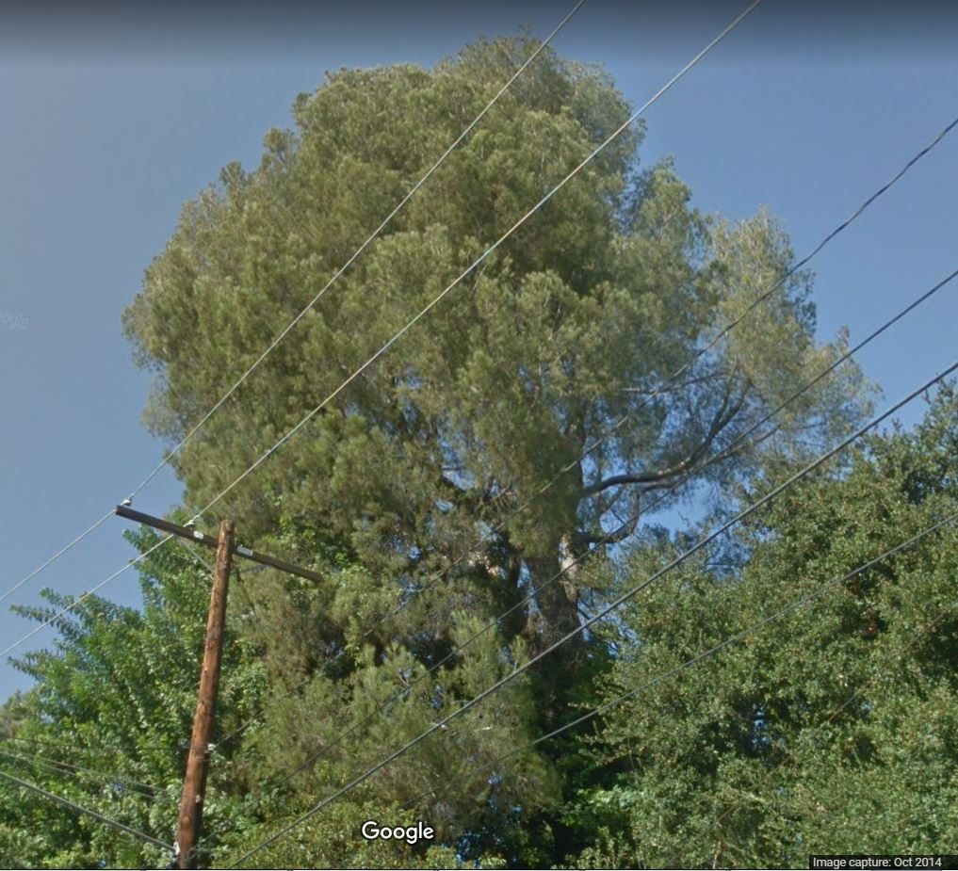
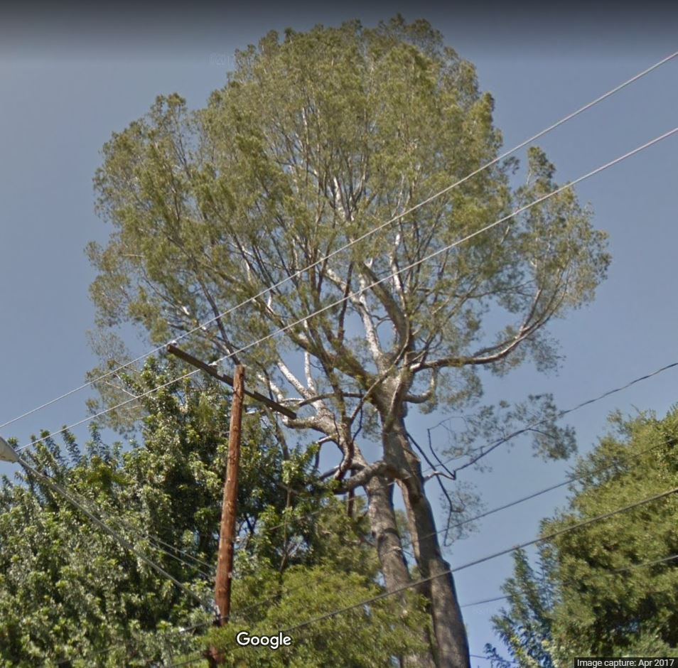
Pruning Specifications
Notes:
Doesn’t consider the species of the tree
Don’t forget 1.3: it also applies to the tree managers, not just the pruning crew

Slide 47
Pruning Cuts
9.8: “When palm pruning practices have a high potential to spread pests, appropriate precautions shall be taken.”

Slide 48
Pruning Cuts
9.8: “When palm pruning practices have a high potential to spread pests, appropriate precautions shall be taken.”

Slide 49
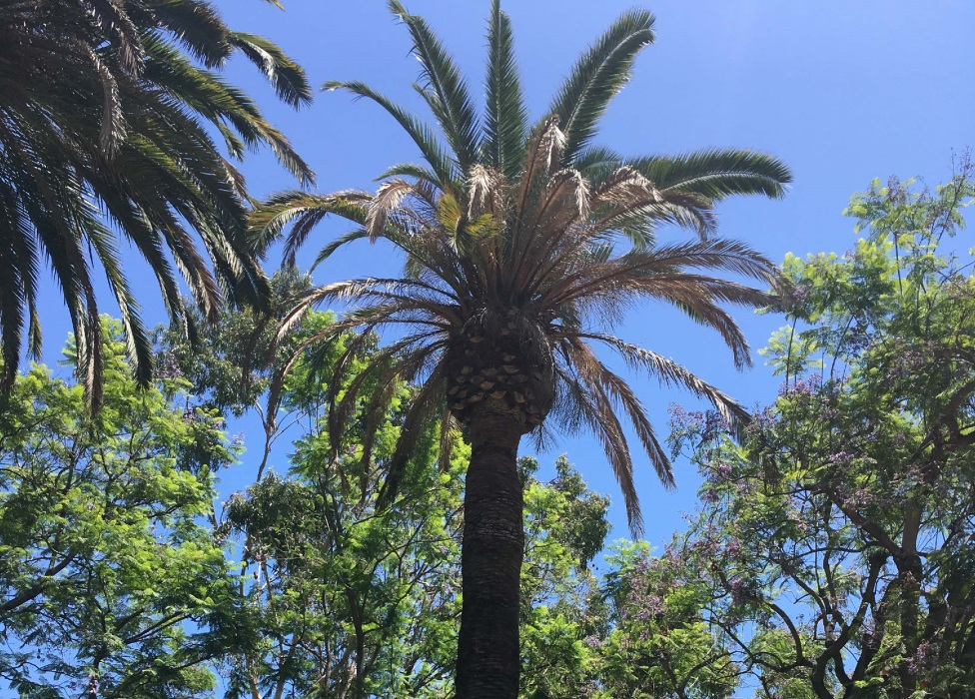
Pruning Cuts
9.8: “When palm pruning practices have a high potential to spread pests, appropriate precautions shall be taken.”

Slide 50
Who is a Risk Assessor?

Slide 51
Who is a Risk Assessor?
95.28: “tree risk assessor: an arborist or other qualified professional with training and experience in the practice of tree risk assessment.”

Slide 52
Who is a Risk Assessor?
95.28: “tree risk assessor: an arborist or other qualified professional with training and experience in the practice of tree risk assessment.”

Slide 53
Who is a Risk Assessor?
95.28: “tree risk assessor: an arborist or other qualified professional with training and experience in the practice of tree risk assessment.”

Slide 54
Scope of Inspection

Slide 55
Scope of Inspection
93.5: “Tree risk assessors shall not be required to assess trees other than those included in the specifications.”

Slide 56
Scope of Inspection
93.5: “Tree risk assessors shall not be required to assess trees other than those included in the specifications.”
93.6: “Tree risk assessors shall not be required to perform a higher level of assessment than specified in the specifications.”

Slide 57
Scope of Inspection
93.5: “Tree risk assessors shall not be required to assess trees other than those included in the specifications.”
93.6: “Tree risk assessors shall not be required to perform a higher level of assessment than specified in the specifications.”

Slide 58
Scope of Inspection

Slide 59
Scope of Inspection

Slide 60
Scope of Inspection
94.3.1: “The tree(s), targets, and unique conditions of concern (if any) to be considered in Level 1 assessments shall be specified.”

Slide 61
Scope of Inspection
94.3.1: “The tree(s), targets, and unique conditions of concern (if any) to be considered in Level 1 assessments shall be specified.”
Notes:
….so if they’re not specified, that means they’re off the scope of work.
Add this to your boilerplate client agreement: “Unless otherwise specified in writing, this estimate constitutes a Level 1 Limited Visual Inspection of only the trees and tree parts specified.”

Slide 62
Scope of Inspection
94.3.1: “The tree(s), targets, and unique conditions of concern (if any) to be considered in Level 1 assessments shall be specified.”
Notes:
….so if they’re not specified, that means they’re off the scope of work.
Add this to your boilerplate client agreement: “Unless otherwise specified in writing, this estimate constitutes a Level 1 Limited Visual Inspection of only the trees and tree parts specified.”

Slide 63
Duty to Report Outside Scope
Notes:
….so if they’re not specified, that means they’re off the scope of work.
Add this to your boilerplate client agreement: “Unless otherwise specified in writing, this estimate constitutes a Level 1 Limited Visual Inspection of only the trees and tree parts specified.”

Slide 64
Duty to Report Outside Scope
8.1.2.1: “When the scope of work is limited by property boundaries, easements, or other constraints, inspection of plants or plant parts outside of the assigned scope of work shall not be inspected.”
Notes:
….so if they’re not specified, that means they’re off the scope of work.
Add this to your boilerplate client agreement: “Unless otherwise specified in writing, this estimate constitutes a Level 1 Limited Visual Inspection of only the trees and tree parts specified.”

Slide 65
Duty to Report Outside Scope
8.1.2.1: “When the scope of work is limited by property boundaries, easements, or other constraints, inspection of plants or plant parts outside of the assigned scope of work shall not be inspected.”
Notes:
….so if they’re not specified, that means they’re off the scope of work.
Add this to your boilerplate client agreement: “Unless otherwise specified in writing, this estimate constitutes a Level 1 Limited Visual Inspection of only the trees and tree parts specified.”

Slide 66
Duty to Report Outside Scope
Notes:
….so if they’re not specified, that means they’re off the scope of work.
Add this to your boilerplate client agreement: “Unless otherwise specified in writing, this estimate constitutes a Level 1 Limited Visual Inspection of only the trees and tree parts specified.”

Slide 67
Duty to Report Outside Scope
8.1.2 (pruning): “Conditions identified in the visual inspection that would affect, or are outside of, the scope of work should be reported to an immediate supervisor or to the client.”
Notes:
….so if they’re not specified, that means they’re off the scope of work.
Add this to your boilerplate client agreement: “Unless otherwise specified in writing, this estimate constitutes a Level 1 Limited Visual Inspection of only the trees and tree parts specified.”

Slide 68
Duty to Report Outside Scope
8.1.2 (pruning): “Conditions identified in the visual inspection that would affect, or are outside of, the scope of work should be reported to an immediate supervisor or to the client.”
53.2 (construction): “If a condition is observed requiring attention beyond the original scope of work, the condition should be reported to an immediate supervisor or to the client.”
Notes:
….so if they’re not specified, that means they’re off the scope of work.
Add this to your boilerplate client agreement: “Unless otherwise specified in writing, this estimate constitutes a Level 1 Limited Visual Inspection of only the trees and tree parts specified.”

Slide 69
Duty to Report Outside Scope
8.1.2 (pruning): “Conditions identified in the visual inspection that would affect, or are outside of, the scope of work should be reported to an immediate supervisor or to the client.”
53.2 (construction): “If a condition is observed requiring attention beyond the original scope of work, the condition should be reported to an immediate supervisor or to the client.”
Notes:
….so if they’re not specified, that means they’re off the scope of work.
Add this to your boilerplate client agreement: “Unless otherwise specified in writing, this estimate constitutes a Level 1 Limited Visual Inspection of only the trees and tree parts specified.”

Slide 70
Duty to Report Outside Scope

Slide 71
Duty to Report Outside Scope
33.2.3 (structural support systems): “If a condition is observed requiring attention beyond the original scope of work, the condition shall be reported to an immediate supervisor, the owner, or the person responsible for authorizing the work.”

Slide 72
Duty to Report Outside Scope
33.2.3 (structural support systems): “If a condition is observed requiring attention beyond the original scope of work, the condition shall be reported to an immediate supervisor, the owner, or the person responsible for authorizing the work.”
63.3.7 (planting): “If a condition is observed while the work is being performed requiring attention beyond the original scope of work, the condition shall be reported to an immediate supervisor, the owner, or person responsible for authorizing the work.”

Slide 73
Duty to Report Outside Scope
33.2.3 (structural support systems): “If a condition is observed requiring attention beyond the original scope of work, the condition shall be reported to an immediate supervisor, the owner, or the person responsible for authorizing the work.”
63.3.7 (planting): “If a condition is observed while the work is being performed requiring attention beyond the original scope of work, the condition shall be reported to an immediate supervisor, the owner, or person responsible for authorizing the work.”

Slide 74
Duty to Report Outside Scope
Should
Shall
33.2.3: Support Systems
63.3.7: Planting
8.1.2: Pruning
53.2: Construction
Shall Not
8.1.2.1: Outside Property Boundaries

Slide 75
Duty to Follow-Up

Slide 76
Duty to Follow-Up
33.4.2 (structural support systems): “Scheduling inspections shall be the responsibility of the tree owner.”

Slide 77
Duty to Follow-Up
33.4.2 (structural support systems): “Scheduling inspections shall be the responsibility of the tree owner.”
87.5 (root management): “Scheduling inspections and treatments shall be the responsibility of the tree owner.”

Slide 78
Duty to Follow-Up
33.4.2 (structural support systems): “Scheduling inspections shall be the responsibility of the tree owner.”
87.5 (root management): “Scheduling inspections and treatments shall be the responsibility of the tree owner.”
94.7.1 (risk assessment): “It shall be the responsibility of the client, owner, the owner’s agent, or the controlling authority to select and implement the mitigation, schedule repeat or advanced assessments, and to schedule future monitoring and maintenance.”

Slide 79
Duty to Follow-Up
33.4.2 (structural support systems): “Scheduling inspections shall be the responsibility of the tree owner.”
87.5 (root management): “Scheduling inspections and treatments shall be the responsibility of the tree owner.”
94.7.1 (risk assessment): “It shall be the responsibility of the client, owner, the owner’s agent, or the controlling authority to select and implement the mitigation, schedule repeat or advanced assessments, and to schedule future monitoring and maintenance.”

Slide 80
Duty to Follow-Up
33.4.2 (structural support systems): “Scheduling inspections shall be the responsibility of the tree owner.”
87.5 (root management): “Scheduling inspections and treatments shall be the responsibility of the tree owner.”
94.7.1 (risk assessment): “It shall be the responsibility of the client, owner, the owner’s agent, or the controlling authority to select and implement the mitigation, schedule repeat or advanced assessments, and to schedule future monitoring and maintenance.”

Slide 81
Duty to Follow-Up
BUT…

Slide 82
Duty to Follow-Up
33.4.2 (structural support systems): “Prior to installation, the owner or owner’s agent shall be notified of the need for periodic inspection by an arborist of the supplemental support system’s condition; position; cable tension; and the tree’s structural integrity…”

Slide 83
Duty to Follow-Up
33.4.2 (structural support systems): “Prior to installation, the owner or owner’s agent shall be notified of the need for periodic inspection by an arborist of the supplemental support system’s condition; position; cable tension; and the tree’s structural integrity…”

Slide 84
Duty to Follow-Up
33.4.2 (structural support systems): “Prior to installation, the owner or owner’s agent shall be notified … … … … … … … … … … … … … … … … … … … … … … … … … … … … … … … … … … … … … … … … … … … … … … … … … .”

Slide 85
Duty to Follow-Up
33.4.2 (structural support systems): “… … … … … … … … … … … … … … … … … … … … of the need for periodic inspection by an arborist of the supplemental support system’s condition; position; cable tension; and the tree’s structural integrity…”

Slide 86
Duty to Follow-Up
33.4.2 (structural support systems): “… … … … … … … … … … … … … … … … … … … … of the need for periodic inspection by an arborist of the supplemental support system’s condition; position; cable tension; and the tree’s structural integrity…”

Slide 87
Duty to Follow-Up
Owner
Arborist
33.4.2: Must tell owner that follow-up inspections are necessary
87.5: Root Inspections
33.4.2: Support System Inspections
94.7.1: Risk Mitigation Actions

Slide 88
Risk Assessment Reports
Notes:
SWORD: tree removal applications based on risk assessments
Get the risk assessment thrown out due to violation of the standards.
Powerful weapon for tree protection.

Slide 89
Risk Assessment Reports
92.3: “Tree risk assessments shall consider the likelihood of failure, the likelihood of the failed tree or tree part impacting a target, and the likely resulting consequences.”
Notes:
SWORD: tree removal applications based on risk assessments
Get the risk assessment thrown out due to violation of the standards.
Powerful weapon for tree protection.

Slide 90
Risk Assessment Reports
92.3: “Tree risk assessments shall consider the likelihood of failure, the likelihood of the failed tree or tree part impacting a target, and the likely resulting consequences.”
93.7: “The time frame of the assessment shall be specified.”
Notes:
SWORD: tree removal applications based on risk assessments
Get the risk assessment thrown out due to violation of the standards.
Powerful weapon for tree protection.

Slide 91
Risk Assessment Reports
92.3: “Tree risk assessments shall consider the likelihood of failure, the likelihood of the failed tree or tree part impacting a target, and the likely resulting consequences.”
93.7: “The time frame of the assessment shall be specified.”
94.6.1: “The tree risk assessor shall analyze the tree, site, and target information and determine the level of risk.”
Notes:
SWORD: tree removal applications based on risk assessments
Get the risk assessment thrown out due to violation of the standards.
Powerful weapon for tree protection.

Slide 92
Risk Assessment Reports
92.3: “Tree risk assessments shall consider the likelihood of failure, the likelihood of the failed tree or tree part impacting a target, and the likely resulting consequences.”
93.7: “The time frame of the assessment shall be specified.”
94.6.1: “The tree risk assessor shall analyze the tree, site, and target information and determine the level of risk.”
Notes:
SWORD: tree removal applications based on risk assessments
Get the risk assessment thrown out due to violation of the standards.
Powerful weapon for tree protection.

Slide 93
Risk Assessment Reports
92.3: “Tree risk assessments shall consider the likelihood of failure, the likelihood of the failed tree or tree part impacting a target, and the likely resulting consequences.”
93.7: “The time frame of the assessment shall be specified.”
94.6.1: “The tree risk assessor shall analyze the tree, site, and target information and determine the level of risk.”

Slide 94
Risk Assessment Reports
“The tree has a 70% chance of failure.”
“…therefore it must be removed.”

Slide 95
Risk Assessment Reports
“If the tree were to fall, it could impact a person.”
“…therefore it must be removed.”
Notes:
93.1 – fails to consider likelihood of failure and likelihood of impact
The mere fact that it could impact a person does not mean it is likely to do so.

Slide 96
Risk Assessment Reports
“The scaffold branch has a probable likelihood of failure and a high likelihood of impacting the house and causing significant consequences.”
Notes:
What’s wrong with this one?

Slide 97
Risk Assessment Reports
“The scaffold branch has a probable likelihood of failure and a high likelihood of impacting the house and causing significant consequences.”
Notes:
Seems like it has the three components of a risk assessment:
Likelihood of failure
Likelihood of impact
Consequences

Slide 98
Risk Assessment Reports
“The scaffold branch has a probable likelihood of failure and a high likelihood of impacting the house and causing significant consequences.”
“…within the next one year time frame.”
Notes:
92.7 requires TIME FRAME

Slide 99
Takeaways
Sword
Shield
93.5: Scope of Inspection
93.6: Level of Inspection
94.7.1: Owner’s duty to follow-up
1.3: Standards Apply to Everyone
2.3.3: Who Can Prune
6.3: Pruning Specifications
92.3: Components of a Risk Assessment
95.28: Who is a Risk Assessor
94.1: Duty to Report Defects Outside Scope of Inspection

Slide 100
Wielding the A300 Standards: The Shield and the Sword
James Komen
BCMA #WE-9909B
RCA #555
www.jameskomen.com
jameskomen@gmail.com

