Slide 1
Machine-Generated Report Writing
James Komen, RCA #555
classonearboriculture@gmail.com
www.jameskomen.com

Slide 2
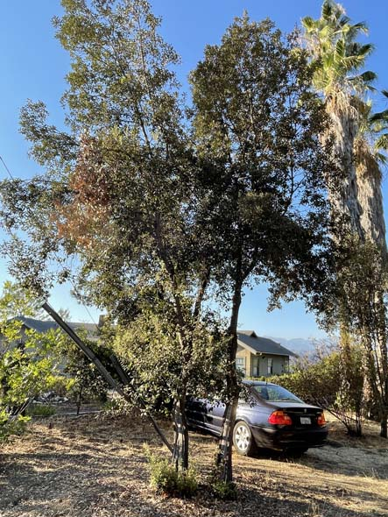
Machine Generated Report Writing

Slide 3

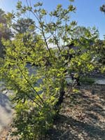
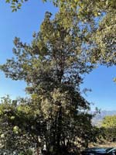
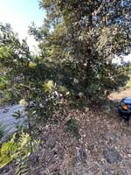
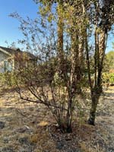
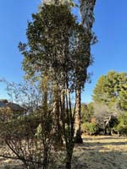
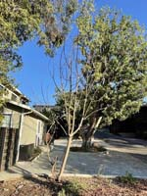
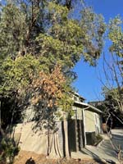
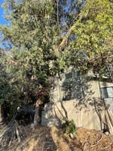
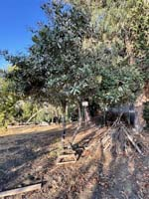
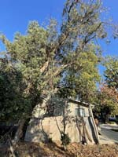
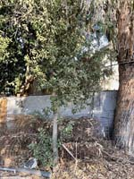
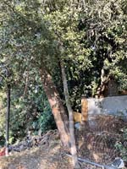
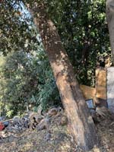
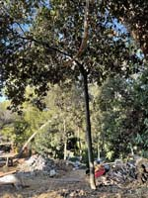
Machine Generated Report Writing

Slide 4
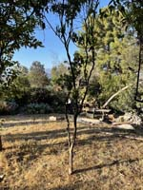
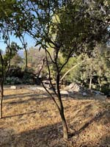
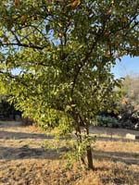
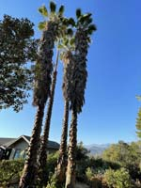
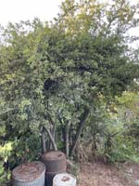
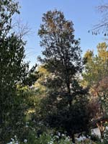
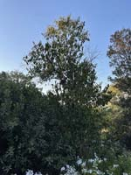
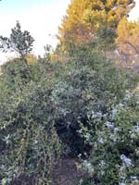
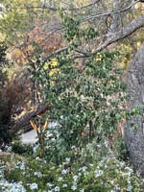
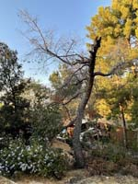
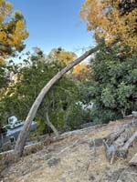
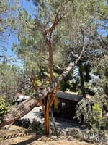
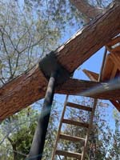
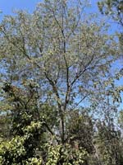
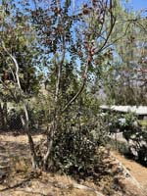
Machine Generated Report Writing

Slide 5
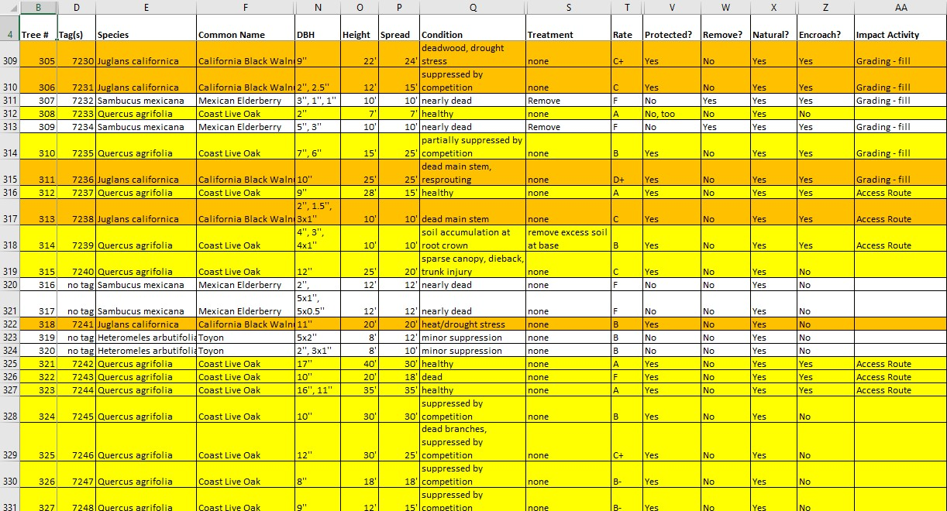
Machine Generated Report Writing

Slide 6
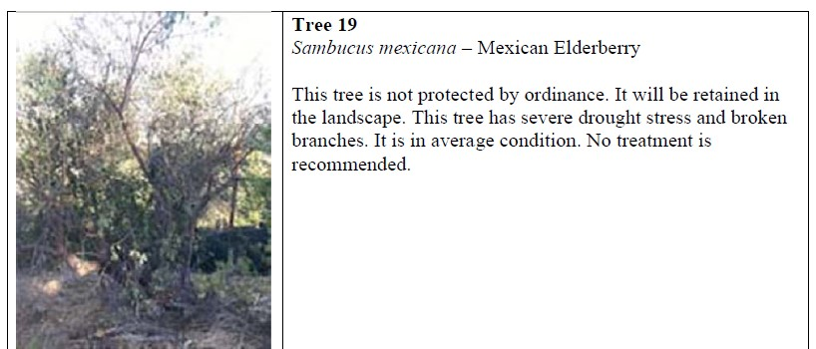
Machine Generated Report Writing

Slide 7
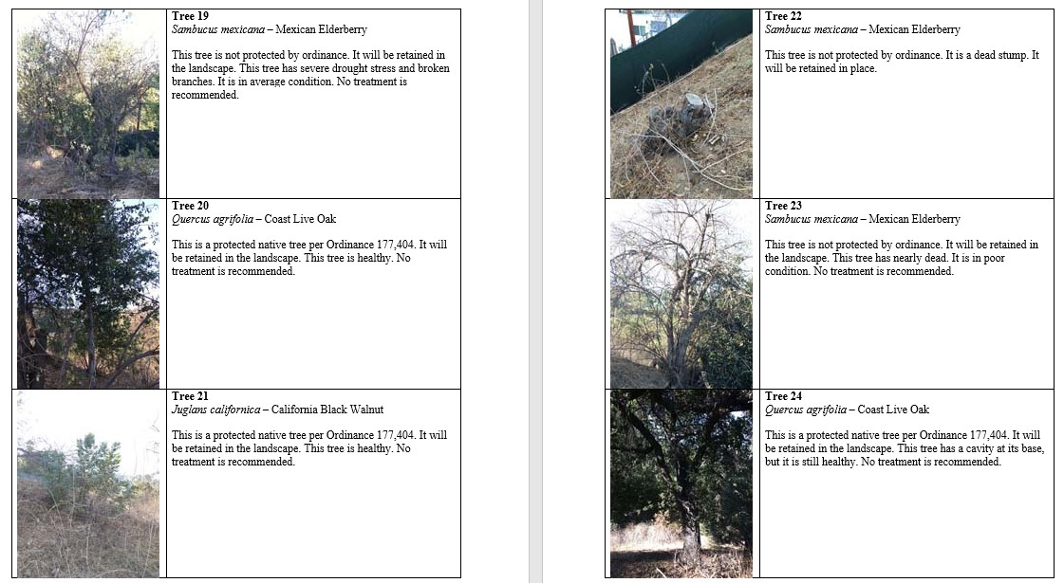
Machine Generated Report Writing

Slide 8
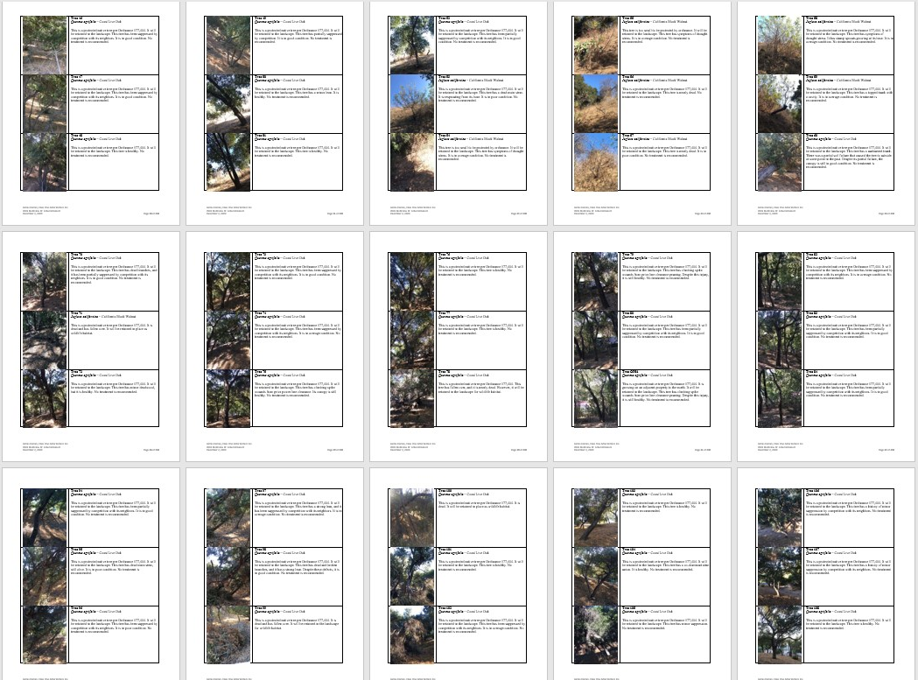
Machine Generated Report Writing

Slide 9
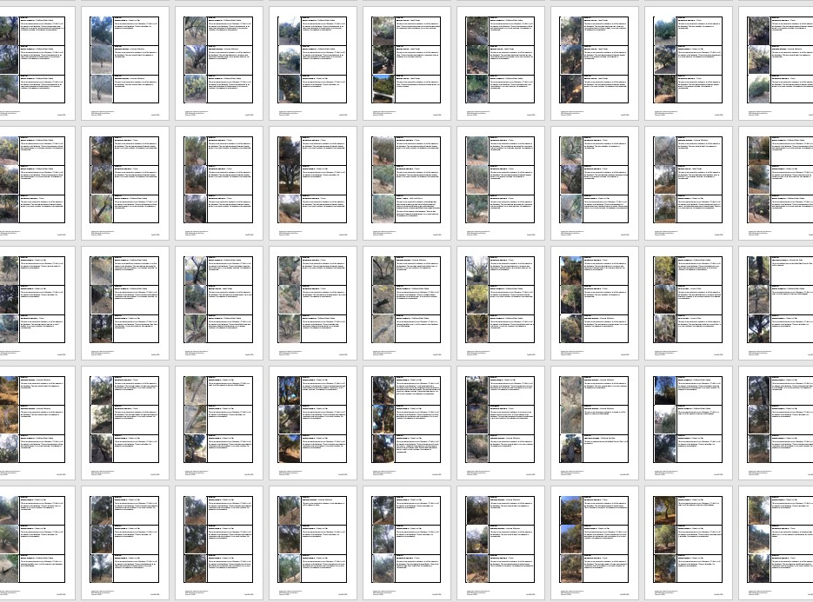
Machine Generated Report Writing

Slide 10
Terms &
Formulas

Slide 11
Terms &
Formulas
String
Cell Reference
Delimiter
Concatenate

Slide 12
Terms &
Formulas
String “…”
Cell Reference A3
Delimiter # @ ,
Concatenate &

Slide 13
String
Series of text characters
“Tree 1 is growing close to the property line.”

Slide 14
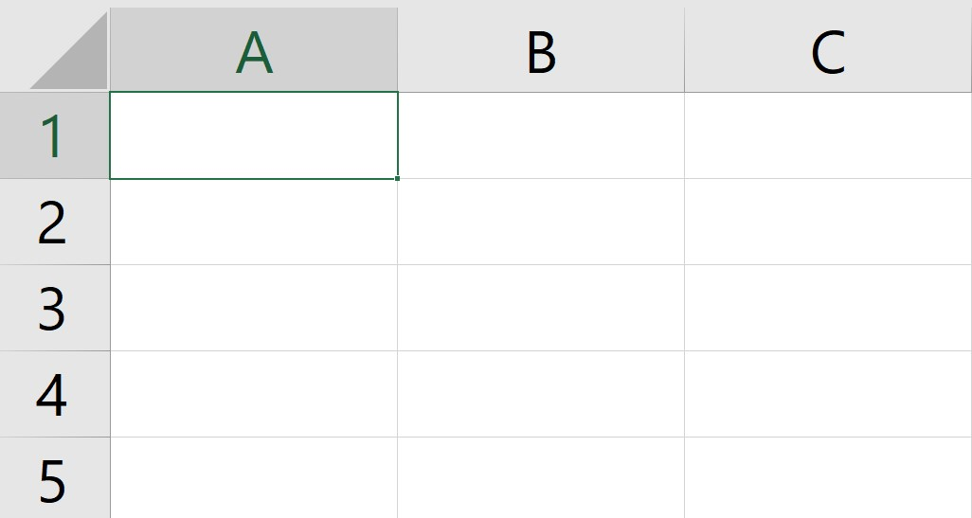
Cell Reference
Location of data stored in an array
A1, B1, C3, etc..

Slide 15
Delimiter
Breaks apart strings into list elements
DBH: “18, 20, 5, 6”

Slide 16
Delimiter
Breaks apart strings into list elements
DBH: “18, 20, 5, 6” → “18”,”20”,”5”,”6”

Slide 17
Delimiter
Breaks apart strings into list elements
DBH: “18, 20, 5, 6” → “18”,”20”,”5”,”6”
“Tree 1#Pinus pinea#Italian stone pine”

Slide 18
Delimiter
Breaks apart strings into list elements
DBH: “18, 20, 5, 6” → “18”,”20”,”5”,”6”
“Tree 1#Pinus pinea#Italian stone pine”
”Tree 1
Pinus pinea
Italian Stone Pine”

Slide 19
Concatenate
Combines Strings
“Tree ” & A3 & “ will be retained in place.”

Slide 20
Concatenate
Combines Strings
“Tree ” & A3 & “ will be retained in place.”
→ “Tree 53 will be retained in place.”

Slide 21
Machine Generated
Report
Phases

Slide 22
Machine Generated
Report
Phases
Data Entry
Image Formatting
Raw Text Generation
Raw Text Formatting
Photo/Text Aggregation
Preliminary Proofreading

Slide 23
Machine Generated
Report
Phases
Data Entry ✔️
Image Formatting ✔️
Raw Text Generation
Raw Text Formatting
Photo/Text Aggregation
Preliminary Proofreading

Slide 24
Machine Generated
Report
Demonstration

Slide 25
Machine Generated
Report
Demonstration
IF YOU GET LOST
Watch the replay of this video
PowerPoint available at:
www.jameskomen.com

Slide 26

Machine Generated
Report
Demonstration
IF YOU GET LOST
Watch the replay of this video
PowerPoint available at:
www.jameskomen.com

Slide 27
Machine Generated
Report
Demonstration
DEMONSTRATION

Slide 28
Machine-Generated Report Writing
James Komen, RCA #555
classonearboriculture@gmail.com
www.jameskomen.com

