Slide 1
What Happens When 14 Arborists Appraise the Same 10 Trees?
Field Testing the Trunk Formula Method
James Komen
BCMA #WE-9909B
RCA #555
March 8, 2017

Slide 2
Approaches to Appraisal
Market Approach
  Sales comparison
Income Approach
  Present value of income generated by trees
Cost Approach
  Replacement Cost
    Direct Replacement
    Trunk Formula Method

Slide 3
Approaches to Appraisal
Market Approach
  Sales comparison
Income Approach
  Present value of income generated by trees
Cost Approach
  Replacement Cost
    Direct Replacement
    Trunk Formula Method

Slide 4

Trunk Formula Method (TFM)
Trunk Area
Unit Cost
Species
Location
Condition

Slide 5
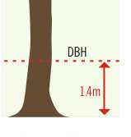
Trunk Area
Measured at Breast Height (DBH)
4.5 Feet above grade
  (1.4 meters)

Slide 6
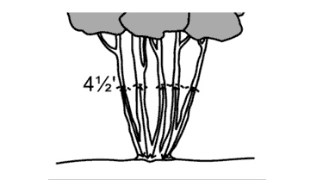
Measuring Tree Size
Multi-stem tree

Slide 7
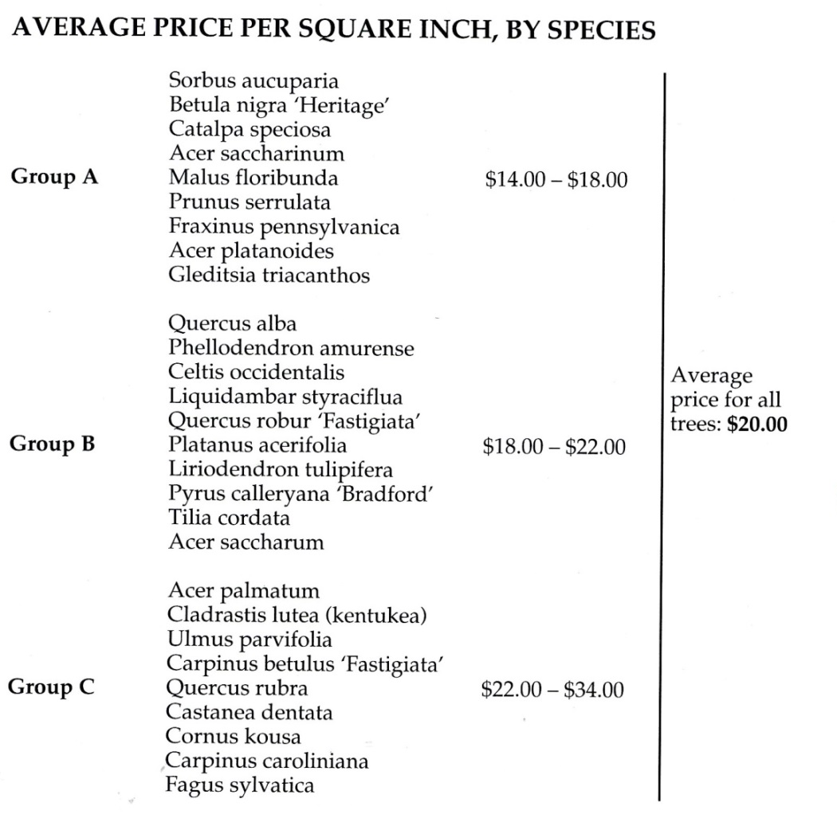
Unit Cost
Cost per unit Trunk Area of nursery stock ($/in²)
Largest Commonly Available Transplantable Tree (LCATT)
Derived from actual nursery data
Regional Plant Appraisal Committee (RPAC)

Slide 8
Depreciation Factors
Reduce Base Cost to account for loss of value
  Species
  Location
  Condition
Value range from 0-100%

Slide 9
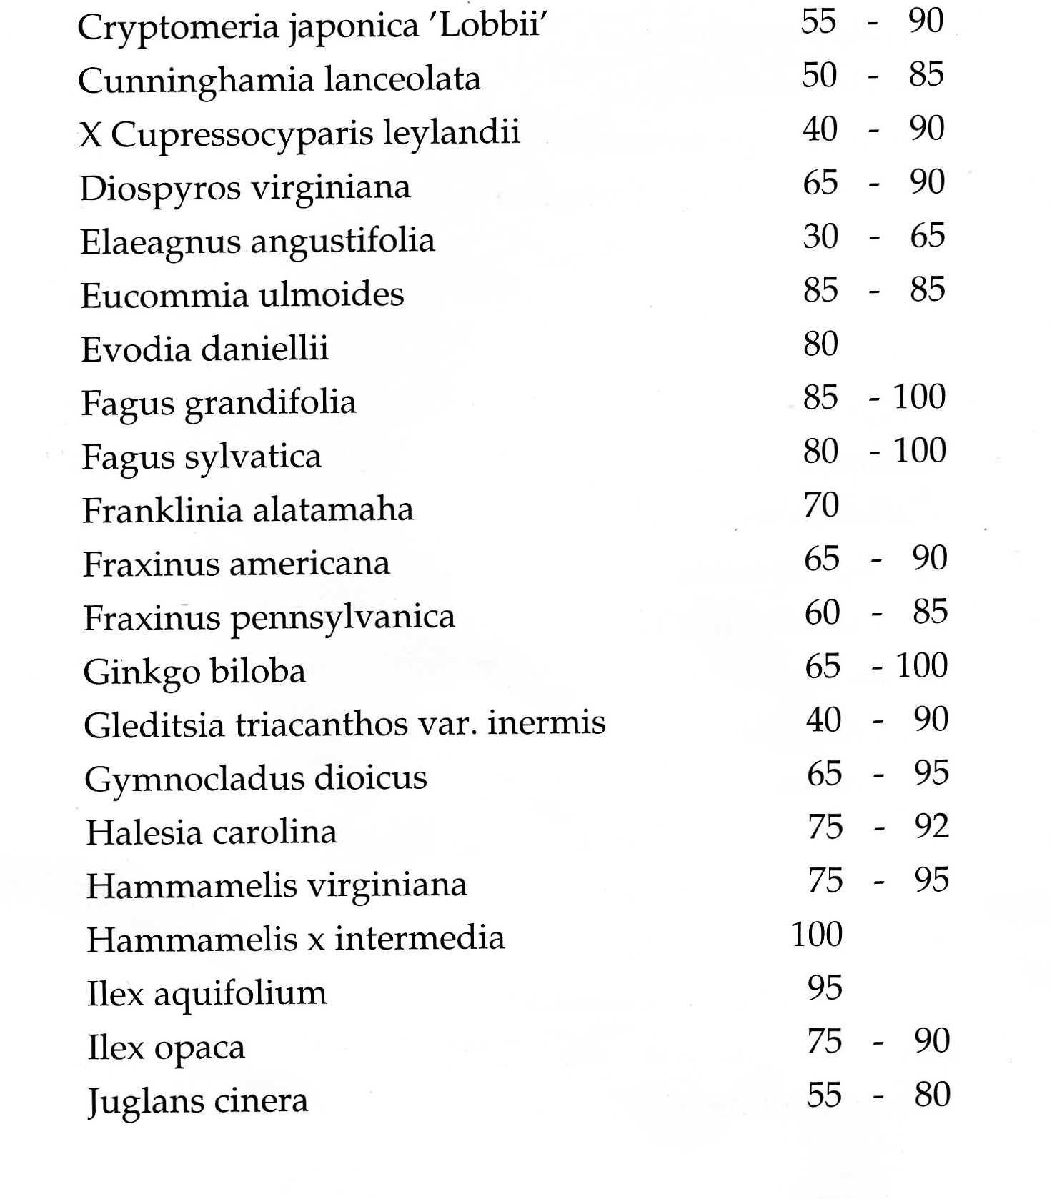
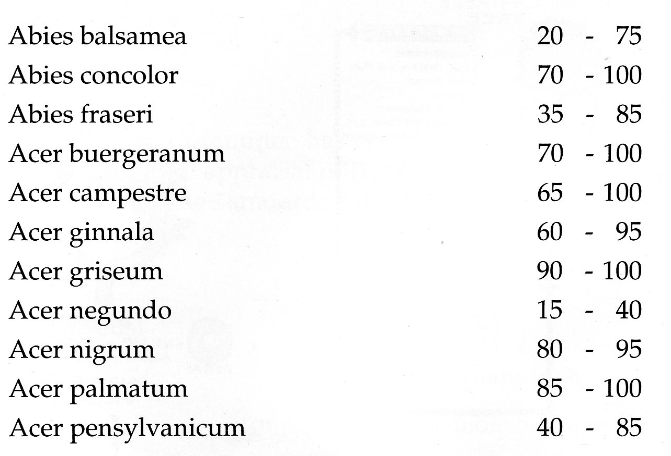
Species
Provided rating from Regional Species Classification Guide
Appraiser discretion +/- 10%

Slide 10
Location
Three Components
  Site: 10%-100%
  Contribution: 10%-100%
  Placement: 10%-100%
Average of the three components

Slide 11
Location: Site
Relative Market Value of Real Estate
  Economic
  Function
  Aesthetic
General appearance of the site
Intensity of Use and Development

Slide 12
Location: Contribution
Degree of benefits gained by tree’s presence
Aesthetic
  Growth habit
  Bark texture/color
  Flowering
  Fruit color
  Aroma
  Defines space
  Historic or Rare Specimen
  Screening undesirable views
Functional
  Allergenic properties
  Light/glare shield
  Shade and cooling
  Safety barrier
  Wind control
  Traffic control
  Erosion control
  Cleanliness of flowers, leaves, and fruit

Slide 13
Location: Placement
How effective the tree is at providing benefits (contribution) as a result of its location
Favorable
  Shade
  Windbreak
  Aesthetic Screen
  Relationship to other trees
    Single Specimen
    One of Many
    One in a row of a formal planting
Unfavorable
  Overhead power lines
  Root restrictions
  Walkways that can be unfavorably affected by fruit drop
  Irrigation

Slide 14
Condition
8 Categories, Rated on a scale of 1-4
  Root Structure
  Root Health
  Trunk Structure
  Trunk Health
  Scaffold Branch Structure
  Scaffold Branch Health
  Branches and Twigs Health
  Foliage and Buds
Ratings added together and divided by 32
  Final score between 25% - 100%
  Each point is worth a little more than 3%

Slide 15
Condition
Rating Scale
  Extreme Problems
  Major Problems
  Minor Problems
  No Apparent Problems
No “middle value”

Slide 16
Trunk Formula Method (TFM)
Trunk Area
Unit Cost
Species
Location
Condition

Slide 17
Trunk Formula Method (TFM)
Trunk Area
Unit Cost
Species
Location
Condition

Slide 18
Methods
14 arborists independently appraised the same ten trees
  Certified Arborists (CA)
  Multiple fields of arboriculture
  Experience range from 2 months as CA to over 30 years
Same measuring tape
Same appraisal form
Final calculations were performed by the researcher to eliminate math error

Slide 19
Methods
Observed participants’ appraisal process
  Data collection
  Value assignment and reasoning
Follow-up Survey to segment participants by:
  Years experience
  Frequency using the Trunk Formula Method
  Field of arboriculture

Slide 20
Results

Slide 21
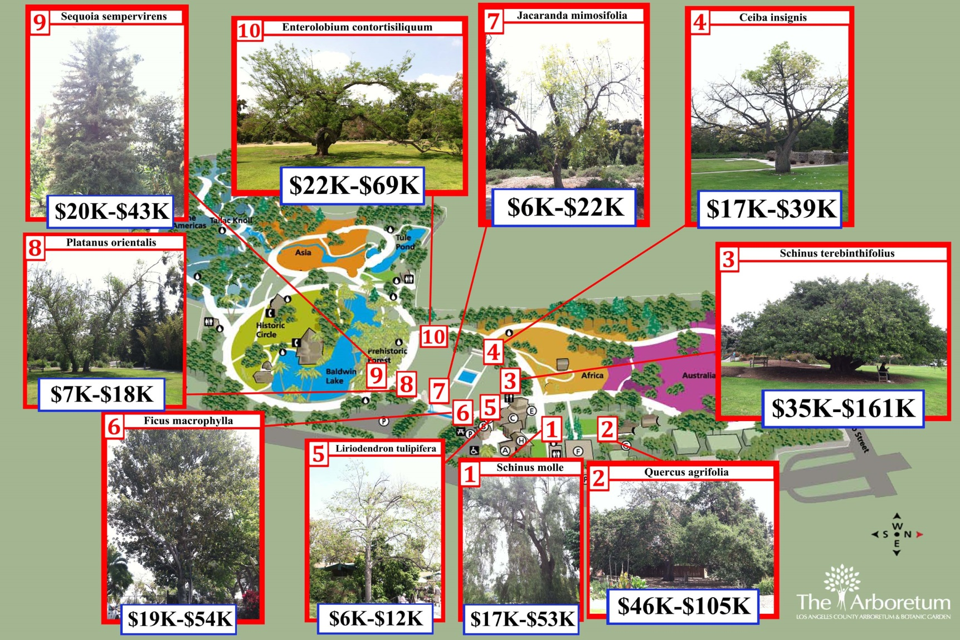
Results

Slide 22
Sources of Error
Trunk Area
Species
Location
Condition

Slide 23
Sources of Error
Trunk Area
Species
Location
Condition

Slide 24
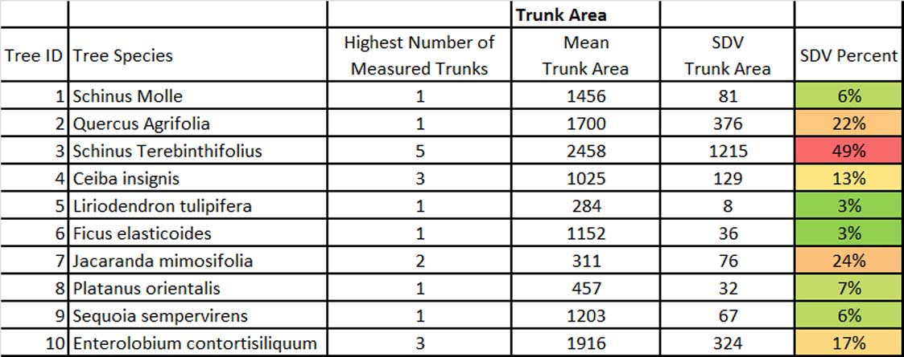
Results
Number of Trunks vs. Trunk Area Error

Slide 25
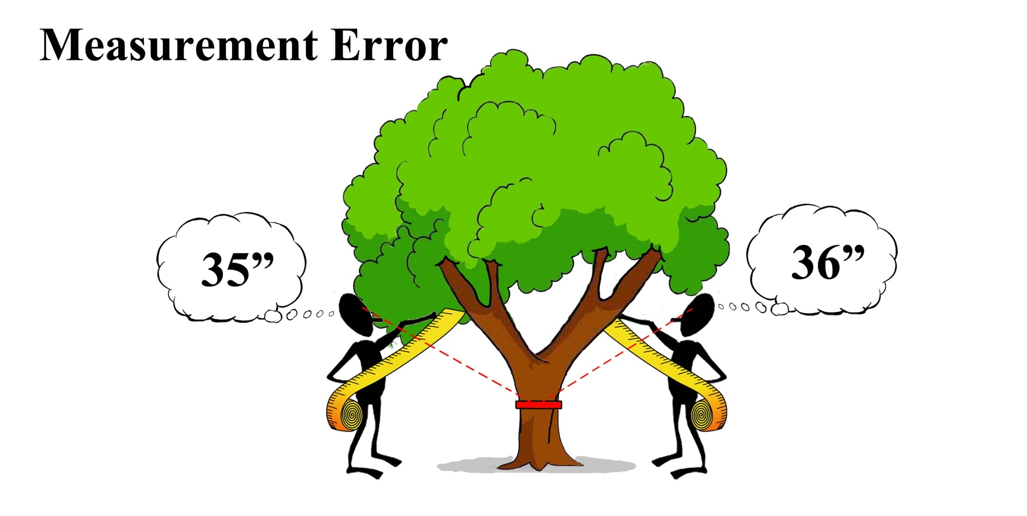
Types of Error

Slide 26
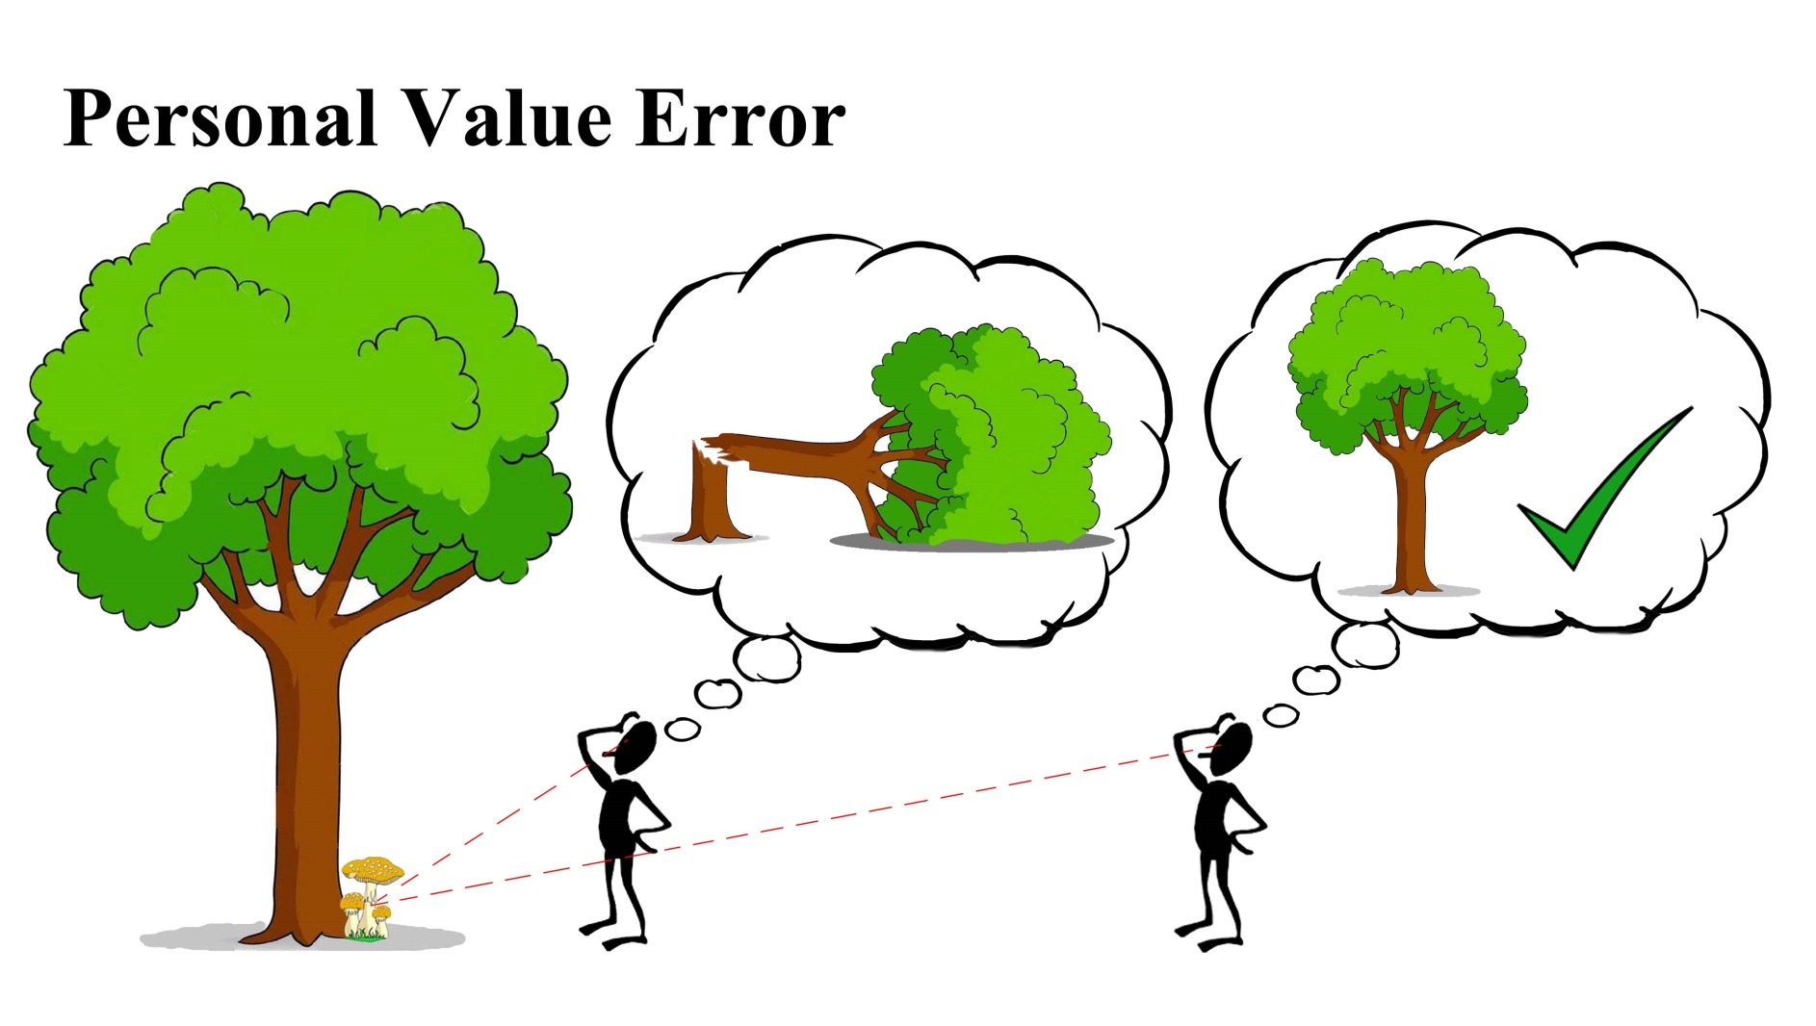
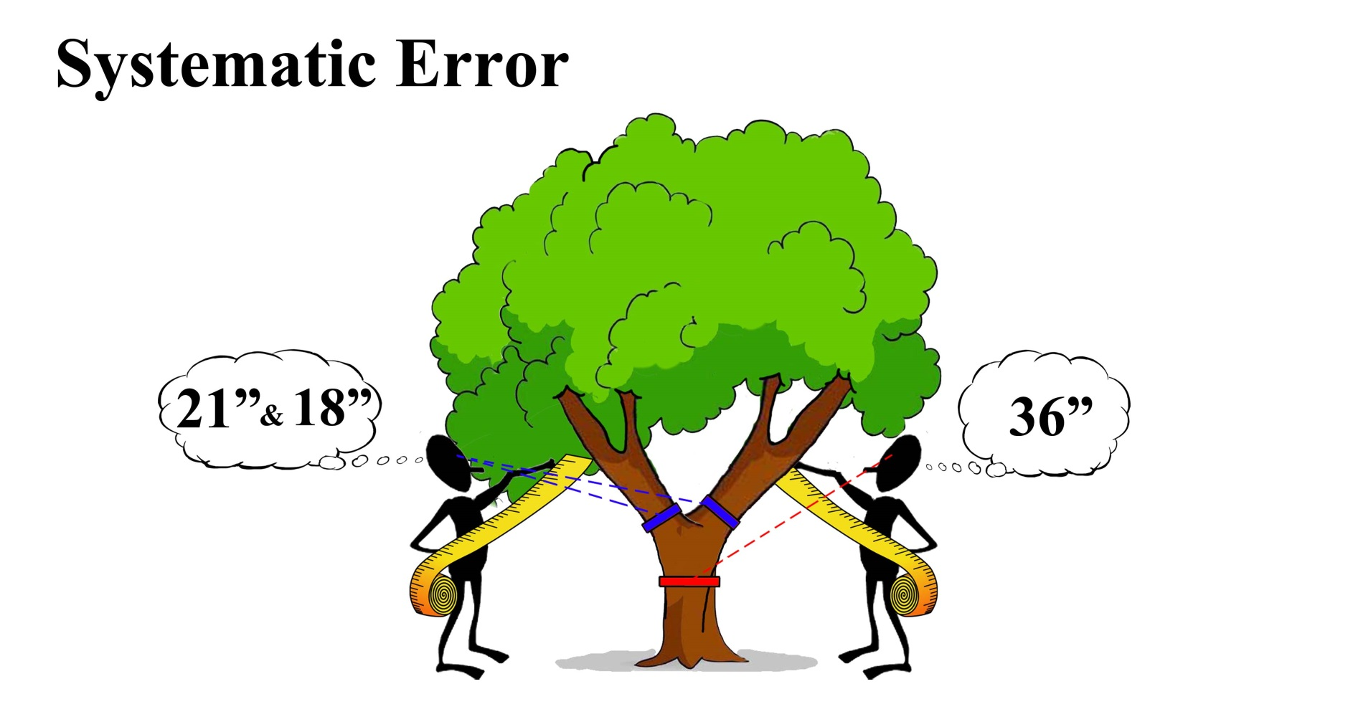
Types of Error

Slide 27
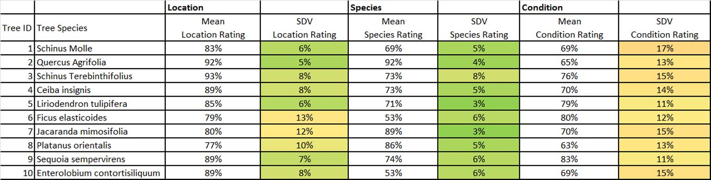
Results
Error in Depreciation Ratings

Slide 28
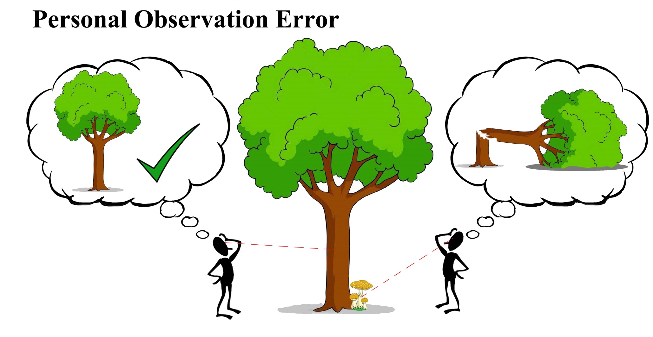
Types of Error

Slide 29
Types of Error

Slide 30
Types of Error
Starting value anchors
  100%
  70%
  50%
  0%

Slide 31
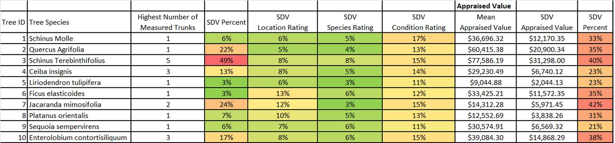
Results
Relative weight of each error component

Slide 32
Practical Significance of STDV
Mean = $77,000
STDV = 40%
1 STDV = $46,500 – $108,000
(66% of the population)
2 STDV = $15,400 – $138,600
(95% of the population)

Slide 33
Results
STDV of appraisals vs. frequency of appraisal

Slide 34
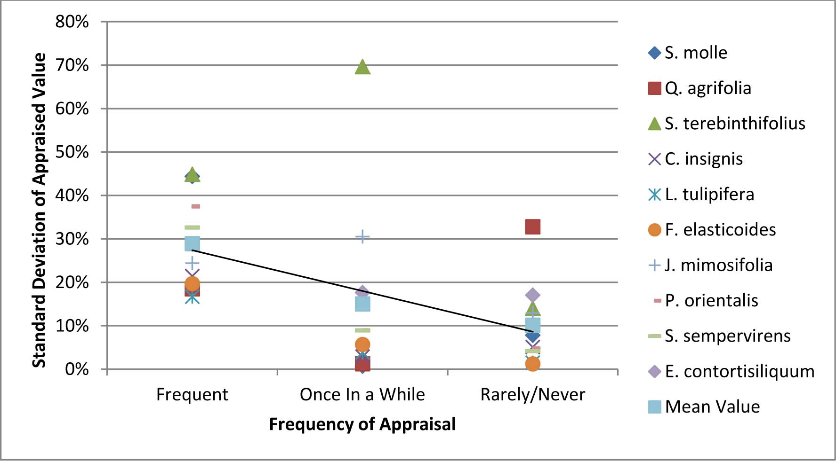
Results
STDV of appraisals vs. frequency of appraisal

Slide 35
Conclusions of Field Study
Largest source of error was the Trunk Area measurement of multi-stem trees
Next largest source of error was the Condition Rating
More experience does not necessarily mean higher precision

Slide 36
Future Research
Trees growing on different land uses: does that cause the location rating to have a larger STDV?
How to parse personal observation error from personal value error?
Most effective method of training appraisers to reduce STDV?

Slide 37
Trunk Formula Method (TFM)
Follow-Up Research
Trunk Area
Unit Cost
Species
Location
Condition

Slide 38
Trunk Formula Method (TFM)
Follow-Up Research
Trunk Area
Unit Cost
Species
Location
Condition

Slide 39
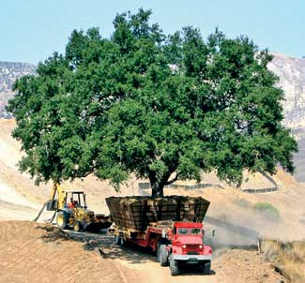
LCATT
Largest
Commonly Available
  Pricing data must be readily available
Transplantable
Tree

Slide 40
Nursery Data Query
Cost of acquiring a given species in a given trunk size
Nursery data provided by HMI
Median prices for each species/size combination
Each median price supported by at least 3 nurseries
Query date May 13, 2016

Slide 41
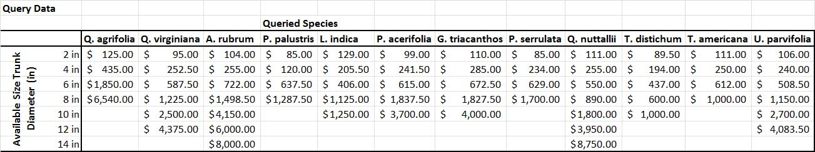
Raw Nursery Data

Slide 42
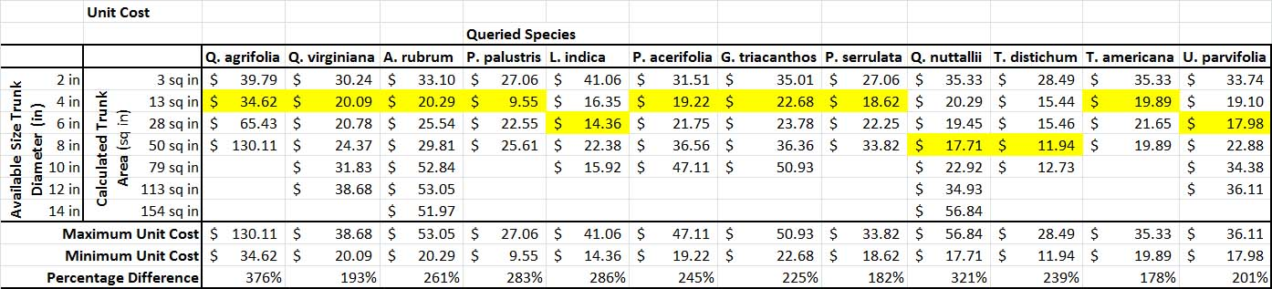
Unit Cost Calculations

Slide 43
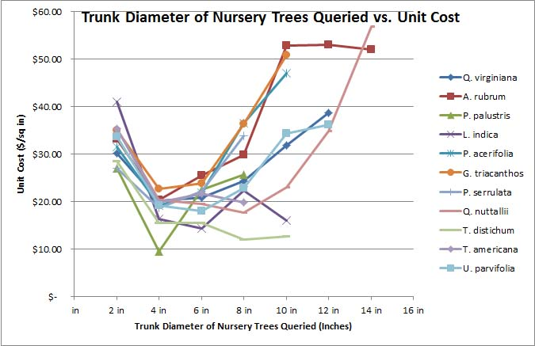
Unit Cost Graph

Slide 44
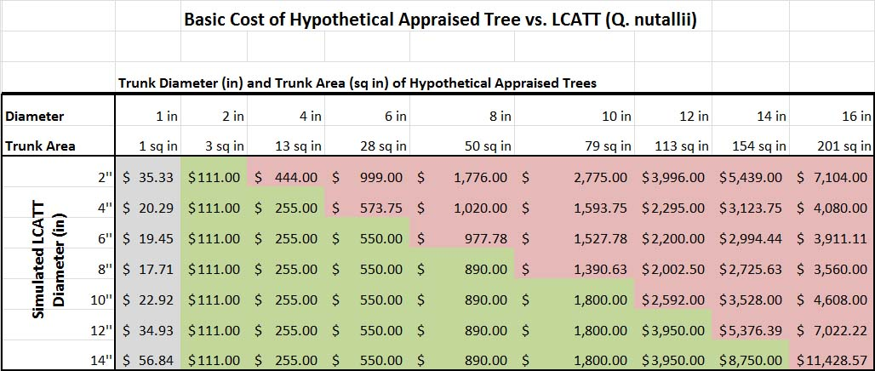
Basic Cost Calculation

Slide 45
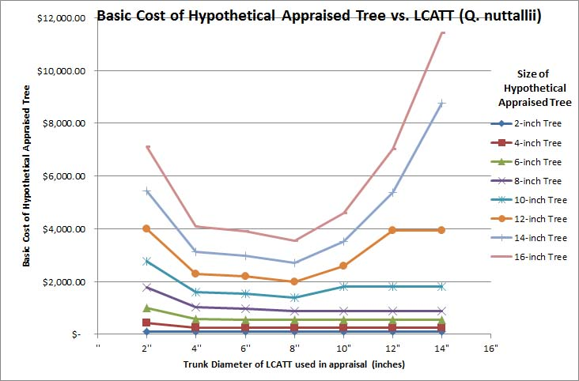
Basic Cost Calculation

Slide 46
LCATT
Largest
Commonly Available
  Pricing data must be readily available
Transplantable
Tree

Slide 47
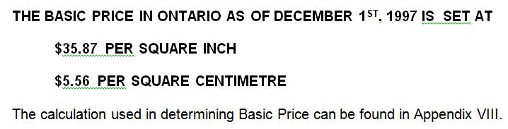
Regional Guides
ISAO
ISAO, 1997

Slide 48
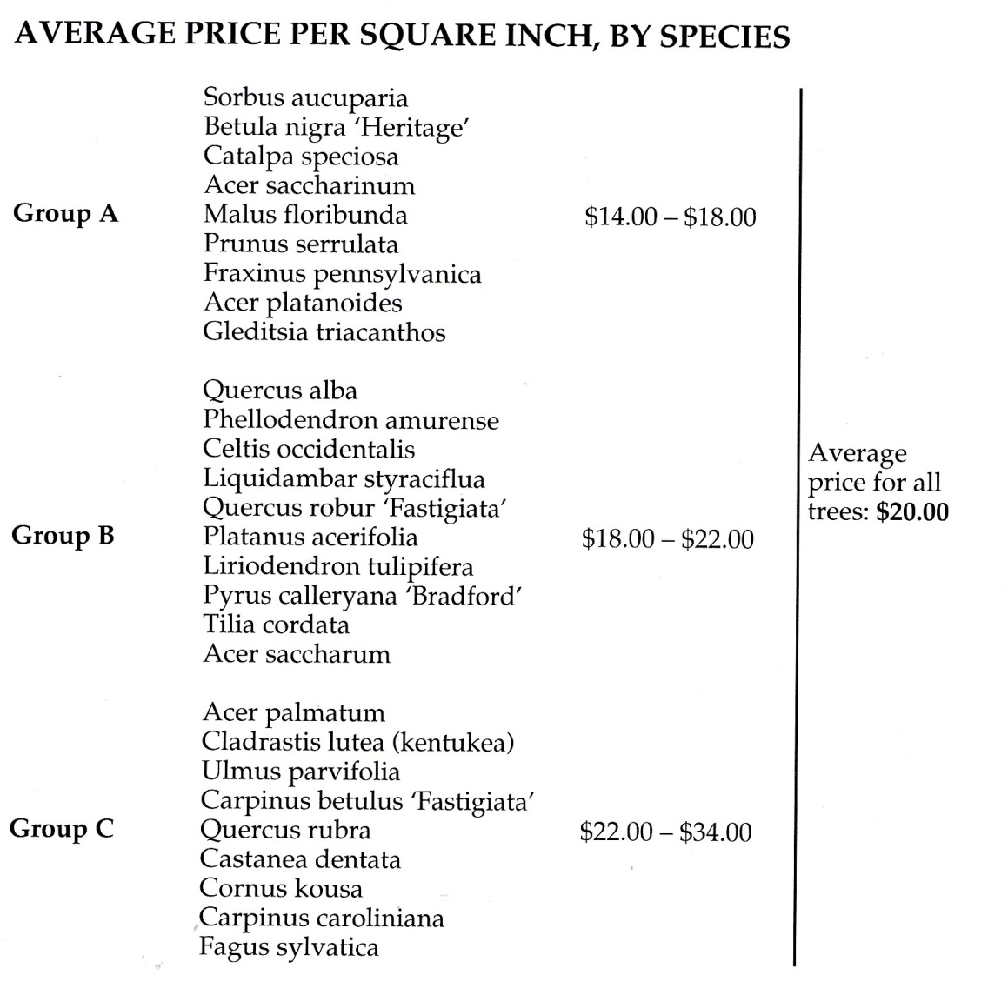
Regional Guides
Penn-Del Chapter, 1993

Slide 49
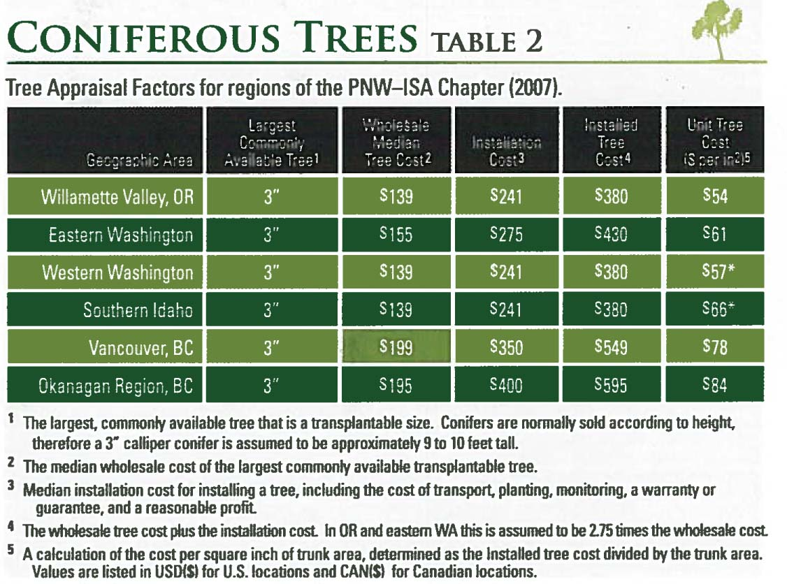
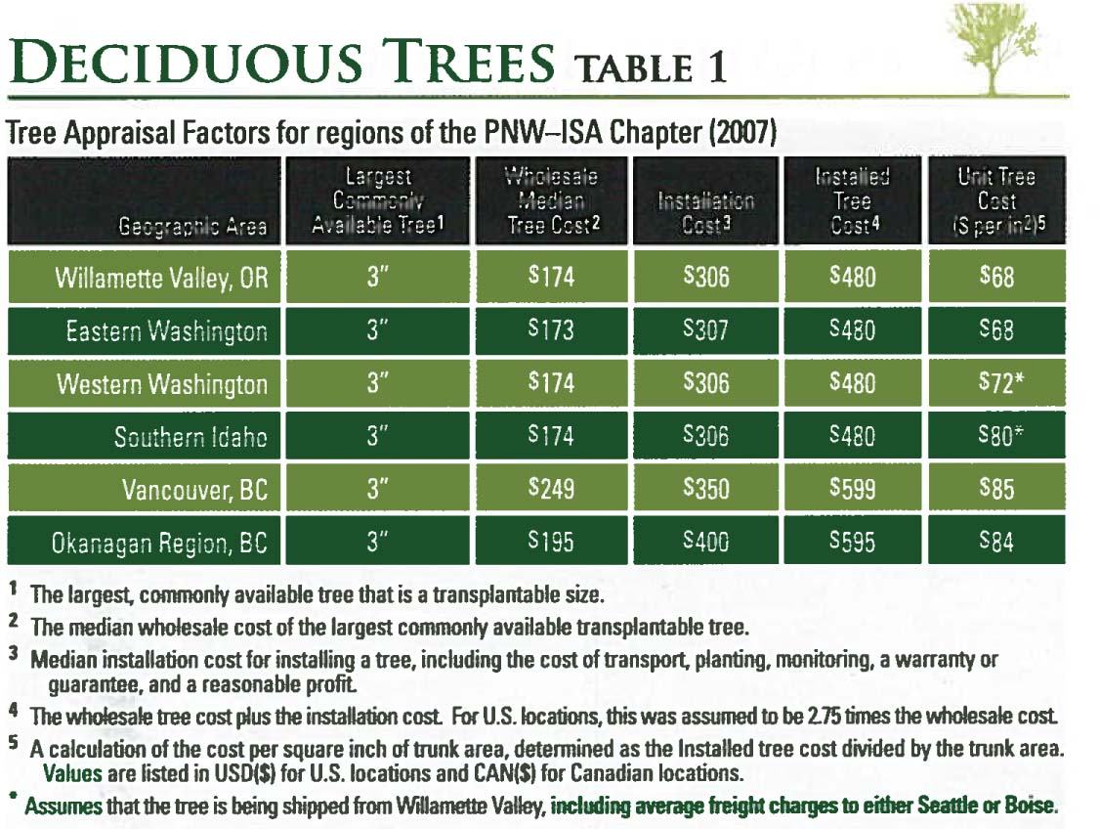
Regional Guides
PNW Chapter, 2007

Slide 50
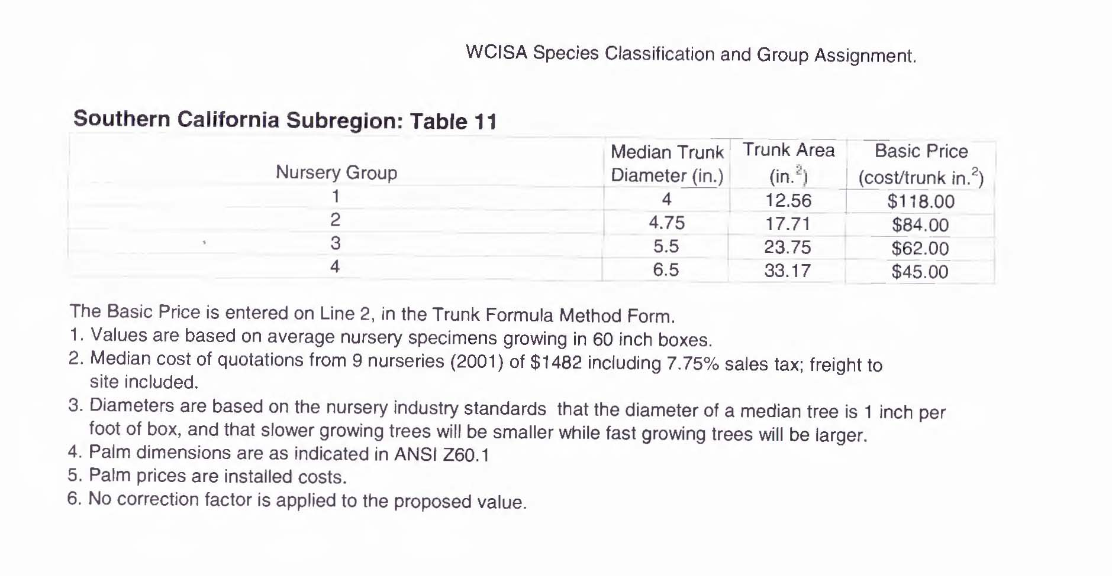
Regional Guides
Western Chapter, 2004

Slide 51
Regional Guides
Aggregate all species in one size
Segment by:
  Price group
  Species characteristics
  Region
  Nursery group
  Individual species
  Combination of above

Slide 52
Trunk Formula Method (TFM)
Trunk Area
Unit Cost
Species
Location
Condition

Slide 53
What Happens When 14 Arborists Appraise the Same 10 Trees?
Field Testing the Trunk Formula Method
James Komen
BCMA #WE-9909B
RCA #555
March 8, 2017

