Slide 1
Competing Interests In Street Trees
James Komen
BCMA #WE-9909B
RCA #555

Slide 2
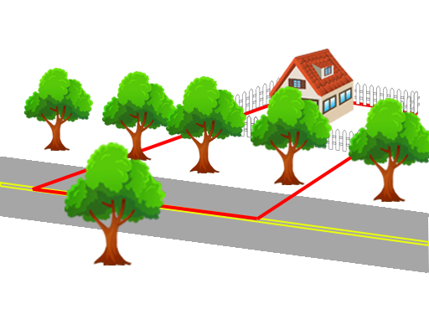
Kingsley v. Pounds (1916 NY)
Notes:
Avenue H in Brooklyn, New York

Slide 3
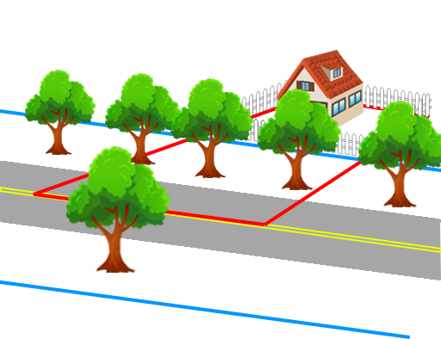
Kingsley v. Pounds (1916 NY)

Slide 4
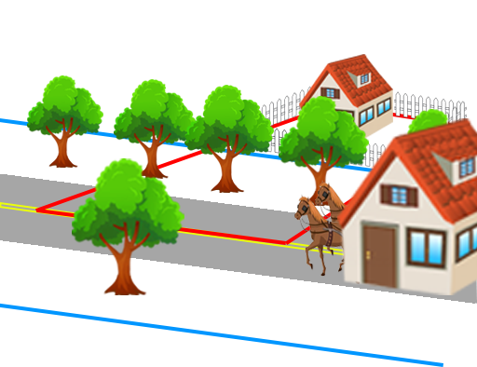
Kingsley v. Pounds (1916 NY)

Slide 5
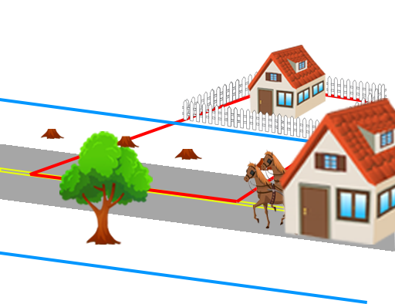
Kingsley v. Pounds (1916 NY)

Slide 6
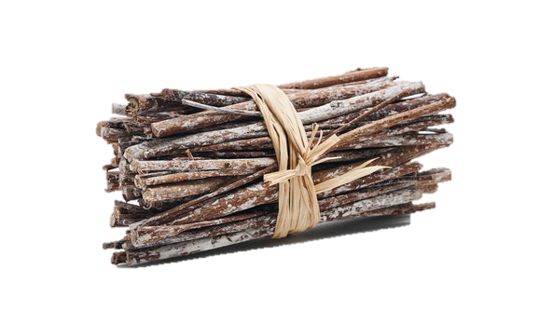
Property Rights
Alienate
Use
Destroy

Slide 7
Easement
Right to use another’s property for a particular purpose
Right to do anything necessary for the enjoyment of that use

Slide 8
Street: A Public Right of Way

Slide 9

Street: A Public Right of Way
Easement

Slide 10
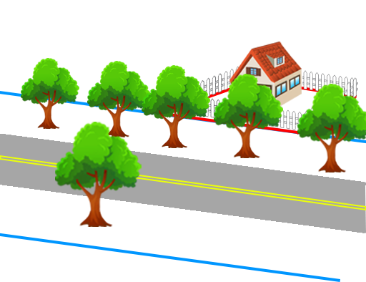
Street: A Public Right of Way
Easement
Fee Simple

Slide 11
Competing Interests in Streets
Landowner
Government/Public
3rd Party
Alienate
Use
Destroy

Slide 12
Competing Interests in Streets
Landowner
Government/Public
3rd Party
Alienate
Use
Destroy

Slide 13
Competing Interests in Streets
Landowner
Government/Public
3rd Party
Alienate
Use
Destroy

Slide 14
Competing Interests in Streets
Landowner
Government/Public
3rd Party
Alienate
Use
Destroy

Slide 15
Competing Interests in Streets
“public use is paramount”
BUT
Taking for public purpose requires
“just compensation”

Slide 16
Public Right of Use

Slide 17
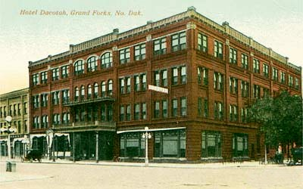
Public Right of Use
Dacotah Hotel v. City of Grand Forks (1961 ND)

Slide 18
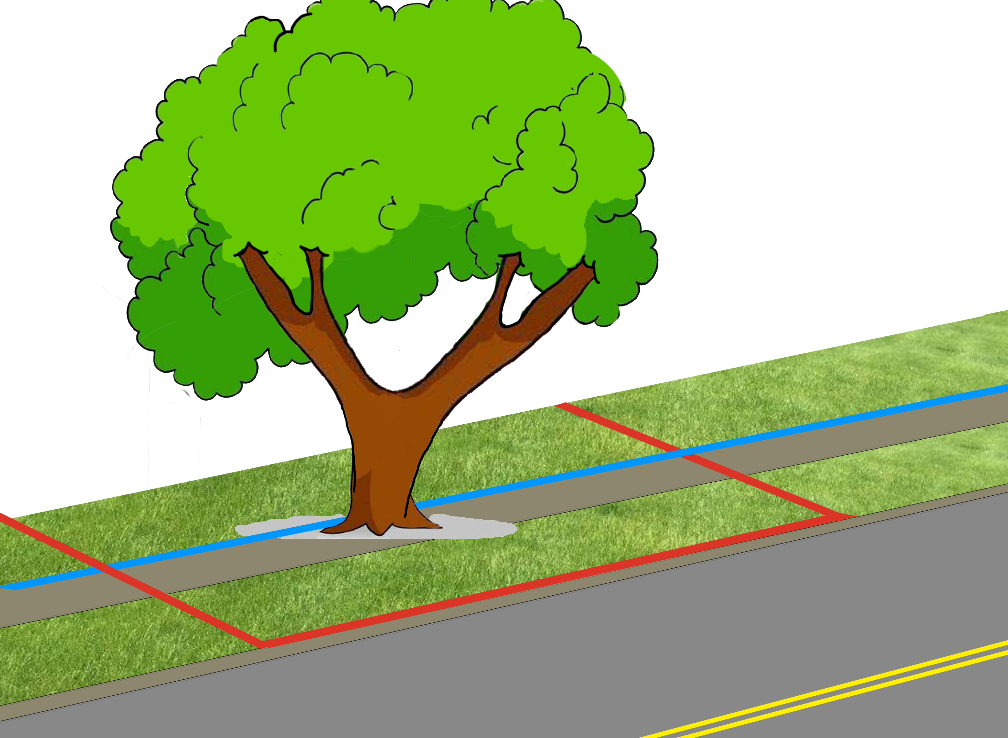
Public Right of Use
Hildrup v. Windfall City (1902 IN)

Slide 19
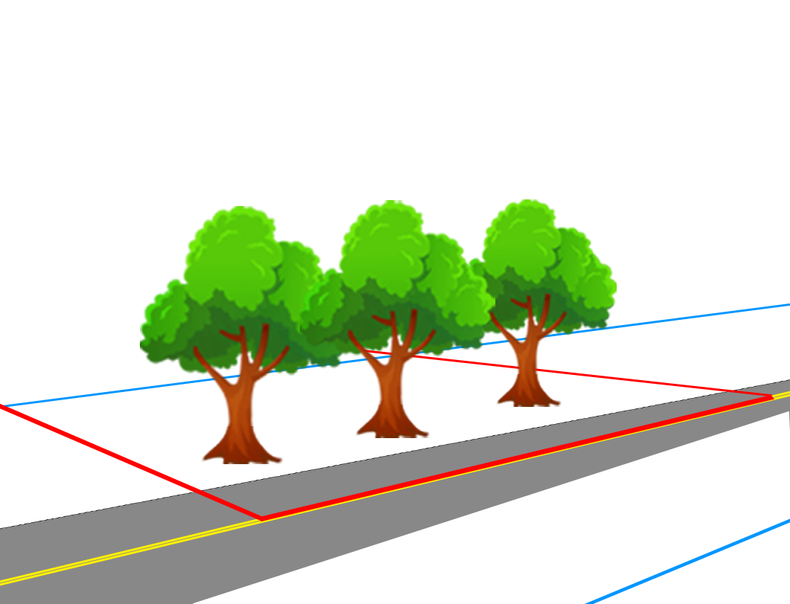
Public Right of Use
Wood v. Thurston County (2005 WA)

Slide 20
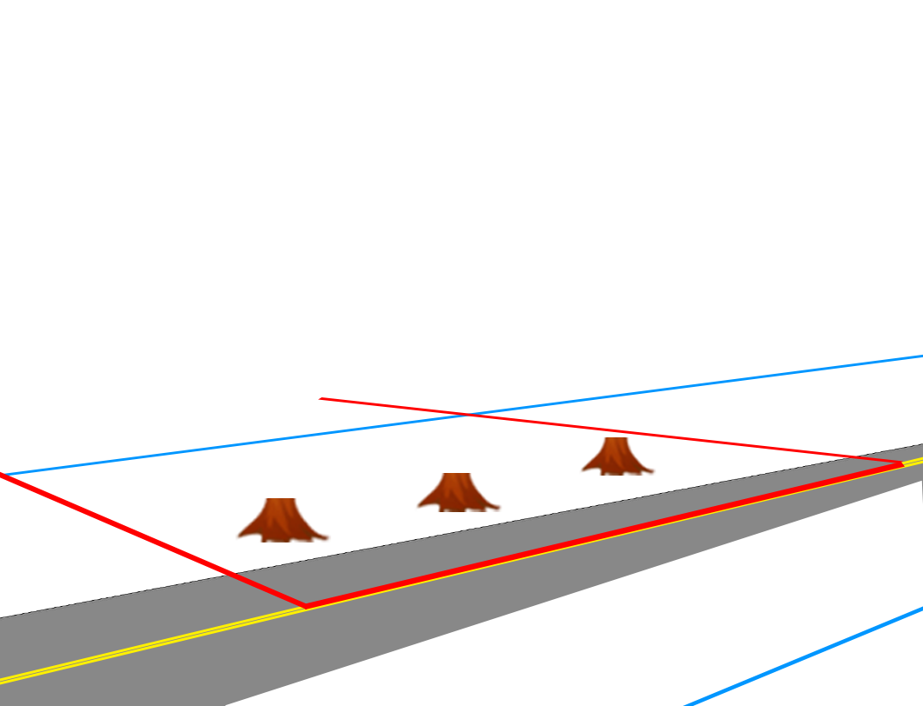
Public Right of Use
Wood v. Thurston County (2005 WA)

Slide 21
Public Right of Use
Wood v. Thurston County (2005 WA)
  Vehicle Safety
  Root Impacts to Road
  Impeded Water Flow
  Impacted Ability to Manage Ice Melt

Slide 22
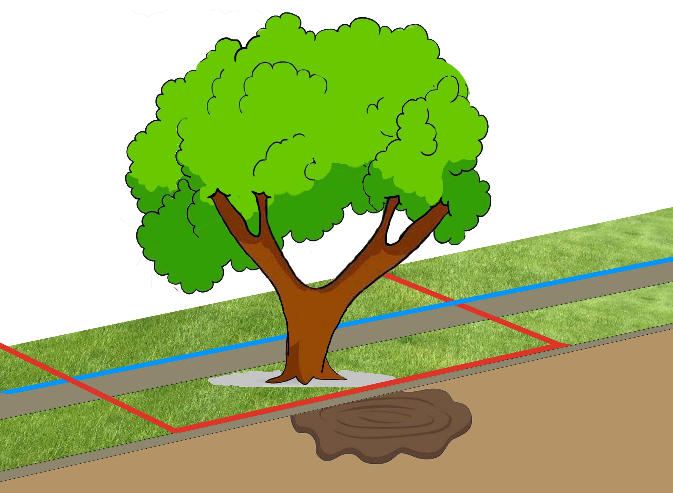
Public Right of Use
Tate v. City of Greensborough (1894 NC)

Slide 23
Public Right of Use
Dacotah Hotel v. City of Grand Forks (1961 ND)
Hildrup v. Windfall City (1902 IN)
Wood v. Thurston County (2005 WA)
Rosauer v. Manos (2019 AK)
Tate v. City of Greensborough (1894 NC)
Ditzen v. Kansas City (1934 KS)
Webber v. Salt Lake City (1911 UT)
Weibel v. City of Beatrice (1956 NE)
Texas Dept. of Transp. V. Kyle (2007 TX)
County Of Broome v. McKune (1943 NY)
Crowell v. New York (1963 NY)
County of Chitaququa v. Swanson
(1940 NY)
Field v. City of Lincoln (1910 NE)

Slide 24
Public Right of Use
“Necessary” vs. “Unnecessary”
Notes:
Foote: 40 ft road in 80ft ROW, widening requiring tree cutting was “necessary”
Durant: tree IN sidewalk is “reasonably necessary” to cut
Johnson: Could have pruned, but didn’t have equipment, so removed. Q of fact whether cutting was “necessary”
Village of Seville: tree cutting “necessary” for road widening within ROW

Slide 25
Public Right of Use
“Necessary” vs. “Unnecessary”
Foote v. City of Crosby (1981 MN)
Durant v. Castleberry (1914 MS)
Johnson v. Town of Oppenheim (2021 NY)
Village of Seville v. Saunders (1999 OH)
Notes:
Foote: 40 ft road in 80ft ROW, widening requiring tree cutting was “necessary”
Durant: tree IN sidewalk is “reasonably necessary” to cut
Johnson: Could have pruned, but didn’t have equipment, so removed. Q of fact whether cutting was “necessary”
Village of Seville: tree cutting “necessary” for road widening within ROW

Slide 26
Public Right of Use
“Necessary” vs. “Unnecessary”
Foote v. City of Crosby (1981 MN) grading was “necessary”
Durant v. Castleberry (1914 MS) “reasonably necessary”
Johnson v. Town of Oppenheim (2021 NY) “necessary”
Village of Seville v. Saunders (1999 OH) “necessary” for road

Slide 27
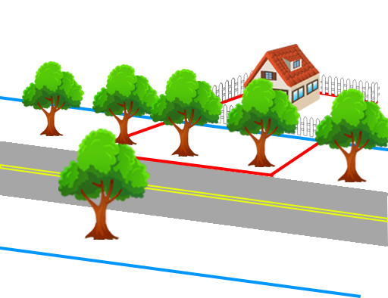
Public Right of Use
Clark v. Dasso (1876 MI)
Notes:
City “sold” the right to harvest the street trees

Slide 28
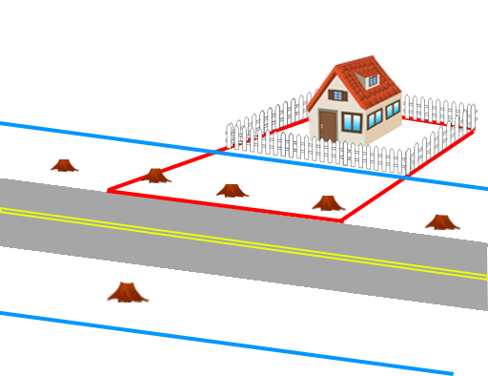
Public Right of Use
Clark v. Dasso (1876 MI)
Notes:
City “sold” the right to harvest the street trees

Slide 29
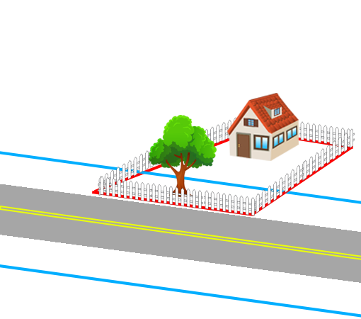
Public Right of Use
Paola v. Wentz (1908 KS)
Notes:
City passed an ordinance to build a sidewalk, but tree wasn’t within the proposed sidewalk.

Slide 30
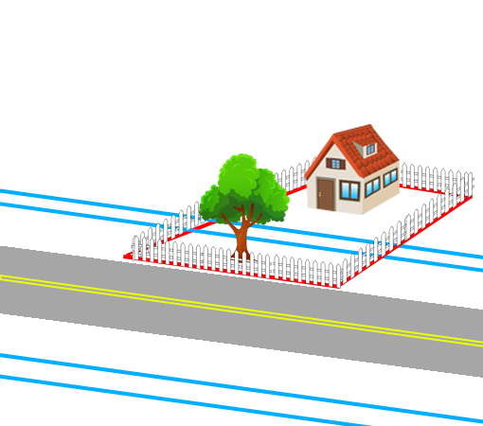
Public Right of Use
Paola v. Wentz (1908 KS)
Notes:
City passed an ordinance to build a sidewalk, but tree wasn’t within the proposed sidewalk.

Slide 31
Public Right of Use
“Unnecessary”
Clark v. Dasso (1876 MI)
Paola v. Wentz (1908 KS)
Village of Amelia v. Hicks (1913 OH)
City of Massillon v. Huff (1910 OH)
Stevens v. New York (1959 NY)
Notes:
Village of Amelia: giving contractor “free trimming privilege” is abuse of city’s discretion
City of Massillon: jury found trees weren’t obstructing ROW when cut
Stevens: healthy tree cut, but not “necessary” for ROW

Slide 32
Landowner Right of Use

Slide 33
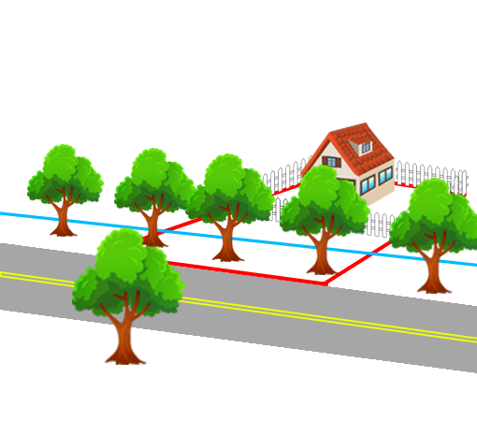
Landowner Right of Use
Kendall v. People’s Gas (1935 LA)

Slide 34
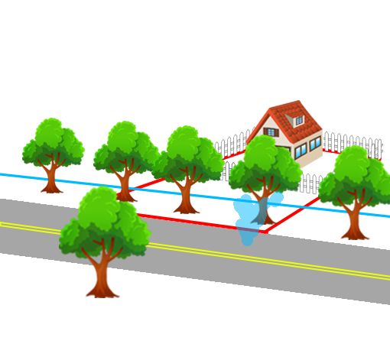
Landowner Right of Use
Kendall v. People’s Gas (1935 LA)

Slide 35
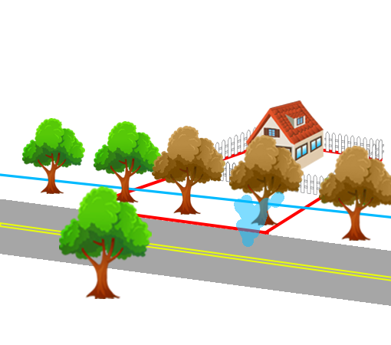
Landowner Right of Use
Kendall v. People’s Gas (1935 LA)

Slide 36
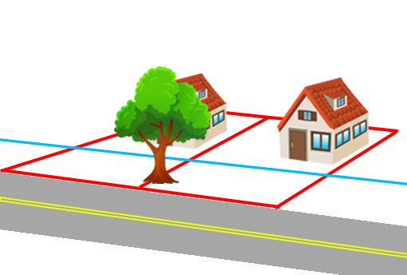
Landowner Right of Use
Blalock v. Atwood (1913 KY)

Slide 37
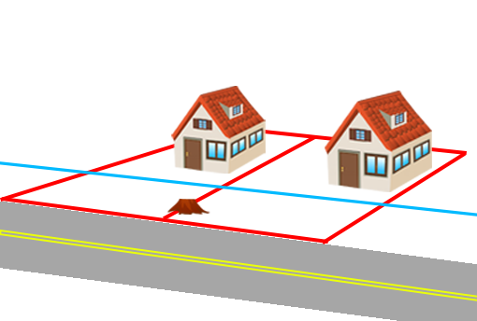
Landowner Right of Use
Blalock v. Atwood (1913 KY)

Slide 38
Landowner Right of Use
Kendall v. People’s Gas (1935 LA)
Blalock v. Atwood (1913 KY)
Brawn v. John Lucas Tree Service (1961 ME)
Goshen v. Crary (1877 IN)

Slide 39
Landowner Right to Destroy

Slide 40
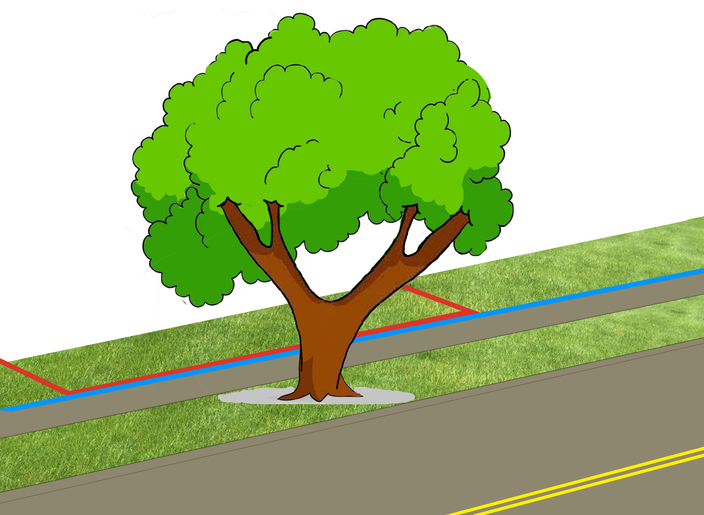
Landowner Right to Destroy
New Orleans v. Shreveport Oil (1930 LA)

Slide 41
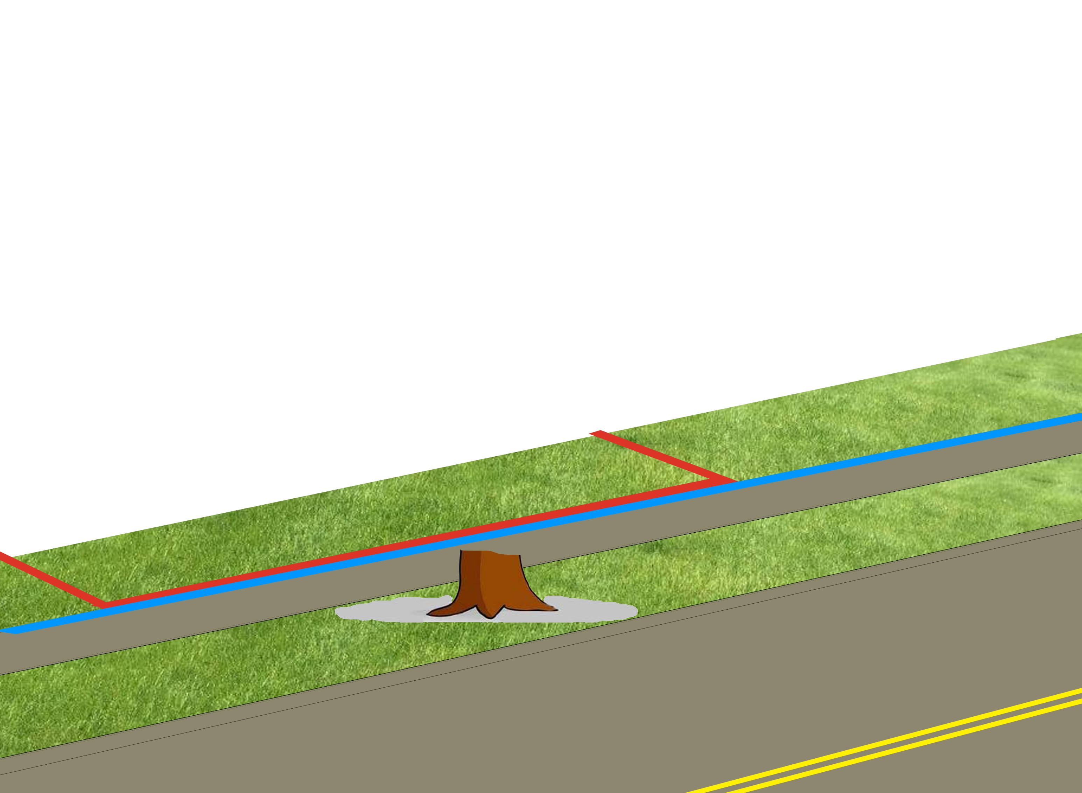
Landowner Right to Destroy
New Orleans v. Shreveport Oil (1930 LA)

Slide 42
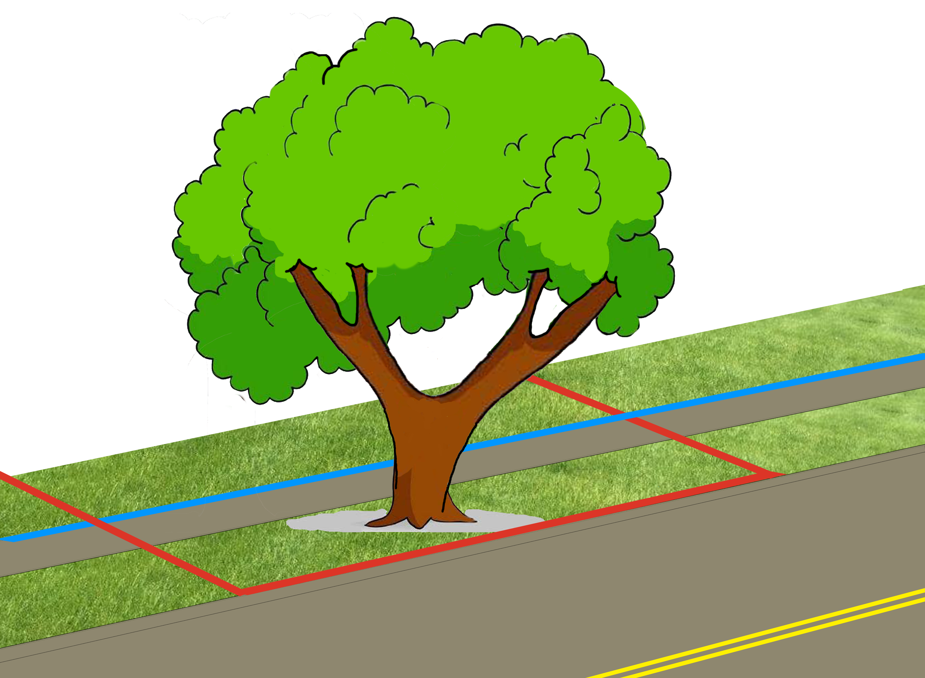
Landowner Right to Destroy
Bigelow v. Whitcomb (1904 NH)

Slide 43
Landowner Right to Destroy
Bigelow v. Whitcomb (1904 NH)
12

Slide 44
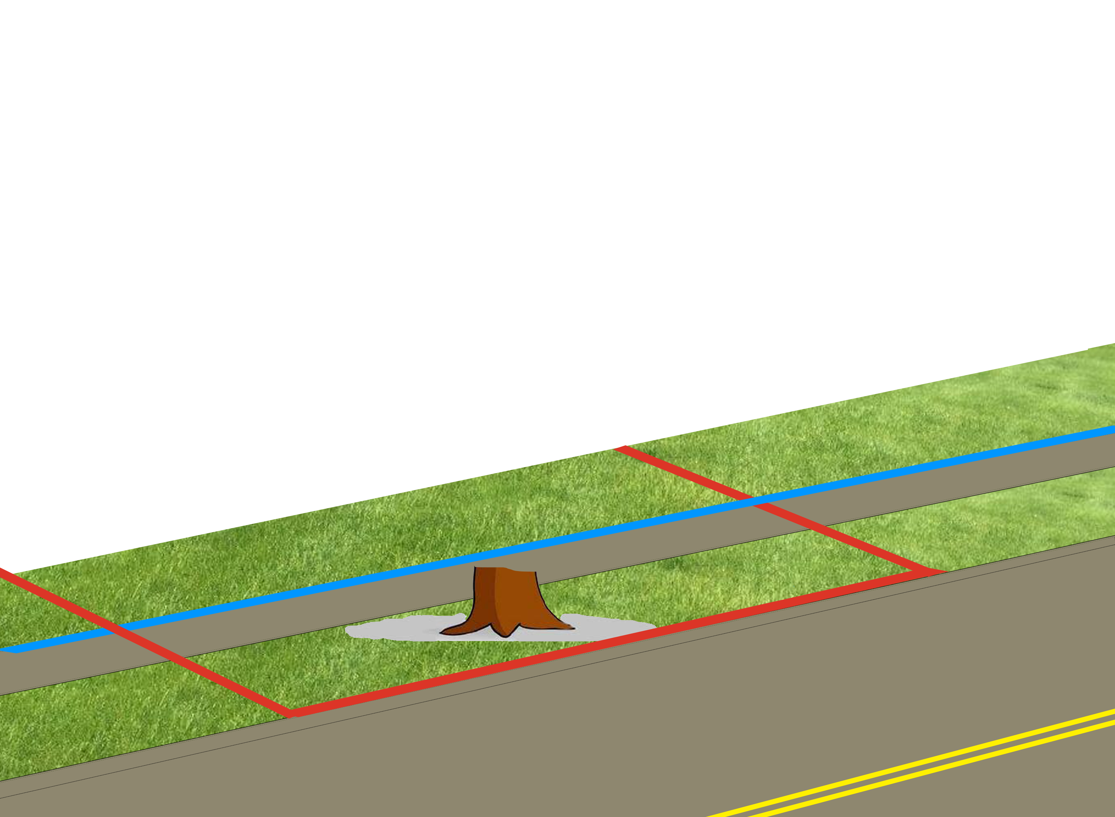
Landowner Right to Destroy
Bigelow v. Whitcomb (1904 NH)

Slide 45
Landowner Right to Destroy
New Orleans v. Shreveport Oil (1930 LA)
Bigelow v. Whitcomb (1904 NH)
Lancaster v. Richardson (1871 NY)
Perkins v. Village of Mexico (1950 NY)

Slide 46
3rd Party Right to Use

Slide 47
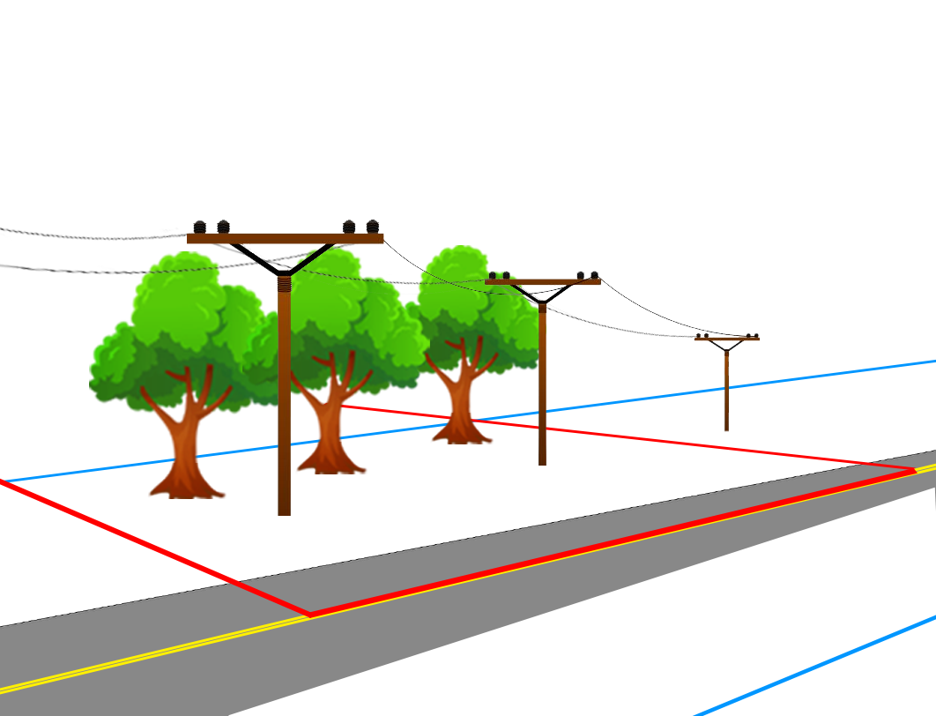
3rd Party Right to Use
Mall v. C&W Rural Electric (1950 KS)

Slide 48
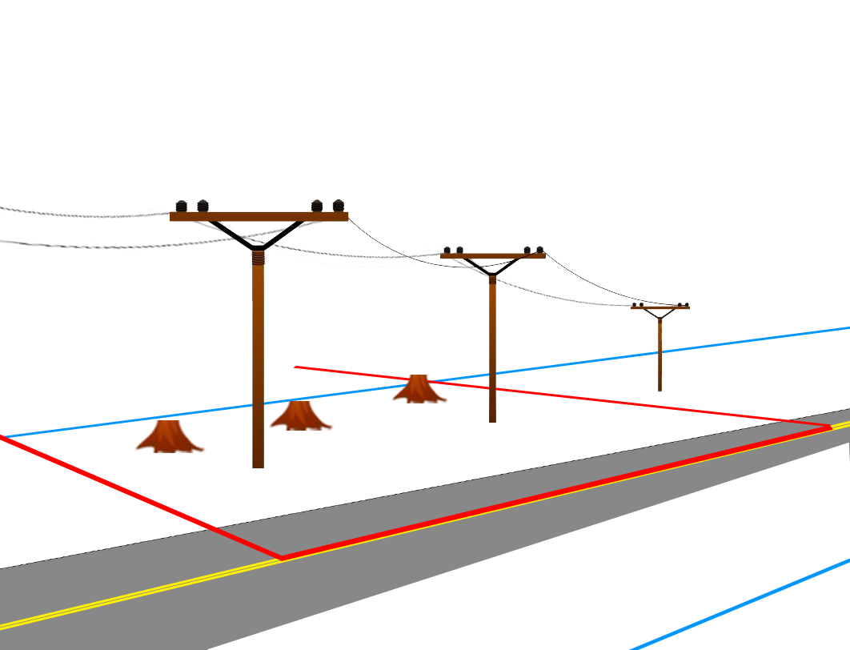
3rd Party Right to Use
Mall v. C&W Rural Electric (1950 KS)

Slide 49
3rd Party Right to Use
Mall v. C&W Rural Electric (1950 KS)
Brown v. Asheville Electric Light Co. (1905 NC)
Bliss v. Ball (1868 MA)
State v. Pratt (1903 MN)
White v. Berry (1927 NY)
Kingsley v. Pounds (1916 NY)
Notes:
Brown: utility company cut ROW tree IN sidewalk to make room for power lines (SEE HILDRUP, where govt cuts tree in sidewalk, NOT utility)
State: house mover fined for cutting street trees
White: house mover fined for cutting street trees AFTER obtaining PERMIT to move HOUSE (but not cut trees)

Slide 50
Government Ownership in Fee

Slide 51
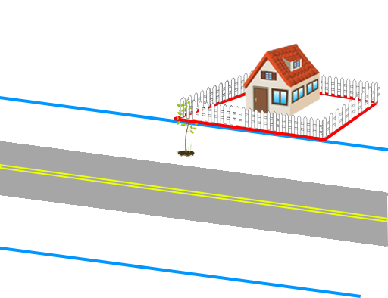
Government Ownership in Fee
Robinson v. Spokane (1912 WA)
Notes:
City ordinance allows planting in ROW
But then
NEW ordinance says all trees in ROW are obstruction to be cut

Slide 52
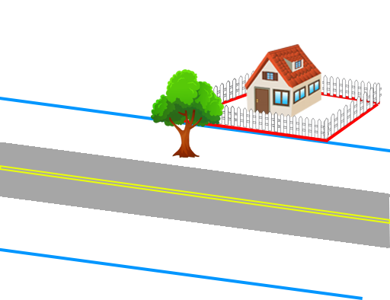
Government Ownership in Fee
Robinson v. Spokane (1912 WA)
Notes:
City ordinance allows planting in ROW
But then
NEW ordinance says all trees in ROW are obstruction to be cut

Slide 53
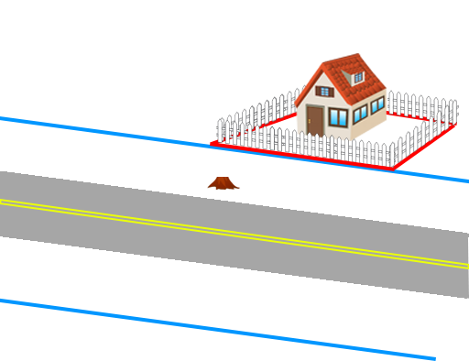
Government Ownership in Fee
Robinson v. Spokane (1912 WA)
Notes:
City ordinance allows planting in ROW
But then
NEW ordinance says all trees in ROW are obstruction to be cut

Slide 54
Government Ownership in Fee
Lane v. Lamkey (1900 NY)

Slide 55
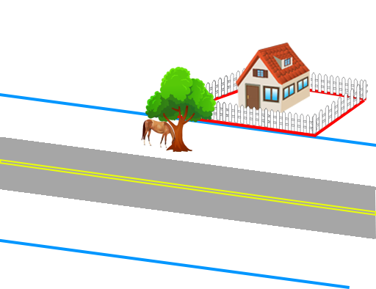
Government Ownership in Fee
Lane v. Lamkey (1900 NY)

Slide 56

Government Ownership in Fee
Lane v. Lamkey (1900 NY)

Slide 57
Government Ownership in Fee
Landowner vs. Government
  Robinson v. Spokane (1912 WA) (“revocable license”)
Landowner vs. 3rd Party
  Lane v. Lamkey (1900 NY)
  Donahue v. Keystone Gas (1905 NY) (“right in nature of an easement”)
  Norman Milling & Grain Co. v. Bethurem (1914 OK) (“equitable easement”)
  Wheeler v. Norfolk Carolina Tel. & Tel. Co. (1916 NC)
Notes:
Donahue: gas leak where gov’t owns fee
Norman Milling: line clearance pruning where gov’t owns fee, “right to occupy the street is NOT the right to occupy EVERY part”
Wheeler: utility cuts trees where gov’t owns fee, “wretched would be the policy that required proving fee title to land in possession”

Slide 58
Competing Interests In Street Trees
Public Right of Use
Landowner Right of Use
Landowner Right to Destroy
3rd Party Right to Use
Government Ownership in Fee

Slide 59
Competing Interests In Street Trees
James Komen
BCMA #WE-9909B
RCA #555

