Slide 1
Case Illustrations from
Southern Chapter Tree Law
James Komen
BCMA #WE-9909B
RCA #555

Slide 2
Tree Failure
Warren v. Tupelo 187 Miss. 816 (MS Supr. Ct. 1940)
Rowe v. McGee 5 N.C. App. 60 (NC Ct. App. 1969)
Griefield v. Gibraltar Fire & Marine 199 Miss. 175 (MS Supr. Ct. 1946)
Wallen v. Riverside Sports Ctr. 173 N.C. App. 408 (NC Ct. App. 2005)
Staples v. Duell 494 S.E.2d 639 (SC Ct. App. 1997)
Toledo v. United States 95 F.Supp. 838 (USDC PR 1951)
Harding v. Bethesda Regional 551 So.2d 299 (AL Supr. Ct. 1989)
Notes:
6 cases

Slide 3
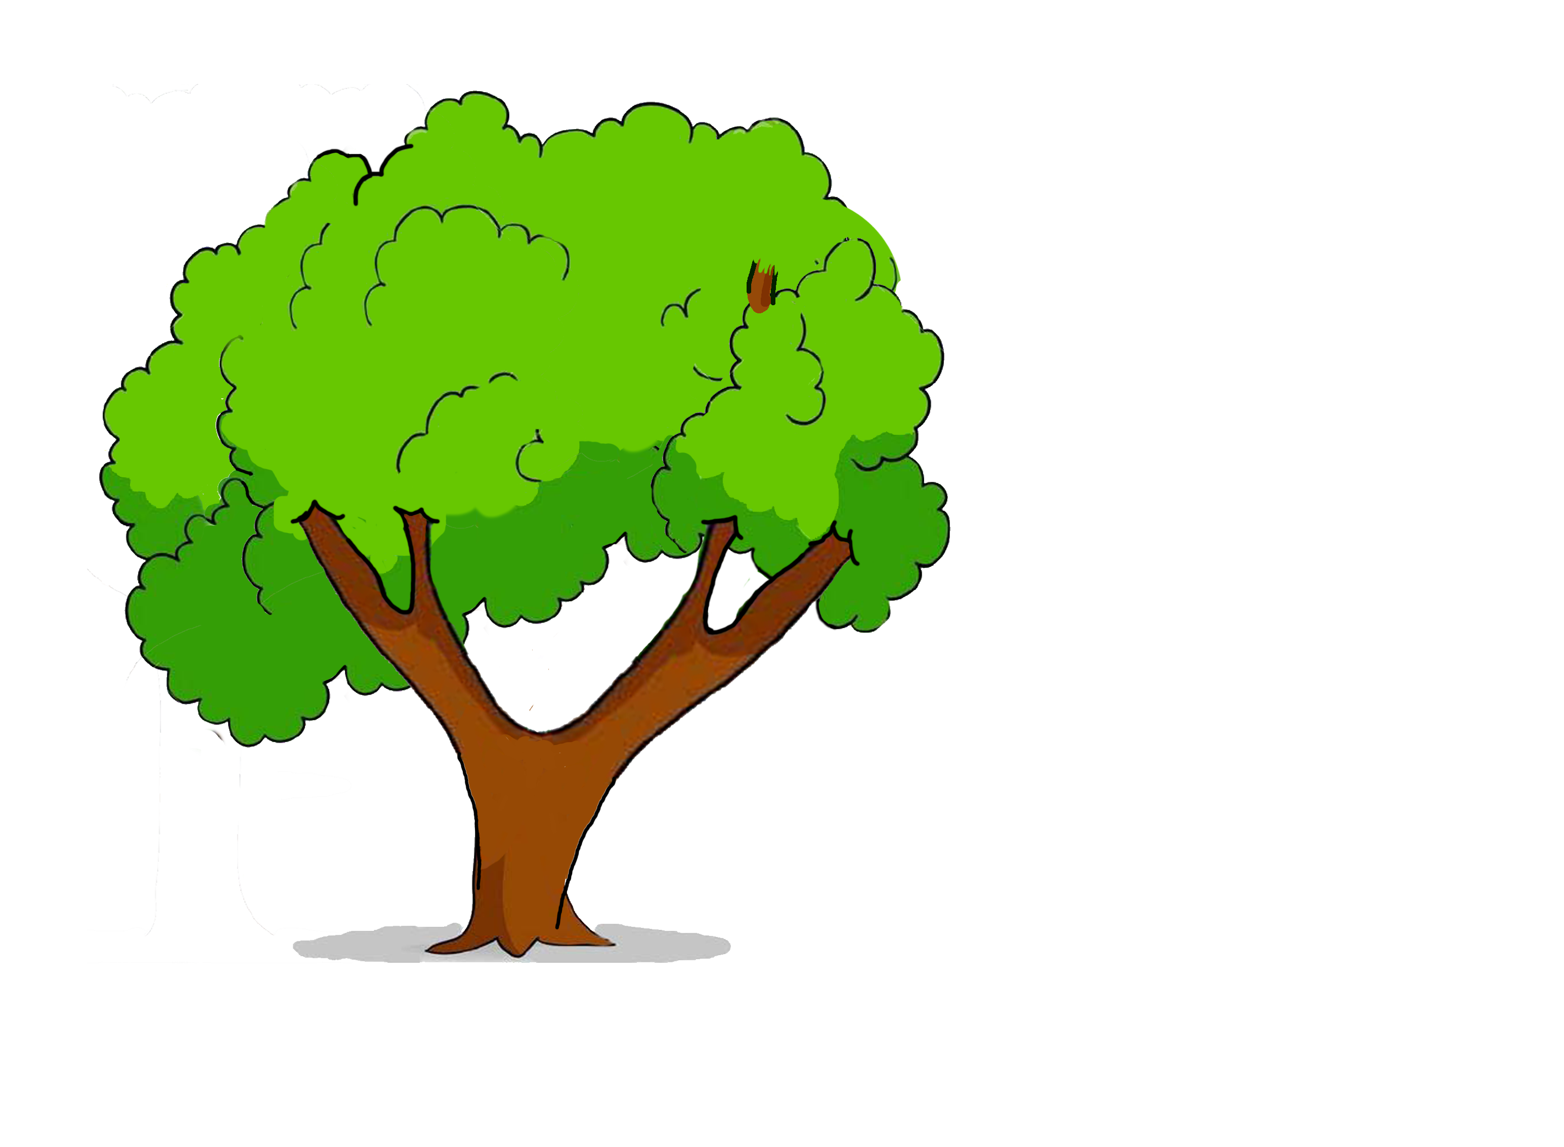
Warren v. Tupelo
187 Miss. 816 (MS Supr. Ct. 1940)
Notes:
MS Supreme Court
Tupelo, MS 1936
Mr. Warren was an auto repairman and welder. One day, while outside his business, a street tree dropped a dead branch on him.
2 months prior, the branch partially failed in a storm
Branch was not rotten, and had not been dead for long. Tree had dense green canopy.
No major prior branch failures. Witness saw hanging branches post-storm, but never reported them to City.
City didn’t have ANY tree inspectors

Slide 4
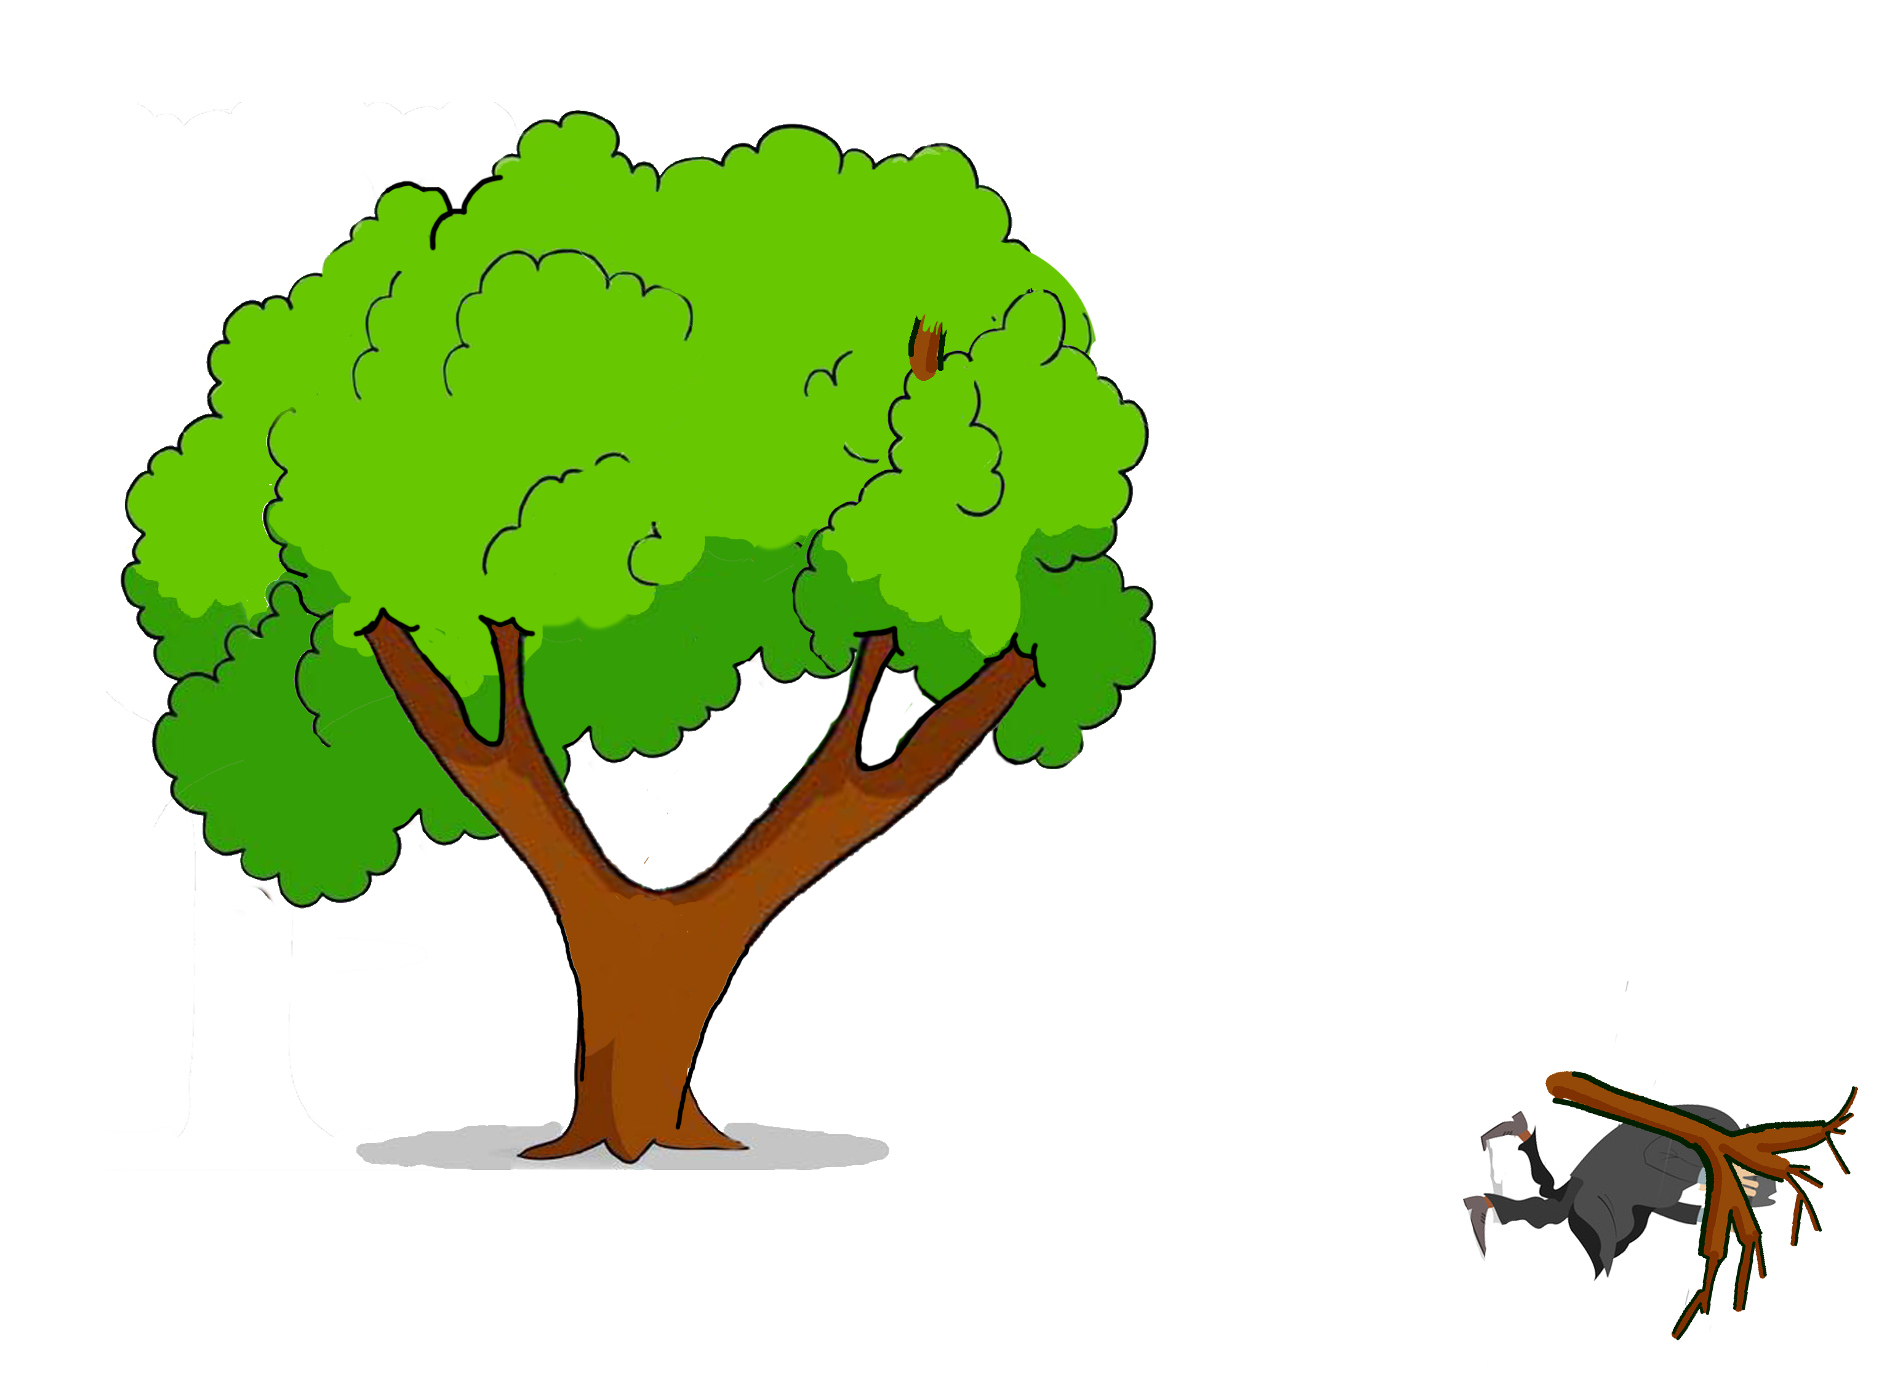
Warren v. Tupelo
187 Miss. 816 (MS Supr. Ct. 1940)
Notes:
MS Supreme Court
Tupelo, MS 1936
Mr. Warren was an auto repairman and welder. One day, while outside his business, a street tree dropped a dead branch on him.
2 months prior, the branch partially failed in a storm
Branch was not rotten, and had not been dead for long. Tree had dense green canopy.
No major prior branch failures. Witness saw hanging branches post-storm, but never reported them to City.
City didn’t have ANY tree inspectors

Slide 5
Warren v. Tupelo
187 Miss. 816 (MS Supr. Ct. 1940)
“It is NOT the duty of a municipality to have a regular or continued inspection of the trees…”
It need only “exercise reasonable care for the people using the streets who themselves are exercising reasonable care.”
“The City created nothing artificial overhead in this tree.”

Slide 6
Warren v. Tupelo
187 Miss. 816 (MS Supr. Ct. 1940)
“The danger was so well concealed that it would almost require that we announce that the municipality in this case was an insurer of the appellant’s safety.”

Slide 7
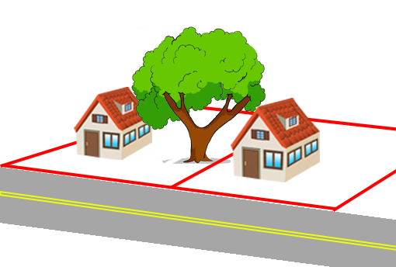
Rowe v. McGee
5 N.C. App. 60 (NC Ct. App. 1969)
Notes:
NC Ct. App.
1967, Newton Township, NC
Large oak tree grew on Noah and Jeanette McGee’s property. Oak tree was “extremely rotted and filled with honey bees”
Neighbors Edward and Josephine Rowe asked defendants at least twice to remove the tree.
McGees had “no objection” to the Rowes cutting it down, but they didn’t want to do it.
Tree broke and landed on house. Rowe’s insurance paid for the damage and then sued the McGees to recover
McGees defended because the tree was a “natural condition of the land.”

Slide 8
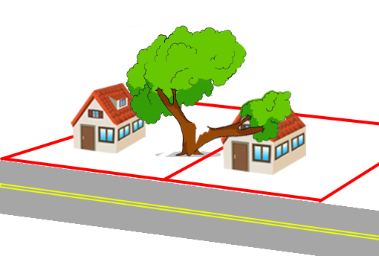
Rowe v. McGee
5 N.C. App. 60 (NC Ct. App. 1969)
Notes:
NC Ct. App.
1967, Newton Township, NC
Large oak tree grew on Noah and Jeanette McGee’s property. Oak tree was “extremely rotted and filled with honey bees”
Neighbors Edward and Josephine Rowe asked defendants at least twice to remove the tree.
McGees had “no objection” to the Rowes cutting it down, but they didn’t want to do it.
Tree broke and landed on house. Rowe’s insurance paid for the damage and then sued the McGees to recover
McGees defended because the tree was a “natural condition of the land.”

Slide 9
Rowe v. McGee
5 N.C. App. 60 (NC Ct. App. 1969)
“[The McGees] knew that the tree…was decayed and liable to fall.”
“Public policy in a civilized community requires that …there be no oases of nonliability where a private nuisance may be maintained with impunity.”
Notes:
Only four states and the District of Columbia follow the contributory negligence rule in the United States: Alabama, Maryland, North Carolina, and Virginia
Even if a plaintiff is just 1% at fault, he cannot recover.

Slide 10
Rowe v. McGee
5 N.C. App. 60 (NC Ct. App. 1969)
“[The McGees] knew that the tree…was decayed and liable to fall.”
“Public policy in a civilized community requires that …there be no oases of nonliability where a private nuisance may be maintained with impunity.”
HOWEVER
Notes:
Only four states and the District of Columbia follow the contributory negligence rule in the United States: Alabama, Maryland, North Carolina, and Virginia
Even if a plaintiff is just 1% at fault, he cannot recover.

Slide 11
Rowe v. McGee
5 N.C. App. 60 (NC Ct. App. 1969)
“[The McGees] knew that the tree…was decayed and liable to fall.”
“Public policy in a civilized community requires that …there be no oases of nonliability where a private nuisance may be maintained with impunity.”
HOWEVER
The Rowes had permission to cut the tree, so they were contributorily negligent
Notes:
Only four states and the District of Columbia follow the contributory negligence rule in the United States: Alabama, Maryland, North Carolina, and Virginia
Even if a plaintiff is just 1% at fault, he cannot recover.

Slide 12
Griefield v. Gibraltar Fire & Marine Ins. Co.
199 Miss. 175 (MS Supr. Ct. 1946)
Notes:
MS Supreme Court
1946, Warren County, MS
Large oak tree growing on Mrs. Griefield’s property reached over Mr. Wahl-Stokes’ property
No evidence tree was NOT natural growth
Mr. Wahl-Stokes notified Mrs. Griefield IN WRITING of the overhanging limb hazard.
Mrs. Griefield promised, IN WRITING, to remove the branch, but then DIDN’T.
Limb fell on Wahl-Stokes house, insurance paid, then subrogated against Mrs. Griefield to recover.

Slide 13
Griefield v. Gibraltar Fire & Marine Ins. Co.
199 Miss. 175 (MS Supr. Ct. 1946)
Notes:
MS Supreme Court
1946, Warren County, MS
Large oak tree growing on Mrs. Griefield’s property reached over Mr. Wahl-Stokes’ property
No evidence tree was NOT natural growth
Mr. Wahl-Stokes notified Mrs. Griefield IN WRITING of the overhanging limb hazard.
Mrs. Griefield promised, IN WRITING, to remove the branch, but then DIDN’T.
Limb fell on Wahl-Stokes house, insurance paid, then subrogated against Mrs. Griefield to recover.

Slide 14
Griefield v. Gibraltar Fire & Marine Ins. Co.
199 Miss. 175 (MS Supr. Ct. 1946)
“[Griefield] was under no obligation…to remove the limb.”

Slide 15
Griefield v. Gibraltar Fire & Marine Ins. Co.
199 Miss. 175 (MS Supr. Ct. 1946)
“[Griefield] was under no obligation…to remove the limb.”
“Her gratuitous promise so to do was not binding on her.”

Slide 16
Griefield v. Gibraltar Fire & Marine Ins. Co.
199 Miss. 175 (MS Supr. Ct. 1946)
“[Griefield] was under no obligation…to remove the limb.”
“Her gratuitous promise so to do was not binding on her.”
“[The Wahl-Stokes] had the right at all times to themselves remove so much of the limb as overhung their land.”

Slide 17
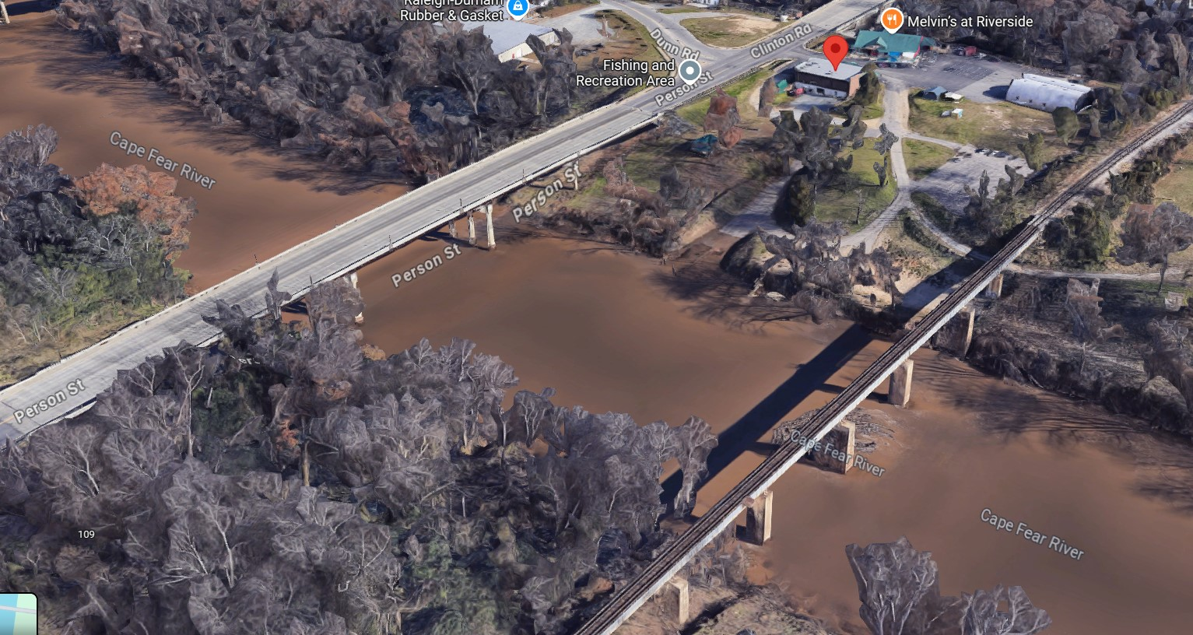
Wallen v. Riverside Sports Ctr.
173 N.C. App. 408 (NC Ct. App. 2005)
Notes:
NC Ct. App.
2001 Fayetteville, NC along the Cape Fear River near the Person St Bridge
Timothy Earl Wallen went fishing. In the afternoon, a storm rolled in, and he moored his boat to a downstream pile near the boat ramp.
Boxelder tree fell and struck Wallen, rendering him paraplegic
Boxelder tree was alive but substantially decayed. It had two old breaks with epicormic sprouts, and it was leaning towards the river.
Trial Court granted MSJ for Riverside Sports Ctr because the tree was a natural condition.

Slide 18
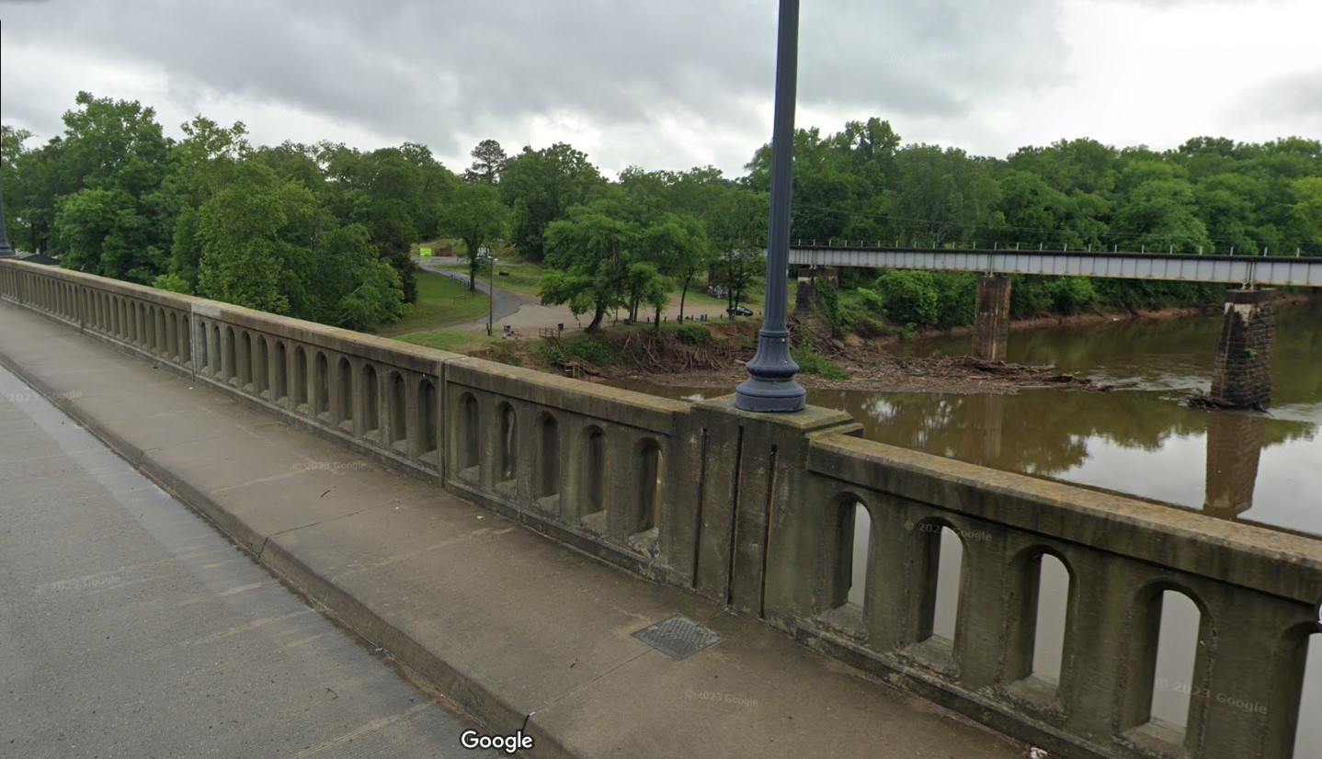
Wallen v. Riverside Sports Ctr.
173 N.C. App. 408 (NC Ct. App. 2005)
Notes:
NC Ct. App.
2001 Fayetteville, NC along the Cape Fear River near the Person St Bridge
Timothy Earl Wallen went fishing. In the afternoon, a storm rolled in, and he moored his boat to a downstream pile near the boat ramp.
Boxelder tree fell and struck Wallen, rendering him paraplegic
Boxelder tree was alive but substantially decayed. It had two old breaks with epicormic sprouts, and it was leaning towards the river.
Trial Court granted MSJ for Riverside Sports Ctr because the tree was a natural condition.

Slide 19
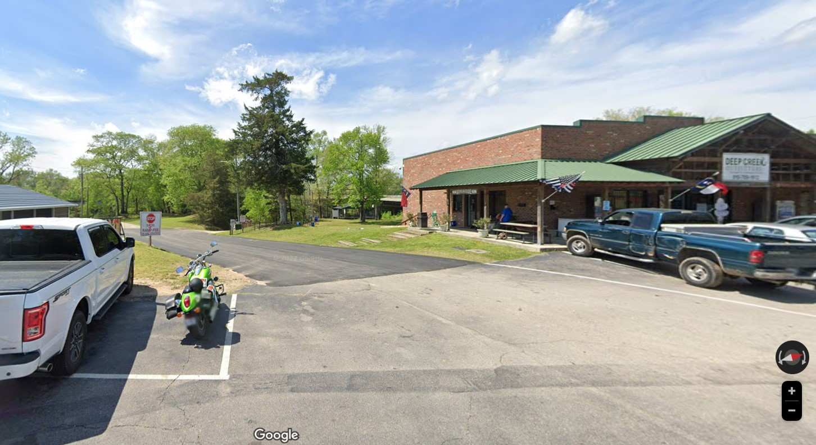
Wallen v. Riverside Sports Ctr.
173 N.C. App. 408 (NC Ct. App. 2005)
Notes:
NC Ct. App.
2001 Fayetteville, NC along the Cape Fear River near the Person St Bridge
Timothy Earl Wallen went fishing. In the afternoon, a storm rolled in, and he moored his boat to a downstream pile near the boat ramp.
Boxelder tree fell and struck Wallen, rendering him paraplegic
Boxelder tree was alive but substantially decayed. It had two old breaks with epicormic sprouts, and it was leaning towards the river.
Trial Court granted MSJ for Riverside Sports Ctr because the tree was a natural condition.

Slide 20
Wallen v. Riverside Sports Ctr.
173 N.C. App. 408 (NC Ct. App. 2005)
R2D §363:
  Generally, no liability for harm caused by natural conditions of the land
  MAY be liable for harm to persons using a public highway in an urban area caused by trees
“Navigable waters constitute a public highway”

Slide 21
Wallen v. Riverside Sports Ctr.
173 N.C. App. 408 (NC Ct. App. 2005)
Urban
  Within Fayetteville
  Zoned industrial
  Along major thoroughfare
  Adjacent to railroad tracks
Rural
  Along Cape Fear River
  Heavily wooded
  Primary use is recreational

Slide 22
Wallen v. Riverside Sports Ctr.
173 N.C. App. 408 (NC Ct. App. 2005)
“[Riverside] had a duty to exercise reasonable care with respect to natural conditions” regardless of whether land is rural or urban.
Rejects R2D §363 rural/urban distinction

Slide 23
Wallen v. Riverside Sports Ctr.
173 N.C. App. 408 (NC Ct. App. 2005)
“[Riverside] had a duty to exercise reasonable care with respect to natural conditions” regardless of whether land is rural or urban.
Rejects R2D §363 rural/urban distinction
“We caution that [this case] is not intended to place an absolute duty upon persons owning property located along a river or other public highway to inspect or trim trees.”

Slide 24
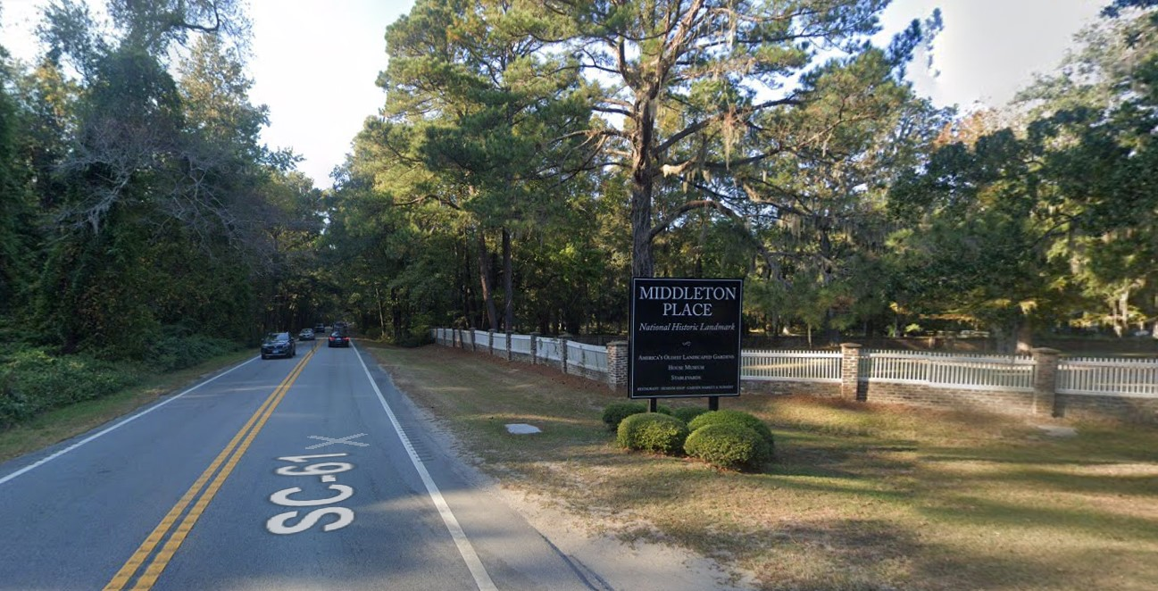
Staples v. Duell
494 S.E.2d 639 (SC Ct. App. 1997)
Notes:
SC Ct. App.
1997, SC
Julie Staples was driving along Highway 61 from Charleston towards Summerville
Collided a dead pine tree that had fallen across the road from Middleton Place National Historic Landmark, owned by Charles Duell
100,000 admission-paying visitors per year
Highway 61 carries 13,500 vehicles PER DAY
Duell hired James Woddle to care for the property, including driving around the perimeter of the property to inspect for things including dead trees.
Trial court held land was RURAL

Slide 25
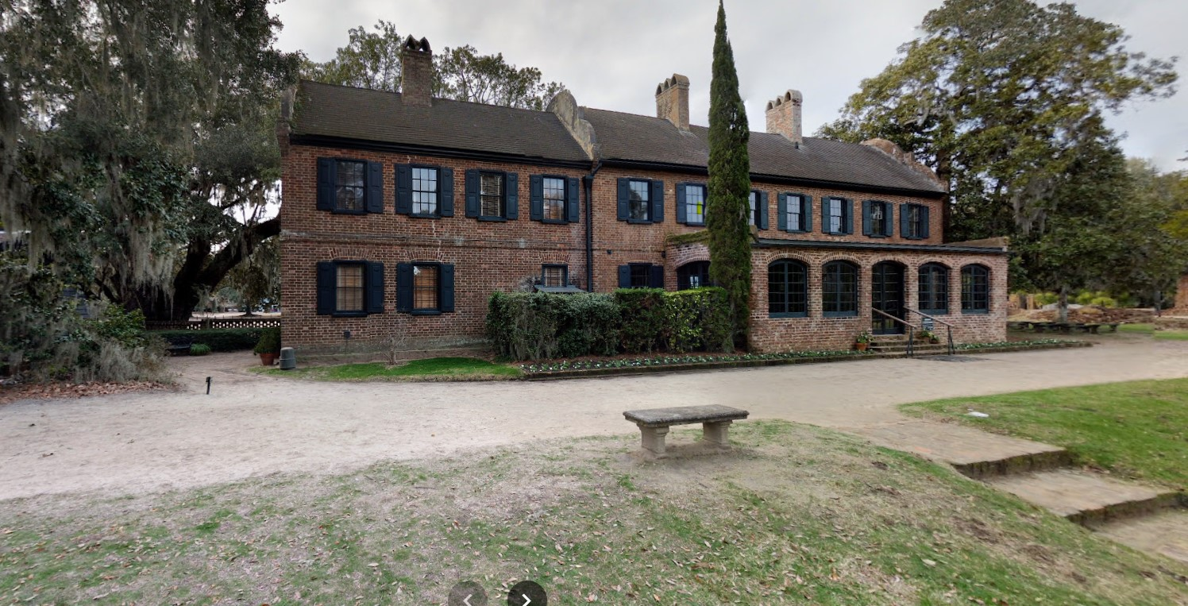
Staples v. Duell
494 S.E.2d 639 (SC Ct. App. 1997)
Notes:
SC Ct. App.
1997, SC
Julie Staples was driving along Highway 61 from Charleston towards Summerville
Collided a dead pine tree that had fallen across the road from Middleton Place National Historic Landmark, owned by Charles Duell
100,000 admission-paying visitors per year
Highway 61 carries 13,500 vehicles PER DAY
Duell hired James Woddle to care for the property, including driving around the perimeter of the property to inspect for things including dead trees.
Trial court held land was RURAL

Slide 26
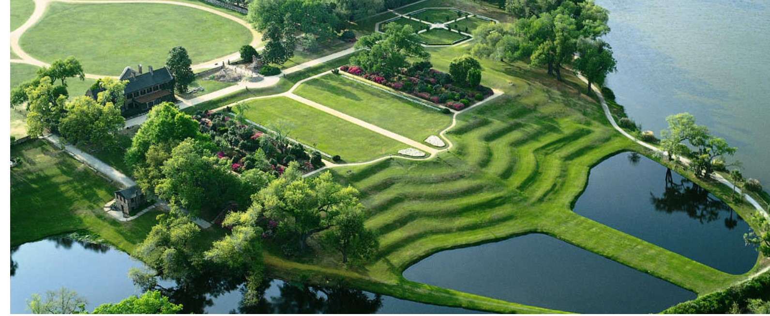
Staples v. Duell
494 S.E.2d 639 (SC Ct. App. 1997)
Notes:
SC Ct. App.
1997, SC
Julie Staples was driving along Highway 61 from Charleston towards Summerville
Collided a dead pine tree that had fallen across the road from Middleton Place National Historic Landmark, owned by Charles Duell
100,000 admission-paying visitors per year
Highway 61 carries 13,500 vehicles PER DAY
Duell hired James Woddle to care for the property, including driving around the perimeter of the property to inspect for things including dead trees.
Trial court held land was RURAL

Slide 27
Staples v. Duell
494 S.E.2d 639 (SC Ct. App. 1997)
“Even though other jurisdictions may be rethinking their approach to landowner liability, South Carolina follows the traditional rural and urban distinction.”

Slide 28
Staples v. Duell
494 S.E.2d 639 (SC Ct. App. 1997)
“Even though other jurisdictions may be rethinking their approach to landowner liability, South Carolina follows the traditional rural and urban distinction.”
“once the trial judge ruled that Duell’s land was rural,” Duell had no duty to inspect

Slide 29
Staples v. Duell
494 S.E.2d 639 (SC Ct. App. 1997)
Woddle’s inspections didn’t increase risk of harm
  “did not hasten the decay of trees” or
  “affect when and where dead trees might fall”

Slide 30
Staples v. Duell
494 S.E.2d 639 (SC Ct. App. 1997)
Woddle’s inspections didn’t increase risk of harm
  “did not hasten the decay of trees” or
  “affect when and where dead trees might fall”
Staples didn’t know of Woddle’s inspections, so she “could not have relied on the policy.”

Slide 31
Staples v. Duell
494 S.E.2d 639 (SC Ct. App. 1997)
Woddle’s inspections didn’t increase risk of harm
  “did not hasten the decay of trees” or
  “affect when and where dead trees might fall”
Staples didn’t know of Woddle’s inspections, so she “could not have relied on the policy.”
“Duell’s policy of looking for dead trees did not create a duty for which he could be held liable.”

Slide 32
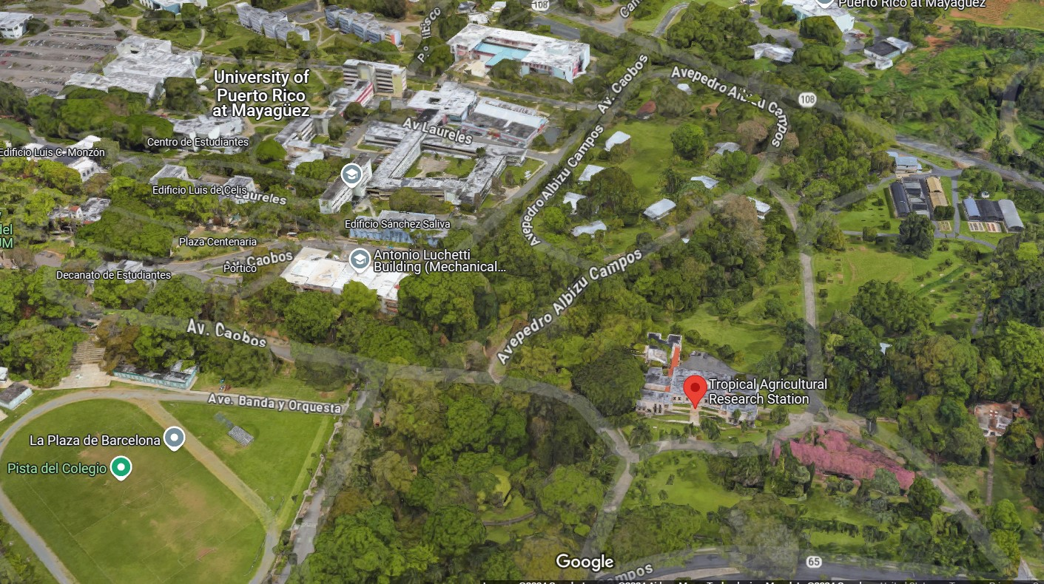
Toledo v. United States
95 F.Supp. 838 (USDC PR 1951)
Notes:
USDC, Puerto Rico
1949, University of Puerto Rico at Mayaguez
In 1901, US Congress established US Experimental Station. Station was managed by US Dept of Agriculture.
Purpose of the experimental station was to: “learn about adaptability and usefulness of tropical plants in PR”

Slide 33
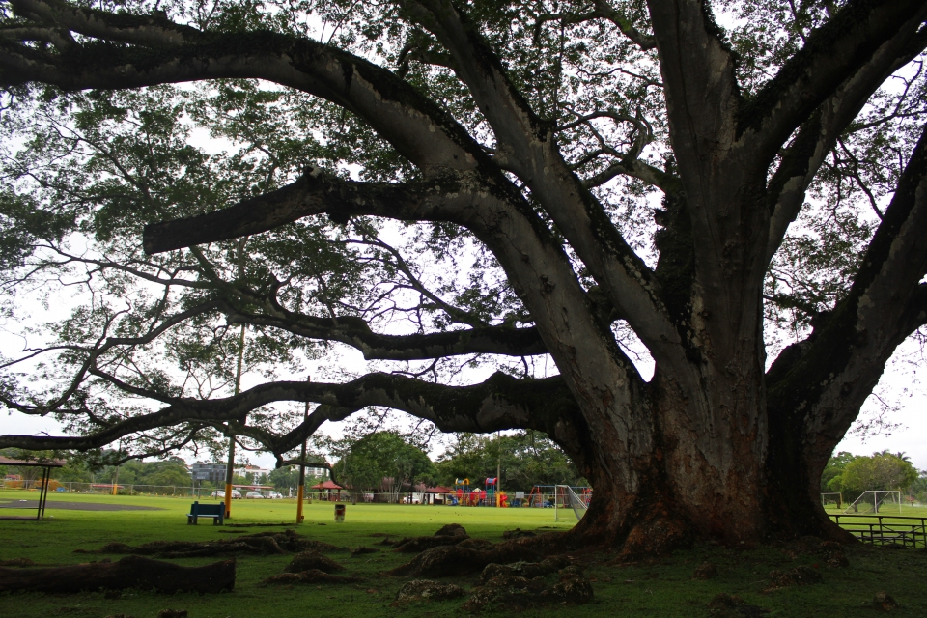
Toledo v. United States
95 F.Supp. 838 (USDC PR 1951)
Notes:
Toledo attended a sporting event and parked beneath an Earpod Tree (Enterolobium)
When he returned, the tree had crushed his car.
The tree’s foliage appeared healthy, but the trunk was completely hollow.
US Gov’t immune, under the discretionary immunity clause of the FTCA – discretion when to plant, maintain, and remove their “experiments.”

Slide 34
Toledo v. United States
95 F.Supp. 838 (USDC PR 1951)
“how long such tree should be preserved for experimentation or when it should be removed and destroyed, are precisely the kind of discretionary functions [that are immune from liability]”

Slide 35
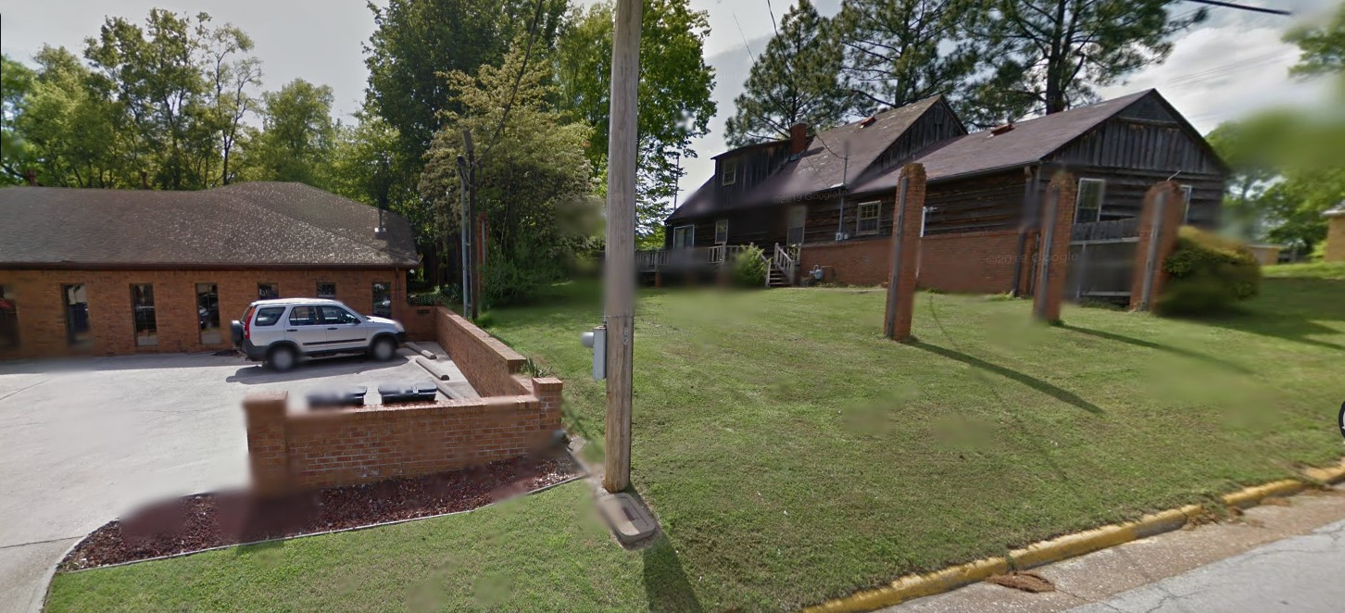
Harding v. Bethesda Regional Cancer Treatment Center
551 So.2d 299 (AL Supr. Ct. 1989)
Notes:
AL Supreme Court
1989 in Florence, AL
Bethesda began excavation for new cancer treatment center
Engineer testified “wind blew the tree over because its root system had been exposed.”
Ag. Extension agent testified “excavation that cut the roots made this tree highly susceptible to wind damage.”

Slide 36
Harding v. Bethesda Regional Cancer Treatment Center
551 So.2d 299 (AL Supr. Ct. 1989)
“cujus est solum ejus est usque ad coelum at ad inferos”
“to whomsoever the soil belongs, he owns also
to the sky and to the depths”

Slide 37
Harding v. Bethesda Regional Cancer Treatment Center
551 So.2d 299 (AL Supr. Ct. 1989)
“The owner of property has no duty to refrain from cutting roots of a tree that intrude upon his property.”
There are no facts to establish negligent excavation.

Slide 38
Utility Vegetation Management
Alabama Power v. Ragland 406 So.2d 363 (AL Supr. Ct. 1981)
Lacy v. Alabama Power 779 So.2d 1184 (AL Supr. Ct. 2000)
Wheeler v. Norfolk Carolina Tel. & Tel. Co. 172 N.C. 9 (NC Supr. Ct. 1916)
Notes:
3 cases

Slide 39
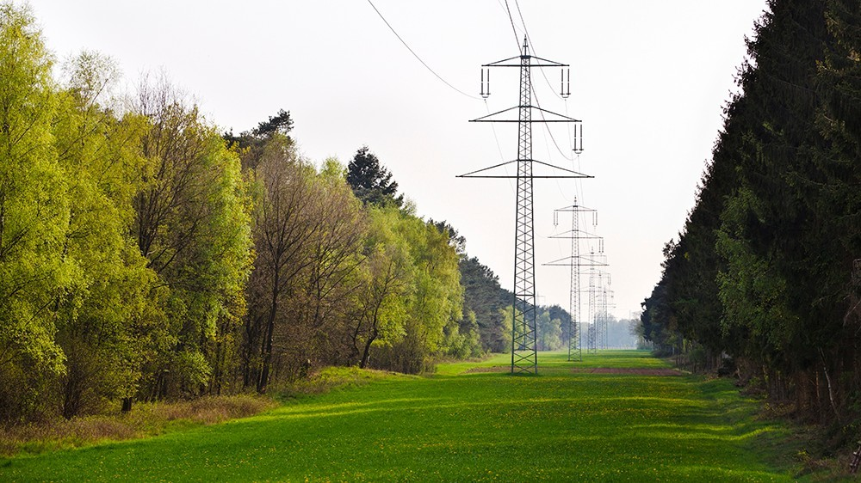
Alabama Power v. Ragland
406 So.2d 363 (AL Supr. Ct. 1981)
Notes:
AL Supreme Court
1975 Bessemer, AL
Utility sent letter to Mr. Ragland of intent to cut trees. Mr. Ragland threatened to shoot anyone who came.
Despite attorney demand letters, utility came with sheriff anyway and cut 15 trees on Ragland’s property
Mr. Ragland’s forester determined trees “did not pose a concrete threat of injury” to the transmission lines (low risk).
Trees would withstand 80-mph winds, but not tornado winds of up to 300 mph.
Trees could be affected by pine beetles in the future.

Slide 40
Alabama Power v. Ragland
406 So.2d 363 (AL Supr. Ct. 1981)
“Danger Tree” = “any tree that would fall within five feet of the nearest conductor”

Slide 41
Alabama Power v. Ragland
406 So.2d 363 (AL Supr. Ct. 1981)
“Danger Tree” = “any tree that would fall within five feet of the nearest conductor”
Likelihood of failure doesn’t matter

Slide 42
Alabama Power v. Ragland
406 So.2d 363 (AL Supr. Ct. 1981)
“the probability of a particular tree falling in a particular direction is not scientifically ascertainable”

Slide 43
Alabama Power v. Ragland
406 So.2d 363 (AL Supr. Ct. 1981)
“the probability of a particular tree falling in a particular direction is not scientifically ascertainable”
“if AL Power has to make a tree-by-tree determination…based on the health of the tree and other arguable factors, the efficiency of tree-clearing operations will be substantially reduced and outages will probably increase”

Slide 44
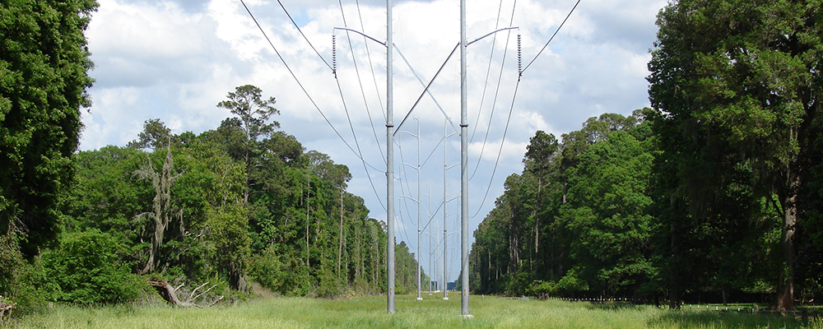
Lacy v. Alabama Power
779 So.2d 1184 (AL Supr. Ct. 2000)
Notes:
AL Supreme Court
1972, AL Power condemned transmission line easement over land in Elmore County over Lacy’s lands
Easement contained language allowing out-of-easement tree removal
Lacy presented evidence that trees outside of easement were not likely to fall
Some trees were in the way of Power company reaching the allegedly dangerous trees

Slide 45
Lacy v. Alabama Power
779 So.2d 1184 (AL Supr. Ct. 2000)
“…including…the right and authority to remove outside of said rights of way such timber as may injure or endanger [the power lines]”

Slide 46
Lacy v. Alabama Power
779 So.2d 1184 (AL Supr. Ct. 2000)
“Not only does AL Power have the right to cut danger trees and collateral trees, but it is obligated under the law to do so.”
Includes right to cut trees to access the collateral trees.
Irrelevant whether trees were likely to fall

Slide 47
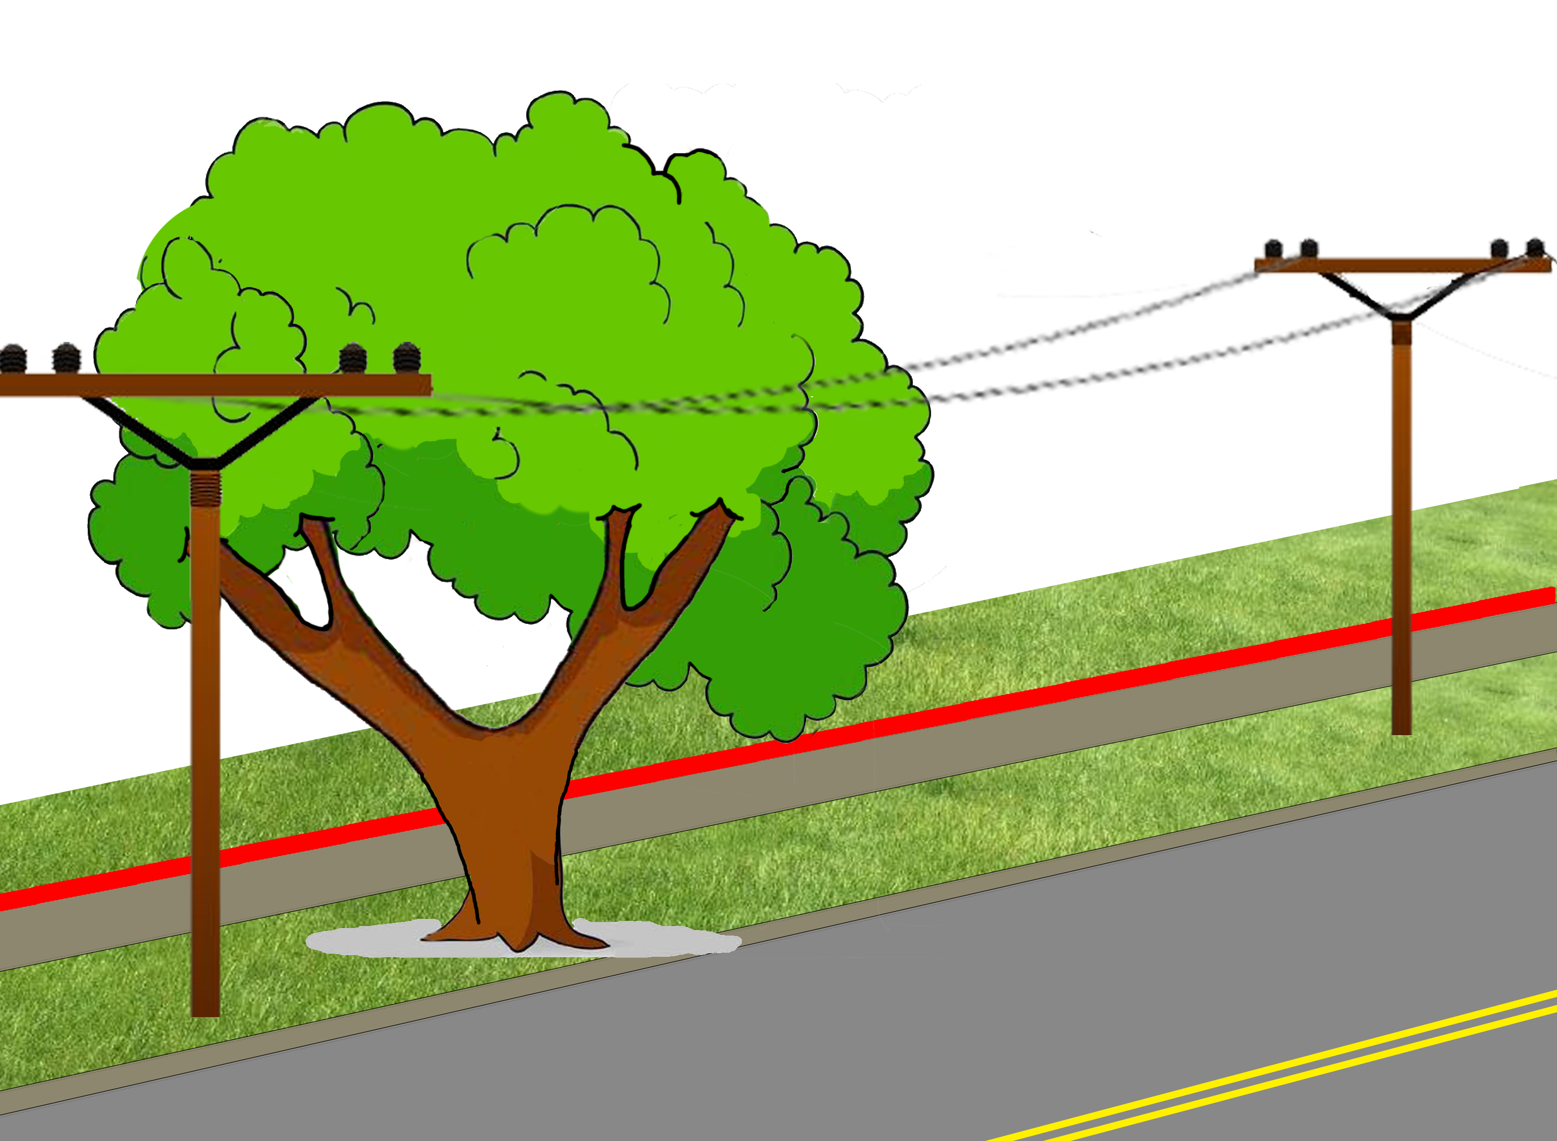
Wheeler v. Norfolk Carolina Tel. & Tel. Co.
172 N.C. 9 (NC Supr. Ct. 1916)
Notes:
NC Supreme Court
1914 Edenton, NC
Norfolk Carolina Telephone Co. pruned street tree fronting Wheeler’s property
The CITY owned the land on which the tree stood – NOT WHEELER
Wheeler sued for property damage.

Slide 48
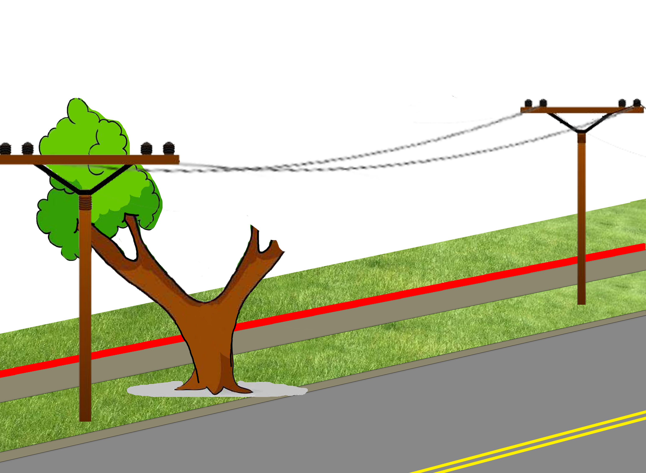
Wheeler v. Norfolk Carolina Tel. & Tel. Co.
172 N.C. 9 (NC Supr. Ct. 1916)
Notes:
NC Supreme Court
1914 Edenton, NC
Norfolk Carolina Telephone Co. pruned street tree fronting Wheeler’s property
The CITY owned the land on which the tree stood – NOT WHEELER
Wheeler sued for property damage.

Slide 49
Wheeler v. Norfolk Carolina Tel. & Tel. Co.
172 N.C. 9 (NC Supr. Ct. 1916)
Doesn’t matter that CITY owns the streets
“[Wheeler] continued to have a proprietary interest in a shade tree, standing on or near his sidewalk…”

Slide 50
Wheeler v. Norfolk Carolina Tel. & Tel. Co.
172 N.C. 9 (NC Supr. Ct. 1916)
“wretched would be the policy which required the title to be shown in every instance where the peaceable possession was disturbed by an intruder who had no right.”

Slide 51
Property Rights
Fontenot v. Central Louisiana Electric Co.147 So. 2d 773 (LA Ct. App. 1962)
First Elec. Coop. Corp. v. Charette 306 Ark. 105 (AR Supr. Ct. 1991)
Hornsby v. Bayou Jack Logging 902 So. 2d 361 (LA Supr. Ct. 2005)
Jack v. Successions of Albert 286 So.3d 432 (LA Ct. App. 2019)
White River Rural Water District v. Moon 310 Ark. 624 (AR Supr. Ct. 1992)
Notes:
4 cases

Slide 52
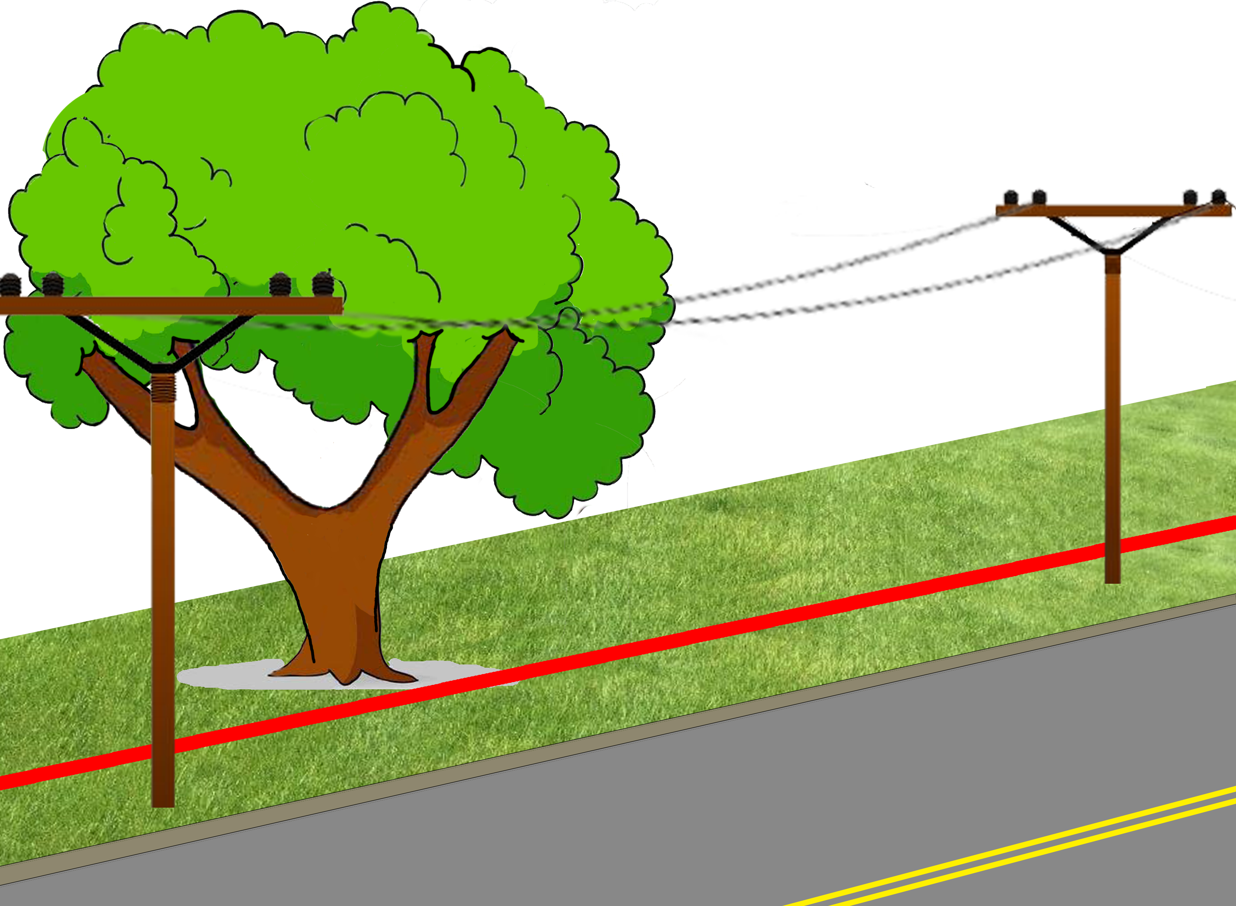
Fontenot v. Central Louisiana Electric Co.
147 So. 2d 773 (LA Ct. App. 1962)
Notes:
LA Ct. App. 3rd Cir.
1962 Ville Platte, LA
Central Louisiana Electric Co contracted Asplundh Tree Expert Company to clear lines
Asplundh asked for and received permission from Mrs. Fontenot to cut branches of her oak tree
Mr. Fontenot discovered the pruning, claiming she had no authority to dispose of marital property without his written consent

Slide 53
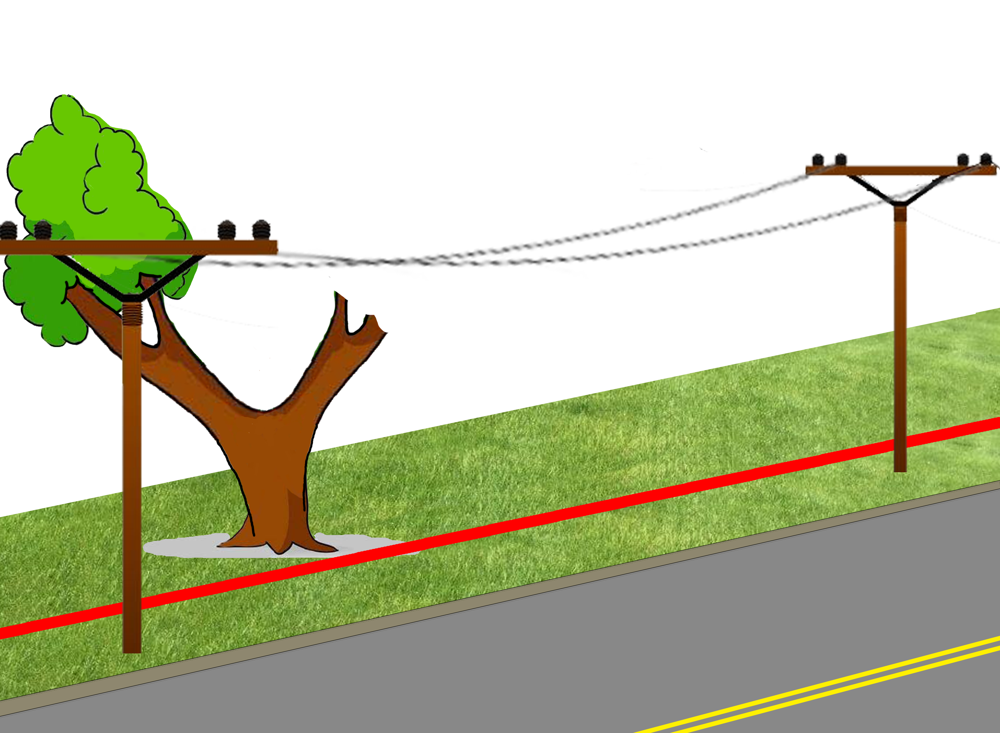
Fontenot v. Central Louisiana Electric Co.
147 So. 2d 773 (LA Ct. App. 1962)
Notes:
LA Ct. App. 3rd Cir.
1962 Ville Platte, LA
Central Louisiana Electric Co contracted Asplundh Tree Expert Company to clear lines
Asplundh asked for and received permission from Mrs. Fontenot to cut branches of her oak tree
Mr. Fontenot discovered the pruning, claiming she had no authority to dispose of marital property without his written consent

Slide 54
Fontenot v. Central Louisiana Electric Co.
147 So. 2d 773 (LA Ct. App. 1962)
“…where overhanging branches cause damage to an adjoining landowner, he can require the landowner to have the overhanging branches cut back to the boundary.”

Slide 55
Fontenot v. Central Louisiana Electric Co.
147 So. 2d 773 (LA Ct. App. 1962)
“…where overhanging branches cause damage to an adjoining landowner, he can require the landowner to have the overhanging branches cut back to the boundary.”
HOWEVER
“…while [the power company] could require [Fontenot] to trim the branches…; it could not avail itself of self-help.”

Slide 56
Fontenot v. Central Louisiana Electric Co.
147 So. 2d 773 (LA Ct. App. 1962)
Harvesting or selling timber from community property requires permission from both spouses.

Slide 57
Fontenot v. Central Louisiana Electric Co.
147 So. 2d 773 (LA Ct. App. 1962)
Harvesting or selling timber from community property requires permission from both spouses.
HOWEVER
Statute doesn’t apply to pruning branches.
Wife’s permission was sufficient.

Slide 58
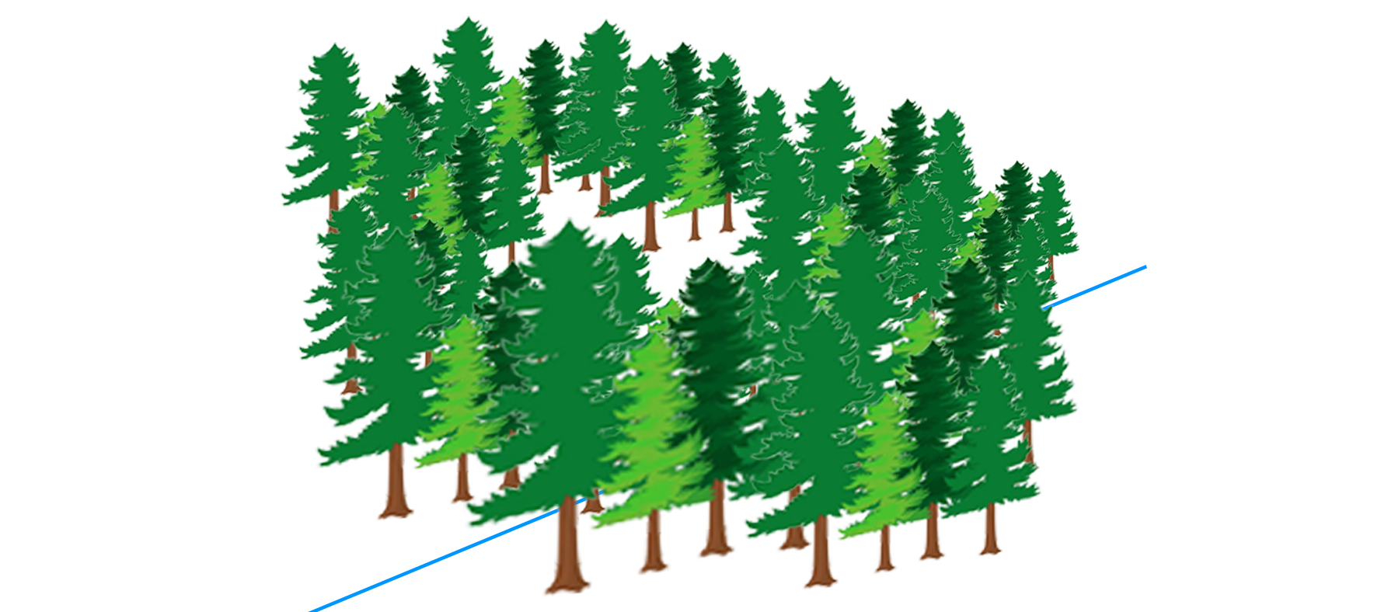
First Elec. Coop. Corp. v. Charette
306 Ark. 105 (AR Supr. Ct. 1991)
Notes:
AR Supreme Ct.
1991, Saline County, AR
Mark and Suzanne Charette bought a 3-acre wooded lot and intended to build a home.
They cleared some of their trees, deliberately leaving a line of trees where they planned to have a tree-lined driveway.
Utility company strayed outside easement, trespassed, and cut trees.
Cost of replacing trees was approximately the same as the value of the land.

Slide 59
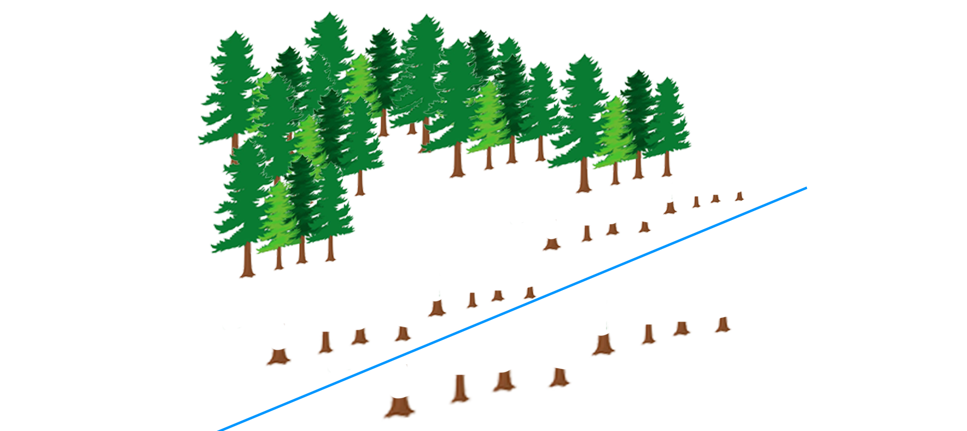
First Elec. Coop. Corp. v. Charette
306 Ark. 105 (AR Supr. Ct. 1991)
Notes:
AR Supreme Ct.
1991, Saline County, AR
Mark and Suzanne Charette bought a 3-acre wooded lot and intended to build a home.
They cleared some of their trees, deliberately leaving a line of trees where they planned to have a tree-lined driveway.
Utility company strayed outside easement, trespassed, and cut trees.
Cost of replacing trees was approximately the same as the value of the land.

Slide 60
First Elec. Coop. Corp. v. Charette
306 Ark. 105 (AR Supr. Ct. 1991)
“the trees that First Electric destroyed were part of the landscaping [the Charettes] had undertaken in preparation for building their house.”
Trial court MAY award replacement costs approximately equal to land value.

Slide 61
First Elec. Coop. Corp. v. Charette
306 Ark. 105 (AR Supr. Ct. 1991)
“the trees that First Electric destroyed were part of the landscaping [the Charettes] had undertaken in preparation for building their house.”
Trial court MAY award replacement costs approximately equal to land value.
It may be possible for replacement cost to be “grossly disproportionate to the fair market value of the land…but this is not such a case.”

Slide 62
Hornsby v. Bayou Jack Logging
902 So. 2d 361 (LA Supr. Ct. 2005)
Notes:
LA Supreme Court
2001 Acadia Parish, LA
Bayou Jack Logging contracted with landowners to harvest trees
Bayou Jack crossed the property line into the Hornsbys’ and Guidrys’ land, cutting trees

Slide 63
Hornsby v. Bayou Jack Logging
902 So. 2d 361 (LA Supr. Ct. 2005)

Slide 64
Hornsby v. Bayou Jack Logging
902 So. 2d 361 (LA Supr. Ct. 2005)
“when π was a child, he and his cousins would play on the property every Sunday”
“the land has primarily been used for cattle grazing”
“there are no utility lines, water lines, or structures on the land”
“intent to build, at a future date, but failed to produce any tangible proof or documentation to support their intent”

Slide 65
Hornsby v. Bayou Jack Logging
902 So. 2d 361 (LA Supr. Ct. 2005)
“We do not find that plaintiffs' self-serving testimony of their inchoate intent to develop the land at some undetermined future point is sufficient to justify recovery of restoration costs in excess of the actual market value of the land and the trees cut. “

Slide 66
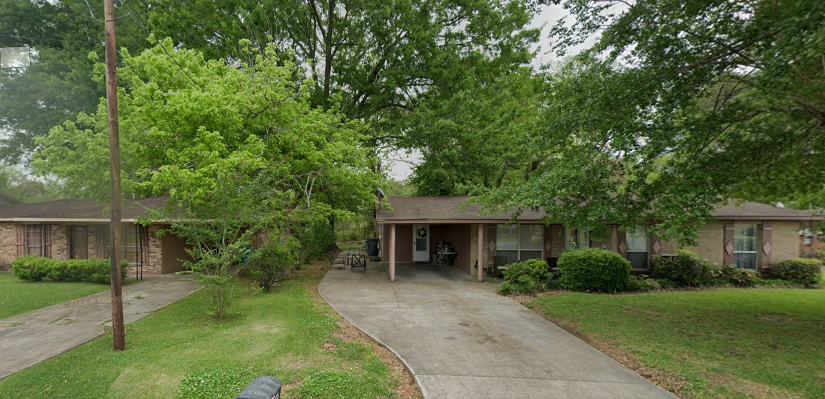
Jack v. Successions of Albert
286 So.3d 432 (LA Ct. App. 2019)
Notes:
LA Ct. App. 1st Cir.
2019 New Roads, LA
Large 48-inch oak tree on boundary line between Jacks (right) and Alberts (left)
Jacks sued to compel Alberts to remove tree and pay for driveway repairs

Slide 67
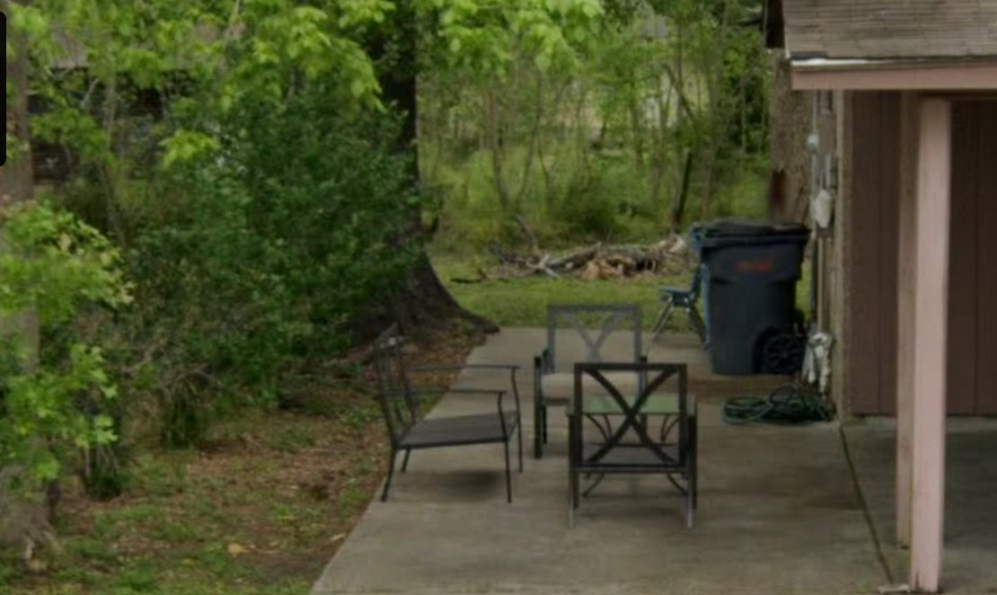
Jack v. Successions of Albert
286 So.3d 432 (LA Ct. App. 2019)
Notes:
Land surveyor said line passed through portion of trunk, but tree’s center was on Alberts’ side
NO ARBORIST TESTIMONY of (1) origin of tree, or (2) growth over the years

Slide 68
Jack v. Successions of Albert
286 So.3d 432 (LA Ct. App. 2019)
LA Civ. Code §688: landowner may demand neighbor trim encroaching branches and roots at neighbor’s expense

Slide 69
Jack v. Successions of Albert
286 So.3d 432 (LA Ct. App. 2019)
LA Civ. Code §688: landowner may demand neighbor trim encroaching branches and roots at neighbor’s expense
LA Civ. Code §687:
  trees on boundary are common unless proof to the contrary
  Landowner may remove tree at his own expense
  IF it interferes with enjoyment of his estate

Slide 70
Jack v. Successions of Albert
286 So.3d 432 (LA Ct. App. 2019)
“the Jacks…failed to…overcome the presumption of commonness”
Should have presented (arborist) evidence of:
  Origin of the tree
  Growth over the years

Slide 71
Jack v. Successions of Albert
286 So.3d 432 (LA Ct. App. 2019)
Concurrence:
It’s absurd to require expert opinion of tree origin for every boundary tree case!
Dissent:
The center of the tree is on Albert’s side, so it’s Albert’s.

Slide 72

Jack v. Successions of Albert
286 So.3d 432 (LA Ct. App. 2019)

Slide 73
Jack v. Successions of Albert
286 So.3d 432 (LA Ct. App. 2019)
Plaintiff’s burden to prove trunk is on property line
π Burden of Proof

Slide 74
Jack v. Successions of Albert
286 So.3d 432 (LA Ct. App. 2019)
Plaintiff’s burden to prove trunk is on property line
Presume co-owned
π Burden of Proof

Slide 75
Jack v. Successions of Albert
286 So.3d 432 (LA Ct. App. 2019)
Plaintiff’s burden to prove trunk is on property line
Presume co-owned
Co-ownership opponent’s burden to prove sole-ownership
Co-ownership opponent
Burden of Proof
π Burden of Proof

Slide 76
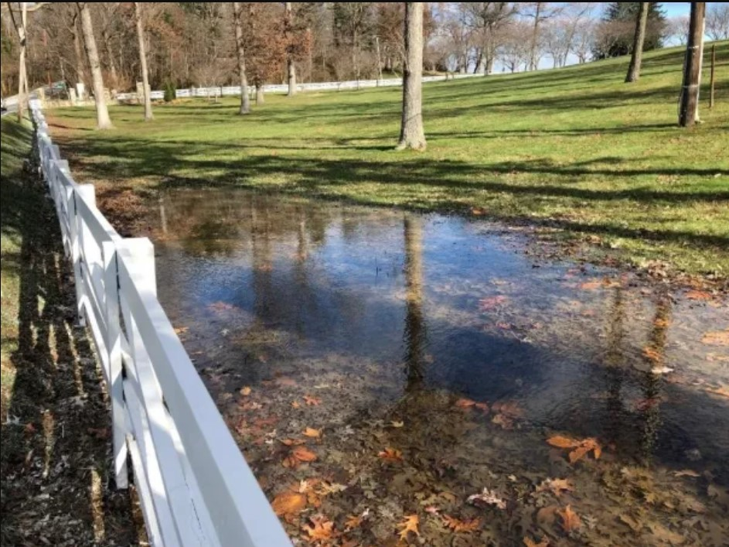
White River Rural Water District v. Moon
310 Ark. 624 (AR Supr. Ct. 1992)
Notes:
AR Supreme Court
1992 Benton County, AR
Leaking water line on Frankie Moon’s property
Standing water around post oak, then oak died
Moon kept insisting there was a leak on his property, and water district refused to act.
When leak was discovered, it was repaired, and the standing water disappeared.
Moon’s attorney introduced University of Arkansas Cooperative Extension article “The Formula Method for Calculating Values of Shade Trees” and performed handwritten calculation

Slide 77
White River Rural Water District v. Moon
310 Ark. 624 (AR Supr. Ct. 1992)
“the tree had been on [Moon’s] property for more than 22 years, but suddenly died shortly after [the district’s] belated actions to fix its lines.”
“Although [Moon’s] proof could have been more compelling with expert testimony,” there was sufficient evidence to prove negligence.

Slide 78
White River Rural Water District v. Moon
310 Ark. 624 (AR Supr. Ct. 1992)
“When ornamental or shade trees are injured, the use made of the land should be considered, and the owner compensated by the damages representing the cost of replacement of the trees.”
Extension article is a “self-authenticating government document”
Notes:
NO APPRAISING ARBORIST NEEDED for a TFT calculation here

Slide 79
Summary
Tree Failure
Utility Vegetation Management
Property Rights
Notes:
Total Cases: 15
Tree Failure: 7
Utility Vegetation Management: 3
Property Rights: 5
Encore: 2

Slide 80
Case Illustrations from
Southern Chapter Tree Law
James Komen
BCMA #WE-9909B
RCA #555

Slide 81
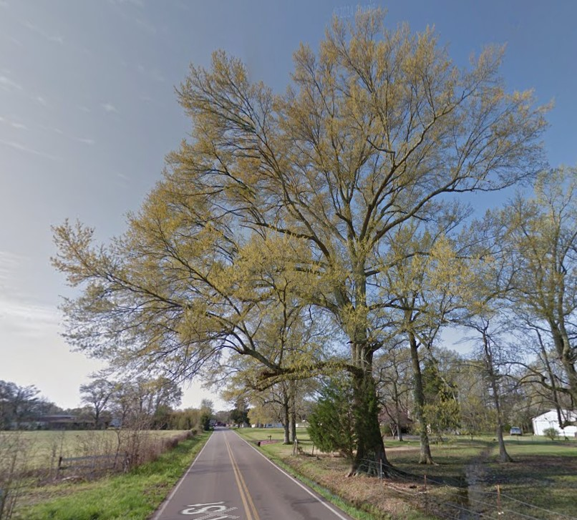
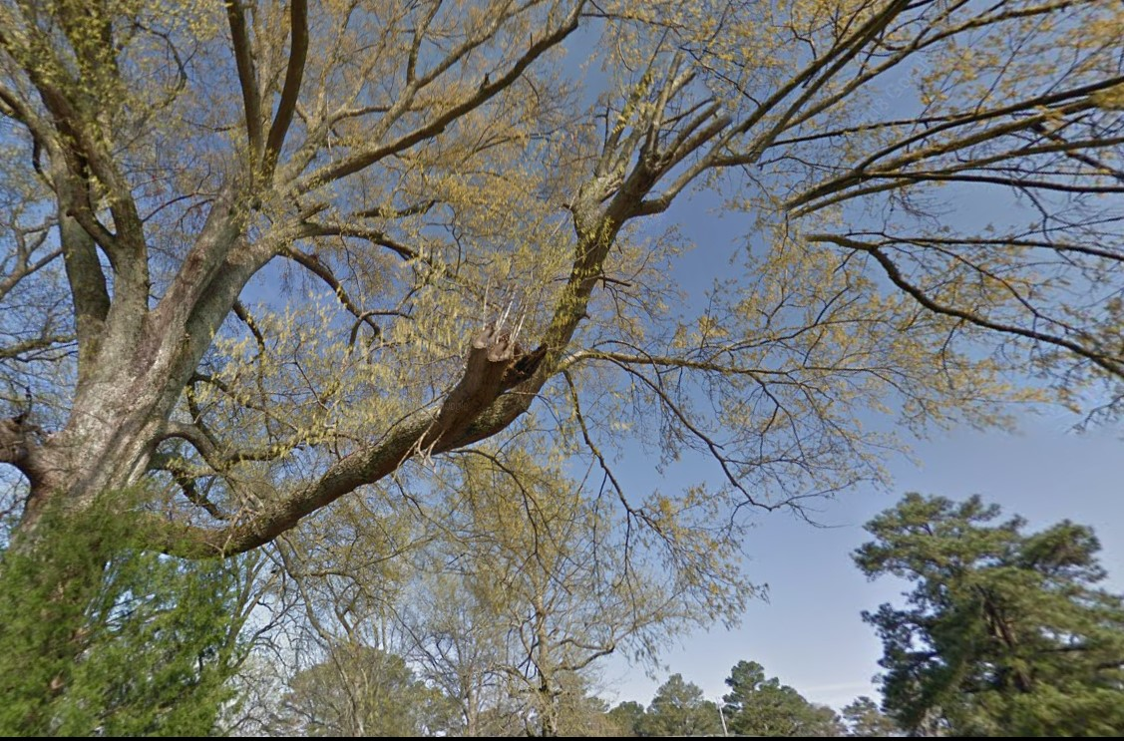
Allred v. Tishomingo County
No. 2023-CA-00569-COA (MS Ct. App. 2024)
Notes:
MS Ct. App.
2019, Golden, MS
Large branch of Willow Oak overhanging road fell onto Mr. and Mrs. Allred’s vehicle
County had received no prior complaints about the tree.
Allred’s expert was a FORESTER. He inspected 2014 google earth imagery and post-failure photos, and observed defective branch.
County’s expert was ARBORIST/FORESTER. His assignment was NOT to determine health of tree but to rebut Allred’s expert. He said that TRAQ requires in-person inspection, and no opinion can be reached based on 5 y/o images of tree.
At bench trial, Trial Court evaluated BOTH experts’ testimony and found county had NO NOTICE of defect.
Allreds appealed, claiming trial court should have excluded County’s expert under Daubert test.

Slide 82
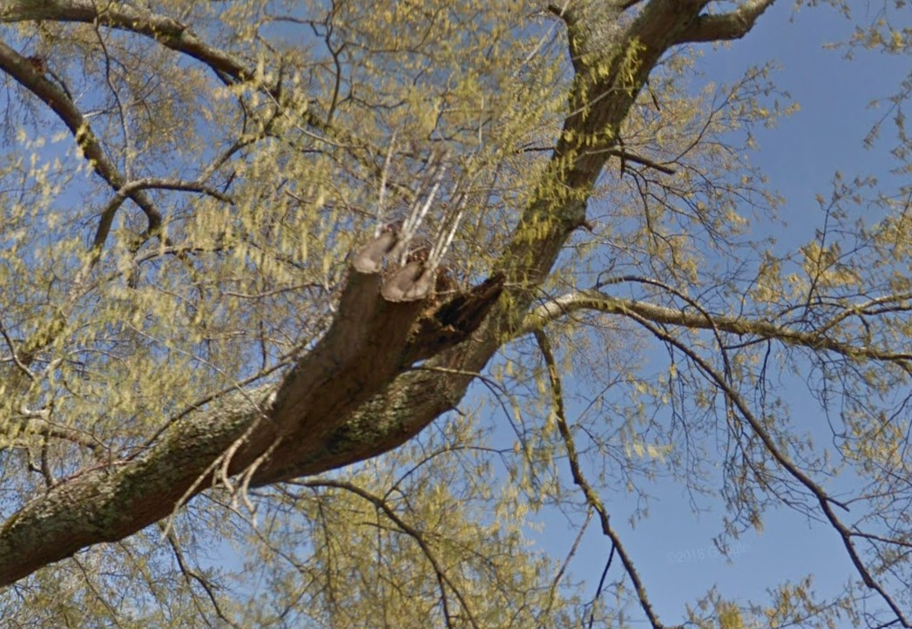
Allred v. Tishomingo County
No. 2023-CA-00569-COA (MS Ct. App. 2024)
Notes:
MS Ct. App.
2019, Golden, MS
Large branch of Willow Oak overhanging road fell onto Mr. and Mrs. Allred’s vehicle
County had received no prior complaints about the tree.
Allred’s expert was a FORESTER. He inspected 2014 google earth imagery and post-failure photos, and observed defective branch.
County’s expert was ARBORIST/FORESTER. His assignment was NOT to determine health of tree but to rebut Allred’s expert. He said that TRAQ requires in-person inspection, and no opinion can be reached based on 5 y/o images of tree.
At bench trial, Trial Court evaluated BOTH experts’ testimony and found county had NO NOTICE of defect.
Allreds appealed, claiming trial court should have excluded County’s expert under Daubert test.

Slide 83
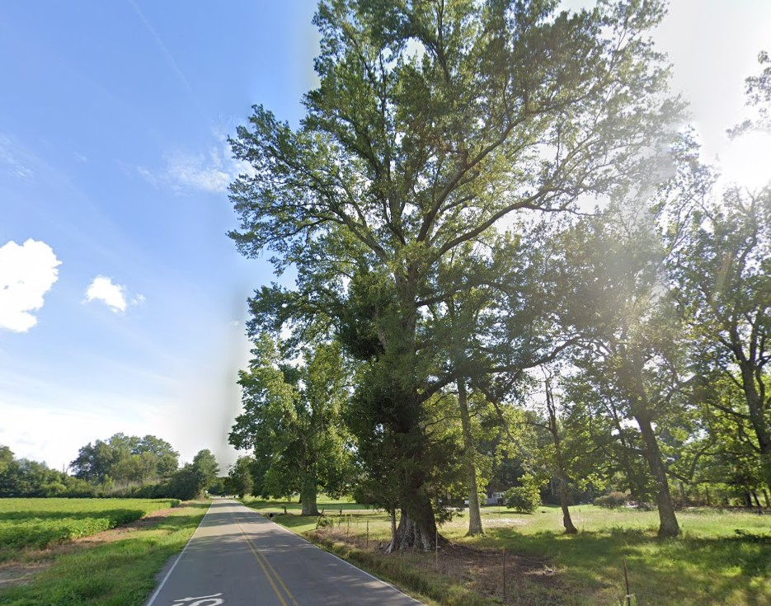
Allred v. Tishomingo County
No. 2023-CA-00569-COA (MS Ct. App. 2024)
Notes:
MS Ct. App.
2019, Golden, MS
Large branch of Willow Oak overhanging road fell onto Mr. and Mrs. Allred’s vehicle
County had received no prior complaints about the tree.
Allred’s expert was a FORESTER. He inspected 2014 google earth imagery and post-failure photos, and observed defective branch.
County’s expert was ARBORIST/FORESTER. His assignment was NOT to determine health of tree but to rebut Allred’s expert. He said that TRAQ requires in-person inspection, and no opinion can be reached based on 5 y/o images of tree.
At bench trial, Trial Court evaluated BOTH experts’ testimony and found county had NO NOTICE of defect.
Allreds appealed, claiming trial court should have excluded County’s expert under Daubert test.

Slide 84
Allred v. Tishomingo County
No. 2023-CA-00569-COA (MS Ct. App. 2024)
The trial court “had the discretion to determine whether the tree in question constituted a dangerous condition that the County failed to appreciate.”
“The County had no prior complaints about the tree and did not see it as a danger.”

Slide 85
Allred v. Tishomingo County
No. 2023-CA-00569-COA (MS Ct. App. 2024)
County’s expert cited TRAQ

Slide 86
Allred v. Tishomingo County
No. 2023-CA-00569-COA (MS Ct. App. 2024)
County’s expert cited TRAQ as “international format to quantify tree risk”

Slide 87
Allred v. Tishomingo County
No. 2023-CA-00569-COA (MS Ct. App. 2024)
County’s expert cited TRAQ as “international format to quantify tree risk”
“[county’s expert] stated that a ‘standard tree risk assessment always begins with a site visit…’”
“[county’s expert] identified an international standard/methodology that is used to assess the health of trees which included a site visit.”

Slide 88
Allred v. Tishomingo County
No. 2023-CA-00569-COA (MS Ct. App. 2024)
County’s expert cited TRAQ as “international format to quantify tree risk”
“[county’s expert] stated that a ‘standard tree risk assessment always begins with a site visit…’”
“[county’s expert] identified an international standard/methodology that is used to assess the health of trees which included a site visit.”

Slide 89

Allred v. Tishomingo County
No. 2023-CA-00569-COA (MS Ct. App. 2024)
Daubert standards for reliability:
  theory or technique can be tested
  subject to peer review
  known or potential error rate
  controlling standards
  general acceptance
Notes:
This case is less important for the law. It’s an ordinary defer-to-the-trial-judge opinion.
But it’s the first opinion that mentions TRAQ, and it cites it favorably

Slide 90
Allred v. Tishomingo County
No. 2023-CA-00569-COA (MS Ct. App. 2024)
Daubert standards for reliability:
  theory or technique can be tested
  subject to peer review
  known or potential error rate
  controlling standards
  general acceptance
Notes:
This case is less important for the law. It’s an ordinary defer-to-the-trial-judge opinion.
But it’s the first opinion that mentions TRAQ, and it cites it favorably

Slide 91
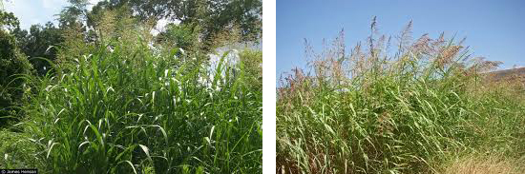
McCutchen v. Blanton
59 Miss. 116 (MS Supr. Ct. 1881)
Notes:
MS Supreme Court
1881, Washington County, MS
John McCutchen was a hay farmer. He had a big idea: Johnson Grass.
When Mr. Blanton and other neighboring farmers found out, they asked for a court order to not plant the INVASIVE grass

Slide 92
McCutchen v. Blanton
59 Miss. 116 (MS Supr. Ct. 1881)
“The history and habits of the grass are too little known and established to authorize its condemnation as a nuisance.”
“It is not enough to show probable or contingent injury, but it must be shown to be inevitable and undoubted.”
Notes:
If the Johnson grass is ACTUALLY as bad as plaintiffs say, then the court’s order will do nothing to affect the inevitable.

Slide 93
McCutchen v. Blanton
59 Miss. 116 (MS Supr. Ct. 1881)
“The fears of mankind, though reasonable, are not nuisance.”
“He who exercises his legal rights harms nobody.”
“To interfere with one’s right to use his own land…in a case of doubt, would be a flagrant abuse of power.”
Notes:
If the Johnson grass is ACTUALLY as bad as plaintiffs say, then the court’s order will do nothing to affect the inevitable.

