Slide 1
Case Illustrations from
Michigan Tree Appraisal Law
James Komen
BCMA #WE-9909B
RCA #555

Slide 2
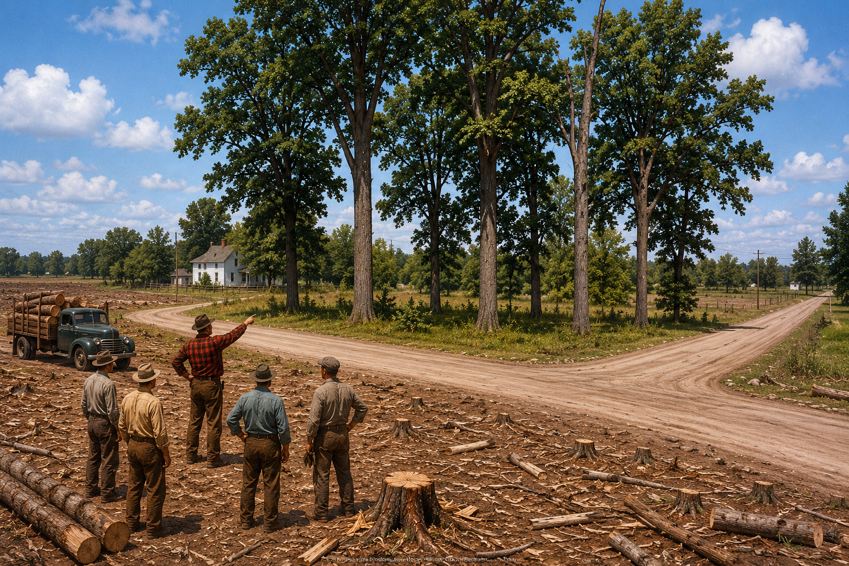
Schankin v. Buskirk
354 Mich. 490 (1958)
Notes:
MI Sup. Ct.
Wayne County, just outside of Detroit
June 13, 1953
Joseph and Marion Schankin purchased 2 vacant corner lots in undeveloped subdivision. Intending to build future home and keep trees.
Clarence Buskirk, owner of Buskirk Lumber Co. was clearing neighboring lots and selling the timber.
Buskirk showed his men the Schankin property and told them to stay off it. Then he left the workers unsupervised.
One of the workers allegedly said “free logs, extra money” and intentionally trespassed on Schankin lot and cut down 6 large trees.
Schankins’ expert testified replacement cost, Buskirk expert testified change in market value.
Jury awarded 3x replacement costs. Buskirk appealed.
Buskirk argued trespass damages are ONLY change in value, and replacement costs were not allowed.
Affirmed.
Court cited R2D 929.

Slide 3
Schankin v. Buskirk
354 Mich. 490 (1958)
“We are not…restricted solely to a value-before and value-after test for injury to the freehold.”
“[the jury] may consider…the value of the trees themselves to the contemplated or existing uses of the land, including the cost of replacement or restoration, in those cases where…the property destroyed has a unique value of its own.”

Slide 4
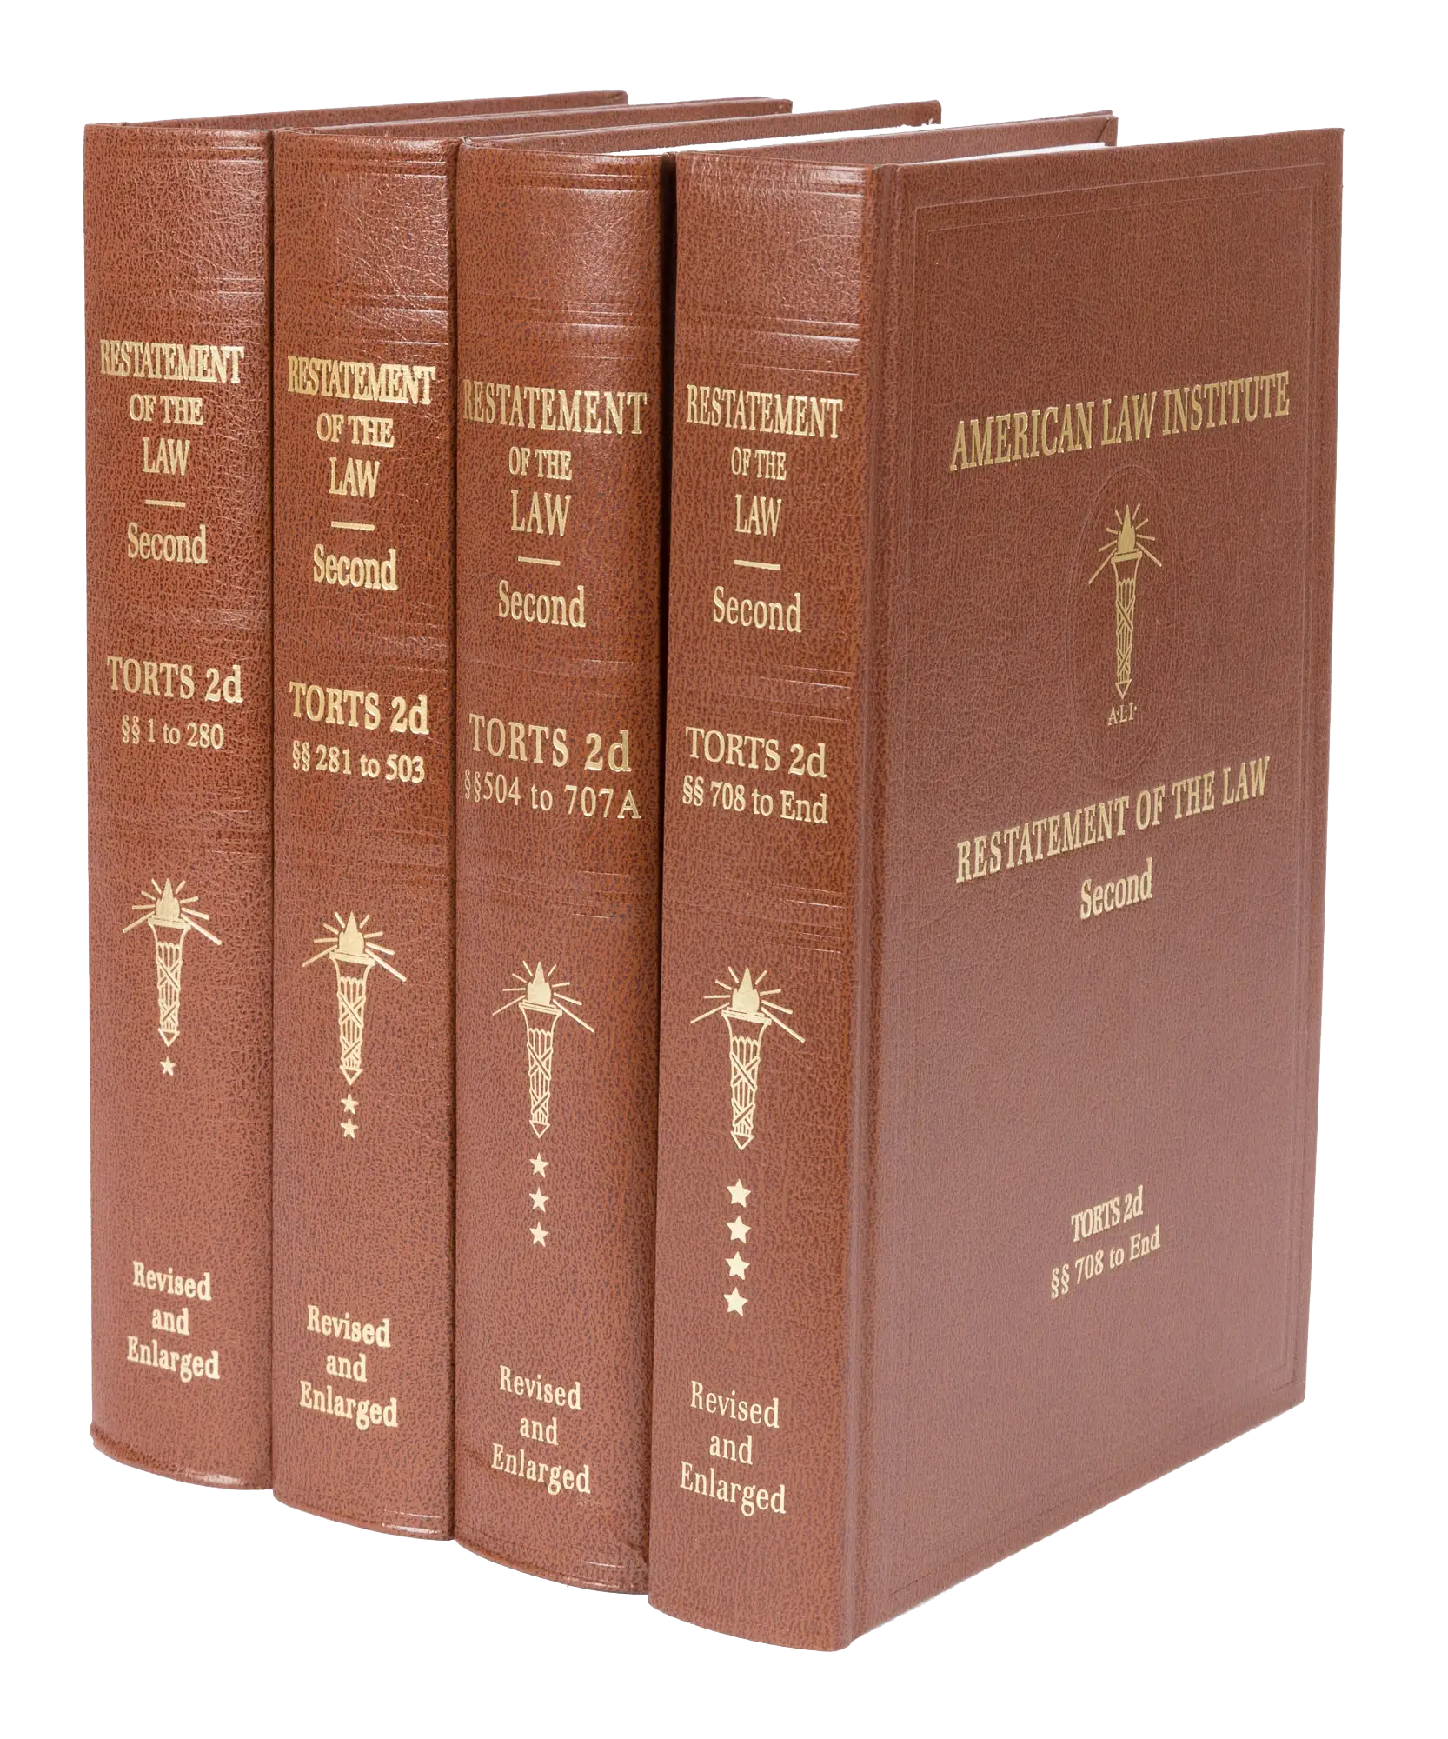
Restatement of the Law of Torts, 2d.

Slide 5
R2D Torts §929(1)
If one is entitled to a judgment for harm to land resulting from a past invasion and not amounting to a total destruction of value, the damages include compensation for:
  the difference between the value of the land before the harm and the value after the harm, or at his election in an appropriate case, the cost of restoration that has been or may be reasonably incurred,
  the loss of use of the land, and
  discomfort and annoyance to him as an occupant.

Slide 6
R2D Torts §929(1)
If one is entitled to a judgment for harm to land resulting from a past invasion and not amounting to a total destruction of value, the damages include compensation for:
  the difference between the value of the land before the harm and the value after the harm, or at his election in an appropriate case, the cost of restoration that has been or may be reasonably incurred,
  the loss of use of the land, and
  discomfort and annoyance to him as an occupant.

Slide 7
R2D Torts §929 cmt. b
“If…the cost of replacing the land in its original condition is disproportionate to the diminution in the value of the land...,
unless there is a reason personal to the owner for restoring the original condition,
damages are measured only by the [diminution in the value of the land].”

Slide 8
R2D Torts §929 cmt. b
“If…the cost of replacing the land in its original condition is disproportionate to the diminution in the value of the land...,
unless there is a reason personal to the owner for restoring the original condition,
damages are measured only by the [diminution in the value of the land].”

Slide 9
R2D Torts §929 Analysis
Restoration Cost vs. Diminution in Value
“Reason Personal”
“Reasonably Incurred” vs. “Disproportionate”

Slide 10
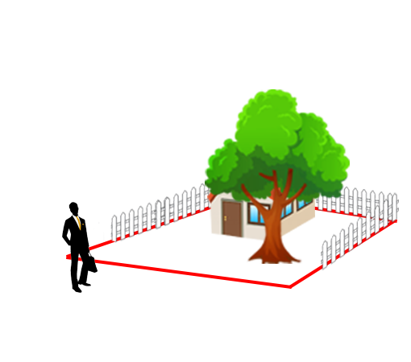
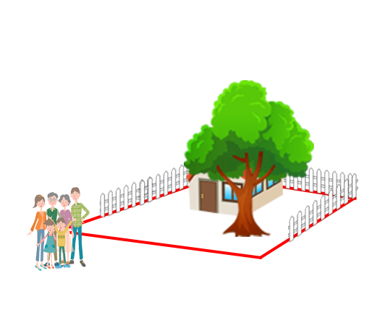
“Reason Personal”

Slide 11
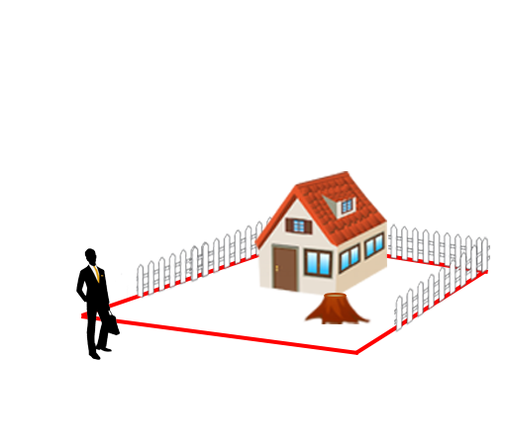
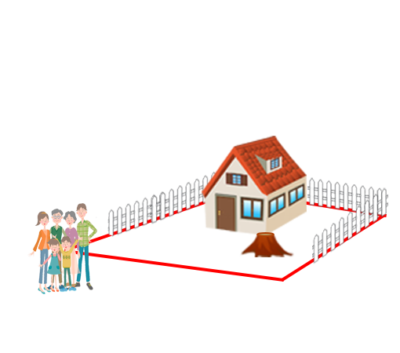
“Reason Personal”

Slide 12
“Reason Personal”
No “Reason Personal”

Slide 13
“Reason Personal”
No “Reason Personal”
“Reason Personal”

Slide 14
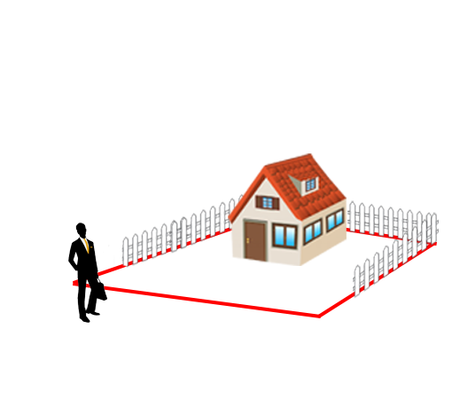
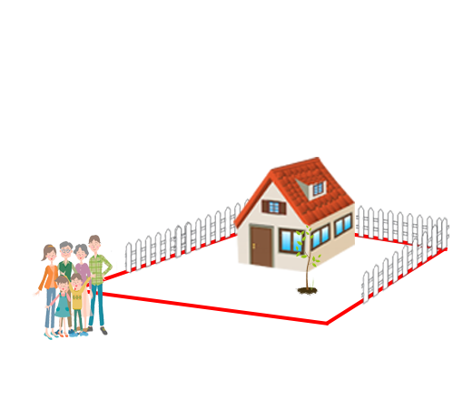
“Reason Personal”
No “Reason Personal”
“Reason Personal”

Slide 15
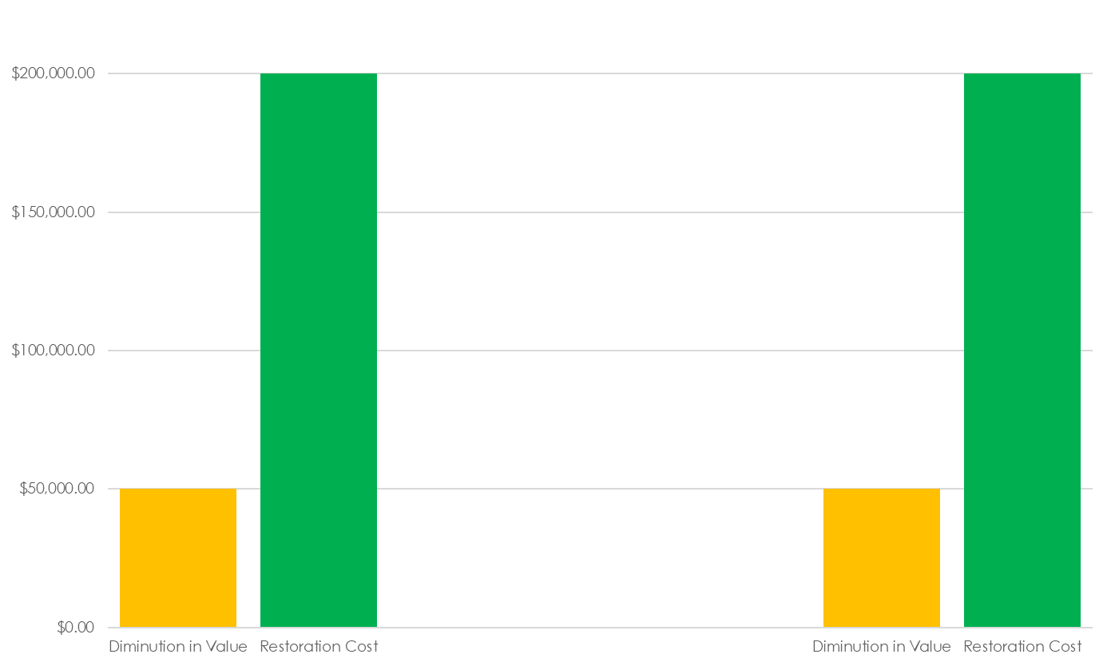
“Reason Personal”
No “Reason Personal”
“Reason Personal”

Slide 16
“Reason Personal”
No “Reason Personal”
“Reason Personal”
Max Award

Slide 17
“Reason Personal”
No “Reason Personal”
“Reason Personal”
Possible
Award
Max Award

Slide 18
R2D Torts §929 Analysis
Restoration Cost vs. Diminution in Value
“Reason Personal”
“Reasonably Incurred” vs. “Disproportionate”

Slide 19

Vanderpool v. Hart
2022 WL 496235 (Mich. Ct. App. Feb. 17, 2022)
Notes:
MI Ct. App.
2016, Lenawee County, MI (close to the Ohio border)
Neighboring property owner Chad Hart cut 20 trees, believing in good faith he had a right to do so.
Wendy Vanderpool hired arborist Mark Webber to appraise the cut trees.
Webber appraised the loss of $149,310, but had to assume the trees were on the Vanderpool property.
Surveyor said some trees were Vanderpool’s, some were Hart’s, and some were jointly owned, but didn’t specify which trees.
Vanderpool testified that an old hickory tree was “hers,” but no other testimony of other trees’ ownership.
Trial court awarded TFM for hickory tree but no damages for any of the other trees.
Vanderpool appealed the limited award. Hart cross-appealed award of replacement cost damages. Affirmed.
Vanderpool needed to prove ownership. Once ownership was proven, replacement costs okay.

Slide 20
Vanderpool v. Hart
2022 WL 496235 (Mich. Ct. App. Feb. 17, 2022)
“family had picnicked in the shade of the trees”
“taken family photographs amongst the trees”
“enjoyed looking at the trees throughout the seasons”
“ridden horses and motorcycles in that area”
“used the tree line to hunt”
“enjoyed watching [animals living amongst trees]”

Slide 21
Vanderpool v. Hart
2022 WL 496235 (Mich. Ct. App. Feb. 17, 2022)
“[Vanderpool] presented evidence that the trees had a unique or aesthetic value.”
“the trial court did not err by determining that the replacement value of the trees was the appropriate measure of damages”

Slide 22
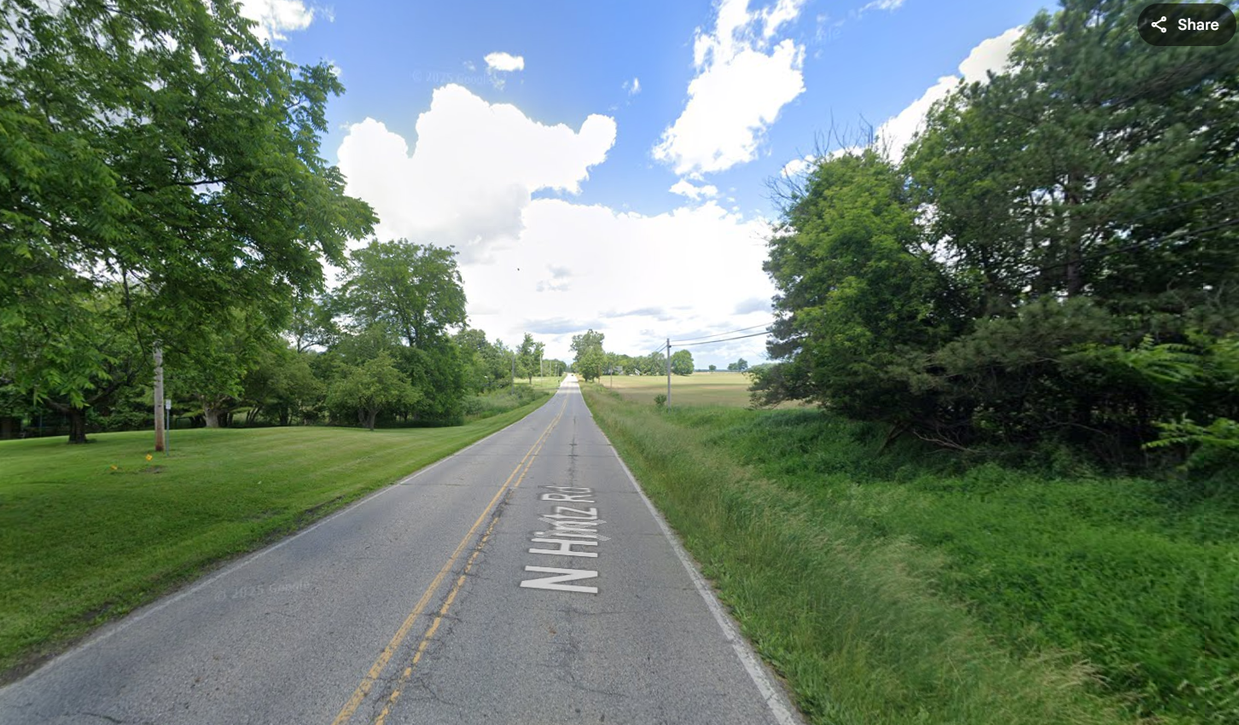
Governale v. City of Owosso
59 Mich. App. 756 (1975)
Notes:
MI Ct. App.
Owosso, MI
Thursday, December 12, 1968.
The Governales and the Jankejes owned land along Hintz Rd.
Land was “unimproved and marshy.” Trees were mix of willows and poplars.
City sought to install water lines within public ROW along Hintz Rd.
City believed ROW extended beyond edge of road. It didn’t. Crews cleared 60 mature trees.
Governales objected. Crews left. They returned Monday and continued clearing. Governales objected AGAIN.
Trial court awarded diminution in land value, NOT replacement cost. Plaintiff appealed. Affirmed (in relevant part).
Other question was whether 3x applies. Here it did.

Slide 23
Governale v. City of Owosso
59 Mich. App. 756 (1975)
The land was “unimproved and marshy.”
Willows and poplars are “soft and short-lived woods”
Award of diminution in value instead of replacement cost “was based on sound judgment.”

Slide 24

Thiele v. Detroit Edison Co.
184 Mich. App. 542 (Ct. App. 1990)
Notes:
MI Ct. App.
1988, Lake Orion Heights, MI
Audrey Thiele purchased an undeveloped wooded lot.
Detroit Edison Co. cut down 8 “wild,” naturally-growing trees.
Thiele sued for replacement cost, testifying she enjoyed sitting and looking at the trees.
Trial court granted directed verdict for Edison because Thiele presented no evidence of change in value of the land.
Thiele appealed. Reversed.

Slide 25
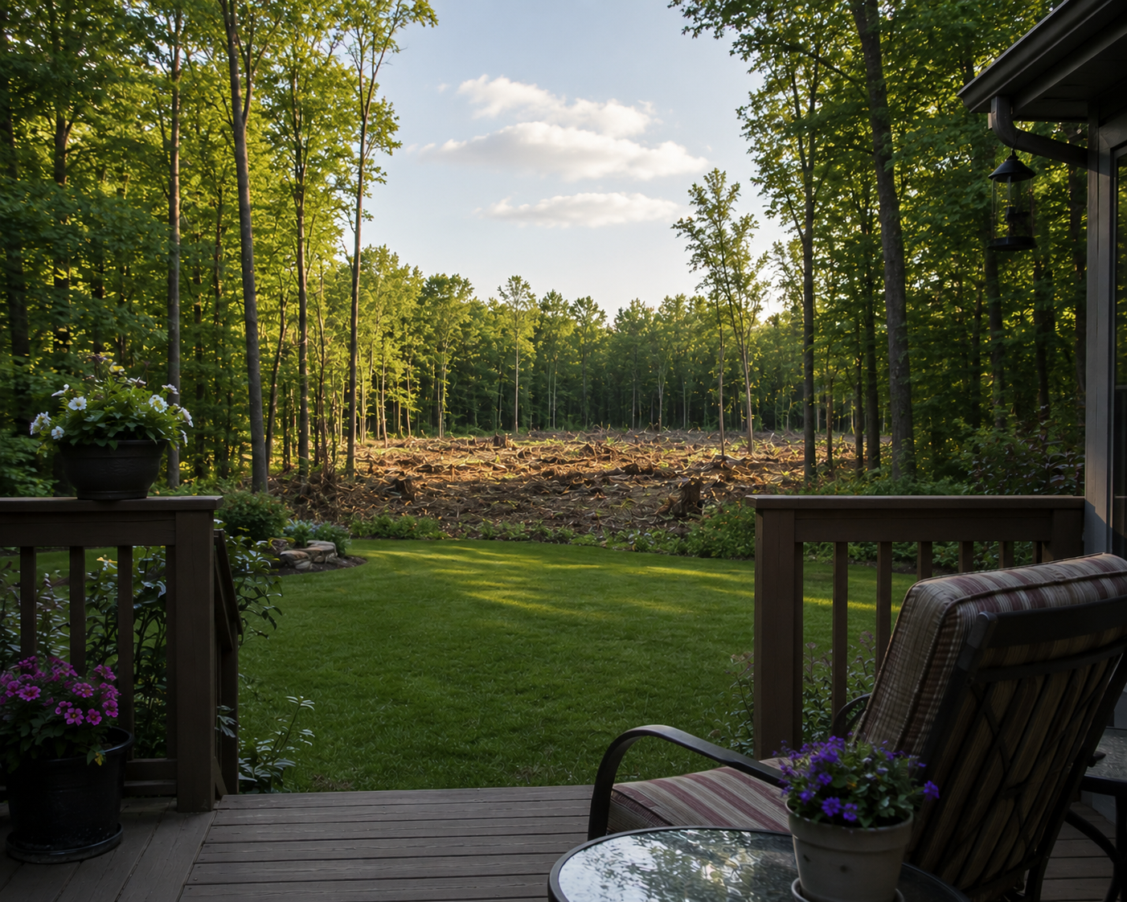
Thiele v. Detroit Edison Co.
184 Mich. App. 542 (Ct. App. 1990)
Notes:
MI Ct. App.
1988, Lake Orion Heights, MI
Audrey Thiele purchased an undeveloped wooded lot.
Detroit Edison Co. cut down 8 “wild,” naturally-growing trees.
Thiele sued for replacement cost, testifying she enjoyed sitting and looking at the trees.
Trial court granted directed verdict for Edison because Thiele presented no evidence of change in value of the land.
Thiele appealed. Reversed.

Slide 26
Thiele v. Detroit Edison Co.
184 Mich. App. 542 (Ct. App. 1990)
“family had picnicked in the shade of the trees”
“taken family photographs amongst the trees”
“enjoyed looking at the trees throughout the seasons”
“ridden horses and motorcycles in that area”
“used the tree line to hunt”
“enjoyed watching [animals living amongst trees]”

Slide 27
Thiele v. Detroit Edison Co.
184 Mich. App. 542 (Ct. App. 1990)
“family had picnicked in the shade of the trees”
“taken family photographs amongst the trees”
“enjoyed looking at the trees throughout the seasons”
“ridden horses and motorcycles in that area”
“used the tree line to hunt”
“enjoyed watching [animals living amongst trees]”

Slide 28
Thiele v. Detroit Edison Co.
184 Mich. App. 542 (Ct. App. 1990)
“the trees could not be classified as ‘ornamental’ or of a variety that are commonly used for landscaping”
HOWEVER
“The loss of aesthetic value, the actual monetary value of the trees lost, and the cost of their replacement constitute evidence of the diminution in value of the freehold estate.”

Slide 29
Thiele v. Detroit Edison Co.
184 Mich. App. 542 (Ct. App. 1990)
“the trees could not be classified as ‘ornamental’ or of a variety that are commonly used for landscaping”
HOWEVER
“The loss of aesthetic value, the actual monetary value of the trees lost, and the cost of their replacement constitute evidence of the diminution in value of the freehold estate.”

Slide 30
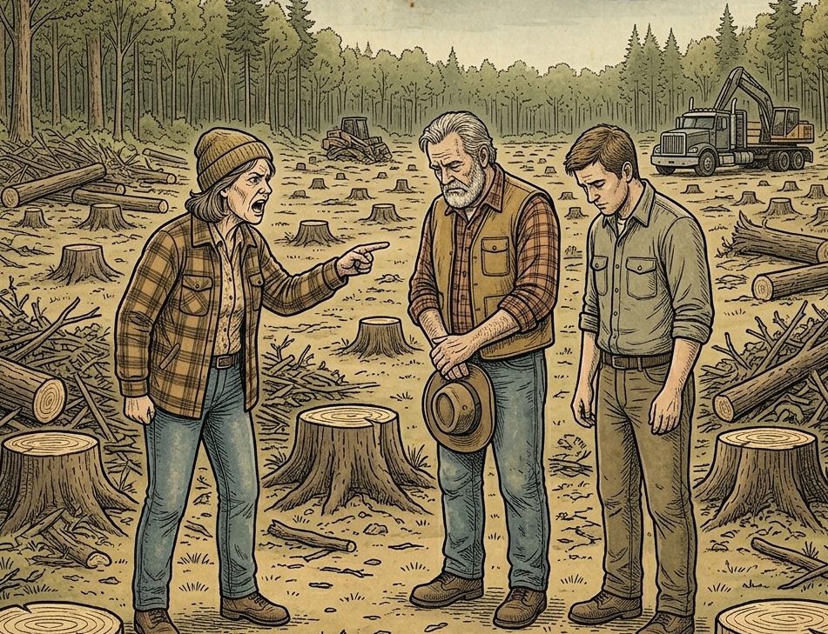
Estate of Vinson v. Lyons
2018 Mich. App. LEXIS 399 (Ct. App. Feb. 27, 2018)
Notes:
MI Ct. App.
Midland, MI
August 11, 2011
Helen Vinson owned 8 acres of vacant land in Midland.
Neighbor Timothy Lyons harvested timber on adjacent property.
Heavy machinery ran over the survey stakes, and the crew trespassed and cut down trees.
Vinson died, and daughter Teresa Vinson-Dopp sued.
Vinson-Dopp’s expert forester Douglas Lee estimated 400 trees had been cut, including: 317 red maples, 32 black oaks, 27 juneberries, 18 aspens, 17 birches, 11 white oaks, 7 cherries, and 1 apple tree.
Vinson-Dopp felt “terribly violated” and read a poem about trees, demanding replacement costs.
Replacement cost: $1.1M
Land value: $8,800
Tree value: $327.08
Plaintiff agreed that loss cannot exceed value of the property.
Trial court refused to allow evidence of replacement cost. Jury found loss was $327.08. Plaintiff appealed. Affirmed.

Slide 31
Estate of Vinson v. Lyons
2018 Mich. App. LEXIS 399 (Ct. App. Feb. 27, 2018)
Replacement Cost: $1,100,000.00
Property Value: $8,800.00
Tree Value: $327.08

Slide 32
Estate of Vinson v. Lyons
2018 Mich. App. LEXIS 399 (Ct. App. Feb. 27, 2018)
“…the trees in this case did not rise to the level of uniqueness where replacement costs were warranted.”
“[they] were simply ordinary trees in a forest of trees on the property.”

Slide 33
Estate of Vinson v. Lyons
2018 Mich. App. LEXIS 399 (Ct. App. Feb. 27, 2018)
No evidence trees were “shade or ornamental trees, or trees that had a unique or aesthetic value considering the contemplated or existing use of the property”
Replacement cost evidence properly excluded

Slide 34

Syzmanski v. Brown
21 Mich. App. 423 (1997)
Notes:
MI Ct. App.
Emmet County, MI
September, 1991
Walter Szymanski and David Brown owned adjacent parcels in Emmet County.
To make a deer hunting blind, Brown trespassed, cut 500 trees on Syzmanski’s land, and bulldozed the soil.
Syzmanski testified he derived aesthetic and spiritual satisfaction from observing nature.
Syzmanski presented replacement cost evidence $5,400-$84,705
Brown presented market value evidence the entire property was worth $27,500
Jury verdict for $37,000. Both appealed.
Reduces award down to land value ($27,500).

Slide 35
Syzmanski v. Brown
21 Mich. App. 423 (1997)
Replacement Cost: $84,705
Property Value: $27,500
Jury Verdict: $37,000

Slide 36
Syzmanski v. Brown
21 Mich. App. 423 (1997)
“Where…the property destroyed has a unique value of its own, it is appropriate to consider the value of the trees themselves to the contemplated or existing uses of the land including the cost of replacement or restoration.”

Slide 37
Syzmanski v. Brown
21 Mich. App. 423 (1997)
HOWEVER
“The jury’s award of $37,000 is unsupported by the evidence”
Reduce award to $27,500 (land value)

Slide 38
Summary
R2D §929
  Restoration Cost vs. Diminution in Value
  “Reason Personal”
  “Reasonably Incurred” vs. “Disproportionate”

Slide 39
Summary
Schankin v. Buskirk
Vanderpool v. Hart
Governale v. City of Owosso
Thiele v. Detroit Edison
Vinson v. Lyons
Syzmanski v. Brown

Slide 40
Case Illustrations from
Michigan Tree Appraisal Law
James Komen
BCMA #WE-9909B
RCA #555

