Slide 1
Case Illustrations in
Missouri Tree Law
James Komen
BCMA #WE-9909B
RCA #555

Slide 2
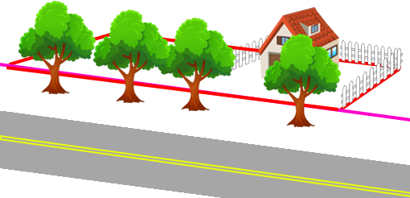
Walker v. City of Sedalia
74 Mo. App. 70 (Mo. Ct. App. 1898)
Notes:
MO Ct. App.
1898, Sedalia, MO
In 1891, City established road grade. In reliance on that grade, property owner Sara Walker built her home and planted trees.
In 1894, City established a new road grade. As a result, the tree roots were cut, and the trees were destroyed.
Walker sued for compensation. Jury instructed to consider value of trees.
Verdict for Walker. City appealed, claiming right to cut obstructions.
Affirmed.

Slide 3
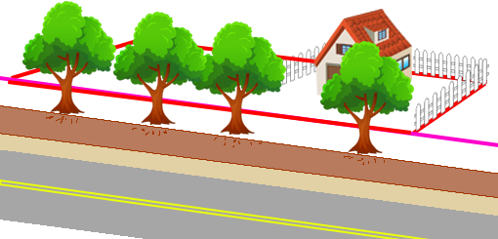
Walker v. City of Sedalia
74 Mo. App. 70 (Mo. Ct. App. 1898)
Notes:
MO Ct. App.
1898, Sedalia, MO
In 1891, City established road grade. In reliance on that grade, property owner Sara Walker built her home and planted trees.
In 1894, City established a new road grade. As a result, the tree roots were cut, and the trees were destroyed.
Walker sued for compensation. Jury instructed to consider value of trees.
Verdict for Walker. City appealed, claiming right to cut obstructions.
Affirmed.

Slide 4
Walker v. City of Sedalia
74 Mo. App. 70 (Mo. Ct. App. 1898)
“The public use of the street was in no way obstructed or endangered by [the trees].”

Slide 5
Walker v. City of Sedalia
74 Mo. App. 70 (Mo. Ct. App. 1898)
“Trees so planted are a public benefit”
“They can not be lawfully destroyed without the call of public necessity.”
“The policy of our laws…favors the planting and preservation of shade trees in the public streets where they do not constitute actual obstructions.”

Slide 6
Walker v. City of Sedalia
74 Mo. App. 70 (Mo. Ct. App. 1898)
“The policy of the law…would be wholly defeated if…the whim or caprice of successive commissioners [could] destroy in an hour all that had been accomplished in many years.”
“The trees are the property of the adjacent owner, who can not lawfully be deprived of [it].”

Slide 7
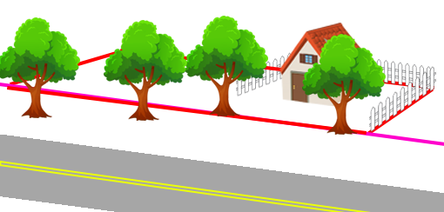
Colston v. St. Joseph
106 Mo. App. 714 (1904)
Notes:
MO Ct. App.
1904, St. Joseph, MO
City graded the street in front of Elizabeth Colston’s property and removed four trees near her front property line.
Colston sued for property damage.
Trial court instructed jury: “plaintiff cannot…recover…if the trees were wholly or partially in the street,…but were so located as to obstruct travel or use of the street unless they were removed.”
Jury verdict for City.
Trial court granted new trial, concluding its own instruction was wrong.
City appealed. Reversed – instruction correct.

Slide 8
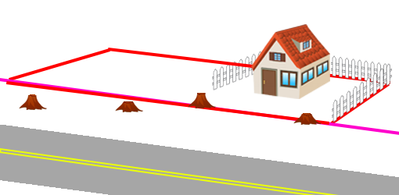
Colston v. St. Joseph
106 Mo. App. 714 (1904)
Notes:
MO Ct. App.
1904, St. Joseph, MO
City graded the street in front of Elizabeth Colston’s property and removed four trees near her front property line.
Colston sued for property damage.
Trial court instructed jury: “plaintiff cannot…recover…if the trees were wholly or partially in the street,…but were so located as to obstruct travel or use of the street unless they were removed.”
Jury verdict for City.
Trial court granted new trial, concluding its own instruction was wrong.
City appealed. Reversed – instruction correct.

Slide 9
Colston v. St. Joseph
106 Mo. App. 714 (1904)
“plaintiff cannot…recover…if the trees were wholly or partially in the street,…but were so located as to obstruct travel or use of the street unless they were removed.”

Slide 10
Colston v. St. Joseph
106 Mo. App. 714 (1904)
“plaintiff cannot…recover…if the trees were wholly or partially in the street,…but were so located as to obstruct travel or use of the street unless they were removed.”

Slide 11
Colston v. St. Joseph
106 Mo. App. 714 (1904)
“a city has a right to remove shade trees or any other obstruction in order to put its streets in condition for the use of the public.”
If trees partially within ROW, no $$ owed

Slide 12
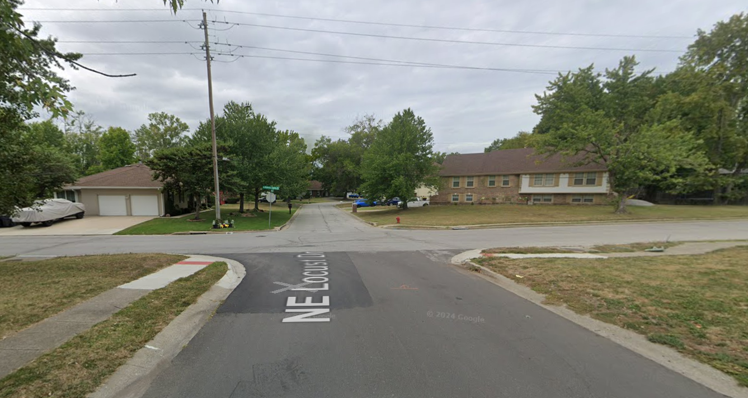
Jackson v. City of Blue Springs
904 S.W.2d 322 (Mo. Ct. App. 1995)
Notes:
MO Ct. App.
Blue Springs, MO
May 30, 1986
Clarence and Elizabeth Watson owned a home at the NE corner of Locust St and Adams Dairy Rd. in Blue Springs, MO.
Tracy Jackson was a passenger in Mary Behnke’s car driving west on Locust St.
Ronald Hanlan was driving a pickup truck south along Adams Dairy Rd.
Bushes, trees, and other vegetation obscured vision of both drivers of each other.
Vehicles crashed, injuring Jackson.
City had never maintained vegetation at corner.
Vegetation violated city ordinance to maintain clear line of sight at intersections.
MSJ for Watsons. Jackson appealed.
Reversed. Q of fact whether outside easement or reasonable to not maintain them.
Artificial/natural condition test for liability?
Per se negl. from ord. violation?

Slide 13
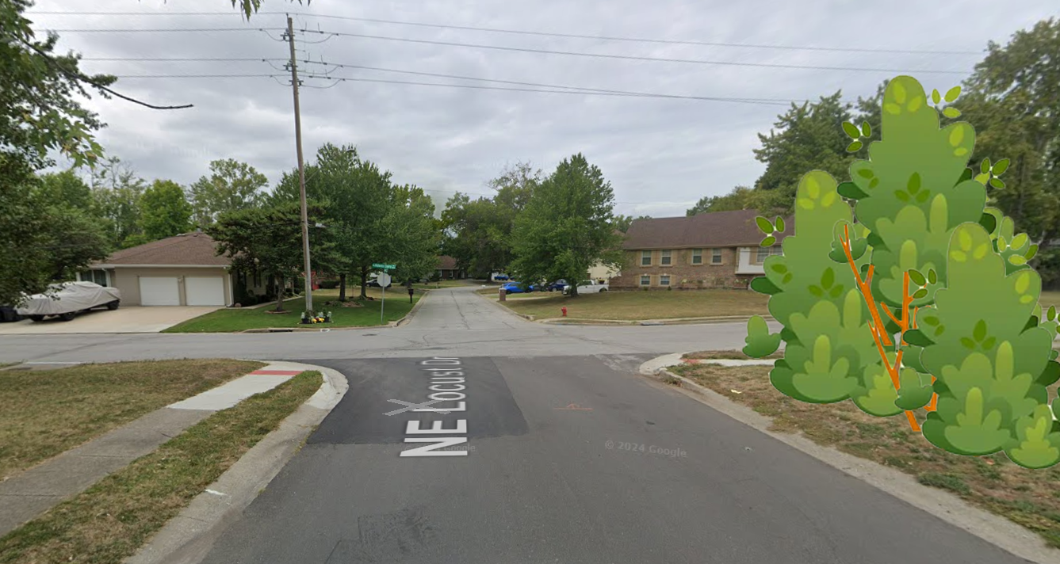
Jackson v. City of Blue Springs
904 S.W.2d 322 (Mo. Ct. App. 1995)

Slide 14
Jackson v. City of Blue Springs
904 S.W.2d 322 (Mo. Ct. App. 1995)
“maintenance of streets and sidewalks is a governmental function and an abutting landowner has no duty to repair or maintain public streets or sidewalks”
“The municipality cannot shift its responsibility to a private person by ordinance”
Duty owed to City, not to drivers

Slide 15
Jackson v. City of Blue Springs
904 S.W.2d 322 (Mo. Ct. App. 1995)
“vegetation is not necessarily a ‘natural’ condition”
“Artificial” conditions include:
  Vegetation planted by landowner
  Vegetation planted by predecessor
  Vegetation growing on land because land has been ‘made receptive to it.’

Slide 16
Jackson v. City of Blue Springs
904 S.W.2d 322 (Mo. Ct. App. 1995)
HOWEVER
“the distinction between natural and artificial conditions is arbitrary and serves no useful purpose in an urban setting”
“the relevant issue…is whether…[the Watsons] acted as a reasonable person would act”

Slide 17
Jackson v. City of Blue Springs
904 S.W.2d 322 (Mo. Ct. App. 1995)
“government…right-of-way over property…to the exclusion of the owners of the abutting land, normally relieves the landowners of any obligation as to vegetation growing thereon”
HOWEVER
Liable if vegetation outside of city easement

Slide 18
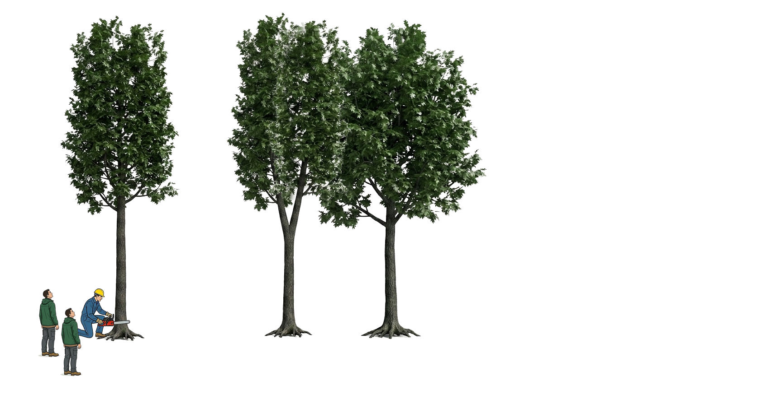
Sellens v. Christman
418 S.W.2d 6 (Mo. 1967)
Notes:
MO Sup. Ct.
Shelby County, MO
January 13, 1963, Sunday
Elvin Christman wanted to try out a new chain saw. He invited James Sellens and Orville Vanskike to join him in the woods.
Christman felled “Tree 1,” 14-inches in diameter. Tree 1 fell 45 degrees, lodging in the fork of Tree 2.
Sellens tried cutting into Tree 2, but not all the way. The three men pushed on Tree 2, but it didn’t move.
Vanskike hit it with an axe. It still didn’t budge.
Sellens then felled Tree 3, about 10 feet away. Tree 3 landed on the ground, and Sellens began sawing it into logs.
While Sellens was working, and 10 min after the attempts to fell Tree 2, BOTH Tree 1 and Tree 2 collapsed onto Sellens.
Sellens sued Christman, alleging landowner liability for hazardous condition.
Trial Ct. directed verdict for defendant Christman. Sellens appealed. Affirmed.

Slide 19
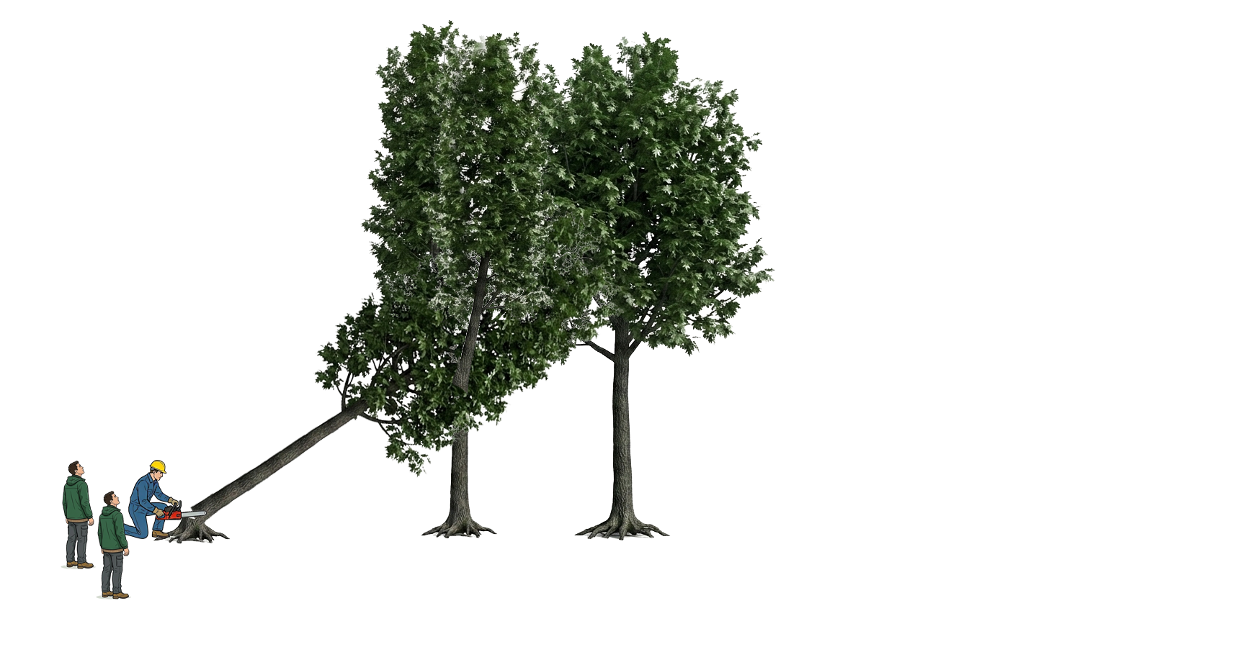
Sellens v. Christman
418 S.W.2d 6 (Mo. 1967)
Notes:
MO Sup. Ct.
Shelby County, MO
January 13, 1963, Sunday
Elvin Christman wanted to try out a new chain saw. He invited James Sellens and Orville Vanskike to join him in the woods.
Christman felled “Tree 1,” 14-inches in diameter. Tree 1 fell 45 degrees, lodging in the fork of Tree 2.
Sellens tried cutting into Tree 2, but not all the way. The three men pushed on Tree 2, but it didn’t move.
Vanskike hit it with an axe. It still didn’t budge.
Sellens then felled Tree 3, about 10 feet away. Tree 3 landed on the ground, and Sellens began sawing it into logs.
While Sellens was working, and 10 min after the attempts to fell Tree 2, BOTH Tree 1 and Tree 2 collapsed onto Sellens.
Sellens sued Christman, alleging landowner liability for hazardous condition.
Trial Ct. directed verdict for defendant Christman. Sellens appealed. Affirmed.

Slide 20
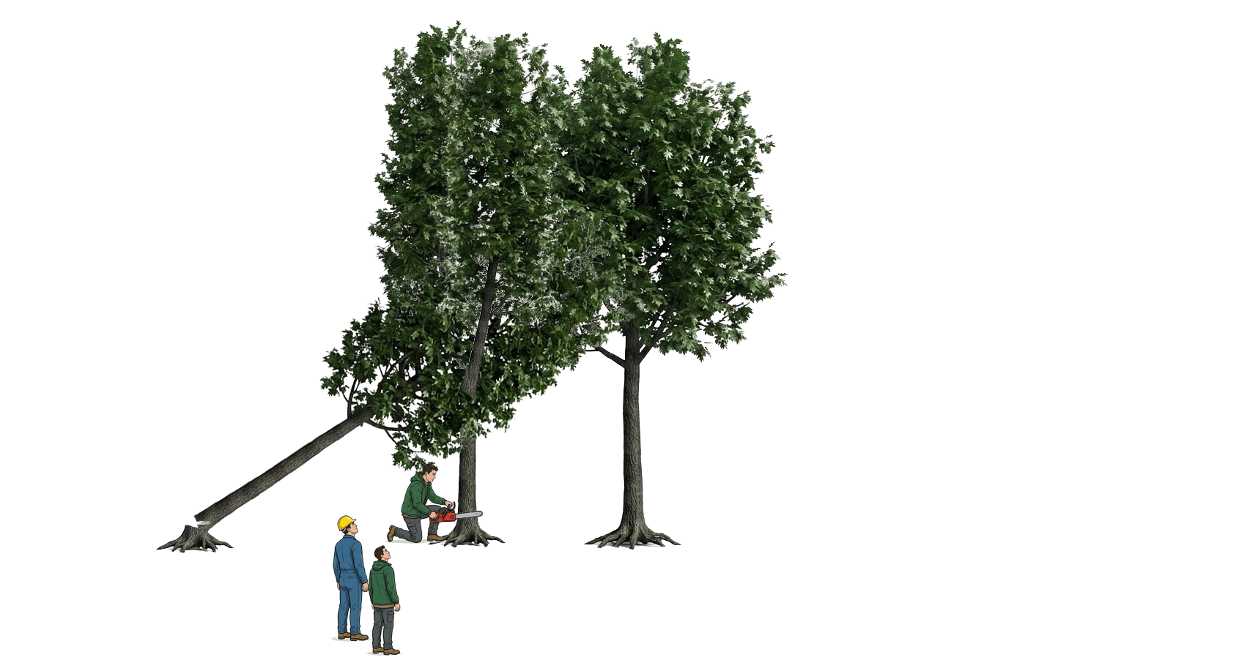
Sellens v. Christman
418 S.W.2d 6 (Mo. 1967)
Notes:
MO Sup. Ct.
Shelby County, MO
January 13, 1963, Sunday
Elvin Christman wanted to try out a new chain saw. He invited James Sellens and Orville Vanskike to join him in the woods.
Christman felled “Tree 1,” 14-inches in diameter. Tree 1 fell 45 degrees, lodging in the fork of Tree 2.
Sellens tried cutting into Tree 2, but not all the way. The three men pushed on Tree 2, but it didn’t move.
Vanskike hit it with an axe. It still didn’t budge.
Sellens then felled Tree 3, about 10 feet away. Tree 3 landed on the ground, and Sellens began sawing it into logs.
While Sellens was working, and 10 min after the attempts to fell Tree 2, BOTH Tree 1 and Tree 2 collapsed onto Sellens.
Sellens sued Christman, alleging landowner liability for hazardous condition.
Trial Ct. directed verdict for defendant Christman. Sellens appealed. Affirmed.

Slide 21
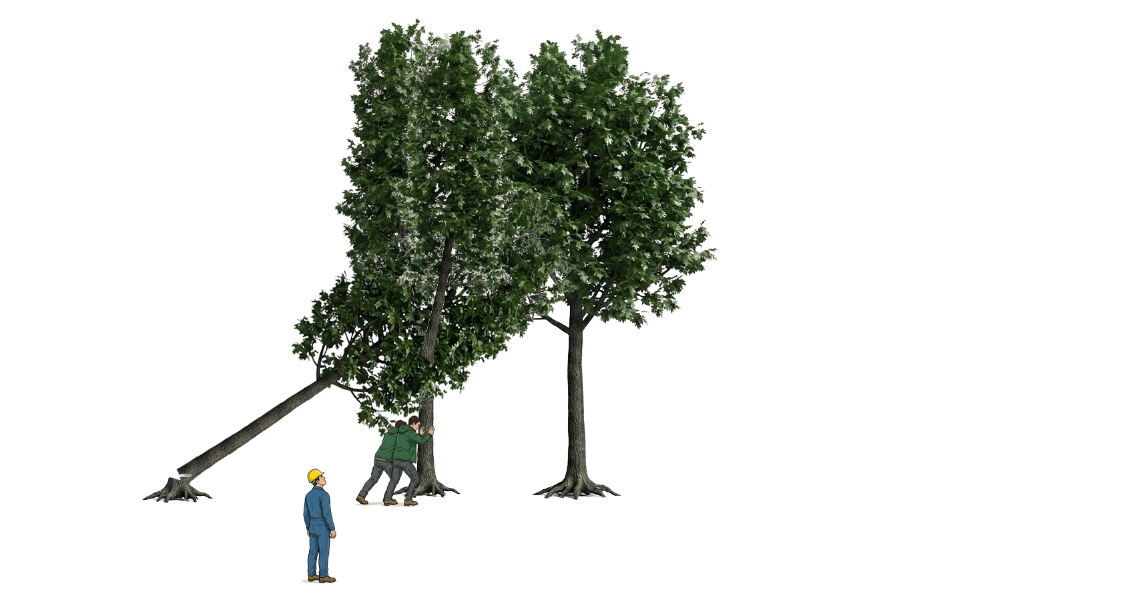
Sellens v. Christman
418 S.W.2d 6 (Mo. 1967)
Notes:
MO Sup. Ct.
Shelby County, MO
January 13, 1963, Sunday
Elvin Christman wanted to try out a new chain saw. He invited James Sellens and Orville Vanskike to join him in the woods.
Christman felled “Tree 1,” 14-inches in diameter. Tree 1 fell 45 degrees, lodging in the fork of Tree 2.
Sellens tried cutting into Tree 2, but not all the way. The three men pushed on Tree 2, but it didn’t move.
Vanskike hit it with an axe. It still didn’t budge.
Sellens then felled Tree 3, about 10 feet away. Tree 3 landed on the ground, and Sellens began sawing it into logs.
While Sellens was working, and 10 min after the attempts to fell Tree 2, BOTH Tree 1 and Tree 2 collapsed onto Sellens.
Sellens sued Christman, alleging landowner liability for hazardous condition.
Trial Ct. directed verdict for defendant Christman. Sellens appealed. Affirmed.

Slide 22
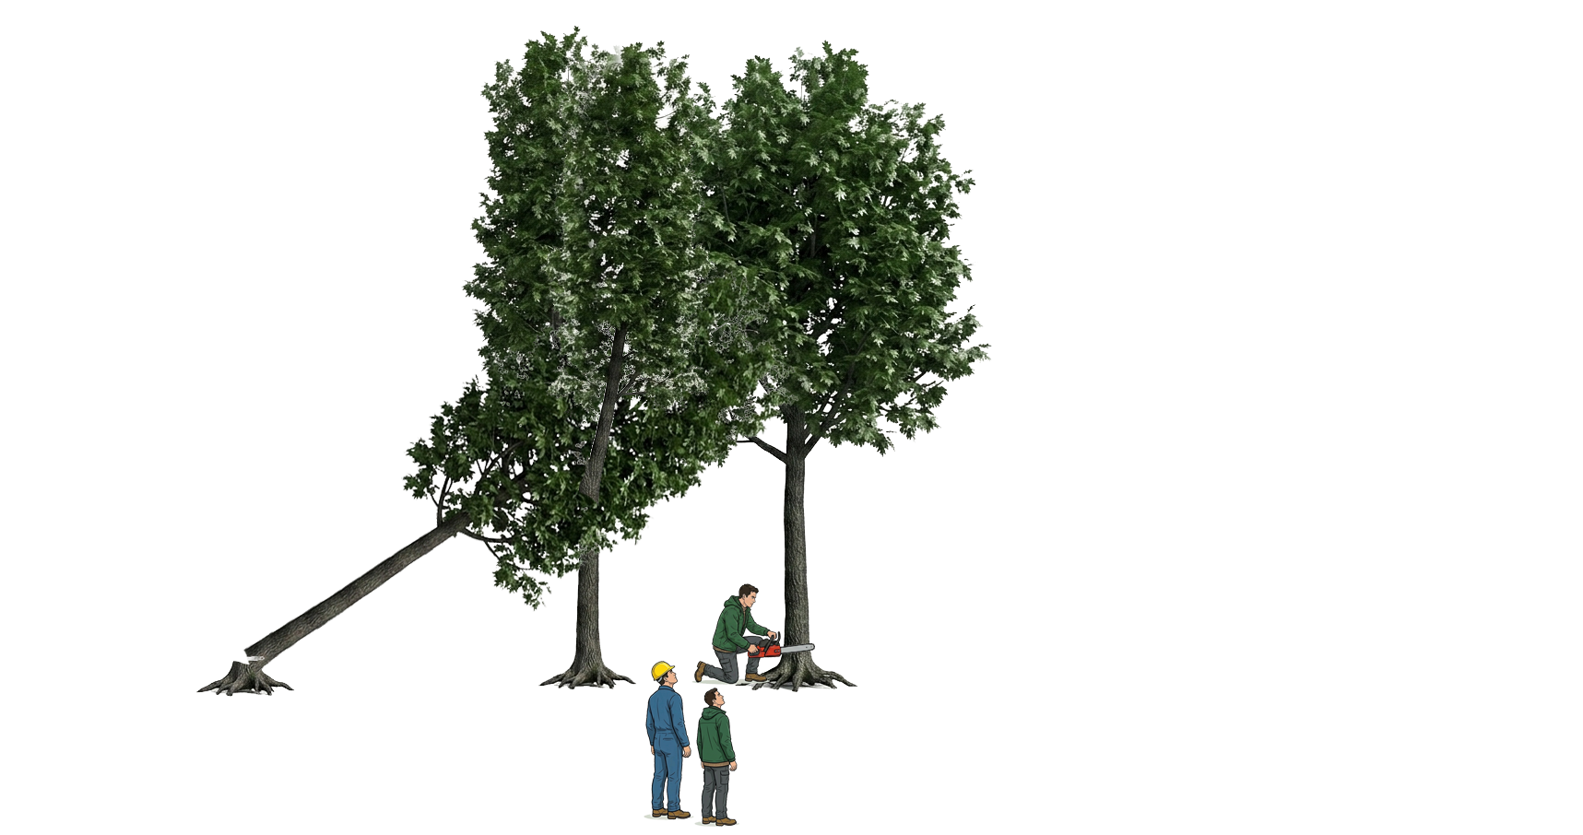
Sellens v. Christman
418 S.W.2d 6 (Mo. 1967)
Notes:
MO Sup. Ct.
Shelby County, MO
January 13, 1963, Sunday
Elvin Christman wanted to try out a new chain saw. He invited James Sellens and Orville Vanskike to join him in the woods.
Christman felled “Tree 1,” 14-inches in diameter. Tree 1 fell 45 degrees, lodging in the fork of Tree 2.
Sellens tried cutting into Tree 2, but not all the way. The three men pushed on Tree 2, but it didn’t move.
Vanskike hit it with an axe. It still didn’t budge.
Sellens then felled Tree 3, about 10 feet away. Tree 3 landed on the ground, and Sellens began sawing it into logs.
While Sellens was working, and 10 min after the attempts to fell Tree 2, BOTH Tree 1 and Tree 2 collapsed onto Sellens.
Sellens sued Christman, alleging landowner liability for hazardous condition.
Trial Ct. directed verdict for defendant Christman. Sellens appealed. Affirmed.

Slide 23
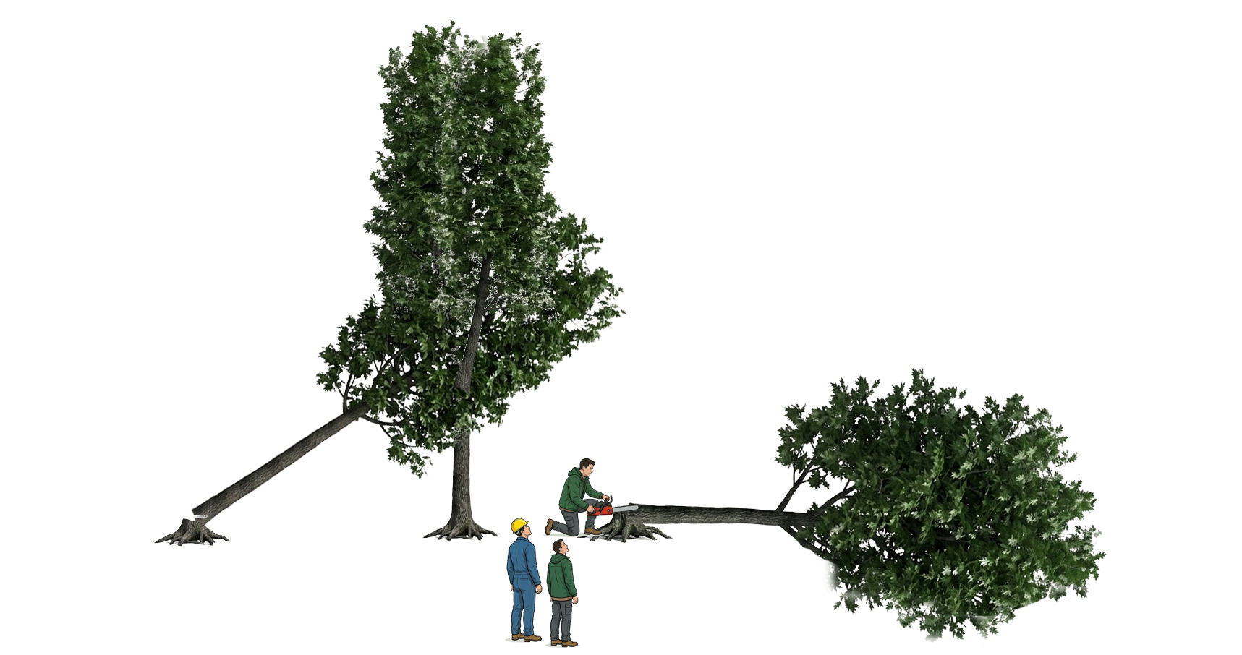
Sellens v. Christman
418 S.W.2d 6 (Mo. 1967)
Notes:
MO Sup. Ct.
Shelby County, MO
January 13, 1963, Sunday
Elvin Christman wanted to try out a new chain saw. He invited James Sellens and Orville Vanskike to join him in the woods.
Christman felled “Tree 1,” 14-inches in diameter. Tree 1 fell 45 degrees, lodging in the fork of Tree 2.
Sellens tried cutting into Tree 2, but not all the way. The three men pushed on Tree 2, but it didn’t move.
Vanskike hit it with an axe. It still didn’t budge.
Sellens then felled Tree 3, about 10 feet away. Tree 3 landed on the ground, and Sellens began sawing it into logs.
While Sellens was working, and 10 min after the attempts to fell Tree 2, BOTH Tree 1 and Tree 2 collapsed onto Sellens.
Sellens sued Christman, alleging landowner liability for hazardous condition.
Trial Ct. directed verdict for defendant Christman. Sellens appealed. Affirmed.

Slide 24
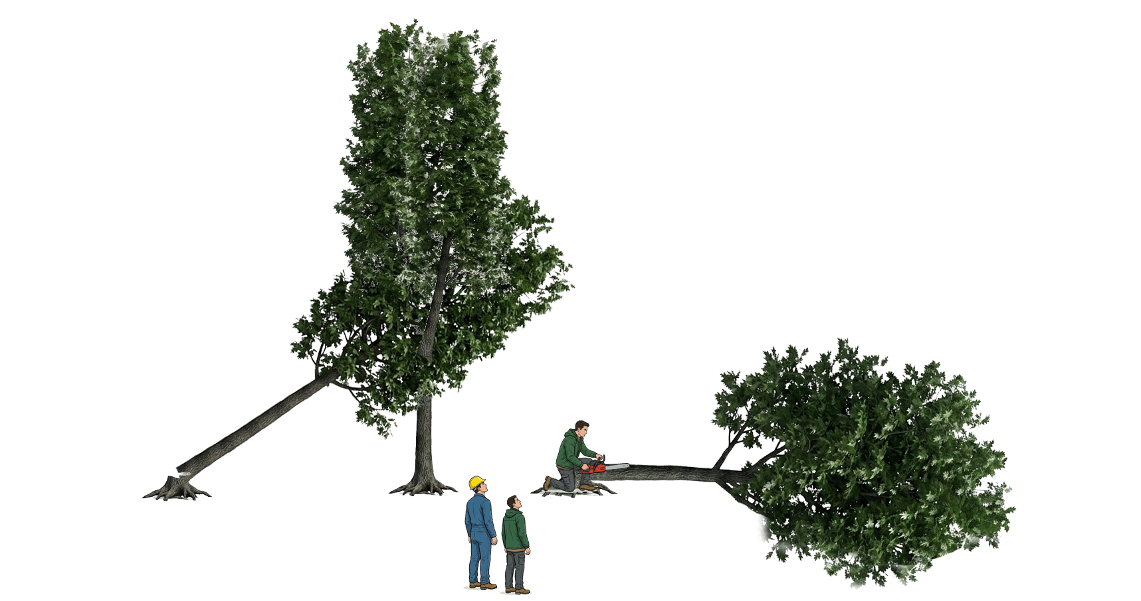
Sellens v. Christman
418 S.W.2d 6 (Mo. 1967)
Notes:
MO Sup. Ct.
Shelby County, MO
January 13, 1963, Sunday
Elvin Christman wanted to try out a new chain saw. He invited James Sellens and Orville Vanskike to join him in the woods.
Christman felled “Tree 1,” 14-inches in diameter. Tree 1 fell 45 degrees, lodging in the fork of Tree 2.
Sellens tried cutting into Tree 2, but not all the way. The three men pushed on Tree 2, but it didn’t move.
Vanskike hit it with an axe. It still didn’t budge.
Sellens then felled Tree 3, about 10 feet away. Tree 3 landed on the ground, and Sellens began sawing it into logs.
While Sellens was working, and 10 min after the attempts to fell Tree 2, BOTH Tree 1 and Tree 2 collapsed onto Sellens.
Sellens sued Christman, alleging landowner liability for hazardous condition.
Trial Ct. directed verdict for defendant Christman. Sellens appealed. Affirmed.

Slide 25
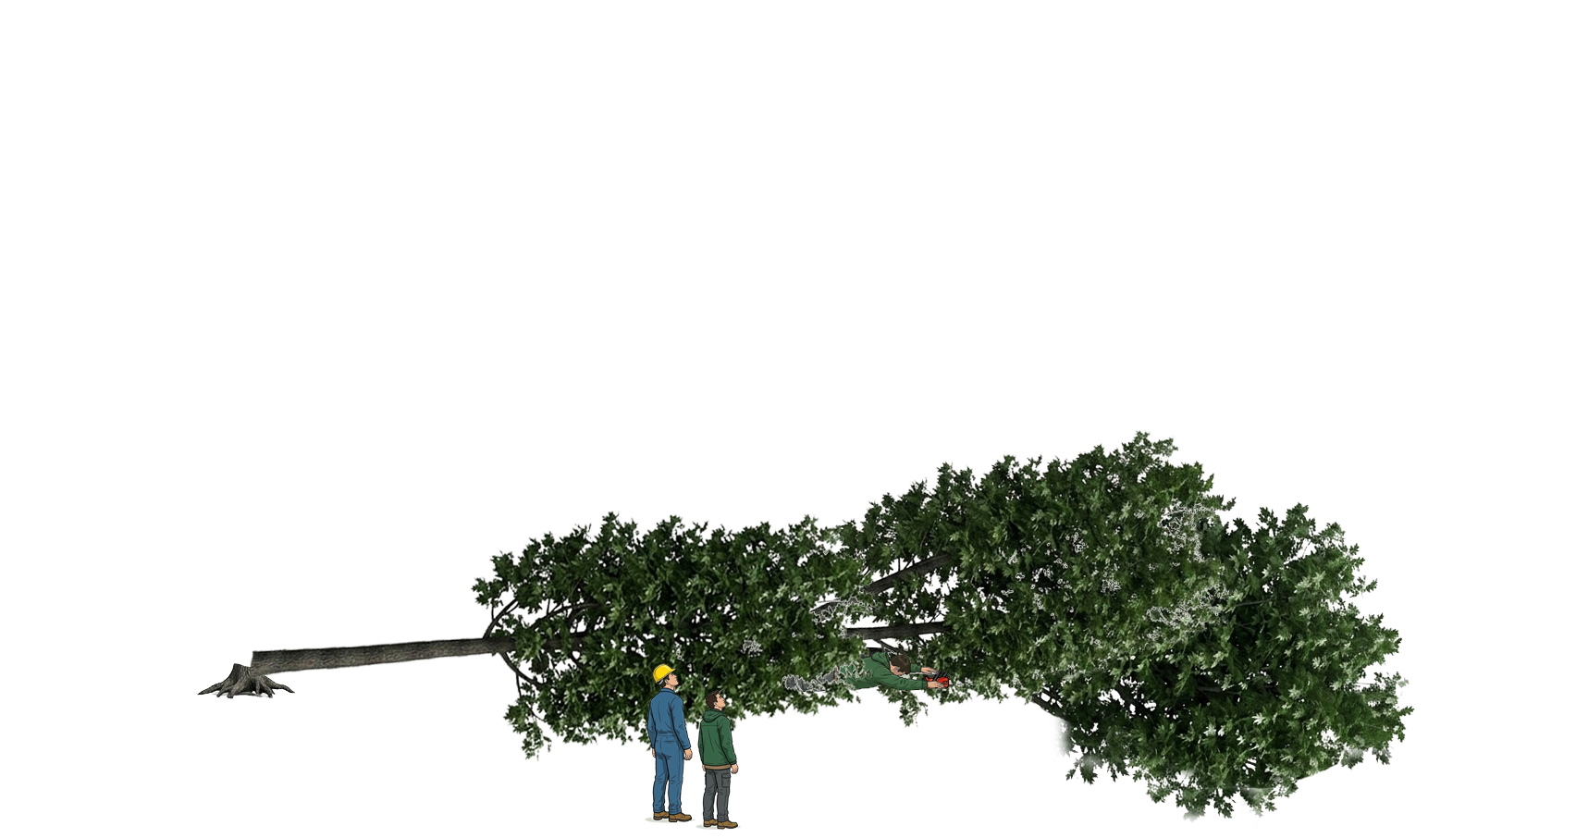
Sellens v. Christman
418 S.W.2d 6 (Mo. 1967)
Notes:
MO Sup. Ct.
Shelby County, MO
January 13, 1963, Sunday
Elvin Christman wanted to try out a new chain saw. He invited James Sellens and Orville Vanskike to join him in the woods.
Christman felled “Tree 1,” 14-inches in diameter. Tree 1 fell 45 degrees, lodging in the fork of Tree 2.
Sellens tried cutting into Tree 2, but not all the way. The three men pushed on Tree 2, but it didn’t move.
Vanskike hit it with an axe. It still didn’t budge.
Sellens then felled Tree 3, about 10 feet away. Tree 3 landed on the ground, and Sellens began sawing it into logs.
While Sellens was working, and 10 min after the attempts to fell Tree 2, BOTH Tree 1 and Tree 2 collapsed onto Sellens.
Sellens sued Christman, alleging landowner liability for hazardous condition.
Trial Ct. directed verdict for defendant Christman. Sellens appealed. Affirmed.

Slide 26
Sellens v. Christman
418 S.W.2d 6 (Mo. 1967)
“The duty to keep premises safe for invitees applies only to defects or conditions which are in the nature of hidden dangers…are not known to the invitee, and would not be observed by him in the exercise of ordinary care.”

Slide 27
Sellens v. Christman
418 S.W.2d 6 (Mo. 1967)
“When the condition relied on is obvious or actually known to the invitee there is no duty on the owner to warn him.”
“[Sellens], having helped to create the danger, and knowing of it, cannot escape those facts.”

Slide 28

Ogden v. Toth
542 S.W.2d 17 (Mo. Ct. App. 1976)
Notes:
MO Ct. App.
Sunday, December 2, 1973
David Ogden agreed to help Alexander Toth and others cut down trees on Toth’s property. The firewood would go to Ogden’s family member.
12”-14” diameter white oak, 50-ft tall, with a “severe lean”, “laying on a heck of an angle” toward the house.
Plan was to piece down the tree.
Ogden climbed ladder and made cut 8’-14’ up. He did not leave a notch.
Top fell to ground, but butt was still attached to tree. Men pulled on rope, but it didn’t budge.
Ogden said “drop the rope,” but Toth kept it pulled taught.
Ogden began to make final cut at the base. He couldn’t see that Toth was still pulling.
While Ogden was cutting, top fell on him, resulting in severe injuries.
Ogden sued Toth. Verdict for Ogden. Trial Ct. granted JNOV for Toth or new trial. Ogden appealed. Reversed, new trial.

Slide 29
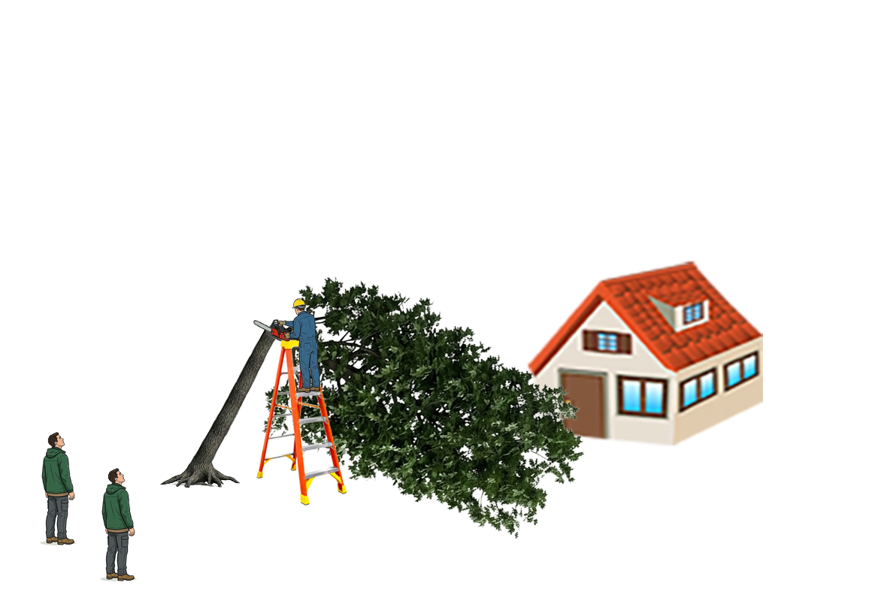
Ogden v. Toth
542 S.W.2d 17 (Mo. Ct. App. 1976)
Notes:
MO Ct. App.
Sunday, December 2, 1973
David Ogden agreed to help Alexander Toth and others cut down trees on Toth’s property. The firewood would go to Ogden’s family member.
12”-14” diameter white oak, 50-ft tall, with a “severe lean”, “laying on a heck of an angle” toward the house.
Plan was to piece down the tree.
Ogden climbed ladder and made cut 8’-14’ up. He did not leave a notch.
Top fell to ground, but butt was still attached to tree. Men pulled on rope, but it didn’t budge.
Ogden said “drop the rope,” but Toth kept it pulled taught.
Ogden began to make final cut at the base. He couldn’t see that Toth was still pulling.
While Ogden was cutting, top fell on him, resulting in severe injuries.
Ogden sued Toth. Verdict for Ogden. Trial Ct. granted JNOV for Toth or new trial. Ogden appealed. Reversed, new trial.

Slide 30
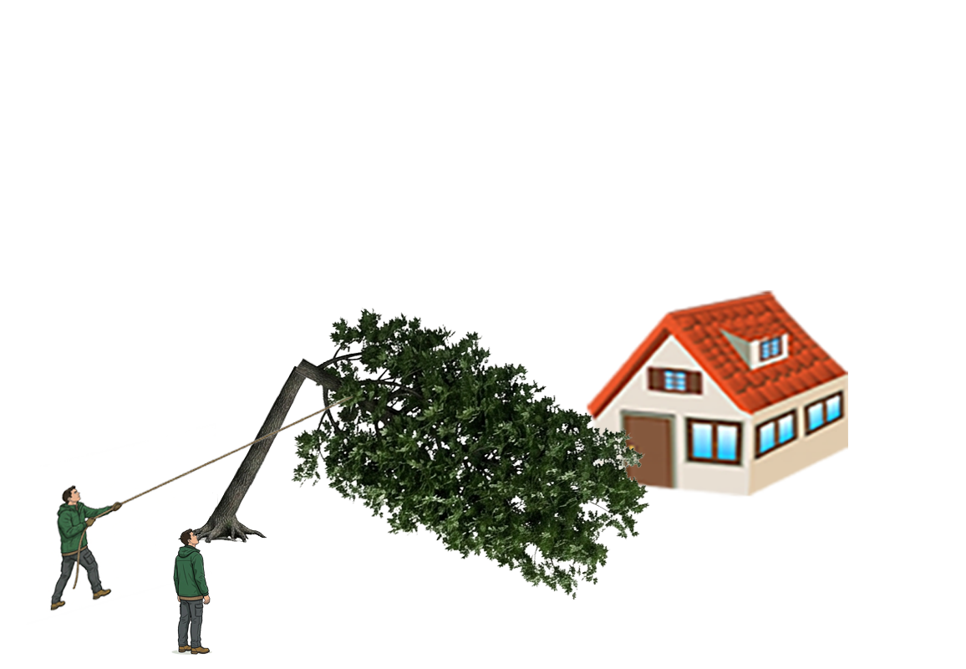
Ogden v. Toth
542 S.W.2d 17 (Mo. Ct. App. 1976)
Notes:
MO Ct. App.
Sunday, December 2, 1973
David Ogden agreed to help Alexander Toth and others cut down trees on Toth’s property. The firewood would go to Ogden’s family member.
12”-14” diameter white oak, 50-ft tall, with a “severe lean”, “laying on a heck of an angle” toward the house.
Plan was to piece down the tree.
Ogden climbed ladder and made cut 8’-14’ up. He did not leave a notch.
Top fell to ground, but butt was still attached to tree. Men pulled on rope, but it didn’t budge.
Ogden said “drop the rope,” but Toth kept it pulled taught.
Ogden began to make final cut at the base. He couldn’t see that Toth was still pulling.
While Ogden was cutting, top fell on him, resulting in severe injuries.
Ogden sued Toth. Verdict for Ogden. Trial Ct. granted JNOV for Toth or new trial. Ogden appealed. Reversed, new trial.

Slide 31

Ogden v. Toth
542 S.W.2d 17 (Mo. Ct. App. 1976)
Notes:
MO Ct. App.
Sunday, December 2, 1973
David Ogden agreed to help Alexander Toth and others cut down trees on Toth’s property. The firewood would go to Ogden’s family member.
12”-14” diameter white oak, 50-ft tall, with a “severe lean”, “laying on a heck of an angle” toward the house.
Plan was to piece down the tree.
Ogden climbed ladder and made cut 8’-14’ up. He did not leave a notch.
Top fell to ground, but butt was still attached to tree. Men pulled on rope, but it didn’t budge.
Ogden said “drop the rope,” but Toth kept it pulled taught.
Ogden began to make final cut at the base. He couldn’t see that Toth was still pulling.
While Ogden was cutting, top fell on him, resulting in severe injuries.
Ogden sued Toth. Verdict for Ogden. Trial Ct. granted JNOV for Toth or new trial. Ogden appealed. Reversed, new trial.

Slide 32
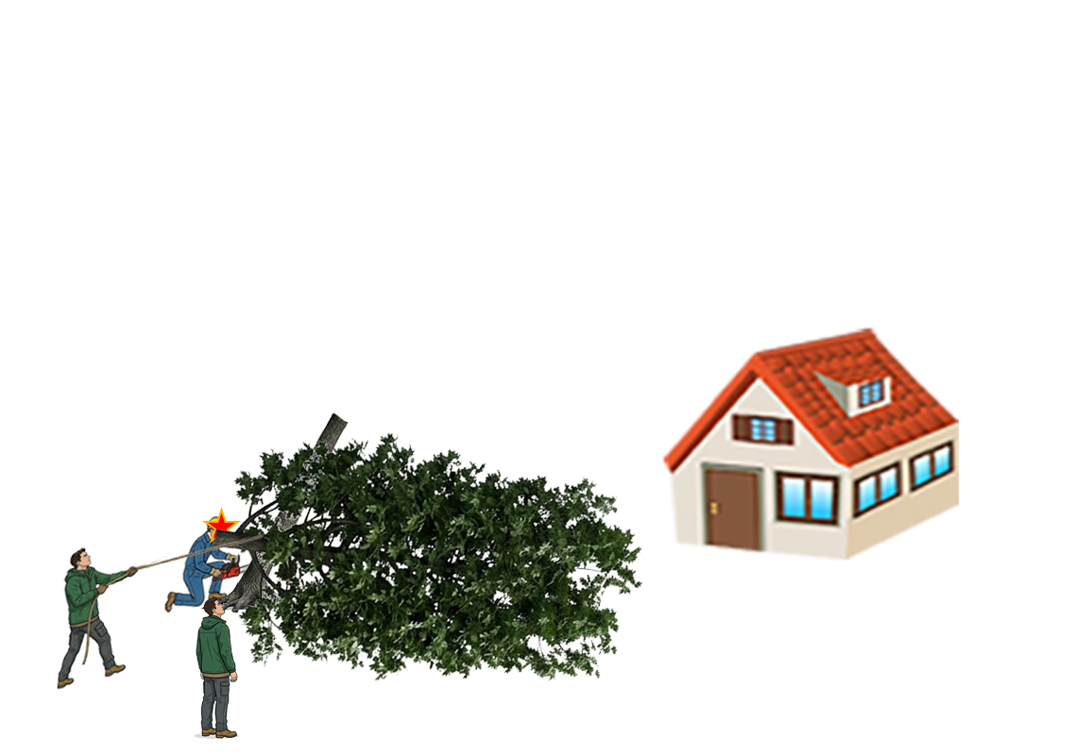
Ogden v. Toth
542 S.W.2d 17 (Mo. Ct. App. 1976)
Notes:
MO Ct. App.
Sunday, December 2, 1973
David Ogden agreed to help Alexander Toth and others cut down trees on Toth’s property. The firewood would go to Ogden’s family member.
12”-14” diameter white oak, 50-ft tall, with a “severe lean”, “laying on a heck of an angle” toward the house.
Plan was to piece down the tree.
Ogden climbed ladder and made cut 8’-14’ up. He did not leave a notch.
Top fell to ground, but butt was still attached to tree. Men pulled on rope, but it didn’t budge.
Ogden said “drop the rope,” but Toth kept it pulled taught.
Ogden began to make final cut at the base. He couldn’t see that Toth was still pulling.
While Ogden was cutting, top fell on him, resulting in severe injuries.
Ogden sued Toth. Verdict for Ogden. Trial Ct. granted JNOV for Toth or new trial. Ogden appealed. Reversed, new trial.

Slide 33
Ogden v. Toth
542 S.W.2d 17 (Mo. Ct. App. 1976)
“sufficient evidence of a breach of a duty of due care in [Toth’s] affirmative act of pulling on the rope in the direction Mr. Ogden was working even though Mr. Ogden had told him to drop the rope.”
“[Toth] had superior knowledge of a dangerous condition and was actively negligent”

Slide 34
Ogden v. Toth
542 S.W.2d 17 (Mo. Ct. App. 1976)
“even if the upper part began to fall solely because of the weakened trunk, [a jury could find that Toth] influenced or deflected the path of the limb on its way down”
“we cannot say that [Ogden] was guilty of contributory negligence as a matter of law in failing to notch the tree”

Slide 35
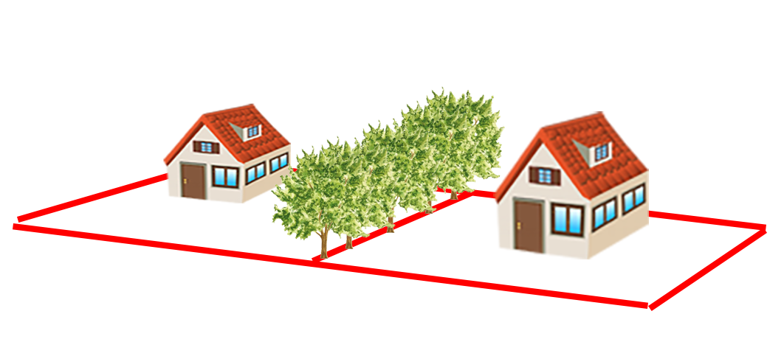
Yoakum v. Davis
162 Mo. App. 253 (1912)
Notes:
MO Ct. App.
Knoxville Township, Ray County, MO
1912
Pryor Yoakum and Samuel Davis owned adjoining properties. Yoakum had a fence inside his land.
Hedge of Osage orange trees grew along true property line. Davis cut them down for fence posts.
Yoakum sued for replevin.
Parties disputed:
adverse possession;
whether the trees were on the line; and
whether prior owners agreed trees were intended to mark the line.
Trial court refused to instruct jury of agreement theory. Judgment for Yoakum. Davis appealed. Reversed.
No replevin IF:
Adverse possession of land;
Trees were on boundary line and T/C;
Prior owners agreed on boundary line and T/C.

Slide 36
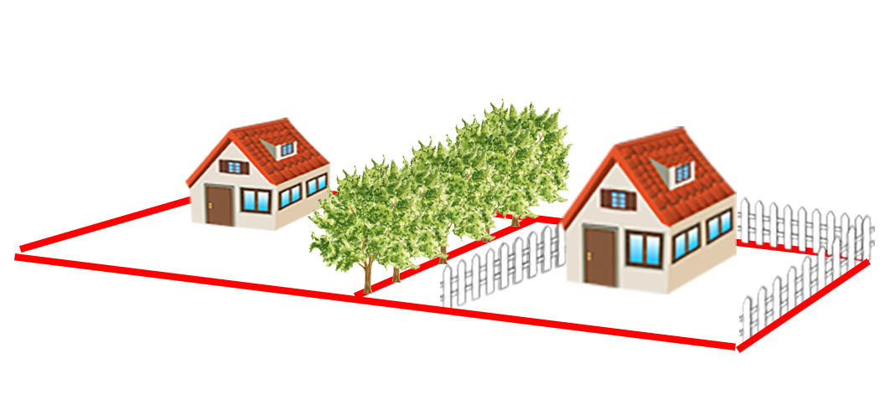
Yoakum v. Davis
162 Mo. App. 253 (1912)
Notes:
MO Ct. App.
Knoxville Township, Ray County, MO
1912
Pryor Yoakum and Samuel Davis owned adjoining properties. Yoakum had a fence inside his land.
Hedge of Osage orange trees grew along true property line. Davis cut them down for fence posts.
Yoakum sued for replevin.
Parties disputed:
adverse possession;
whether the trees were on the line; and
whether prior owners agreed trees were intended to mark the line.
Trial court refused to instruct jury of agreement theory. Judgment for Yoakum. Davis appealed. Reversed.
No replevin IF:
Adverse possession of land;
Trees were on boundary line and T/C;
Prior owners agreed on boundary line and T/C.

Slide 37
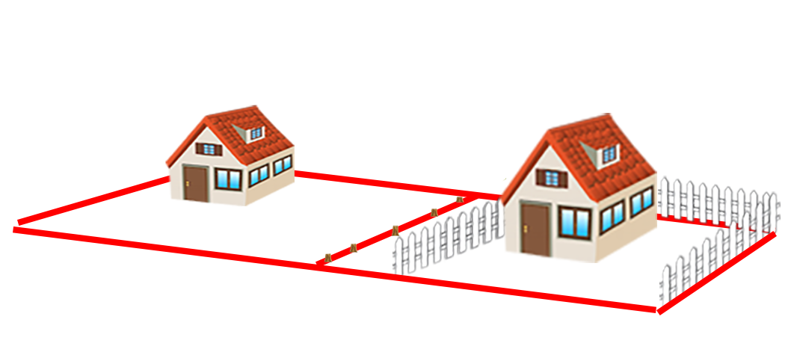
Yoakum v. Davis
162 Mo. App. 253 (1912)
Notes:
MO Ct. App.
Knoxville Township, Ray County, MO
1912
Pryor Yoakum and Samuel Davis owned adjoining properties. Yoakum had a fence inside his land.
Hedge of Osage orange trees grew along true property line. Davis cut them down for fence posts.
Yoakum sued for replevin.
Parties disputed:
adverse possession;
whether the trees were on the line; and
whether prior owners agreed trees were intended to mark the line.
Trial court refused to instruct jury of agreement theory. Judgment for Yoakum. Davis appealed. Reversed.
No replevin IF:
Adverse possession of land;
Trees were on boundary line and T/C;
Prior owners agreed on boundary line and T/C.

Slide 38
Yoakum v. Davis
162 Mo. App. 253 (1912)
“If trees stand on the dividing line of adjoining landowners, with a part of the trunks on either side of the line, the adjoining owners are joint owners in common.”
Trees starting on one side and growing across a line “become the property of both, in common.”

Slide 39
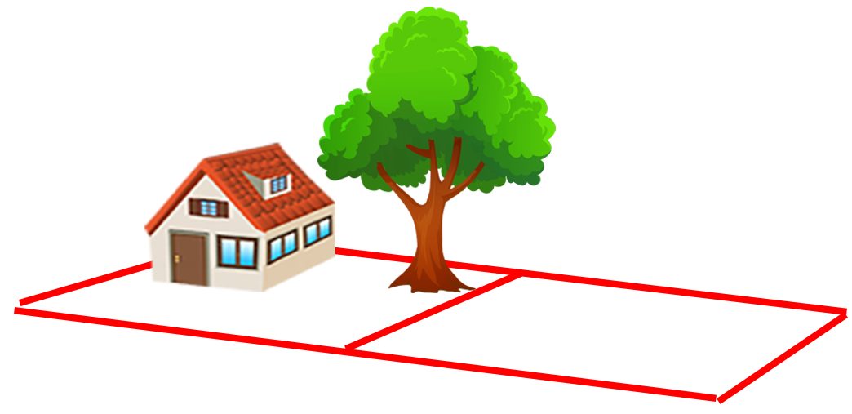
Tanner v. Wallbrunn
77 Mo. App. 262 (1898)
Notes:
MO Ct. App.
1898, Chillicothe, MO
J.B Tanner and H. Wallbrunn owned adjoining lots.
Wallbrunn planted a large maple tree that grew over Tanner property line.
THEN Tanner built a home on the prop line, 3 feet from tree. Branches scraped Tanner’s roof and chimney.
Tanner sued for injunction to compel Wallbrunn to cut back nuisance tree branches.
Trial Ct. granted injunction, ordering removal of the entire tree. Wallbrunn appealed. Reversed.

Slide 40
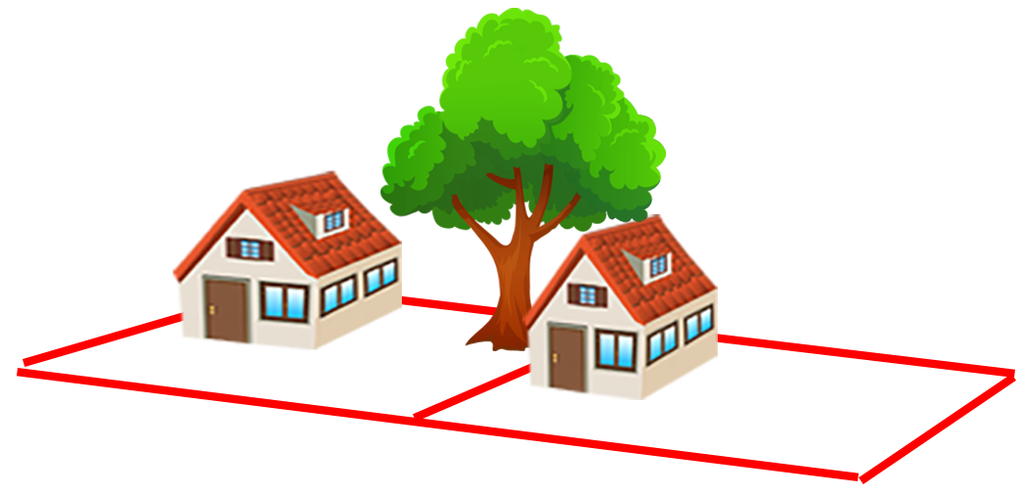
Tanner v. Wallbrunn
77 Mo. App. 262 (1898)
Notes:
MO Ct. App.
1898, Chillicothe, MO
J.B Tanner and H. Wallbrunn owned adjoining lots.
Wallbrunn planted a large maple tree that grew over Tanner property line.
THEN Tanner built a home on the prop line, 3 feet from tree. Branches scraped Tanner’s roof and chimney.
Tanner sued for injunction to compel Wallbrunn to cut back nuisance tree branches.
Trial Ct. granted injunction, ordering removal of the entire tree. Wallbrunn appealed. Reversed.

Slide 41
Tanner v. Wallbrunn
77 Mo. App. 262 (1898)
“Trees whose branches extend over the land of another are not nuisances except to the extent to which the branches overhang the adjoining land.”
“the person over whose land they extend may cut them off, or have his action for damages…but he may not cut down the tree”

Slide 42
Tanner v. Wallbrunn
77 Mo. App. 262 (1898)
“had Wallbrunn refused to cut off such overreaching limbs, [Tanner] had the undoubted legal right, himself, so to do.”
“And, having this right, it was his duty to avail himself thereof before resorting to [injunction].”
Insufficient evidence of damage from root intrusion

Slide 43
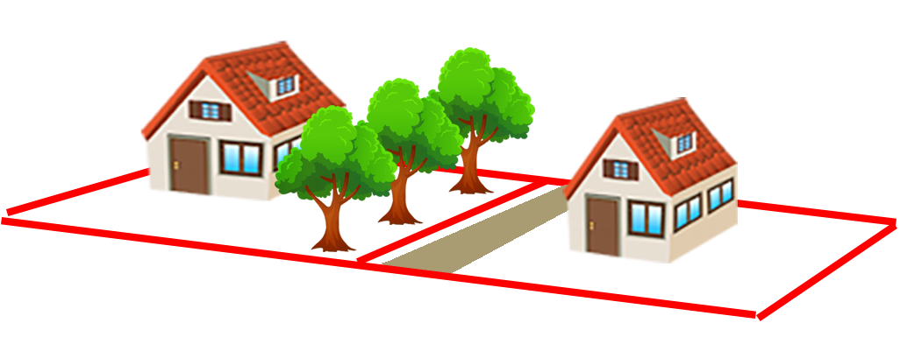
Hasapopoulos v. Murphy
689 S.W.2d 118 (Mo. Ct. App. 1985)
Notes:
MO Ct. App.
St. Louis County, MO
In 1969, Pete and Elen Hasapopoulos purchased a home in St. Louis County. 3 Chinese Elm trees were growing on Joyce Murphy’s property near the line.
By 1974, trees grew to 24” DBH, 50 ft tall. Roots cracked driveway.
No evidence who planted them or IF they were planted at all.
In 1984, Hasapopoulos cut back encroaching branches and sued for damages to driveway.
Trial Ct. held no nuisance, held for Murphy. Hasapopoulos appealed. Affirmed.

Slide 44
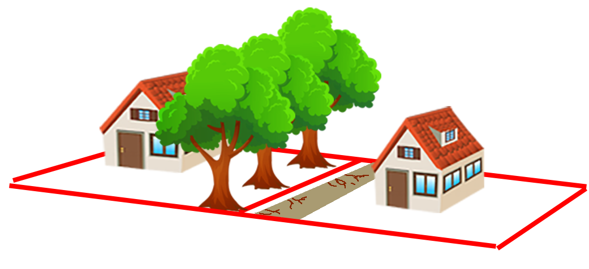
Hasapopoulos v. Murphy
689 S.W.2d 118 (Mo. Ct. App. 1985)
Notes:
MO Ct. App.
St. Louis County, MO
In 1969, Pete and Elen Hasapopoulos purchased a home in St. Louis County. 3 Chinese Elm trees were growing on Joyce Murphy’s property near the line.
By 1974, trees grew to 24” DBH, 50 ft tall. Roots cracked driveway.
No evidence who planted them or IF they were planted at all.
In 1984, Hasapopoulos cut back encroaching branches and sued for damages to driveway.
Trial Ct. held no nuisance, held for Murphy. Hasapopoulos appealed. Affirmed.

Slide 45
Hasapopoulos v. Murphy
689 S.W.2d 118 (Mo. Ct. App. 1985)
“responsibility flows not only from the creation of the nuisance, but from its continued maintenance as well.”
“we reject [the argument] that proof of a landowner’s planting or nurturing a tree is an essential element”

Slide 46
Hasapopoulos v. Murphy
689 S.W.2d 118 (Mo. Ct. App. 1985)
HOWEVER
“The trees and their proximity to plaintiffs’ land existed when plaintiffs purchased their residence. They must be charged with awareness of the potential effects of growing trees.”
“self-help to protect from damage…was available to plaintiffs for 15 years”

Slide 47
Hasapopoulos v. Murphy
689 S.W.2d 118 (Mo. Ct. App. 1985)
There is “no liability upon the owner of a healthy tree”
“liability may not be predicated upon nothing more than letting nature take its course”

Slide 48
Case Illustrations in
Missouri Tree Law
James Komen
BCMA #WE-9909B
RCA #555

