Slide 1
Case Illustrations from
Florida Tree Law
James Komen
BCMA #WE-9909B
RCA #555

Slide 2
Landowner Liability
City of Jacksonville v. Foster, 41 So. 2d 548 (Fla. 1949)
Murphy v. Boca Raton Hotel and Club, LP, 745 So. 2d 463 (Fla. 4th DCA 1999)
Cassel v. Price, 396 So.2d 258 (Fla. 1st DCA 1981)
Mazyck v. Caribbean Lawn, Inc., 587 So.2d 573 (Fla. 3rd DCA 1991)
Fieldhouse v. Tam Inv. Co., 959 So.2d 1214 (Fla. 4th DCA 2007)
Arnoul v. Busch Entertainment Corp., 2008 WL 4525106 (M.D. Fla. Oct. 6, 2008)
Notes:
6 cases

Slide 3
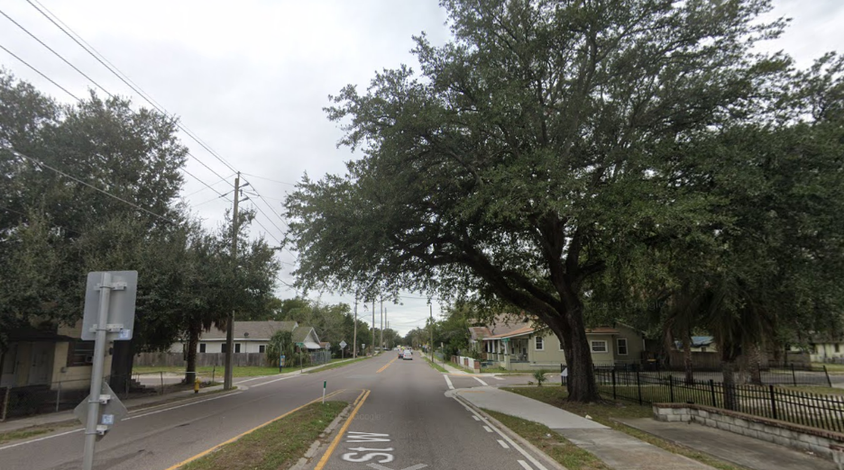
City of Jacksonville v. Foster
41 So. 2d 548 (Fla. 1949)
Notes:
FL Supreme Court
1949 Jacksonville, FL
Martha Foster was driving on 8th St. in a storm. A strong wind blew over a live oak street tree that fell on her car and injured her.
The tree had green leaves, but the roots were rotted, and there was a white fungal growth at the base of the tree.
Jury found for Foster. City appealed.

Slide 4
City of Jacksonville v. Foster
41 So. 2d 548 (Fla. 1949)
Witness testimony:
  Tree had green leaves
  “white fungus growth appeared on the tree at the earth line”, indicating “decay of the root structure”
  “decayed place at the bottom of the trunk which was perceptible before the tree fell”

Slide 5
City of Jacksonville v. Foster
41 So. 2d 548 (Fla. 1949)
“When an evergreen…retains its leaves, although the root system is in fact largely decayed, the danger is genuinely insidious.”
“The condition would not be immediately apparent to passersby…, but could be detected by an inspection because of the telltale fungus”

Slide 6
City of Jacksonville v. Foster
41 So. 2d 548 (Fla. 1949)
“we think an inspection of the trunk near the ground line would have shown it to have become so diseased as to constitute a potential danger”
“the jury reasonably deducted that this condition…had existed for such length of time as to charge the city with awareness of it”

Slide 7
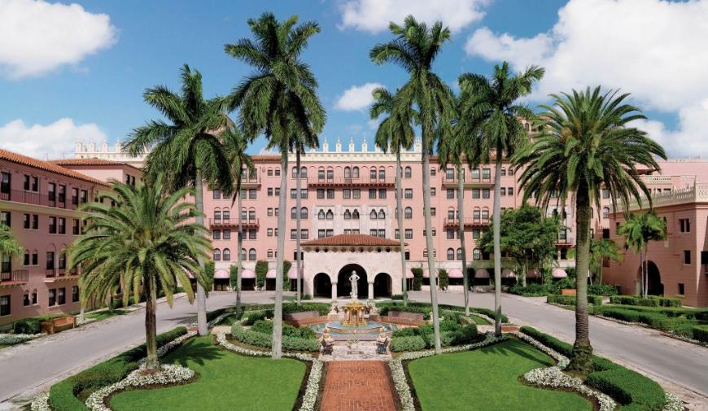
Murphy v. Boca Raton Hotel and Club, LP
745 So. 2d 463 (Fla. 4th DCA 1999)
Notes:
FL 4th District Ct. App.
1999 Boca Raton, FL
Patricia Murphy was a guest at the Boca Raton Hotel and Club
Struck by a falling palm tree frond. The frond was dead and had been dipping below the horizontal plane.
Trial court granted summary judgement for Hotel. Plaintiff appealed.

Slide 8
Murphy v. Boca Raton Hotel and Club, LP
745 So. 2d 463 (Fla. 4th DCA 1999)
Witness testimony:
  “browning fronds dipping below the horizontal plane present an identifiable risk of danger”
  “browning is the result of aging, as is the dipping”

Slide 9
Murphy v. Boca Raton Hotel and Club, LP
745 So. 2d 463 (Fla. 4th DCA 1999)
“Palm fronds may detach and fall from the trees and thereby injure an invitee”
The Hotel may have been on notice of the “dangerous condition”

Slide 10
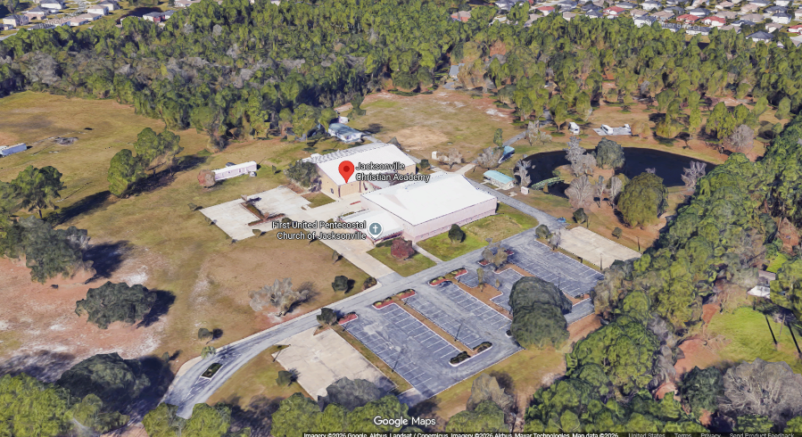
Cassel v. Price
396 So.2d 258 (Fla. 1st DCA 1981)
Notes:
FL 1st District Ct. App.
1981 Jacksonville, FL
Kenneth Regan Cassel was an 11 y/o boy attending Jacksonville Christian Academy (west of Jacksonville, near route 23 and route 228)
After school hours, he climbed a tree on school property and fell, striking his head on a broken piece of a concrete block beneath the tree.
Kenneth died from his injury. The parents sued the trustees of the church.
Trial court granted MSJ for School. Parents appealed.

Slide 11
Cassel v. Price
396 So.2d 258 (Fla. 1st DCA 1981)
“The element of an inherently dangerous factor…is totally absent”
“The consequences of a fall of sufficient height from any tree…can be disastrous…without negligence or fault of any kind”
“it would be…speculation to assume that the…partially covered…pieces of…concrete…had any bearing upon the child’s decision to climb the tree.”

Slide 12
Cassel v. Price
396 So.2d 258 (Fla. 1st DCA 1981)
“To impose upon the landowner the duty to anticipate and guard against the consequences of a falling child striking a hard ground surface…would impose an unreasonable and prohibitively burdensome duty”

Slide 13
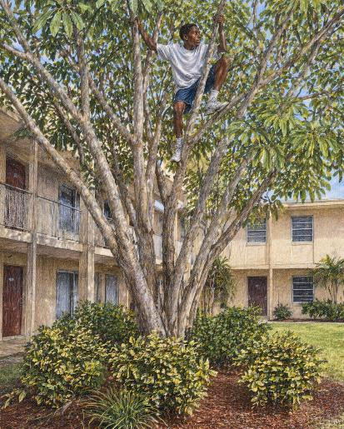
Mazyck v. Caribbean Lawn, Inc.
587 So.2d 573 (Fla. 3rd DCA 1991)
Notes:
FL 3rd District Ct. App.
1991 Dade County, FL
Jamone Williams was a child who lived at a public housing facility.
The landscaping was managed by Caribbean Lawn, Inc.
An umbrella tree on the grounds was adorned with bushes below. The gardener cut the bushes in a way that left a “spear-like protrusion.”
A resident complained to the gardener’s supervisor that children playing ball in the area could get hurt.
Jamone was playing hide-and-seek. He climbed the umbrella tree, fell, and landed on the bush. The bush impaled him, and he died.
Barbara Mazyck, representative of Jamone’s estate, sued Caribbean Lawn.
The trial court granted MSJ for Caribbean Lawn. Jamone’s estate appealed.

Slide 14
Mazyck v. Caribbean Lawn, Inc.
587 So.2d 573 (Fla. 3rd DCA 1991)
“the exact manner in which this accident happened might not have been foreseeable

Slide 15
Mazyck v. Caribbean Lawn, Inc.
587 So.2d 573 (Fla. 3rd DCA 1991)
“the exact manner in which this accident happened might not have been foreseeable, but that is not required in order to impose liability…so long as it was foreseeable that a child might be injured in some way”

Slide 16
Mazyck v. Caribbean Lawn, Inc.
587 So.2d 573 (Fla. 3rd DCA 1991)
“a jury could find that:
  there was a dangerous non-natural condition…
  the defendant refused to correct this dangerous condition when it was specifically called to its attention; and
  it was foreseeable that a child might be injured”

Slide 17
Mazyck v. Caribbean Lawn, Inc.
587 So.2d 573 (Fla. 3rd DCA 1991)
DISSENT:
“If there is no liability for…placing broken concrete blocks under a tree…, I do not see any basis for liability in the instant action.”

Slide 18
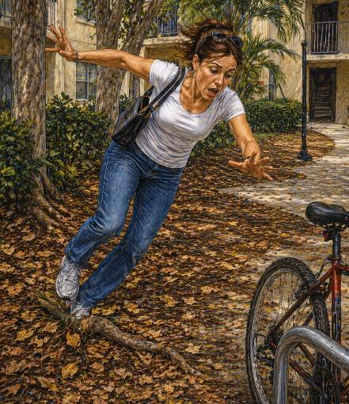
Fieldhouse v. Tam Inv. Co.
959 So.2d 1214 (Fla. 4th DCA 2007)
Notes:
FL 4th District Ct. App.
March 9, 2003 – location not known
Gillian Fieldhouse was a tenant at an apartment complex owned by Tam Investment Company. Leaves from trees at the complex were scattered over the ground.
While walking across the leaf-covered lawn to retrieve her bicycle, Gillian tripped on a tree root concealed beneath the leaves.
Gillian sued Tam Investment Co. The Trial court granted MSJ for Tam. Gilliam appealed.

Slide 19
Fieldhouse v. Tam Inv. Co.
959 So.2d 1214 (Fla. 4th DCA 2007)
Duties owed to invitees:
  Use reasonable care in maintaining the premises; and
  Warn of concealed perils

Slide 20
Fieldhouse v. Tam Inv. Co.
959 So.2d 1214 (Fla. 4th DCA 2007)
“although the open and obvious nature of a hazard may discharge a landowner’s duty to warn, it does not discharge the duty to maintain the property in a reasonably safe condition.”
Whether the “leaves concealed the root on the day of the injury” was a question for the jury

Slide 21
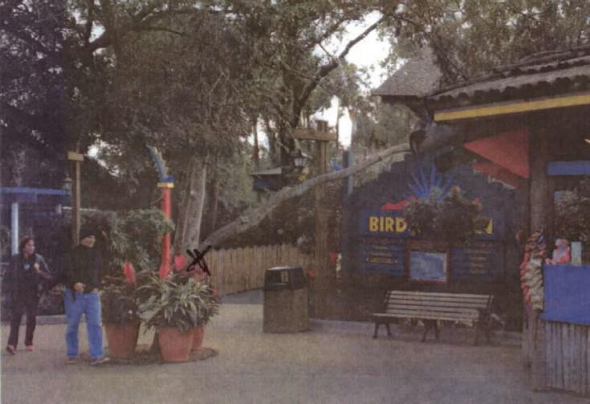
Arnoul v. Busch Entertainment Corp.
2008 WL 4525106 (M.D. Fla. Oct. 6, 2008)
Notes:
US District Court, Middle District of Florida
Bush Gardens Amusement Park, Tampa Bay, FL
December 26, 2006
Frederick Arnoul visited Bush Gardens with his son and granddaughter.
In Bird Garden, a tree branch protruded over a walkway. Mr. Arnoul saw the branch.
But in a momentary lapse of attention, he looked down to respond to his granddaughter and walked headfirst into the branch.
He fell and suffered severe back, spine, and head injuries.
This opinion is from the trial court (granting MSJ for theme park)
https://www.google.com/maps/place/Busch+Gardens+Tampa+Bay/@28.0340355,-82.4249566,3a,75y,189.22h,77.32t/data=!3m7!1e1!3m5!1sip0phLjnU5GiCu2r9A-hlA!2e0!6shttps:%2F%2Fstreetviewpixels-pa.googleapis.com%2Fv1%2Fthumbnail%3Fcb_client%3Dmaps_sv.tactile%26w%3D900%26h%3D600%26pitch%3D12.684419345286443%26panoid%3Dip0phLjnU5GiCu2r9A-hlA%26yaw%3D189.22489132214858!7i13312!8i6656!4m6!3m5!1s0x88c2c64f0d381a85:0xa8a5fe0830e10852!8m2!3d28.037066!4d-82.4194607!16zL20vMDY1cjQ0?entry=ttu&g_ep=EgoyMDI2MDQxNC4wIKXMDSoASAFQAw%3D%3D

Slide 22
Arnoul v. Busch Entertainment Corp.
2008 WL 4525106 (M.D. Fla. Oct. 6, 2008)
Duties owed to invitees:
  Use reasonable care in maintaining the premises; and
  Warn of concealed perils

Slide 23
Arnoul v. Busch Entertainment Corp.
2008 WL 4525106 (M.D. Fla. Oct. 6, 2008)
“A landowner has a duty to make his property reasonably safe”
HOWEVER
“some injury-causing conditions are so open and obvious that they can be held as a matter of law not to give rise to liability as dangerous conditions.”

Slide 24
Arnoul v. Busch Entertainment Corp.
2008 WL 4525106 (M.D. Fla. Oct. 6, 2008)
“There is no premises safe enough to entirely foreclose the risk that a guest might injure himself during an inattentive moment.”
“The Court is not prepared to dispense with the duty of care owed to one’s self”

Slide 25
Arnoul v. Busch Entertainment Corp.
2008 WL 4525106 (M.D. Fla. Oct. 6, 2008)
Notes:
This is what it looked like in 2006

Slide 26
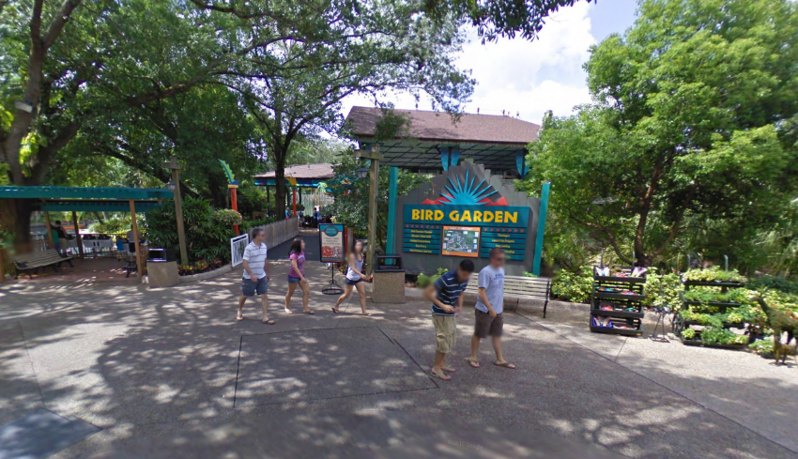
Arnoul v. Busch Entertainment Corp.
2008 WL 4525106 (M.D. Fla. Oct. 6, 2008)
Notes:
The tree ended up being removed anyway.
This image is from 2009.
https://www.google.com/maps/place/Busch+Gardens+Tampa+Bay/@28.0340355,-82.4249566,3a,75y,189.22h,77.32t/data=!3m7!1e1!3m5!1sip0phLjnU5GiCu2r9A-hlA!2e0!6shttps:%2F%2Fstreetviewpixels-pa.googleapis.com%2Fv1%2Fthumbnail%3Fcb_client%3Dmaps_sv.tactile%26w%3D900%26h%3D600%26pitch%3D12.684419345286443%26panoid%3Dip0phLjnU5GiCu2r9A-hlA%26yaw%3D189.22489132214858!7i13312!8i6656!4m6!3m5!1s0x88c2c64f0d381a85:0xa8a5fe0830e10852!8m2!3d28.037066!4d-82.4194607!16zL20vMDY1cjQ0?entry=ttu&g_ep=EgoyMDI2MDQxNC4wIKXMDSoASAFQAw%3D%3D

Slide 27
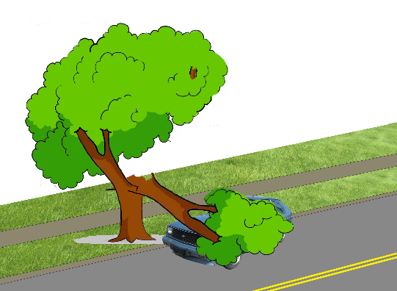
Landowner Liability - Summary
Knowledge
“Dangerous Condition”
Duties to Invitees
  Duty to Maintain
  Duty to Warn

Slide 28
Utility Vegetation Management
Stark v. Holtzclaw, 90 Fla. 207 (1925)
Lopez v. Fla. Power & Light Co., 501 So.2d 1339 (Fla. 3rd DCA 1987)
Marimon v. Florida Power & Light Co., 787 So.2d 887 (Fla. 3rd DCA 2001)
Norris v. Miami, 367 So.2d 1038 (Fla. 3rd DCA 1979)
Braden v. Florida Power and Light Co., 413 So. 2d 1291 (Fla. 5th DCA 1982)
Notes:
5 cases

Slide 29
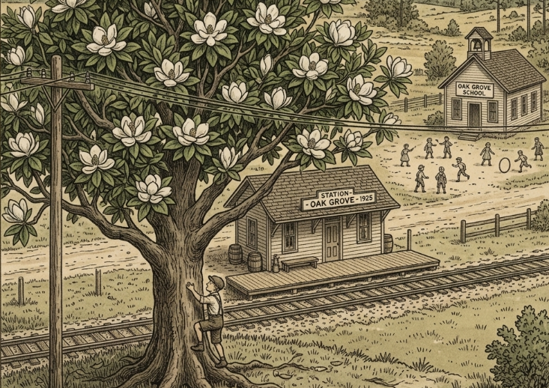
Stark v. Holtzclaw
90 Fla. 207 (1925)
Notes:
FL Supreme Ct.
Escambia County, May 12, 1922
Schoolhouse across the street from a train station.
Across the tracks from the station was a magnolia tree.
Lines owned and managed by the Pensacola Electric Company ran through the canopy.
After school, Frederick Stark, an 8 y/o boy ventured across the road, across the tracks, and trespassed on RR property.
Stark climbed up into the magnolia tree to collect flowers. He contacted the lines and was horribly injured.
Stark’s parents sued J.G. Holtzclaw, the receiver of the Pensacola Electric Company. Trial court sustained demurrer. Starks appealed.

Slide 30
Stark v. Holtzclaw
90 Fla. 207 (1925)
“One is held responsible for all the consequences of his acts which are natural and probable, and ought to have been foreseen by a reasonably prudent man.”
“But even where the highest degree of care is demanded, still the one from whom it is due is bound to guard only against those occurrences which can reasonably be anticipated by the utmost foresight.”

Slide 31
Stark v. Holtzclaw
90 Fla. 207 (1925)
“if men went about to guard themselves against every risk to themselves or others which might by ingenious conjecture be conceived as possible, human affairs could not be carried on at all.”

Slide 32
Stark v. Holtzclaw
90 Fla. 207 (1925)
HOWEVER
“the tree was…near a railway station and a schoolhouse where children played, and [the utility company] should have foreseen…that boys of venturesome dispositions…would be apt to climb [it]”

Slide 33
Stark v. Holtzclaw
90 Fla. 207 (1925)
CONCUR
The tree itself was not a nuisance
Stringing wires through the tree made it a nuisance

Slide 34
Stark v. Holtzclaw
90 Fla. 207 (1925)
DISSENT
“white it may be a boyish instinct to climb trees and rob bird nests, I am not prepared to say it is a boyish instinct to climb trees for the purpose of gathering flowers. Boys rather affect a contempt and distain for such girlish trophies.”

Slide 35
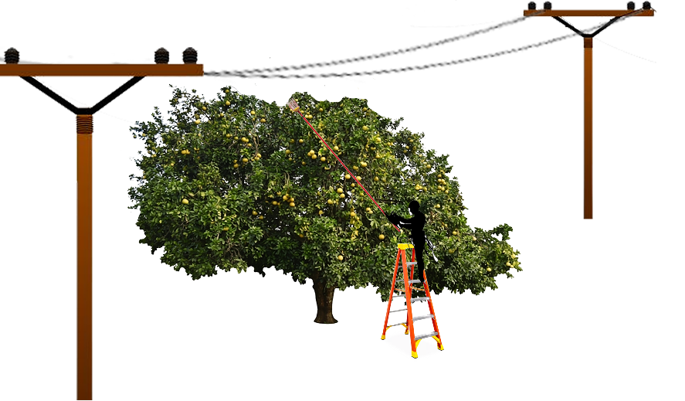
Lopez v. Fla. Power & Light Co.
501 So.2d 1339 (Fla. 3rd DCA 1987)
Notes:
FL 3rd Dist. Ct. App.
1987 in Southern Florida
Fruit tree in the backyard of Lucio Pablo Lopez. Electric lines owned and managed by FPL ran over the tree. FPL had recently pruned the tree so the branches were 3-5 feet clear of the lines.
Lopez fashioned a “16-foot metal picker of his own invention” and climbed a 6-ft stepladder.
Lopez’s picker made contact with the lines, and he was electrocuted and killed.
The estate of Lopez sued FPL and Asplundh (tree service). A jury found for Lopez. The trial judge granted JNOV and held for FPL and Asplundh. Estate appealed.

Slide 36
Lopez v. Fla. Power & Light Co.
501 So.2d 1339 (Fla. 3rd DCA 1987)
“An electric company [must] do all that human care, vigilance, and foresight can reasonably do…to protect those who use its electricity, but it is not an insurer against all possible accidents”

Slide 37
Lopez v. Fla. Power & Light Co.
501 So.2d 1339 (Fla. 3rd DCA 1987)
“Acts which cause injury but are foreseeable only as remote possibilities…are beyond the limit of legal liability.”
“The inherent danger of electrically energized wires is well known to all except those of tenderest age”
“The hazards of electrical wires should have been manifest to him.”

Slide 38
Lopez v. Fla. Power & Light Co.
501 So.2d 1339 (Fla. 3rd DCA 1987)
DISSENT
“The jury could…properly find that the power company negligently maintained its…wire in a position of foreseeable danger, too close to the tree.”

Slide 39
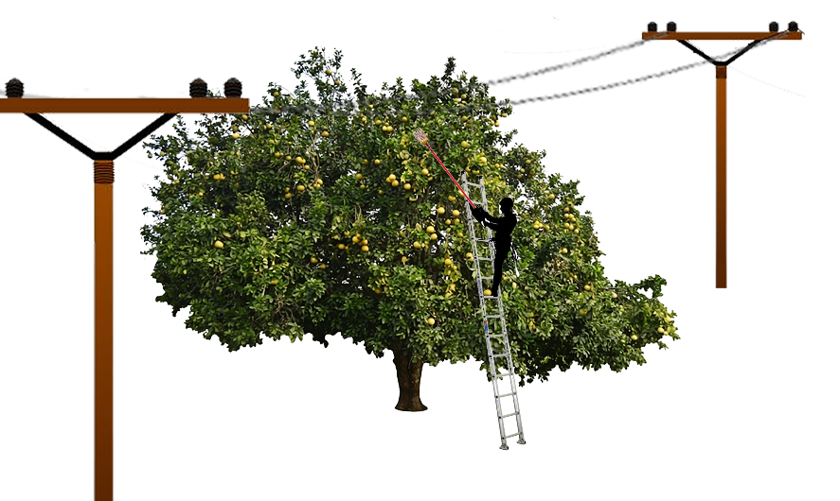
Marimon v. Florida Power & Light Co.
787 So.2d 887 (Fla. 3rd DCA 2001)
Notes:
FL 3rd District Ct. App.
December 17, 1994
Miami-Dade County
Leosbel Marimon, a 17 y/o young man was invited by Juan Martinez to pick fruit from a neighbor’s tree
The tree was owned by Antoine St. Victor.
St. Victor’s girlfriend happily gave Marimon and Martinez permission to pick fruit “anytime they wished.”
Electric wires ran through the canopy of the tree. Lines were not visible from BENEATH the tree, but they could be seen entering and exiting the canopy.
Marimon climbed a 14-ft extension ladder and used an aluminum pole to pick fruit.
Marimon was shocked and killed by either a branch or his pole touching the lines.
Estate of Marimon sued both the landowner and FPL. Trial court granted MSJ for both defendants. Estate appealed.

Slide 40
Marimon v. Florida Power & Light Co.
787 So.2d 887 (Fla. 3rd DCA 2001)
Public Invitee: enters by invitation
  Duty to inform of concealed perils that landowner should know about
Uninvited Licensee: enters for own convenience without invitation
  Duty to inform of concealed perils that landowner knows about

Slide 41
Marimon v. Florida Power & Light Co.
787 So.2d 887 (Fla. 3rd DCA 2001)
“Undisputed that [they were] invited…to pick [fruit] at any time he wished. Thus, [they] were invitees.”

Slide 42
Marimon v. Florida Power & Light Co.
787 So.2d 887 (Fla. 3rd DCA 2001)
“Marimon’s comparative negligence does not totally absolve FPL of liability if it did not properly maintain its lines.”
“The fact that it may be difficult for [the estate] to prevail…does not mean that [it’s impossible.]”

Slide 43
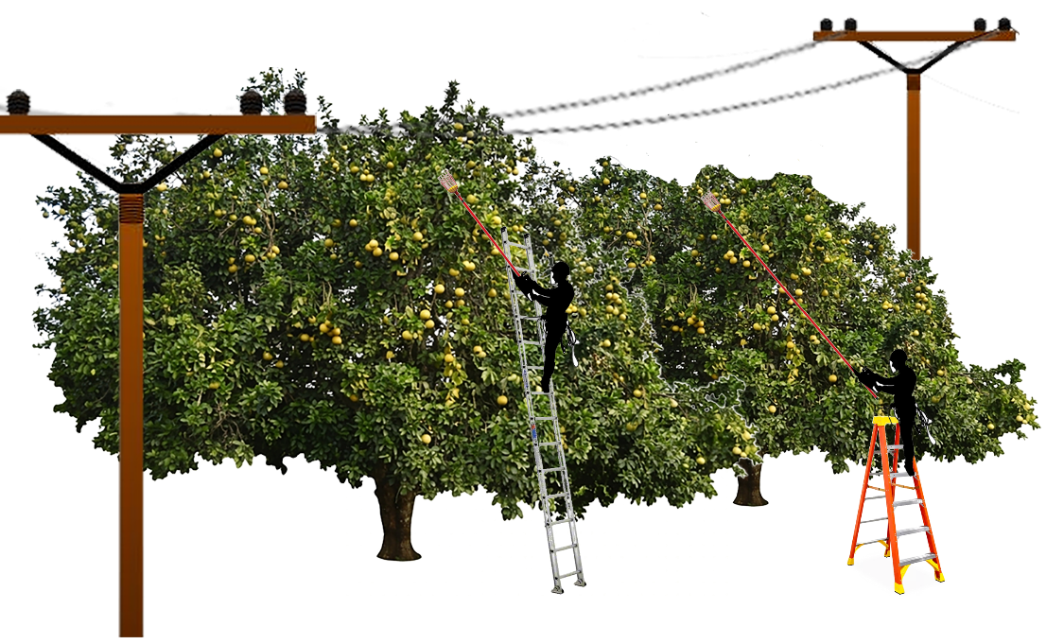
Marimon
Lopez

Slide 44
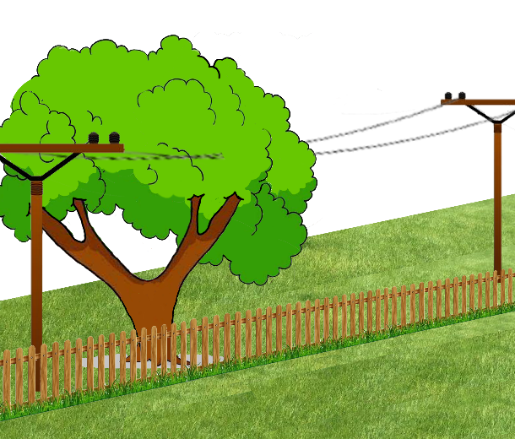
Norris v. Miami
367 So.2d 1038 (Fla. 3rd DCA 1979)
Notes:
FL 3rd Dist. Ct. App.
1979 Miami, FL
Florida Power & Light owned electrical lines through canopy of tree on property owned by City. A portion of the tree’s canopy overhung land owned by Homeowner.
Homeowner hired Norris to prune the overhang.
Norris knew a permit was required, but did not obtain one.
Norris climbed over a fence to access the tree.
Then Plaintiff cut a branch and was shocked.
MSJ for both Utility and City, Plaintiff was a trespasser
Affirmed for City. Plaintiff was a trespasser.
Reversed for Utility. Utility didn’t own the land or the tree; it just owned the lines. People climbing trees is foreseeable, regardless of their legal status in relation to the property owner. Utility owed a duty to protect tree climbers from injury by its electrical lines. REMAND.

Slide 45
Norris v. Miami
367 So.2d 1038 (Fla. 3rd DCA 1979)
“[Norris] was clearly a trespasser as to the City of Miami.”
“…City owed no greater duty than to avoid wilful and wanton conduct toward him”

Slide 46
Norris v. Miami
367 So.2d 1038 (Fla. 3rd DCA 1979)
HOWEVER
“…as long as [FPL] could have reasonably anticipated [Norris’s] presence on the City of Miami right of way, its duty to [Norris] was as great as must be exercised by an electric company to the general public.”

Slide 47
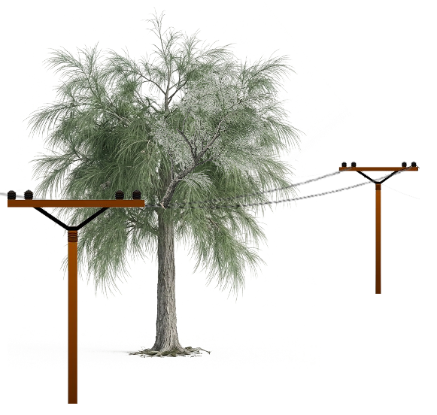
Braden v. Florida Power and Light Co.
413 So. 2d 1291 (Fla. 5th DCA 1982)
Notes:
FL 5th Dist. Ct. App.
1982, Central Florida
Some Australian pines were growing on private property adjacent to power lines owned and managed by FPL.
Steve Sharek was hired to remove the trees.
Steve’s father Albert came to watch, and Albert brought his grandson Randy Braden.
One of the trees had a wasp nest on it. Albert gave Randy a jelly jar fully of gasoline, and told him to pour it on the nest after the tree was felled.
When the tree was cut, it landed on the power line and broke it. The severed line did not de-energize. A spark from the severed line lit the gasoline and horribly burned Randy.
Upon inspection, the FPL line had previously broken and had been incorrectly spliced together.
Braden’s parents sued FPL. Trial court granted MSJ for FPL. Parents appealed.

Slide 48
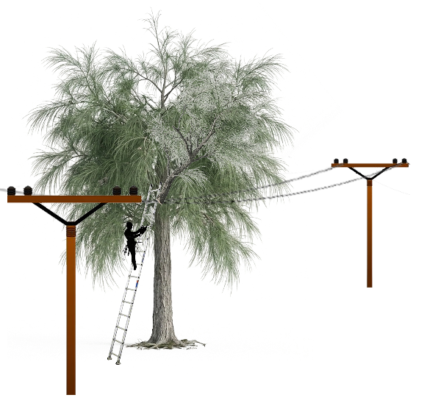
Braden v. Florida Power and Light Co.
413 So. 2d 1291 (Fla. 5th DCA 1982)
Notes:
FL 5th Dist. Ct. App.
1982, Central Florida
Some Australian pines were growing on private property adjacent to power lines owned and managed by FPL.
Steve Sharek was hired to remove the trees.
Steve’s father Albert came to watch, and Albert brought his grandson Randy Braden.
One of the trees had a wasp nest on it. Albert gave Randy a jelly jar fully of gasoline, and told him to pour it on the nest after the tree was felled.
When the tree was cut, it landed on the power line and broke it. The severed line did not de-energize. A spark from the severed line lit the gasoline and horribly burned Randy.
Upon inspection, the FPL line had previously broken and had been incorrectly spliced together.
Braden’s parents sued FPL. Trial court granted MSJ for FPL. Parents appealed.

Slide 49
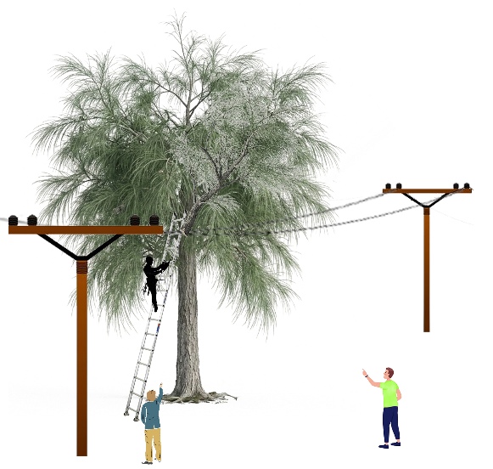
Braden v. Florida Power and Light Co.
413 So. 2d 1291 (Fla. 5th DCA 1982)
Notes:
FL 5th Dist. Ct. App.
1982, Central Florida
Some Australian pines were growing on private property adjacent to power lines owned and managed by FPL.
Steve Sharek was hired to remove the trees.
Steve’s father Albert came to watch, and Albert brought his grandson Randy Braden.
One of the trees had a wasp nest on it. Albert gave Randy a jelly jar fully of gasoline, and told him to pour it on the nest after the tree was felled.
When the tree was cut, it landed on the power line and broke it. The severed line did not de-energize. A spark from the severed line lit the gasoline and horribly burned Randy.
Upon inspection, the FPL line had previously broken and had been incorrectly spliced together.
Braden’s parents sued FPL. Trial court granted MSJ for FPL. Parents appealed.

Slide 50
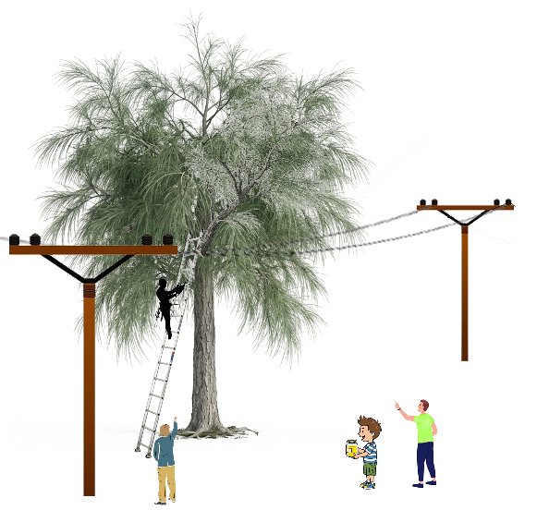
Braden v. Florida Power and Light Co.
413 So. 2d 1291 (Fla. 5th DCA 1982)
Notes:
FL 5th Dist. Ct. App.
1982, Central Florida
Some Australian pines were growing on private property adjacent to power lines owned and managed by FPL.
Steve Sharek was hired to remove the trees.
Steve’s father Albert came to watch, and Albert brought his grandson Randy Braden.
One of the trees had a wasp nest on it. Albert gave Randy a jelly jar fully of gasoline, and told him to pour it on the nest after the tree was felled.
When the tree was cut, it landed on the power line and broke it. The severed line did not de-energize. A spark from the severed line lit the gasoline and horribly burned Randy.
Upon inspection, the FPL line had previously broken and had been incorrectly spliced together.
Braden’s parents sued FPL. Trial court granted MSJ for FPL. Parents appealed.

Slide 51
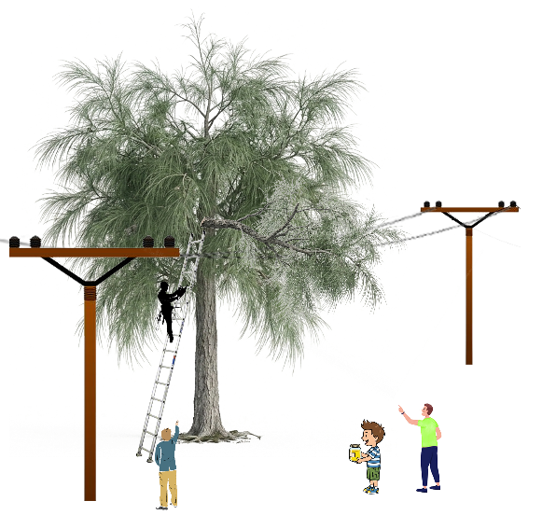
Braden v. Florida Power and Light Co.
413 So. 2d 1291 (Fla. 5th DCA 1982)
Notes:
FL 5th Dist. Ct. App.
1982, Central Florida
Some Australian pines were growing on private property adjacent to power lines owned and managed by FPL.
Steve Sharek was hired to remove the trees.
Steve’s father Albert came to watch, and Albert brought his grandson Randy Braden.
One of the trees had a wasp nest on it. Albert gave Randy a jelly jar fully of gasoline, and told him to pour it on the nest after the tree was felled.
When the tree was cut, it landed on the power line and broke it. The severed line did not de-energize. A spark from the severed line lit the gasoline and horribly burned Randy.
Upon inspection, the FPL line had previously broken and had been incorrectly spliced together.
Braden’s parents sued FPL. Trial court granted MSJ for FPL. Parents appealed.

Slide 52
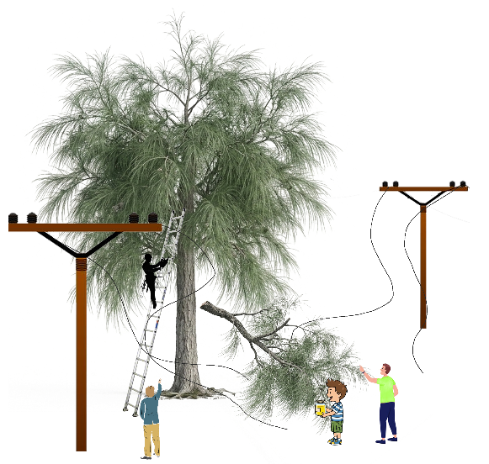
Braden v. Florida Power and Light Co.
413 So. 2d 1291 (Fla. 5th DCA 1982)
Notes:
FL 5th Dist. Ct. App.
1982, Central Florida
Some Australian pines were growing on private property adjacent to power lines owned and managed by FPL.
Steve Sharek was hired to remove the trees.
Steve’s father Albert came to watch, and Albert brought his grandson Randy Braden.
One of the trees had a wasp nest on it. Albert gave Randy a jelly jar fully of gasoline, and told him to pour it on the nest after the tree was felled.
When the tree was cut, it landed on the power line and broke it. The severed line did not de-energize. A spark from the severed line lit the gasoline and horribly burned Randy.
Upon inspection, the FPL line had previously broken and had been incorrectly spliced together.
Braden’s parents sued FPL. Trial court granted MSJ for FPL. Parents appealed.

Slide 53
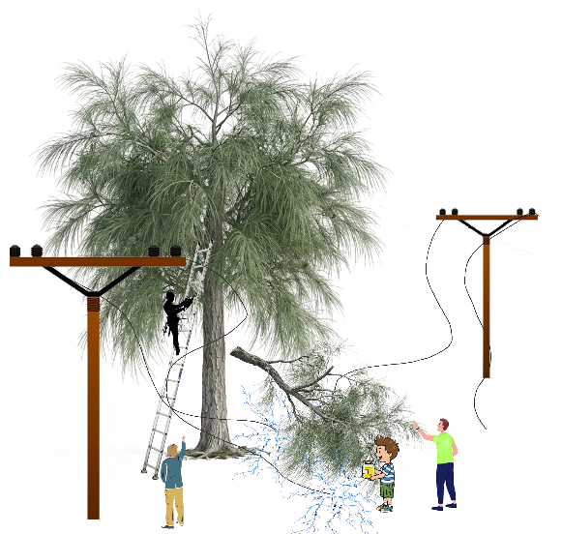
Braden v. Florida Power and Light Co.
413 So. 2d 1291 (Fla. 5th DCA 1982)
Notes:
FL 5th Dist. Ct. App.
1982, Central Florida
Some Australian pines were growing on private property adjacent to power lines owned and managed by FPL.
Steve Sharek was hired to remove the trees.
Steve’s father Albert came to watch, and Albert brought his grandson Randy Braden.
One of the trees had a wasp nest on it. Albert gave Randy a jelly jar fully of gasoline, and told him to pour it on the nest after the tree was felled.
When the tree was cut, it landed on the power line and broke it. The severed line did not de-energize. A spark from the severed line lit the gasoline and horribly burned Randy.
Upon inspection, the FPL line had previously broken and had been incorrectly spliced together.
Braden’s parents sued FPL. Trial court granted MSJ for FPL. Parents appealed.

Slide 54
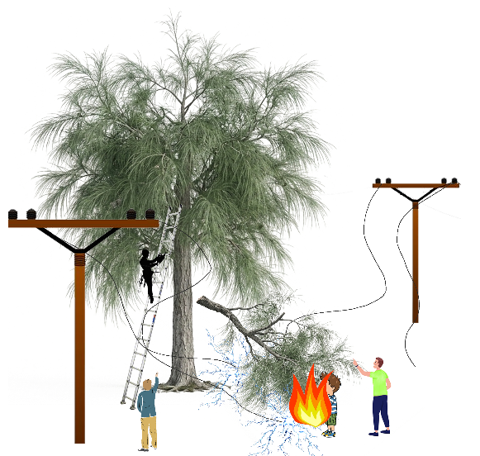
Braden v. Florida Power and Light Co.
413 So. 2d 1291 (Fla. 5th DCA 1982)
Notes:
FL 5th Dist. Ct. App.
1982, Central Florida
Some Australian pines were growing on private property adjacent to power lines owned and managed by FPL.
Steve Sharek was hired to remove the trees.
Steve’s father Albert came to watch, and Albert brought his grandson Randy Braden.
One of the trees had a wasp nest on it. Albert gave Randy a jelly jar fully of gasoline, and told him to pour it on the nest after the tree was felled.
When the tree was cut, it landed on the power line and broke it. The severed line did not de-energize. A spark from the severed line lit the gasoline and horribly burned Randy.
Upon inspection, the FPL line had previously broken and had been incorrectly spliced together.
Braden’s parents sued FPL. Trial court granted MSJ for FPL. Parents appealed.

Slide 55
Braden v. Florida Power and Light Co.
413 So. 2d 1291 (Fla. 5th DCA 1982)
“If the harm that occurs is within the scope of danger created by the defendant’s negligent conduct, then such harm is a reasonably foreseeable consequence of the negligence.”

Slide 56
Braden v. Florida Power and Light Co.
413 So. 2d 1291 (Fla. 5th DCA 1982)
“it is not unforeseeable that something, such as a falling tree, would cause [FPL’s] negligent splice to break”
“it is not unlikely that the discharge would set something nearby on fire”
“it is not unforeseeable that someone…would be burned”
“the question of foreseeability should have been resolved by a jury.”

Slide 57
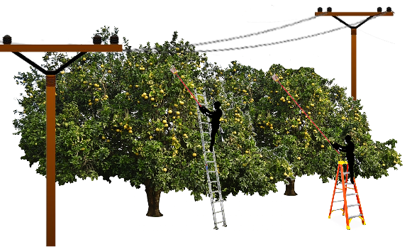
UVM - Summary
Foreseeability
Comparative Negligence
Invitee vs. Trespasser

Slide 58
Valuation
Watson v. Jones, 160 Fla. 819 (1949)
Elowsky v. Gulf Power Co., 172 So.2d 643 (Fla. 1st DCA 1965)
Ragland v. Clarson, 259 So.2d 757 (Fla. 1st DCA 1972)
Clark v. J.W. Conner & Sons, Inc., 441 So.2d 674 (Fla. 2nd DCA 1983)
Notes:
4 cases

Slide 59
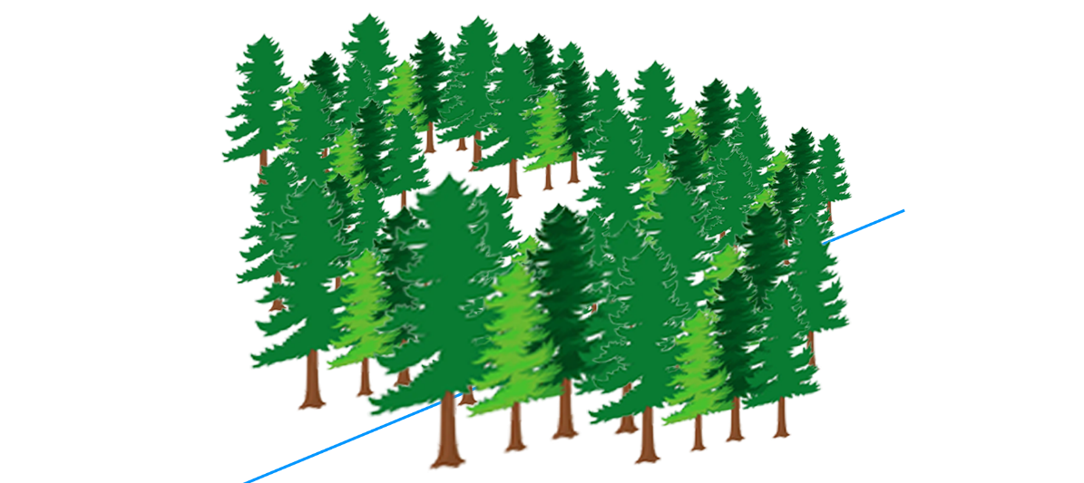
Watson v. Jones
160 Fla. 819 (1949)
Notes:
FL Supreme Ct.
1948, Hillsborough County, FL
Leo and Helen Jones purchased a forested tract of land they intended to use as a “tourist camp.” They valued the trees for their shade.
Tree cutters employed by Cleo and Nettie Watson trespassed and cut down 97 pine trees on the Jones property.
Watson presented evidence that the HBU of the property was timber, and offered small amount of money for value of trees as logs.
Jones presented evidence that the value of the trees for the intended use was much higher.
Jury found for Jones and awarded a very large amount. Trial court entered remittitur for a *still pretty large* amount. Watson appealed.

Slide 60
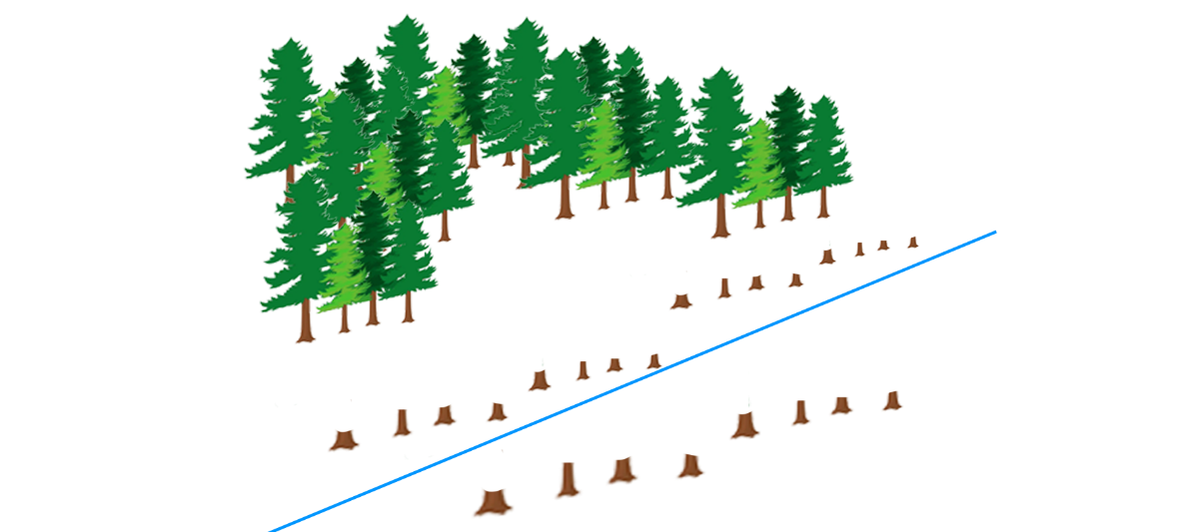
Watson v. Jones
160 Fla. 819 (1949)
Notes:
FL Supreme Ct.
1948, Hillsborough County, FL
Leo and Helen Jones purchased a forested tract of land they intended to use as a “tourist camp.” They valued the trees for their shade.
Tree cutters employed by Cleo and Nettie Watson trespassed and cut down 97 pine trees on the Jones property.
Watson presented evidence that the HBU of the property was timber, and offered small amount of money for value of trees as logs.
Jones presented evidence that the value of the trees for the intended use was much higher.
Jury found for Jones and awarded a very large amount. Trial court entered remittitur for a *still pretty large* amount. Watson appealed.

Slide 61
Watson v. Jones
160 Fla. 819 (1949)
“the measure of damages for the destruction of shade, ornamental, or fruit trees, is the difference in the value of the land before and after their destruction”
“…construed or extended to allow recovery for” their “contemplated use…for a particular purpose”

Slide 62
Watson v. Jones
160 Fla. 819 (1949)
“The owner of property has a right to hold it for his own use as well as to hold it for sale, and if he has elected the former he should be compensated for an injury wrongfully done him in that respect, although that injury might be unappreciable to one holding the same premises for purposes of sale”

Slide 63
Watson v. Jones
160 Fla. 819 (1949)
“The owner of property has a right to hold it for his own use as well as to hold it for sale, and if he has elected the former he should be compensated for an injury wrongfully done him in that respect, although that injury might be unappreciable to one holding the same premises for purposes of sale”

Slide 64
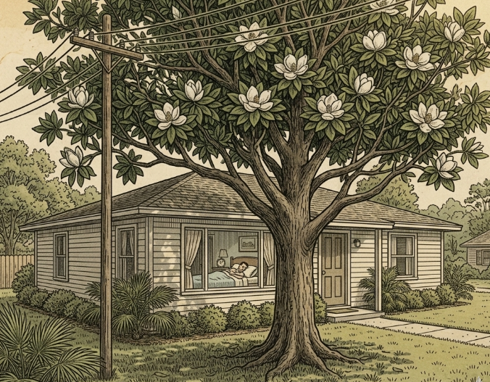
Elowsky v. Gulf Power Co.
172 So.2d 643 (Fla. 1st DCA 1965)
Notes:
FL 1st Dist. Ct. App.
August 20, 1962
James Elowsky owned a home in the panhandle of Florida. A large tree shaded the southwestern corner of his home from the afternoon sun.
Power lines owned by Gulf Power Company were strung nearby.
Elowsky worked a night shift and slept during the day. The tree kept his house cool and dark in the afternoon so he could sleep.
At the direction of Gulf Power, Matthews Tree Surgery cut down Elowsky’s tree.
Elowsky sued. Evidence showed that his property decreased in value by $200.
Jury returned a verdict for $500. Trial court ordered a remittitur to $200. Elowsky appealed.

Slide 65
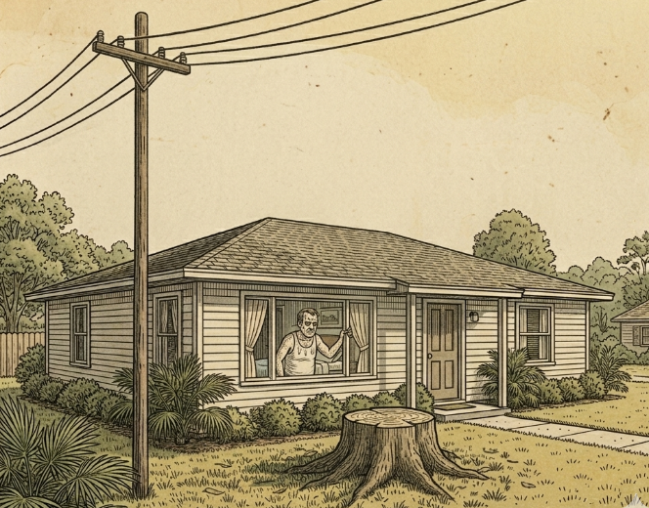
Elowsky v. Gulf Power Co.
172 So.2d 643 (Fla. 1st DCA 1965)
Notes:
FL 1st Dist. Ct. App.
August 20, 1962
James Elowsky owned a home in the panhandle of Florida. A large tree shaded the southwestern corner of his home from the afternoon sun.
Power lines owned by Gulf Power Company were strung nearby.
Elowsky worked a night shift and slept during the day. The tree kept his house cool and dark in the afternoon so he could sleep.
At the direction of Gulf Power, Matthews Tree Surgery cut down Elowsky’s tree.
Elowsky sued. Evidence showed that his property decreased in value by $200.
Jury returned a verdict for $500. Trial court ordered a remittitur to $200. Elowsky appealed.

Slide 66
Elowsky v. Gulf Power Co.
172 So.2d 643 (Fla. 1st DCA 1965)
“We are here concerned not only with the reduction in value of the land resulting from removal of the tree, but also with the loss of the ornamental value and the creature comforts provided by the tree”

Slide 67
Elowsky v. Gulf Power Co.
172 So.2d 643 (Fla. 1st DCA 1965)
“the rule of damages adopted should be such as to more carefully guard against failure of compensation…than against possible overcharge upon the wrongdoer.”

Slide 68
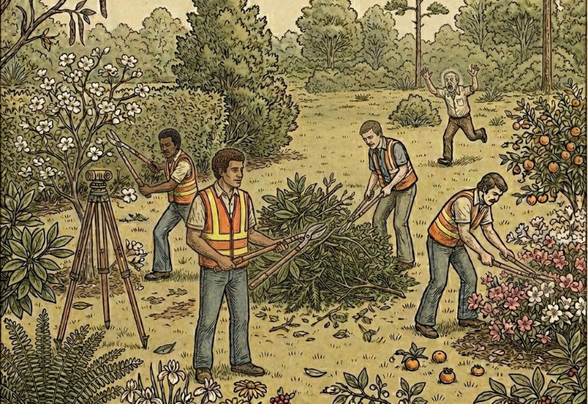
Ragland v. Clarson
259 So.2d 757 (Fla. 1st DCA 1972)
Notes:
FL 1st Dist. Ct. App.
1969 Duval County
Robert Ragland had been caring for “Grandma’s Farm” for the past 20 years. He had planted a wide variety of trees, plants, and shrubs from 1965-1969 and kept careful records of his plantings.
His diary of plantings included: dogwood, magnolia, cherry laurel, redbud, myrtle, cedar, crab apple, peaches, plums, persimmons, a collection of azaleas, maidenhair fern, atamasco lilies, columbine, phlox, nandina, brown-eyed Susans, mountain laurel, white fringed orchid, Cherokee roses, red bay, and silver bell.
He had also planted 19,500 slash pines, 2,500 longleaf pines, 750 cedars, 1,000 spruce pines, and 500 Arizona cypress.
In January of 1969, the Duval County School Board decided to appropriate a portion of “Grandma’s Farm” for a school site through eminent domain.
As part of the process, the school board hired Richard P. Clarson and Associates to survey Ragland’s property.
Ragland’s attorney wrote to Clarson and reminded him that while a surveyor may have the right to enter Ragland’s land, he doesn’t have the right to destroy anything without written permission.
Nevertheless, Clarson instructed his crew to cut trees and plants that interfered with the data collection process.
Ragland sued for “deprivation of convenience, comfort, and enjoyment” and the “replacement value” of each plant.
Jury returned a verdict for Clarson. Ragland appealed.

Slide 69
Ragland v. Clarson
259 So.2d 757 (Fla. 1st DCA 1972)
No “replacement value” evidence allowed
HOWEVER
“Ragland’s damages were clearly sought for deprivation of his convenience, comfort and enjoyment of the subject parcel.”
“The evidence was not in dispute that [Clarson] deprived [Ragland] of his convenience and comfort”

Slide 70
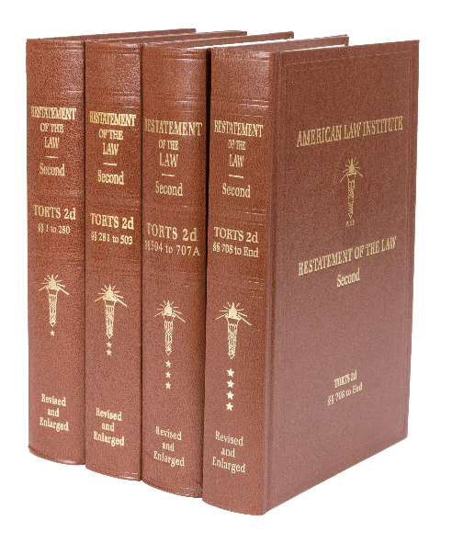
Restatement of the Law of Torts, 2d.

Slide 71
R2D Torts §929(1)
If one is entitled to a judgment for harm to land resulting from a past invasion and not amounting to a total destruction of value, the damages include compensation for:
  the difference between the value of the land before the harm and the value after the harm, or at his election in an appropriate case, the cost of restoration that has been or may be reasonably incurred,
  the loss of use of the land, and
  discomfort and annoyance to him as an occupant.

Slide 72
R2D Torts §929(1)
If one is entitled to a judgment for harm to land resulting from a past invasion and not amounting to a total destruction of value, the damages include compensation for:
  the difference between the value of the land before the harm and the value after the harm, or at his election in an appropriate case, the cost of restoration that has been or may be reasonably incurred,
  the loss of use of the land, and
  discomfort and annoyance to him as an occupant.

Slide 73
R2D Torts §929 cmt. b
“If…the cost of replacing the land in its original condition is disproportionate to the diminution in the value of the land...,
unless there is a reason personal to the owner for restoring the original condition,
damages are measured only by the [diminution in the value of the land].”

Slide 74
R2D Torts §929 cmt. b
“If…the cost of replacing the land in its original condition is disproportionate to the diminution in the value of the land...,
unless there is a reason personal to the owner for restoring the original condition,
damages are measured only by the [diminution in the value of the land].”

Slide 75
R2D Torts §929 Analysis
Restoration Cost vs. Diminution in Value
“Reason Personal”
“Reasonably Incurred” vs. “Disproportionate”

Slide 76
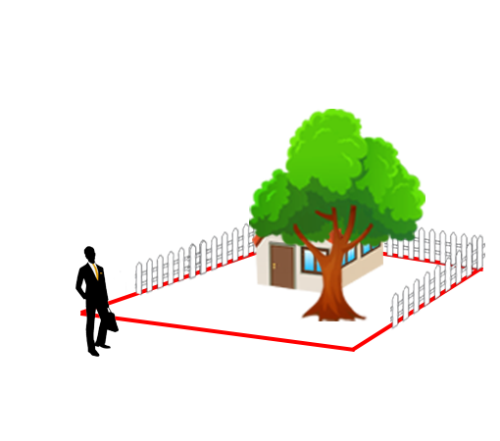
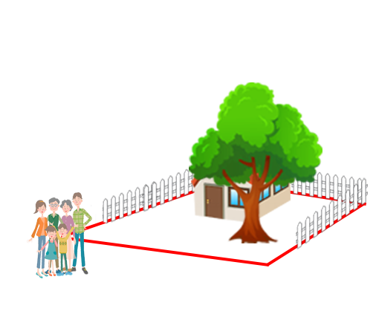
“Reason Personal”

Slide 77
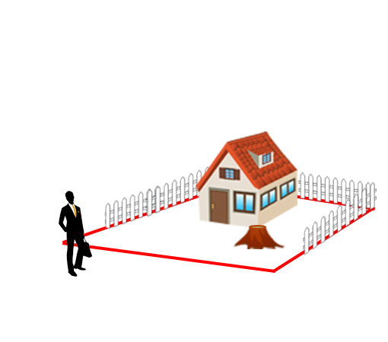
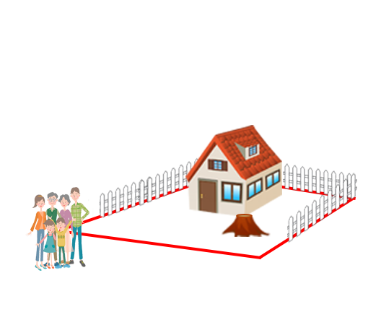
“Reason Personal”

Slide 78
“Reason Personal”
No “Reason Personal”

Slide 79
“Reason Personal”
No “Reason Personal”
“Reason Personal”

Slide 80
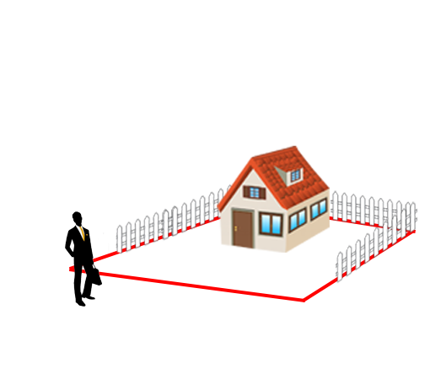
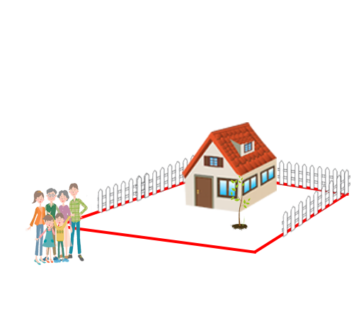
“Reason Personal”
No “Reason Personal”
“Reason Personal”

Slide 81
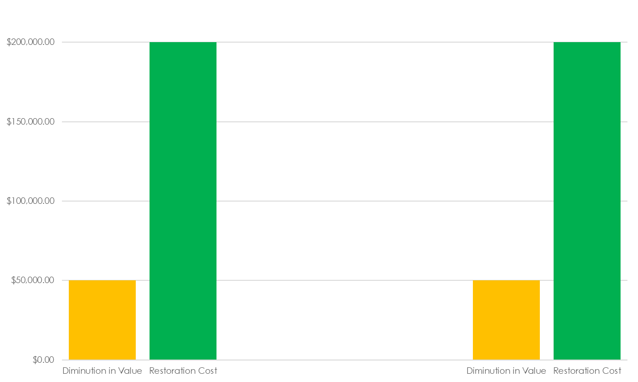
“Reason Personal”
No “Reason Personal”
“Reason Personal”

Slide 82
“Reason Personal”
No “Reason Personal”
“Reason Personal”
Max Award

Slide 83
“Reason Personal”
No “Reason Personal”
“Reason Personal”
Possible
Award
Max Award

Slide 84

Clark v. J.W. Conner & Sons, Inc.
441 So.2d 674 (Fla. 2nd DCA 1983)
Notes:
FL 2nd Dist. Ct. App.
1979, Hillsborough County, FL
Earnest and Katherine Clark owned 8 acres of undeveloped property. They intended to build residential duplexes on the land and had hired an architect and surveyor.
J.W. Conner & Sons was a contractor working on construction of the Crosstown Expressway.
Clarks’ neighbor gave permission for JW Connor & Sons to use their property for access. By mistake, JW Connor & Sons used Clark’s property instead, removing many trees.
From 1979 to 1981, the Clarks knew about the construction activity, but didn’t realize it was taking place on their land until 1981.
Clarks sued J.W. Connor & Sons. Clarks presented evidence of cleanup costs, but trial court refused to allow Clarks to present “tree value” evidence. Clarks did not present change in market value evidence.
Clarks and J.W. Connor consented to judgment for cleanup costs, subject to the right to appeal. Clarks appealed.

Slide 85
Clark v. J.W. Conner & Sons, Inc.
441 So.2d 674 (Fla. 2nd DCA 1983)
“As a general rule, the measure of damages…is the difference between the value of the land before and after the injury.”
“Where the reduction in market value is an inadequate measure, recovery has been allowed for losses personal to the owner.”

Slide 86
Clark v. J.W. Conner & Sons, Inc.
441 So.2d 674 (Fla. 2nd DCA 1983)
HOWEVER
“We do not believe [construction of residential duplexes] is the kind of personal interest in land which would authorize the recovery of replacement value.”

Slide 87
Clark v. J.W. Conner & Sons, Inc.
441 So.2d 674 (Fla. 2nd DCA 1983)
“The Clarks introduced no evidence whatsoever concerning the value of the land before and after the trespass.”
“Even [cleanup costs] should have been recovered as a part of the loss of market value.”

Slide 88

Valuation - Summary
R2D Torts §929
  Change in Value
  Loss of Use
  Convenience and Comfort
  Replacement Cost

Slide 89
Tree Regulation
Graham v. Estuary Properties, Inc., 399 So. 2d 1374 (Fla. 1981)
Vatalaro v. Dept. of Env. Reg., 601 So.2d 1223 (Fla. 5th DCA 1992)
Pinellas County v. Jasmine Plaza, Inc., 334 So. 2d 639 (Fla. 2nd DCA 1976)
Watson v. City of St. Petersburg, 489 So. 2d 138 (Fla. 2nd DCA 1986)
Notes:
5 cases

Slide 90
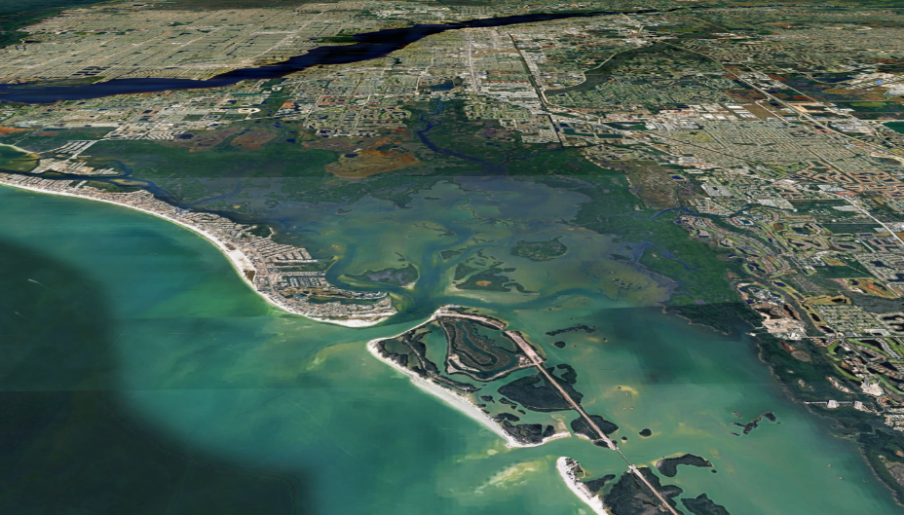
Graham v. Estuary Properties, Inc.
399 So. 2d 1374 (Fla. 1981)
Notes:
FL Supreme Ct.
Estuary Properties owned 6,500 acres of coastal land in Lee county near Ft. Meyers, including substantial wetlands. Only ~526 acres are non-wetlands.
Estuary planned to develop: 26,500 dwelling units, 11 commercial centers, 4 marinas, 5 boat basins, 3 golf courses, and 28 acres of tennis facilities
It planned to preserve 2,800 acres of red mangroves, but it would require demolition of 1,800 acres of black mangroves
Southwest Florida Regional Planning Council recommended denial of the project due to adverse impact of project on fishing industries from tree removal.
Alternative plans would cut the developable area by about half.
The Land and Water Adjudicatory Commission adopted the recommendations and denied the permit.
Estuary appealed in the District Court of Appeal. The DCA reversed, instructing the Commission to permit the development plan.
Lee County and the Commission appealed to the Supreme Court.

Slide 91
Graham v. Estuary Properties, Inc.
399 So. 2d 1374 (Fla. 1981)
“Protection of environmentally sensitive areas and pollution prevention are legitimate concerns within the police power.”
“The owner of private property is not entitled to the highest and best use of his property if that use will create a public harm.”

Slide 92
Graham v. Estuary Properties, Inc.
399 So. 2d 1374 (Fla. 1981)
“the public benefits in that the bays will remain clean
BUT
that is a benefit in the form of maintaining the status quo. Estuary is not being required to change its development plan so that public waterways will be improved.”

Slide 93
Graham v. Estuary Properties, Inc.
399 So. 2d 1374 (Fla. 1981)
“Simply because [development] would increase the value of the property does not mean that disallowing it constitutes a taking.”
“Nor is a taking established merely because Estuary may be allowed to build a development only half the size of its original proposal.”
“The instant reduction is a valid exercise of the police power.”

Slide 94
Graham v. Estuary Properties, Inc.
399 So. 2d 1374 (Fla. 1981)
DISSENT
“Government action other than acquisition of title…can be a ‘taking’…where the effects completely deprive the owner of all or most of his interest in the property.”
“Lee County…[has] a right to preserve these mangrove forests

Slide 95
Graham v. Estuary Properties, Inc.
399 So. 2d 1374 (Fla. 1981)
DISSENT
“Government action other than acquisition of title…can be a ‘taking’…where the effects completely deprive the owner of all or most of his interest in the property.”
“Lee County…[has] a right to preserve these mangrove forests, as long as the property owner is compensated.”

Slide 96
Graham v. Estuary Properties, Inc.
399 So. 2d 1374 (Fla. 1981)
DISSENT
“The right of an individual to own and enjoy property was one of the foundation stones on which our government was formed. As government grows the individual property rights diminish, for we focus our attention on the welfare of the majority at the expense, and ultimate destruction, of the property owner. If one foundation stone crumbles, our form of government will fall.”

Slide 97
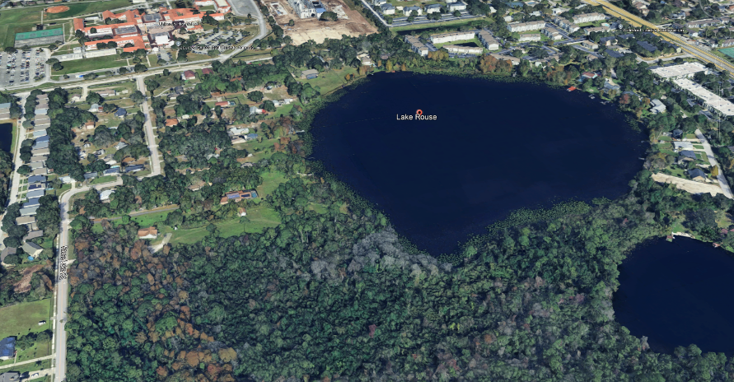
Vatalaro v. Dept. of Env. Reg.
601 So.2d 1223 (Fla. 5th DCA 1992)
Notes:
FL 5th Dist. Ct. App.
Lake Rouse, Orange County, FL
July 16, 1986
Billie Vatalaro purchased 11 lakefront acres spanning two lots, intending to build two houses: one for herself and one for her daughter to look after her. She paid about $100,000 for the lots.
She loved the trees and paid a premium for the land because of the trees.
Her son was the contractor who would build them.
Property was zoned residential. OC EPA told Vatalaro that part of the property was in a “conservation area.”
Vatalaro was told by the building department, the planning department, the zoning department, and OC EPA that property was zoned for home construction. The DER was never mentioned.
In January of 1988, OC issued building permits. In February, the EPA informed Vatalaro of jurisdictional wetland and required dredge & fill permit from DER.
DER told Vatalaro the land was suitable only for light recreational use: “an elevated wooden boardwalk through a portion of the property would be permittable” so long as no trees or soil would be removed.
Vatalaro sued DER for inverse condemnation. Trial court granted MSJ for DER. Vatalaro appealed.

Slide 98
Vatalaro v. Dept. of Env. Reg.
601 So.2d 1223 (Fla. 5th DCA 1992)
“use of the subject land is limited to just looking at it. Apparently even walking across the land is destructive to its delicate balance”
“an owner has no absolute right to change the character of his land if the change injures the public.”

Slide 99
Vatalaro v. Dept. of Env. Reg.
601 So.2d 1223 (Fla. 5th DCA 1992)
HOWEVER
“where the owner is left with no viable economic use of the land, a taking has occurred.”
“Even a regulation that complies with the standards for the exercise of police power may still result in a taking.”

Slide 100
Vatalaro v. Dept. of Env. Reg.
601 So.2d 1223 (Fla. 5th DCA 1992)
“the land [was] purchased with future development legitimately anticipated and with no existing bar thereto.”
“[Vatalaro] was left with no economically viable uses of the land.”

Slide 101
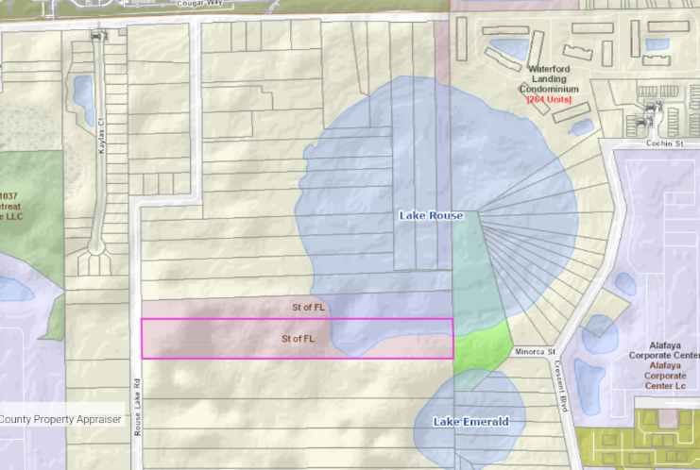
Vatalaro v. Dept. of Env. Reg.
601 So.2d 1223 (Fla. 5th DCA 1992)
Notes:
Billie Vatalaro passed away before the proceedings concluded.
In 1995, the property was transferred by judicial sale from the estate of Billie Vatalaro to the State of Florida for $140,000 plus interest, for a total of $220,000.
The trial court denied recovery of investments that were made into the property.
The lots are now owned by the State of Florida, managed by the Board of Trustees of the Internal Improvement Trust Fund (TIITF)

Slide 102

Pinellas County v. Jasmine Plaza, Inc.
334 So. 2d 639 (Fla. 2nd DCA 1976)
Notes:
FL 2nd Dist. Ct. App.
1976, Pinellas County, FL
Pinellas County had a tree protection ordinance.
Jasmine Plaza, Inc. removed protected trees and refused to plant replacements or pay a fee.
Pinellas County sued to obtain financial relief and a mandatory injunction to plant replacement trees.
Trial court held ordinance unconstitutional and granted MSJ for Jasmine Plaza. County appealed.

Slide 103
Pinellas County v. Jasmine Plaza, Inc.
334 So. 2d 639 (Fla. 2nd DCA 1976)
When evaluating a proposed tree removal, the County Administrator shall consider:
The condition of the trees with respect to disease, danger of falling, proximity to existing or proposed structures, and interference with utility services;
Necessity to remove trees in order to construct proposed improvements to allow economic enjoyment of the property;
Topography of land and the effect of tree removal on erosion, soil retention and the diversion or increased flow of surface waters

Slide 104
Pinellas County v. Jasmine Plaza, Inc.
334 So. 2d 639 (Fla. 2nd DCA 1976)
“when the power to issue or deny permits is delegated to an official, it must be accompanied by definitive standards”
“the ordinance constituted an unlawful delegation of authority because it granted the administrator the power to arbitrarily decide each case.”

Slide 105
Pinellas County v. Jasmine Plaza, Inc.
334 So. 2d 639 (Fla. 2nd DCA 1976)
HOWEVER
“This decision does not preclude [Pinellas County] from passing an appropriate tree ordinance”

Slide 106

Watson v. City of St. Petersburg
489 So. 2d 138 (Fla. 2nd DCA 1986)
Notes:
FL 2nd Dist. Ct. App.
1980s, St. Petersburg, FL
This opinion does not state the underlying facts or procedural background.
St. Petersburg had tree protection ordinance that restricted tree removal, but gave the city manager the power to waive requirements.
W.L. Watson challenged the ordinance as unconstitutional delegation of authority.
Trial court granted MSJ for Watson that the waiver term was unconstitutional, but it was severable, so the rest of the ordinance was still valid.
Watson appealed.

Slide 107
Watson v. City of St. Petersburg
489 So. 2d 138 (Fla. 2nd DCA 1986)
“the city manager shall issue a permit…for the removal or relocation of tree(s)…IF:”
  “…unreasonably restricts the economic enjoyment”
  “…diseased, injured, in danger of falling…”
  “…site contains equivalent number of trees…as does the average site of similar size in the immediate surrounding area”

Slide 108
Watson v. City of St. Petersburg
489 So. 2d 138 (Fla. 2nd DCA 1986)
“the city manager…shall deny the permit IF:”
  “…substantial adverse impact upon existing biological and ecological systems…”
  “…reduce the ability of the existing vegetation to reduce wind velocities to the degree that a nuisance is anticipated…”
  “…significantly reduce available habitat for wildlife…”
  “…adverse effect on property values in the neighborhood…”

Slide 109
Watson v. City of St. Petersburg
489 So. 2d 138 (Fla. 2nd DCA 1986)
“[the ordinance] contains sufficient standards”
“substantially” and “significantly” are not too vague

Slide 110
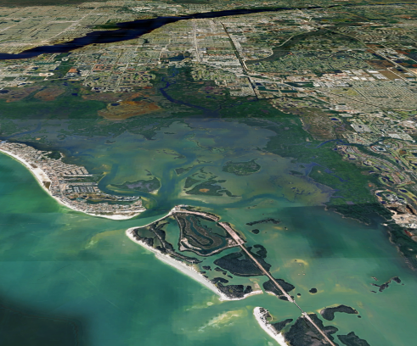
Tree Regulations - Summary
Takings
  Denominator Problem
Delegation of Authority
  Standards

Slide 111
Summary
Landowner Liability
  Duties to Entrants
  Knowledge
  “Dangerous Conditions”
UVM
  Foreseeability
Valuation
  Land Value vs. Loss of Use
  Replacement and Cleanup Costs
Tree Regulation
  Takings
  Delegation of Authority

Slide 112
Case Illustrations from
Florida Tree Law
James Komen
BCMA #WE-9909B
RCA #555

