Slide 1
Case Illustrations from Carolina Tree Law
James Komen
BCMA #WE-9909B
RCA #555

Slide 2
WIFI
SSID: ISASC
Password: 26palm3tto

Slide 3
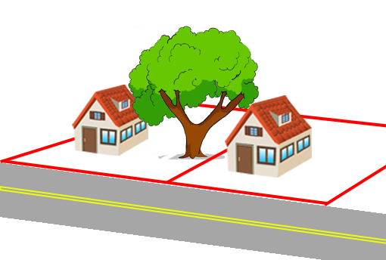
Rowe v. McGee 5 N.C. App. 60 (NC Ct. App. 1969)
Notes:
NC Ct. App.
1967, Newton Township, NC
Large oak tree grew on Noah and Jeanette McGee’s property. Oak tree was “extremely rotted and filled with honey bees”
Neighbors Edward and Josephine Rowe asked defendants at least twice to remove the tree.
McGees had “no objection” to the Rowes cutting it down, but they didn’t want to do it.
Tree broke and landed on house. Rowe’s insurance paid for the damage and then sued the McGees to recover
McGees defended because the tree was a “natural condition of the land.”

Slide 4
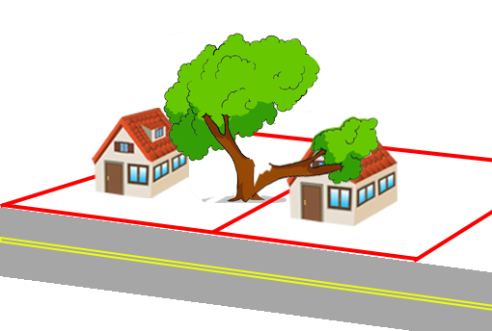
Rowe v. McGee 5 N.C. App. 60 (NC Ct. App. 1969)
Notes:
NC Ct. App.
1967, Newton Township, NC
Large oak tree grew on Noah and Jeanette McGee’s property. Oak tree was “extremely rotted and filled with honey bees”
Neighbors Edward and Josephine Rowe asked defendants at least twice to remove the tree.
McGees had “no objection” to the Rowes cutting it down, but they didn’t want to do it.
Tree broke and landed on house. Rowe’s insurance paid for the damage and then sued the McGees to recover
McGees defended because the tree was a “natural condition of the land.”

Slide 5
Rowe v. McGee 5 N.C. App. 60 (NC Ct. App. 1969)
“[The McGees] knew that the tree…was decayed and liable to fall.”
Notes:
Only four states and the District of Columbia follow the contributory negligence rule in the United States: Alabama, Maryland, North Carolina, and Virginia
Even if a plaintiff is just 1% at fault, he cannot recover.

Slide 6
Rowe v. McGee 5 N.C. App. 60 (NC Ct. App. 1969)
“[The McGees] knew that the tree…was decayed and liable to fall.”
“Public policy in a civilized community requires that …there be no oases of nonliability where a private nuisance may be maintained with impunity.”
Notes:
Only four states and the District of Columbia follow the contributory negligence rule in the United States: Alabama, Maryland, North Carolina, and Virginia
Even if a plaintiff is just 1% at fault, he cannot recover.

Slide 7
Rowe v. McGee 5 N.C. App. 60 (NC Ct. App. 1969)
“[The McGees] knew that the tree…was decayed and liable to fall.”
“Public policy in a civilized community requires that …there be no oases of nonliability where a private nuisance may be maintained with impunity.”
HOWEVER
Notes:
Only four states and the District of Columbia follow the contributory negligence rule in the United States: Alabama, Maryland, North Carolina, and Virginia
Even if a plaintiff is just 1% at fault, he cannot recover.

Slide 8
Rowe v. McGee 5 N.C. App. 60 (NC Ct. App. 1969)
“[The McGees] knew that the tree…was decayed and liable to fall.”
“Public policy in a civilized community requires that …there be no oases of nonliability where a private nuisance may be maintained with impunity.”
HOWEVER
The Rowes had permission to cut the tree, so they were contributorily negligent
Notes:
Only four states and the District of Columbia follow the contributory negligence rule in the United States: Alabama, Maryland, North Carolina, and Virginia
Even if a plaintiff is just 1% at fault, he cannot recover.

Slide 9
Tree Failure
Rowe v. McGee 5 N.C. App. 60 (NC Ct. App. 1969)
Ford v. S.C. Dep't of Transp. 492 S.E.2d 811 (SC Ct. App. 1997)
Wallen v. Riverside Sports Ctr. 173 N.C. App. 408 (NC Ct. App. 2005)
Staples v. Duell 494 S.E.2d 639 (SC Ct. App. 1997)
Gaines v. CSX Transp., Inc. 2019 WL 315980 (USDC 2019)
Gibson v. Hunsberger 109 N.C.App. 671 (NC Ct. App. 1993)
Marsh v. SCDHPT 298 S.C. 420 (SC Ct. App. 1989)
Breland v. SC Dept. of Transp. 2013 WL 12122175 (SC Ct. Cm. Pl. 2013)
Inabinett v. State Hwy Dept. 196 S.C. 117 (SC Sup. Ct. 1941)
Notes:
9 cases

Slide 10
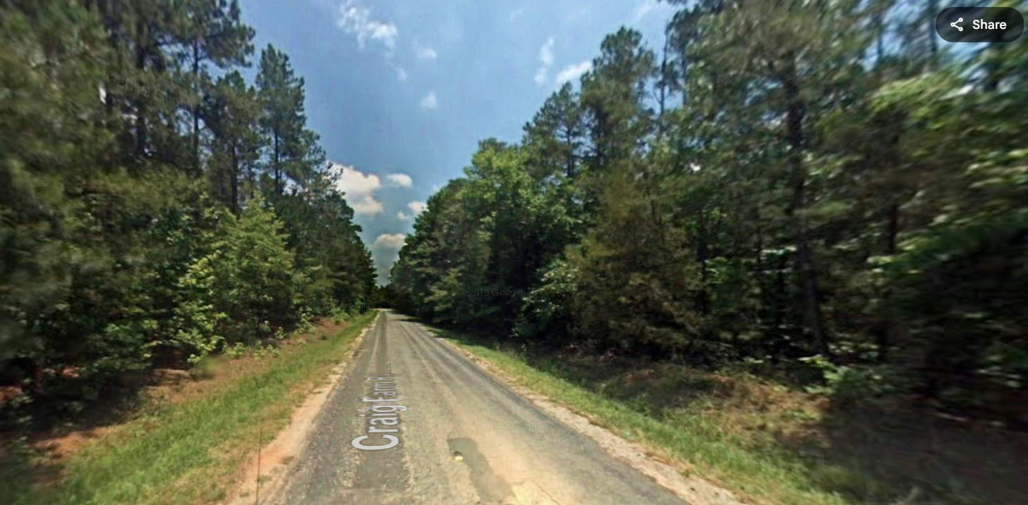
Ford v. S.C. Dep't of Transp. 492 S.E.2d 811 (SC Ct. App. 1997)
Notes:
SC Ct. App.
Jan 17, 1993, Lancaster County, State Rd 185 (Craig Farm Rd.)
James Robert Carroll and Mable O. Carroll owned 99 acres east of the state road.
Tree was naturally-growing on Carroll property
45 feet from center of road, 37 feet from edge of pavement, 14 feet beyond edge of ROW
In the early morning hours, tree fell in a storm due to saturated soils
5:00am: Aaron D. Ford driving south, collided with tree that had fallen across the road.
Over the past four years, Olin Kilman Pratt, a local resident, had repeatedly told hwy patrolmen that trees along the road were leaning, dangerous, and had fallen.
Mr. Pratt never identified this particular tree as hazardous.
A photo of the accident scene showed several other trees leaning over the roadway.

Slide 11
Ford v. S.C. Dep't of Transp. 492 S.E.2d 811 (SC Ct. App. 1997)
“…a landowner in a residential or urban area has a duty to others outside the property to prevent an unreasonable risk of harm from defective or unsound trees.”
Notes:
No Liab. For LANDOWNERS
Natural Condition Immunity

Slide 12
Ford v. S.C. Dep't of Transp. 492 S.E.2d 811 (SC Ct. App. 1997)
“…a landowner in a residential or urban area has a duty to others outside the property to prevent an unreasonable risk of harm from defective or unsound trees.”
Notes:
No Liab. For LANDOWNERS
Natural Condition Immunity

Slide 13
Ford v. S.C. Dep't of Transp. 492 S.E.2d 811 (SC Ct. App. 1997)
“The rule of non-liability for natural conditions remains to a considerable extent a necessity in rural communities, where the burden of inspecting and improving the land is likely to be entirely disproportionate not only to any threatened harm but even to the value of the land itself.”
Notes:
No Liab. For LANDOWNERS
Natural Condition Immunity

Slide 14
Ford v. S.C. Dep't of Transp. 492 S.E.2d 811 (SC Ct. App. 1997)
“The rule of non-liability for natural conditions remains to a considerable extent a necessity in rural communities, where the burden of inspecting and improving the land is likely to be entirely disproportionate not only to any threatened harm but even to the value of the land itself.”
Notes:
No Liab. For LANDOWNERS
Natural Condition Immunity

Slide 15
Ford v. S.C. Dep't of Transp. 492 S.E.2d 811 (SC Ct. App. 1997)
“…even though a landowner is not liable to persons travelling on adjacent highways for harm resulting from natural conditions of the land, the Department has the privilege to enter the land and do what is necessary to remedy the harm resulting from such natural conditions.”
Notes:
Possible Liab. for STATE
Duty to keep streets and hwys reasonably safe
Prior notice

Slide 16
Ford v. S.C. Dep't of Transp. 492 S.E.2d 811 (SC Ct. App. 1997)
“The Department…has a higher duty of care than did the Carrolls, to discover and remedy potential obstructions, even those obstructions originating on private property.”
Notes:
Possible Liab. for STATE
Duty to keep streets and hwys reasonably safe
Prior notice

Slide 17
Ford v. S.C. Dep't of Transp. 492 S.E.2d 811 (SC Ct. App. 1997)
“The Department…has a higher duty of care than did the Carrolls, to discover and remedy potential obstructions, even those obstructions originating on private property.”
Notes:
Possible Liab. for STATE
Duty to keep streets and hwys reasonably safe
Prior notice

Slide 18
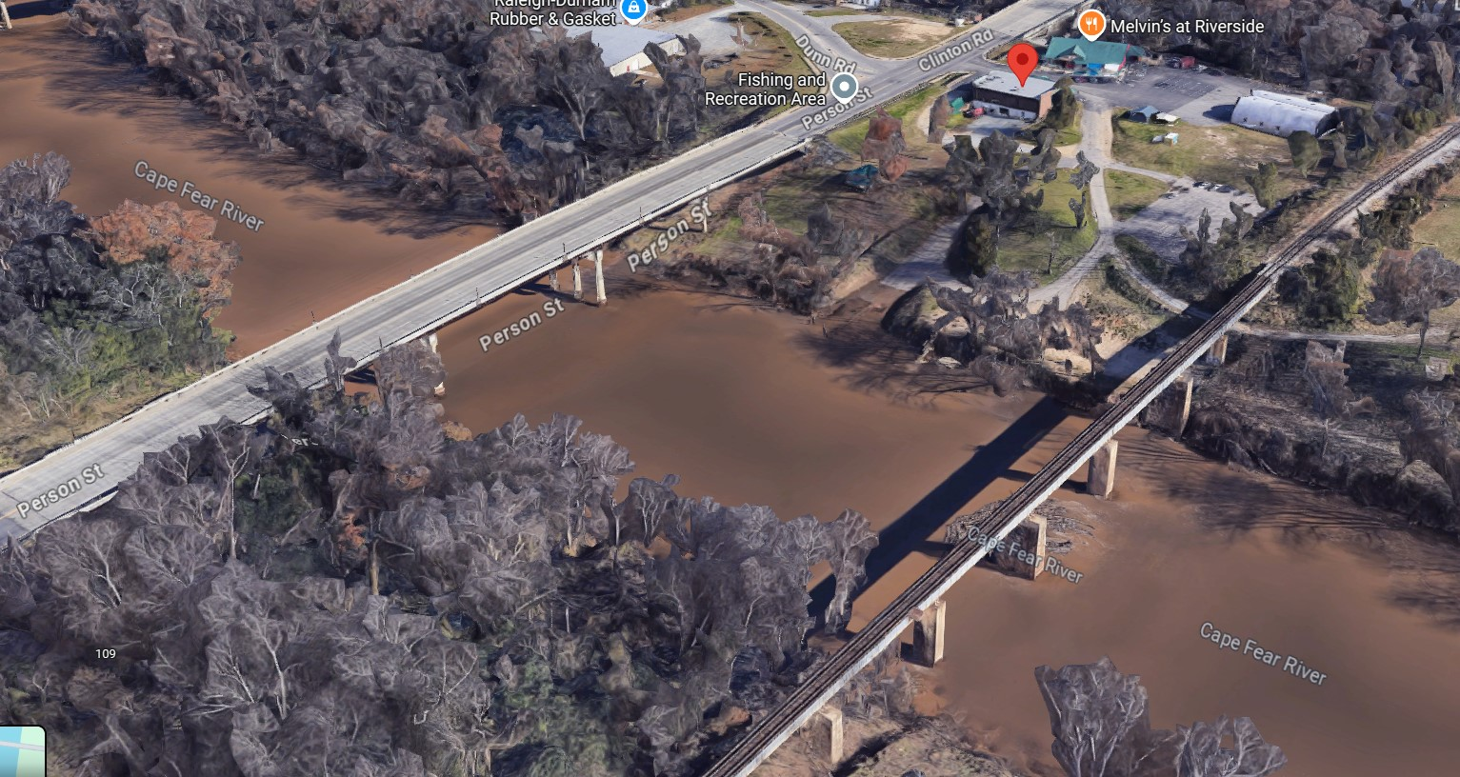
Wallen v. Riverside Sports Ctr. 173 N.C. App. 408 (NC Ct. App. 2005)
Notes:
NC Ct. App.
2001 Fayetteville, NC along the Cape Fear River near the Person St Bridge
Timothy Earl Wallen went fishing. In the afternoon, a storm rolled in, and he moored his boat to a downstream pile near the boat ramp.
Boxelder tree fell and struck Wallen, rendering him paraplegic
Boxelder tree was alive but substantially decayed. It had two old breaks with epicormic sprouts, and it was leaning towards the river.
Trial Court granted MSJ for Riverside Sports Ctr because the tree was a natural condition.

Slide 19
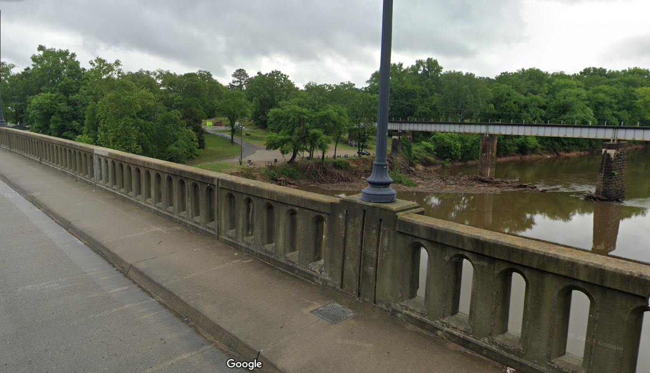
Wallen v. Riverside Sports Ctr. 173 N.C. App. 408 (NC Ct. App. 2005)
Notes:
NC Ct. App.
2001 Fayetteville, NC along the Cape Fear River near the Person St Bridge
Timothy Earl Wallen went fishing. In the afternoon, a storm rolled in, and he moored his boat to a downstream pile near the boat ramp.
Boxelder tree fell and struck Wallen, rendering him paraplegic
Boxelder tree was alive but substantially decayed. It had two old breaks with epicormic sprouts, and it was leaning towards the river.
Trial Court granted MSJ for Riverside Sports Ctr because the tree was a natural condition.

Slide 20
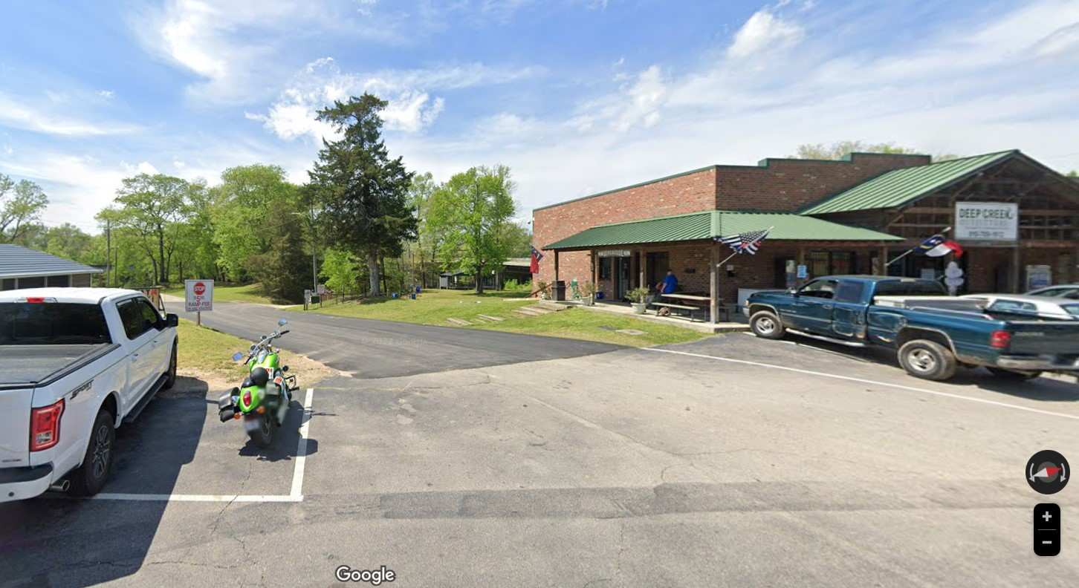
Wallen v. Riverside Sports Ctr. 173 N.C. App. 408 (NC Ct. App. 2005)
Notes:
NC Ct. App.
2001 Fayetteville, NC along the Cape Fear River near the Person St Bridge
Timothy Earl Wallen went fishing. In the afternoon, a storm rolled in, and he moored his boat to a downstream pile near the boat ramp.
Boxelder tree fell and struck Wallen, rendering him paraplegic
Boxelder tree was alive but substantially decayed. It had two old breaks with epicormic sprouts, and it was leaning towards the river.
Trial Court granted MSJ for Riverside Sports Ctr because the tree was a natural condition.

Slide 21
Wallen v. Riverside Sports Ctr. 173 N.C. App. 408 (NC Ct. App. 2005)
R2D §363:
Generally, no liability for harm caused by natural conditions of the land
MAY be liable for harm to persons using a public highway in an urban area caused by trees
“Navigable waters constitute a public highway”

Slide 22
Wallen v. Riverside Sports Ctr. 173 N.C. App. 408 (NC Ct. App. 2005)
Urban
Within Fayetteville
Zoned industrial
Along major thoroughfare
Adjacent to railroad tracks
Rural
Along Cape Fear River
Heavily wooded
Primary use is recreational

Slide 23
Wallen v. Riverside Sports Ctr. 173 N.C. App. 408 (NC Ct. App. 2005)
“[Riverside] had a duty to exercise reasonable care with respect to natural conditions” regardless of whether land is rural or urban.
Rejects R2D §363 rural/urban distinction

Slide 24
Wallen v. Riverside Sports Ctr. 173 N.C. App. 408 (NC Ct. App. 2005)
“[Riverside] had a duty to exercise reasonable care with respect to natural conditions” regardless of whether land is rural or urban.
Rejects R2D §363 rural/urban distinction
“We caution that [this case] is not intended to place an absolute duty upon persons owning property located along a river or other public highway to inspect or trim trees.”

Slide 25
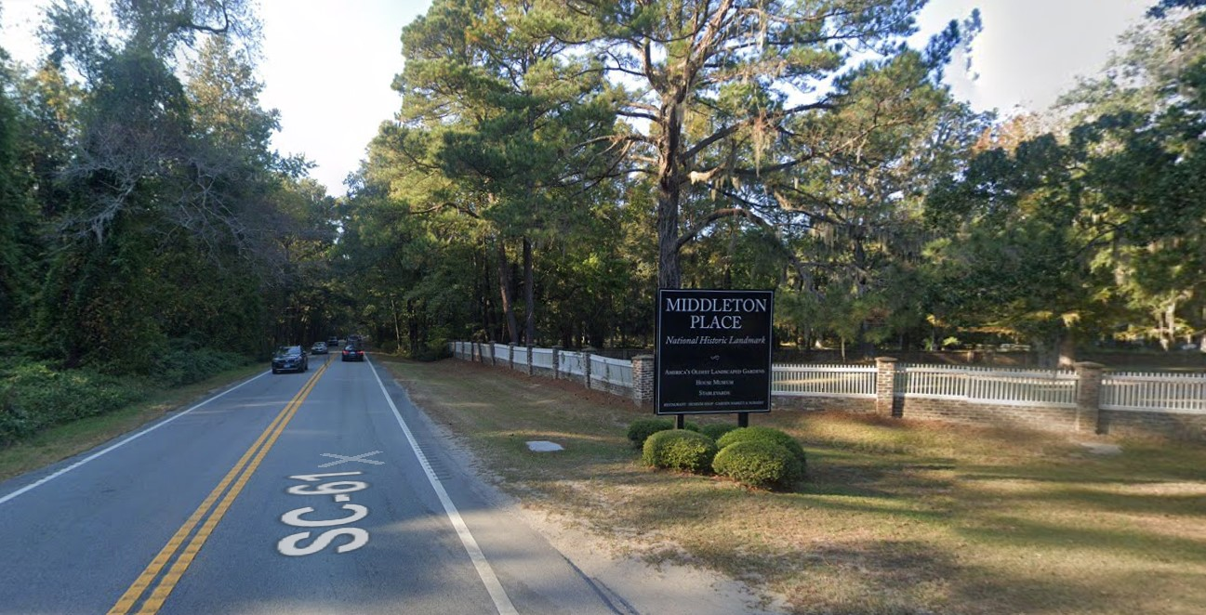
Staples v. Duell 494 S.E.2d 639 (SC Ct. App. 1997)
Notes:
SC Ct. App.
1997, SC
Julie Staples was driving along Highway 61 from Charleston towards Summerville
Collided a dead pine tree that had fallen across the road from Middleton Place National Historic Landmark, owned by Charles Duell
100,000 admission-paying visitors per year
Highway 61 carries 13,500 vehicles PER DAY
Duell hired James Woddle to care for the property, including driving around the perimeter of the property to inspect for things including dead trees.
Trial court held land was RURAL

Slide 26
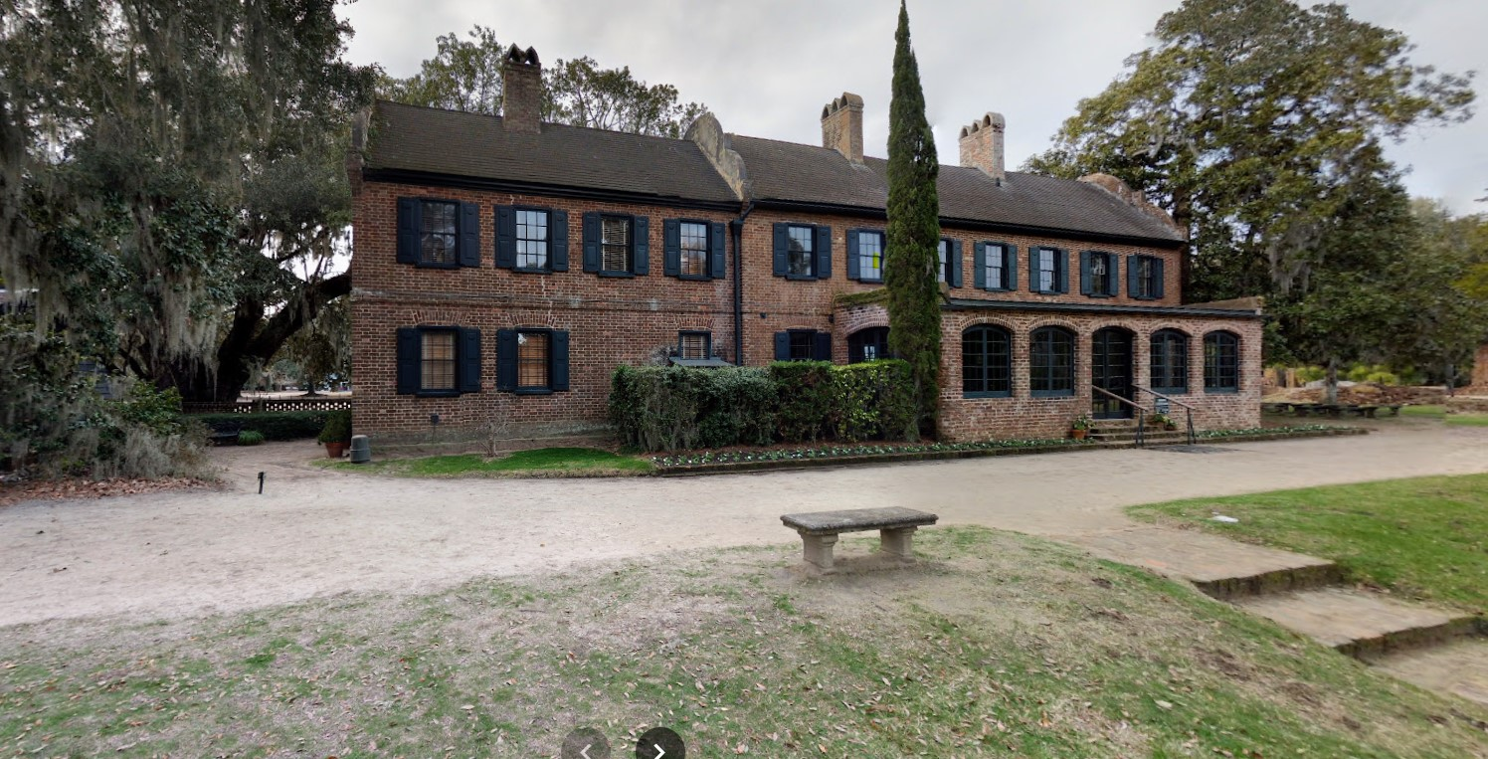
Staples v. Duell 494 S.E.2d 639 (SC Ct. App. 1997)
Notes:
SC Ct. App.
1997, SC
Julie Staples was driving along Highway 61 from Charleston towards Summerville
Collided a dead pine tree that had fallen across the road from Middleton Place National Historic Landmark, owned by Charles Duell
100,000 admission-paying visitors per year
Highway 61 carries 13,500 vehicles PER DAY
Duell hired James Woddle to care for the property, including driving around the perimeter of the property to inspect for things including dead trees.
Trial court held land was RURAL

Slide 27
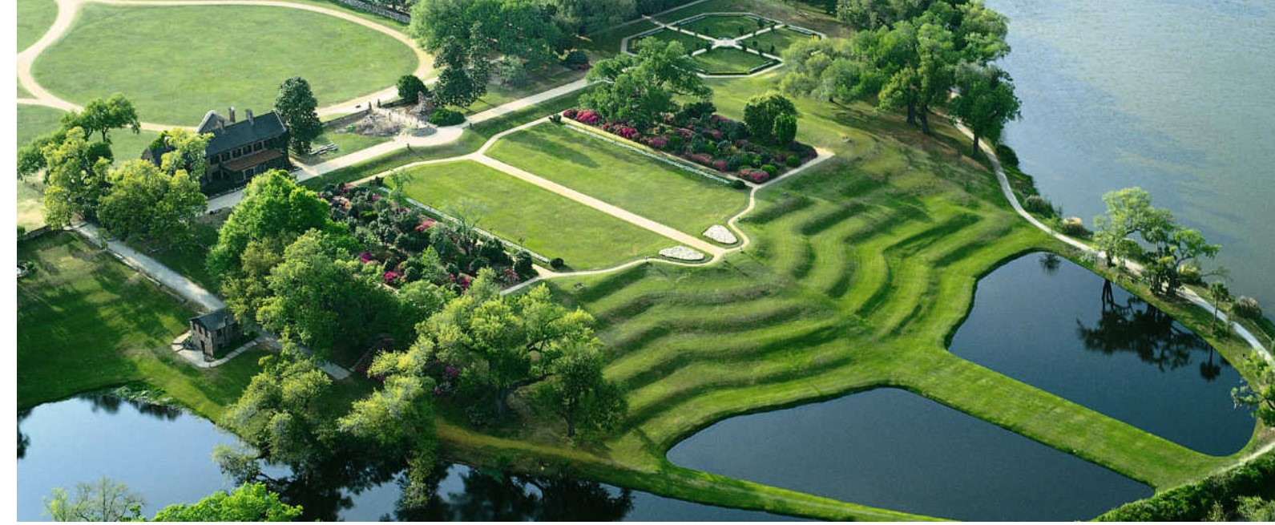
Staples v. Duell 494 S.E.2d 639 (SC Ct. App. 1997)
Notes:
SC Ct. App.
1997, SC
Julie Staples was driving along Highway 61 from Charleston towards Summerville
Collided a dead pine tree that had fallen across the road from Middleton Place National Historic Landmark, owned by Charles Duell
100,000 admission-paying visitors per year
Highway 61 carries 13,500 vehicles PER DAY
Duell hired James Woddle to care for the property, including driving around the perimeter of the property to inspect for things including dead trees.
Trial court held land was RURAL

Slide 28
Staples v. Duell 494 S.E.2d 639 (SC Ct. App. 1997)
“Even though other jurisdictions may be rethinking their approach to landowner liability, South Carolina follows the traditional rural and urban distinction.”

Slide 29
Staples v. Duell 494 S.E.2d 639 (SC Ct. App. 1997)
“Even though other jurisdictions may be rethinking their approach to landowner liability, South Carolina follows the traditional rural and urban distinction.”
“once the trial judge ruled that Duell’s land was rural,” Duell had no duty to inspect

Slide 30
Staples v. Duell 494 S.E.2d 639 (SC Ct. App. 1997)
Woddle’s inspections didn’t increase risk of harm
“did not hasten the decay of trees” or
“affect when and where dead trees might fall”

Slide 31
Staples v. Duell 494 S.E.2d 639 (SC Ct. App. 1997)
Woddle’s inspections didn’t increase risk of harm
“did not hasten the decay of trees” or
“affect when and where dead trees might fall”
Staples didn’t know of Woddle’s inspections, so she “could not have relied on the policy.”

Slide 32
Staples v. Duell 494 S.E.2d 639 (SC Ct. App. 1997)
Woddle’s inspections didn’t increase risk of harm
“did not hasten the decay of trees” or
“affect when and where dead trees might fall”
Staples didn’t know of Woddle’s inspections, so she “could not have relied on the policy.”
“Duell’s policy of looking for dead trees did not create a duty for which he could be held liable.”

Slide 33
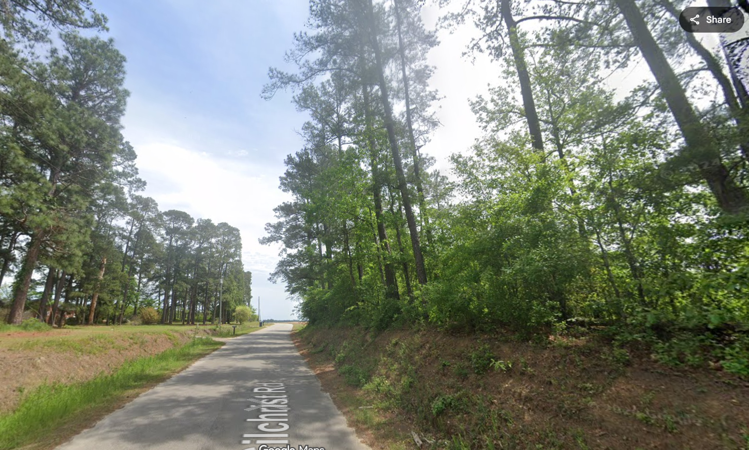
Gaines v. CSX Transp., Inc. 2019 WL 315980 (USDC 2019)
Notes:
USDC, SC
February 24, 2016 Darlington County, SC
On a windy day, Michael Gaines was driving along Gilchrist Rd, encountered branch blocking the road.
Stepped out of the car to remove the branch, and a pine tree fell on him.
CSX owned abandoned railbed next to road in “sparsely populated” area.
No trains on road since 1970s. Trees had sprouted on the railbed naturally.

Slide 34
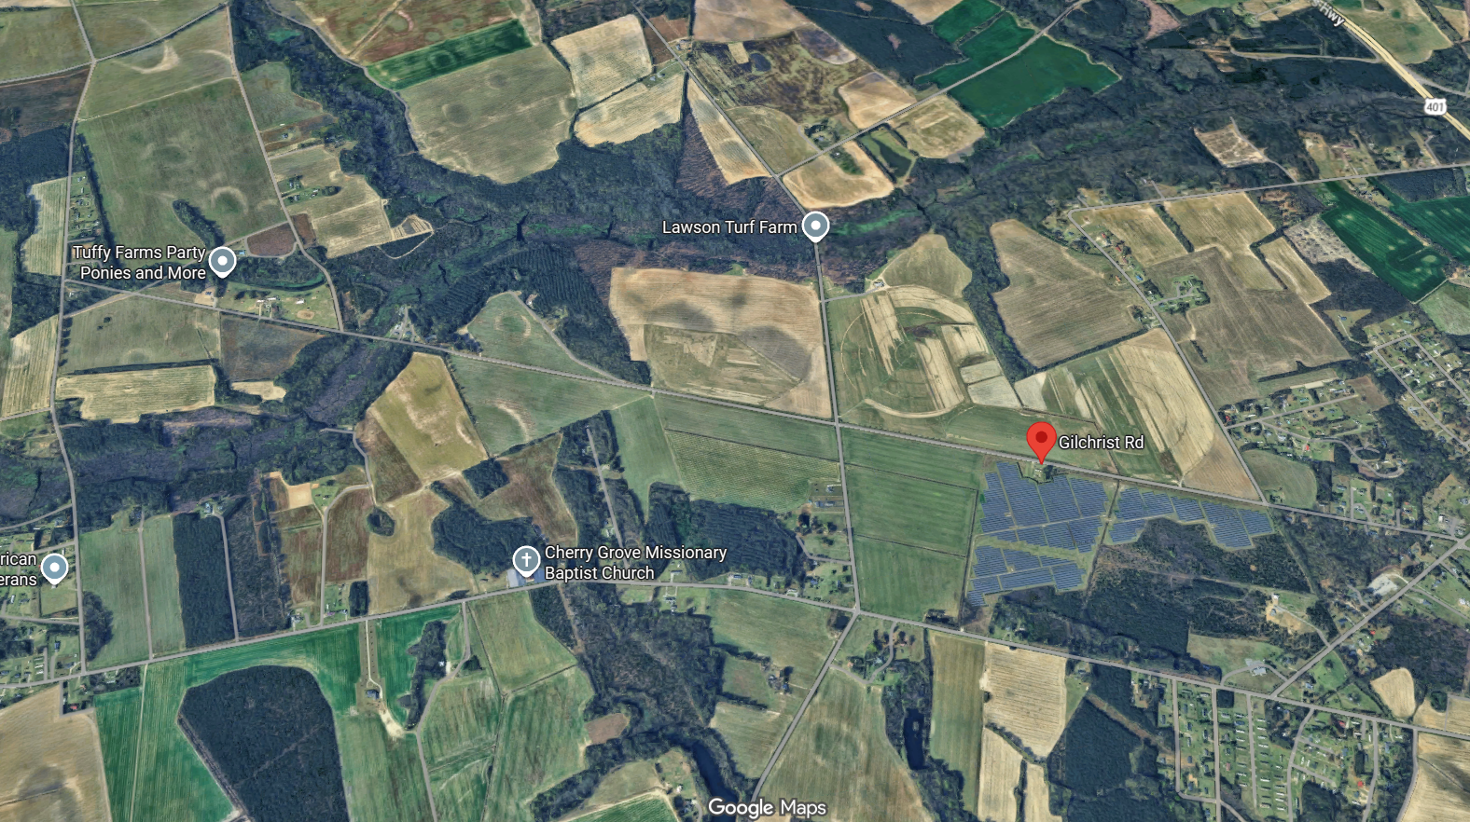
Gaines v. CSX Transp., Inc. 2019 WL 315980 (USDC 2019)
Notes:
USDC, SC
February 24, 2016 Darlington County, SC
On a windy day, Michael Gaines was driving along Gilchrist Rd, encountered branch blocking the road.
Stepped out of the car to remove the branch, and a pine tree fell on him.
CSX owned abandoned railbed next to road in “sparsely populated” area.
No trains on road since 1970s. Trees had sprouted on the railbed naturally.

Slide 35
Gaines v. CSX Transp., Inc. 2019 WL 315980 (USDC 2019)
“…whether [CSX] had a duty…depends on whether its property was located on rural, undeveloped land or whether it was in a residential or urban area.”

Slide 36
Gaines v. CSX Transp., Inc. 2019 WL 315980 (USDC 2019)
Urban
Multiple nearby homes
Nearby auto auction
Cultivated farmland is “developed”
“frequently traveled roadway”
Rural
6 vehicles per hour
“sparsely populated”
No tracks or trains since 1970s
No change to area except road paving

Slide 37
Gaines v. CSX Transp., Inc. 2019 WL 315980 (USDC 2019)
“…there is a genuine issue of material fact whether [CSX’s] property is rural, undeveloped land”

Slide 38
Gaines v. CSX Transp., Inc. 2019 WL 315980 (USDC 2019)
“…there is a genuine issue of material fact whether [CSX’s] property is rural, undeveloped land”
“Staples did not argue the classification of [the] property as urban or rural land constituted a jury question.”

Slide 39
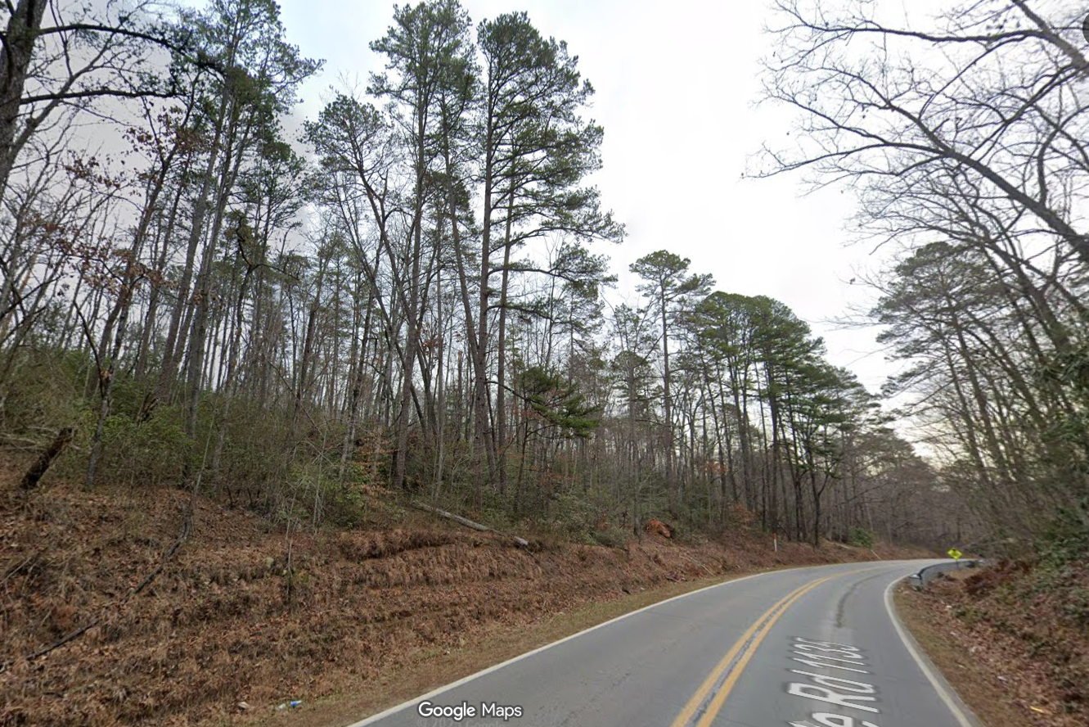
Gibson v. Hunsberger 109 N.C.App. 671 (NC Ct. App. 1993)
Notes:
NC Ct. App. 1993
McDowell County, NC, Old Fort-Sugar Hill Rd.
Russell Hunsberger was absentee landlord of rural, heavily-wooded property in its natural undeveloped state
Leaning tree on property over rural road.
Base of tree was 46 feet from center of road. No signs of decay, rot, or poor health.
Early morning hours of February 15, 1989, Thomas Keith Gibson ran into tree fallen across the road.

Slide 40
Gibson v. Hunsberger 109 N.C.App. 671 (NC Ct. App. 1993)
π expert:
“Virginia Pines have a shallow root system.”
“The healthier the tree, the more apt it is to fall over.”
The tree fell because:
It was healthy and had a heavy crown
Ground was moist and contained gravel

Slide 41
Gibson v. Hunsberger 109 N.C.App. 671 (NC Ct. App. 1993)
NC DOT engineer:
“many, many, many” trees were leaning along the highways

Slide 42
Gibson v. Hunsberger 109 N.C.App. 671 (NC Ct. App. 1993)
NC DOT engineer:
“many, many, many” trees were leaning along the highways
Duke Power Technician:
“if we called in every tree we saw leaning, that would probably be about a full-time job.”

Slide 43
Gibson v. Hunsberger 109 N.C.App. 671 (NC Ct. App. 1993)
“the tree was leaning prior to the accident”

Slide 44
Gibson v. Hunsberger 109 N.C.App. 671 (NC Ct. App. 1993)
“the tree was leaning prior to the accident”
BUT

Slide 45
Gibson v. Hunsberger 109 N.C.App. 671 (NC Ct. App. 1993)
“the tree was leaning prior to the accident”
BUT
“the tree was not leaning out over the road”

Slide 46
Gibson v. Hunsberger 109 N.C.App. 671 (NC Ct. App. 1993)
“leaning…was common in the area”

Slide 47
Gibson v. Hunsberger 109 N.C.App. 671 (NC Ct. App. 1993)
“leaning…was common in the area”
“It was not readily observable that the tree would fall into the road.”

Slide 48
Gibson v. Hunsberger 109 N.C.App. 671 (NC Ct. App. 1993)
“leaning…was common in the area”
“It was not readily observable that the tree would fall into the road.”
None of this evidence would have put a reasonable landowner on notice that a dangerous condition existed.”

Slide 49

Marsh v. SCDHPT 298 S.C. 420 (SC Ct. App. 1989)
Notes:
SC Ct. App. 1989
Berkeley County, SC, Highway 41
For four years, a 26-inch pine tree growing in ROW for Hwy 41.
Tree leaned across hwy at 60-70 degree angle.
Mowing crews instructed DAILY to inspect for “dangerous trees”
July 20, 1984: The tree fell on Russell Marsh.
Upon inspection, base of tree was decayed

Slide 50
Marsh v. SCDHPT 298 S.C. 420 (SC Ct. App. 1989)
“Anyone travelling Highway 41 could have seen that the tree was leaning.”

Slide 51
Marsh v. SCDHPT 298 S.C. 420 (SC Ct. App. 1989)
“Anyone travelling Highway 41 could have seen that the tree was leaning.”
“The disease, which takes no expert to detect, typically causes structural weakness and, ultimately, trunk or stem breakage.”

Slide 52
Marsh v. SCDHPT 298 S.C. 420 (SC Ct. App. 1989)
“Anyone travelling Highway 41 could have seen that the tree was leaning.”
“The disease, which takes no expert to detect, typically causes structural weakness and, ultimately, trunk or stem breakage.”
“This evidence…establishes that the Department…should have known…”

Slide 53

Breland v. SC Dept. of Transp. 2013 WL 12122175 (SC Ct. Common Pleas 2013)
Notes:
SC Ct. Common Pleas 2013
Orangeburg County, SC
January 8, 2010, William Breland drove into a dead tree that had fallen across US Highway 321.
SC Dept of Transp. MSJ’d.
Trial court denied MSJ.

Slide 54
Breland v. SC Dept. of Transp. 2013 WL 12122175 (SC Ct. Common Pleas 2013)
“…genuine issue of material fact exists as to whether SCDOT had constructive notice of the tree and its condition…”

Slide 55
Breland v. SC Dept. of Transp. 2013 WL 12122175 (SC Ct. Common Pleas 2013)
“…genuine issue of material fact exists as to whether SCDOT had constructive notice of the tree and its condition…”
“…the Court is not subjecting SCDOT to strict liability for merely failing to keep its roadways free from debris…”

Slide 56
Breland v. SC Dept. of Transp. 2013 WL 12122175 (SC Ct. Common Pleas 2013)
“…genuine issue of material fact exists as to whether SCDOT had constructive notice of the tree and its condition…”
“…the Court is not subjecting SCDOT to strict liability for merely failing to keep its roadways free from debris…”
A dead tree is enough to create a question of notice

Slide 57
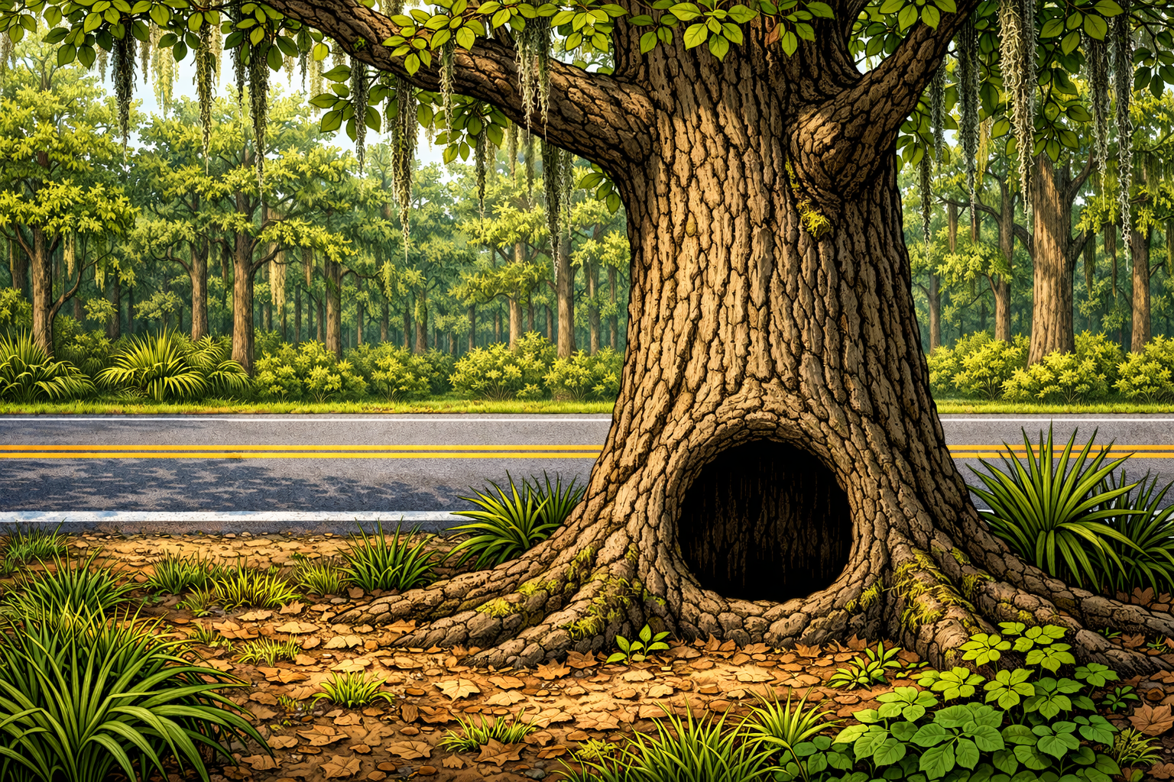
Inabinett v. State Hwy Dept. 196 S.C. 117 (SC Sup. Ct. 1941)
Notes:
SC Supreme Court 1941
September 5, 1935 between Adams Run and Parkers Ferry in Charleston County, SC
Gum tree TWO INCHES onto private land owned by Miss H. R. Gonzales had large basal cavity facing AWAY from the street and a few dead branches.
Windy day. Tree fell on Frances Inabinett, passenger in a car on the highway.
Witnesses observed that after the failure, 2-3 inch dead branches were lying on the road and ground.
Cavity was NOT VISIBLE FROM THE HWY.
Hwy was inspected shortly before the failure, and no problem was identified.
NONSUIT for private landowner, JURY found for Plaintiff against State. Hwy Dept.

Slide 58
Inabinett v. State Hwy Dept. 196 S.C. 117 (SC Sup. Ct. 1941)
π tree expert:
“…in about ninety [percent of] the cases, dead limbs at the top of the tree indicated that some of the roots are dead”
“decayed portion of the stump could be seen from the highway side from a distance of about two feet away”

Slide 59
Inabinett v. State Hwy Dept. 196 S.C. 117 (SC Sup. Ct. 1941)
“…if they…should know that the tree is dangerous to the safety of the public…it is their duty to enter upon the land and remove the danger.”

Slide 60
Inabinett v. State Hwy Dept. 196 S.C. 117 (SC Sup. Ct. 1941)
“…if they…should know that the tree is dangerous to the safety of the public…it is their duty to enter upon the land and remove the danger.”

Slide 61
Inabinett v. State Hwy Dept. 196 S.C. 117 (SC Sup. Ct. 1941)
“…if they…should know that the tree is dangerous to the safety of the public…it is their duty to enter upon the land and remove the danger.”
“…such action is not a trespass, but falls within the scope of the duty of the Highway Department to keep the road safe for those who are lawfully upon it.”

Slide 62
Tree Failure - Summary
Natural vs. Artificial Conditions
Urban vs. Rural Land
Private vs. Public duty
Notice
Leaning Trees
Dead Trees

Slide 63
Street Trees
Tate v. City of Greenville 228 S.C. 530 (SC Sup. Ct. 1956)
Tate v. City of Greensboro 114 N.C. 392 (NC Sup. Ct. 1894)
Munday v. Newton 167 N.C. 656 (NC Sup. Ct. 1914)
Rosenthal v. Goldsboro 149 N.C. 128 (NC Sup. Ct. 1908)
Hoyle v. City of Hickory 167 N.C. 619 (NC Sup. Ct. 1914)
Moore v. Carolina Power & Light Co. 163 N.C. 300 (NC Sup. Ct. 1913)
Brown v. Asheville Electric Light Co. 51 S.E. 62 (NC Sup. Ct. 1905)
Wheeler v. Norfolk Carolina Tel. & Tel. Co. 172 N.C. 9 (NC Sup. Ct. 1916)
Notes:
5 cases (+3 supplemental)

Slide 64

Tate v. City of Greenville 228 S.C. 530 (SC Sup. Ct. 1956)
Notes:
SC Supreme Court 1956
Greenville, SC
May of 1954, 11am.
Robert Hughes, an employee of George Tate was driving a truck along Arlington Avenue
High profile truck ran into low branch over road, damaging truck.
Tate sued Greenville for damages to his truck.
Trial court directed nonsuit, Tate appealed.
Is overhanging branch a DEFECT?
Is Hughes guilty of contributory negligence?

Slide 65
Tate v. City of Greenville 228 S.C. 530 (SC Sup. Ct. 1956)
“…liability of a city…is not confined to cases of obstructions upon the surface of the street, for overhead…objects may be as dangerous as an obstruction upon the surface, because they are not likely to be observed and avoided.”

Slide 66
Tate v. City of Greenville 228 S.C. 530 (SC Sup. Ct. 1956)
“…liability of a city…is not confined to cases of obstructions upon the surface of the street, for overhead…objects may be as dangerous as an obstruction upon the surface, because they are not likely to be observed and avoided.”
Low branch CAN be defect.

Slide 67
Tate v. City of Greenville 228 S.C. 530 (SC Sup. Ct. 1956)
“It cannot be said as a matter of law this limb overhung in such a manner as to be a patent, open and obvious obstacle”

Slide 68
Tate v. City of Greenville 228 S.C. 530 (SC Sup. Ct. 1956)
“It cannot be said as a matter of law this limb overhung in such a manner as to be a patent, open and obvious obstacle”
“The driver’s attention was directed to traffic hazards”

Slide 69
Tate v. City of Greenville 228 S.C. 530 (SC Sup. Ct. 1956)
“It cannot be said as a matter of law this limb overhung in such a manner as to be a patent, open and obvious obstacle”
“The driver’s attention was directed to traffic hazards”
“It may be that the overhanging limb could have been observed and the collision prevented, but this presented an issue for jury determination.”

Slide 70
Tate v. City of Greenville 228 S.C. 530 (SC Sup. Ct. 1956)
“It cannot be said…that one who uses a highway,, even though he knows of a defect in it…is guilty of negligence in doing so…”

Slide 71
Tate v. City of Greenville 228 S.C. 530 (SC Sup. Ct. 1956)
“It cannot be said…that one who uses a highway,, even though he knows of a defect in it…is guilty of negligence in doing so…”
“To hold otherwise would make every traveler on the streets or highways assume the risk of injury from all such defects or dangers.”

Slide 72
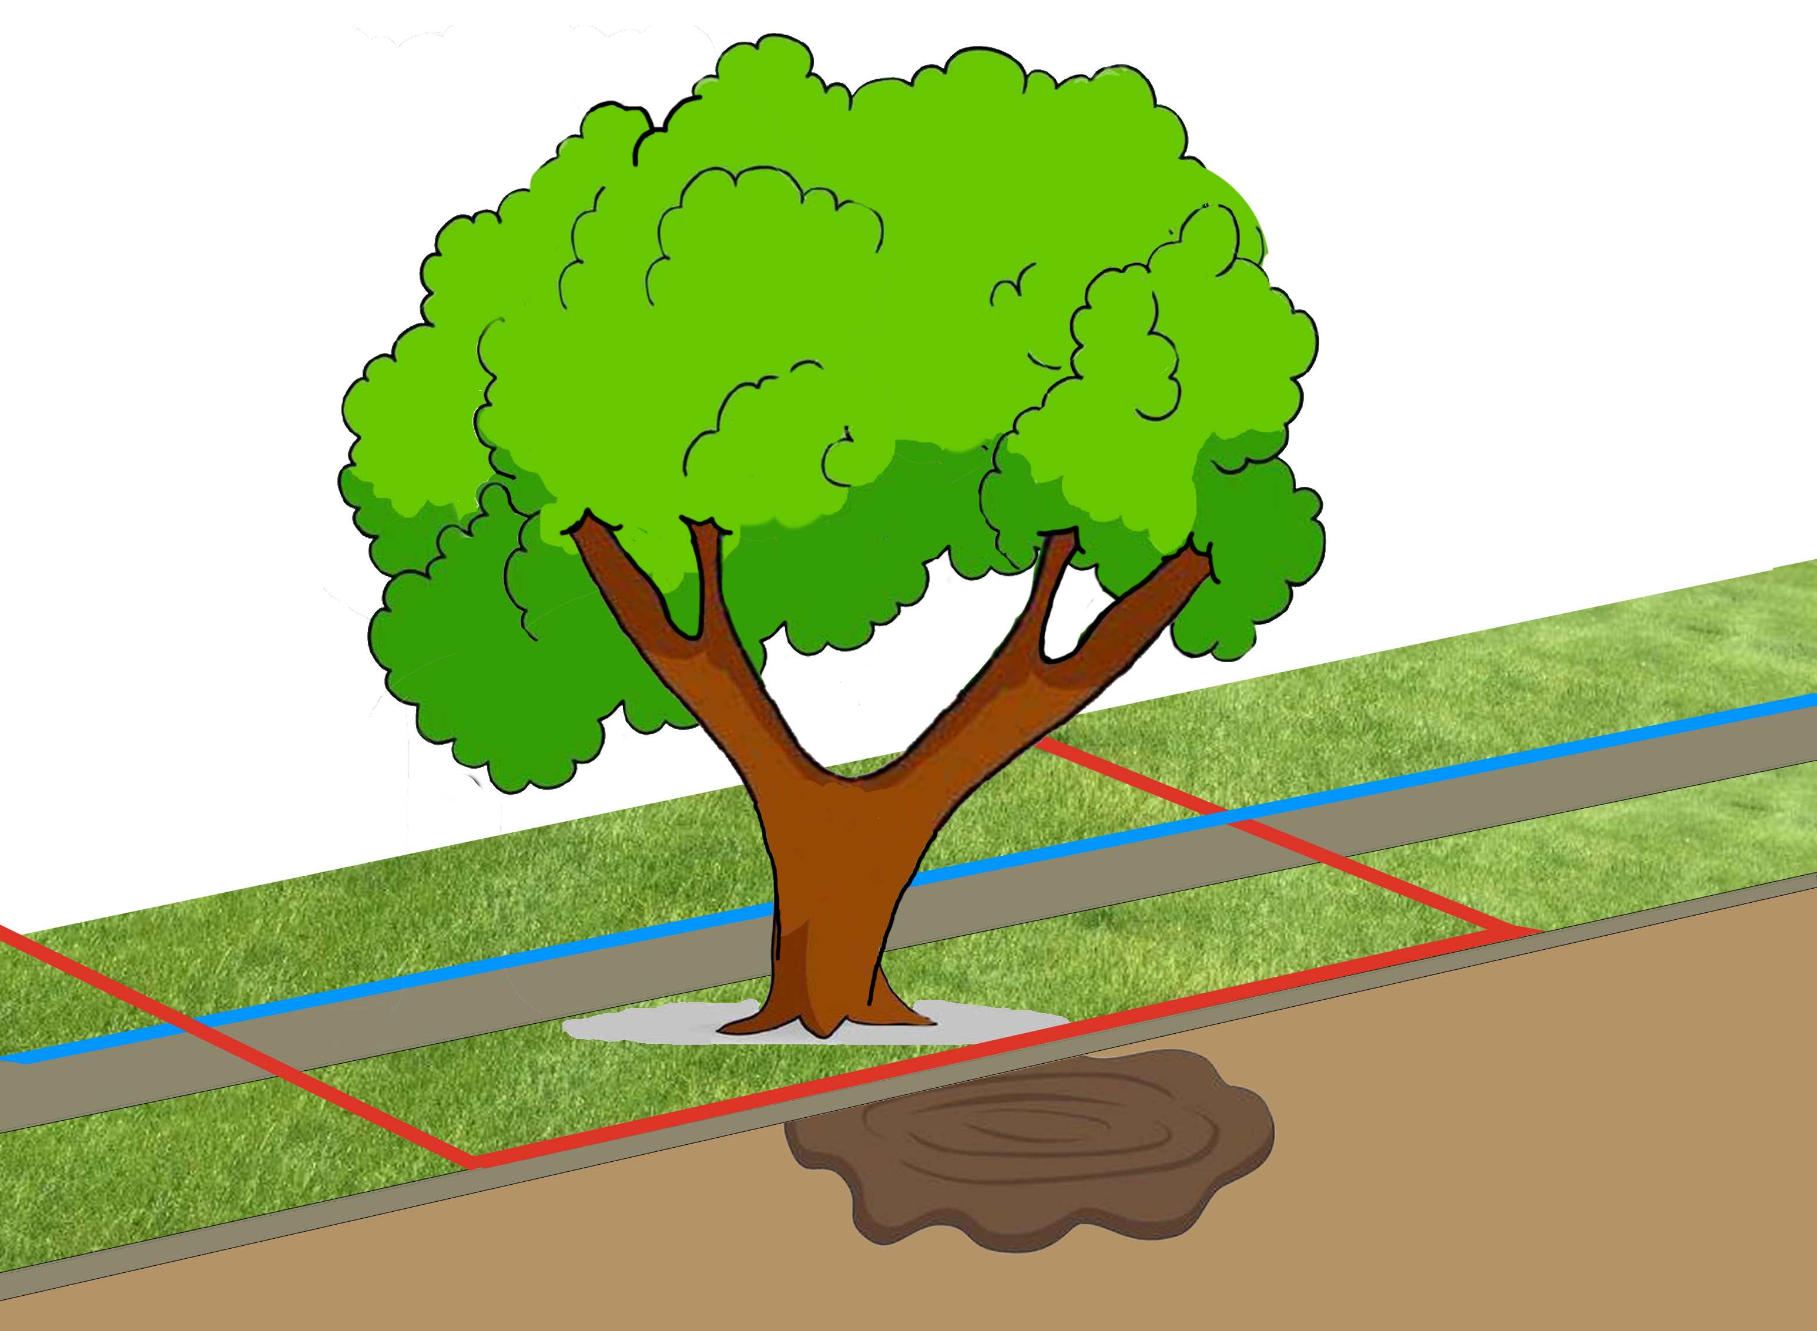
Tate v. City of Greensboro 114 N.C. 392 (NC Sup. Ct. 1894)
Notes:
1894 NC Supreme Ct.
Mattie Tate owned property in the City of Greensborough with street trees out front.
City decided to destroy street trees to cure “conditions of dampness”

Slide 73
Tate v. City of Greensboro 114 N.C. 392 (NC Sup. Ct. 1894)
“The trees standing in the street along the sidewalk are, in a restricted sense, π’s trees. If they are cut or injured by an individual who has no authority from the city to cut or remove them, π may recover damages”

Slide 74
Tate v. City of Greensboro 114 N.C. 392 (NC Sup. Ct. 1894)
“the law gives [cities] an almost absolute discretion in the maintenance of their streets”

Slide 75
Tate v. City of Greensboro 114 N.C. 392 (NC Sup. Ct. 1894)
“the law gives [cities] an almost absolute discretion in the maintenance of their streets”
“No other power can so wisely and judiciously control this subject as the authority of the immediate locality…”

Slide 76
Tate v. City of Greensboro 114 N.C. 392 (NC Sup. Ct. 1894)
“the law gives [cities] an almost absolute discretion in the maintenance of their streets”
“No other power can so wisely and judiciously control this subject as the authority of the immediate locality…”
“The maintenance of such an action would transfer to court and jury the discretion which the law vests in the municipality”

Slide 77
Tate v. City of Greensboro 114 N.C. 392 (NC Sup. Ct. 1894)
DISSENT:

Slide 78
Tate v. City of Greensboro 114 N.C. 392 (NC Sup. Ct. 1894)
DISSENT:
“a shade tree is the property of the abutting owner, which cannot be destroyed, as a nuisance, unless it hinders the free use of the highway by the public”

Slide 79
Tate v. City of Greensboro 114 N.C. 392 (NC Sup. Ct. 1894)
DISSENT:
“a shade tree is the property of the abutting owner, which cannot be destroyed, as a nuisance, unless it hinders the free use of the highway by the public”
“the town [has] the right to remove it ONLY [if] it obstructs the highway…or after condemnation.”

Slide 80
Tate v. City of Greensboro 114 N.C. 392 (NC Sup. Ct. 1894)
DISSENT:
“if the dampness under the dense foliage of the trees made them a nuisance, every shade tree …would be liable to destruction at the arbitrary bidding of any agent of a town”

Slide 81
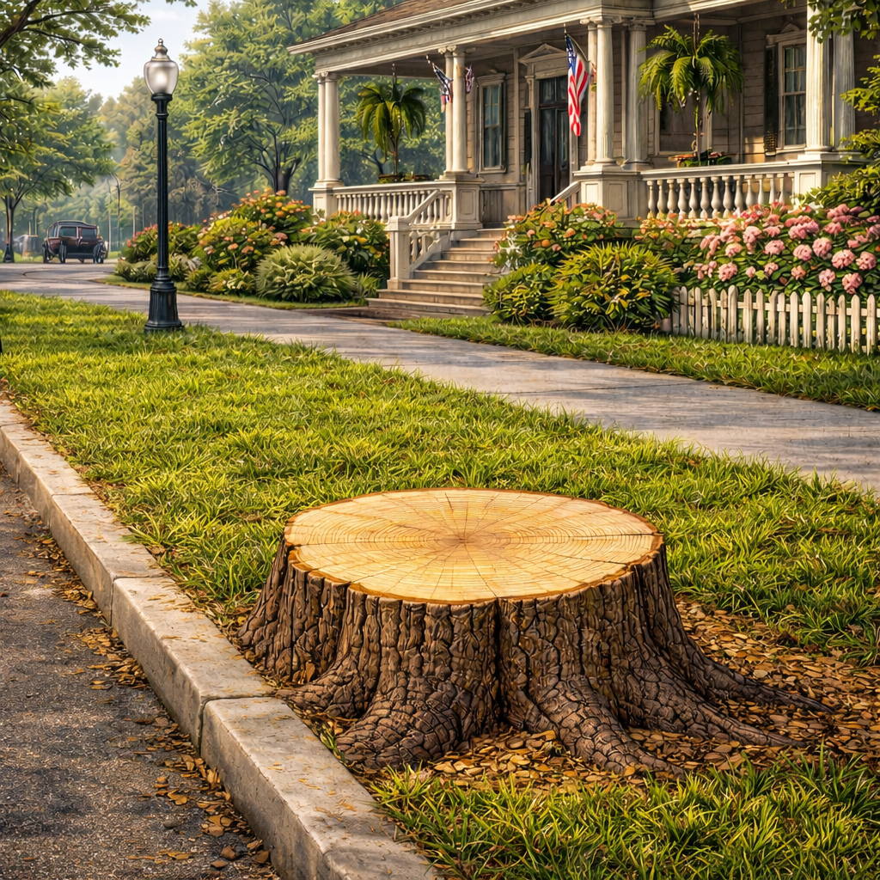
Munday v. Newton 167 N.C. 656 (NC Sup. Ct. 1914)
Notes:
1914 NC Sup. Ct.
Town of Newton removed street trees in front of Eva Munday’s home for “street improvements”
Jury verdict for Munday, Town appealed.
Reversed – nonsuit.

Slide 82
Munday v. Newton 167 N.C. 656 (NC Sup. Ct. 1914)
Court cannot second-guess the aldermen without “erecting a despotism of five men”
Notes:
1914 NC Sup. Ct.
Town of Newton removed street trees in front of Eva Munday’s home.
Jury verdict for Munday, Town appealed.
Reversed – nonsuit.

Slide 83
Munday v. Newton 167 N.C. 656 (NC Sup. Ct. 1914)
Court cannot second-guess the aldermen without “erecting a despotism of five men”
“Mistake in judgment…cannot be corrected…by this court”
Notes:
1914 NC Sup. Ct.
Town of Newton removed street trees in front of Eva Munday’s home.
Jury verdict for Munday, Town appealed.
Reversed – nonsuit.

Slide 84
Munday v. Newton 167 N.C. 656 (NC Sup. Ct. 1914)
Court cannot second-guess the aldermen without “erecting a despotism of five men”
“Mistake in judgment…cannot be corrected…by this court”
“For the exercise of powers conferred by the Constitution the people must rely upon the honesty of…the persons elected to fill places of trust.”
Notes:
1914 NC Sup. Ct.
Town of Newton removed street trees in front of Eva Munday’s home.
Jury verdict for Munday, Town appealed.
Reversed – nonsuit.

Slide 85
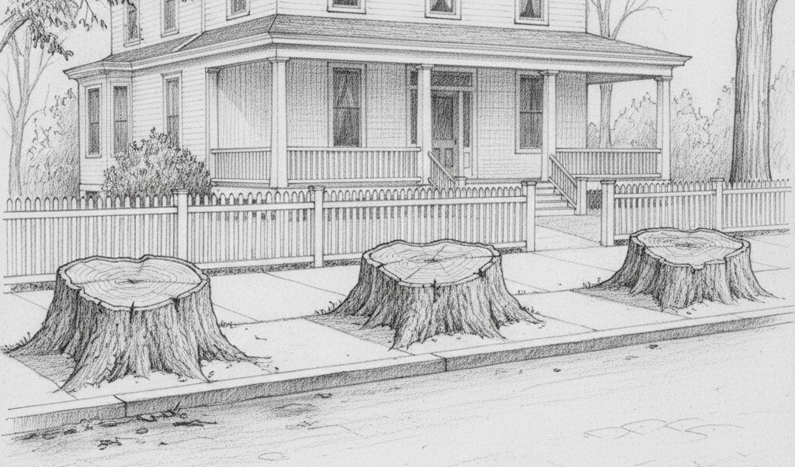
Rosenthal v. Goldsboro 149 N.C. 128 (NC Sup. Ct. 1908)
Notes:
1908 NC Sup. Ct.
Eva Rosenthal owned home in City of Goldsboro with street trees
City removed the trees because roots damaged sewer
Trial court judgment for Rosenthal, City appealed.
Reversed, should have been nonsuit.

Slide 86
Rosenthal v. Goldsboro 149 N.C. 128 (NC Sup. Ct. 1908)
“…it would lead to most deplorable results if municipal governments could be stopped or hindered in their efforts taken in good faith to preserve the public health”
Notes:
1908 NC Sup. Ct.
Eva Rosenthal owned home in City of Goldsboro with street trees
City removed the trees because roots damaged sewer
Trial court judgment for Rosenthal, City appealed.
Reversed, should have been nonsuit.

Slide 87
Rosenthal v. Goldsboro 149 N.C. 128 (NC Sup. Ct. 1908)
“…it would lead to most deplorable results if municipal governments could be stopped or hindered in their efforts taken in good faith to preserve the public health”
“…there is no legal right…infringed upon”
Notes:
1908 NC Sup. Ct.
Eva Rosenthal owned home in City of Goldsboro with street trees
City removed the trees because roots damaged sewer
Trial court judgment for Rosenthal, City appealed.
Reversed, should have been nonsuit.

Slide 88
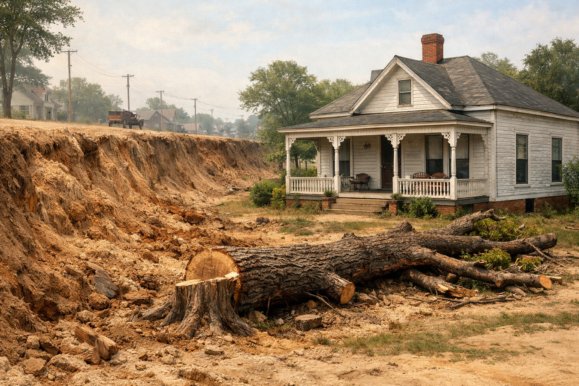
Hoyle v. City of Hickory 167 N.C. 619 (NC Sup. Ct. 1914)
Notes:
1914 NC Sup. Ct.
Ollie Hoyle owned property fronted by street trees in City of Hickory, NC
City raised grade of the street and cut down a tree in front of her house.
At trial, jury found grading was negligently done, resulting in harm to Hoyle.
Hickory appealed. Affirmed.

Slide 89
Hoyle v. City of Hickory 167 N.C. 619 (NC Sup. Ct. 1914)
“For any inconvenience or damage sustained…from placing the fill in the street…plaintiffs cannot recover

Slide 90
Hoyle v. City of Hickory 167 N.C. 619 (NC Sup. Ct. 1914)
“For any inconvenience or damage sustained…from placing the fill in the street…plaintiffs cannot recover
UNLESS the work was done negligently.”

Slide 91
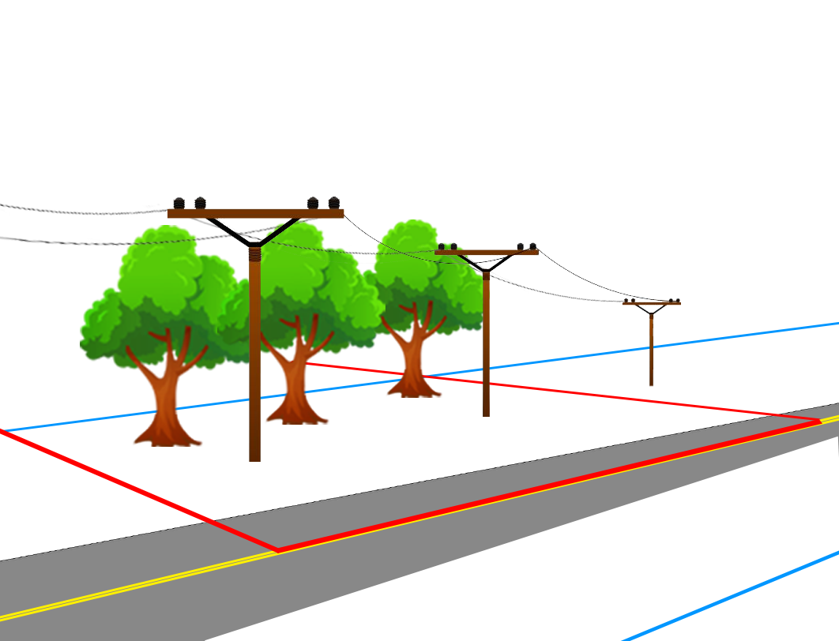
Moore v. Carolina Power & Light Co. 163 N.C. 300 (NC Sup. Ct. 1913)
Notes:
1913 NC Sup. Ct.
Van Moore owned home in Raleigh, NC with street trees in ROW in front of his home.
Raleigh granted Carolina Power the right to erect electric lines and poles along ROW.
Carolina Power cut Moore’s trees because they were in the way.
Moore sued. Trial court granted judgment for Carolina Power. Moore appealed.
Reversed, city cannot delegate power to manage trees to utility.

Slide 92
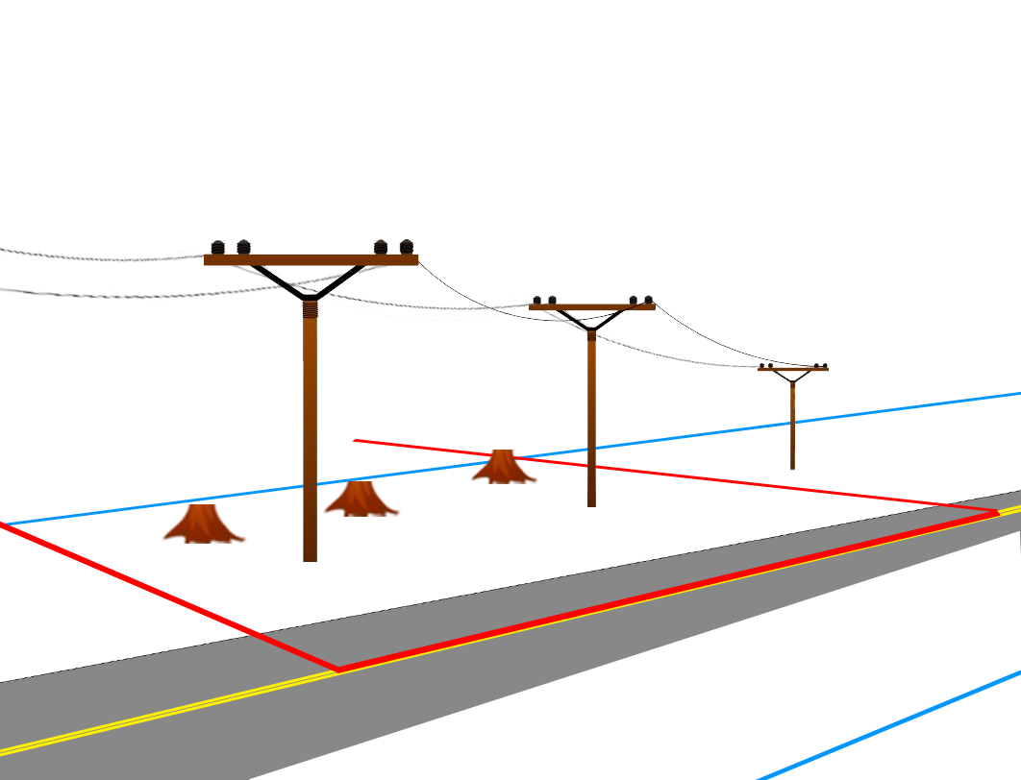
Moore v. Carolina Power & Light Co. 163 N.C. 300 (NC Sup. Ct. 1913)
Notes:
1913 NC Sup. Ct.
Van Moore owned home in Raleigh, NC with street trees in ROW in front of his home.
Raleigh granted Carolina Power the right to erect electric lines and poles along ROW.
Carolina Power cut Moore’s trees because they were in the way.
Moore sued. Trial court granted judgment for Carolina Power. Moore appealed.
Reversed, city cannot delegate power to manage trees to utility.

Slide 93
Moore v. Carolina Power & Light Co. 163 N.C. 300 (NC Sup. Ct. 1913)
“The city…can, in its discretion, cut down or trim up the trees bordering the streets”

Slide 94
Moore v. Carolina Power & Light Co. 163 N.C. 300 (NC Sup. Ct. 1913)
“The city…can, in its discretion, cut down or trim up the trees bordering the streets”
HOWEVER
“The city cannot transfer…this superior right which it can exercise only for the public benefit.”

Slide 95
Moore v. Carolina Power & Light Co. 163 N.C. 300 (NC Sup. Ct. 1913)
“[Moore’s] property in the tree (subject to the superior right of the city to cut or remove it for public purposes)…entitle him to compensation for the loss.”

Slide 96
Brown v. Asheville Electric Light Co. 51 S.E. 62 (NC Sup. Ct. 1905)
Notes:
1905 NC Sup. Ct.
B.C. Brown owned property in Asheville, NC fronted by street trees
Asheville gave Utility right to erect poles and lines.
Utility chopped Brown’s trees. Brown sued.
Trial court held for Brown, Utility appealed. Affirmed.

Slide 97
Brown v. Asheville Electric Light Co. 51 S.E. 62 (NC Sup. Ct. 1905)
“The Legislature had no power itself to empower corporations to appropriate private property without compensation”
Notes:
1905 NC Sup. Ct.
B.C. Brown owned property in Asheville, NC fronted by street trees
Asheville gave Utility right to erect poles and lines.
Utility chopped Brown’s trees. Brown sued.
Trial court held for Brown, Utility appealed. Affirmed.

Slide 98
Brown v. Asheville Electric Light Co. 51 S.E. 62 (NC Sup. Ct. 1905)
“The Legislature had no power itself to empower corporations to appropriate private property without compensation”
“…the city has no power to confer authority except in the manner and for the purpose for which it may do the act itself.”
Notes:
1905 NC Sup. Ct.
B.C. Brown owned property in Asheville, NC fronted by street trees
Asheville gave Utility right to erect poles and lines.
Utility chopped Brown’s trees. Brown sued.
Trial court held for Brown, Utility appealed. Affirmed.

Slide 99
Brown v. Asheville Electric Light Co. 51 S.E. 62 (NC Sup. Ct. 1905)
“The Legislature had no power itself to empower corporations to appropriate private property without compensation”
“…the city has no power to confer authority except in the manner and for the purpose for which it may do the act itself.”
“…shade trees may not be removed, except when necessary for the use of the street”
Notes:
1905 NC Sup. Ct.
B.C. Brown owned property in Asheville, NC fronted by street trees
Asheville gave Utility right to erect poles and lines.
Utility chopped Brown’s trees. Brown sued.
Trial court held for Brown, Utility appealed. Affirmed.

Slide 100
Brown v. Asheville Electric Light Co. 51 S.E. 62 (NC Sup. Ct. 1905)
“The Legislature had no power itself to empower corporations to appropriate private property without compensation”
“…the city has no power to confer authority except in the manner and for the purpose for which it may do the act itself.”
“…shade trees may not be removed, except when necessary for the use of the street”
Notes:
1905 NC Sup. Ct.
B.C. Brown owned property in Asheville, NC fronted by street trees
Asheville gave Utility right to erect poles and lines.
Utility chopped Brown’s trees. Brown sued.
Trial court held for Brown, Utility appealed. Affirmed.

Slide 101
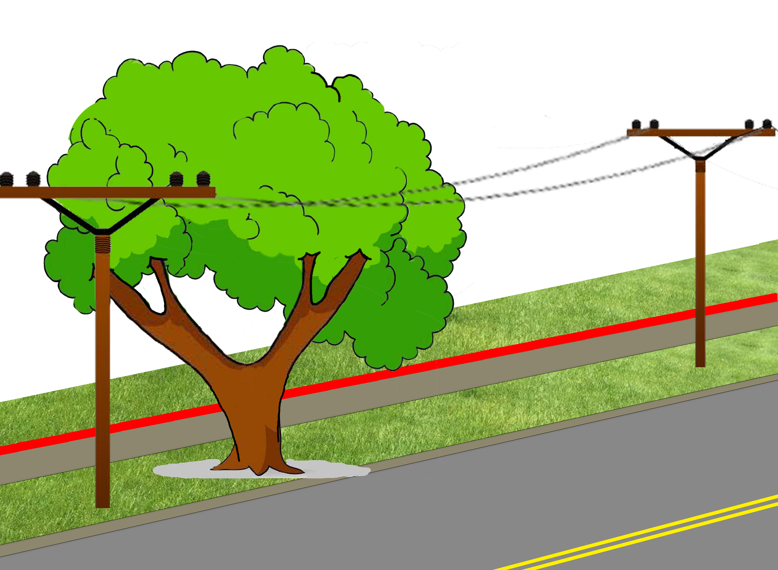
Wheeler v. Norfolk Carolina Tel. & Tel. Co. 172 N.C. 9 (NC Sup. Ct. 1916)
Notes:
NC Supreme Court
1914 Edenton, NC
Norfolk Carolina Telephone Co. pruned street tree fronting Wheeler’s property
The CITY owned the land on which the tree stood – NOT WHEELER
Wheeler sued for property damage.

Slide 102
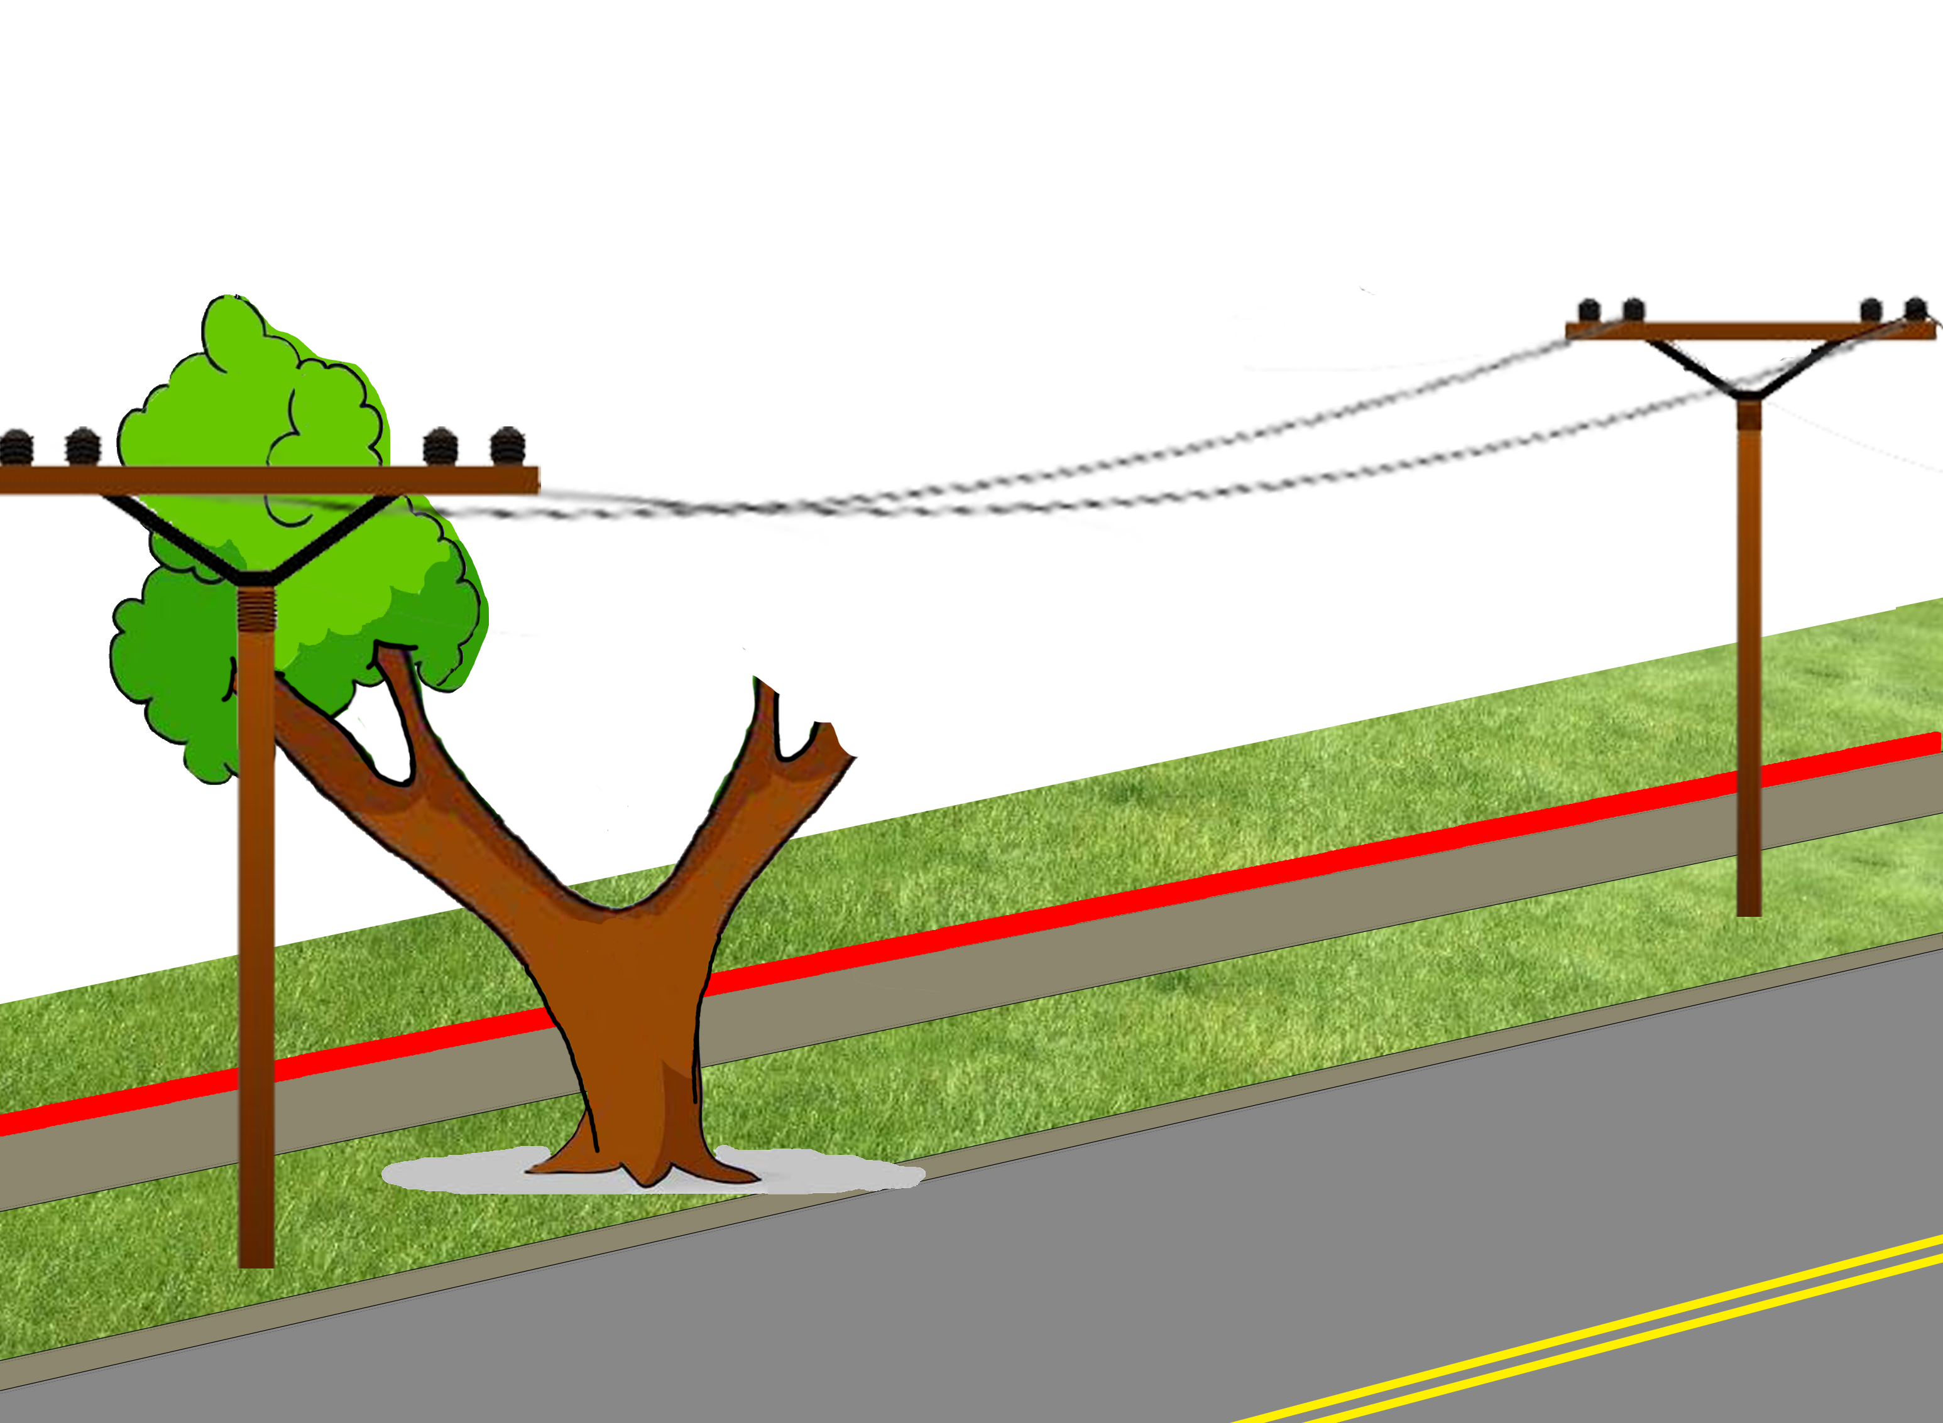
Wheeler v. Norfolk Carolina Tel. & Tel. Co. 172 N.C. 9 (NC Sup. Ct. 1916)
Notes:
NC Supreme Court
1914 Edenton, NC
Norfolk Carolina Telephone Co. pruned street tree fronting Wheeler’s property
The CITY owned the land on which the tree stood – NOT WHEELER
Wheeler sued for property damage.

Slide 103
Wheeler v. Norfolk Carolina Tel. & Tel. Co. 172 N.C. 9 (NC Sup. Ct. 1916)
Doesn’t matter that CITY owns the streets
“[Wheeler] continued to have a proprietary interest in a shade tree, standing on or near his sidewalk…”

Slide 104
Wheeler v. Norfolk Carolina Tel. & Tel. Co. 172 N.C. 9 (NC Sup. Ct. 1916)
“wretched would be the policy which required the title to be shown in every instance where the peaceable possession was disturbed by an intruder who had no right.”

Slide 105
Street Trees - Summary
Obstructions
City’s power to remove obstructions
Separation of powers
Delegation of powers
Private rights in off-property ROW trees

Slide 106
Utility Vegetation Management
Duke Energy Progress Inc. v. Kane 827 S.E.2d 312 (NC Ct. App. 2019)
Patterson v. Duke Power Co. 256 S.C. 479 (SC Sup. Ct. 1971)
SC Pub. Serv. Authority v. Ocean Forest, Inc. 275 S.C. 552 (SC Sup. Ct. 1981)
Weyerhaeuser Co. v. Carolina Power & Light 127 S.E.2d 539 (NC Sup. Ct. 1962)
Duke Energy Corp. v. Malcolm 178 N.C. App. 62 (2006)
Notes:
4 cases (+1 supplemental)

Slide 107
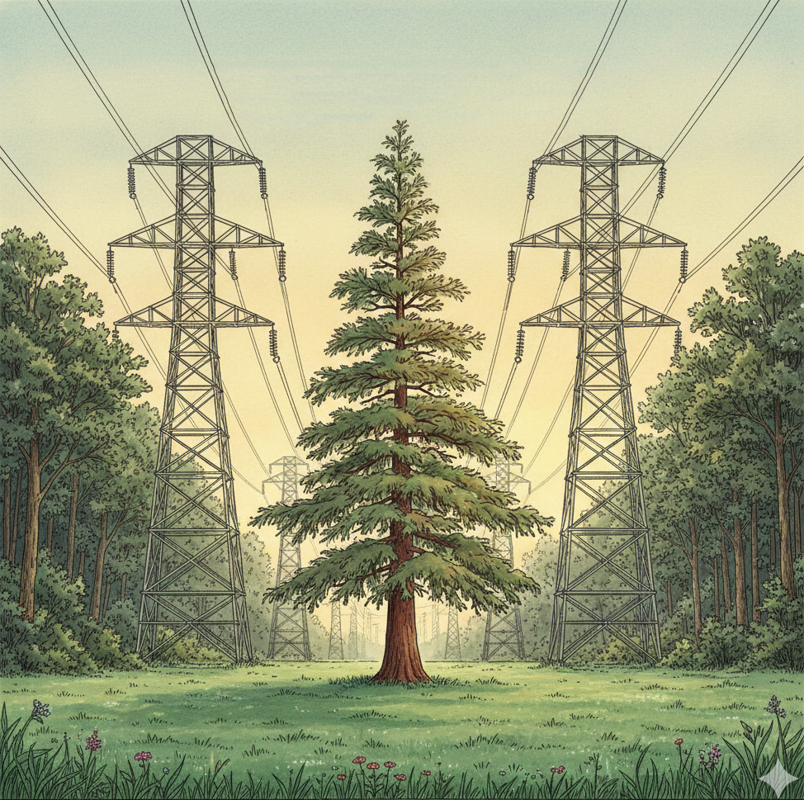
Duke Energy Progress Inc. v. Kane 827 S.E.2d 312 (NC Ct. App. 2019)
Notes:
NC Ct. App. 2019
Duke Energy owned easement over John and Katherine Kane’s property in Wake County, NC.
A 44-ft willow tree and a 57-ft dawn redwood tree grew in the easement. Power line was 10 feet above willow and 6 feet above redwood.
Kanes refused access. Duke sued for declaratory relief.
Kanes argued:
statute of limitations because didn’t cut tree for long time
Scope of easement didn’t allow removal of tree
Trial court held that “irreparable injury” would result if Duke could not remove tree.

Slide 108
Duke Energy Progress Inc. v. Kane 827 S.E.2d 312 (NC Ct. App. 2019)
“An easement…is…real property because it implies an interest in the land that grants a degree of control over a specified portion of land.”

Slide 109
Duke Energy Progress Inc. v. Kane 827 S.E.2d 312 (NC Ct. App. 2019)
“An easement…is…real property because it implies an interest in the land that grants a degree of control over a specified portion of land.”
Duke Energy “forever holds [the] easement right and has the right to maintain the lines.”

Slide 110
Duke Energy Progress Inc. v. Kane 827 S.E.2d 312 (NC Ct. App. 2019)
“An easement…is…real property because it implies an interest in the land that grants a degree of control over a specified portion of land.”
Duke Energy “forever holds [the] easement right and has the right to maintain the lines.”

Slide 111
Duke Energy Progress Inc. v. Kane 827 S.E.2d 312 (NC Ct. App. 2019)
Duke Energy’s right to cut “is not absolute”
“removal must be justified and reasonable.”

Slide 112
Duke Energy Progress Inc. v. Kane 827 S.E.2d 312 (NC Ct. App. 2019)
Duke Energy’s right to cut “is not absolute”
“removal must be justified and reasonable.”
HOWEVER

Slide 113
Duke Energy Progress Inc. v. Kane 827 S.E.2d 312 (NC Ct. App. 2019)
Duke Energy’s right to cut “is not absolute”
“removal must be justified and reasonable.”
HOWEVER
“…it remains a matter of record that the removal of the redwood tree was necessary to prevent irreparable injury to [Duke’s] easement.”

Slide 114
Duke Energy Progress Inc. v. Kane 827 S.E.2d 312 (NC Ct. App. 2019)
Duke Energy’s right to cut “is not absolute”
“removal must be justified and reasonable.”
HOWEVER
“…it remains a matter of record that the removal of the redwood tree was necessary to prevent irreparable injury to [Duke’s] easement.”

Slide 115
Duke Energy Progress Inc. v. Kane 827 S.E.2d 312 (NC Ct. App. 2019)
CONCUR:
“[the easement language] does not limit [Duke’s] ‘right to clear and keep cleared’ the right of way by cutting down any trees that are within it.”

Slide 116
Duke Energy Progress Inc. v. Kane 827 S.E.2d 312 (NC Ct. App. 2019)
CONCUR:
“[the easement language] does not limit [Duke’s] ‘right to clear and keep cleared’ the right of way by cutting down any trees that are within it.”

Slide 117
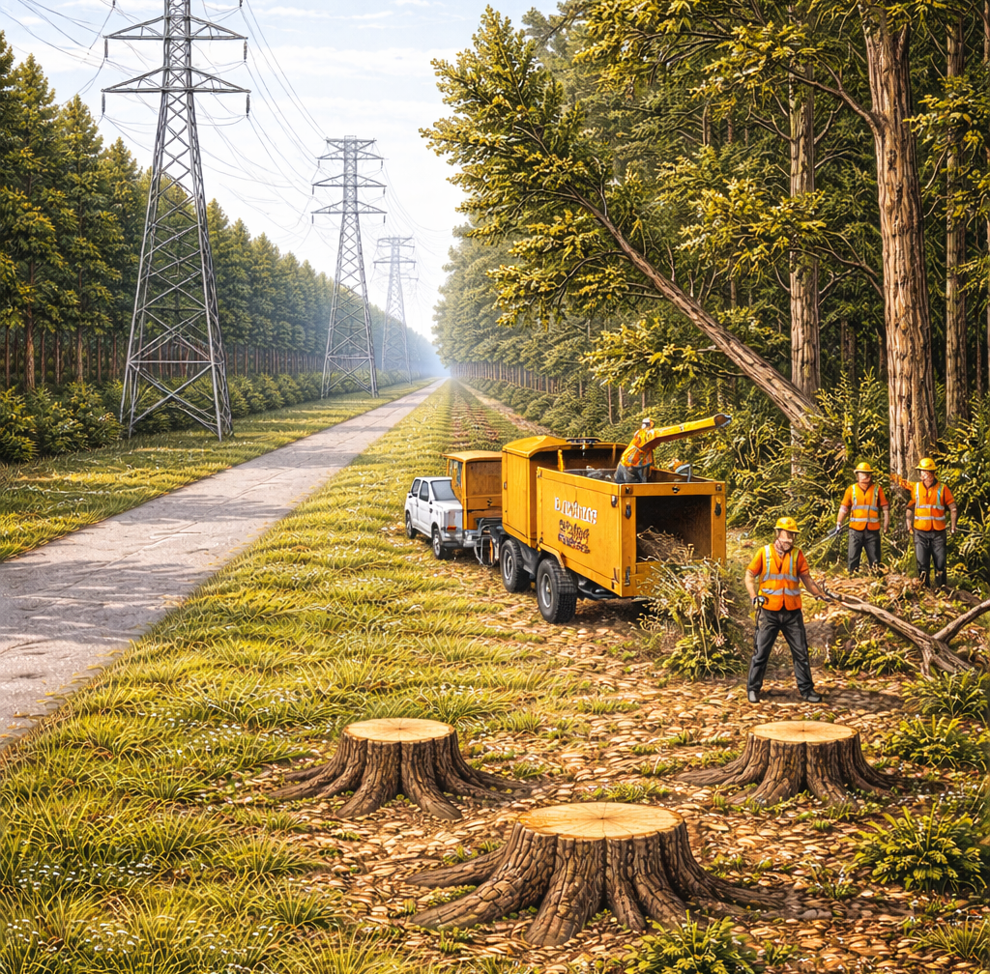
Patterson v. Duke Power Co. 256 S.C. 479 (SC Sup. Ct. 1971)
Notes:
SC Sup. Ct. 1971
Duke Energy owned easement over William and Lena Patterson’s property in Pickens County, SC.
Easement did not specify the width of the right-of-way.
Easement gave Duke “the right to cut away and keep clear of said lines all trees and other like obstructions that may, in any way, endanger the proper operation of the same.”
For many years, Duke regularly pruned the ROW 20-25 feet clear from the center line.
Duke removed many large trees that were located “a considerable distance” from the lines.
Trial court found for Pattersons. Trial court: (1) ordered Duke to pay damages, and (2) enjoined all future pruning beyond 25-ft vertical plane.
Duke paid the damages judgment but appealed the injunction.

Slide 118
Patterson v. Duke Power Co. 256 S.C. 479 (SC Sup. Ct. 1971)
25 ft
Notes:
SC Sup. Ct. 1971
Duke Energy owned easement over William and Lena Patterson’s property in Pickens County, SC.
Easement did not specify the width of the right-of-way.
Easement gave Duke “the right to cut away and keep clear of said lines all trees and other like obstructions that may, in any way, endanger the proper operation of the same.”
For many years, Duke regularly pruned the ROW 20-25 feet clear from the center line.
Duke removed many large trees that were located “a considerable distance” from the lines.
Trial court found for Pattersons. Trial court: (1) ordered Duke to pay damages, and (2) enjoined all future pruning beyond 25-ft vertical plane.
Duke paid the damages judgment but appealed the injunction.

Slide 119
Patterson v. Duke Power Co. 256 S.C. 479 (SC Sup. Ct. 1971)
“Danger Trees” = “trees which, by reason of size or condition, and contiguity to [Duke’s] right of way, involve a concrete threat of injury to [Duke’s] transmission or telephone lines”

Slide 120
Patterson v. Duke Power Co. 256 S.C. 479 (SC Sup. Ct. 1971)
“…the right to…keep the transmission lines clear of danger trees does not limit [Duke] to trim…only trees or branches that overhang the transmission lines in a vertical plane,

Slide 121
Patterson v. Duke Power Co. 256 S.C. 479 (SC Sup. Ct. 1971)
“…the right to…keep the transmission lines clear of danger trees does not limit [Duke] to trim…only trees or branches that overhang the transmission lines in a vertical plane, but the right is granted to cut away all trees that may in any way endanger the proper operation of the said transmission lines.”

Slide 122
Patterson v. Duke Power Co. 256 S.C. 479 (SC Sup. Ct. 1971)
“[Duke] had a right to remove any and all trees which would endanger the proper operation of the transmission lines whether such trees were within or without the normal right-of-way”

Slide 123
Patterson v. Duke Power Co. 256 S.C. 479 (SC Sup. Ct. 1971)
“[Duke] had a right to remove any and all trees which would endanger the proper operation of the transmission lines whether such trees were within or without the normal right-of-way”

Slide 124
Patterson v. Duke Power Co. 256 S.C. 479 (SC Sup. Ct. 1971)
HOWEVER
If Duke cuts beyond what is “reasonably sufficient,” then “[Patterson] may recover damages”

Slide 125
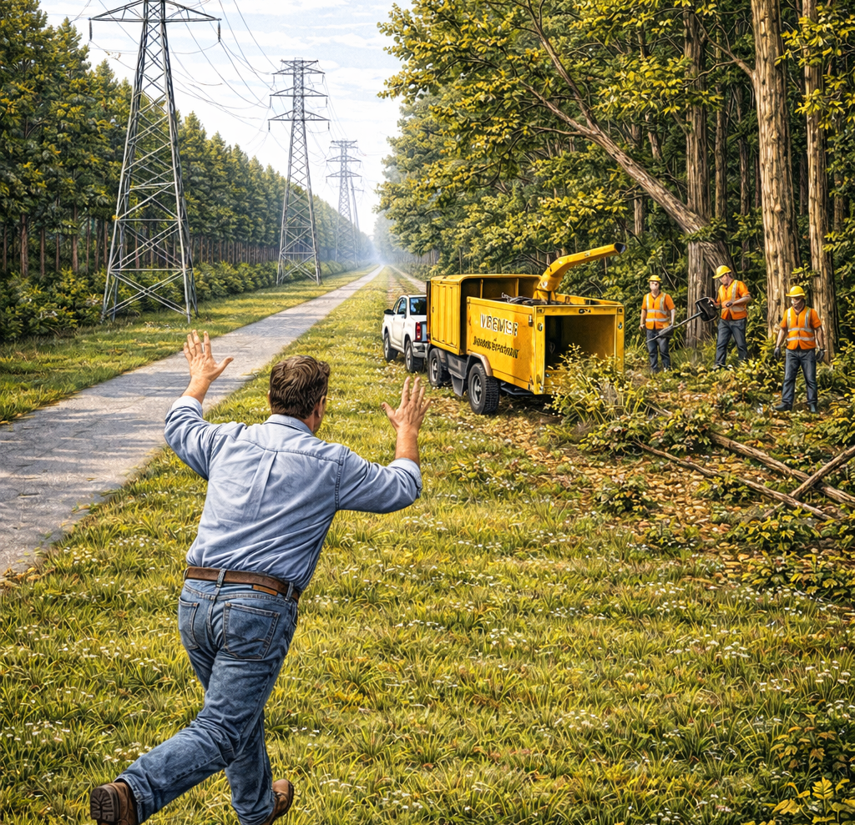
SC Pub. Serv. Authority v. Ocean Forest, Inc. 275 S.C. 552 (SC Sup. Ct. 1981)
Notes:
SC Sup. Ct. 1981
Ocean Forest Inc. owned land burdened by an electrical transmission easement.
SC Public Service Authority attempted to clear “danger trees,” and Ocean Forest refused access.
Trial court enjoined Ocean Forest from interfering with SC Pub. Serv. Auth.
Ocean Forest appealed.
INJUNCTION VALID. Damages are the remedy.

Slide 126
SC Pub. Serv. Authority v. Ocean Forest, Inc. 275 S.C. 552 (SC Sup. Ct. 1981)
“…the right to clear…a strip 25 feet wide…as well as all danger trees at a greater distance which would injure the transmission line in falling.”

Slide 127
SC Pub. Serv. Authority v. Ocean Forest, Inc. 275 S.C. 552 (SC Sup. Ct. 1981)
“Danger Trees” = “trees which, by reason of size or condition, and contiguity to [the] right of way, involve a concrete threat of injury to [the] transmission or telephone lines”

Slide 128
SC Pub. Serv. Authority v. Ocean Forest, Inc. 275 S.C. 552 (SC Sup. Ct. 1981)
“Danger Trees” = “trees which, by reason of size or condition, and contiguity to [the] right of way, involve a concrete threat of injury to [the] transmission or telephone lines”
“trees which have come to be dangerous since the grant are to be included in the class guarded against.”

Slide 129
SC Pub. Serv. Authority v. Ocean Forest, Inc. 275 S.C. 552 (SC Sup. Ct. 1981)
“[Ocean Forest] has a remedy at law or in equity for damages…if the Authority exceeded the scope of its easement.”

Slide 130
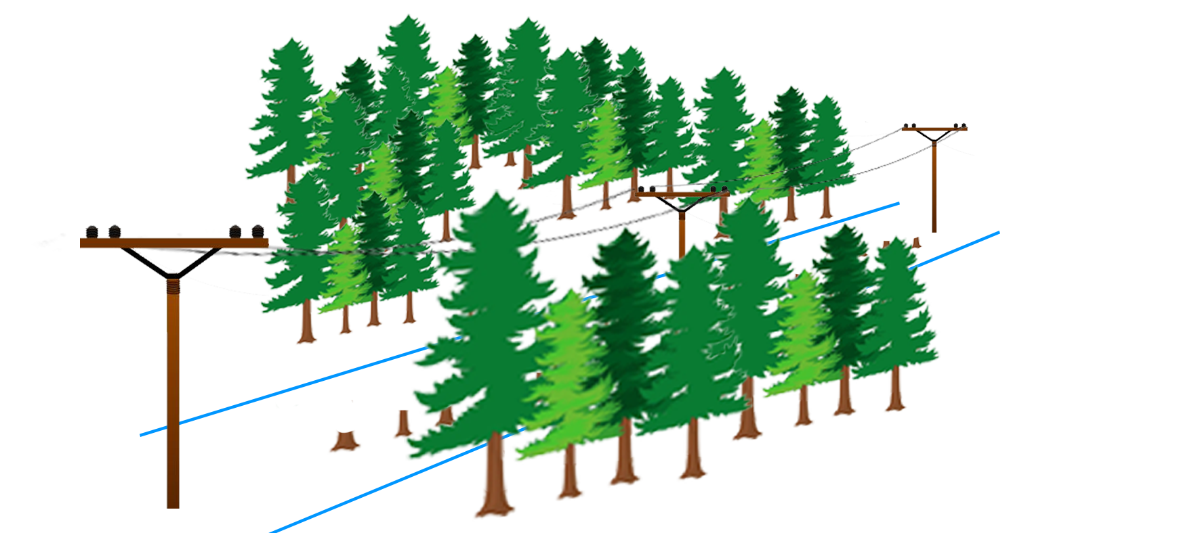
Weyerhaeuser Co. v. Carolina Power & Light 127 S.E.2d 539 (NC Sup. Ct. 1962)
Notes:
NC Sup. Ct. 1962
Carolina Power & Light owned a utility easement over Weyerhaeuser Co.’s land in Pender County, NC (north of Wilmington)
The easement provided the right to clear the easement to its full width AND
“keep clear all trees that might in any way endanger the proper operation, including all trees off the right-of-way, which in falling might endanger the line.”
Weyerhaeuser AGREED Utility has the right to cut off-easement trees, but sued for VALUE of off-easement trees cut
Trial court dismissed action, Weyerhaeuser appealed.
Right to cut trees was included in the contract.

Slide 131
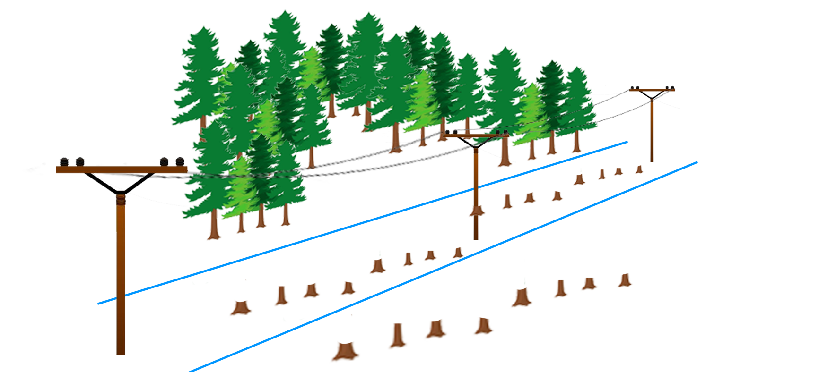
Weyerhaeuser Co. v. Carolina Power & Light 127 S.E.2d 539 (NC Sup. Ct. 1962)
Notes:
NC Sup. Ct. 1962
Carolina Power & Light owned a utility easement over Weyerhaeuser Co.’s land in Pender County, NC (north of Wilmington)
The easement provided the right to clear the easement to its full width AND
“keep clear all trees that might in any way endanger the proper operation, including all trees off the right-of-way, which in falling might endanger the line.”
Weyerhaeuser AGREED Utility has the right to cut off-easement trees, but sued for VALUE of off-easement trees cut
Trial court dismissed action, Weyerhaeuser appealed.
Right to cut trees was included in the contract.

Slide 132
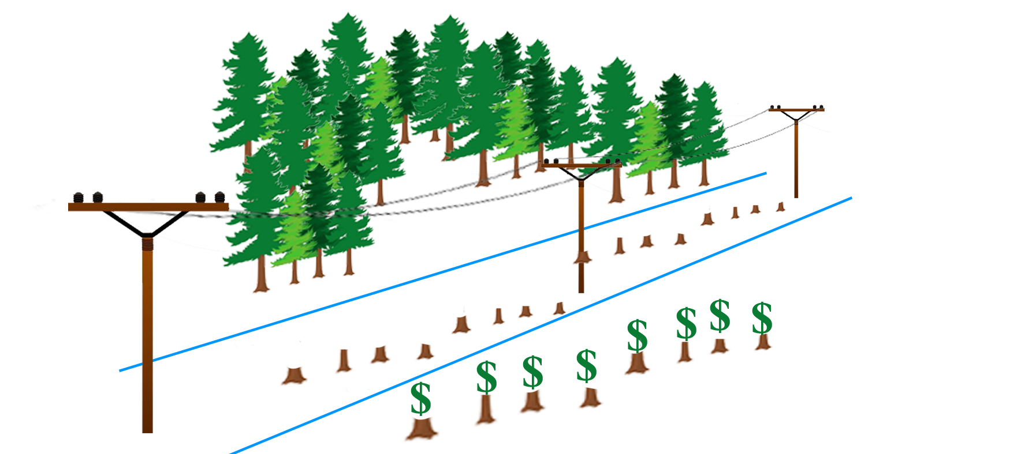
Weyerhaeuser Co. v. Carolina Power & Light 127 S.E.2d 539 (NC Sup. Ct. 1962)
Notes:
NC Sup. Ct. 1962
Carolina Power & Light owned a utility easement over Weyerhaeuser Co.’s land in Pender County, NC (north of Wilmington)
The easement provided the right to clear the easement to its full width AND
“keep clear all trees that might in any way endanger the proper operation, including all trees off the right-of-way, which in falling might endanger the line.”
Weyerhaeuser AGREED Utility has the right to cut off-easement trees, but sued for VALUE of off-easement trees cut
Trial court dismissed action, Weyerhaeuser appealed.
Right to cut trees was included in the contract.

Slide 133
Weyerhaeuser Co. v. Carolina Power & Light 127 S.E.2d 539 (NC Sup. Ct. 1962)
“The mere right-of-way…would be of little value without the right to maintain and protect the line.”
The right to cut danger trees was already included in the easement, so no new compensation is required.

Slide 134
Weyerhaeuser Co. v. Carolina Power & Light 127 S.E.2d 539 (NC Sup. Ct. 1962)
HOWEVER
“[Weyerhaeuser] may anticipate cutting by [Carolina Power] and…dispose of the trees at a time and in a manner which will best serve [Weyerhaeuser’s] advantage.”

Slide 135
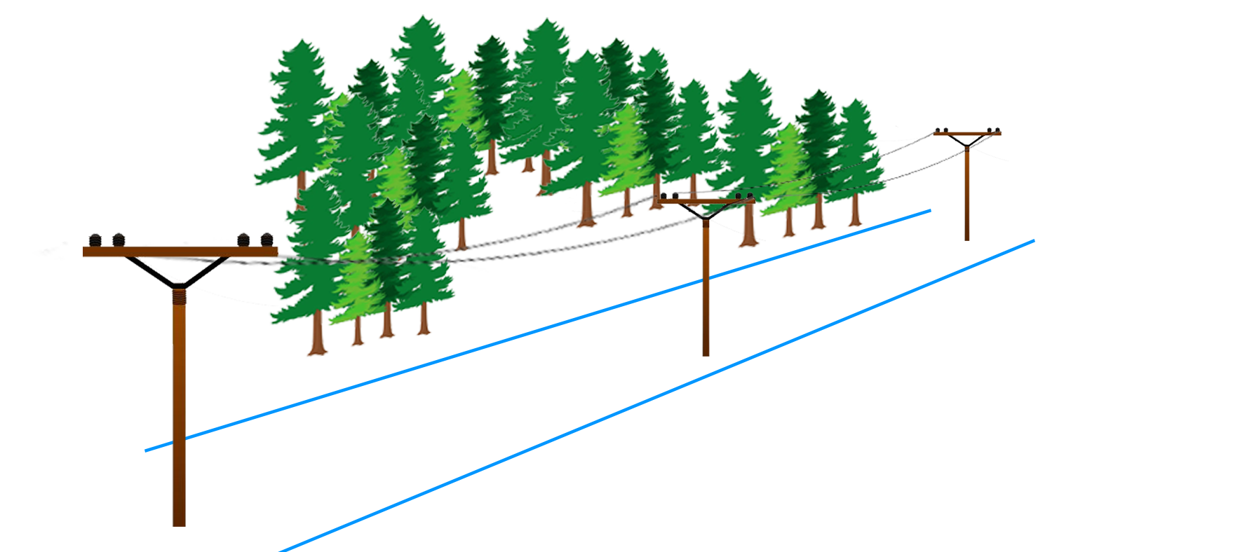
Duke Energy Corp. v. Malcolm 178 N.C. App. 62 (NC Ct. App. 2006)
Notes:
NC Ct. App. 2006
Wendell Malcolm owned land burdened by a Duke Energy utility easement at I-485 and Route 16 near Charlotte, NC
Malcolm planned to develop land into “Callabridge Landing” shopping mall
Mr. Malcolm planted crape myrtles in the right of way.
Duke objected to Mr. Malcolm’s trees, but Mr. Malcolm refused to remove them.
Duke sued. Trial court ordered the trees removed. Mr. Malcolm appealed.
Can Duke order removal of the crape myrtles?

Slide 136
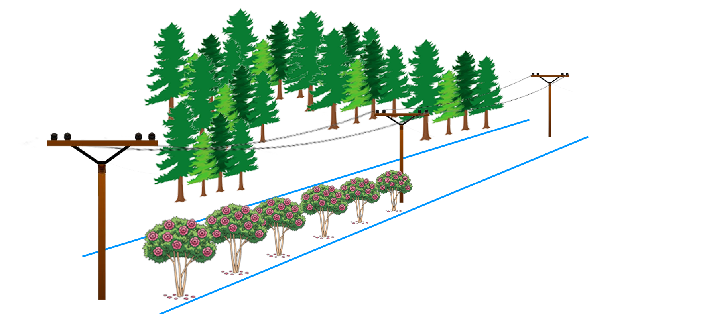
Duke Energy Corp. v. Malcolm 178 N.C. App. 62 (NC Ct. App. 2006)
Notes:
NC Ct. App. 2006
Wendell Malcolm owned land burdened by a Duke Energy utility easement at I-485 and Route 16 near Charlotte, NC
Malcolm planned to develop land into “Callabridge Landing” shopping mall
Mr. Malcolm planted crape myrtles in the right of way.
Duke objected to Mr. Malcolm’s trees, but Mr. Malcolm refused to remove them.
Duke sued. Trial court ordered the trees removed. Mr. Malcolm appealed.
Can Duke order removal of the crape myrtles?

Slide 137
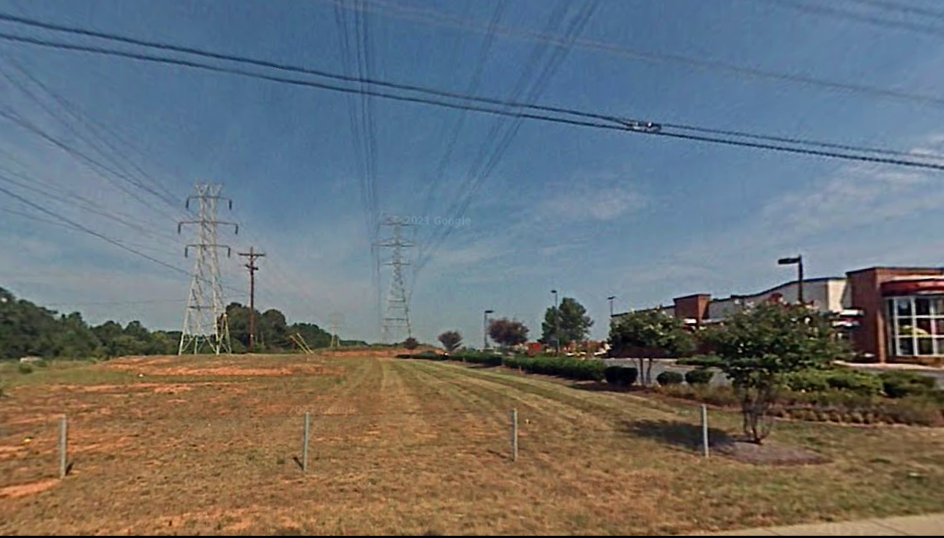
Duke Energy Corp. v. Malcolm 178 N.C. App. 62 (NC Ct. App. 2006)
Notes:
NC Ct. App. 2006
Wendell Malcolm owned land burdened by a Duke Energy utility easement at I-485 and Route 16 near Charlotte, NC
Malcolm planned to develop land into “Callabridge Landing” shopping mall
Mr. Malcolm planted crape myrtles in the right of way.
Duke objected to Mr. Malcolm’s trees, but Mr. Malcolm refused to remove them.
Duke sued. Trial court ordered the trees removed. Mr. Malcolm appealed.
Can Duke order removal of the crape myrtles?

Slide 138
Duke Energy Corp. v. Malcolm 178 N.C. App. 62 (NC Ct. App. 2006)
“…the right for [Duke] at any time to…keep said strip clear of any and all structures, trees, fire hazards and other objects of any nature”
Notes:
NC Ct. App. 2006
Wendell Malcolm owned land burdened by a Duke Energy utility easement at I-485 and Route 16 near Charlotte, NC
Malcolm planned to develop land into “Callabridge Landing” shopping mall
Mr. Malcolm planted crape myrtles in the right of way.
Duke objected to Mr. Malcolm’s trees, but Mr. Malcolm refused to remove them.
Duke sued. Trial court ordered the trees removed. Mr. Malcolm appealed.
Can Duke order removal of the crape myrtles?

Slide 139
Duke Energy Corp. v. Malcolm 178 N.C. App. 62 (NC Ct. App. 2006)
“planting of trees…is necessarily inconsistent with the enumerated right…to keep the land clear of such trees”

Slide 140
Duke Energy Corp. v. Malcolm 178 N.C. App. 62 (NC Ct. App. 2006)
“planting of trees…is necessarily inconsistent with the enumerated right…to keep the land clear of such trees”
“It would be nonsensical to…permit [Malcolm] to plant trees…and simultaneously…allow [Duke] to clear [them]”

Slide 141
Duke Energy Corp. v. Malcolm 178 N.C. App. 62 (NC Ct. App. 2006)
DISSENT:

Slide 142
Duke Energy Corp. v. Malcolm 178 N.C. App. 62 (NC Ct. App. 2006)
DISSENT:
“The appropriate balance…is whether the landowner’s use of the easement materially impairs the set of rights given to the utility company.”

Slide 143
Duke Energy Corp. v. Malcolm 178 N.C. App. 62 (NC Ct. App. 2006)
DISSENT:
“The appropriate balance…is whether the landowner’s use of the easement materially impairs the set of rights given to the utility company.”
The crape myrtles aren’t interfering with the utility company’s use of the land

Slide 144
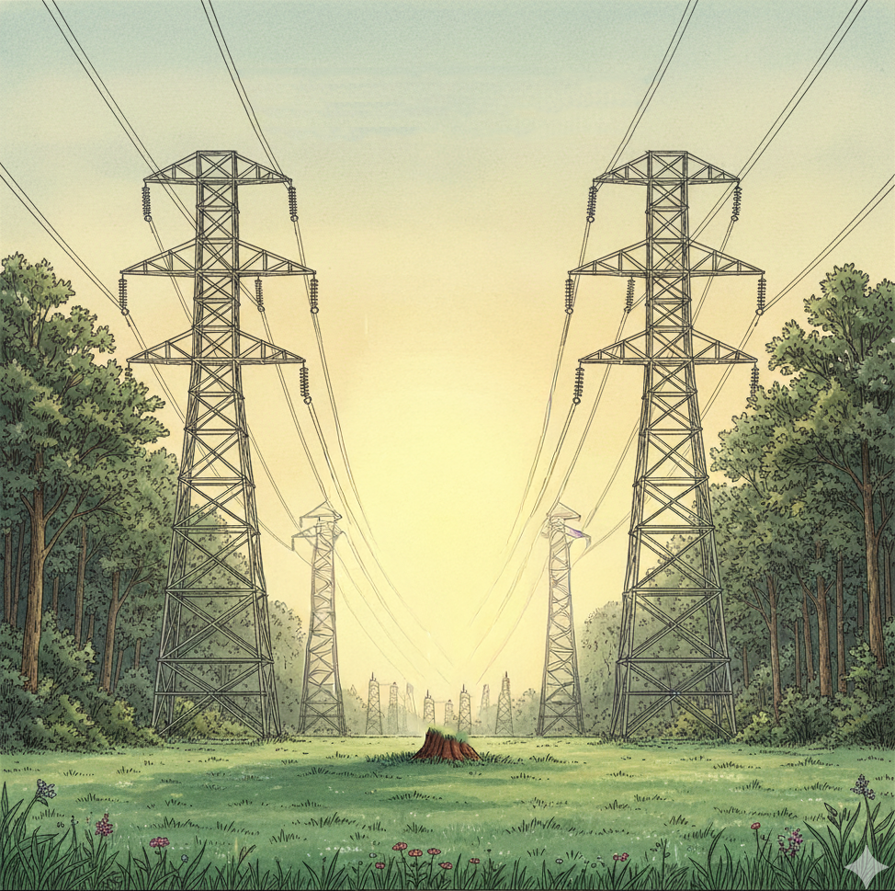
UVM - Summary
Absolute Right to Cut vs. “Reasonably Necessary”
Danger Trees
Off-ROW vs. In-ROW
Damages vs. Injunction

Slide 145
Valuation
King v. Duke Energy Progress, LLC 276 N.C. App. 36 (NC Ct. App. 2021)
Huberth v. Holly 120 N.C. App. 348 (NC Ct. App. 1995)
Steele v. Steele 2008 S.C. App. Unpub. LEXIS 22 (SC Ct. App. 2008)
City of Hillsborough v. Hughes 140 N.C.App. 714 (NC Ct. App. 2000)
Notes:
4 cases

Slide 146
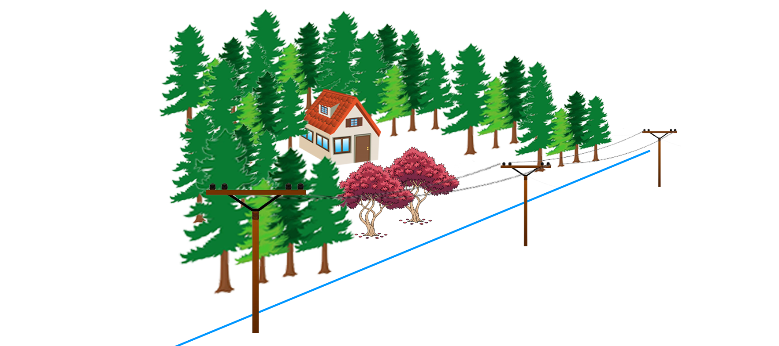
King v. Duke Energy Progress, LLC 276 N.C. App. 36 (NC Ct. App. 2021)
Notes:
NC Ct. App. 2021
John and Leslie King live on land in Laurinburg, NC
Two mature Japanese maples blocked an undesirable view of the power lines from the deck above their master bedroom.
Kings presented replacement cost ONLY. Trial court directed verdict for Duke. Kings appealed.
Remand, replacement evid OK.

Slide 147
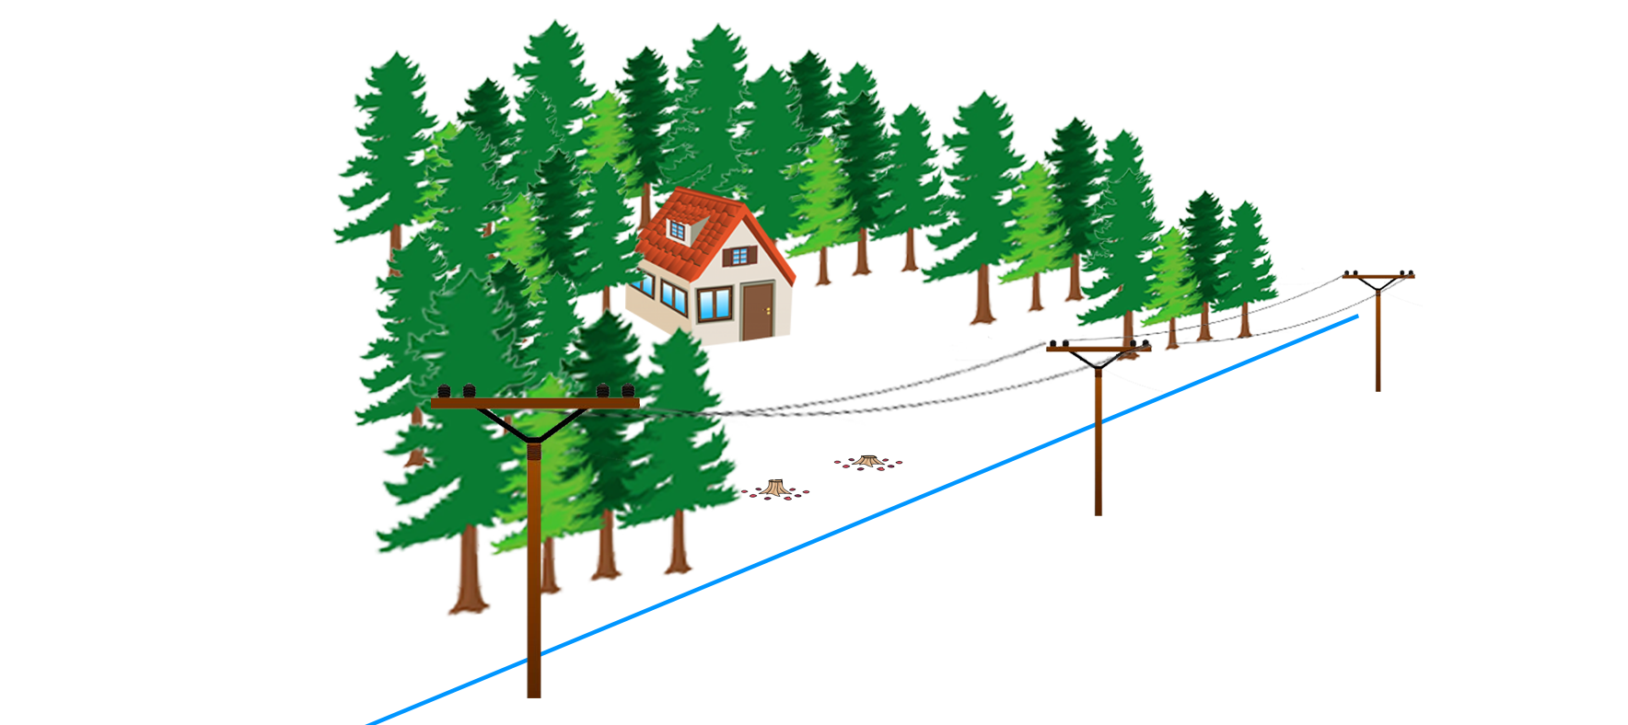
King v. Duke Energy Progress, LLC 276 N.C. App. 36 (NC Ct. App. 2021)
Notes:
NC Ct. App. 2021
John and Leslie King live on land in Laurinburg, NC
Two mature Japanese maples blocked an undesirable view of the power lines from the deck above their master bedroom.
Kings presented replacement cost ONLY. Trial court directed verdict for Duke. Kings appealed.
Remand, replacement evid OK.

Slide 148
King v. Duke Energy Progress, LLC 276 N.C. App. 36 (NC Ct. App. 2021)
“Two alternative measures of damages are available in a suit claiming unlawful cutting of timber”:
“difference in the value of his property” OR
“the value of the timber itself”

Slide 149
King v. Duke Energy Progress, LLC 276 N.C. App. 36 (NC Ct. App. 2021)
HOWEVER

Slide 150
King v. Duke Energy Progress, LLC 276 N.C. App. 36 (NC Ct. App. 2021)
HOWEVER
“…replacement cost of trees can be used to establish the diminution in value of real property”

Slide 151
King v. Duke Energy Progress, LLC 276 N.C. App. 36 (NC Ct. App. 2021)
HOWEVER
“…replacement cost of trees can be used to establish the diminution in value of real property”
“…evidence of the cost of reasonable remedial measures…constitutes competent evidence of the diminution in value of the real property, provided it is owned for personal use.”

Slide 152
King v. Duke Energy Progress, LLC 276 N.C. App. 36 (NC Ct. App. 2021)
HOWEVER
“…replacement cost of trees can be used to establish the diminution in value of real property”
“…evidence of the cost of reasonable remedial measures…constitutes competent evidence of the diminution in value of the real property, provided it is owned for personal use.”

Slide 153
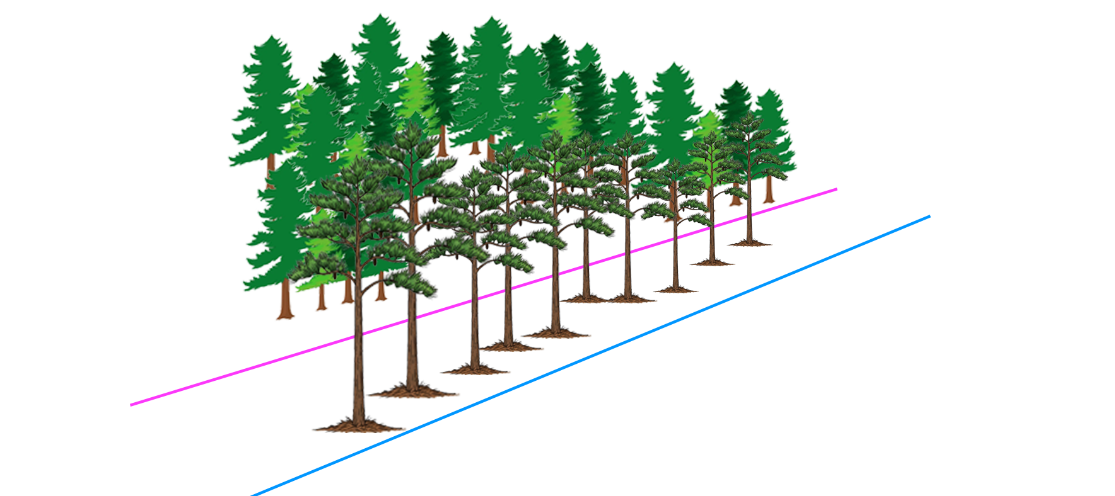
Huberth v. Holly 120 N.C. App. 348 (NC Ct. App. 1995)
Notes:
NC Ct. App. 1995
Anne Huberth owned property in Moore County, NC.
Anne agreed to grant a road easement to Holly’s predecessor, so long as no trees would be cut. Agreement was recorded, but never signed.
Holly removed 10 large loblolly pines and many small trees
Huberth presented ONLY replacement cost evidence. No other evidence presented. Trial court awarded replacement cost. Holly appealed.
NO EASEMENT – there was never a signed contract granting the easement, so Huberths owned the trees.
Replacement cost OK as evid ONLY IF “reason personal”, NOT HERE
Change in land value only, but since no evidence, NOMINALS

Slide 154
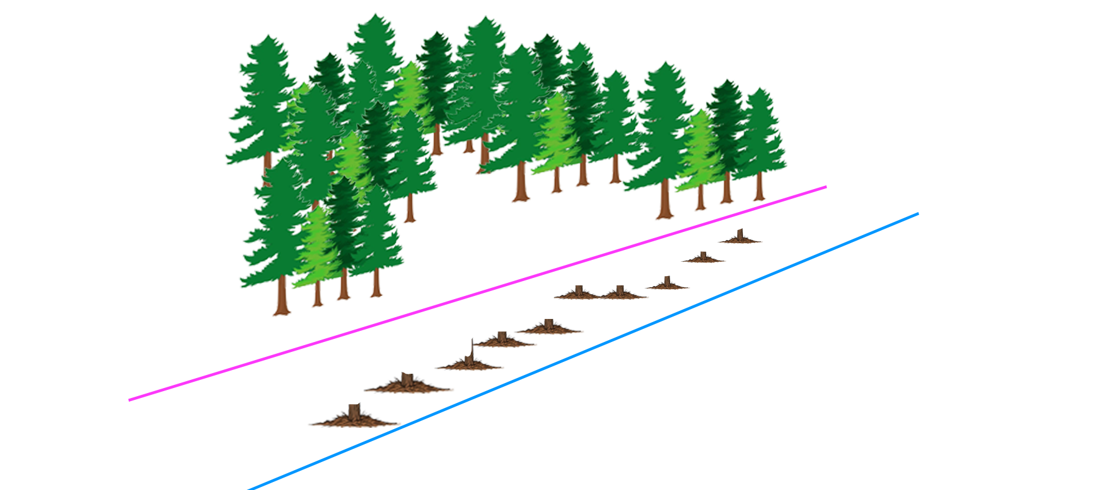
Huberth v. Holly 120 N.C. App. 348 (NC Ct. App. 1995)
Notes:
NC Ct. App. 1995
Anne Huberth owned property in Moore County, NC.
Anne agreed to grant a road easement to Holly’s predecessor, so long as no trees would be cut. Agreement was recorded, but never signed.
Holly removed 10 large loblolly pines and many small trees
Huberth presented ONLY replacement cost evidence. No other evidence presented. Trial court awarded replacement cost. Holly appealed.
NO EASEMENT – there was never a signed contract granting the easement, so Huberths owned the trees.
Replacement cost OK as evid ONLY IF “reason personal”, NOT HERE
Change in land value only, but since no evidence, NOMINALS

Slide 155
Huberth v. Holly 120 N.C. App. 348 (NC Ct. App. 1995)
“the measure of damages ‘is the difference between the market value of the property before and after the injury.’”

Slide 156
Huberth v. Holly 120 N.C. App. 348 (NC Ct. App. 1995)
“the measure of damages ‘is the difference between the market value of the property before and after the injury.’”
“When…land is used for a purpose that is personal to the owner, the replacement cost is an acceptable measure of damages.”

Slide 157
Huberth v. Holly 120 N.C. App. 348 (NC Ct. App. 1995)
HOWEVER

Slide 158
Huberth v. Holly 120 N.C. App. 348 (NC Ct. App. 1995)
HOWEVER
“there is no evidence that the property was used for a purpose that was personal to the [Huberths].”

Slide 159
Huberth v. Holly 120 N.C. App. 348 (NC Ct. App. 1995)
HOWEVER
“there is no evidence that the property was used for a purpose that was personal to the [Huberths].”
“the [Huberths] presented no evidence of diminution in value”

Slide 160
Huberth v. Holly 120 N.C. App. 348 (NC Ct. App. 1995)
HOWEVER
“there is no evidence that the property was used for a purpose that was personal to the [Huberths].”
“the [Huberths] presented no evidence of diminution in value”
NOMINAL DAMAGES ONLY

Slide 161
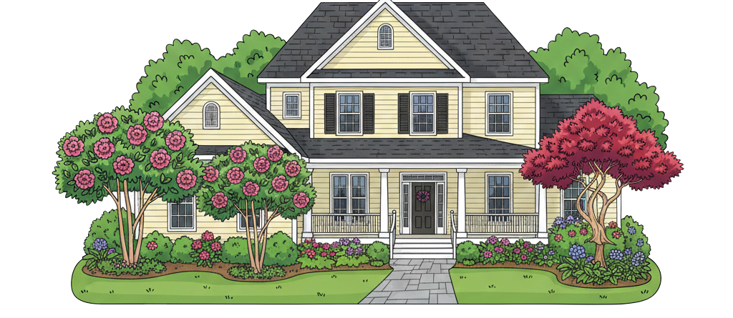
Steele v. Steele 2008 S.C. App. Unpub. LEXIS 22 (SC Ct. App. 2008)
Notes:
SC Ct. App. 2008
David Steele was a professional landscaper and had beautified his home over the years with many trees and plants
David his wife Clara were getting divorced.
By agreement, Clara could live in the couple’s home until the divorce was finalized, then she would move out, and David would own it
Shortly after David moved in, all the landscaping died.
Trial court held wife in contempt. Home was worth $160,000. Replacement landscaping bids between $6K-$70K. Trial court awarded $45K to David. Wife appealed.

Slide 162
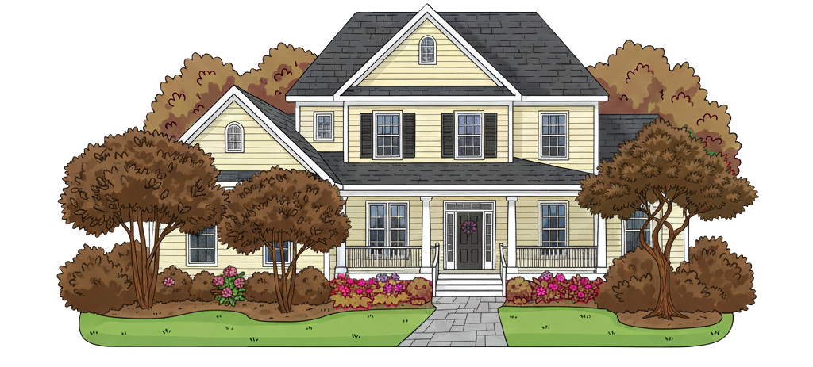
Steele v. Steele 2008 S.C. App. Unpub. LEXIS 22 (SC Ct. App. 2008)
Notes:
SC Ct. App. 2008
David Steele was a professional landscaper and had beautified his home over the years with many trees and plants
David his wife Clara were getting divorced.
By agreement, Clara could live in the couple’s home until the divorce was finalized, then she would move out, and David would own it
Shortly after David moved in, all the landscaping died.
Trial court held wife in contempt. Home was worth $160,000. Replacement landscaping bids between $6K-$70K. Trial court awarded $45K to David. Wife appealed.

Slide 163
Steele v. Steele 2008 S.C. App. Unpub. LEXIS 22 (SC Ct. App. 2008)
“Generally, a court may measure damages to property by determining the cost of restoring damaged or destroyed trees, shrubs, and other vegetation.”

Slide 164
Steele v. Steele 2008 S.C. App. Unpub. LEXIS 22 (SC Ct. App. 2008)
“Generally, a court may measure damages to property by determining the cost of restoring damaged or destroyed trees, shrubs, and other vegetation.”
“If the restoration cost is disproportionate to the diminution in value of the land, the proper measure of damages is the lost value of the land, unless the owner has a personal reason for restoration.”

Slide 165
Steele v. Steele 2008 S.C. App. Unpub. LEXIS 22 (SC Ct. App. 2008)
“Generally, a court may measure damages to property by determining the cost of restoring damaged or destroyed trees, shrubs, and other vegetation.”
“If the restoration cost is disproportionate to the diminution in value of the land, the proper measure of damages is the lost value of the land, unless the owner has a personal reason for restoration.”

Slide 166
Steele v. Steele 2008 S.C. App. Unpub. LEXIS 22 (SC Ct. App. 2008)
“Husband’s desire to restore the landscaping he personally labored to create around his home constitutes ‘a personal reason’”

Slide 167
Steele v. Steele 2008 S.C. App. Unpub. LEXIS 22 (SC Ct. App. 2008)
“Husband’s desire to restore the landscaping he personally labored to create around his home constitutes ‘a personal reason’”
“the family court did not err in awarding Husband damages based on the cost of restoring the lost plants and trees.”

Slide 168
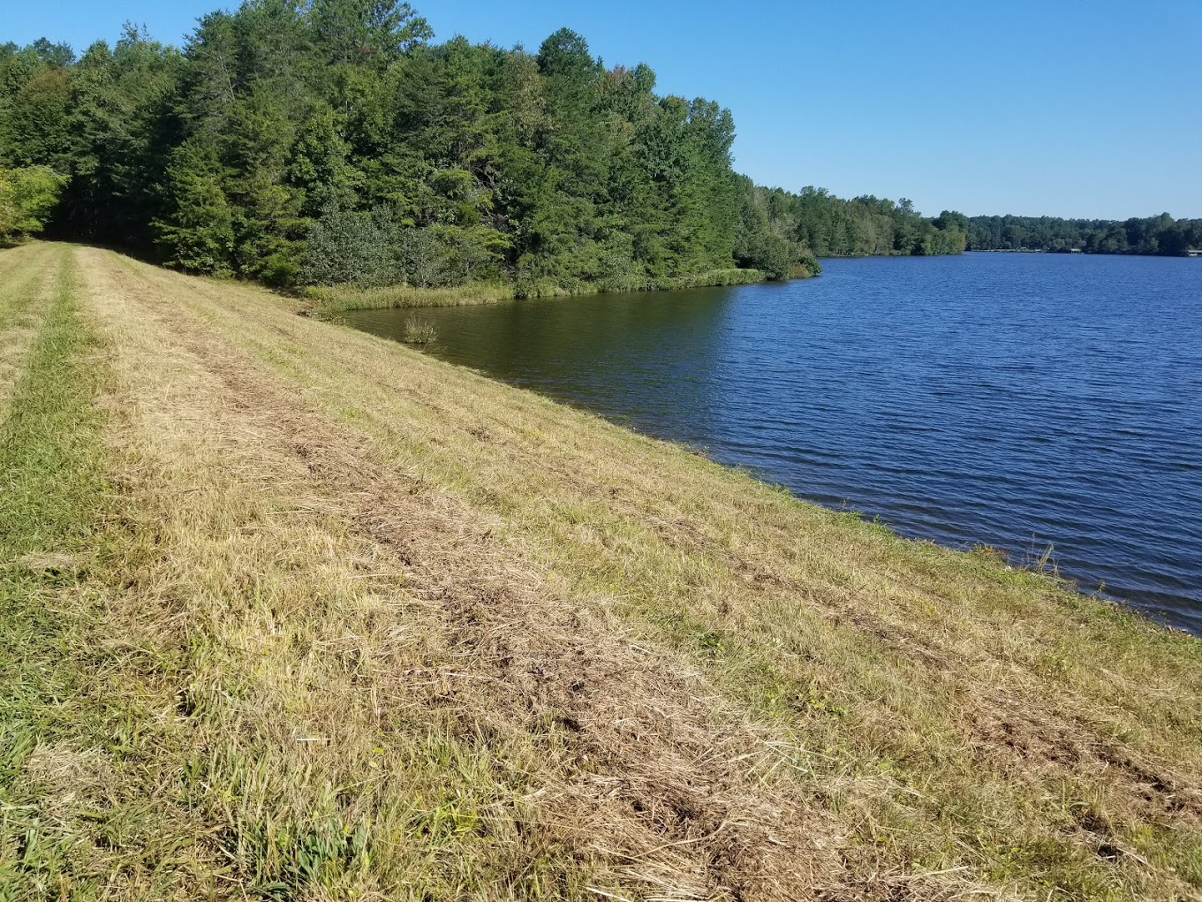
City of Hillsborough v. Hughes 140 N.C.App. 714 (NC Ct. App. 2000)
Notes:
NC Ct. App. 2000
Samuel Hughes owned a 93-acre tract of land in Cedar Grove Township in Orange County, NC.
The City of Hillsborough condemned 80 acres to build a reservoir.
Trial court allowed Hughes’s experts Charles Moody and Richard Bernard to testify about the value of the trees.
Judgment in favor of landowner, town appealed.
Does not violate Unit Rule.

Slide 169
City of Hillsborough v. Hughes 140 N.C.App. 714 (NC Ct. App. 2000)
“the ‘Unit Rule’…prevents an award of just compensation from assigning separate values to component parts of the property and requires that the improved property be valued as a whole.”

Slide 170
City of Hillsborough v. Hughes 140 N.C.App. 714 (NC Ct. App. 2000)
“the ‘Unit Rule’…prevents an award of just compensation from assigning separate values to component parts of the property and requires that the improved property be valued as a whole.”
“may not add the timber that might have been or could have been removed from this property.”

Slide 171
City of Hillsborough v. Hughes 140 N.C.App. 714 (NC Ct. App. 2000)
“the property should be valued as a whole for the purpose of assessing compensation for the taking

Slide 172
City of Hillsborough v. Hughes 140 N.C.App. 714 (NC Ct. App. 2000)
“the property should be valued as a whole for the purpose of assessing compensation for the taking
BUT
This does not preclude the admission of testimony showing particular elements of value for consideration by the jury.”

Slide 173
Valuation - Summary
Change in Value vs. Restoration Cost
“Personal Reason”
Tort vs. Condemnation
Unit Rule

Slide 174
Trip and Fall
Joyce v. City of High Point 226 S.E.2d 856 (NC Ct. App. 1976)
Henderson v. St. Francis Comm. Hospital 399 S.E.2d 767 (SC Sup. Ct. 1990)
Notes:
2 cases

Slide 175
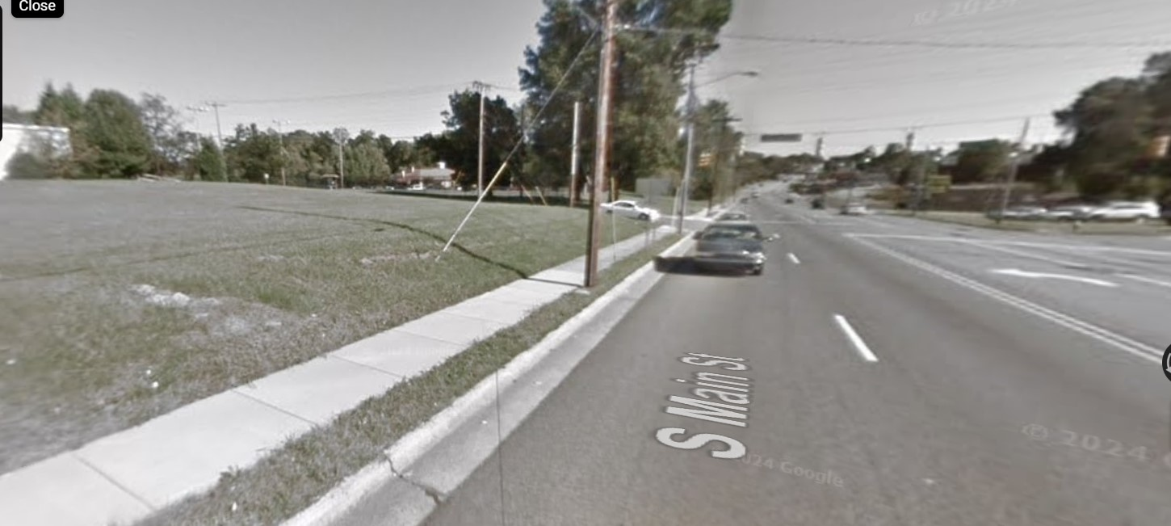
Joyce v. City of High Point 226 S.E.2d 856 (NC Ct. App. 1976)
Notes:
NC Ct. App. 1976
On September 24, 1974, 69-y/o Nannie Joyce went for a walk in High Point, NC.
As she passed the Quaker Friends Center at the corner of Nathan Hunt Drive and South Main St., she tripped on a crack in the sidewalk
Private landowner had negligently allowed a tree’s root to lift the sidewalk.
Sidewalk was dry, sun was shining. Joyce was looking straight ahead.
Trial Court MSJ’d for defendants because contributory negligence. Affirmed.
1-inch displacement is de minimis, NO BREACH OF DUTY
ALSO, condition was obvious enough to be CONTRIBUTORY NEGLIGENCE AS A MATTER OF LAW

Slide 176
Joyce v. City of High Point 226 S.E.2d 856 (NC Ct. App. 1976)
“difference in elevation of approximation one inch…did not constitute a breach of [City’s]…duty”

Slide 177
Joyce v. City of High Point 226 S.E.2d 856 (NC Ct. App. 1976)
“difference in elevation of approximation one inch…did not constitute a breach of [City’s]…duty”
MOREOVER
“[Joyce] was guilty of contributory negligence as a matter of law.”

Slide 178

Henderson v. St. Francis Comm. Hospital 399 S.E.2d 767 (SC Sup. Ct. 1990)
Notes:
SC Ct. App. 1990
January 30, 1985, Peggy Henderson visited a friend at St. Francis Community Hospital.
Peggy tripped and fell on sweet gum balls in the parking area.
3 years ago, parking lot design group Snoddy & McCuloch Associates recommended removal of the liquidambar trees due to the nuisance debris
St. Francis refused to remove the tree. Instead, it built a stairway next to one of the trees
Jury verdict for Peggy. Trial court granted JNOV for defendants. Peggy appealed.
Reversed, verdict re-instated.

Slide 179
Henderson v. St. Francis Comm. Hospital 399 S.E.2d 767 (SC Sup. Ct. 1990)
“gum balls are hard and round, take years to deteriorate and are dangerous to pedestrians.”

Slide 180
Henderson v. St. Francis Comm. Hospital 399 S.E.2d 767 (SC Sup. Ct. 1990)
“gum balls are hard and round, take years to deteriorate and are dangerous to pedestrians.”
“The hospital was specifically advised to remove the trees because they produced debris.”

Slide 181
Henderson v. St. Francis Comm. Hospital 399 S.E.2d 767 (SC Sup. Ct. 1990)
“gum balls are hard and round, take years to deteriorate and are dangerous to pedestrians.”
“The hospital was specifically advised to remove the trees because they produced debris.”
“Rather than correct this dangerous condition,…the hospital built a stairway immediately adjacent to one of the trees [and] failed to use a regular maintenance program.”

Slide 182
Henderson v. St. Francis Comm. Hospital 399 S.E.2d 767 (SC Sup. Ct. 1990)
“the jury might reasonably have inferred…the hospital was negligent…by not removing the trees or employing an adequate maintenance program”

Slide 183
Henderson v. St. Francis Comm. Hospital 399 S.E.2d 767 (SC Sup. Ct. 1990)
DISSENT
“The mere fact that sweet gum balls were present in the lot does not establish negligent maintenance.”

Slide 184
Trip and Fall - Summary
Actual vs. Constructive Notice
De minimis
Contributory Negligence

Slide 185
Tree Regulations
Dunbar v. City of Spartanburg 266 S.C. 113 (SC Sup. Ct. 1976)
County of Charleston v. Dept. of Transp. 420 S.C. 405 (SC Ct. App. 2017)
Notes:
2 cases

Slide 186
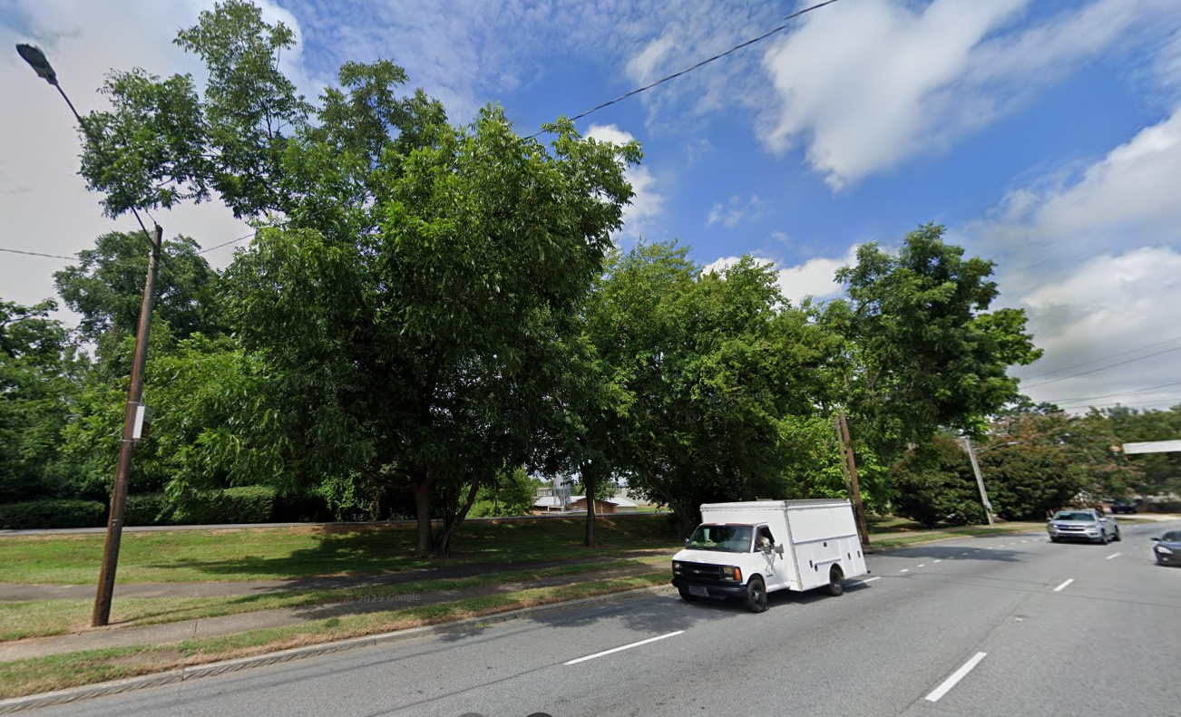
Dunbar v. City of Spartanburg 266 S.C. 113 (SC Sup. Ct. 1976)
Notes:
SC Sup. Ct. 1976
Claude Dunbar owned land in the City of Spartanburg, SC
Property had 900 feet of frontage along Pine St (US-176), varying in depth between 9 feet and 39 feet.
Impossible to build without a variance from the setback zoning code.
Duke maintained utility lines over the property. Dunbar agreed to allow Duke to remove all trees. Spartanburg stopped Duke, citing its tree ordinance.
Dunbar sued to declare the zoning ordinance declared unconstitutional. He did not apply for a zoning variance.
Is the tree ordinance constitutional?

Slide 187
Dunbar v. City of Spartanburg 266 S.C. 113 (SC Sup. Ct. 1976)
“…a municipality, being a creature of the legislature, may exercise only such authority as is granted to it.”

Slide 188
Dunbar v. City of Spartanburg 266 S.C. 113 (SC Sup. Ct. 1976)
“…a municipality, being a creature of the legislature, may exercise only such authority as is granted to it.”
“…the tree protective ordinance is constitutionally invalid because it is not authorized by the Act of the General Assembly.”

Slide 189
Dunbar v. City of Spartanburg 266 S.C. 113 (SC Sup. Ct. 1976)
“In the absence of language clearly indicating that the legislature intended that the City could forbid landowners to cut trees and require landowners to plant trees in replacement we hold that the tree protection ordinance, as written, has not been authorized by the General Assembly.”

Slide 190
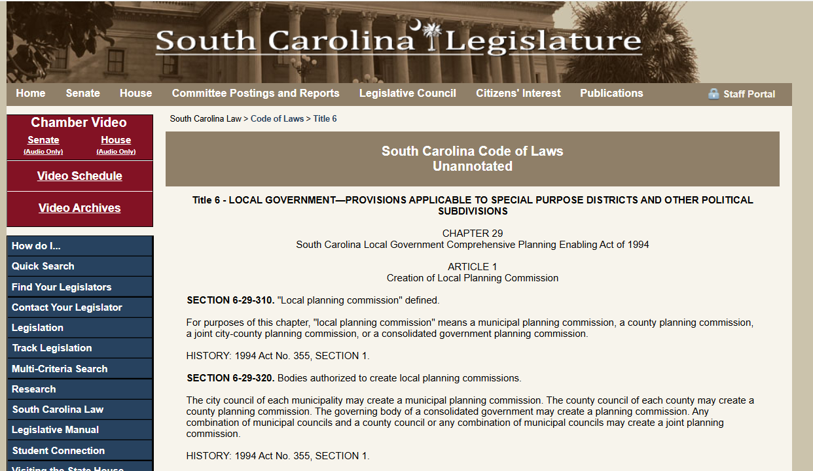
Dunbar v. City of Spartanburg
Notes:
In 1994, SC Passed the South Carolina Local Government Comprehensive Planning and Enabling Act of 1994
The act specifically authorizes municipalities to pass a tree ordinance.
IT ONLY TOOK 18 YEARS!

Slide 191
Dunbar v. City of Spartanburg
SECTION 6-29-340. Functions, powers, and duties of local planning commissions.
…
(B) In the discharge of its responsibilities, the local planning commission has the power and duty to:
…
(2) prepare and recommend for adoption to the appropriate governing authority or authorities as a means for implementing the plans and programs in its area:
…
(d) a landscaping ordinance setting forth required planting, tree preservation, and other aesthetic considerations for land and structures;

Slide 192
Dunbar v. City of Spartanburg
SECTION 6-29-340. Functions, powers, and duties of local planning commissions.
…
(B) In the discharge of its responsibilities, the local planning commission has the power and duty to:
…
(2) prepare and recommend for adoption to the appropriate governing authority or authorities as a means for implementing the plans and programs in its area:
…
(d) a landscaping ordinance setting forth required planting, tree preservation, and other aesthetic considerations for land and structures;

Slide 193
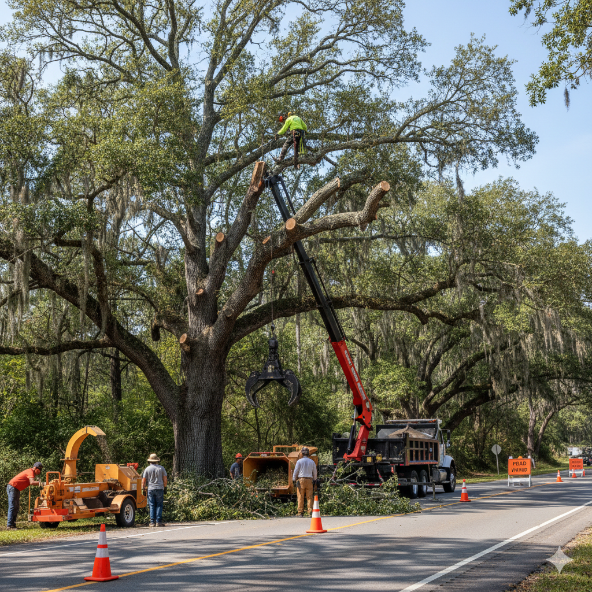
County of Charleston v. Dept. of Transp. 420 S.C. 405 (SC Ct. App. 2017)
Notes:
SC Ct. App. 2017
Charleston County had a “Zoning and Land Development Regulations Ordinance” that restricted tree removal without a permit.
SC State Dept of Transportation removed 3 Grand Trees without a permit.
County issued Notice of Tree Violation. County refused to comply.
County sued for declaratory relief.
Is State Dept. of Transp. subject to county tree ordinance?
NO

Slide 194
County of Charleston v. Dept. of Transp. 420 S.C. 405 (SC Ct. App. 2017)
“[the Department] has exclusive authority over the state highway system, and any ordinances which conflict with this authority are void.”

Slide 195
County of Charleston v. Dept. of Transp. 420 S.C. 405 (SC Ct. App. 2017)
“[the Department] has exclusive authority over the state highway system, and any ordinances which conflict with this authority are void.”
“the Department is exempt from complying with the [tree ordinance] because the [tree ordinance] attempts to limit the Department’s exclusive authority to construct and maintain a uniform state highway system.”

Slide 196
Tree Regulations - Summary
Municipal Authority
Zoning Enabling Act
Preemption

Slide 197
Summary
Tree Failure
Natural vs. Artificial Conditions
Urban vs. Rural Land
Private vs. Public duty
Street Trees
UVM
Valuation
Trip & Fall
Tree Regulation
Notes:
Total Cases: 30
Tree Failure: 9
Street Trees: 5 (+3)
UVM: 4 (+1)
Valuation: 4
Trip & Fall: 2
Tree Regulation: 2

Slide 198
Case Illustrations from Carolina Tree Law
James Komen
BCMA #WE-9909B
RCA #555

