Slide 1
Case Illustrations in
Arizona Tree Law
James Komen
BCMA #WE-9909B
RCA #555

Slide 2
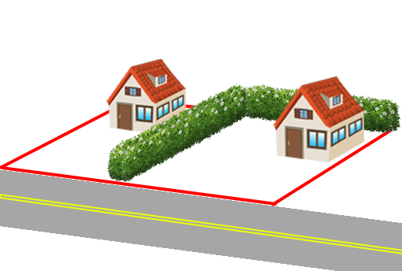
Sensibar v. Diller
2005 LEXIS 213 (2005 AZ Ct. App.)
Notes:
2002, Tucson, AZ
Noah and Judith Sensibar bought their home in 1997
mature privet hedge maintained for many years by the prior owner
James and Sheila Diller bought the house next door in 2002
Land survey showed that part of hedge was on Diller’s side, so Dillers cleared it away.

Slide 3
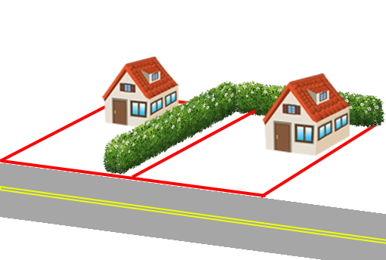
Sensibar v. Diller
2005 LEXIS 213 (2005 AZ Ct. App.)
Notes:
2002, Tucson, AZ

Slide 4
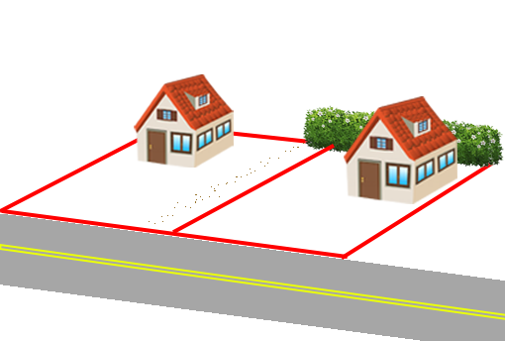
Sensibar v. Diller
2005 LEXIS 213 (2005 AZ Ct. App.)
Notes:
2002, Tucson, AZ

Slide 5

Sensibar v. Diller
2005 LEXIS 213 (2005 AZ Ct. App.)
Adverse Possession:
  Actual
  Open and Notorious
  Hostile
  Under Claim of Right
  Exclusive
  Continuous
  For 10 Year Period

Slide 6
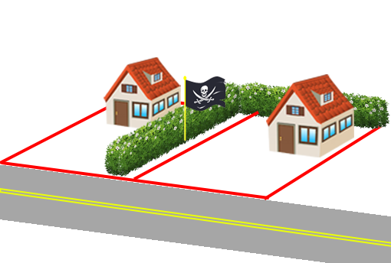
Sensibar v. Diller
2005 LEXIS 213 (2005 AZ Ct. App.)
Notes:
2002, Tucson, AZ

Slide 7
Sensibar v. Diller
2005 LEXIS 213 (2005 AZ Ct. App.)
“the privet hedge…had remained largely intact and unaltered since at least 1952.”
Hedge maintenance “was adequate to put the Dillers’ predecessors on notice of [the] adverse claim.”
Dillers must replace the hedge

Slide 8
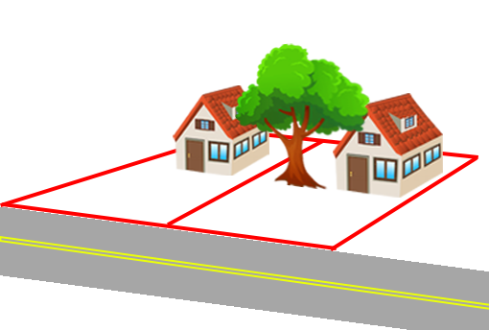
Cannon v. Dunn
145 Ariz. 115 (1985 AZ Ct. App.)
Notes:
1985, Pima County, AZ
Lamar Dunn owned a eucalyptus tree
Neighbor Joan Cannon did not like the tree
Evidence conflicted on whether the tree was causing actual damage to Cannon’s property.
Trial Court held NO ACTUAL DAMAGE.

Slide 9
Cannon v. Dunn
145 Ariz. 115 (1985 AZ Ct. App.)
R2D §158: “One is subject to liability to another for trespass irrespective of whether he thereby causes harm…if he intentionally:
  …
  (c) Fails to remove from the land a thing which he is under a duty to remove.”

Slide 10
Cannon v. Dunn
145 Ariz. 115 (1985 AZ Ct. App.)
Rule of Self-Help:
“A landowner who sustains injury by the branches or roots of a tree or plant on adjoining land intruding into his domain,
regardless of their non-poisonous character may, without notice,
cut off the offending branches or roots at his property line.”

Slide 11
Cannon v. Dunn
145 Ariz. 115 (1985 AZ Ct. App.)
Adopts a modified “Virginia Rule” for intrusion of roots of “noxious tree”:
  If “sensible injury”:
    MAY sue in trespass or nuisance after notice to tree owner
    OR Self-Help
  If no “sensible injury”:
    ONLY Self-Help

Slide 12
Cannon v. Dunn
145 Ariz. 115 (1985 AZ Ct. App.)
Adopts a modified “Virginia Rule” for intrusion of roots of “noxious tree”:
  If “sensible injury”:
    MAY sue in trespass or nuisance after notice to tree owner
    OR Self-Help
  If no “sensible injury”:
    ONLY Self-Help
No duty to remove roots here because no sensible injury

Slide 13
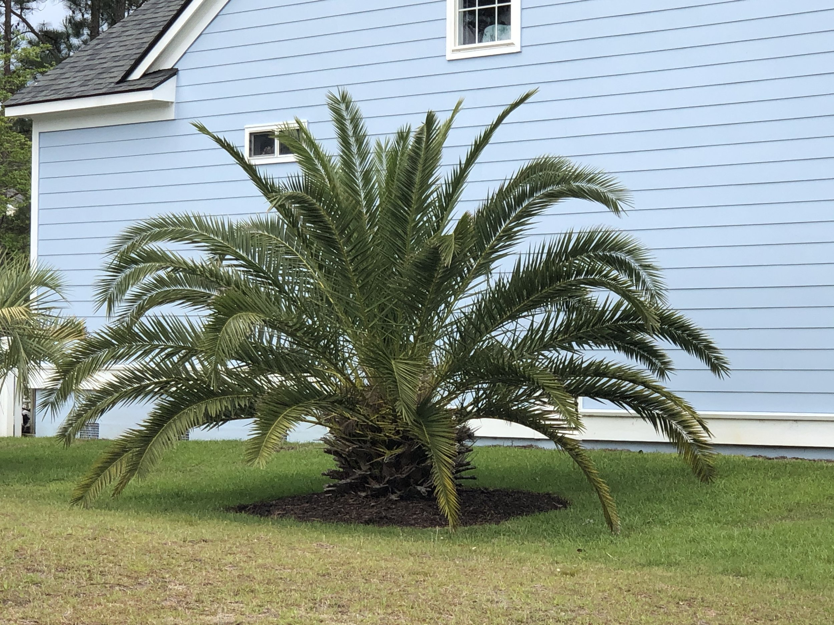
Robles v. Severyn
19 Ariz. App. 61 (1973 AZ Ct. App.)
Notes:
AZ Court of Appeals
1966, Pima County
Peter Robles, age 3 ½, went next door to play with neighbor boy.
Played among palm trees “short squatty trunk, looking almost like a pineapple” with “narrow and long fan leaves” (doesn’t say Canary Island Palm)
One of the fronds poked Peter’s eye

Slide 14
Robles v. Severyn
19 Ariz. App. 61 (1973 AZ Ct. App.)
Status of Entrant Upon Land
  Invitee: enters property with a business purpose
  Licensee: enters property as a guest
  Trespasser: enters without permission

Slide 15
Robles v. Severyn
19 Ariz. App. 61 (1973 AZ Ct. App.)
Status of Entrant Upon Land
  Invitee: duty to protect against defects that reasonably should be discovered
  Licensee: duty to protect from known concealed hazards or willful/wanton harm
  Trespasser: duty to protect from willful/wanton harm

Slide 16
Robles v. Severyn
19 Ariz. App. 61 (1973 AZ Ct. App.)
Status of Entrant Upon Land
  Invitee: duty to protect against defects that reasonably should be discovered
  Licensee: duty to protect from known concealed hazards or willful/wanton harm
  Trespasser: duty to protect from willful/wanton harm

Slide 17
Robles v. Severyn
19 Ariz. App. 61 (1973 AZ Ct. App.)
Palm tree fronds are not a “hidden peril” that “gives a dangerous instrumentality or condition an innocent appearance.”

Slide 18
Robles v. Severyn
19 Ariz. App. 61 (1973 AZ Ct. App.)
Palm tree fronds are not a “hidden peril” that “gives a dangerous instrumentality or condition an innocent appearance.”
“The use of property…should not be encumbered with the necessity of taking precautions against every conceivable danger to which an irrepressible spirit of adventure may lead a child.”

Slide 19
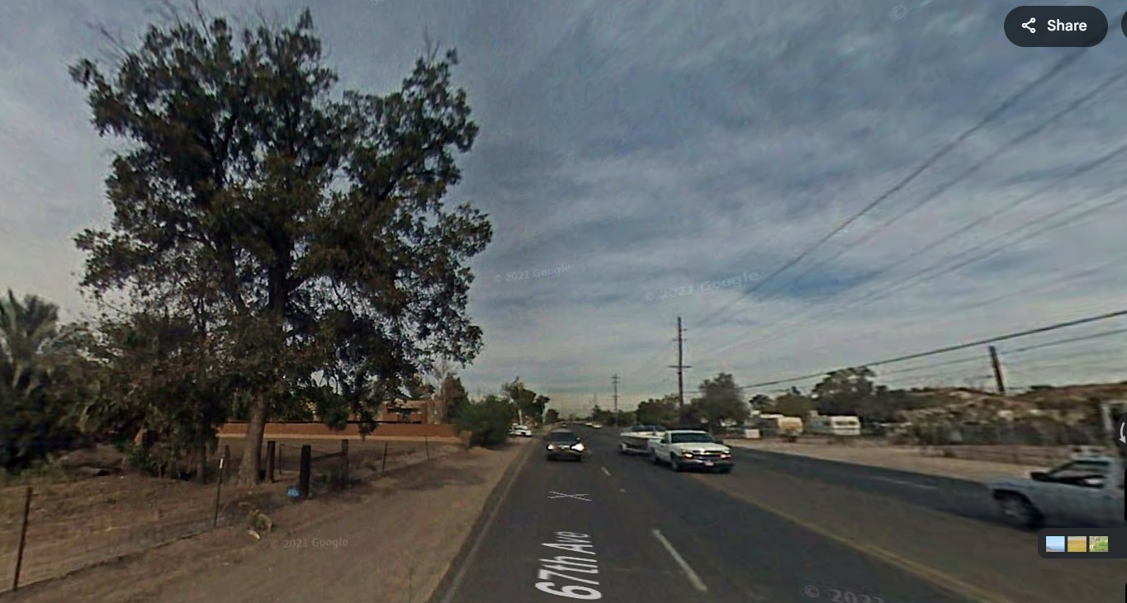
Carver v. Salt River Valley Water Users' Ass’n
104 Ariz. 513 (1969 AZ Supr. Ct.)
Notes:
1963, Maricopa County, AZ
Gail Carver was driving south on 67th Avenue in present-day Glendale, AZ
A large PLANTED cottonwood tree outside the ROW fell across the irrigation ditch onto her car
Plaintiff’s counsel hired Professor Decker, a tree physiologist, and located local witnesses to testify about condition of tree
They filed witness lists that neglected to include Decker. They repeatedly said “we’re ready for trial.”
6 days before trial, they realized the error. They found their one local witness was unavailable. With no witnesses, they attempted to do last-minute discovery.
ALL NEW WITNESSES EXCLUDED, Trial court held for defendants as matter of LAW.
Court of appeals reversed for Salt River: there was evidence of defective conditions
But NOT for county: trunk wasn’t OVER ROAD, so it wasn’t a public nuisance
Carver and Salt River both appeal to Supreme Court

Slide 20
Carver v. Salt River Valley Water Users' Ass’n
104 Ariz. 513 (1969 AZ Supr. Ct.)
Evidence:
  Char marks on the outside of the 3-ft stump
  Decay pocket inside the tree
  Undermining of root zone from water in irrigation ditch
  Photos of neighboring trees with many dead branches
Notes:
There may be char marks, but no evidence of place, nature, or extent of burns or affect on Likelihood of Failure
There may be decay, but there’s no evidence that it would have been EXTERNALLY VISIBLE
There may be undermining, but that’s not how the tree failed – no CAUSATION
Photos of neighboring trees irrelevant because no evidence that they were in the SAME CONDITION as the failed tree

Slide 21
Carver v. Salt River Valley Water Users' Ass’n
104 Ariz. 513 (1969 AZ Supr. Ct.)
Evidence:
  Char marks on the outside of the 3-ft stump
  Decay pocket inside the tree
  Undermining of root zone from water in irrigation ditch
  Photos of neighboring trees with many dead branches
Notes:
There may be char marks, but no evidence of place, nature, or extent of burns or affect on Likelihood of Failure
There may be decay, but there’s no evidence that it would have been EXTERNALLY VISIBLE
There may be undermining, but that’s not how the tree failed – no CAUSATION
Photos of neighboring trees irrelevant because no evidence that they were in the SAME CONDITION as the failed tree

Slide 22
Carver v. Salt River Valley Water Users' Ass’n
104 Ariz. 513 (1969 AZ Supr. Ct.)
Evidence:
  Char marks on the outside of the 3-ft stump
  Decay pocket inside the tree
  Undermining of root zone from water in irrigation ditch
  Photos of neighboring trees with many dead branches
Notes:
There may be char marks, but no evidence of place, nature, or extent of burns or affect on Likelihood of Failure
There may be decay, but there’s no evidence that it would have been EXTERNALLY VISIBLE
There may be undermining, but that’s not how the tree failed – no CAUSATION
Photos of neighboring trees irrelevant because no evidence that they were in the SAME CONDITION as the failed tree

Slide 23
Carver v. Salt River Valley Water Users' Ass’n
104 Ariz. 513 (1969 AZ Supr. Ct.)
Evidence:
  Char marks on the outside of the 3-ft stump
  Decay pocket inside the tree
  Undermining of root zone from water in irrigation ditch
  Photos of neighboring trees with many dead branches
Notes:
There may be char marks, but no evidence of place, nature, or extent of burns or affect on Likelihood of Failure
There may be decay, but there’s no evidence that it would have been EXTERNALLY VISIBLE
There may be undermining, but that’s not how the tree failed – no CAUSATION
Photos of neighboring trees irrelevant because no evidence that they were in the SAME CONDITION as the failed tree

Slide 24
Carver v. Salt River Valley Water Users' Ass’n
104 Ariz. 513 (1969 AZ Supr. Ct.)
Evidence:
  Char marks on the outside of the 3-ft stump
  Decay pocket inside the tree
  Undermining of root zone from water in irrigation ditch
  Photos of neighboring trees with many dead branches
Notes:
There may be char marks, but no evidence of place, nature, or extent of burns or affect on Likelihood of Failure
There may be decay, but there’s no evidence that it would have been EXTERNALLY VISIBLE
There may be undermining, but that’s not how the tree failed – no CAUSATION
Photos of neighboring trees irrelevant because no evidence that they were in the SAME CONDITION as the failed tree

Slide 25
Carver v. Salt River Valley Water Users' Ass’n
104 Ariz. 513 (1969 AZ Supr. Ct.)
Evidence:
  Char marks on the outside of the 3-ft stump
  Decay pocket inside the tree
  Undermining of root zone from water in irrigation ditch
  Photos of neighboring trees with many dead branches
No Evidence of Negligence
Notes:
There may be char marks, but no evidence of place, nature, or extent of burns or affect on Likelihood of Failure
There may be decay, but there’s no evidence that it would have been EXTERNALLY VISIBLE
There may be undermining, but that’s not how the tree failed – no CAUSATION
Photos of neighboring trees irrelevant because no evidence that they were in the SAME CONDITION as the failed tree

Slide 26
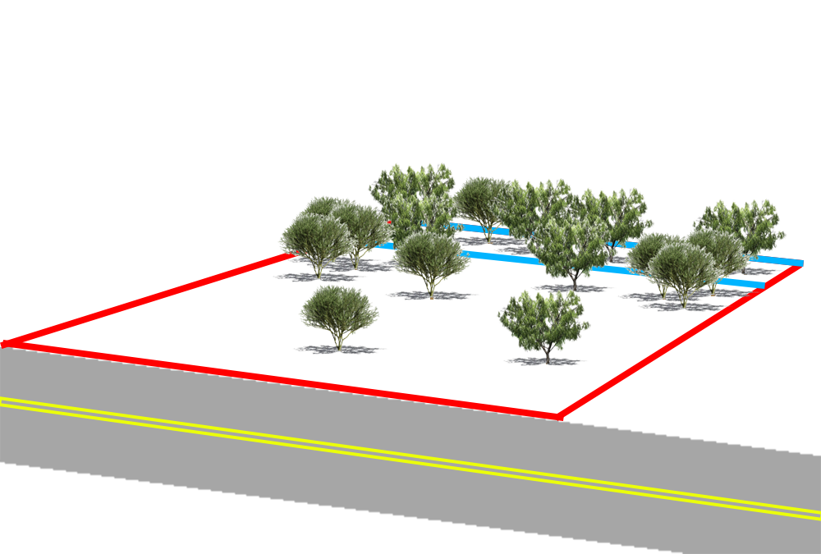
Dixon v. City of Phoenix
173 Ariz. 612 (1992 AZ Ct. App.)
Notes:
1986, Phoenix, AZ
City condemned a water line easement across Jimmie and Carolyn Dixons’ property. Easement says NO TREES, ONLY GRASS.
To shortcut the process, City and Dixons signed an early entry agreement in exchange for “all trees to be preserved,” and “all damages caused by city will be REPAIRED”
Jimmie Dixon PERSONALLY PRUNED trees along easement to make room for contractors to work. He planned to build a home on the lot.
Contractor cleared the entire lot, including OFF EASEMENT trees
Cutting the trees resulted in NO CHANGE in market value of the land
Dixons sued BOTH City AND Contractor. Trial Court dismissed action because NO DAMAGE.

Slide 27
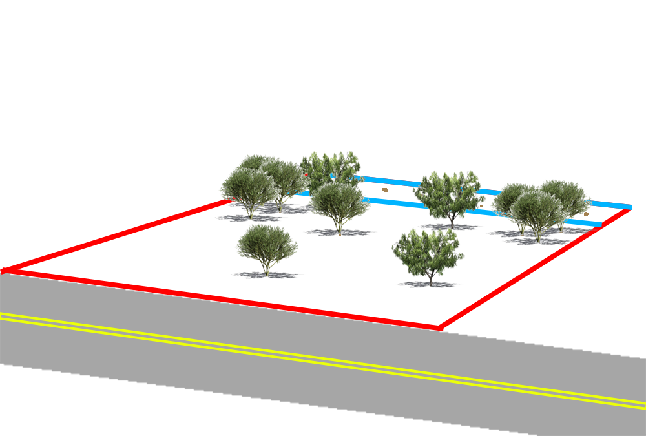
Dixon v. City of Phoenix
173 Ariz. 612 (1992 AZ Ct. App.)

Slide 28
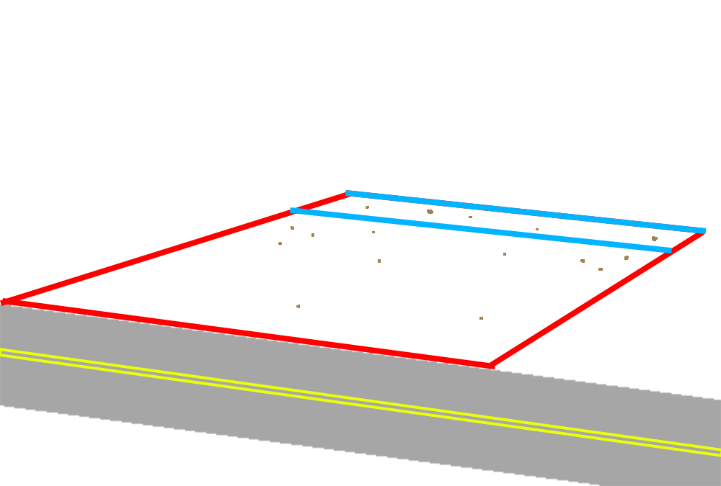
Dixon v. City of Phoenix
173 Ariz. 612 (1992 AZ Ct. App.)

Slide 29
Dixon v. City of Phoenix
173 Ariz. 612 (1992 AZ Ct. App.)
Value of Easement: $14,000
Change in Land Value: $0
Tree Replacement Cost: $200,000

Slide 30
Dixon v. City of Phoenix
173 Ariz. 612 (1992 AZ Ct. App.)
“The police power does not give the State authority to make and breach contracts with impunity.”

Slide 31

Dixon v. City of Phoenix
173 Ariz. 612 (1992 AZ Ct. App.)
“The police power does not give the State authority to make and breach contracts with impunity.”
Early Entry
“Public Purpose”
Not Disputed
No Tree Removal
Replacement of
Property Damage

Slide 32
Dixon v. City of Phoenix
173 Ariz. 612 (1992 AZ Ct. App.)
“The police power does not give the State authority to make and breach contracts with impunity.”
Early Entry
“Public Purpose”
Not Disputed
No Tree Removal
Replacement of
Property Damage

Slide 33
Dixon v. City of Phoenix
173 Ariz. 612 (1992 AZ Ct. App.)
“to the extent the easement holder exceeds [its] right, it will be regarded as a trespasser”
“removal of the Dixons’ vegetation was not a necessary incident of the construction…and therefore constituted a trespass.”

Slide 34
Dixon v. City of Phoenix
173 Ariz. 612 (1992 AZ Ct. App.)
Follows R2D §929:
  In general, limited to diminished value of land
  BUT IF “reason personal”,
    THEN “reasonable restoration costs”

Slide 35
Dixon v. City of Phoenix
173 Ariz. 612 (1992 AZ Ct. App.)
Follows R2D §929:
  In general, limited to diminished value of land
  BUT IF “reason personal”,
    THEN “reasonable restoration costs”
Remand to determine whether restoration cost is “reasonable”

Slide 36
Summary
Adverse Possession
Nuisance
Duty to Visitors
Tree Failure
Trespass
Notes:
Total Cases: 7

Slide 37
Case Illustrations in
Arizona Tree Law
James Komen
BCMA #WE-9909B
RCA #555

