Slide 1
Valuing Tree Losses Selections from New Jersey Case Law
James Komen
BCMA #WE-9909B
RCA #555

Slide 2
Huber v. Serpico 71 N.J. Super. 329 (Ct. App. 1962)
π
Δ

Slide 3
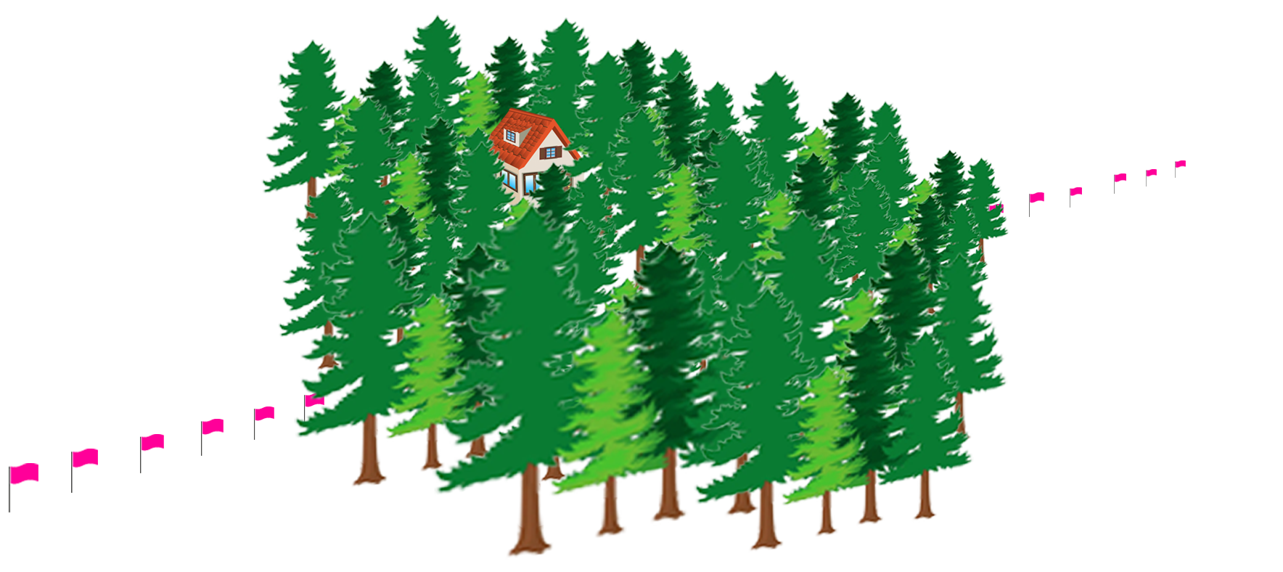
Huber v. Serpico 71 N.J. Super. 329 (Ct. App. 1962)
π
Δ

Slide 4
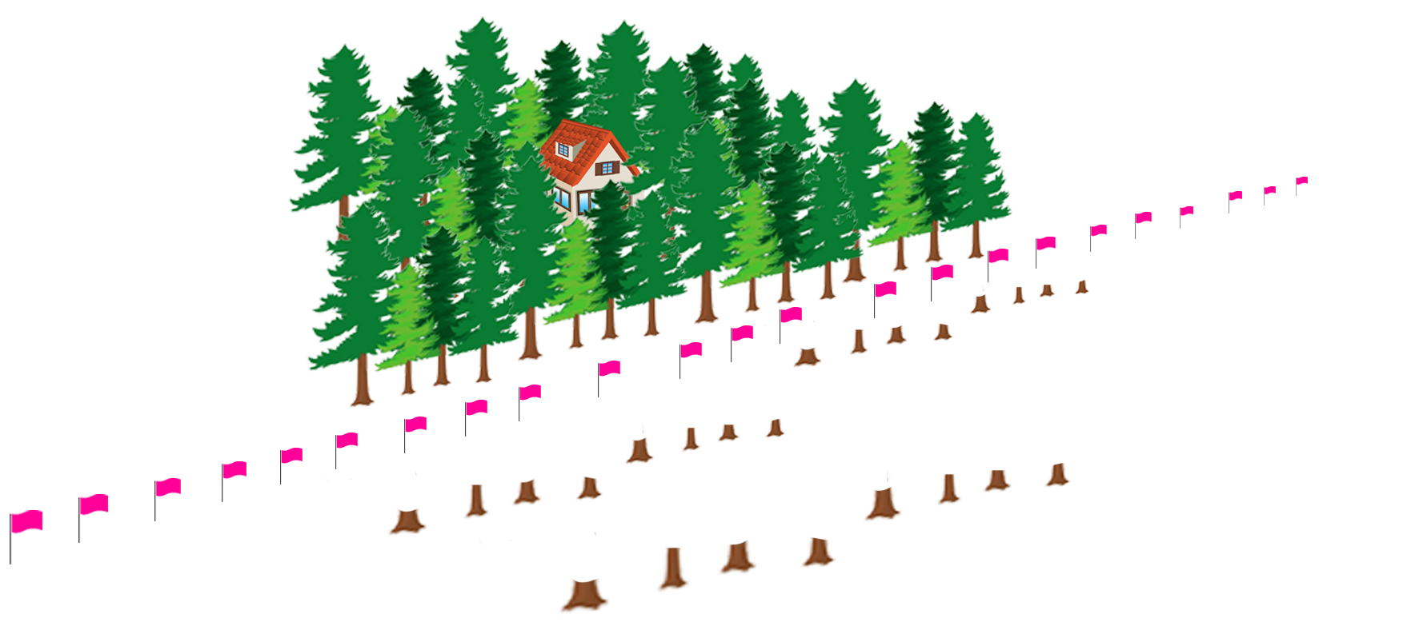
Huber v. Serpico 71 N.J. Super. 329 (Ct. App. 1962)
π
Δ

Slide 5
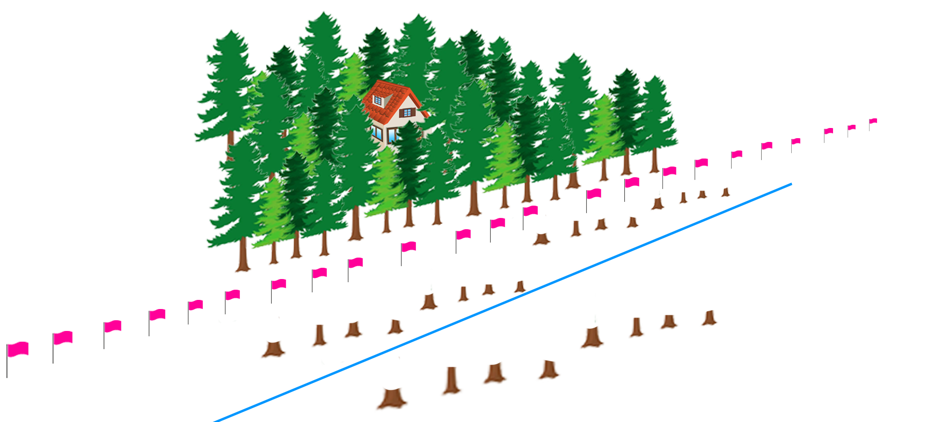
Huber v. Serpico 71 N.J. Super. 329 (Ct. App. 1962)
π
Δ

Slide 6
Huber v. Serpico 71 N.J. Super. 329 (Ct. App. 1962)

Slide 7
Huber v. Serpico 71 N.J. Super. 329 (Ct. App. 1962)
Direct Replacement Cost
Transplant 19” Replacements
~$100,000

Slide 8
Huber v. Serpico 71 N.J. Super. 329 (Ct. App. 1962)
Direct Replacement Cost
Transplant 19” Replacements
Cost of Cure
Install 3” Saplings
~$100,000
~$5,000

Slide 9
Huber v. Serpico 71 N.J. Super. 329 (Ct. App. 1962)
Direct Replacement Cost
Transplant 19” Replacements
Cost of Cure
Install 3” Saplings
Cleanup Cost
~$100,000
~$5,000
~$1,500

Slide 10
Huber v. Serpico 71 N.J. Super. 329 (Ct. App. 1962)
Direct Replacement Cost
Transplant 19” Replacements
Cost of Cure
Install 3” Saplings
Cleanup Cost
Value of 14 Acre Property
~$100,000
~$5,000
~$1,500
~$20,000

Slide 11
Huber v. Serpico 71 N.J. Super. 329 (Ct. App. 1962)
Direct Replacement Cost
Transplant 19” Replacements
Cost of Cure
Install 3” Saplings
Cleanup Cost
Value of 14 Acre Property
Value of 3 Acres Clear Cut
~$100,000
~$5,000
~$1,500
~$20,000
~$2,000

Slide 12
Huber v. Serpico 71 N.J. Super. 329 (Ct. App. 1962)
Direct Replacement Cost
Transplant 19” Replacements
Cost of Cure
Install 3” Saplings
Cleanup Cost
Value of 14 Acre Property
Value of 3 Acres Clear Cut
Change in Value of 3 Acres
~$100,000
~$5,000
~$1,500
~$20,000
~$2,000
$0

Slide 13
Huber v. Serpico 71 N.J. Super. 329 (Ct. App. 1962)

Slide 14
Huber v. Serpico 71 N.J. Super. 329 (Ct. App. 1962)
$6,500

Slide 15
Huber v. Serpico 71 N.J. Super. 329 (Ct. App. 1962)
Court of Appeals
$6,500

Slide 16
Huber v. Serpico 71 N.J. Super. 329 (Ct. App. 1962)
Direct Replacement Cost
Transplant 19” Replacements
Cost of Cure
Install 3” Saplings
Cleanup Cost
Value of 14 Acre Property
Value of 3 Acres Clear Cut
Change in Value of 3 Acres
~$100,000
~$5,000
~$1,500
~$20,000
~$2,000
$0

Slide 17
Huber v. Serpico 71 N.J. Super. 329 (Ct. App. 1962)

Slide 18
Huber v. Serpico 71 N.J. Super. 329 (Ct. App. 1962)
“The controlling criterion is the difference between the value of the property before and after the trespass.”

Slide 19
Huber v. Serpico 71 N.J. Super. 329 (Ct. App. 1962)
“The controlling criterion is the difference between the value of the property before and after the trespass.”
BUT

Slide 20
Huber v. Serpico 71 N.J. Super. 329 (Ct. App. 1962)
“The controlling criterion is the difference between the value of the property before and after the trespass.”
BUT
In some cases, court may award “…the fair cost of restoring his land to a reasonable approximation of its former condition, without necessary limitation to the diminution in the market value of the land where a trespasser has destroyed shade or ornamental trees or shrubbery having peculiar value to the owner.”

Slide 21
Huber v. Serpico 71 N.J. Super. 329 (Ct. App. 1962)
“The controlling criterion is the difference between the value of the property before and after the trespass.”
BUT
In some cases, court may award “…the fair cost of restoring his land to a reasonable approximation of its former condition, without necessary limitation to the diminution in the market value of the land where a trespasser has destroyed shade or ornamental trees or shrubbery having peculiar value to the owner.”

Slide 22
Huber v. Serpico 71 N.J. Super. 329 (Ct. App. 1962)
“The owner of property has a right to hold it for his own use as well as to hold it for sale
Quoting Gilman v. Brown, 115 Wis. 1 (WI Sup. Ct. 1902)

Slide 23
Huber v. Serpico 71 N.J. Super. 329 (Ct. App. 1962)
“The owner of property has a right to hold it for his own use as well as to hold it for sale, and if he has elected the former he should be compensated…although that injury might be unappreciable to one holding the same premises for purposes of sale.”
Quoting Gilman v. Brown, 115 Wis. 1 (WI Sup. Ct. 1902)

Slide 24
Huber v. Serpico 71 N.J. Super. 329 (Ct. App. 1962)
Court of Appeals
$6,500

Slide 25
Huber v. Serpico 71 N.J. Super. 329 (Ct. App. 1962)
Court of Appeals
$6,500
✓

Slide 26
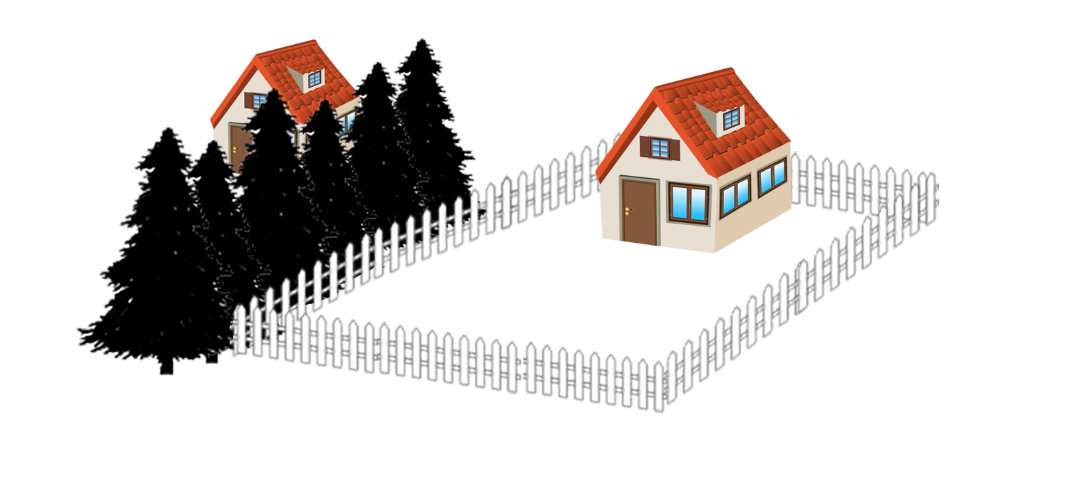
Mosteller v. Naiman 416 N.J. Super. 632 (Ct. App. 2010)
Δ
π
Notes:
Mosteller owned a rental property surrounded by a fence

Slide 27
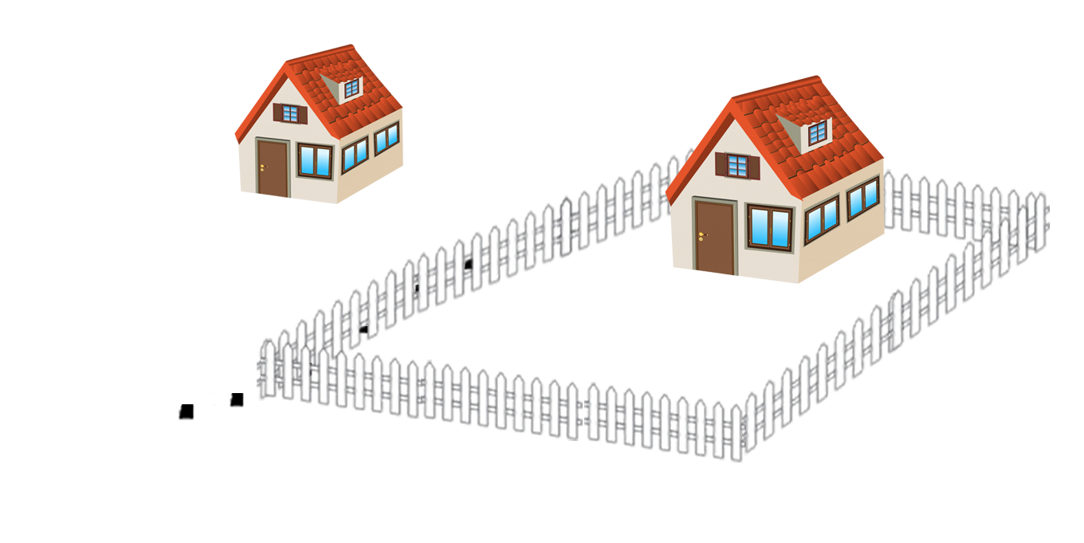
Mosteller v. Naiman 416 N.J. Super. 632 (Ct. App. 2010)
Δ
π
Notes:
Naiman chopped down the trees on his side of the fence

Slide 28
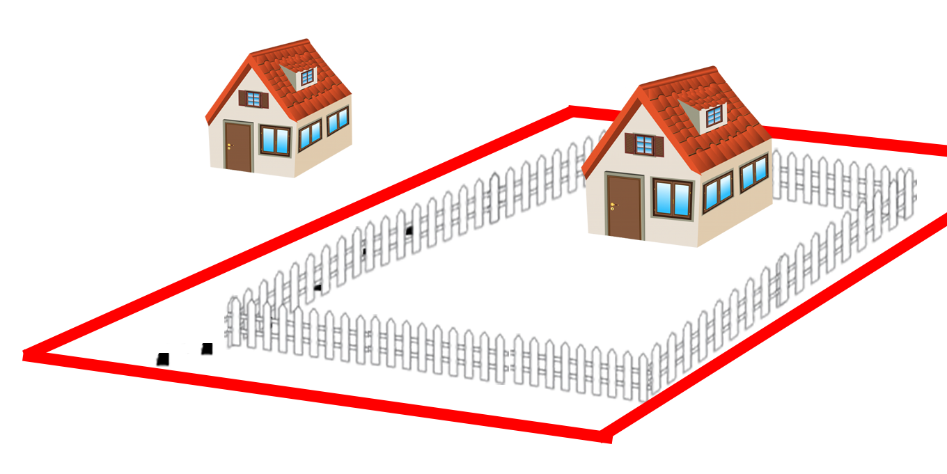
Mosteller v. Naiman 416 N.J. Super. 632 (Ct. App. 2010)
Δ
π
Notes:
Turns out the fence was not the property line

Slide 29
Mosteller v. Naiman 416 N.J. Super. 632 (Ct. App. 2010)

Slide 30
Mosteller v. Naiman 416 N.J. Super. 632 (Ct. App. 2010)
π Evidence
Loss of privacy
Loss of aesthetics
Increased insect infestation
Lawn dieback

Slide 31
Mosteller v. Naiman 416 N.J. Super. 632 (Ct. App. 2010)
π Evidence
Δ Evidence
Loss of privacy
Loss of aesthetics
Increased insect infestation
Lawn dieback
π lives in VA, 5 hours away
No tenant complained
When one moved out, another one signed lease for same rent

Slide 32
Mosteller v. Naiman 416 N.J. Super. 632 (Ct. App. 2010)
π Evidence
Δ Evidence
Loss of privacy
Loss of aesthetics
Increased insect infestation
Lawn dieback
Replacement cost: ~$400,000
π lives in VA, 5 hours away
No tenant complained
When one moved out, another one signed lease for same rent
Change in land value: ~$0 – $20,000

Slide 33
Mosteller v. Naiman 416 N.J. Super. 632 (Ct. App. 2010)

Slide 34
Mosteller v. Naiman 416 N.J. Super. 632 (Ct. App. 2010)
$20,000

Slide 35
Mosteller v. Naiman 416 N.J. Super. 632 (Ct. App. 2010)
Court of Appeals
$20,000

Slide 36
Mosteller v. Naiman 416 N.J. Super. 632 (Ct. App. 2010)
“Peculiar value to the owner is a fair and equitable consideration in deciding whether to enhance an owner’s recovery beyond the diminution of the property’s value.”

Slide 37
Mosteller v. Naiman 416 N.J. Super. 632 (Ct. App. 2010)
“Peculiar value to the owner is a fair and equitable consideration in deciding whether to enhance an owner’s recovery beyond the diminution of the property’s value.”
“…loss of shade, increased erosion, insect risks…are typical negative consequences that unfortunately result from the destruction of trees and shrubbery

Slide 38
Mosteller v. Naiman 416 N.J. Super. 632 (Ct. App. 2010)
“Peculiar value to the owner is a fair and equitable consideration in deciding whether to enhance an owner’s recovery beyond the diminution of the property’s value.”
“…loss of shade, increased erosion, insect risks…are typical negative consequences that unfortunately result from the destruction of trees and shrubbery, and they do not establish that plaintiff’s trees were of peculiar value to him.”

Slide 39
Mosteller v. Naiman 416 N.J. Super. 632 (Ct. App. 2010)
“…full compensation to the owner

Slide 40
Mosteller v. Naiman 416 N.J. Super. 632 (Ct. App. 2010)
“…full compensation to the owner within the overall limitation of reasonableness.”

Slide 41
Mosteller v. Naiman 416 N.J. Super. 632 (Ct. App. 2010)
“…full compensation to the owner within the overall limitation of reasonableness.”
“…the need to deter deliberate wrongdoing or reckless behavior with a harsh remedy is not present in this case.”

Slide 42
Mosteller v. Naiman 416 N.J. Super. 632 (Ct. App. 2010)
Court of Appeals
$20,000

Slide 43
Mosteller v. Naiman 416 N.J. Super. 632 (Ct. App. 2010)
Court of Appeals
$20,000
✓

Slide 44
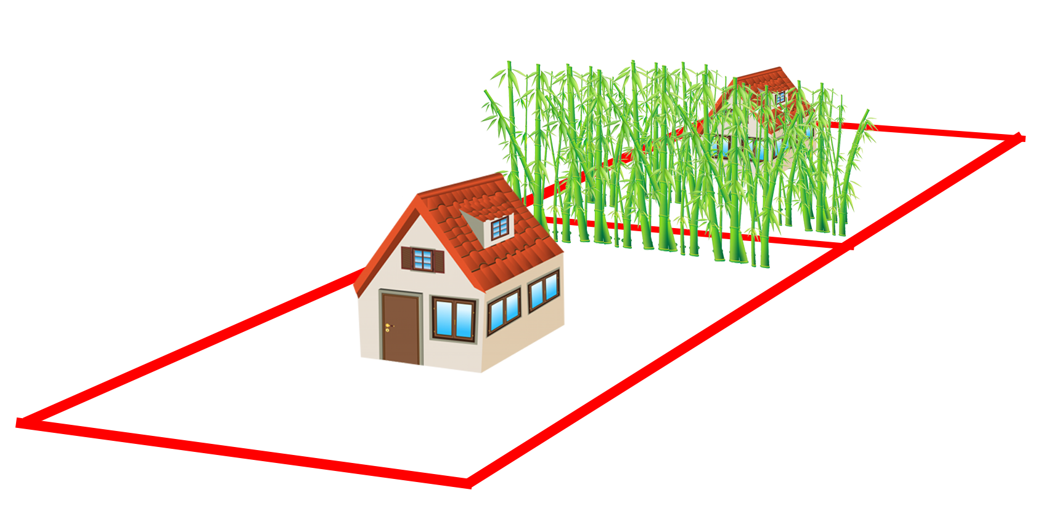
Kornbleuth v. Westover 241 N.J. 289 (Supreme Ct. 2020)
Δ
π

Slide 45
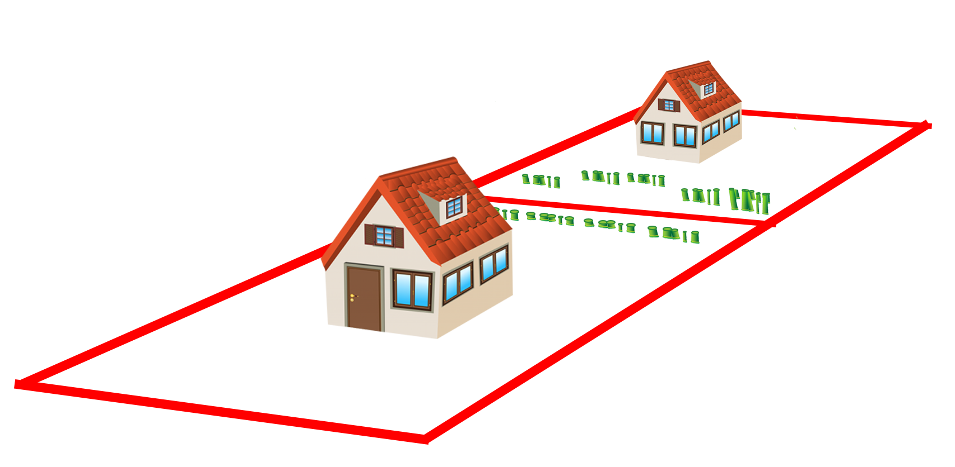
Kornbleuth v. Westover 241 N.J. 289 (Supreme Ct. 2020)
Δ
π

Slide 46
Kornbleuth v. Westover 241 N.J. 289 (Supreme Ct. 2020)
π Evidence
Loss of privacy
Loss of aesthetics
Replacement cost: $17,000 - $41,000

Slide 47
Kornbleuth v. Westover 241 N.J. 289 (Supreme Ct. 2020)
π Evidence
Δ Evidence
Loss of privacy
Loss of aesthetics
Replacement cost: $17,000 - $41,000
…

Slide 48
Kornbleuth v. Westover 241 N.J. 289 (Supreme Ct. 2020)

Slide 49
Kornbleuth v. Westover 241 N.J. 289 (Supreme Ct. 2020)
$0

Slide 50
Kornbleuth v. Westover 241 N.J. 289 (Supreme Ct. 2020)
NJ Supreme Court
$0

Slide 51
Kornbleuth v. Westover 241 N.J. 289 (Supreme Ct. 2020)
Restatement (Second) Torts §929
Compensation for harm to land:
Change in market value of the land OR
Cost of restoration reasonably incurred if there is a reason personal to the owner

Slide 52
Kornbleuth v. Westover 241 N.J. 289 (Supreme Ct. 2020)
Restatement (Second) Torts §929
Compensation for harm to land:
Change in market value of the land OR
Cost of restoration reasonably incurred if there is a reason personal to the owner

Slide 53
Kornbleuth v. Westover 241 N.J. 289 (Supreme Ct. 2020)
“…general interest in privacy and vague assertions of aesthetic worth cannot…establish value personal to the owner”

Slide 54
Kornbleuth v. Westover 241 N.J. 289 (Supreme Ct. 2020)
“…general interest in privacy and vague assertions of aesthetic worth cannot…establish value personal to the owner”
“When restoration costs are disproportionate to diminution of value and there is no reason personal to the owner for restoring the property…restoration costs are not reasonable.”

Slide 55
Kornbleuth v. Westover 241 N.J. 289 (Supreme Ct. 2020)
π Evidence
Δ Evidence
Loss of privacy
Loss of aesthetics
Replacement cost: $17,000 - $41,000
…

Slide 56
Kornbleuth v. Westover 241 N.J. 289 (Supreme Ct. 2020)
π Evidence
Δ Evidence
…
…

Slide 57
Kornbleuth v. Westover 241 N.J. 289 (Supreme Ct. 2020)
EVEN IF π had “a reason…for restoring the property…, the upper limit of damages is ‘reasonableness’”
“…reasonableness of restoration costs [cannot] be determined without evidence of diminished value or some similarly helpful yardstick for comparison.”

Slide 58
Kornbleuth v. Westover 241 N.J. 289 (Supreme Ct. 2020)
NJ Supreme Court
$0

Slide 59
Kornbleuth v. Westover 241 N.J. 289 (Supreme Ct. 2020)
NJ Supreme Court
$0
✓

Slide 60
Kornbleuth v. Westover 241 N.J. 289 (Supreme Ct. 2020)
NJ Supreme Court
4:3
$0
✓

Slide 61
Kornbleuth v. Westover 241 N.J. 289 (Supreme Ct. 2020)
DISSENT:
Majority opinion “provides an illusory remedy for New Jersey residential homeowners”
“π should not be compelled to produce evidence of diminution in value”

Slide 62
Valuing Tree Losses Selections from New Jersey Case Law
Huber v. Serpico
Mosteller v. Naiman
Kornbleuth v. Westover

Slide 63
Valuing Tree Losses Selections from New Jersey Case Law
Huber v. Serpico
Mosteller v. Naiman
Kornbleuth v. Westover
Restoration costs OK IF “peculiar value”

Slide 64
Valuing Tree Losses Selections from New Jersey Case Law
Huber v. Serpico
Mosteller v. Naiman
Kornbleuth v. Westover
Restoration costs OK IF “peculiar value”
Restoration costs OK ONLY IF “peculiar value” is to the owner

Slide 65
Valuing Tree Losses Selections from New Jersey Case Law
Huber v. Serpico
Mosteller v. Naiman
Kornbleuth v. Westover
Restoration costs OK IF “peculiar value”
Restoration costs OK ONLY IF “peculiar value” is to the owner
Restoration costs must be reasonable
There must be a basis for comparison to determine reasonableness

Slide 66
Valuing Tree Losses Selections from New Jersey Case Law
James Komen
BCMA #WE-9909B
RCA #555

