Slide 1
Tree Appraisal and the Principle of Substitution
James Komen, BCMA #WE-9909B
Albuquerque, NM
August 16, 2023

Slide 2
Approaches to Appraisal

Slide 3
Approaches to Appraisal
Market
Income
Cost

Slide 4
Methods of Appraisal
Market
Income
Cost
Timber Value
CREMV
Direct Capitalization
DCF
Reproduction
Funct. Replacement
Repair

Slide 5
Principle of Substitution

Slide 6
Principle of Substitution
A thing cannot appraise for more than a substitute of equivalent utility

Slide 7
Principle of Substitution

Slide 8
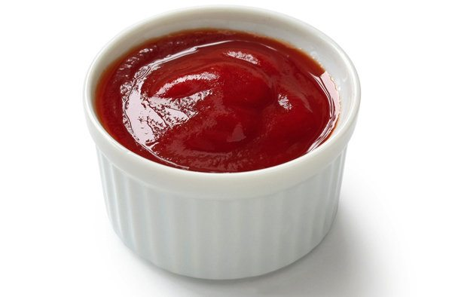
Principle of Substitution
$

Slide 9
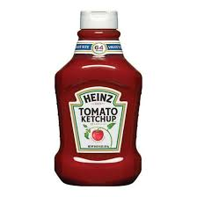
Principle of Substitution
$
$$

Slide 10
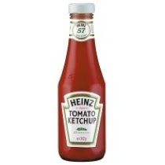
Principle of Substitution
$
$$
$$$

Slide 11
Principle of Substitution
$
$$
$$$

Slide 12
Principle of Substitution
$
$$
$$$

Slide 13
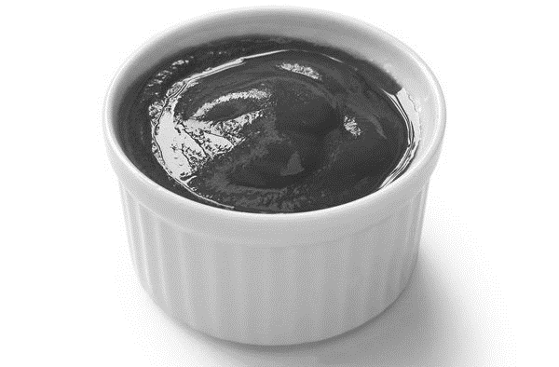
Principle of Substitution
X
$
$$
$$$

Slide 14
Principle of Substitution
X
$
$$
$$$

Slide 15
Principle of Substitution
$
$$
$$$

Slide 16
Principle of Substitution
X
$
$$
$$$

Slide 17
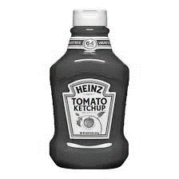
Principle of Substitution
X
X
$
$$
$$$

Slide 18
Principle of Substitution
X
X
$
$$
$$$

Slide 19
Legal Damages

Slide 20
Legal Damages
“make the injured party whole [and] put that person in the same position he was in prior to the damage”
Kornbleuth v. Westover (2020) S.Ct. NJ

Slide 21
Legal Damages
“make the injured party whole [and] put that person in the same position he was in prior to the damage”
Kornbleuth v. Westover (2020) S.Ct. NJ
“there is no fixed, inflexible rule for determining…what sum shall compensate…the owner”
Schankin v. Buskirk (1958) S.Ct. MI

Slide 22
Legal Damages
“make the injured party whole [and] put that person in the same position he was in prior to the damage”
Kornbleuth v. Westover (2020) S.Ct. NJ
“there is no fixed, inflexible rule for determining…what sum shall compensate…the owner”
Schankin v. Buskirk (1958) S.Ct. MI
MAY NOT rely on:
“personal feelings”
“sentimental value”
Wernberg v. Matanuska Elec. Ass’n (1972) S.Ct. AK
Commonwealth v. Smith (1929) Ct. App. KY

Slide 23
Applying the Principle of Substitution

Slide 24
Applying the Principle of Substitution
Identify the utility

Slide 25
Applying the Principle of Substitution
Identify the utility
Appraise substitutes that replace the utility

Slide 26
Applying the Principle of Substitution
Identify the utility
Appraise substitutes that replace the utility
Determine (non)equivalence

Slide 27
Applying the Principle of Substitution
Identify the utility
Appraise substitutes that replace the utility
Determine (non)equivalence
Select the lowest cost alternative of equivalent utility

Slide 28
Cases Applying the Principle of Substitution
1) Identify the Utility
2) Appraise substitutes that replace the utility
Montgomery v. Locke (1887) S.Ct. CA
Giese v. Neal (2014) Ct. App. IL
Delay v. Great Plains (2016) Ct. App. KS
Pennington v. Beatty (1932) S.Ct. SD
Heninger v. Dunn (1980) Ct. App. CA
Wood v. Wolfenbarger (2012) Ct. App. TN
3) Determine (non)equivalence
4) Select the lowest cost alternative
Bullock v. B&O (1912) S.Ct. PA
Evenson v. Liley (2012) S.Ct. KS
Moss v. People’s CA Hydro (1930) S.Ct. OR
Kornbleuth v. Westover (2020) S.Ct. NJ

Slide 29
Identify the Utility

Slide 30
Montgomery v. Locke (1887) S.Ct. CA

Slide 31
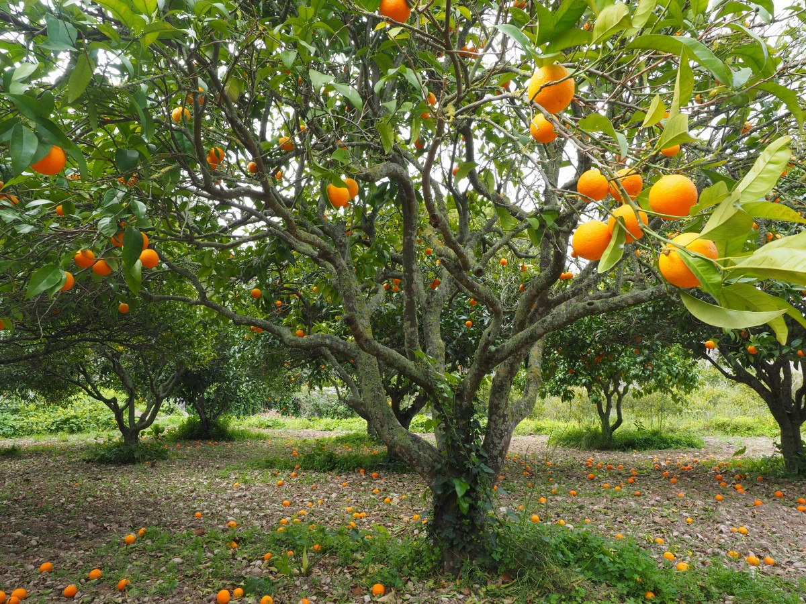
Montgomery v. Locke (1887) S.Ct. CA
$$

Slide 32
Montgomery v. Locke (1887) S.Ct. CA
vs.
$$
$

Slide 33
Montgomery v. Locke (1887) S.Ct. CA
X
vs.
$$
$

Slide 34
Montgomery v. Locke (1887) S.Ct. CA
X
vs.
$$
$

Slide 35
Giese v. Neal (2014) Ct. App. IL

Slide 36
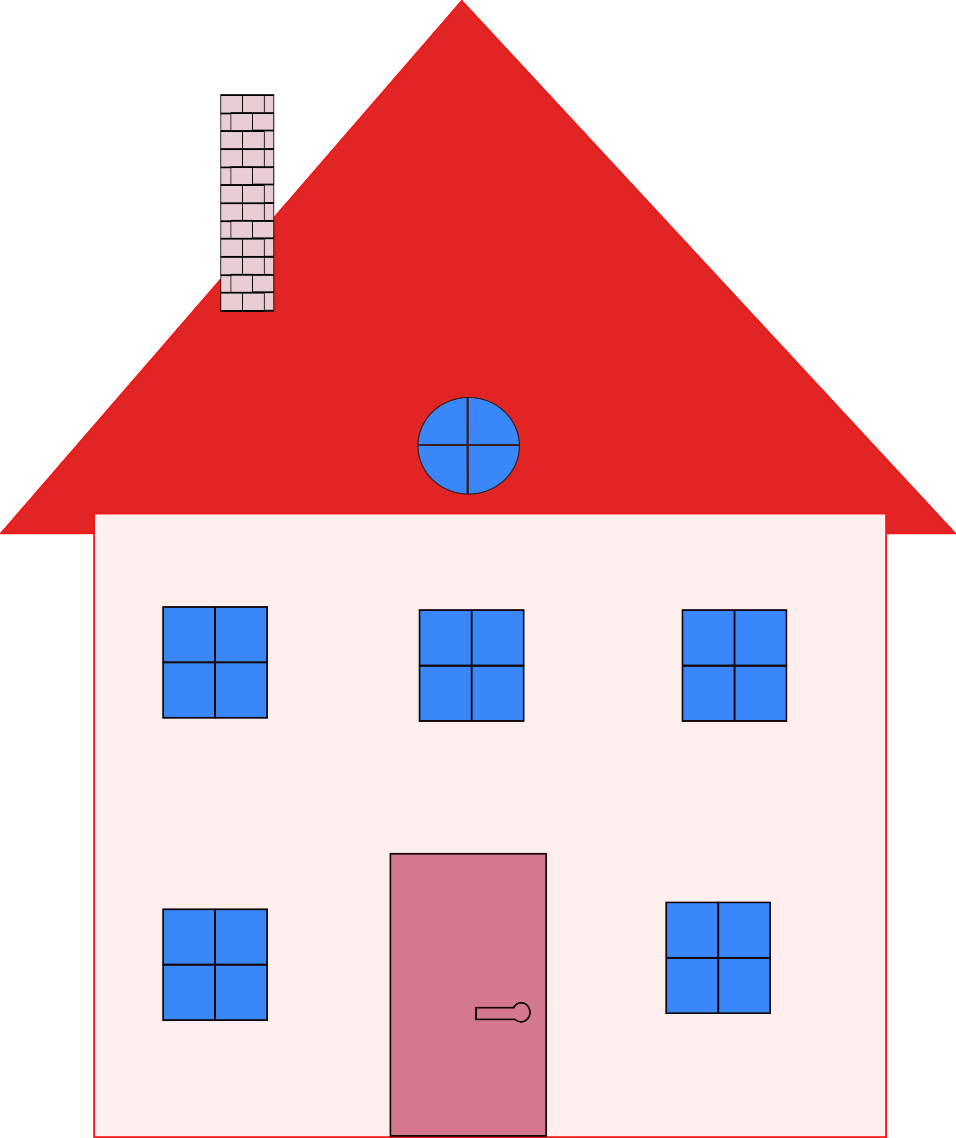
Giese v. Neal (2014) Ct. App. IL
$$$

Slide 37
Giese v. Neal (2014) Ct. App. IL
vs.
$$$
$

Slide 38
Giese v. Neal (2014) Ct. App. IL
vs.
$$$
$

Slide 39
Delay v. Great Plains (2016) Ct. App. KS

Slide 40
Delay v. Great Plains (2016) Ct. App. KS
$$$

Slide 41
Delay v. Great Plains (2016) Ct. App. KS
vs.
$$$
$

Slide 42
Delay v. Great Plains (2016) Ct. App. KS
X
vs.
$$$
$

Slide 43
Delay v. Great Plains (2016) Ct. App. KS
X
vs.
$$$
$

Slide 44
Appraise Substitutes That Replace the Utility

Slide 45
Pennington v. Beatty (1932) S.Ct. SD

Slide 46
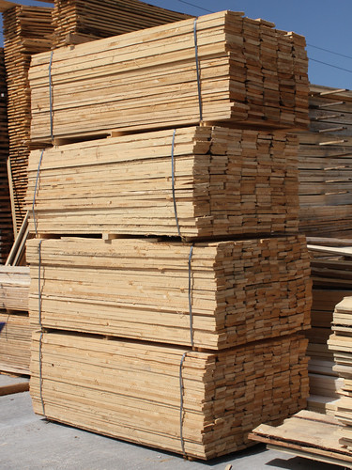
Pennington v. Beatty (1932) S.Ct. SD
$$

Slide 47
Pennington v. Beatty (1932) S.Ct. SD
vs.
$$
$

Slide 48
Pennington v. Beatty (1932) S.Ct. SD
vs.
$$
$

Slide 49
Heninger v. Dunn (1980) Ct. App. CA

Slide 50
Heninger v. Dunn (1980) Ct. App. CA
$$$

Slide 51
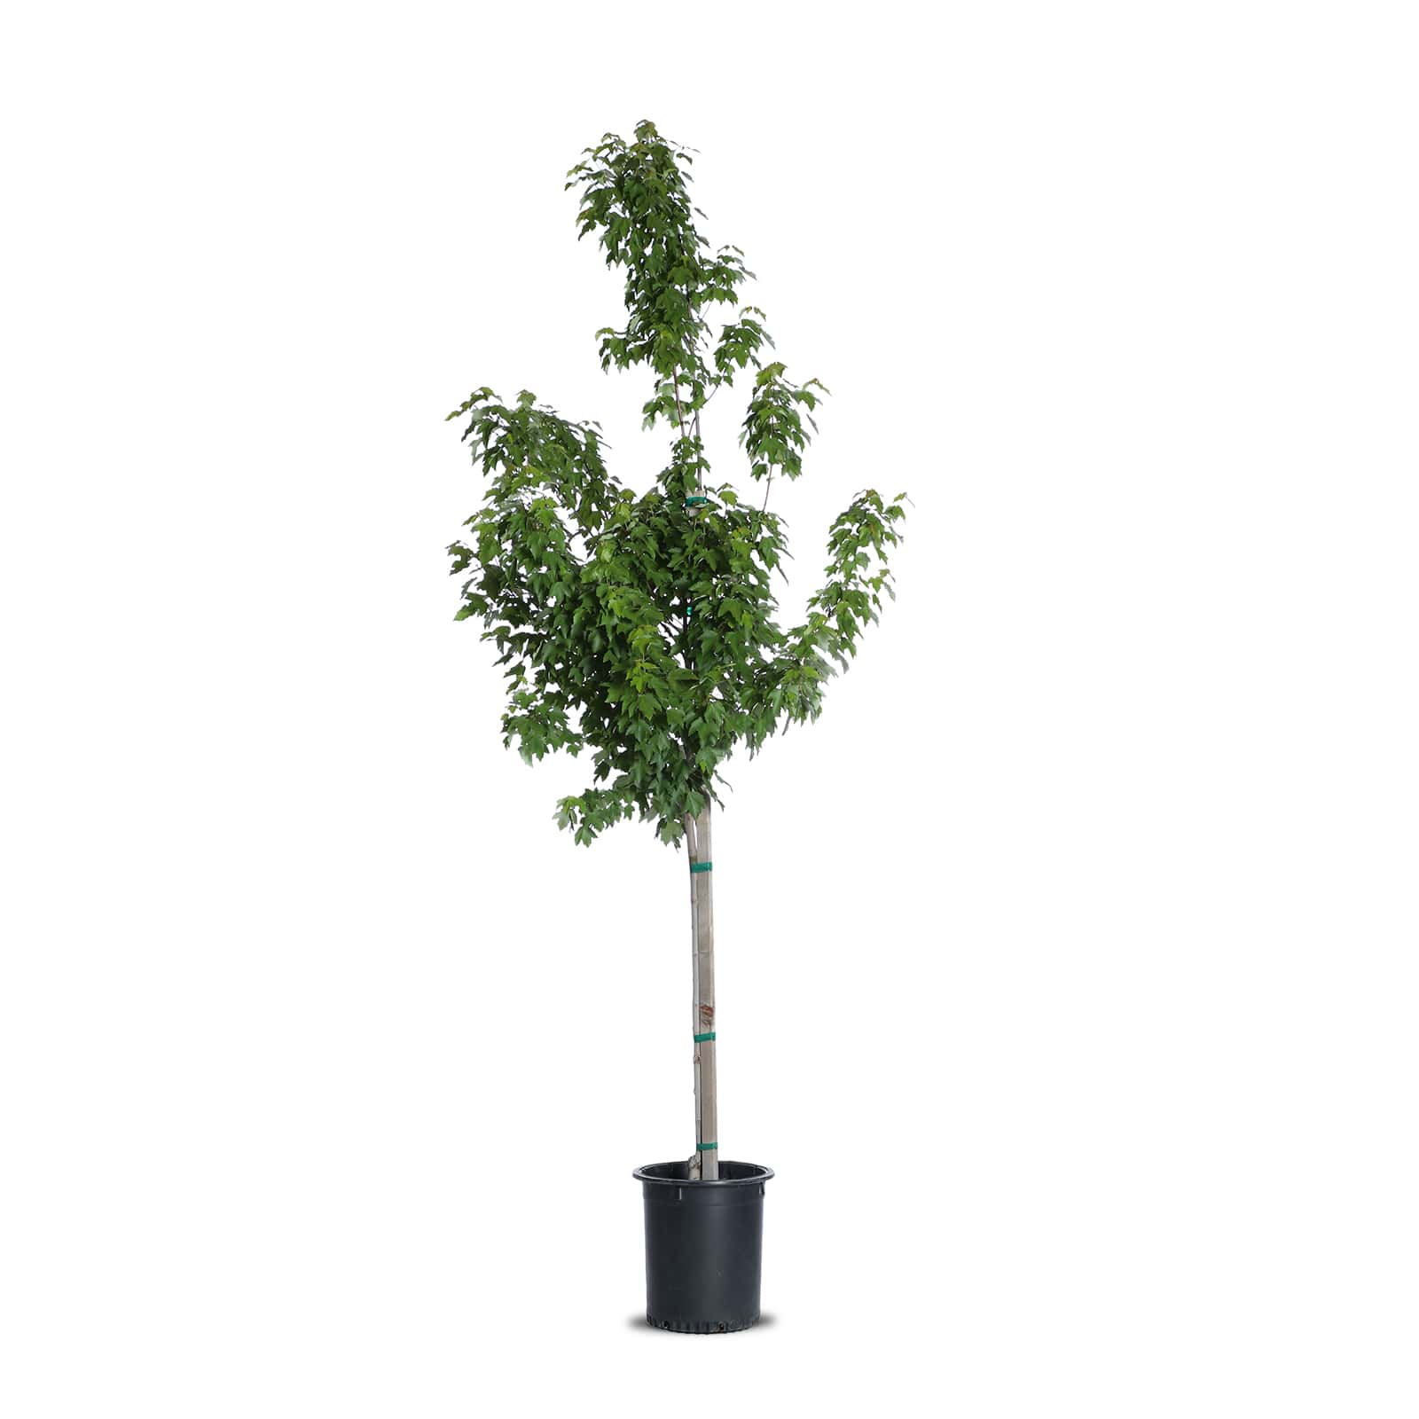
Heninger v. Dunn (1980) Ct. App. CA
vs.
$$$
$$

Slide 52
Heninger v. Dunn (1980) Ct. App. CA
vs.
vs.
$$$
$$
$0

Slide 53
Heninger v. Dunn (1980) Ct. App. CA
X
vs.
vs.
$$$
$$
$0

Slide 54
Heninger v. Dunn (1980) Ct. App. CA
X
vs.
vs.
$$$
$$
$0

Slide 55
Wood v. Wolfenbarger (2012) Ct. App. TN

Slide 56
Wood v. Wolfenbarger (2012) Ct. App. TN
DCT
$$$

Slide 57
Wood v. Wolfenbarger (2012) Ct. App. TN
vs.
DCT
TFM
$$$
$$

Slide 58
Wood v. Wolfenbarger (2012) Ct. App. TN
vs.
vs.
DCT
TFM
$$$
$$
$

Slide 59
Wood v. Wolfenbarger (2012) Ct. App. TN
X
vs.
vs.
DCT
TFM
$$$
$$
$

Slide 60
Wood v. Wolfenbarger (2012) Ct. App. TN
X
vs.
vs.
DCT
TFM
$$$
$$
$

Slide 61
Determine (Non)Equivalence

Slide 62
Bullock v. B&O (1912) S.Ct. PA

Slide 63
Bullock v. B&O (1912) S.Ct. PA
$

Slide 64
Bullock v. B&O (1912) S.Ct. PA
vs.
$
$0

Slide 65
Bullock v. B&O (1912) S.Ct. PA
vs.
X
$
$0

Slide 66
Bullock v. B&O (1912) S.Ct. PA
vs.
X
$
$0

Slide 67
Evenson v. Liley (2012) S.Ct. KS

Slide 68
Evenson v. Liley (2012) S.Ct. KS
$$$

Slide 69
Evenson v. Liley (2012) S.Ct. KS
vs.
$$$
$

Slide 70
Evenson v. Liley (2012) S.Ct. KS
vs.
$$$
$

Slide 71
Select the Lowest Cost Alternative of Equivalent Utility

Slide 72
Moss v. People’s CA Hydro (1930) S.Ct. OR

Slide 73
Moss v. People’s CA Hydro (1930) S.Ct. OR
$$

Slide 74
Moss v. People’s CA Hydro (1930) S.Ct. OR
vs.
…
$$

Slide 75
Moss v. People’s CA Hydro (1930) S.Ct. OR
vs.
…
$$

Slide 76
Kornbleuth v. Westover (2020) S.Ct. NJ

Slide 77
Kornbleuth v. Westover (2020) S.Ct. NJ
$$

Slide 78
Kornbleuth v. Westover (2020) S.Ct. NJ
vs.
…
$$

Slide 79
Kornbleuth v. Westover (2020) S.Ct. NJ
X
vs.
…
$$

Slide 80
Cases Applying the Principle of Substitution
1) Identify the Utility
2) Appraise substitutes that replace the utility
Montgomery v. Locke (1887) S.Ct. CA
Giese v. Neal (2014) Ct. App. IL
Delay v. Great Plains (2016) Ct. App. KS
Pennington v. Beatty (1932) S.Ct. SD
Heninger v. Dunn (1980) Ct. App. CA
Wood v. Wolfenbarger (2012) Ct. App. TN
3) Determine (non)equivalence
4) Select the lowest cost alternative
Bullock v. B&O (1912) S.Ct. PA
Evenson v. Liley (2012) S.Ct. KS
Moss v. People’s CA Hydro (1930) S.Ct. OR
Kornbleuth v. Westover (2020) S.Ct. NJ

Slide 81
Tree Appraisal and the Principle of Substitution
James Komen, BCMA #WE-9909B
Albuquerque, NM
August 16, 2023

