Slide 1
Wielding the A300 Standards: The Shield and the Sword
James Komen
BCMA #WE-9909B
RCA #555
www.jameskomen.com
jameskomen@gmail.com

Slide 2
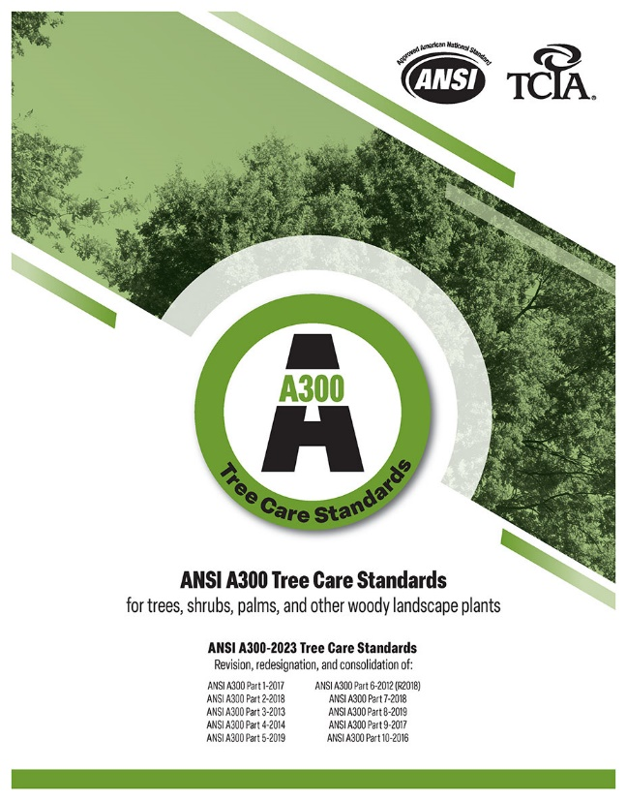
ANSI A300 Standards
American National Standards Institute
Consensus Document

Slide 3
Language of the Standards

Slide 4
Language of the Standards
SHALL
SHOULD
MAY
NOT
OR
AND

Slide 5
Language of the Standards
SHALL
SHOULD
MAY
NOT
OR
AND

Slide 6
Language of the Standards
SHALL
SHOULD

Slide 7
Language of the Standards
SHALL
“As used in this standard, denotes a mandatory requirement”

Slide 8
Language of the Standards
SHOULD
“As used in this standard, denotes an advisory recommendation”

Slide 9
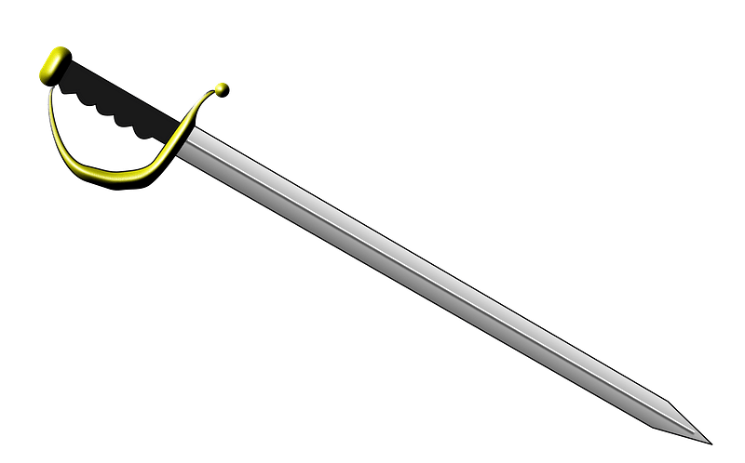

Slide 10
Applicability to Individuals

Slide 11
Applicability to Individuals
1.3: “ANSI A300 standards shall apply to any person or entity engaged in the management of trees, shrubs, palms, or other woody plants, including federal, state, or local agencies, utilities, arborists, consultants, arboricultural or landscape firms, horticulturalists, landscape architects, and managers or owners of property.”

Slide 12
Applicability to Individuals
1.3: “ANSI A300 standards shall apply to any person or entity engaged in the management of trees, shrubs, palms, or other woody plants, including federal, state, or local agencies, utilities, arborists, consultants, arboricultural or landscape firms, horticulturalists, landscape architects, and managers or owners of property.”

Slide 13
Applicability to Individuals
1.3: “ANSI A300 standards shall apply to any person … … engaged in the management of trees, … … , … … , … … … … … … … , including … … …, … … , … … … … … , … … , arborists, … … … …, … … … … … … … … … …, … … … … … , … … … … … … , and managers or owners of property.”

Slide 14
Normative References

Slide 15
Normative References
3: “The following standards contain provisions, which, through reference in the text, constitute provisions of this American National Standard. … ”

Slide 16
Normative References
3: “The following standards contain provisions, which, through reference in the text, constitute provisions of this American National Standard. … ANSI Z133 … Safety Requirements ”

Slide 17
Normative References
3: “The following standards contain provisions, which, through reference in the text, constitute provisions of this American National Standard. … ANSI Z133 … Safety Requirements 29 CFR 1910 [OSHA] ”

Slide 18
Normative References
3: “The following standards contain provisions, which, through reference in the text, constitute provisions of this American National Standard. … ANSI Z133 … Safety Requirements 29 CFR 1910 [OSHA] 16 U.S.C. §703-711, Migratory Bird Treaty Act ”

Slide 19
Normative References
3: “The following standards contain provisions, which, through reference in the text, constitute provisions of this American National Standard. … ANSI Z133 … Safety Requirements 29 CFR 1910 [OSHA] 16 U.S.C. §703-711, Migratory Bird Treaty Act 16 U.S.C. §1531-1544, Endangered Species Act ”

Slide 20
Who Can Work On Trees?

Slide 21
Who Can Work On Trees?
4.4.3: “Tree care operations shall be performed by arborists or other qualified professionals who, through related training and on-the-job experience, are familiar with the standards, practices, and hazards of arboriculture operations and equipment.”

Slide 22
Who Can Work On Trees?
4.4.3: “Tree care operations shall be performed by arborists or other qualified professionals who, through related training and on-the-job experience, are familiar with the standards, practices, and hazards of arboriculture operations and equipment.”

Slide 23
Who Can Work On Trees?
4.4.3: “Tree care operations shall be performed by arborists or other qualified professionals who, through related training and on-the-job experience, are familiar with the standards, practices, and hazards of arboriculture operations and equipment.”

Slide 24
Who Can Work On Trees?
4.4.3: “Tree care operations shall be performed by arborists … … … … … … … … … … who … … … …. … … … … … … … … … … … ... are familiar with the standards … … … … … … ... … of arboriculture … … … … … … … …. … … … … … … … … ….”

Slide 25
Who Can Work On Trees?
4.4.3: “Tree care operations shall be performed by arborists … … … … … … … … … … who … … … …. … … … … … … … … … … … ... are familiar with the standards, practices, and hazards of arboriculture … … … … … … … …. … … … … … … … … ….”

Slide 26
Who Can Work On Trees?

Slide 27
Who Can Work On Trees?

Slide 28
Who Can Work On Trees?
4.4.3: “Tree care operations shall be performed by arborists or other qualified professionals who, through related training and on-the-job experience … … … … … … … … … … … … … … … … … … … … … … … … … …. … … … … … … … … … … … … ….”

Slide 29
Who Can Work On Trees?
4.4.3: “Tree care operations shall be performed by arborists or other qualified professionals who, through related training and on-the-job experience … … … … … … … … … … … … … … … … … … … … … … … … … …. … … … … … … … … … … … … ….”

Slide 30
Who Can Work On Trees?
4.4.3: “Tree care operations shall be performed by arborists or other qualified professionals who, through related training and on-the-job experience… … … … … … … … … … … … … … … … … … … … … … … … … …. … … … … … … … … … … … … ….”

Slide 31
Who Can Work On Trees?

Slide 32
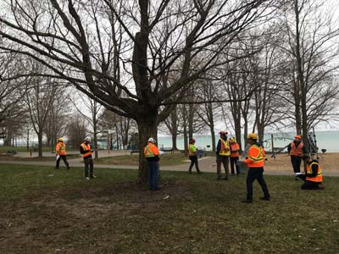
Who Can Work On Trees?

Slide 33
Pruning Specifications

Slide 34
Pruning Specifications
4.3.1: “One or more pruning objectives shall be specified...”

Slide 35
Pruning Specifications
4.3.1: “One or more pruning objectives shall be specified...”

Slide 36
Pruning Specifications
4.3.1: “One or more pruning objectives shall be specified...”
5.3.2: “The pruning system, plant health, growth habit, structure, species characteristics, expected response, and the ability of a plant to sustain the amount of pruning proposed shall be considered when establishing pruning objectives.”

Slide 37
Pruning Specifications
4.3.1: “One or more pruning objectives shall be specified...”
5.3.2: “The pruning system, plant health, growth habit, structure, species characteristics, expected response, and the ability of a plant to sustain the amount of pruning proposed shall be considered when establishing pruning objectives.”
5.4.4: “Species, size, age, condition, and site shall be considered when specifying the location and amount of living material to be removed.”

Slide 38
Pruning Specifications
4.3.1: “One or more pruning objectives shall be specified...”
5.3.2: “The pruning system, plant health, growth habit, structure, species characteristics, expected response, and the ability of a plant to sustain the amount of pruning proposed shall be considered when establishing pruning objectives.”
5.4.4: “Species, size, age, condition, and site shall be considered when specifying the location and amount of living material to be removed.”

Slide 39
Pruning Specifications
4.3.1: “One or more pruning objectives shall be specified...”
5.3.2: “The pruning system, plant health, growth habit, structure, species characteristics, expected response, and the ability of a plant to sustain the amount of pruning proposed shall be considered when establishing pruning objectives.”
5.4.4: “Species, size, age, condition, and site shall be considered when specifying the location and amount of living material to be removed.”

Slide 40
Pruning Specifications
“Trees along 3rd Street: 25% thinning”

Slide 41
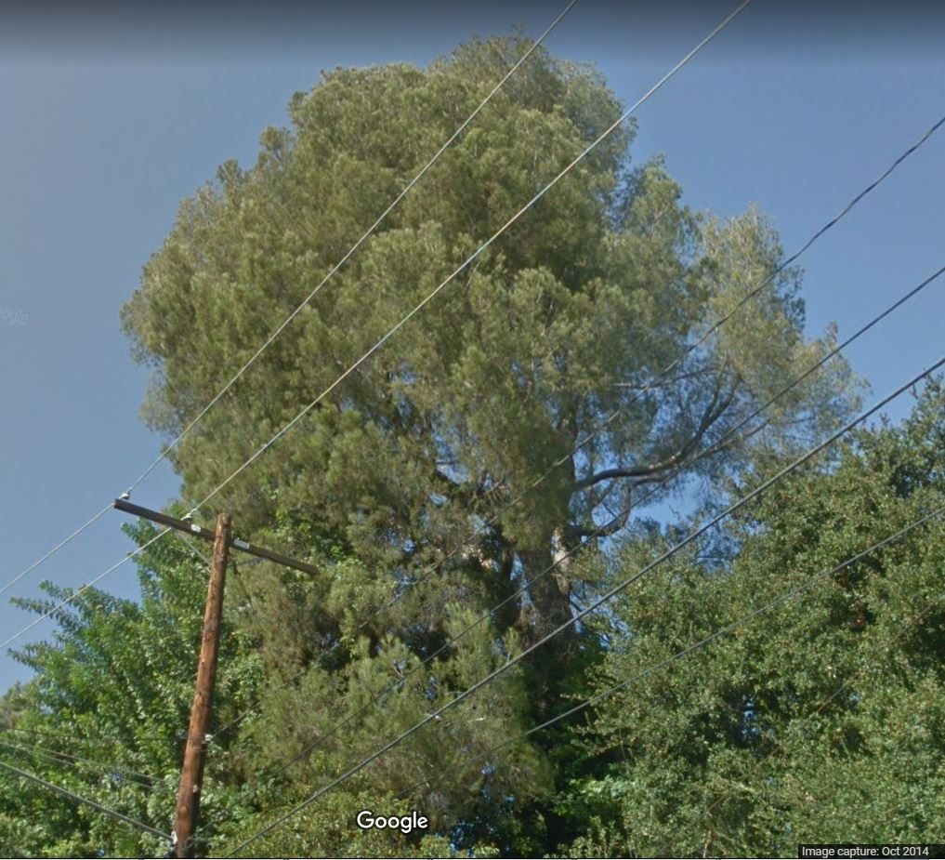
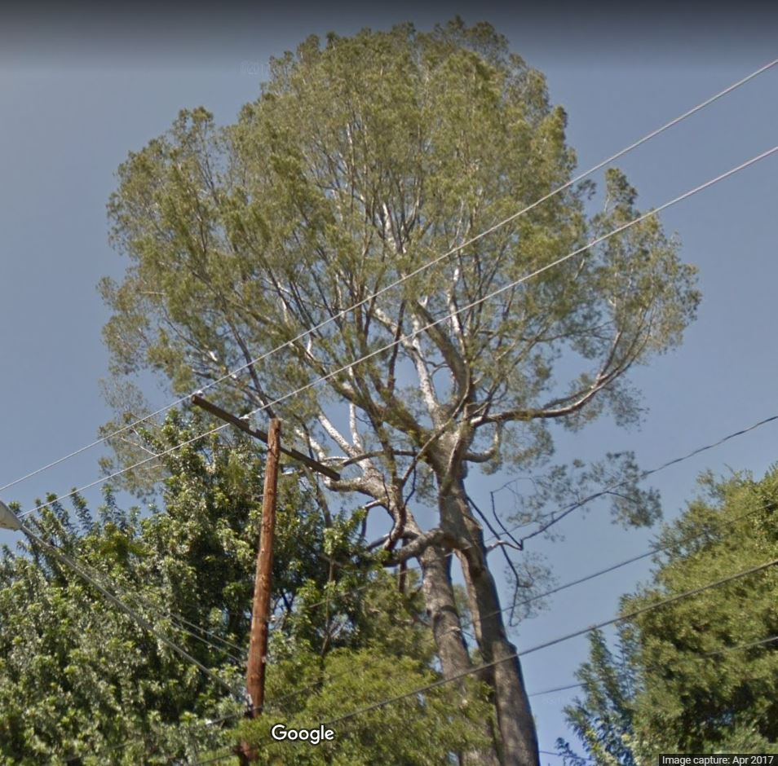
Pruning Specifications

Slide 42
Pruning Specifications

Slide 43
Pruning Specifications
4.3.1: “One or more pruning objectives shall be specified...”

Slide 44
Pruning Specifications
4.3.1: “One or more pruning objectives shall be specified...”
5.3.1: “Objectives may include:
Manage risk (see Clause 13 Tree Risk Assessment …)
…”

Slide 45
Pruning Specifications
4.3.1: “One or more pruning objectives shall be specified...”
5.3.1: “Objectives may include:
Manage risk (see Clause 13 Tree Risk Assessment …)
…”

Slide 46
Pruning Specifications
4.3.1: “One or more pruning objectives shall be specified...”
5.3.1: “Objectives may include:
Manage risk (see Clause 13 Tree Risk Assessment …)
…”
5.5.1: “Pruning cuts should be the smallest diameter and the fewest number required to meet the specified objective.”

Slide 47
Pruning Specifications
4.3.1: “One or more pruning objectives shall be specified...”
5.3.1: “Objectives may include:
Manage risk (see Clause 13 Tree Risk Assessment …)
…”
5.5.1: “Pruning cuts should be the smallest diameter and the fewest number required to meet the specified objective.”

Slide 48
Who is a Risk Assessor?

Slide 49
Who is a Risk Assessor?
15: “tree risk assessor: an arborist or other qualified professional with training and experience in the practice of tree risk assessment.”

Slide 50
Who is a Risk Assessor?
15: “tree risk assessor: an arborist or other qualified professional with training and experience in the practice of tree risk assessment.”
13.3.2: “Tree risk assessors shall have sufficient training and experience to provide the specified level and details of the tree risk assessment.”

Slide 51
Who is a Risk Assessor?
15: “tree risk assessor: an arborist or other qualified professional with training and experience in the practice of tree risk assessment.”
13.3.2: “Tree risk assessors shall have sufficient training and experience to provide the specified level and details of the tree risk assessment.”

Slide 52
Who is a Risk Assessor?
15: “tree risk assessor: an arborist or other qualified professional with training and experience in the practice of tree risk assessment.”
13.3.2: “Tree risk assessors shall have sufficient training and experience to provide the specified level and details of the tree risk assessment.”

Slide 53
Scope of Assessment

Slide 54
Scope of Assessment
13.4.3: “Tree risk assessors shall not be required to assess trees other than those specified in the scope of work.”

Slide 55
Scope of Assessment
13.4.3: “Tree risk assessors shall not be required to assess trees other than those specified in the scope of work.”
13.4.4: “Tree risk assessors shall not be required to perform a higher level of assessment than specified in the scope of work.”

Slide 56
Scope of Assessment
13.4.3: “Tree risk assessors shall not be required to assess trees other than those specified in the scope of work.”
13.4.4: “Tree risk assessors shall not be required to perform a higher level of assessment than specified in the scope of work.”

Slide 57
Scope of Assessment

Slide 58
Scope of Assessment

Slide 59
Level of Assessment

Slide 60
Level of Assessment
13.5.1 Level 1: Limited Visual Tree Risk Assessment

Slide 61
Level of Assessment
13.5.1 Level 1: Limited Visual Tree Risk Assessment
13.5.1.1: “The tree(s), targets, and conditions of concern (if any) to be considered, and the perspective of the assessment, … shall be specified.”

Slide 62
Level of Assessment
13.5.1 Level 1: Limited Visual Tree Risk Assessment
13.5.1.1: “The tree(s), targets, and conditions of concern (if any) to be considered, and the perspective of the assessment, … shall be specified.”

Slide 63
Level of Assessment
13.5.1 Level 1: Limited Visual Tree Risk Assessment
13.5.1.1: “The tree(s), targets, and conditions of concern (if any) to be considered, and the perspective of the assessment, … shall be specified.”

Slide 64
Level of Assessment
13.5.1 Level 1: Limited Visual Tree Risk Assessment
13.5.1.1: “The tree(s), targets, and conditions of concern (if any) to be considered, and the perspective of the assessment, … shall be specified.”
13.2.2.1: “Trees to be assessed at Level 1 may be viewed remotely or in person.”

Slide 65
Level of Assessment
13.5.1 Level 1: Limited Visual Tree Risk Assessment
13.5.1.1: “The tree(s), targets, and conditions of concern (if any) to be considered, and the perspective of the assessment, … shall be specified.”
13.2.2.1: “Trees to be assessed at Level 1 may be viewed remotely or in person.”

Slide 66
Level of Assessment
13.5.2 Level 2: Basic Tree Risk Assessment

Slide 67
Level of Assessment
13.5.2 Level 2: Basic Tree Risk Assessment
13.5.2.1: “Basic tree risk assessments shall include a 360 degree ground based inspection around the tree.”
13.2.2.2: “Trees to be assessed at Level 2 shall be visually inspected in person.”

Slide 68
Level of Assessment
13.5.2 Level 2: Basic Tree Risk Assessment
13.5.2.1: “Basic tree risk assessments shall include a 360 degree ground based inspection around the tree.”
13.2.2.2: “Trees to be assessed at Level 2 shall be visually inspected in person.”

Slide 69
Level of Assessment
13.5.2 Level 2: Basic Tree Risk Assessment
13.5.2.1: “Basic tree risk assessments shall include a 360 degree ground based inspection around the tree.”
13.2.2.2: “Trees to be assessed at Level 2 shall be visually inspected in person.”
13.5.2.3: “Simple tools may be used at the discretion of the risk assessor or shall be used as specified.”
13.5.2.3.1: “Simple tools may include:

Slide 70
Level of Assessment
13.5.2 Level 2: Basic Tree Risk Assessment
13.5.2.1: “Basic tree risk assessments shall include a 360 degree ground based inspection around the tree.”
13.2.2.2: “Trees to be assessed at Level 2 shall be visually inspected in person.”
13.5.2.3: “Simple tools may be used at the discretion of the risk assessor or shall be used as specified.”
13.5.2.3.1: “Simple tools may include:

Slide 71
Level of Assessment
13.5.2 Level 2: Basic Tree Risk Assessment
13.5.2.1: “Basic tree risk assessments shall include a 360 degree ground based inspection around the tree.”
13.2.2.2: “Trees to be assessed at Level 2 shall be visually inspected in person.”
13.5.2.3: “Simple tools may be used at the discretion of the risk assessor or shall be used as specified.”
13.5.2.3.1: “Simple tools may include:
Mallet;
Probe
Binoculars
Trowel or shovel
Diameter tape
Clinometer/ hypsometer

Slide 72
Duty to Report Outside Scope

Slide 73
Duty to Report Outside Scope
4.2.4: “When the scope of work is limited by property boundaries, easements, or other constraints, inspection of plants or plant parts outside of the assigned scope of work shall not be required.”

Slide 74
Duty to Report Outside Scope
4.2.4: “When the scope of work is limited by property boundaries, easements, or other constraints, inspection of plants or plant parts outside of the assigned scope of work shall not be required.”

Slide 75
Duty to Report Outside Scope
BUT…

Slide 76
Duty to Report Outside Scope
4.2.3 (work-site inspection): “Conditions that would affect, or are outside of, the scope of work should be reported to an immediate supervisor or to the client.”

Slide 77
Duty to Report Outside Scope
4.2.3 (work-site inspection): “Conditions that would affect, or are outside of, the scope of work should be reported to an immediate supervisor or to the client.”
9.4.3 (construction): “Trees adjacent to the site that may be adversely affected by the construction or may affect the construction activity should be included in the evaluation.”

Slide 78
Duty to Report Outside Scope
4.2.3 (work-site inspection): “Conditions that would affect, or are outside of, the scope of work should be reported to an immediate supervisor or to the client.”
9.4.3 (construction): “Trees adjacent to the site that may be adversely affected by the construction or may affect the construction activity should be included in the evaluation.”

Slide 79
Duty to Follow-Up

Slide 80
Duty to Follow-Up
4.7.3 (general): “Scheduling of monitoring and maintenance shall be the responsibility of the client.”

Slide 81
Duty to Follow-Up
4.7.3 (general): “Scheduling of monitoring and maintenance shall be the responsibility of the client.”
5.10.3 (pruning): “Monitoring and maintenance scheduling shall be the responsibility of the client.”

Slide 82
Duty to Follow-Up
4.7.3 (general): “Scheduling of monitoring and maintenance shall be the responsibility of the client.”
5.10.3 (pruning): “Monitoring and maintenance scheduling shall be the responsibility of the client.”
6.10.3 (soil management): “Monitoring and maintenance scheduling shall be the responsibility of the client.”

Slide 83
Duty to Follow-Up
4.7.3 (general): “Scheduling of monitoring and maintenance shall be the responsibility of the client.”
5.10.3 (pruning): “Monitoring and maintenance scheduling shall be the responsibility of the client.”
6.10.3 (soil management): “Monitoring and maintenance scheduling shall be the responsibility of the client.”
7.12.2 (structural support): “Scheduling monitoring and maintenance shall be the responsibility of the tree owner.”

Slide 84
Duty to Follow-Up
4.7.3 (general): “Scheduling of monitoring and maintenance shall be the responsibility of the client.”
5.10.3 (pruning): “Monitoring and maintenance scheduling shall be the responsibility of the client.”
6.10.3 (soil management): “Monitoring and maintenance scheduling shall be the responsibility of the client.”
7.12.2 (structural support): “Scheduling monitoring and maintenance shall be the responsibility of the tree owner.”
10.6.1.1 (planting): “It shall be the responsibility of the client, owner, or owner’s agent to provide post-planting monitoring and maintenance.”

Slide 85
Duty to Follow-Up
4.7.3 (general): “Scheduling of monitoring and maintenance shall be the responsibility of the client.”
5.10.3 (pruning): “Monitoring and maintenance scheduling shall be the responsibility of the client.”
6.10.3 (soil management): “Monitoring and maintenance scheduling shall be the responsibility of the client.”
7.12.2 (structural support): “Scheduling monitoring and maintenance shall be the responsibility of the tree owner.”
10.6.1.1 (planting): “It shall be the responsibility of the client, owner, or owner’s agent to provide post-planting monitoring and maintenance.”

Slide 86
Duty to Follow-Up
4.7.3 (general): “Scheduling of monitoring and maintenance shall be the responsibility of the client.”
5.10.3 (pruning): “Monitoring and maintenance scheduling shall be the responsibility of the client.”
6.10.3 (soil management): “Monitoring and maintenance scheduling shall be the responsibility of the client.”
7.12.2 (structural support): “Scheduling monitoring and maintenance shall be the responsibility of the tree owner.”
10.6.1.1 (planting): “It shall be the responsibility of the client, owner, or owner’s agent to provide post-planting monitoring and maintenance.”

Slide 87
Duty to Follow-Up

Slide 88
Duty to Follow-Up
13.3.6 (risk assessment): “It shall not be the tree risk assessor’s responsibility to select and implement the mitigation, schedule repeat or advanced assessments, or to schedule future monitoring and maintenance, unless included in the scope of work.”

Slide 89
Duty to Follow-Up
13.3.6 (risk assessment): “It shall not be the tree risk assessor’s responsibility to select and implement the mitigation, schedule repeat or advanced assessments, or to schedule future monitoring and maintenance, unless included in the scope of work.”

Slide 90
Duty to Follow-Up
BUT…

Slide 91
Duty to Follow-Up
4.7.1 (general): “A monitoring interval should be recommended.”

Slide 92
Duty to Follow-Up
4.7.1 (general): “A monitoring interval should be recommended.”
5.10.2 (pruning): “Monitoring intervals should be recommended…”

Slide 93
Duty to Follow-Up
4.7.1 (general): “A monitoring interval should be recommended.”
5.10.2 (pruning): “Monitoring intervals should be recommended…”
6.10.2 (soil management): “Monitoring intervals should be recommended…”

Slide 94
Duty to Follow-Up
4.7.1 (general): “A monitoring interval should be recommended.”
5.10.2 (pruning): “Monitoring intervals should be recommended…”
6.10.2 (soil management): “Monitoring intervals should be recommended…”
13.7.1 (risk assessment): “The tree risk assessor should inform the client of the need for monitoring.”

Slide 95
Duty to Follow-Up
4.7.1 (general): “A monitoring interval should be recommended.”
5.10.2 (pruning): “Monitoring intervals should be recommended…”
6.10.2 (soil management): “Monitoring intervals should be recommended…”
13.7.1 (risk assessment): “The tree risk assessor should inform the client of the need for monitoring.”

Slide 96
Duty to Follow-Up

Slide 97
Duty to Follow-Up
4.7.2 (general): “Maintenance recommendations shall be made to the client, where applicable.”

Slide 98
Duty to Follow-Up
4.7.2 (general): “Maintenance recommendations shall be made to the client, where applicable.”
7.12.1 (structural support): “The client, owner or owner’s agent shall be notified of the need for periodic monitoring and maintenance.”

Slide 99
Duty to Follow-Up
4.7.2 (general): “Maintenance recommendations shall be made to the client, where applicable.”
7.12.1 (structural support): “The client, owner or owner’s agent shall be notified of the need for periodic monitoring and maintenance.”
8.7.2 (lightning protection): “The client, owner or owner’s agent shall be informed of the need for periodic inspection and maintenance of the system.”

Slide 100
Duty to Follow-Up
4.7.2 (general): “Maintenance recommendations shall be made to the client, where applicable.”
7.12.1 (structural support): “The client, owner or owner’s agent shall be notified of the need for periodic monitoring and maintenance.”
8.7.2 (lightning protection): “The client, owner or owner’s agent shall be informed of the need for periodic inspection and maintenance of the system.”
10.6.1 (planting): “The client, owner, or owner’s agent shall be notified of the need for post-planting monitoring and maintenance.”

Slide 101
Duty to Follow-Up
4.7.2 (general): “Maintenance recommendations shall be made to the client, where applicable.”
7.12.1 (structural support): “The client, owner or owner’s agent shall be notified of the need for periodic monitoring and maintenance.”
8.7.2 (lightning protection): “The client, owner or owner’s agent shall be informed of the need for periodic inspection and maintenance of the system.”
10.6.1 (planting): “The client, owner, or owner’s agent shall be notified of the need for post-planting monitoring and maintenance.”
12.6.1 (root management): “Recommendations for monitoring and maintenance shall be made to the client.”

Slide 102
Duty to Follow-Up
4.7.2 (general): “Maintenance recommendations shall be made to the client, where applicable.”
7.12.1 (structural support): “The client, owner or owner’s agent shall be notified of the need for periodic monitoring and maintenance.”
8.7.2 (lightning protection): “The client, owner or owner’s agent shall be informed of the need for periodic inspection and maintenance of the system.”
10.6.1 (planting): “The client, owner, or owner’s agent shall be notified of the need for post-planting monitoring and maintenance.”
12.6.1 (root management): “Recommendations for monitoring and maintenance shall be made to the client.”

Slide 103
Duty to Follow-Up
Owner
Arborist
4.7.3 (general)
5.10.3 (pruning)
6.10.3 (soil management)
7.12.2 (structural support)
8.7.3 (lightning protection)
10.6.1.1 (planting)
12.6.5 (root management)
Notify owner of the need for monitoring and maintenance

Slide 104
Duty to Notify
Should
Shall
4.7.1 (general) “monitoring”
5.10.2 (pruning)
6.10.2 (soil management)
13.7.1 (risk assessment)
4.7.2 (general) “maintenance”
7.12.1 (structural support)
8.7.2 (lightning protection)
10.6.1 (planting)
12.6.1 (root management)

Slide 105
Risk Assessment Reports

Slide 106
Risk Assessment Reports
13.6.3: “[Risk Assessment] reports shall include:
Objective
Location
Targets
Date of Inspection
Time Frame
Risk Rating
Risk Mitigation Options.”

Slide 107
Risk Assessment Reports
13.6.3: “[Risk Assessment] reports shall include:
Objective
Location
Targets
Date of Inspection
Time Frame
Risk Rating
Risk Mitigation Options.”

Slide 108
Risk Assessment Reports
13.6.3: “[Risk Assessment] reports shall include:
13.3.4: “The tree risk assessor shall consider the likelihood of a tree failure impacting a target and the likely severity of the consequence.”
Objective
Location
Targets
Date of Inspection
Time Frame
Risk Rating
Risk Mitigation Options.”

Slide 109
Risk Assessment Reports
13.6.3: “[Risk Assessment] reports shall include:
13.3.4: “The tree risk assessor shall consider the likelihood of a tree failure impacting a target and the likely severity of the consequence.”
Objective
Location
Targets
Date of Inspection
Time Frame
Risk Rating
Risk Mitigation Options.”

Slide 110
Risk Assessment Reports
13.6.3: “[Risk Assessment] reports shall include:
13.3.4: “The tree risk assessor shall consider the likelihood of a tree failure impacting a target and the likely severity of the consequence.”
Objective
Location
Targets
Date of Inspection
Time Frame
Risk Rating
Risk Mitigation Options.”

Slide 111
Risk Assessment Reports

Slide 112
Risk Assessment Reports
“The tree has a 70% chance of failure.”
“…therefore it must be removed.”

Slide 113
Risk Assessment Reports
“If the tree were to fall, it could impact a person.”
“…therefore it must be removed.”

Slide 114
Risk Assessment Reports
“The scaffold branch has a probable likelihood of failure and a high likelihood of impacting the house and causing significant consequences.”

Slide 115
Risk Assessment Reports
“The scaffold branch has a probable likelihood of failure and a high likelihood of impacting the house and causing significant consequences.”

Slide 116
Risk Assessment Reports
“The scaffold branch has a probable likelihood of failure and a high likelihood of impacting the house and causing significant consequences.”
“…within the next one year time frame.”

Slide 117
Takeaways
Sword
Shield
4.4.3: Who Work On Trees
13.3.2: Who Can Assess Trees
5.4.4: Pruning Specifications
13.6.3: Components of a Risk Assessment Report
4.2.3: Duty to Report Off-scope Conditions
4.2.4: Offsite, Off-scope Trees
4.7.3: Owner’s Duty to Follow-up
13.4.3: Scope of Assessment
13.4.4: Level of Assessment
1.3: Standards Apply to Everyone

Slide 118
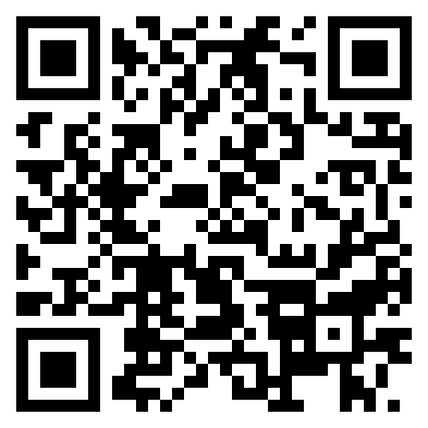
Wielding the A300 Standards: The Shield and the Sword
James Komen
BCMA #WE-9909B
RCA #555
www.jameskomen.com
jameskomen@gmail.com

