Slide 1
Case Illustrations from Kansas Tree Law
James Komen
BCMA #WE-9909B
RCA #555

Slide 2
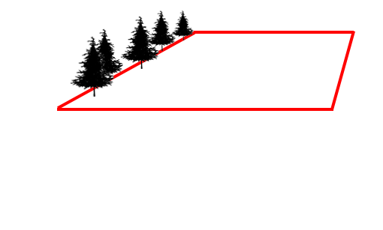
Collins v. Morris 97 Kan. 264 (Sup. Ct. 1916)
Δ Morris
π Collins

Slide 3
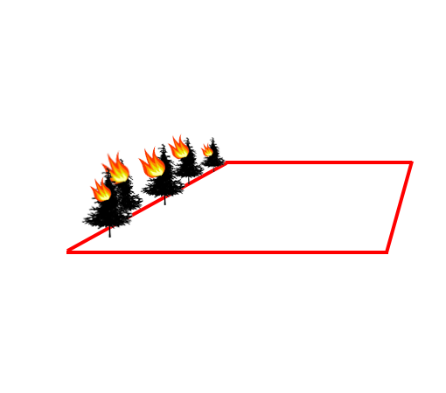
Collins v. Morris 97 Kan. 264 (Sup. Ct. 1916)
Δ Morris
π Collins

Slide 4
Collins v. Morris 97 Kan. 264 (Sup. Ct. 1916)
“Bundle of Rights”
Alienate
Possess
Use
Destroy
Notes:
Bundle of Rights
What remedy addresses each right?
Co-ownership impairment of rights

Slide 5
Collins v. Morris 97 Kan. 264 (Sup. Ct. 1916)
Δ Morris
π Collins
Tree Value = $$

Slide 6
Collins v. Morris 97 Kan. 264 (Sup. Ct. 1916)
Δ Morris
π Collins
Tree Value = $$
Land Value Diminution = 0

Slide 7
Property Rights
Collins v. Morris 97 Kan. 264 (Sup. Ct. 1916)
Ditzen v. Kansas City 138 Kan. 830 (Sup. Ct. 1934)
City of Paola v. Wentz 79 Kan. 148 (Sup. Ct. 1908)
Presnell v. Cullen 508 P.3d 875 (Ct. App. 2022)
Mall v. C & W Rural Electric Co-op Ass’n 168 Kan. 518 (Sup. Ct. 1950)
Miessler v. John Solida & Sons Tree Serv. 140 P.3d 1061 (Ct. App. 2006)
Notes:
6 cases

Slide 8
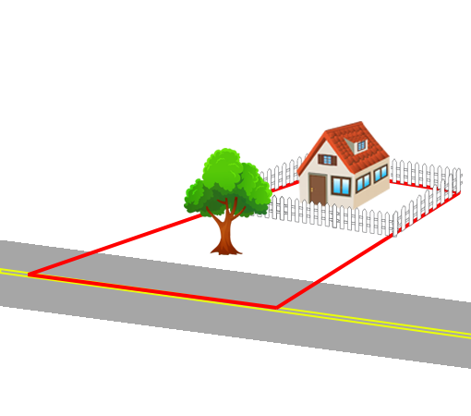
Ditzen v. Kansas City 138 Kan. 830 (Sup. Ct. 1934)
Notes:
City cut down street trees in front of plaintiff’s house.
Plaintiff has no recourse.
Liability ONLY IF “unnecessary” or “unreasonable”

Slide 9
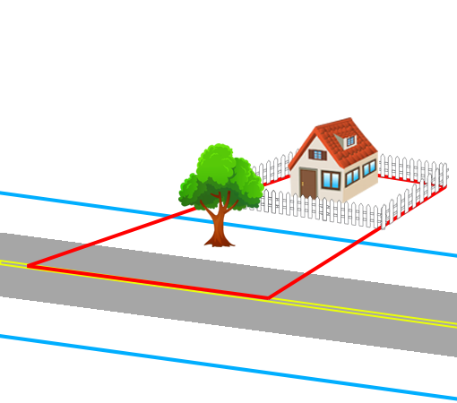
Ditzen v. Kansas City 138 Kan. 830 (Sup. Ct. 1934)
Notes:
City cut down street trees in front of plaintiff’s house.
Plaintiff has no recourse.
Liability ONLY IF “unnecessary” or “unreasonable”

Slide 10
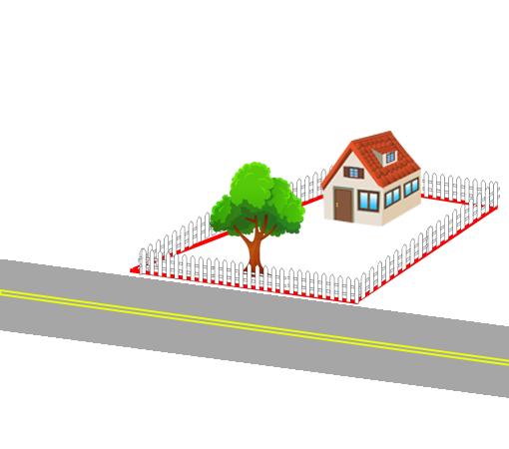
City of Paola v. Wentz 79 Kan. 148 (Sup. Ct. 1908)
Notes:
Unnecessary cutting of street trees
City enjoined from cutting plaintiff’s trees
“we’re building a sidewalk 5 feet beyond road” (but tree wasn’t within the area surveyed)

Slide 11
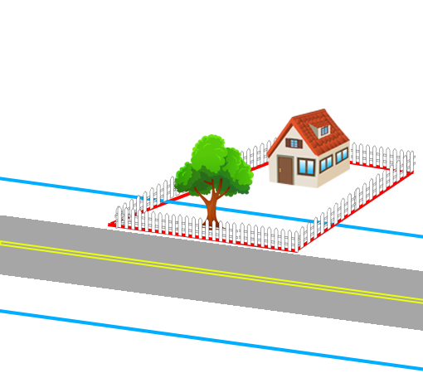
City of Paola v. Wentz 79 Kan. 148 (Sup. Ct. 1908)
Notes:
Unnecessary cutting of street trees
City enjoined from cutting plaintiff’s trees
“we’re building a sidewalk 5 feet beyond road” (but tree wasn’t within the area surveyed)

Slide 12
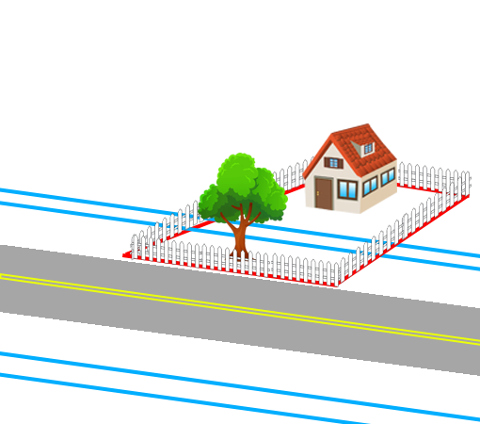
City of Paola v. Wentz 79 Kan. 148 (Sup. Ct. 1908)
Notes:
Unnecessary cutting of street trees
City enjoined from cutting plaintiff’s trees
“we’re building a sidewalk 5 feet beyond road” (but tree wasn’t within the area surveyed)

Slide 13
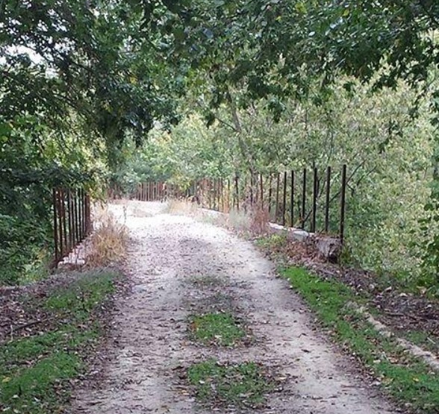
Presnell v. Cullen 508 P.3d 875 (Ct. App. 2022) Unpublished
Notes:
Rails to trails tree cutting was “reasonably necessary” for providing access to equipment to construct trail
McPherson county
Tracy Presnell vs. Michele Cullen

Slide 14
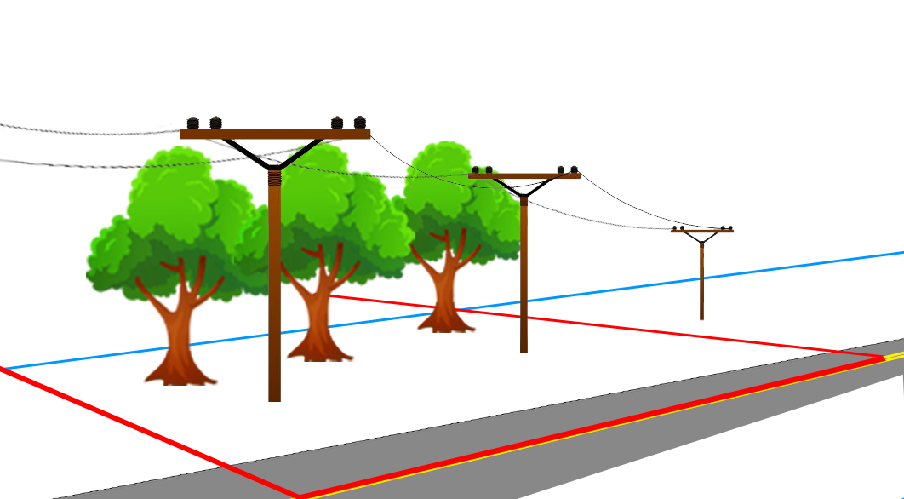
Mall v. C & W Rural Electric Co-op Ass’n 168 Kan. 518 (Sup. Ct. 1950)
Notes:
Utility company exceeded scope of necessary pruning of lines within HIGHWAY easement
Sufficient evidence of INTENT for 3X, even without MALICE

Slide 15
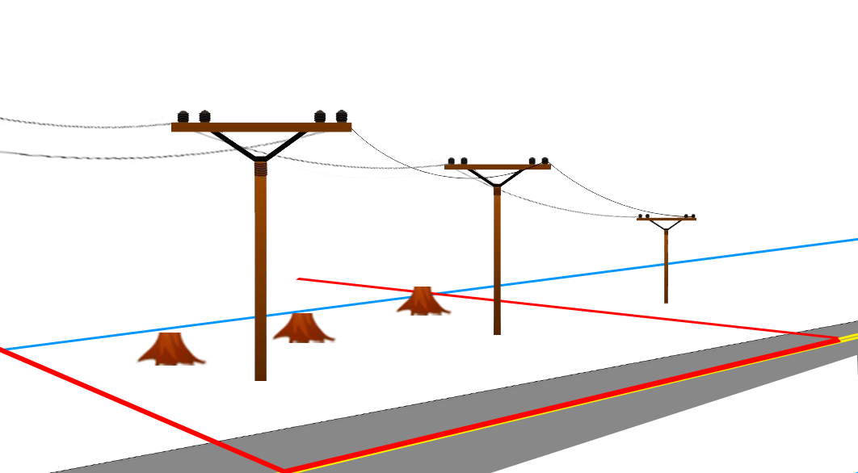
Mall v. C & W Rural Electric Co-op Ass’n 168 Kan. 518 (Sup. Ct. 1950)
Notes:
Utility company exceeded scope of necessary pruning of lines within HIGHWAY easement
Sufficient evidence of INTENT for 3X, even without MALICE

Slide 16
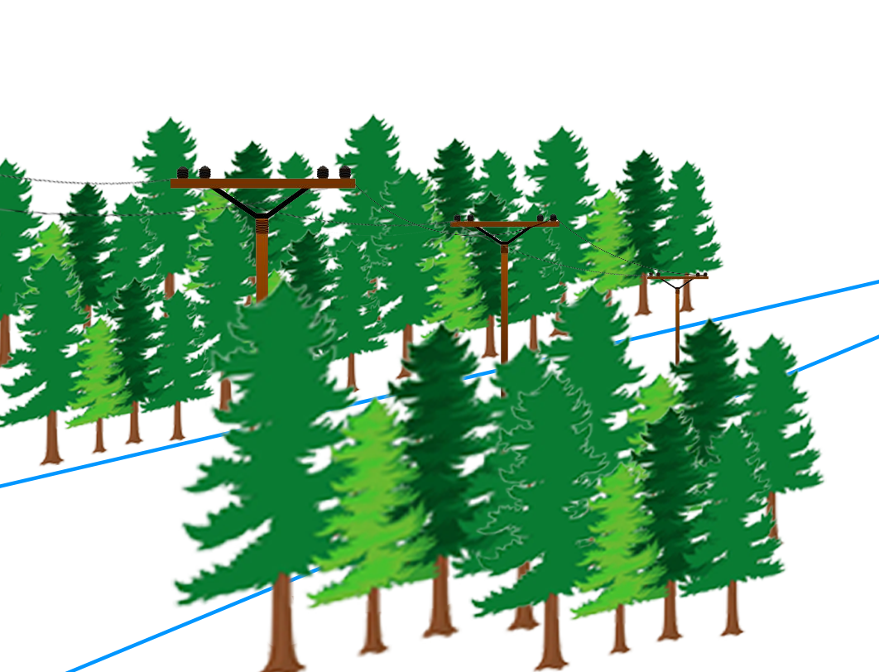
Miessler v. John Solida & Sons Tree Serv. 140 P.3d 1061 (Ct. App. 2006) Unpublished
Notes:
Utility pruning beyond boundaries of easement.
Question of fact whether trees “may interfere or threaten the operation or maintenance of the lines”
Trial Court instructed jury that defendant had the burden to prove the cutting was “necessary.”
NEW TRIAL – plaintiff has burden to show that cutting was UN-necessary

Slide 17
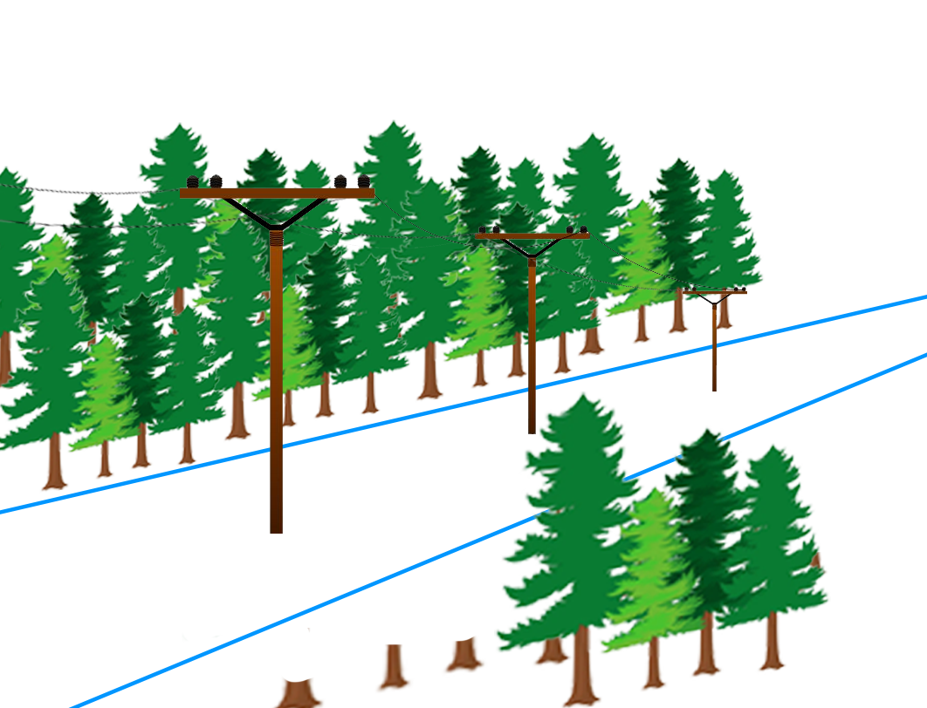
Miessler v. John Solida & Sons Tree Serv. 140 P.3d 1061 (Ct. App. 2006) Unpublished
Notes:
Utility pruning beyond boundaries of easement.
Question of fact whether trees “may interfere or threaten the operation or maintenance of the lines”
Trial Court instructed jury that defendant had the burden to prove the cutting was “necessary.”
NEW TRIAL – plaintiff has burden to show that cutting was UN-necessary

Slide 18
Constitutional Law
Glover v. State Highway Com. 147 Kan. 279 (Sup. Ct. 1938)
Carrasco v. City of Udall 2022 WL 522959 (Ct. App. 2022)
Balch v. Glenn 85 Kan. 735 (Sup. Ct. 1911)
Notes:
3 cases

Slide 19
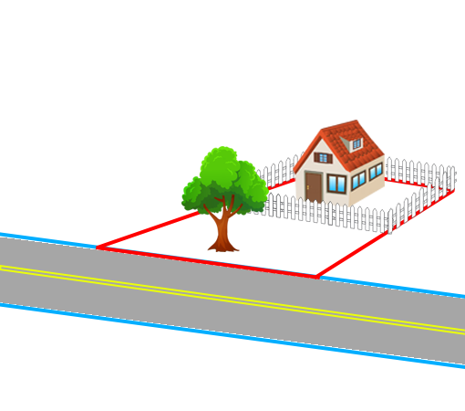
Glover v. State Highway Com. 147 Kan. 279 (Sup. Ct. 1938)
Notes:
Condemnation
- CANT USE evidence of TREE VALUE
- MUST USE evidence of market value of land ONLY
NEW TRIAL

Slide 20
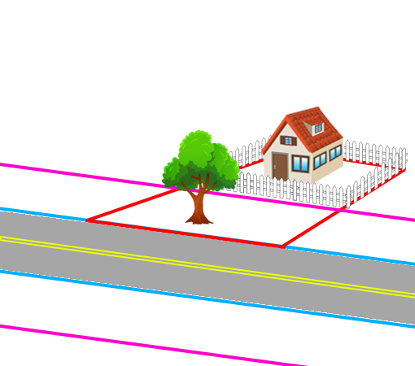
Glover v. State Highway Com. 147 Kan. 279 (Sup. Ct. 1938)
Notes:
Condemnation
- CANT USE evidence of TREE VALUE
- MUST USE evidence of market value of land ONLY
NEW TRIAL

Slide 21
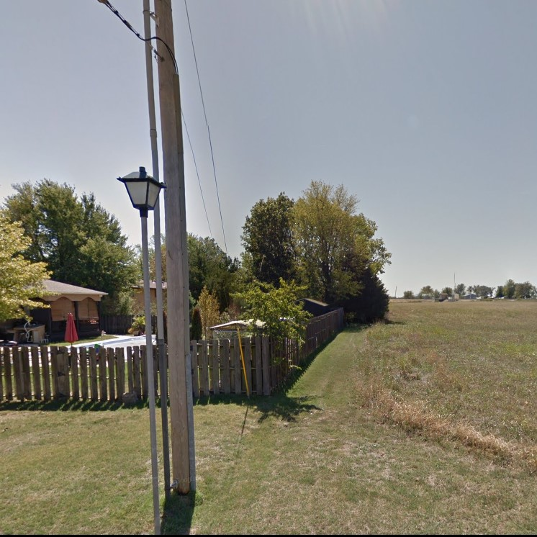
Carrasco v. City of Udall 2022 WL 522959 (Ct. App. 2022) Unpublished
Notes:
Trees in electrical easement removed w/o notice because they MAY harm electrical lines
- NOT 5th A (risk of interference ALONE is sufficient)
- NOT due process violation because no prop right

Slide 22
Carrasco v. City of Udall 2022 WL 522959 (Ct. App. 2022) Unpublished
Notes:
Trees in electrical easement removed w/o notice because they MAY harm electrical lines
- NOT 5th A (risk of interference ALONE is sufficient)
- NOT due process violation because no prop right

Slide 23
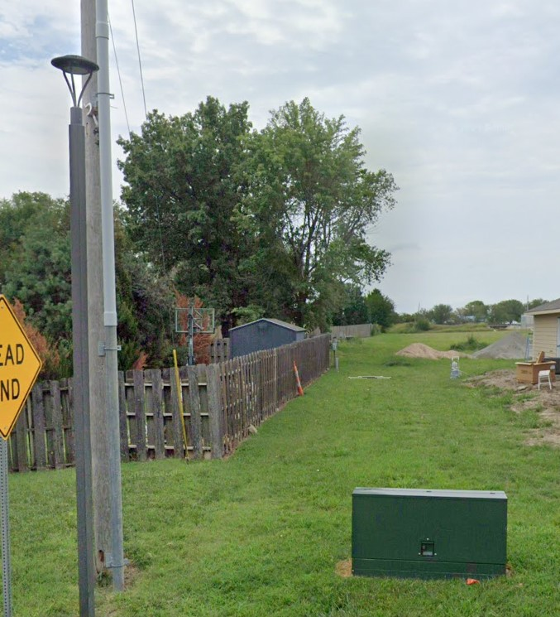
Carrasco v. City of Udall 2022 WL 522959 (Ct. App. 2022) Unpublished
Notes:
Trees in electrical easement removed w/o notice because they MAY harm electrical lines
- NOT 5th A (risk of interference ALONE is sufficient)
- NOT due process violation because no prop right

Slide 24
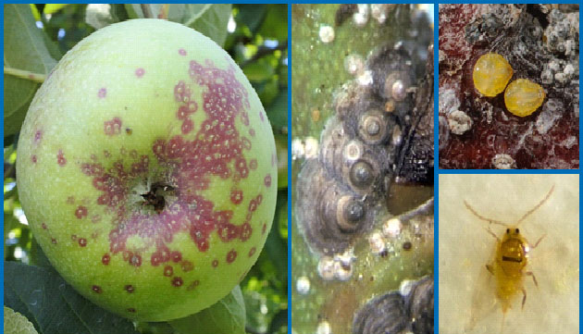
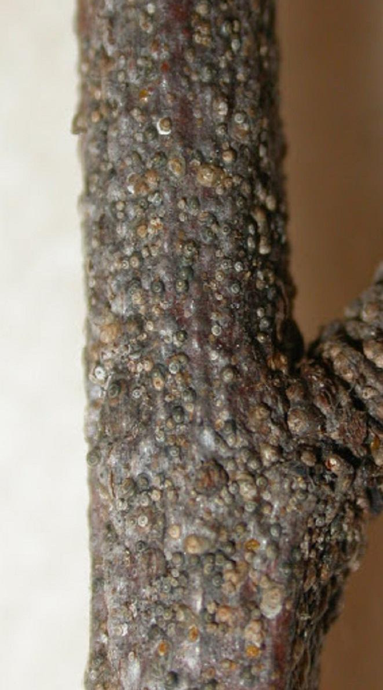
Balch v. Glenn 85 Kan. 735 (Sup. Ct. 1911)
Notes:
1909 Entomological Commission created
San Jose Scale
- may destroy trees, NOT A TAKING (see Miller v. Schoene US Sup. Ct. 1928)
- determination of nuisance not subject to challenge when entomological commission is comprised of hort experts

Slide 25
Tree Risk
Pierce v. Casady 711 P.2d 766 (Ct. App. 1985)
Am. Family Ins. v. Anderson 107 P.3d 1262 (Ct. App. 2005)
Turner v. Wichita 143 Kan. 808 (Sup. Ct. 1936)
Swope v. Wichita 141 Kan. 388 (Sup. Ct. 1935)
Siple v. Topeka 235 Kan. 167 (Sup. Ct. 1984)
Brown v. State Highway Com. 202 Kan. 1 (Sup. Ct. 1968)
Manley v. Hallbauer 308 Kan. 723 (Sup. Ct. 2018)
Notes:
7 cases

Slide 26
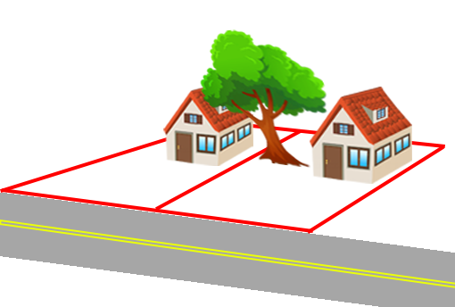
Pierce v. Casady 711 P.2d 766 (Ct. App. 1985)
π
Δ
Notes:
1985
Paul and DeLena Casady (tree owners)
James and Mary Jo Pierce (neighbors)
Neosho County

Slide 27
Pierce v. Casady 711 P.2d 766 (Ct. App. 1985)
π
Δ
Notes:
Tree risk poses a private nuisance.
No Prescriptive Easement into airspace
Even if cabling would reduce the risk, it would require impairing plaintiff’s property.
- no prescriptive easement for airspace over property
- doesn’t address the right to cut the tree in the absence of nuisance

Slide 28
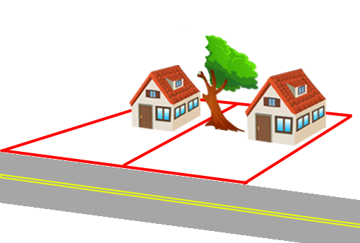
Pierce v. Casady 711 P.2d 766 (Ct. App. 1985)
π
Δ
Notes:
Tree risk poses a private nuisance.
No Prescriptive Easement into airspace
Even if cabling would reduce the risk, it would require impairing plaintiff’s property.
- no prescriptive easement for airspace over property
- doesn’t address the right to cut the tree in the absence of nuisance

Slide 29
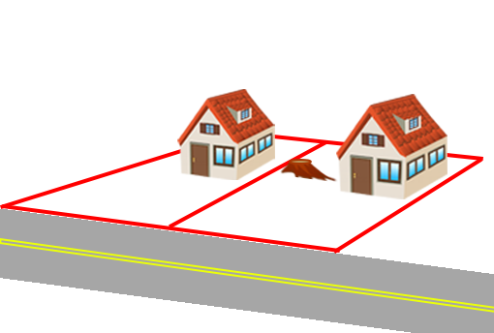
Pierce v. Casady 711 P.2d 766 (Ct. App. 1985)
π
Δ
Notes:
Tree risk poses a private nuisance.
No Prescriptive Easement into airspace
Even if cabling would reduce the risk, it would require impairing plaintiff’s property.
- no prescriptive easement for airspace over property
- doesn’t address the right to cut the tree in the absence of nuisance

Slide 30
Pierce v. Casady 711 P.2d 766 (Ct. App. 1985)
“The result reached here will be distasteful to all who treasure trees. … [W]henever neighbors cannot agree, the law will protect each property owner’s rights insofar as that is possible. Any other result would cause landowners to seek self-help or to litigate each time a piece of vegetation starts to overhang…”

Slide 31
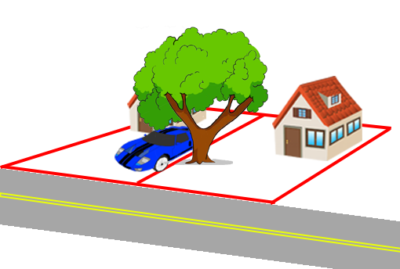
Am. Family Ins. v. Anderson 107 P.3d 1262 (Ct. App. 2005) Unpublished
π
Δ
Notes:
Lindsborg, KS
Stenfors and Andersons
1992: Part of tree failed into Anderson’s yard, no damage
2002: Tree failed onto Stenfors’ property, causing property damage

Slide 32
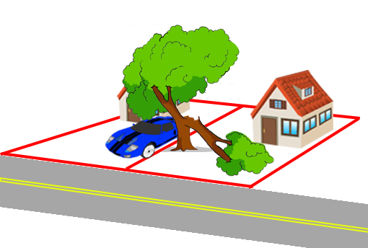
Am. Family Ins. v. Anderson 107 P.3d 1262 (Ct. App. 2005) Unpublished
π
Δ
Notes:
Tree part failed once, leaving a wound. The wound healed over. Then the rest of the tree failed YEARS LATER.
- NO NOTICE, NO DUTY TO ACT
- No nuisance because no negligence

Slide 33
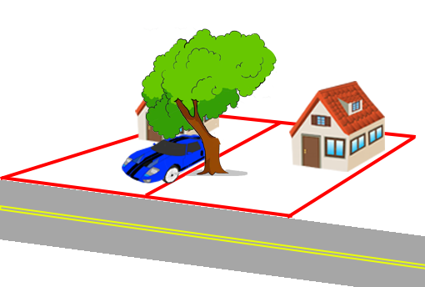
Am. Family Ins. v. Anderson 107 P.3d 1262 (Ct. App. 2005) Unpublished
π
Δ
Notes:
Tree part failed once, leaving a wound. The wound healed over. Then the rest of the tree failed YEARS LATER.
- NO NOTICE, NO DUTY TO ACT
- No nuisance because no negligence

Slide 34
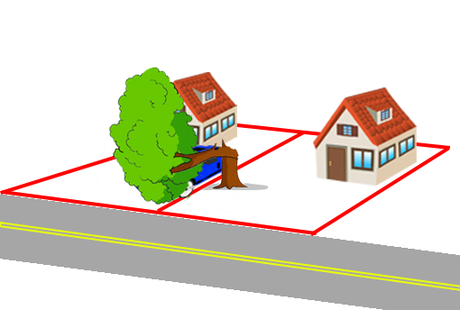
Am. Family Ins. v. Anderson 107 P.3d 1262 (Ct. App. 2005) Unpublished
π
Δ
Notes:
Tree part failed once, leaving a wound. The wound healed over. Then the rest of the tree failed YEARS LATER.
- NO NOTICE, NO DUTY TO ACT
- No nuisance because no negligence

Slide 35
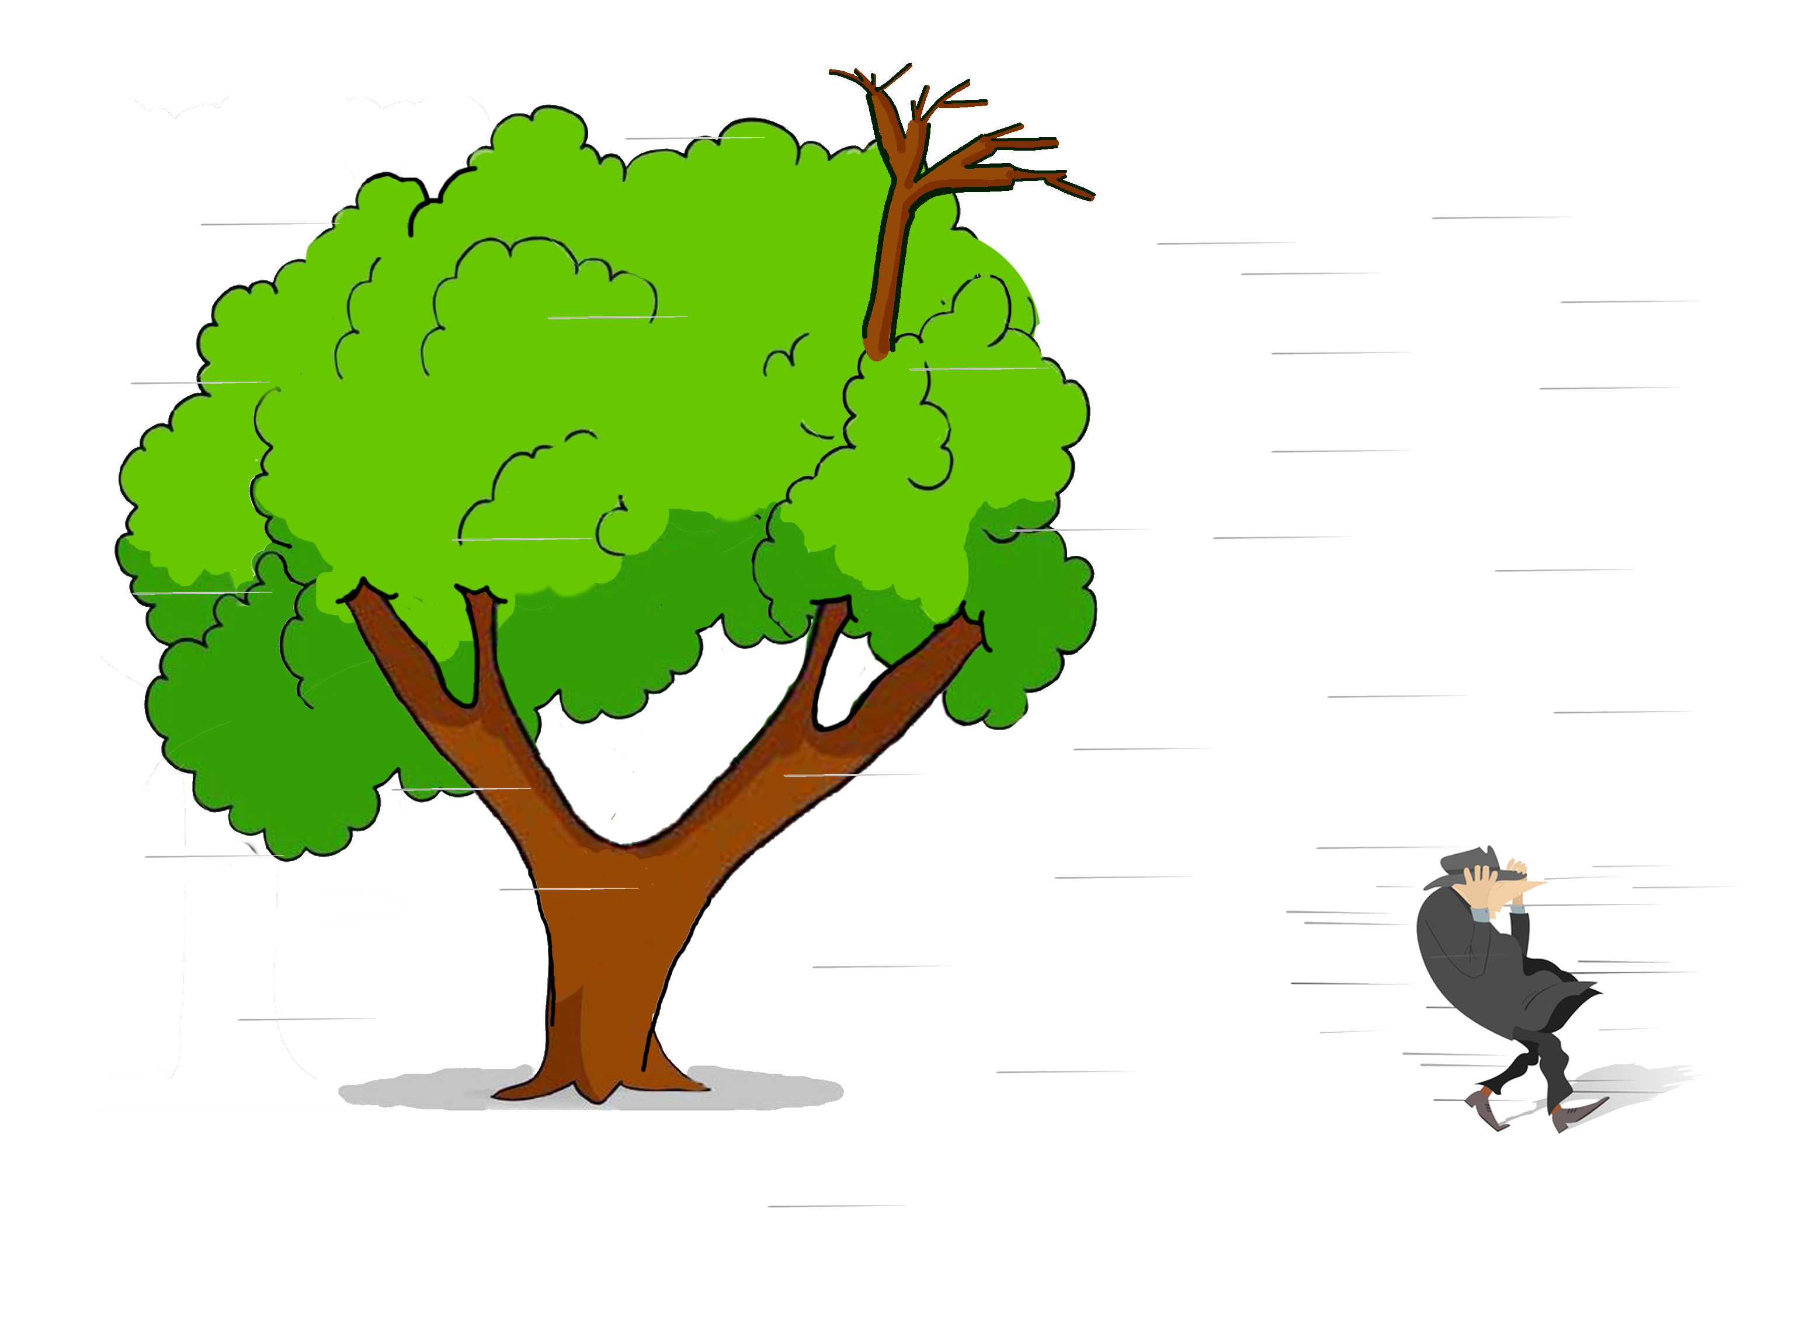
Turner v. Wichita 143 Kan. 808 (Sup. Ct. 1936)
Notes:
Dead branch on topped street tree maple falls in strong wind and kills pedestrian
- Not normal wind (2 hands on hat and 44ft branch throw)
- Just because branch is dead (but not soft) doesn’t mean “extremely bad” defect
- 3 weeks isn’t too long to be an “utter disregard”

Slide 36
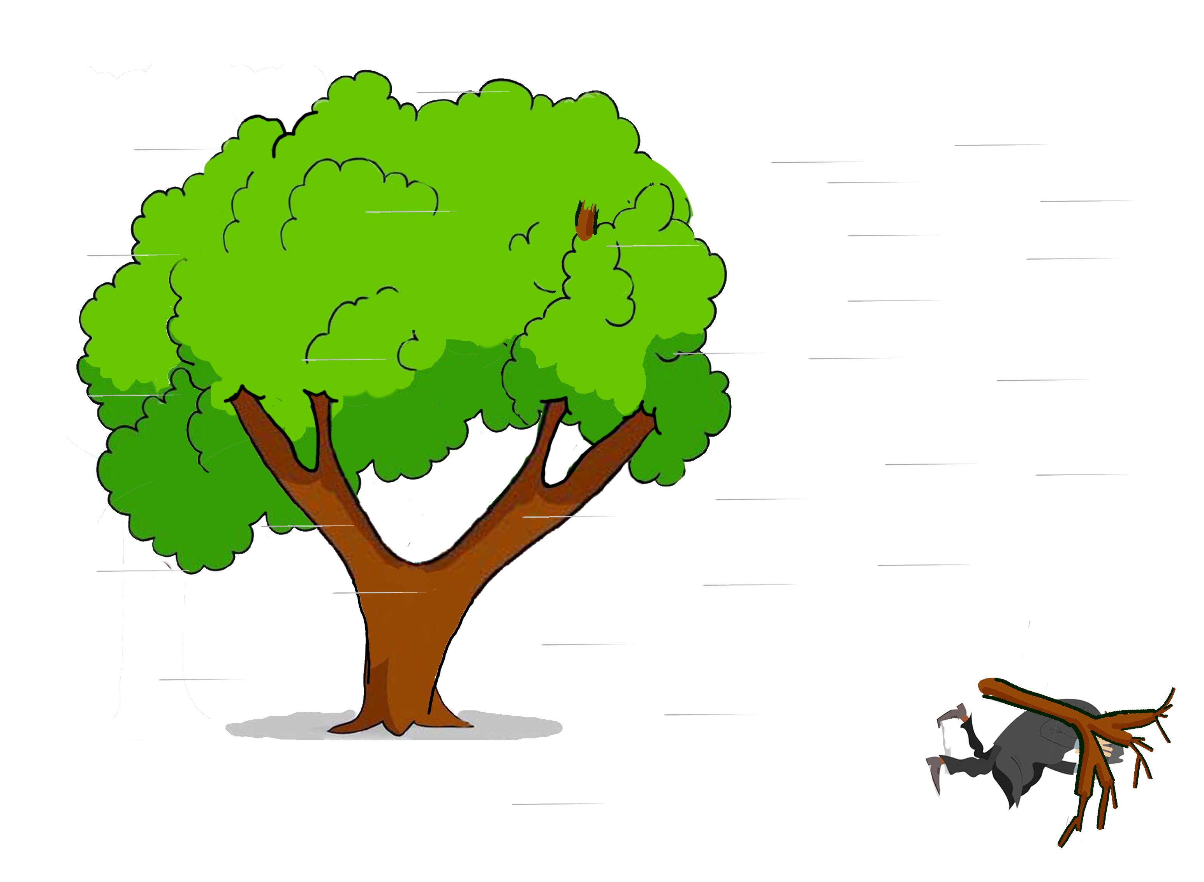
Turner v. Wichita 143 Kan. 808 (Sup. Ct. 1936)
Notes:
Dead branch on topped street tree maple falls in strong wind and kills pedestrian
- Not normal wind (2 hands on hat and 44ft branch throw)
- Just because branch is dead (but not soft) doesn’t mean “extremely bad” defect
- 3 weeks isn’t too long to be an “utter disregard”

Slide 37
Turner v. Wichita 143 Kan. 808 (Sup. Ct. 1936)
City Liability for Falling Branches
Notice AND [failed in normal wind OR because of defect]
OR
Condition is “patently bad” AND existed a long time as “utter disregard for safety”
Notes:
Dead branch on topped street tree maple falls in strong wind and kills pedestrian
- Not normal wind (2 hands on hat and 44ft branch throw)
- Just because branch is dead (but not soft) doesn’t mean “extremely bad” defect
- 3 weeks isn’t too long to be an “utter disregard”

Slide 38
Turner v. Wichita 143 Kan. 808 (Sup. Ct. 1936)
Pre-1974 Rule
City Liability for Falling Branches
Not externally Visible
City NOT liable, no constructive notice
Visible upon inspection
City liable, constructive notice
Obvious without inspection
City NOT liable, injured party negligent
Really Friggin’ Obvious™
and tons of time to fix
City liable, “utter disregard”
Notes:
Dead branch on topped street tree maple falls in strong wind and kills pedestrian
- Not normal wind (2 hands on hat and 44ft branch throw)
- Just because branch is dead (but not soft) doesn’t mean “extremely bad” defect
- 3 weeks isn’t too long to be an “utter disregard”

Slide 39
Turner v. Wichita 143 Kan. 808 (Sup. Ct. 1936)
City Liability for Falling Branches
Not externally Visible
City NOT liable, no constructive notice
Visible upon inspection
City liable, constructive notice
“Fixed” in
1974 with
Obvious without inspection
City NOT liable, injured party negligent
K.S.A §60-258a
Really Friggin’ Obvious™
and tons of time to fix
City liable, “utter disregard”
Notes:
Dead branch on topped street tree maple falls in strong wind and kills pedestrian
- Not normal wind (2 hands on hat and 44ft branch throw)
- Just because branch is dead (but not soft) doesn’t mean “extremely bad” defect
- 3 weeks isn’t too long to be an “utter disregard”

Slide 40
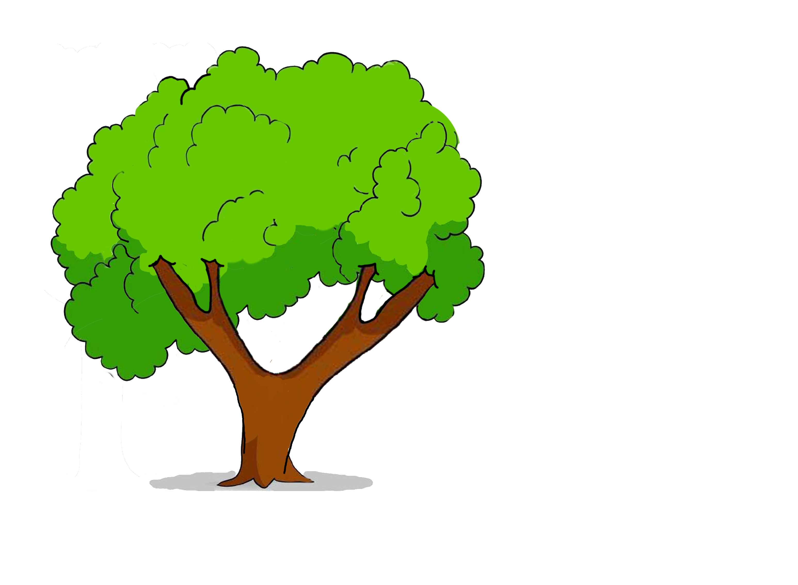
Swope v. Wichita 141 Kan. 388 (Sup. Ct. 1935)
Notes:
Street tree failed AFTER City inspected it
- just because INSPECTION, doesn’t mean NOTICE OF DEFECT
- follows the Turner Test

Slide 41
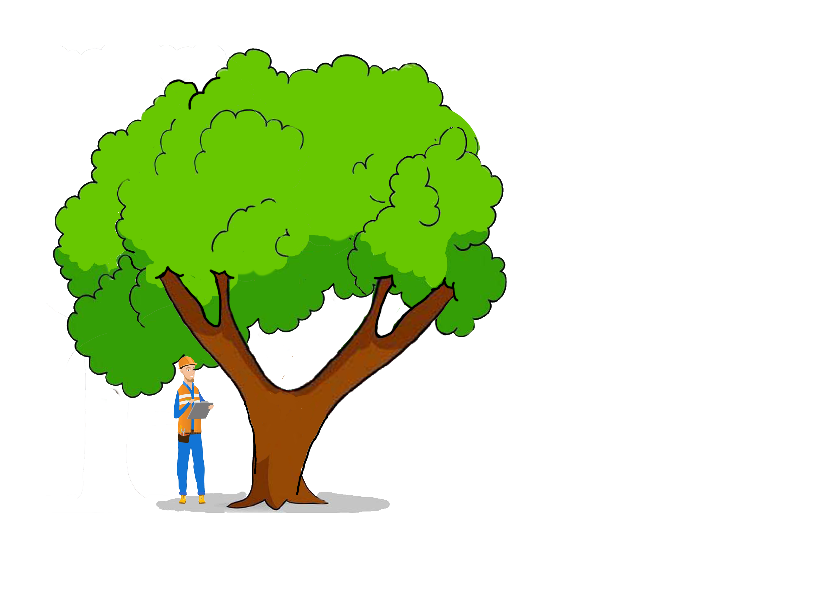
Swope v. Wichita 141 Kan. 388 (Sup. Ct. 1935)
Notes:
Street tree failed AFTER City inspected it
- just because INSPECTION, doesn’t mean NOTICE OF DEFECT
- follows the Turner Test
Mr. Swope, parked beneath the tree, was getting out of his car, when a branch fell and struck him

Slide 42
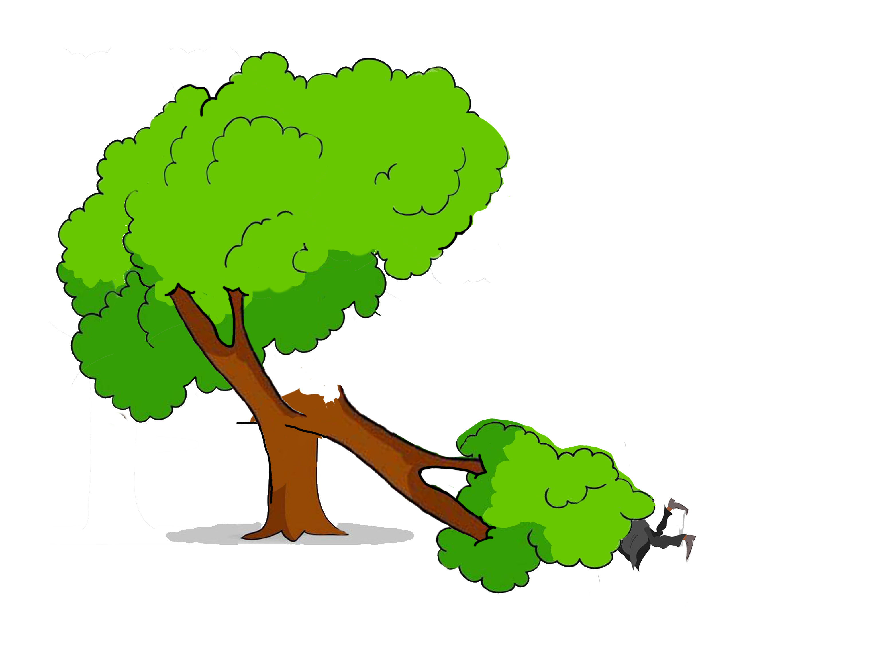
Swope v. Wichita 141 Kan. 388 (Sup. Ct. 1935)
Notes:
Street tree failed AFTER City inspected it
- just because INSPECTION, doesn’t mean NOTICE OF DEFECT
- follows the Turner Test

Slide 43
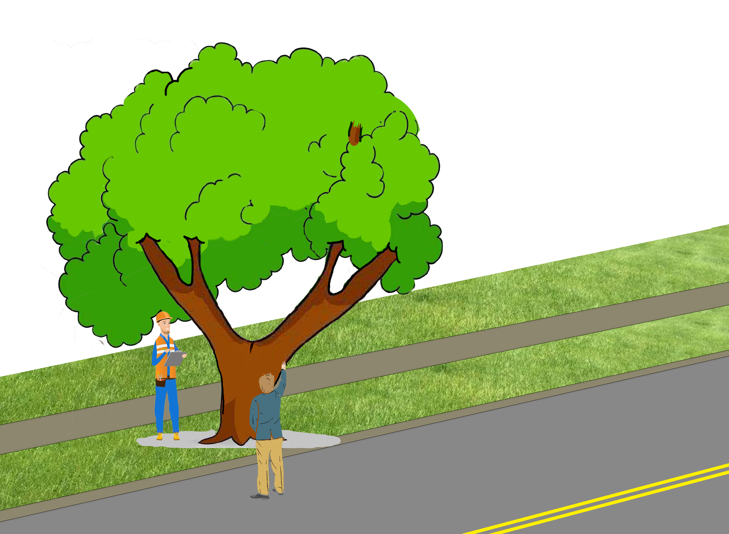
Siple v. Topeka 235 Kan. 167 (Sup. Ct. 1984)
Notes:
Street tree failed AFTER City inspected it NEGLIGENTLY
- immunity under inspection statute
-

Slide 44
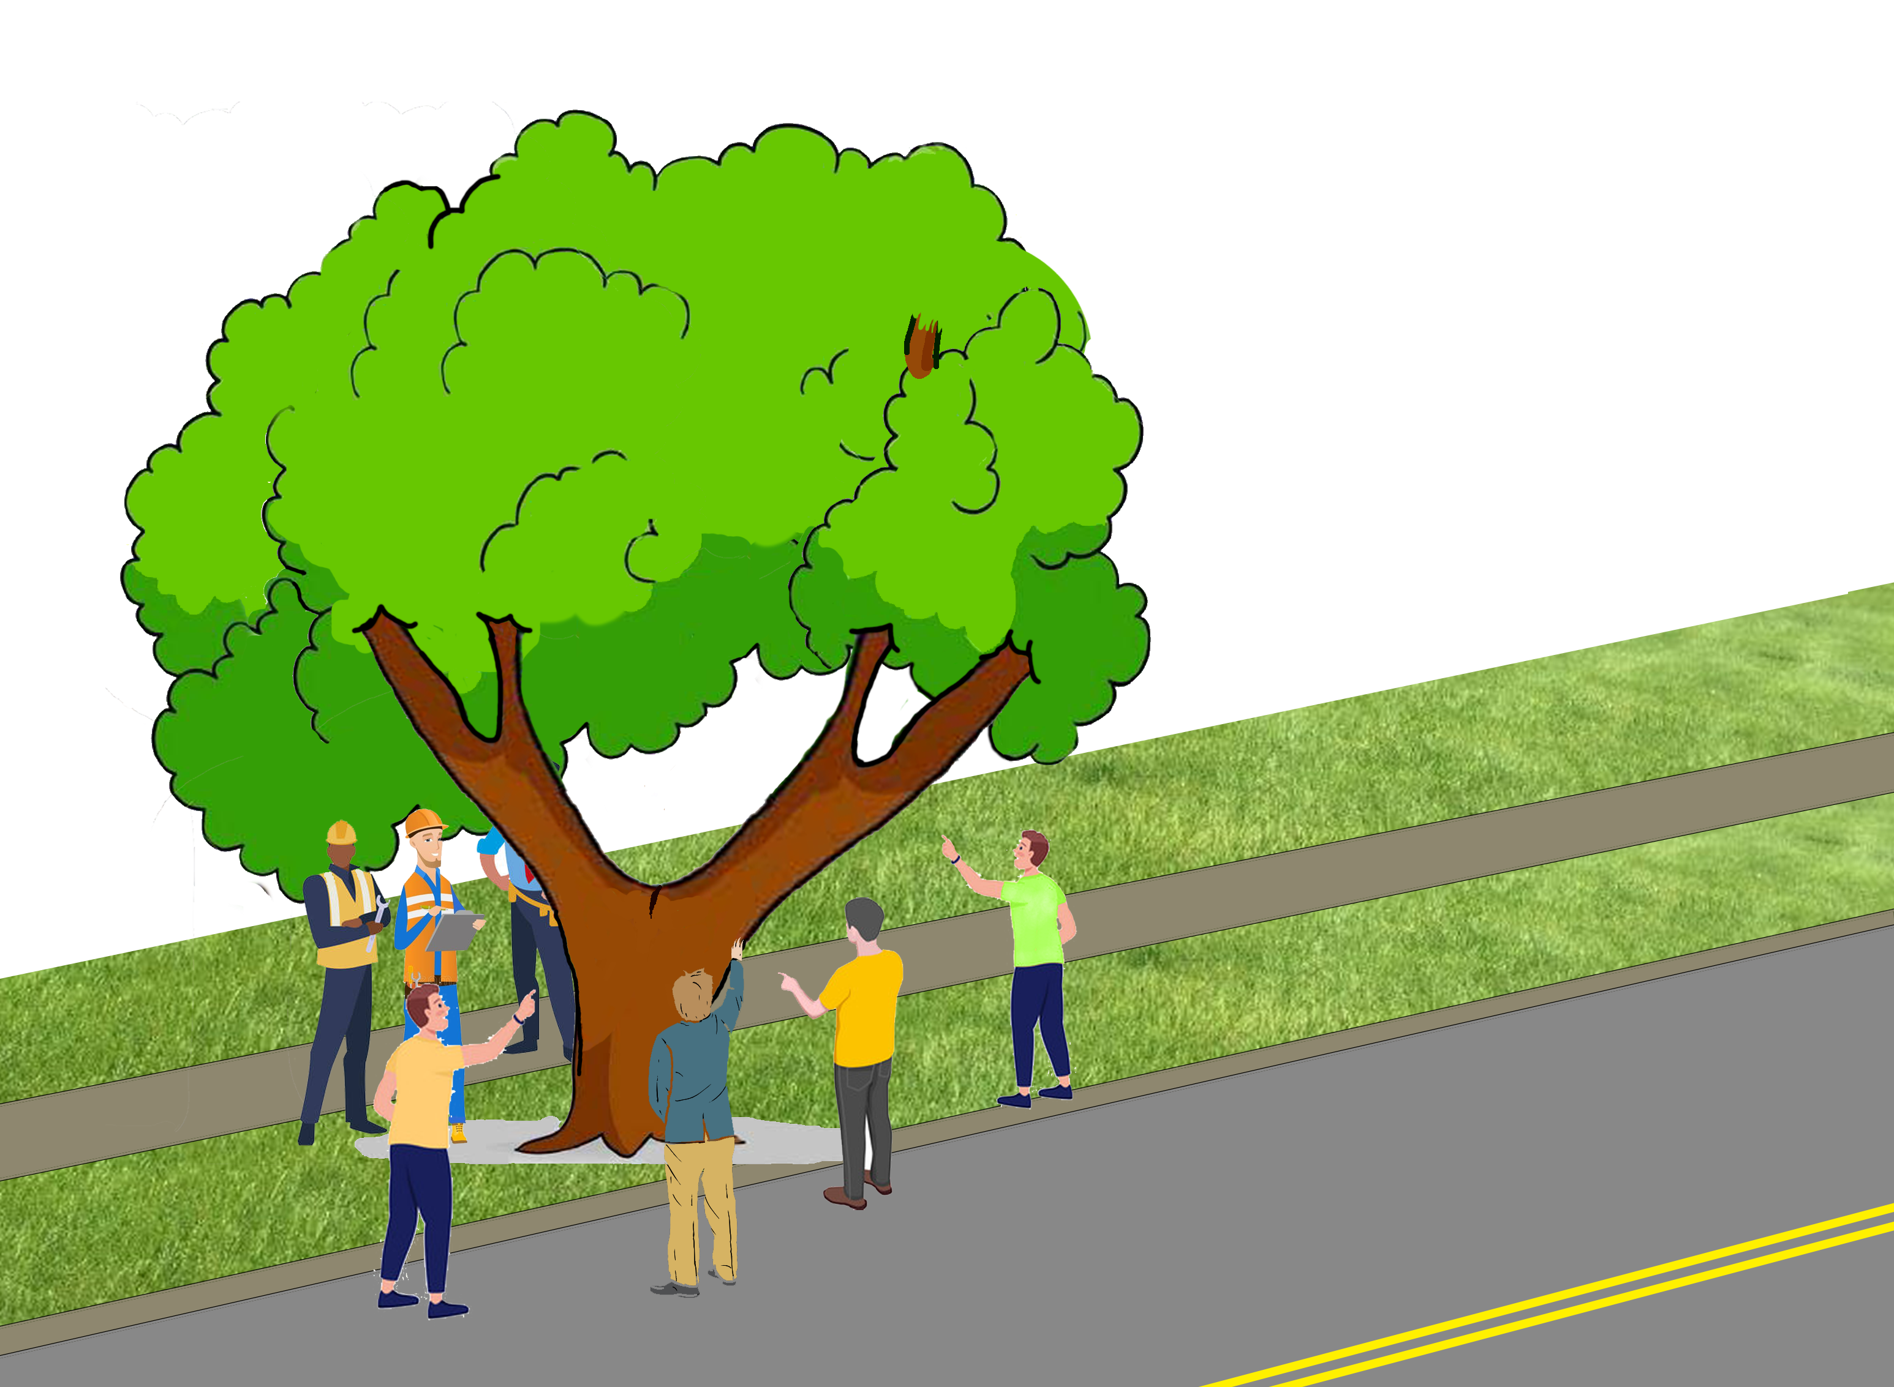
Siple v. Topeka 235 Kan. 167 (Sup. Ct. 1984)
Notes:
Street tree failed AFTER City inspected it NEGLIGENTLY
- immunity under inspection statute
-

Slide 45
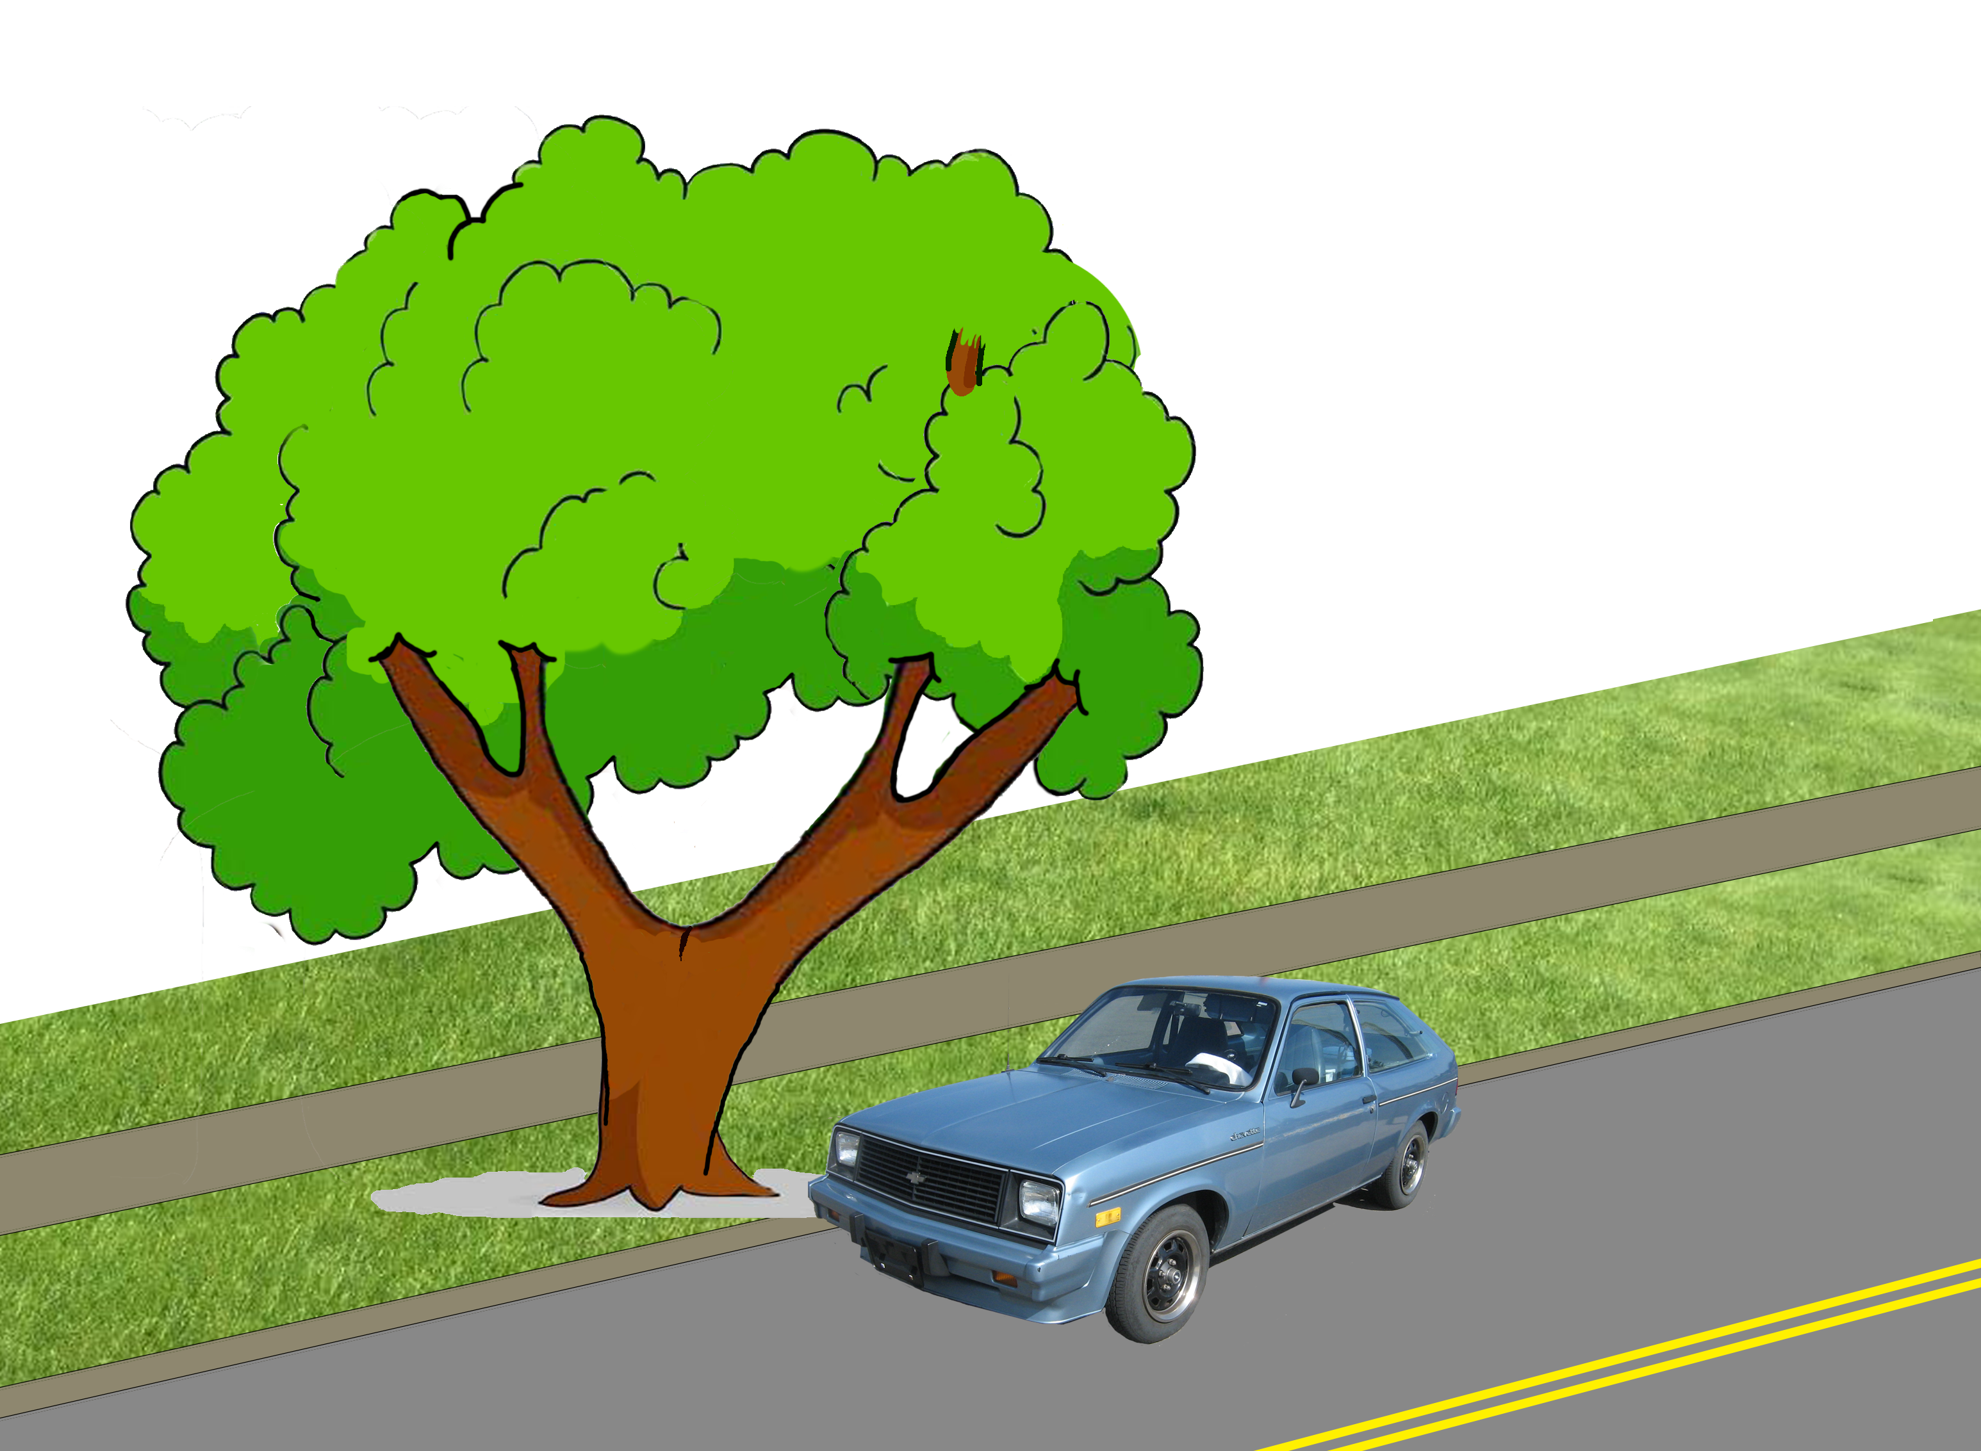
Siple v. Topeka 235 Kan. 167 (Sup. Ct. 1984)
Notes:
Street tree failed AFTER City inspected it NEGLIGENTLY
- immunity under inspection statute
-

Slide 46
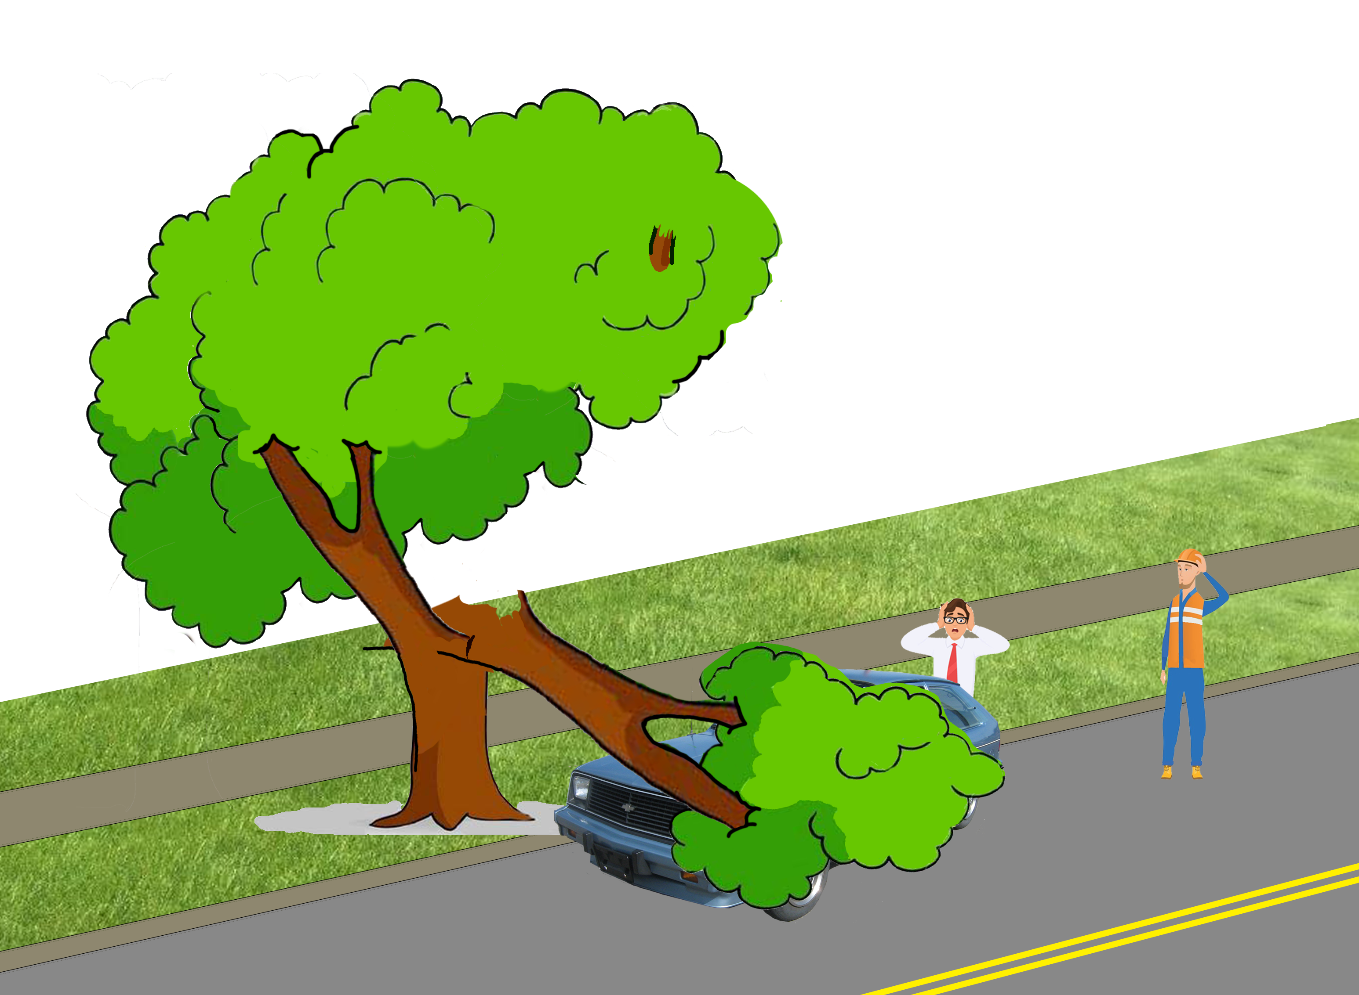
Siple v. Topeka 235 Kan. 167 (Sup. Ct. 1984)
Notes:
Street tree failed AFTER City inspected it NEGLIGENTLY
- immunity under inspection statute
-

Slide 47
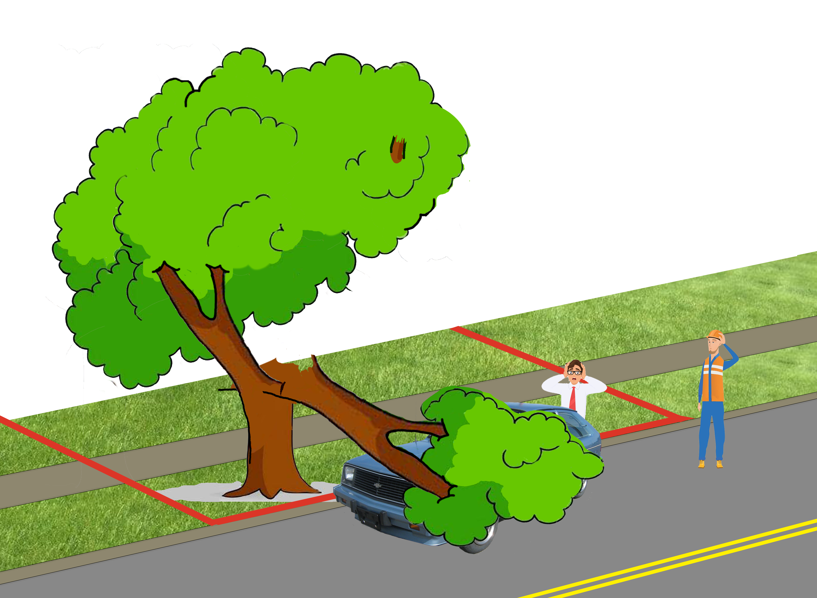
Siple v. Topeka 235 Kan. 167 (Sup. Ct. 1984)
Notes:
Street tree failed AFTER City inspected it NEGLIGENTLY
- immunity under inspection statute
-

Slide 48
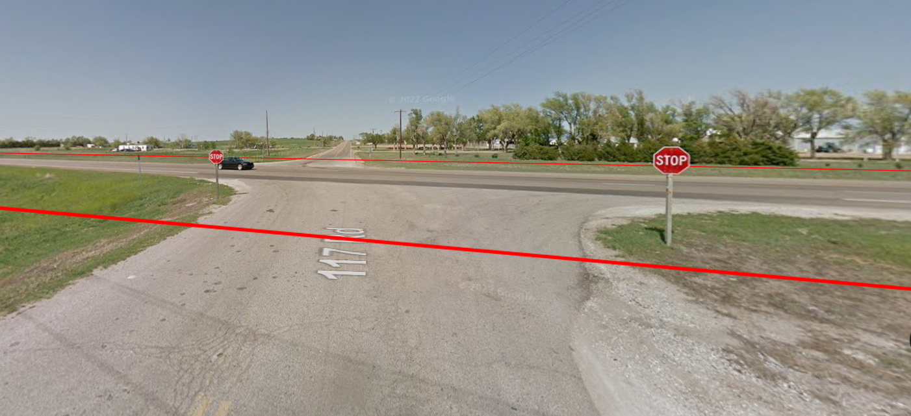
Brown v. State Highway Com 202 Kan. 1 (Sup. Ct. 1968)
Notes:
1963 incident
US 400 (formerly US 154) and Coronado Bridge Rd, 2 miles east of Dodge City

Slide 49
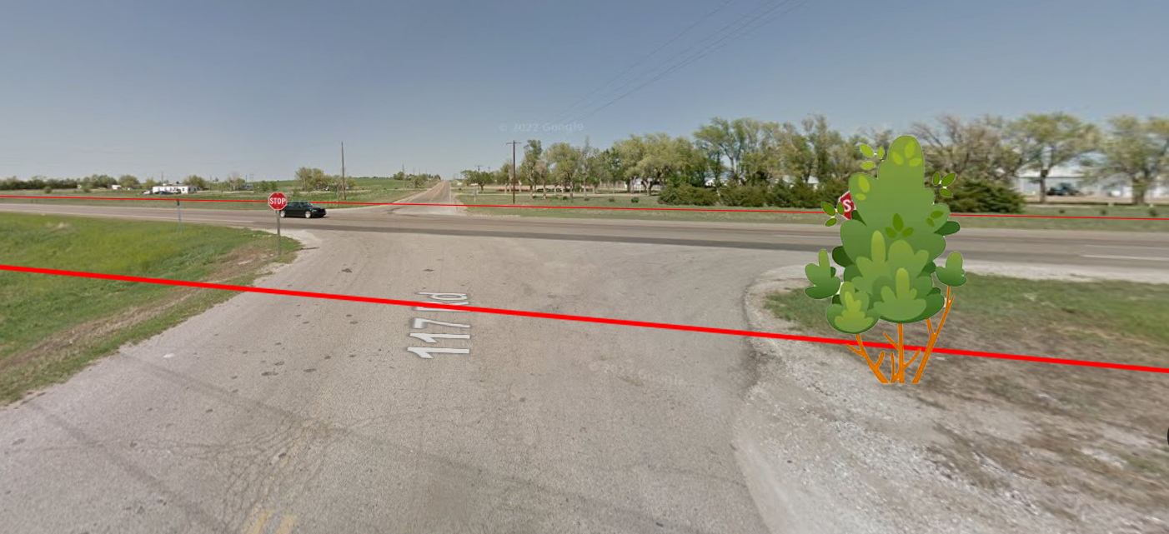
Brown v. State Highway Com 202 Kan. 1 (Sup. Ct. 1968)
Notes:
Private trees blocking stop sign in rural area

Slide 50
Brown v. State Highway Com 202 Kan. 1 (Sup. Ct. 1968)
π
Notes:
- Brown (driving east), Vogel (driving west), Eggleston (itinerant farm laborer with blind right eye)

Slide 51
Brown v. State Highway Com 202 Kan. 1 (Sup. Ct. 1968)
π
Notes:
- Private property trees CAN be a “road defect”
- Need NOT be in traveled portion
- Sufficient evidence state KNEW of defect

Slide 52
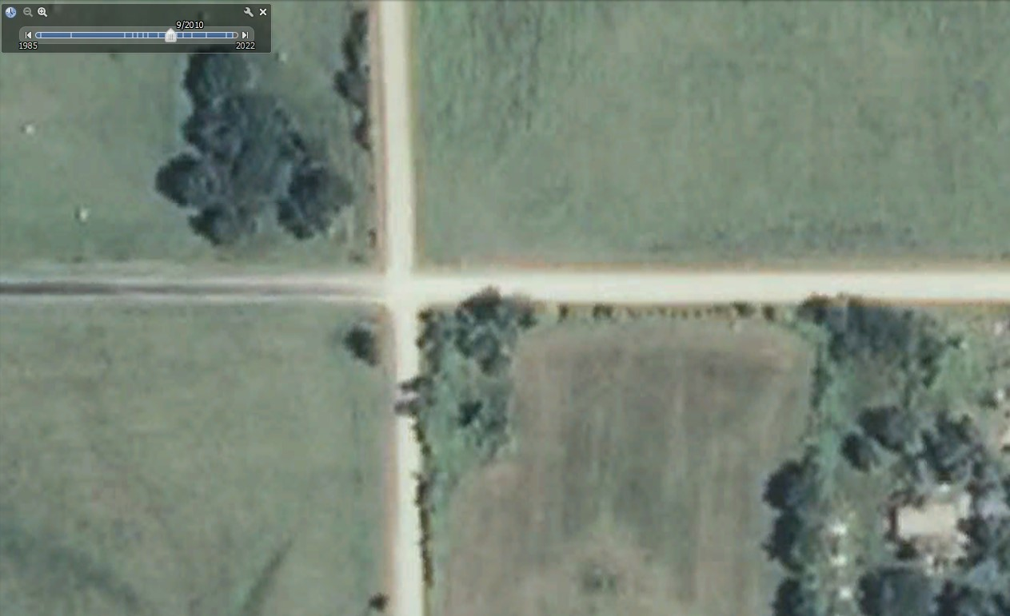
Manley v. Hallbauer 308 Kan. 723 (Sup. Ct. 2018)
Notes:
2011
Steven and Kathie Hallbauer (landowners)
20,000 Rd and Anderson Rd in rural Labette Cty.
Unsigned rural intersection of gravel roads

Slide 53
Manley v. Hallbauer 308 Kan. 723 (Sup. Ct. 2018)
Δ
π
Notes:
3:30pm in the afternoon
Darren Ray Manley (51, of Cherryville) (driving north), John Ethan Patton (28, Cherryville) (driving west)

Slide 54
Manley v. Hallbauer 308 Kan. 723 (Sup. Ct. 2018)
Δ
π
Notes:
Private trees block stop sign in rural area
- NO DUTY by PRIVATE LANDOWNER

Slide 55
Manley v. Hallbauer 308 Kan. 723 (Sup. Ct. 2018)
Δ1
Δ2
π
Notes:
Private trees block stop sign in rural area
- NO DUTY by PRIVATE LANDOWNER
- Estate of Manley sued: Patton (other driver), County (failure to erect stop sign), Hallbauer (failure to cut trees)

Slide 56
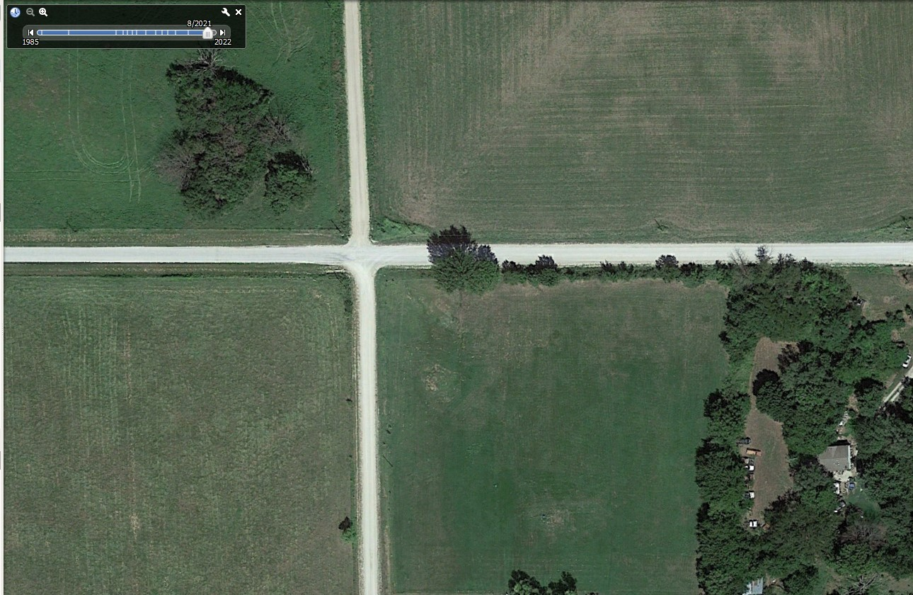
Manley v. Hallbauer 308 Kan. 723 (Sup. Ct. 2018)
Notes:
Private trees block stop sign in rural area
- NO DUTY by PRIVATE LANDOWNER for PUBLIC POLICY REASONS (does not decide foreseeability)
- tall crops often obscure visibility
- rural landowners have many miles of property to maintain
- driver responsibility to drive cautiously
- open and obvious danger

Slide 57
Tree Appraisal
“The Railroad Cases”
Nordgren v. Southwestern Bell Tel. Co . 125 Kan. 33 (Sup. Ct. 1928)
Evenson v. Lilley 295 Kan. 43 (Sup. Ct. 2012)
Notes:
“4” cases (counting all the railroad cases as one

Slide 58
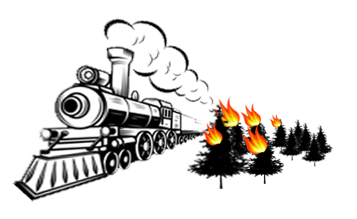
“The Railroad Cases”

Slide 59
“The Railroad Cases”
Atchison, T. & S. F. R. Co. v. Arthurs 63 Kan. 404 (Sup. Ct. 1901)
Atchison, T. & S. F. R. Co. v. Owens 6 Kan. App. 515 (Ct. App. 1897)
Atchison, T. & S. F. R. Co. v. Hays 8 Kan. App. 545 (Ct. App. 1898)
Atchison, T. & S. F. R. Co. v. Hamilton 6 Kan. App. 447 (Ct. App. 1897)
Atchison, T. & S. F. R. Co. v. Geiser 68 Kan. 281 (Sup. Ct. 1904)
Missouri, K. & T. R. Co. v. Lycan 57 Kan. 635 (Sup. Ct. 1897)
Missouri, K. & T. R. Co. v. Steinberger 6 Kan. App. 585 (Ct. App. 1897)
St. Louis & S. F. R. Co. v. Noland 75 Kan. 691 (Sup. Ct. 1907)
Barker v. Missouri P. R. Co. 94 Kan. 61 (Sup. Ct. 1915)
Notes:
Atchison, Topeka and Santa Fe Railroad Company
Missouri, Kansas, and Texas Railway Company
St. Louis & San Francisco Railroad Company
Missouri Pacific Railroad Company

Slide 60
“The Railroad Cases”
Arthurs (Sup. Ct. 1901): diminution of land value is absolute cap
Owens (Ct. App. 1897): diminution evidence preferred, but “tree value” OK
Hays (Ct. App. 1898): diminution is proper measure, but “tree value” is evidence of diminution
Hamilton (Ct. App. 1897): “tree value” or diminution OK
Geiser (Sup. Ct. 1904): “tree value” or diminution OK
Lycan (Sup. Ct. 1897): “tree value” OK, even if MORE than diminution
Steinberger (Ct. App. 1897): “tree value” OK, even if no diminution evidence
Noland (Sup. Ct. 1907): “tree value” OK, even if no diminution evidence
Barker (Sup. Ct. 1915): diminution evidence excluded

Slide 61
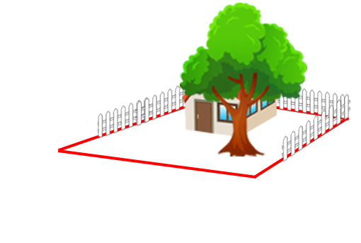
Nordgren v. Southwestern Bell Tel. Co 125 Kan. 33 (Sup. Ct. 1928)
Notes:
Utility company gives blueprint to Mr. Bloom, telling him to cut all trees in the way of proposed telephone line construction
Bloom should stack wood at edge of property
Utility company’s employees would pick up the wood

Slide 62
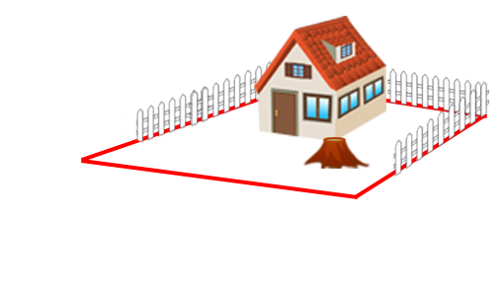
Nordgren v. Southwestern Bell Tel. Co 125 Kan. 33 (Sup. Ct. 1928)
Notes:
Bloom cut down trees on the wrong property, belonging to Nordgren

Slide 63
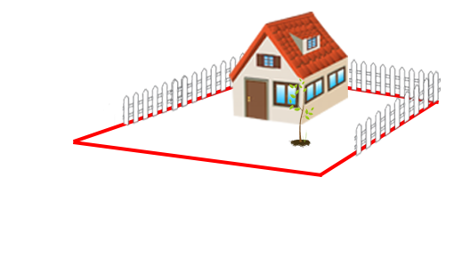
Nordgren v. Southwestern Bell Tel. Co 125 Kan. 33 (Sup. Ct. 1928)
Notes:
“replacement cost” offered by utility company was too low, court preferred diminution of land value

Slide 64
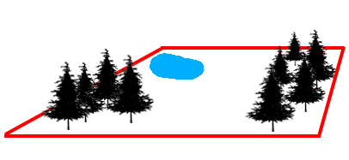
Evenson v. Lilley 295 Kan. 43 (Sup. Ct. 2012)
Notes:
2006 in rural Greenwood County
Mark and Janis Evenson owned hunting property
Tim Lilley started “controlled fire”

Slide 65
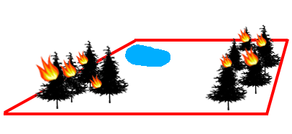
Evenson v. Lilley 295 Kan. 43 (Sup. Ct. 2012)
Notes:
Fire burns trees on hunting property with personal significance to owner, but owner never testifies how TREES have personal significance
Limited to diminution

Slide 66
Pollution and Contamination
Kansas Zinc Mining & Smelting Co. v. Brown 8 Kan. App. 802 (Sup. Ct. 1899)
Wichita Gas, Elec. & Power Co. v. Wright 9 Kan. App. 730 (Ct. App. 1900)
Delay v. Great Plains Custom Application 376 P.3d 95 (Ct. App. 2016)
Notes:
3 cases

Slide 67
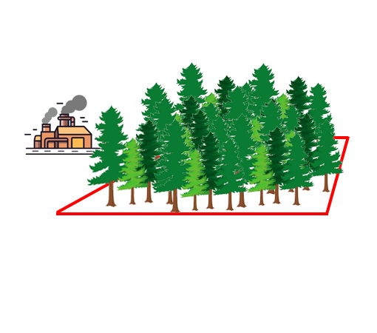
Kansas Zinc Mining & Smelting Co. v. Brown 8 Kan. App. 802 (Sup. Ct. 1899)
Δ
π
Notes:
Toxic fumes kill trees

Slide 68
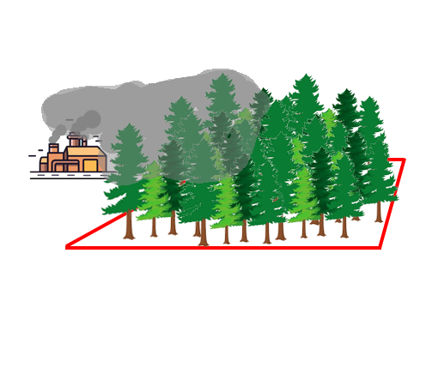
Kansas Zinc Mining & Smelting Co. v. Brown 8 Kan. App. 802 (Sup. Ct. 1899)
Δ
π
Notes:
Toxic fumes kill trees

Slide 69
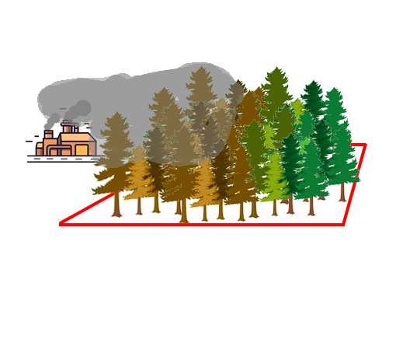
Kansas Zinc Mining & Smelting Co. v. Brown 8 Kan. App. 802 (Sup. Ct. 1899)
Δ
π
Notes:
Toxic fumes kill trees

Slide 70
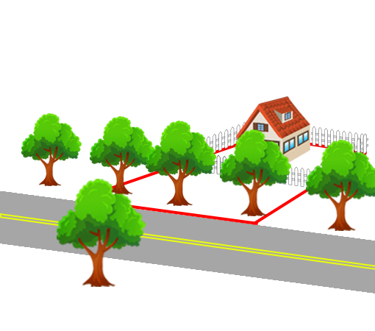
Wichita Gas, Electric Light & Power Co. v. Wright 9 Kan. App. 730 (Ct. App. 1900)
Notes:
Gas leak kills trees

Slide 71
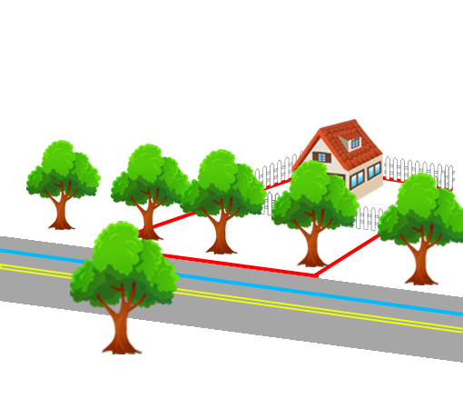
Wichita Gas, Electric Light & Power Co. v. Wright 9 Kan. App. 730 (Ct. App. 1900)
Notes:
Gas leak kills trees

Slide 72
Wichita Gas, Electric Light & Power Co. v. Wright 9 Kan. App. 730 (Ct. App. 1900)
Notes:
Gas leak kills trees

Slide 73
Wichita Gas, Electric Light & Power Co. v. Wright 9 Kan. App. 730 (Ct. App. 1900)
Notes:
Gas leak kills trees

Slide 74
Wichita Gas, Electric Light & Power Co. v. Wright 9 Kan. App. 730 (Ct. App. 1900)
Notes:
Gas leak kills trees

Slide 75
Delay v. Great Plains Custom Application 376 P.3d 95 (Ct. App. 2016) Unpublished
Notes:
Herbicide application kills trees on rental property, but landlord lives next door
Delay Expert: Frank Swan of KSU in Stanton County
Doesn’t specifically refer to TFM, but refers to “K-State Ornamental Tree and Shrub Analysis Form”
GPCA Expert: Chad Gilliland of Arbor Masters Trees and Landscape in Kansas City
Claims trees were exacerbated by drought stress

Slide 76
Summary
Property Rights
Constitutional Law
Tree Risk
Tree Appraisal
Pollution and Contamination
Notes:
23 total cases:
- 6 prop rights
- 3 con law
- 7 tree risk
- 3 tree appraisal
- 3 pollution

Slide 77
Case Illustrations from Kansas Tree Law
James Komen
BCMA #WE-9909B
RCA #555

